Slide 1
Rehabilitating the athlete, not just the injury Adam Gledhill Leeds Beckett University @gleds13 Dale Forsdyke York St. John University @forsdyke_dale
Notes:
See pack p.12 - Differences?

Slide 2
Plan for today
Identify key psychosocial considerations in sports injury rehabilitation
Outline how these factors may impact on the rehabilitation of an injured player
Demonstrate ways that these considerations have been adopted within an interdisciplinary support programme in elite sport
Notes:
See pack p.12 - Differences?

Slide 3
Why are we here?
The scale of the problem…
What can a football team expect (adapted from Ekstrand et al., 2011)
50 injuries causing time-loss from play each season (approx. 2 injuries/player)
37% are moderate (absence 1-4 weeks)
16% are severe (>4 weeks)
Approx. 12% of the squad unavailable due to injury at any point during the season
Fewer injuries major factor in soccer team success (Carling et al. 2014)
Over half of injured athletes do not return to their previous level of sport activity, even less return to competition (Ardern et al. 2014)
Physical and psychological recovery may not coincide (Podlog & Eklund, 2007; Wadey & Evans, 2011)
Injury main cause of sport career termination (Ristolainen et al. 2012)
Notes:
See pack p.12 - Differences?

Slide 4
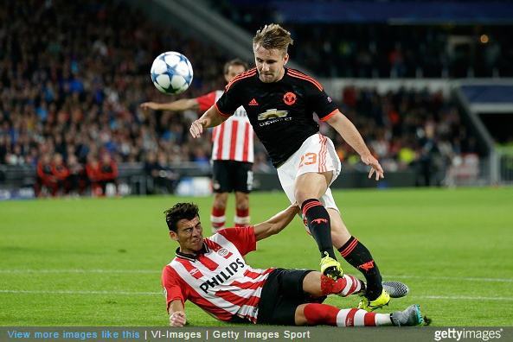
Scope of today
Risk of injury
Responses to injury
Rehabilitation
Return to competition
Retirement from injury
Notes:
See pack p.12 - Differences?

Slide 5
Activity What are your experiences?
In groups discuss:
How do you think football players react to injuries?
Currently, how do you deal with injured players?
Be as specific as you can
Notes:
See pack p.12 - Differences?

Slide 6
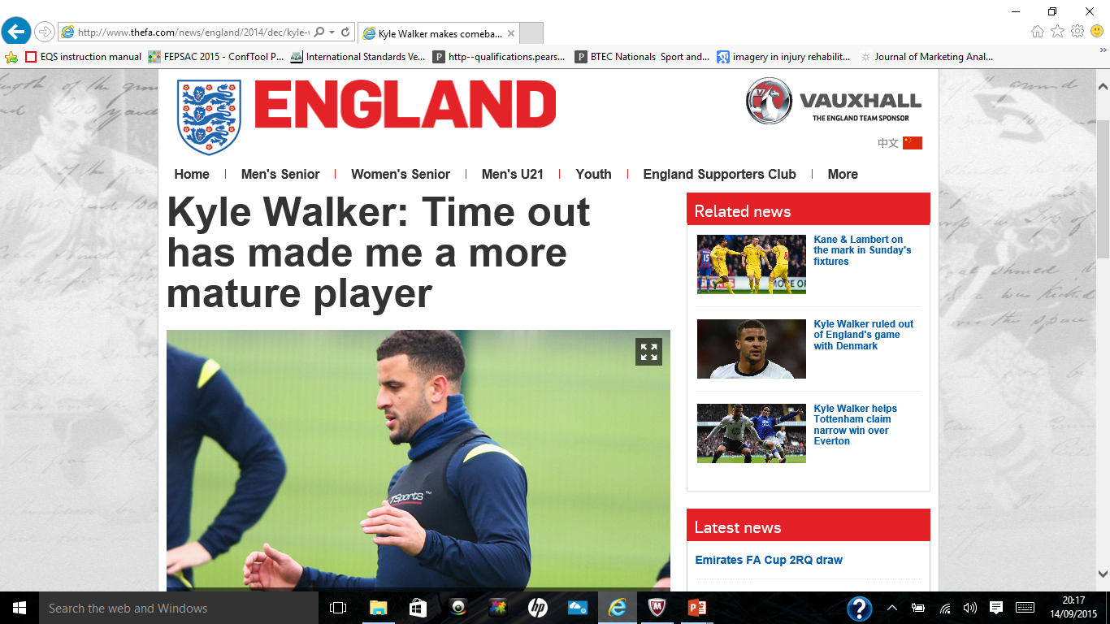
High profile responses to injury Some examples…
Notes:
See pack p.12 - Differences?

Slide 7
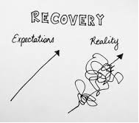
Recovery from injury Perceptions vs. reality
Notes:
See pack p.12 - Differences?

Slide 8
Recovery from injury Player blog data: What do you think?
“Rehab was quite slow at first which I got very frustrated with simple exercises that I thought I could do easily which turned out I couldn’t. But when I was able to do an exercise I felt great inside. Felt like I accomplished something, and in a way I felt proud. Just simply having full extension felt like I just ran a marathon.”
“After 1 week of having him I was doing sports specific rehab, FINALLY touching a ball after 7 months. Oh when you get you first touch of the ball again it’s a magical feeling. Just feels like Christmas day. I was feeling great at the time like nothing could stop me and it was just getting better by each week.”
“ ‘Next Thursday you will be in training but non-contact’ absolutely buzzing, just what I wanted to hear. I think my ‘injury’ will always be in the back of my mind but just to be back playing is amazing for me. GET ME ON THAT PITCH!!!!!!!!!!!!”
Notes:
See pack p.12 - Differences?

Slide 9
Recovery from injury Examples from practice
Use of interviews to monitor responses to injury, with other appropriate measures
Emotional Response to Athletic Injury Questionnaire
Psychological Responses to Sport Injury Inventory
Blogs / use of images (emotional disclosure)
Creating a reflective ‘expert patient’
Social modelling
Use of social media (e.g. Twitter)
Notes:
See pack p.12 - Differences?

Slide 10
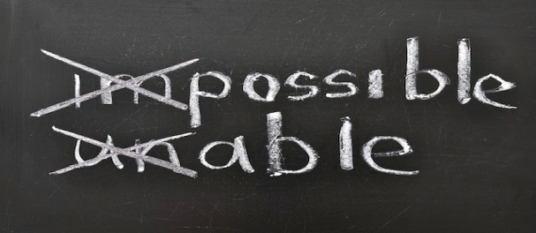
Fostering rehabilitation Case study of an elite football player
Use of interviews to monitor rehabilitation beliefs and adherence
Sports Injury Rehabilitation Beliefs Scale
Sports Injury Rehabilitation Adherence Scale
Goal setting (holistic perspective)
Strategies for maintaining athletic identity
Training / match day roles and responsibilities
Rehabilitation near team
Optimising ‘trainability’
Psychological skills training
Notes:
See pack p.12 - Differences?

Slide 11
Is injury only bad? Positive experiences of injury
Personal, psychological, social, and physical growth (Wadey et al. 2014)
Injury as a learning experience
Athlete education
Coach – athlete relationships
Overcoming adversity
Notes:
See pack p.12 - Differences?

Slide 12
Return to competition How do you know a player is ready to return to competition?
In groups discuss:
How do you know a player is ready to return to competition?
Who takes ownership of this decision?
What do you think the process should be?
Notes:
See pack p.12 - Differences?

Slide 13
Return to competition How do you know a player is ready to return to competition?
Readiness to return
Biopsychosocial outcome measures
Triangulation of RTP/RTT/RTC decisions
Replaying the inciting incident
Performance expectations
Readiness to return
Confidence
Realistic expectations
Previous performance standards
Adapted from Podlog et al. (2015)
Notes:
See pack p.12 - Differences?

Slide 14
Return to competition Case study of an elite football player
Responses to injury: ERAIQ and interviews; assessment of social support
Athlete education re: injury
Physical rehabilitation near team where possible; multimodal PST integrated
Social modelling and use of social media
Weekly plenary activities
Match day roles with first team
Player, coach and support staff updates re: injury progress
RTP: Behavioural observations, i-PRRS, RIAI, interviews
Post-RTC monitoring
Notes:
See pack p.12 - Differences?

Slide 15
Player reflections Case study of an elite football player
“It’s been 9 months since my injury and 7 months since my operation and without the support I get from coaches, staff, players and support I get at home I don’t think I would be at this stage today. Especially if I didn’t have (sports therapist) and (sport scientist) not just working on my physical rehab but also the psychological side.”
Notes:
See pack p.12 - Differences?

Slide 16
Activity Moving forwards
In groups discuss:
How will you support your players in their return to competition?
Consider:
How can you enhance the 6Cs and 3Rs of the England DNA throughout injury response, rehabilitation and return to training / competition?
Notes:
See pack p.12 - Differences?

