Slide 1
A small scale evaluative review of a written summative assessment feedback form.
SEDA: dialogic, participatory
Sharing & development of collaborative- and partnership-modes of knowledge creation with our students
Knowledge about feedback practices
Knowledge of how to develop students’ assessment literacies through meaningful engagement with (written) summative feedback
Dr Jane Rand
York St John University
j.rand@yorksj.ac.uk

Slide 2
Look IN to the project….the findings
Look OUT from the project…consider the potential for co-creation of knowledge
What? [Description]
So What? [Theory-building]
Now What? [Action-orientation]
(Rolfe, et al., 2001)

Slide 3
WHAT?
Where are we now?
Malmö University – Students as co-creators – developing methods for increased student participation. https://www.mah.se/upload/BIT/Projekt/poster_LILAC_students%20as%20cocreators.pdf [Accessed 8/2/16]

Slide 4
WHAT?
WHAT?
Short-life working group, post-NSS
NEW TEMPLATE:
separate sections for:
Evaluation of “current” (submitted) task
Generic areas for development for “future” tasks
Highlighted assessment criteria (to support grade decision)
Semester 1
Application to University Students as Researchers Scheme to support evaluation
Semester 2
Student researcher appointed (from Psychology)
3 key questions to support evaluation of our new form:
How do students engage with summative feedback. That is, how do students understand, approach and experience it?
How comprehensive is students’ understanding of the strengths and areas for development of their work as a result of summative feedback?
What do students do as a result of receiving summative feedback?
2014/15
Student focus groups, led & designed by student researcher…30 students, representing four (of nine) programmes. ~2:1 ratio 2nd:1st year students
THEMES:
Inconsistencies:
narrative & assessment criteria
between lecturers
Vagueness
Students’ desire for:
positive comments
personalisation
Students read the grade before reading the comments
Many never read the comments
Some read the comments the day after receiving a “bad” grade
Most students don’t use previous feedback to support future assessments
….revised form….GRADE AT THE TOP... Students delighted!! Programme-team discussions re: themes
Follow-up case studies with 2nd year (now 3rd year) students.
2015/16

Slide 5
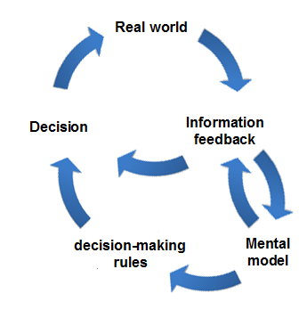
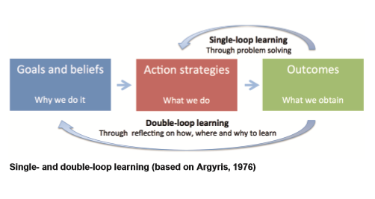
WHAT
WHAT?
Double-loop
http://www.classroom-aid.com

Slide 6
SO WHAT?
To what extent do you recognise the themes from your experience of students’ reports of feedback?
What does this tell us?
What practical steps can we take to support students to engage (more) meaningfully with summative assessment feedback.

Slide 7
NOW WHAT?
What practical action did we take?
New template
Unsuccessful with bid for 2nd round of Student as Researcher funding
Follow-up case studies – early results…
How can we make our research practices more participatory?
Where do we want to be? (Malmo)
Identify short-term ambition(s) for change/development
How are we going to get there?
Identify practical steps to changing practice

Slide 8
I will collate information from today’s session & disseminate.

Slide 9
Bibliography
Glover, C., & Brown, E. (2006) Written Feedback for Students: too much, too detailed or too incomprehensive to be effective? Bioscience Education, 7 (May) [Online]. Available at https://www.heacademy.ac.uk/written-feedback-students-too-much-too-detailed-or-too-incomprehensible-be-effective
Maggs, L. (2014) A case study of staff and student satisfaction with assessment feedback at a small specialised higher education institution. Journal of Further and Higher Education, 38 (1), pp. 1-18.
McCann, L., & Saunders, G. (2009) Exploring student perceptions of assessment feedback. SWAP Report. York, HEA.
Rolfe, G., Freshwater, D. & Jasper, M. (2001) Critical reflection in nursing and the helping professions: a user’s guide. Basingstoke, Palgrave Macmillan
Weaver, M. R. (2006) Do students value feedback? Student perceptions of tutors’ written responses. Assessment & Evaluation in Higher Education, 31 (3), pp. 379-394.

