Slide 1
CONVERSATIONS THAT MATTER: Professor Lynne Gabriel
MENTAL HEALTH Mindfield:
stories from the frontline

Slide 2
Three foci today…
Mental health ‘then and now’
A mental health minefield: personal and professional pathways
Counselling & Mental Health Clinic
Notes:
Mental Health Minefield: Stories from the Frontline
From a long history of work in the mental health field, I’m bringing personal and professional experiences and anecdotes to inform and enliven my talk. Be prepared to be engaged! I will talk about the work of York St John's Counselling & Mental Health Clinic, which I founded and direct. With reference to the 'cast of characters' involved in delivering the clinic services, I will share powerful and poignant examples from my work and the clinic's mental health work and will highlight research, giving examples of publications and ongoing projects – including Rich’s work on disability, John’s on loss/bereavement, Gary’s on anger management, my work in domestic/relational abuse. I will draw from personal, professional and academic worlds to talk about the significance of people being able to experience ‘mental health moments’, ‘memory making’, and ‘meaning making’; and will outline the challenges of mental ill-health for individuals and communities.

Slide 3
What does mental health mean to you?
Talk to the person next to you…
Notes:
Brief initial audience interaction to provide people with an opportune moment to simply reflect on ‘what does mental health mean to me?’
Allow time for 2-3 comments from the audience before moving onto next slide

Slide 4
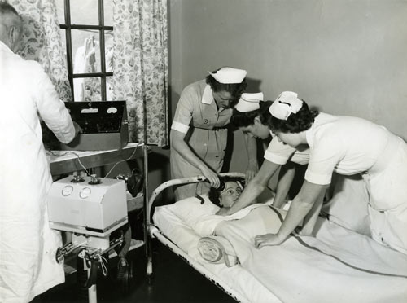
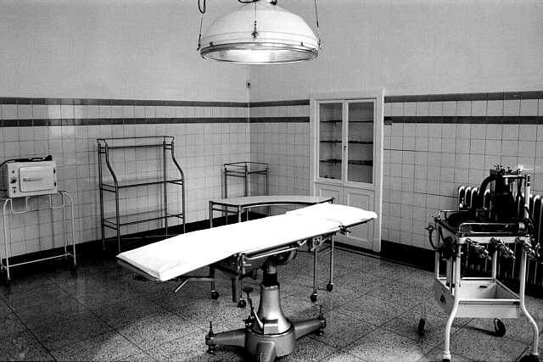
Mental health
Then….
Notes:
From the austere and, arguably, punitive - historical approaches to mental health interventions….prior to the roll-out of ‘care in the community’ in the UK, psychiatric interventions were provided in state or private institutions.
I remember the operating theatre – the actual theatre at my training institution is shown here – although I did not take part in the lobotomy operations that were performed.
The picture of ECT being administered resonates with my experiences in an early 1970s psychiatric setting; a difficult experience as a young trainee… Practices and interventions have, thankfully, moved on. That said, we continue to have cases of compassion fatigue and lapses in care. Health trusts aiming for partnership and connectivity – ‘joined up’ healthcare based upon Trieste.

Slide 5
Mental Health
Now…
Minister for Loneliness
Notes:
To the surreal….a Minister for Loneliness!!
In the current political landscape, mental health is never far from the headlines – the recent announcement that Tracey Crouch, already mental health minister, had taken on the mantel of ‘Minister for Loneliness’ offered a surreal moment. It is important that we maintain the focus upon ‘no health without mental health’
Citizen wellbeing is crucial to the ongoing health and wellbeing of our national and international communities.
The World Health Organization defines wellbeing as a state where everyone is able to realise their potential, can cope with the normal stresses of life, can work productively and fruitfully and is able to make a contribution to their community (WHO (2016). Mental health: A state of well-being).
Key activity and campaigning through social movements such as Time to Change, led by Sue Baker and supported by a number of high profile celebrities.
In the recent UK budget, it was announced that funding for mental health services would grow as a share of the overall NHS budget across the next five years; good news and we need more…this is a multi-generational transition that requires additional investment from successive Governments.

Slide 6
Facts, figures, futures…
Children and young people: 6 times more of them have mental health problems than a decade ago
Adults: women are more likely than men to have a common mental health problem; in 2013, of the 6,233 suicides recorded in UK for people aged 15 and older, 78% were male
Elders: Age UK project a 49% increase in loneliness by 2026
Social contexts: minorities, disability, gender, identity and acceptance issues; bullying; ageism
NHS: advent of Increasing Access to Psychological Therapies (IAPT); social prescribing; GP counselling
Politics: Tracey Crouch, Minister for Loneliness…!!
Notes:
NOTES:
Contemporary mental health facts, figures, fears
Children and young people: 6 times more have mental health problems than a decade ago; a troubling thought given that some children become leaders of tomorrow; how are we helping/hindering our young people for their futures?
2. Adults: women are more likely than men to have a common mental health problem WHY DO YOU THINK THIS IS? - ASK THE AUDIENCE; in 2013, of the 6,233 suicides recorded in UK for people aged 15 and older. 78% were male - WHY DO YOU THINK THIS IS? - ASK THE AUDIENCE
3. Elders: Age UK project a 49% increase in loneliness by 2026
4. Social contexts, disability, gender: identity, acceptance issues; bullying; ageism; sexism/misogyny; challenges with emotional and behavioural regulation
5. NHS: Development and extension of IAPT; recent growth in social prescribing; education/competencies for health and social care workers
6. Politics: Tracey Crouch, Minister for Loneliness…mmmm…When elected as Chair of BACP (British Association for Counselling & Psychotherapy) my first task was to initiate member action to challenge NICE guidance and exclusion of counselling from depression guidelines; hundreds took action, leading to positive, although limited change, plus to NICE changing how people could submit feedback….
7. Change across generation(s)…

Slide 7
Healer heal thyself…
Notes:
Enshrined in the BACP Ethical Framework for the Counselling Professions is the notion of practitioner self-care. This is an essential feature of working as a therapist in the helping professions.
The idea of knowing and understanding oneself, alongside the development of understanding self in relationships with others, forms a central part of counselling and therapy training. The Jungian/Analytical concept of the ‘wounded healer’ and the notion of ‘healer heal thyself’ remains central to work in the healing and helping professions.
My own journey into helping work started when I was very small and became a reluctant carer for my younger brother….
Across the years, starting with my early trip to tech college at 15 to do a pre-nursing course (at that time children could leave education at 15), plus a job at 16 as a cadet nurse, through mental health nurse training, into marriage, motherhood, support and care of elder relatives, training as a therapist and now clinic Director, I’ve become better at self-care. It’s been a tricky journey however, with moments when my presence in the world was fragile…
Through the next couple of slides, I will outline some key character forming times, some magical moments and momentous changes

Slide 8
Pathways of meaning-making…
Child
Young adulthood: Teen nurse cadet
Adulthood: Mother, therapist, professional body chair, academic, clinic director
Cronehood … and beyond
Notes:
Difficult to extract discrete pathways and moments, however, this slide highlights themes based around age/life stage and the following slides provide prompts for parts of my story.

Slide 9
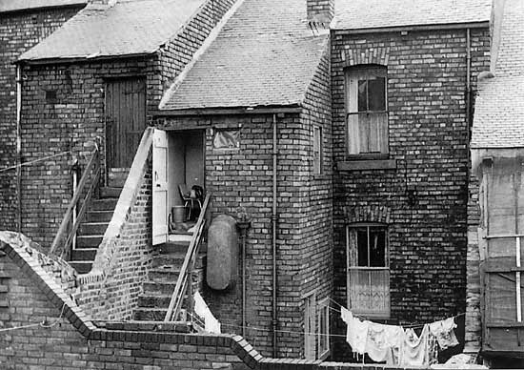
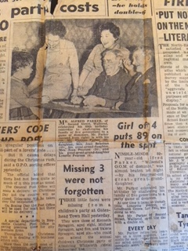
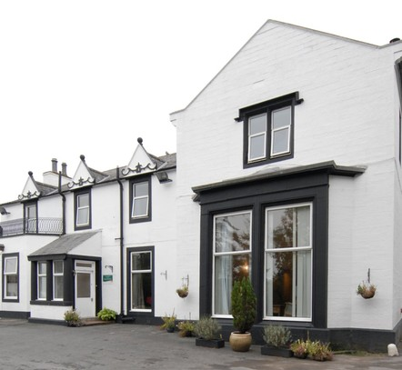
Childhood
Notes:
Picture Key:
Four generations: my great-great-grandfather, my great-grandfather, my grandmother, my mother, me…I clearly have a very large family in parts of the UK…
58 Conyers Road, Byker; Irish contingent; Conyers Road was demolished, along with many other working class terraces in Byker, to make way for ‘The Byker Wall’…
Cargenholm, South West Scotland; spent a large part of my childhood here; a haunted house and a key part of the development of my independent and fighting spirit

Slide 10
Young
adulthood
Notes:
Picture Key:
From top left-hand corner:
my son Simon
me as a trainee mental health nurse – get the hair that both Simon and I inherited…
me as a biker chick in late 1970s
my Scottish hometown of Dumfries

Slide 11
Adulthood
Notes:
Picture Key:
From top left-hand corner:
my PhD graduation shot
me today
animals and other special people in my life…
my son and I after my MEd graduation; our last day together before he died…

Slide 12
Cronehood companion
Notes:
My life partner, Pat!
Sharing cronehood…and facing new health challenges with me…

Slide 13
York St John Counselling & Mental Health Clinic
Celebrating counselling
in June 2018
Innovating UK therapy database development in
2019
Clinic opens
Doors open
2016
May 2016
Notes:
CMHC – Counselling and Mental Health Clinic
Purpose
Provision of high quality, accessible, evidence-based mental health services to support personal, relational and professional development and facilitate people to reach their aims and aspirations
Vision
To develop as an Internationally recognised Centre for Mental Health, distinguished through our founding values of collaboration, creativity and community
Aims
To deliver research projects and outcomes with social, political, professional and Research Excellence Framework (REF) impact
To offer professional services through: CPD, training, supervision and collaborative consultancy
To expand income to facilitate employment opportunities, growth in services, and positive impact upon community mental health
To secure UK Professional Body Service Accreditation
Additional information:
35 strong clinic team: director, clinic coordinator, administrator, duty leads, trained and trainee counsellors (11 of each), research fellows, placement students; 4 new trainees commencing this November
2 scheduled clinic sessions per week on Monday and Wednesday evenings, plus additional daytime sessions and groups
Minimum dataset: GAD 7/PHQ9/CORE 34/CORE 10/WEMWBS; used for counselling and group delivery
Outputs: papers, conferences, bids
Income projection: minimum £132K per annum by 2021 based upon minimum 5 rooms at full occupancy
Currently developing CMHC logo and brand with DVC and Advisory Board
Clarence Street development for 2019 entry; medical group co-location; space for expansion and revenue generation
Current caseload:
Currently 40-50 clients per week
Waiting list for assessments currently 20, with additional average 5 referrals weekly

Slide 14
Notes:
!!Preparing for the opening of the York St John Counselling & Mental Health Clinic!!
Clockwise from left to right:
David Britten, clinic counsellor
Ashley Hullock, clinic’s first Graduate Intern – a YSJ BSc Psychology Graduate
Hazel James, former YSJ academic and clinic researcher
Gary Shepherd, clinic psychotherapist, duty lead, anger management project lead
ME…….
Christine Muller, former clinic Research Assistant, YSJ Occupational Therapy graduate

Slide 15
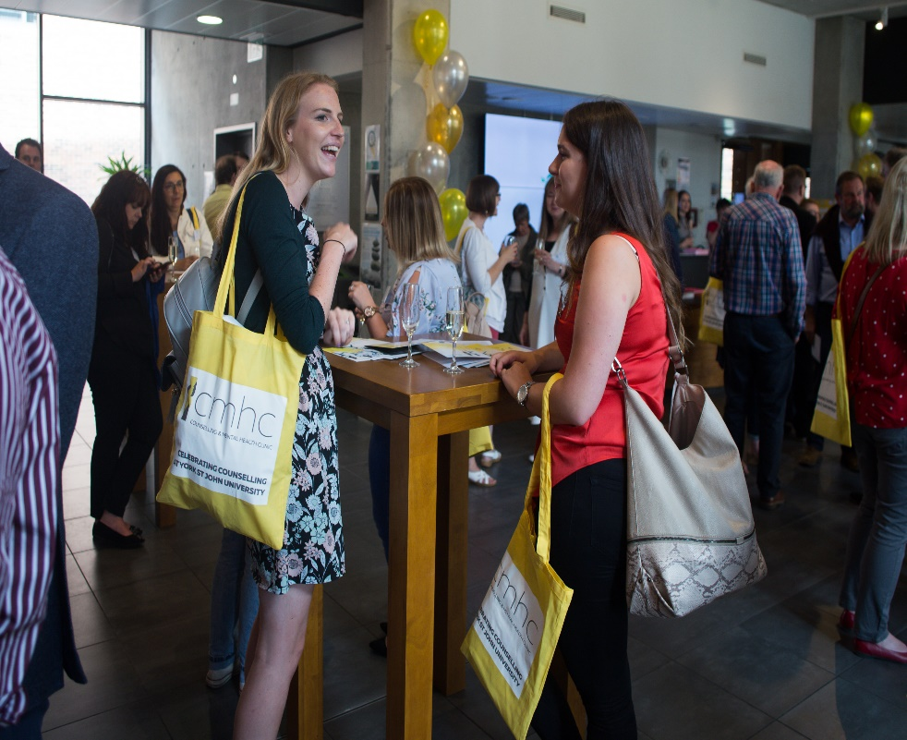
2018 celebrating 30 years of counselling at York St John
Alumni power
Student power
Notes:
A host of fabulous students and alumni….!!
Left to right:
Left: Catherine Stephenson, NHS Leeds/Selby Trust, a lead in their Recovery College
Middle: former students
Right: Grace Holland, involved in young persons coaching; Rachel Williams, York St John Language and Linguistics graduate and our most recent clinic Graduate Intern
In addition:
Alice Corbally, clinic administrator; YJS BA Counselling Studies graduate; now on full time funded PhD at Sheffield University
Judy Field, former clinic administrator, now pursuing own private practice business; YSJ PG Diploma in Counselling graduate
Abigail Kennedy, former clinic Graduate Intern and graduate of YSJ BSc Psychology; recently trained as a counsellor and now working within the field

Slide 16
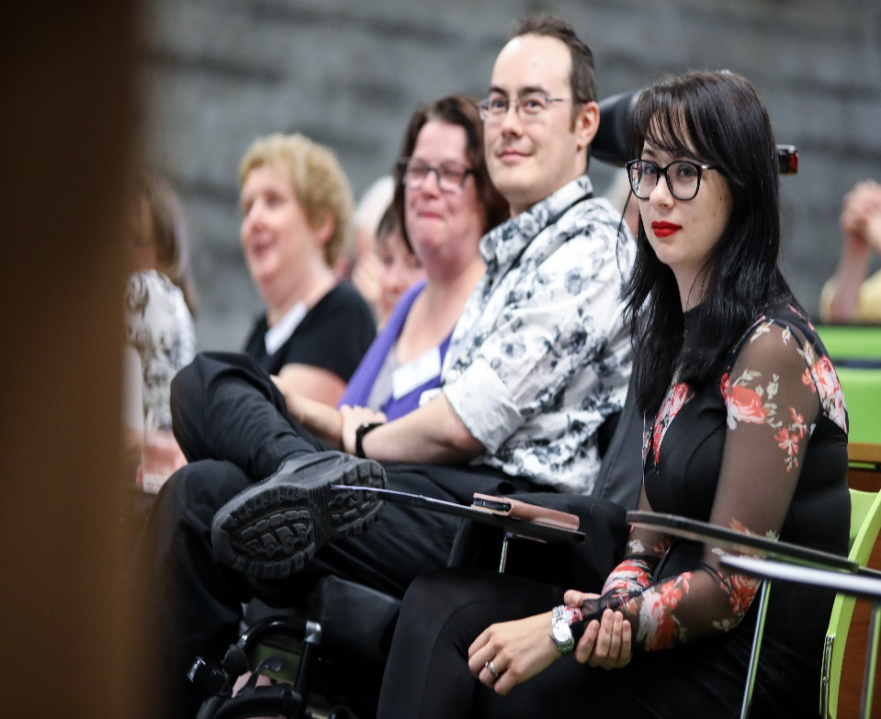
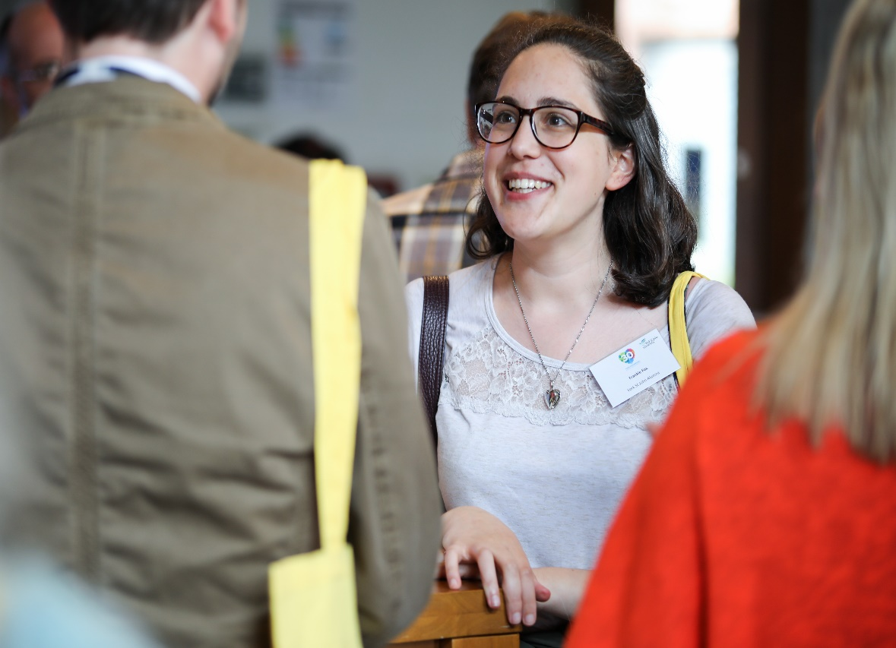
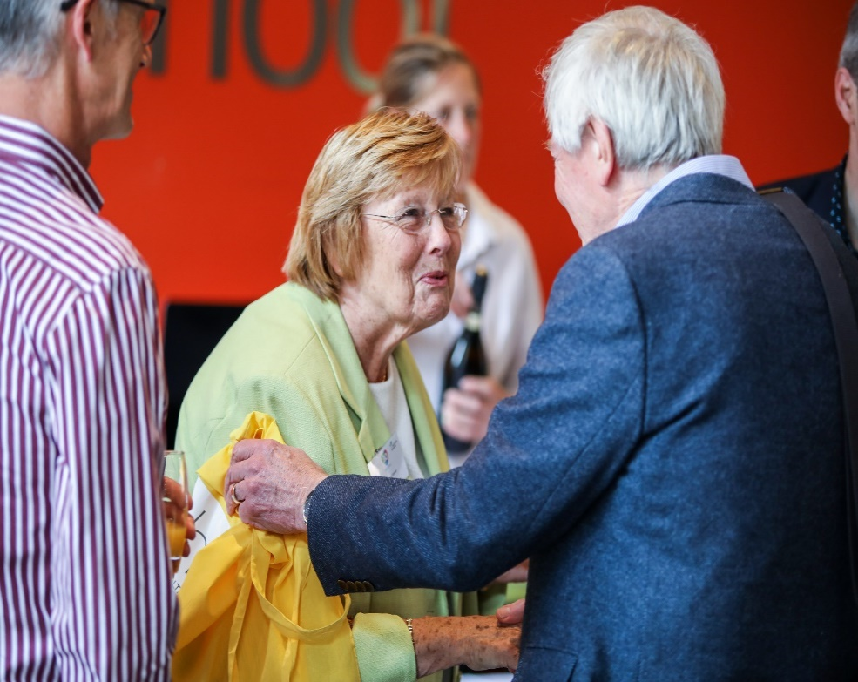
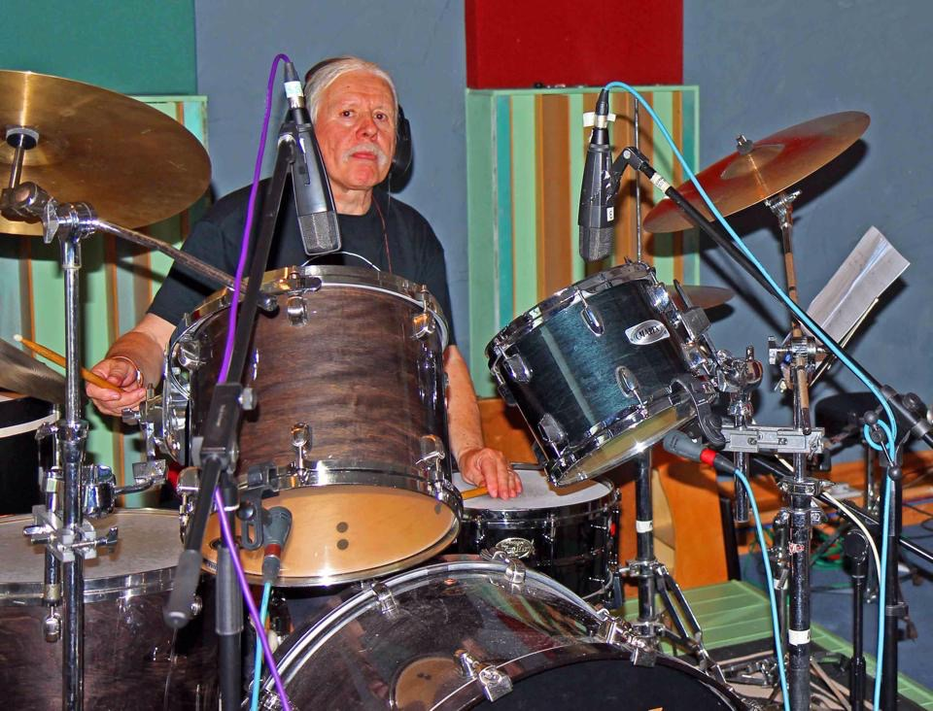
Cast of Characters…
Notes:
More fabulous characters…
Top left: clinic colleagues from York St John and Abertay Universities; will say more a little later about the clinic consortium…!!
Top right: Rich and Ruth Knight, York St John Clinic; Rich, clinic lead and coordinator; Ruth, recently joined and will manage our web-based/media presence, plus lead on an eating disorders project with a York University colleague, Dr Catherine Preston
Bottom left: Professors Gerry Egan, Tim Bond and John McLeod; none of whom could be here, but most definitely with us in spirit!!
Bottom middle: Dr. Mary Connor, founder of counsellor training at York St John; Peter Cook former consultant and trainer
Bottom right: Dr John Wilson clinic bereavement project lead

Slide 17
colleagues and alumni…
Notes:
Yet more fabulous characters….!!
Sophie, Emily and Andy, clinic counsellors

Slide 18
the A-team …
Notes:
Don’t mess with us….!! The A Team
Me
Andy Pendle
Rich Knight
Gary Shepherd

Slide 19
General counselling
Bereavement
Anger management
Behavioural & emotional regulation
Domestic violence
Coaching
Research
Governance:
Advisory Board
Management Group
Office staff and volunteers
CMH Clinic
Collaborative
Creative
Community
Trainee placements
Service-related opportunities
CPD provision
Postgraduate opportunities

Slide 20
Work in progress…
Notes:
A feature for the University magazine, highlighting the Mental Health Conference in June

Slide 21
Feedback
I have noticed a significant improvement in my anxiety and confidence levels, as well as my ability to self-care. I feel so much stronger as a person than when I started.
This has been one of the best things I have ever done for myself.
I am so grateful for the services the clinic provided – I always felt absolutely welcome and at ease, the atmosphere is incredibly safe and nurturing.
The clinic itself is a relaxing, safe environment. I have benefited from my sessions in processing some issues and being aware of others. Thank you to all staff
Notes:
A brief example of comments from clinic clients

Slide 22
Research
Research Projects
Minimum dataset – cross consortium and professional body project
Bereavement
Children & young people
Domestic abuse
Eating disorders
DBT (dialectical behavioural therapy)
Elders
Papers & Texts
Domestic violence (DV) model for training professionals 2018
DV and abuse papers in 2017 & 2018
Bereavement papers; 2 in preparation currently
Professional ethics: Ethical Decision-Making Model for Professional Body 2018
Developing 2nd edition of relational ethics edited text
Notes:
NOTES:
Research project developments
Clinic consortium minimum dataset – all clinics
Anger management - Gary
Bereavement – John
Young people – Grace, Pete, Sinead
Disability - Rich
Domestic abuse – Lynne / Jeannette / consortium
Eating disorders – Ruth / Catherine
Elders – Lynne, Lizzie, John L

Slide 23
Horizons…

Slide 24
Work in progress…
Notes:
Developing a second edition of Relational Ethics in Practice, with Dr Alan Dunnett and Reverend Professor Alistair Ross as co-editors
Keynote at the Council for Psychoanalysis & Jungian Analysis in March 2018
Conference proposal: developing a research clinic in UK HEI sector; collaborative venture with research clinic consortium colleagues.
Plus: 1) Invited presentation to GPs on men’s mental health; 2) Invited keynote at Keele Conferencer 2019; 3) invited talk on DV at York University

Slide 25
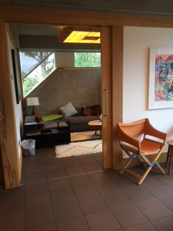
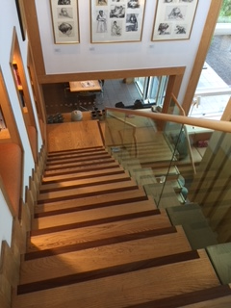
Clarence Street development
2019
Notes:
Exciting development!
The clinic is moving into Clarence Street in September 2019, to work in shared accommodation with a local medical group to provide an accessible and welcoming health/mental health context. The project is led by YSJ Estates team (under Director Debbi Angell) and the refurb is led by Martin Dougherty. York St John talent – staff and students – will develop and deliver on the refurbishment.

Slide 26
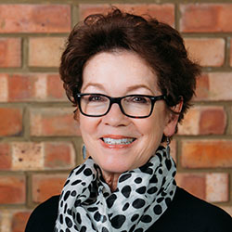
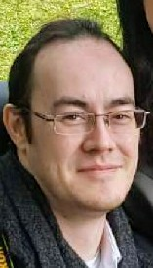
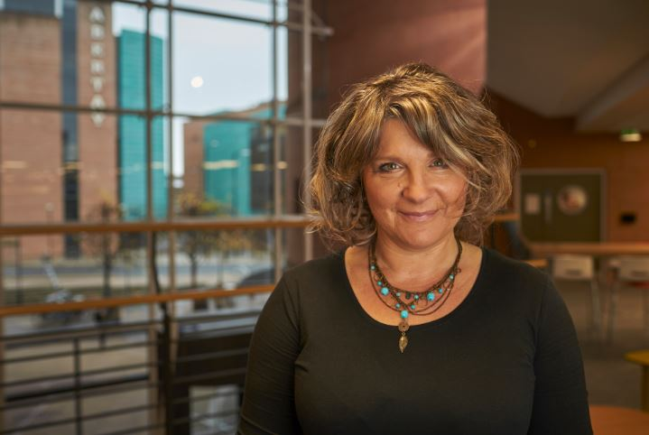
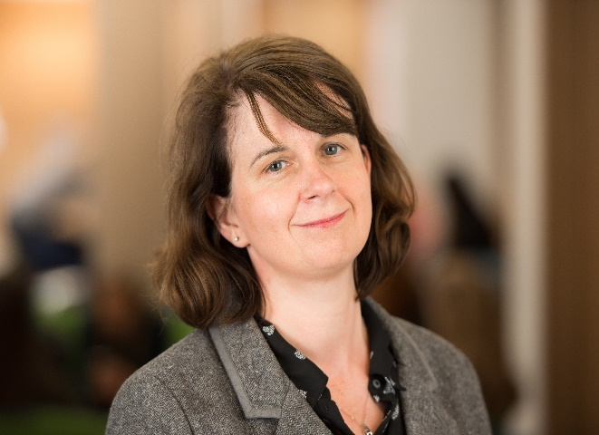
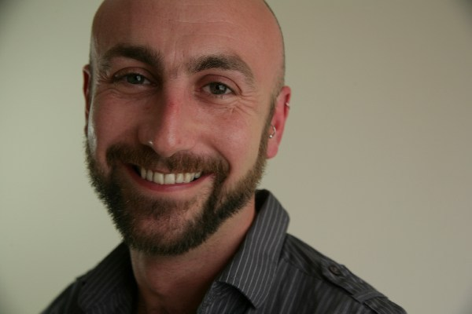
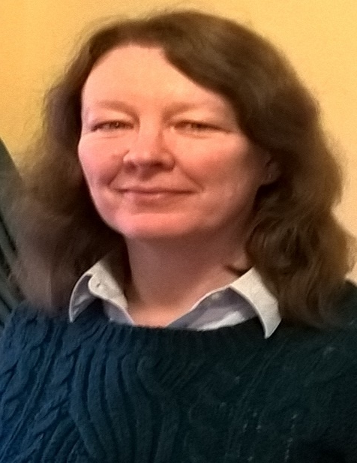
Clinic consortium 2019 and beyond…
Notes:
From top left: Me and Rich Knight, York St John Clinic; Kate Smith, Abertay Clinic
From bottom left: Colette Lewis, Newman Clinic; Mark Widdowson and Jeannette Roddy, Salford Clinic

Slide 27
What
do
you
see?
Share with person next
to you
Notes:
NOTES
So, following our journey through some of my personal, professional and relational terrain, it is time to draw to a close
Time for a moment of contemplation and reflection; reflect upon the image and note anything that comes to mind or seems significant for you
Share your reflections with the person next to you
Take 2-3 comments from audience if people want to share
Image prepared by local / International musician and artist Heather Hammond…
Lead into comments and question time for final 10 minutes
Remind audience of drinks and nibbles in De Grey reception
Note CPD development and show flier slide next

Slide 28
Hot off
the
press...
New
CPD
offers

Slide 29
Comments & Questions
cmhc@yorksj.ac.uk
www.yorksj.ac.uk/cmhc
Notes:
Professor Lynne Gabriel
E: l.gabriel2@yorksj.ac.uk
T: 01904 624624 / M: 07958475919

