Slide 1
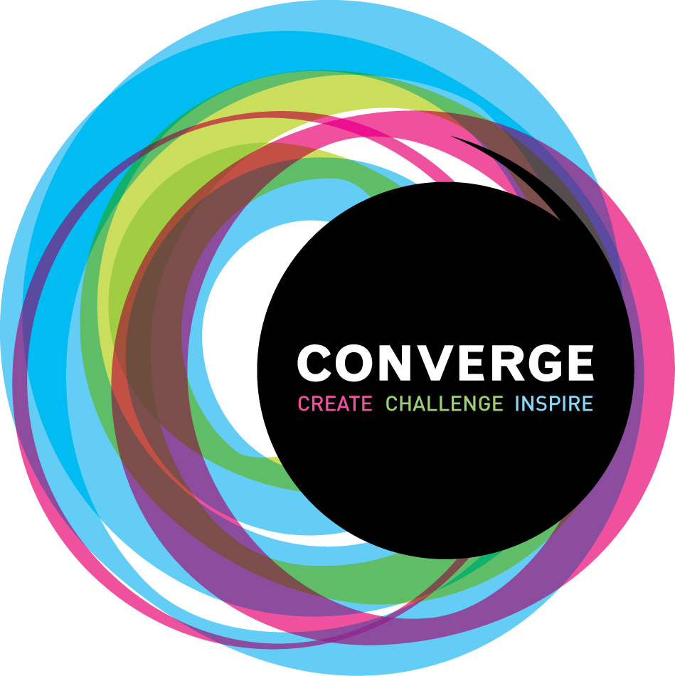
Converge: University arts education and adults with mental health problems.
UoA 33 Multi-Component Output with contextual information
Nick Rowe
2014-20

Slide 2
Index of Contents
300 word statement 3
Introduction 4
Overarching themes 5
Research questions 6
Research process 7
Insights. RO1 8
Insights. RO2 9
Insights. RO3 10
Insights. RO4 11
Dissemination 12
Appendices 13+

Slide 3
Converge – 300 word statement
Converge is a longitudinal practice-research project of which Nick Rowe is the founder and director, which uses action research, peer research and reflective practice to explore the efficacy of situating arts and mental health programmes in a university context. Each year Converge engages 6 university staff and 60 university students in delivering a range of educational courses to 150 local people who have mental health problems.
Within the Converge project, two overarching strands of research can be identified. Firstly, through cycles of practice, collaborative reflection, data gathering and conceptualisation, Converge seeks to develop and refine an educational model of mental health practice, and to evaluate its impact on mental health and higher education practice, on mental health service users and on participating university students. This has been the core of Converge’s practice research enquiry throughout this REF period.
Secondly, since 2017, Converge has followed the same practice research methodology to test innovative models of peer research in the mental health context. In particular, it has established the Converge Evaluation and Research Team (CERT), a group of people with lived experience of mental health difficulties who have received training in research methods and have been commissioned to undertake bespoke evaluation for six services. Further, Converge’s theatre company Out Of Character carried out a groundbreaking drama-led participatory research project into alternative futures for mental health services. The research objective of this strand is to test and disseminate a model of peer research in mental health, seeking to change practice within the NHS, local government and national policy making.
The conceptual and methodological advances generated through both strands of practice research have been disseminated not only through academic publications but through conference presentations, performances, creative outputs (including several plays and numerous workshops) and via Converge’s national and international partnerships. These are presented in the supporting contextual information.

Slide 4
Introduction
Converge is an extended piece of practice as research. In collaboration with the NHS, the project provides university-based arts education to local people in York who use mental health services.
Each academic year we offer over 40 courses, providing over 1500 hours of teaching. Currently we run courses in theatre, dance, music, creative writing, design, stained glass making, and research methods.
We run a choir and a theatre company, Out of Character, members of which comprise local people with mental health problems, university students and staff.
Converge and its associated support service is funded by Tees, Esk & Wear Valleys NHS Mental Health Trust and, in kind, by York St John University. At the time of writing (May 2020), 6 NHS staff are seconded to the university to work with Converge and over 60 university students are involved in the project.
The research focus of Converge is to develop and evaluation innovative practice in the provision of university arts courses to adults with mental health problems.

Slide 5
Overarching themes
Since 2014, through cycles of practice-based research, the project has sought to address two key overarching themes, which reflect contemporary and pressing debates in community mental health practice. These themes are:
a) The impact of adopting an arts-based educational model in a mental health context.
We are interested in what may be the benefits of offering university-based arts courses to local people with mental health problems. The development of ‘Recovery Colleges’ in the UK since 2011 has focused on what is commonly called ‘psychoeducation’ (Perkins et al, 2012) providing education to enable people to manage their mental health. Converge has taken a different approach through focusing on the arts and not on the mental health problem directly.
b) The possibilities of creative research methodologies to enable a more genuine, less tokenistic forms of coproduction.
Coproduction in mental health is directed toward addressing the power imbalances in the mental health system and creating services more sensitive to the needs of people who use services (Clark, 2015). Our approach, through practice and reflection, has been to explore the potential of creative methodologies to enable more sustained and genuine engagement. See Lambley et al. (2019) as an example of the approach. Reference appendices – document.

Slide 6
Research Questions
Four key research questions
What conditions foster a successful relationship between university and health services?
What is the impact on university students involved?
What is the impact on mental health service users?
What is the potential for peer research in the mental health context?

Slide 7
Research Process
Through iterative cycles of practice-as-research we have sought to understand the unfolding impact of adopting an art based educational model and how creative methodologies may enhance genuine participation.
The philosophy and methodology of action research has been central to our research design. We have sought to bring about change in community mental health approaches through a process of action, reflection and research. Each cycle of action and research allows us to adapt the project’s activity and the philosophy that underpins it.
Participatory Action research has developed since 2017 through the development of Converge Evaluation and Research Team (see page 11), a team of researchers all of whom have lived experience of mental ill health. The team have developed its approaches through externally commissioned evaluations and publications (see example right).

Slide 8
Insights – RQ1. What conditions foster a successful relationship between university and health services?
The focus on education and artmaking rather than the mental health problem has emerged as a pivotal theme throughout our practice and publications. Rowe (2015) provides evidence that taking on the role of student is one route to overcoming the stigmatised or ‘spoiled identity’ (Goffman 1968) of the ‘mentally ill person’. This understanding is closely related to the social model of disability. Converge courses aim to counteract the tendency of mental health diagnoses to ‘overshadow’ a person’s identity, as well as ameliorating other factors resulting from an episode of mental ill health, specifically a loss of confidence/hope, social isolation, stigma, and feelings of passivity or loss of purpose.
A related key theme in how researchers and practitioners understand Converge’s approach to inclusion is the politics of space. Courses are located in the university and in other socially valued public spaces. Newton and Rowe underline the principle of redistributive justice behind this: Converge: ‘aims to make the privileges and opportunities of Higher Education accessible to people who are often marginalised from mainstream society’ (2018:150).
The use of a university space is understood by Newton and Rowe (2018) to be hospitable to mental health recovery, in that ‘whereas a psychiatric hospital is ‘still redolent of a history of control and constraint’ (p.148-9), universities are ‘places of hope and aspiration, orientated towards the future’ (p.149).

Slide 9
Insights – RQ2. What is the impact on university students involved?
The Converge process involves adults with mental health problems attending university based arts courses. These are delivered in collaboration with university students on BA and MA programmes across a range of subjects. Through the research Converge has conceived of this as a form of knowledge exchange, in which the university provides knowledge and experience, through the courses it provides, to people who use mental health services. The university benefits through providing students ‘real life’ experience of working alongside people who use mental health services.
The theme of reciprocity, at both institutional and interpersonal levels, is a recurring one in our practice and publications and is a key finding of project. Reciprocal benefit to the university and the mental health community was a key priority at the outset of the project and its title of the project, Converge, was carefully chosen to indicate that a convergence of interests would be a key characteristic of the project’ (Rowe 2015:130).
The educational benefits to university students involved in courses as assistant tutors or volunteers are explored by Asghar and Rowe (2016), and Rowe, Forshaw and Alldred (2013). They discuss the benefits to university students in relation to the concept of ‘service learning’, a pedagogy of active citizenship with ‘core values of reciprocity and mutuality - less about doing something for a community, more about engaging with that community to solve problems and address challenges together.

Slide 10
Insights – RQ3. What is the impact on mental health service users?
The notion of recovery is a key concept in contemporary mental health practice. Converge has through its practice and research has contributed to evolving critical understandings of recovery that pose a challenge to ‘the short-term, individualised approaches that are currently prevalent in mental health.’
Participatory processes: Asghar and Rowe (2016) exemplify how Converge has contributed substantially to the body of understanding of the benefits of participatory arts processes.
Resilience: Heinemeyer and Rowe (2019)’s study of the role Out of Character (Converge’s theatre company) plays in its members’ recovery processes found the long-term nature of involvement in a theatre troupe to be pivotal. Interviewees and focus group members in this research posited ‘being known’ in the theatre company as a stronghold within their lives and recovery processes. This should perhaps lend weight to critical perspectives on resilience and recovery, suggesting that resilience is less a property of individuals than of supportive, enduring communities.
Image: Out of Character’s show at York Theatre Royal, ‘Less than Human’. March 2020.

Slide 11
Insights – RQ4. What is the potential for peer research in the mental health context?
Within this question we have explore the ways in which creative research methodologies may enable a more genuine, less tokenistic forms of coproduction?
Genuine participation in service provision, evaluation and research is a major priority for mental health services. The challenge is that coproduction can be tokenistic and conducted in professional discourses from which many people feel excluded. Since 2014 we have explored how genuine coproduction can be facilitated through the arts and through an educational paradigm. This has taken the form of the Converge Evaluation and Research Team (CERT)
CERT comprises people with lived experience of mental ill health supported by university academics at York St John University. It carries out external evaluations (see an example in appendix ?) and publishes on issues relevant to the group.
CERT is particularly interested in ways in which the voices of people with mental ill health can be facilitated in research. The group’s study of the experiences of mental ill health within Converge (Lambley, Rowe et al 2019) adopted a Participatory Action Research approach, employing photo elicitation as a means of facilitating conversations with participants. More recently an article accepted for publication in Qualitative Research in Psychology explores the value of ‘allyship’.

Slide 12
Dissemination
The nature of practice of research lends itself of dissemination throughout the work, therefore the dissemination takes a number of forms:
Performance: Through performances from the theatre company, Out of Character, the choir and the publication of anthologies of creative writing (Creative Writing Heals: 1 and 2), or our magazine: - we have disseminated work as it develops. The dissemination is a key part of the practice itself.
Publications. A full list of publications by those involved in Converge in Appendix 1.
Conference presentations: we have presented at conferences see appendix tbc.
Training of health professionals: since 2015, we contribute to the training of health professionals at Huddersfield and York University nursing schools through performance and simulated patient work. Occupational Therapy doctoral students from Pacific University Oregon work with us each year over a two-week period.
Expansion of the Converge approach: The Converge model has extended to other universities:
Northumbria University, Converge Newcastle offers courses in theatre and fashion to local people with mental health problems.
Leeds University, Leeds Becket, Leeds Trinity and Leeds College of Music offered Converge courses from 2015-18.
Pacific University Oregon offers a Converge course in theatre.

Slide 13
Appendix 1. List of publications
Since 2014, Rowe has published the following work relating to Converge:
Rowe, N. (2015). Creating a Healing Campus: A Partnership between a University and a Provider of Mental Health Services. University Partnerships for Community and School System Development. (Vol. 5, pp. 119-134). Online: Emerald Insight.
Asghar, M. and Rowe, N. (2016). Learning from the unfamiliar: How does working with people who use mental health services impact on students' learning and development? Journal of Further and Higher Education.
Asghar, M, & Rowe, N. (2017). Reciprocity and critical reflection as the key to social justice in service learning: A case study. Innovations in Education and Teaching International.
Pendle, A, Rowe, N, & Britten, D. (2017). Coaching in a non-clinical setting with coachees who access mental health services. International Journal of Evidence Based coaching and Mentoring, 15(1)
Rowe, N. (2017) Converge. In Higgins, L and L.Willingham. Engaging in Community Music: an introduction. Pages 111-113. New York and London: Routledge.
Rowe, N. and Reason, M. Purpose, Outcomes and Obliquity: To Plan or Not to Plan. in Reason, M. and Rowe, N. (eds) (2017) Applied Practice: Evidence and Impact in Theatre Music and Art. London: Bloomsbury.
Newton, S. and Rowe, N (2018) Students not Patients: Opening up the University to those with mental health problems. In Billingham, S. (Ed) Access to Success and Social Mobility Through Higher Education. Emerald Publishing: Bingley, UK.
Wall, T., J.Fries.,N. Rowe., E. Malone., E. Osterlind (2018) Drama and Theatre for Health and Wellbeing. In Encyclopedia of the UN Sustainable Development Goals. Good Health and Well-Being.
Heinemeyer, Catherine and Rowe, Nick (2019) Being known, branching out: troupes, teams and recovery. Mental Health Review Journal. (In Press). http://ray.yorksj.ac.uk/id/eprint/3957
Lambley, R. Kaley, E. Morris, R. Robinson, A. Rowe, N. Sellar-Edmunds, J. and Wynn-Werninck, T. (2019) Wow, it’s a University!’ Experiences of people with mental illness of an educational arts programme. Journal of Applied Arts and Health. Vol. 10 No:3.

