Slide 1
Warren Fearn M.A. / P.G.C.E
Creative Director

Slide 2
I FEEL THE CHEMISTRY
Established WAK Studios 6 years ago working in the commercial industry for several years and on animation projects within the education sector.
WAK Educate - New social enterprise company formed in to enable us to reach more students and contribute to the community. Specialising in delivering creative media courses to schools and colleges.
Bridge the gap
Animation Project

Slide 3
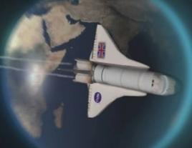
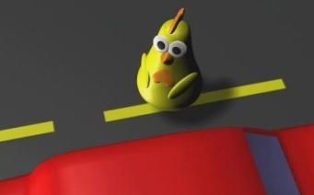
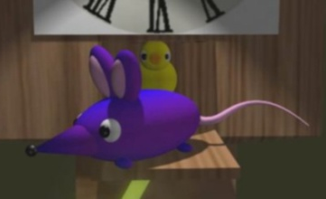
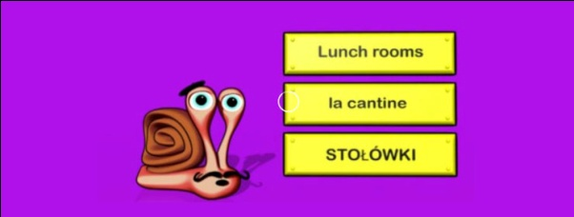
I FEEL THE CHEMISTRY
National Schools Film and Animation
Award Winner
Member of the Autodesk Secondary
Advisory Education Board for Schools
New Deal 4 Learning Award
Animation Project

Slide 4
I FEEL THE CHEMISTRY
Animation Project

Slide 5
I FEEL THE CHEMISTRY
I Feel the Chemistry
An accredited project to teach children about the
‘Periodic Table’ using animation.
Animation Project

Slide 6
I FEEL THE CHEMISTRY
Aim
The concept of this project is that the students are challenged
with creating a song and dance animation, to teach other
children about science and the periodic table.
Students are able to learn:-
About Chemistry in a fun and innovative way.
New animation techniques using Autodesk Maya.
And receive an equivalent to 2 GCSE’s (A-C) on a final pass mark
using a LEVEL 2 in Animation NCFE.
Aim

Slide 7
I FEEL THE CHEMISTRY
Pathway – NCFE Level 2 in Animation
Learn about animation techniques and the history of animation
Develop your own character designs and environments
Create a storyboard
Produce and present a computer animation sequence
using Autodesk Maya.
UNIT 1
UNIT 2
UNIT 3
Pathway

Slide 8
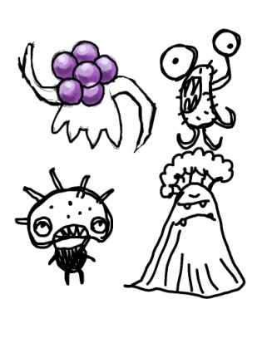
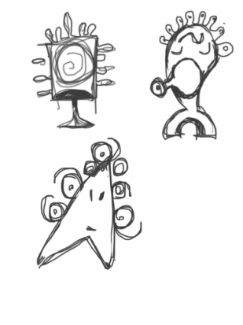
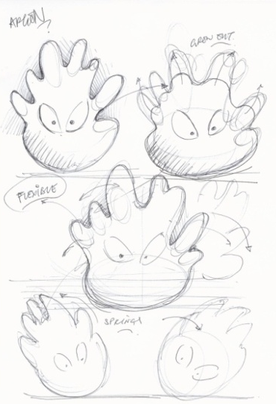
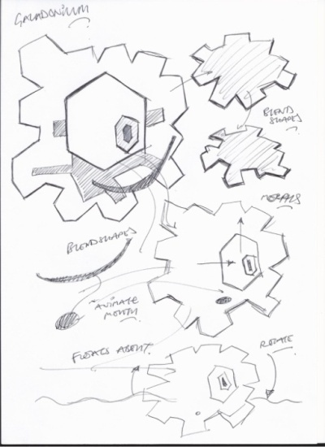
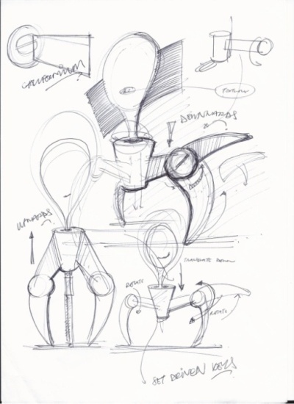
I FEEL THE CHEMISTRY
UNIT 2
Character Designs – Initial Concepts
Develop a range of characters
Think about how your characters will move?
Rough Pencil Sketches
Character Design

Slide 9
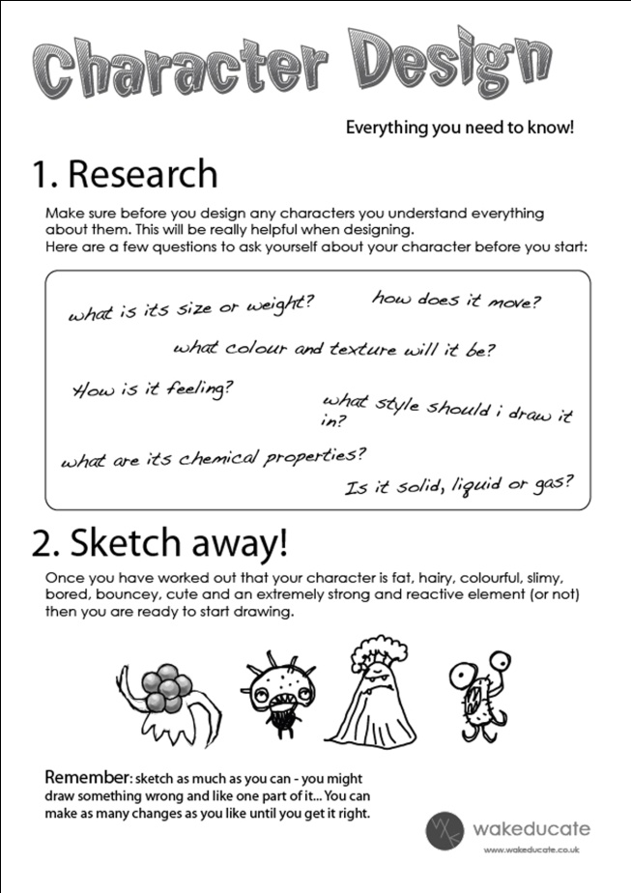
I FEEL THE CHEMISTRY
UNIT 2
Character Designs – Character Sheet
We have created a character
sheet for you download.
This will help in generating new
ideas and provide direction for
your own Periodic character designs.
Character Design

Slide 10
I FEEL THE CHEMISTRY
UNIT 2
Character Designs – Final Concepts
Develop a range of characters
Click to watch the video.
Character Design

Slide 11
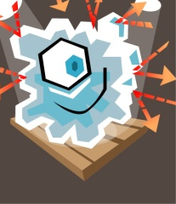
I FEEL THE CHEMISTRY
UNIT 2
Character Designs – Final Concepts
Develop a range of characters
Finalise your ideas!! This is using Adobe Illustrator
Please take a look at Autodesk Sketchbook Designer
http://usa.autodesk.com/adsk/servlet/pc/index?id=15793589&siteID=123112
Character Design

Slide 12
I FEEL THE CHEMISTRY
UNIT 2
Character Designs – Final Concepts
Develop a range of characters
Think about applying the
technical aspects to a
character using Autodesk
Maya.
Spritely Character
Rigging a Character
Using Blend shapes
Slinky Character
Rigging a Character
Using Constraints
Chilled Out Character
Using Set Driven Keys
Using Animated Texture Maps
Character Design

Slide 13
I FEEL THE CHEMISTRY
UNIT 2
Character Designs – Final Concepts
Develop a range of characters
Scooter Character
Rigging a Character
Floating Character
Using Blend shapes
Springy / Rubber Character
Using the Jiggle Deformer
Bouncy /Flexible
Using Linear Deformers
-Squash
-Bend
Using Clusters
Character Design

Slide 14
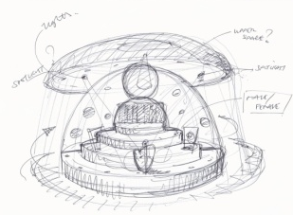
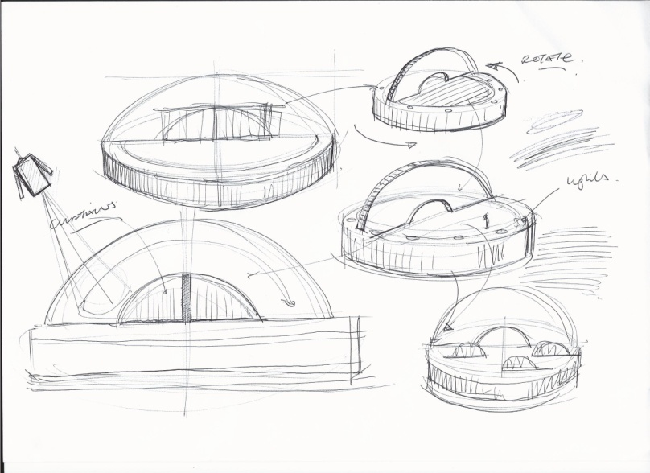
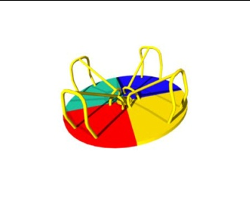
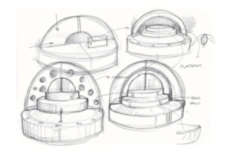
I FEEL THE CHEMISTRY
UNIT 2
Environment Design – Concept Ideas
Inspiration for ideas
Rough Pencil Sketches
Environment Design

Slide 15
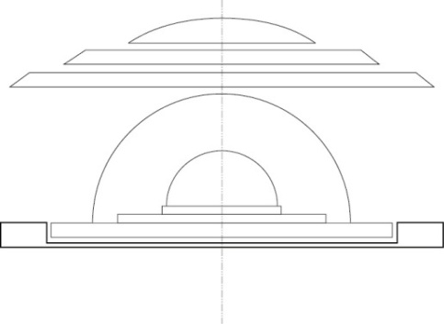
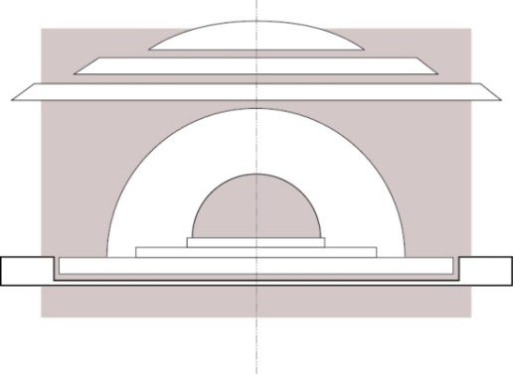
I FEEL THE CHEMISTRY
UNIT 2
Environment Design – Concept Ideas
Did you know?
If you have created a building or
an environment in AutoCAD you could import this directly into Autodesk Maya.
Please take a look at
http://findyourautocad.autodesk.com/?mktvar004=ilt-wwm-amer-us-acadgc--DynGrid-acadprog---#find-your-autocad
Environment Design

Slide 16
I FEEL THE CHEMISTRY
UNIT 2
Environment Design – Assets
You may wish to create props for your environment. These are
the props we designed using vector graphics.
Speaker Stage Light Speaker
Environment Design

Slide 17
I FEEL THE CHEMISTRY
UNIT 2
Environment Design – Concept Ideas
Click to watch the video
Environment Design

Slide 18
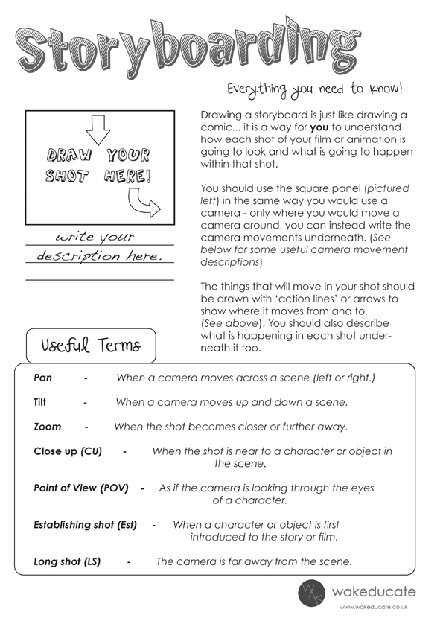
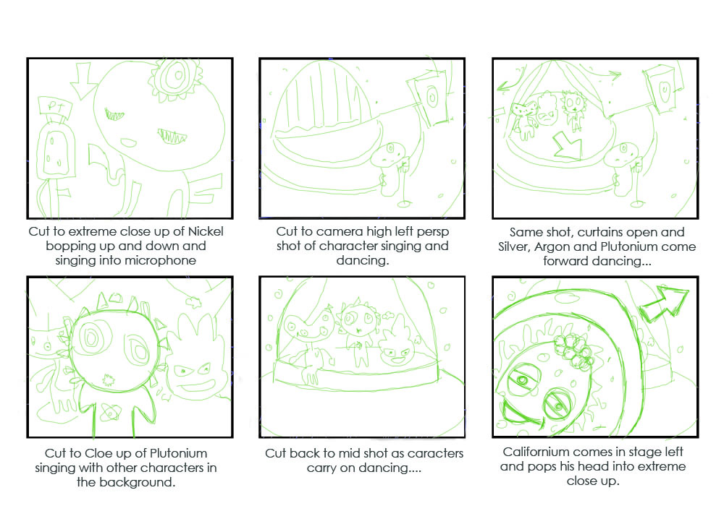
I FEEL THE CHEMISTRY
UNIT 2
Storyboarding
Produce a storyboard
Storyboarding

Slide 19
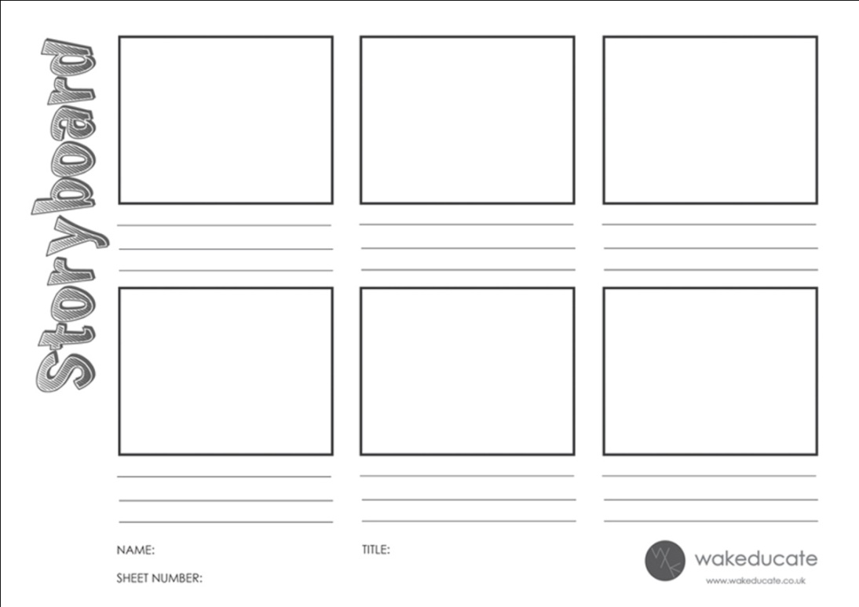
I FEEL THE CHEMISTRY
UNIT 2
Storyboarding
- Storyboard Template
Click to watch the video
We have created a storyboard template
for you to use.
Storyboarding

Slide 20
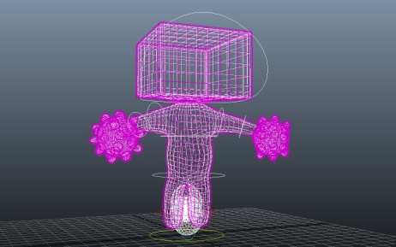
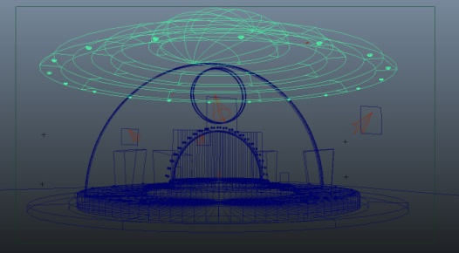
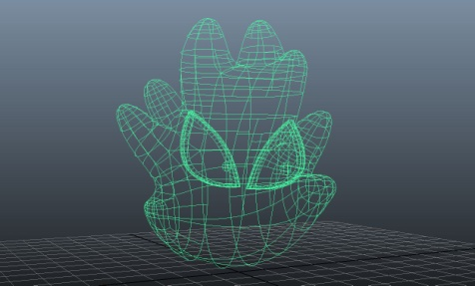
I FEEL THE CHEMISTRY
UNIT 2
Modelling
NURBS
Polygons
Subdivisions
Click to watch the video
Watch more videos on how to model characters
and the environment using Autodesk Maya.
Modelling

Slide 21
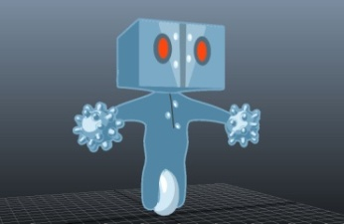
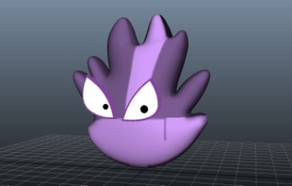
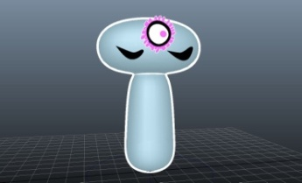
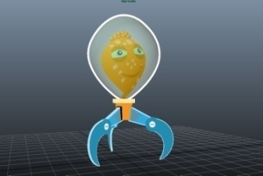
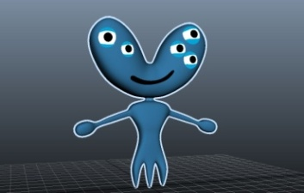
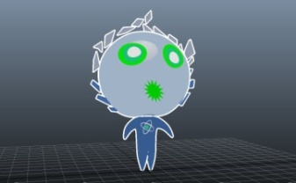
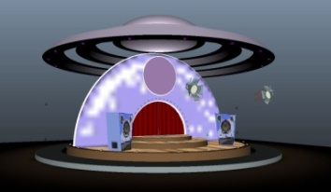
I FEEL THE CHEMISTRY
UNIT 2
Shading / Texturing
Click to watch the video
Watch more videos on how to shade and texture
the characters using Autodesk Maya.
Shading /Texturing

Slide 22
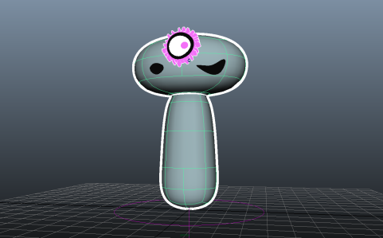
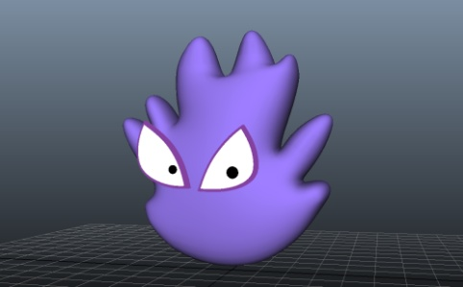
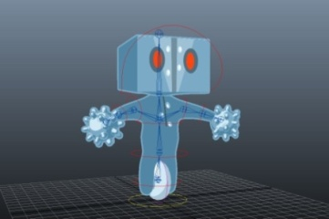
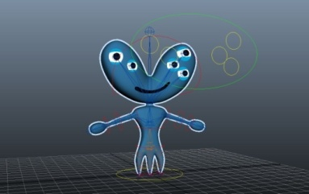
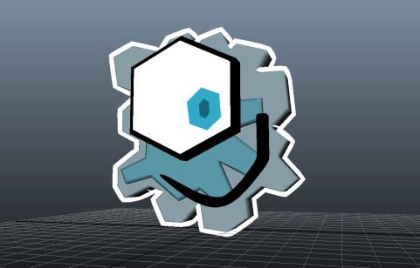
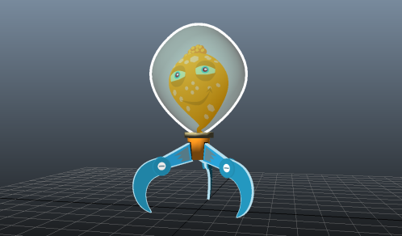
I FEEL THE CHEMISTRY
- BEND / SQUASH deformers
- Jiggle Deformer
UNIT 2
Character Set Up
Rigging Characters
- BLEND Shapes
- Set Driven Keys
Click to watch the video
Watch more videos on how to set up the characters
using Autodesk Maya.
Character Setup

Slide 23
I FEEL THE CHEMISTRY
UNIT 3
Animating – key framing
Audio and Script
By importing the audio file ‘I Feel the Chemistry’ into Autodesk Maya.
This will help to understand the timings for the sequence. The
script is also available as a word document for you to print out.
Click to play sound file.
Animating

Slide 24
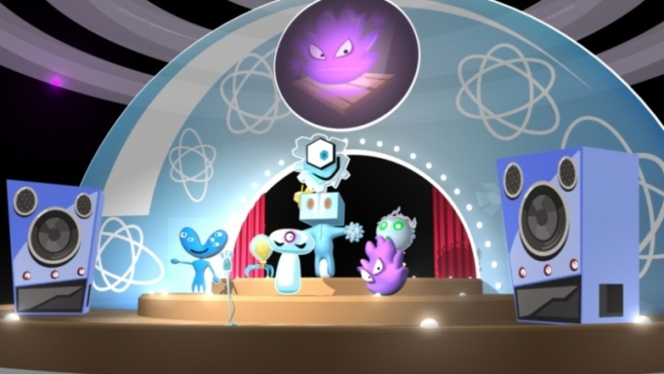
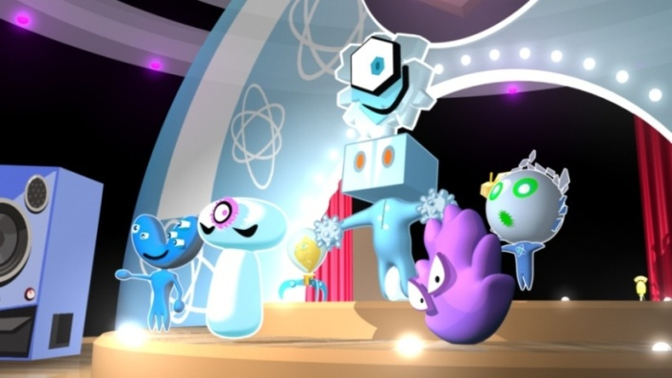
I FEEL THE CHEMISTRY
UNIT 3
Lighting / Rendering
Click to watch the video
Lighting / Rendering

Slide 25
I FEEL THE CHEMISTRY
Final Animation
Remember: Your own animation needs to be 1min (high quality) or
1min 30 sec (medium quality) as part of the NCFE Level 2 in animation requirement.
UNIT 3
Click and watch the video
Here is an example of the animation.
Final Animation

Slide 26
I FEEL THE CHEMISTRY
AUGMENTED REALITY – SECOND SIGHT
Cross plat forming the characters from using Autodesk Maya
and importing them onto an educational sheet, triggering 3D model / audio / video etc.
Augmented Reality

Slide 27
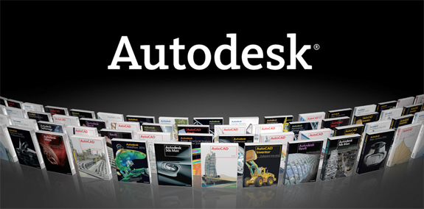
I FEEL THE CHEMISTRY
AUTODESK STEAM PROJECT
Autodesk STEAM Project
http://www.autodesk.com/digitalsteam
Design & Technology
Engineering
- Media
Autodesk STEAM Project – (‘I FEEL THE CHEMISTRY’)
http://curriculum.autodesk.com/student/public/Level3/overview/project_id/33/project_type/individual
Augmented Reality

Slide 28
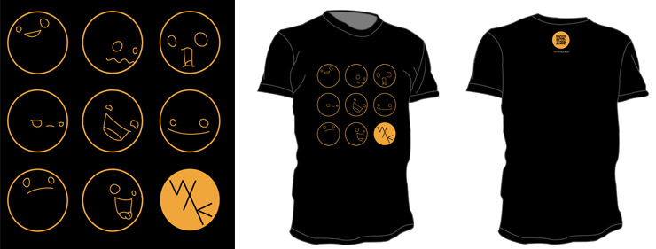
I FEEL THE CHEMISTRY
FREE ANIMATION WAK COMPETITION
Win a WAK QR (Quick Response T-Shirt)
£60 Amazon Voucher
http://www.wakeducate.co.uk/wakcomp
Augmented Reality

Slide 29
I FEEL THE CHEMISTRY
For further information, please contact
WAK Educate
E: warren@wakeducate.co.uk
W: www.wakeducate.co.uk
T: 01302 215294
Augmented Reality

