Slide 1
The formation of teacher professionalism: an actor-network ethnography
Ruth Unsworth: PhD candidate, Durham University, UK ruth.tromans@durham.ac.uk

Slide 2
The formation of teacher professionalism: an actor-network ethnography Introduction
Why research how teacher professionalism has been formed?
Theoretical framework and research questions
Ethnographic methodology and analysis through actor-network theory
Exemplar data and early findings of the study
Limitations and next steps

Slide 3
Research problem and background
As a school leader, being able to define teacher professionalism enables discussion of what is working and how we can improve
BUT
I found it difficult to find an accurate definition which described the common professional actions and beliefs in our school (nor encompassed the idiosyncrasies of individual teachers)

Slide 4
The problem framed by the literature
Teacher professionalism is often seen as tacit knowledge, difficult to grasp (Polanyi 1967)
Attempts to define the term have led to a plethora of definitions (Evetts 2009)
Standards documents can be seen as interpreted, non-standardising (Tummons 2014)
Hargreaves and Goodson (1996) argued that professionalism itself is ‘not universally agreed or understood’ and more recent research has concluded that teacher professionalism is ‘fluid…dynamic’ (Jones et al, 2008)

Slide 5
Research questions
A view situated within this uncertainty/ complexity
To view how professionalism is formed in a highly-regarded school, in order to: develop dialogue rooted in knowledge of its formation, rather than in response to a pre-determined ‘list of professional characteristics’ therefore, be able to intentionally sculpt teacher professional action and beliefs: understand the present by understanding its past in order to influence the future
Main research question: How has teacher professionalism been formed in this instance? How can the relationship between leadership, workforce reform and teacher professionalism be characterised?

Slide 6
An ethnographic approach
Where?
Well-regarded primary school (students 3-11 years old), in the north of England
Who?
Teachers, deputy principal, principal, subject leaders, National Centre for Excellence in the Teaching of Mathematics (NCETM) trainers
What?
Shadowing teachers (May-July 2018) - observational field notes
Semi-structured interviews
Documents and resources which were interacted with/ created by teachers

Slide 7
Data analysis for understanding the formation of a perception – actor-network theory (ANT)
A sociology of associations
Actor = anything around us which exerts influence on other things
Actors can be both human and non-human (teachers/ documents/ room layout/ displays/ resources/ etc)
Action and belief seen as performed into being by a network of influencing actors which work together
Follow the actors to ‘unblackbox’ and describe the network

Slide 8
Early findings
Major influencing actors:
Distributed leadership
Leadership of reframing teacher knowledge (+ actions + beliefs) through the considered use of documents
Collaborative opportunities and knowledge embodied in colleagues (near and far) are key
Becoming professional is discursive, relational, contextualised

Slide 9
Early findings: setting the scene The case of reframing teacher knowledge
The school had worked on introducing ‘maths mastery’ as a pedagogical approach over the last 2 years and continued these efforts during the period of fieldwork
Adopting the mastery approach involved changes to (reframing of) teachers’ content knowledge (CK) and pedagogical content knowledge (PCK) for the teaching of mathematics
Using the notions of ‘following the actors’ and ‘translation’ from ANT, I traced the actors involved in this reframing

Slide 10
Translation
‘…what happens when entities, human and non-human, come together and connect, changing one another to form links. Entities that connect eventually form a web or network of action and things, and these networks tend to become stable and durable.’
(Fenwick 2010, p.182-3)

Slide 11
Documentary data overview - Moments of translation of the mastery approach
National level | Multi-academy trust level | School level | Teaching team planning level | Classroom level
National curriculum and assessment documents MP documents, website and training materials Mastery textbooks Web-based planning documents Nationally-published planning guides | ‘Landmarks’ document ‘Small steps’ document Maths policy document(s) Teacher Research Group reflection document | Year-by year planning guidance Staff training slide-decks and handouts Reasoning icons for use across school Planning format (‘S plan’) for use across school School development and action plans | Weekly collaboratively-planned slide decks and resources Weekly planning using S planning format for small steps Team/ individual research project reflections linked to school development plans | Slide-decks used to structure lessons and ‘maths voice’ of teacher and students ‘Live marking’ concept in books Reasoning icons Paper resources and other materials represent concepts and shape learning Working wall collects language and central ideas

Slide 12
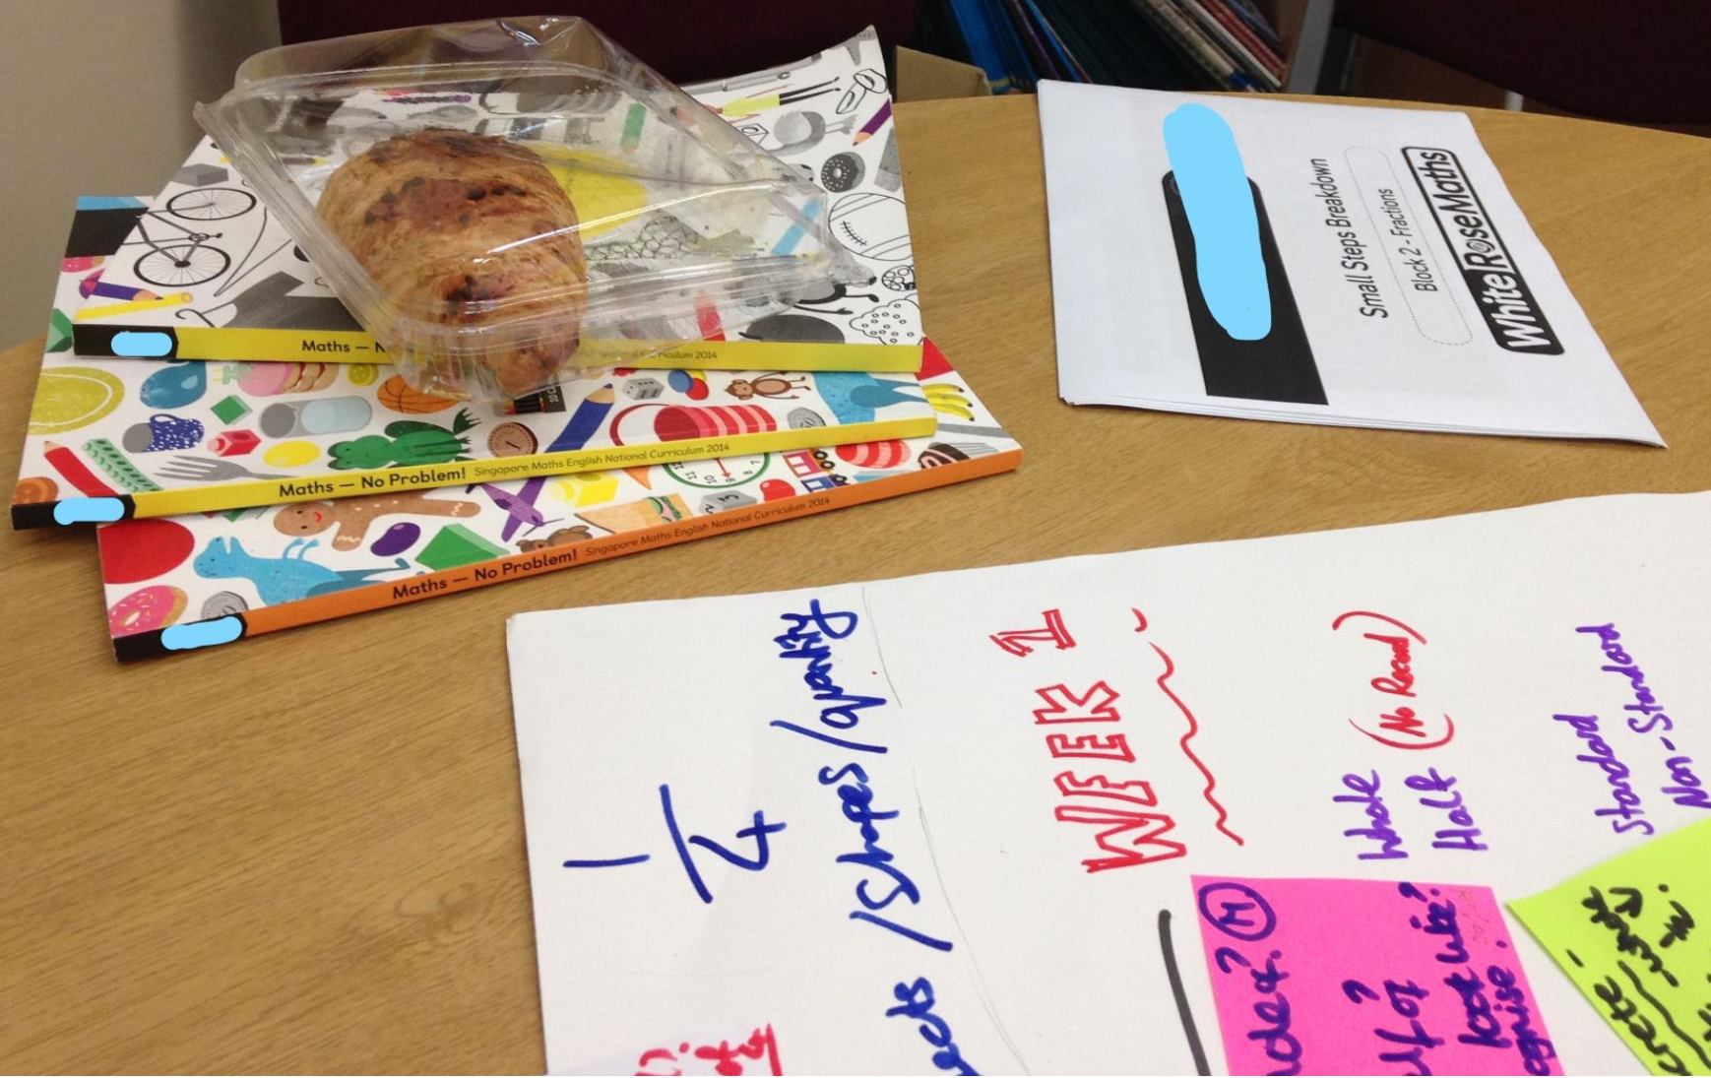
Examplar data: Planning session
Frances now directs everyone’s attention to the items on the table and files open on the screen on his PC. He introduces the task: to create an ‘S plan’ for the next Maths unit, which will last for 2 weeks. The teachers discuss aims, small steps and teaching ideas, dipping in to the different resources, comparing the ideas contained there and deciding the most relevant for their students in light of previous experiences and national expectations.
- Fieldnotes, week 3: Teaching team weekly planning session
Documents often act as reference points, mobilising knowledge into practice, reframing professional dialogue in the world of mastery

Slide 13
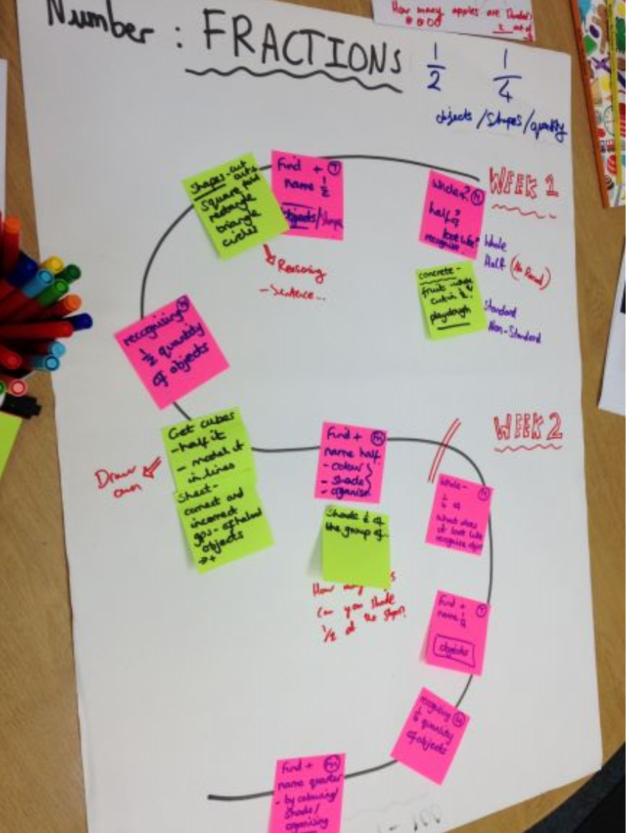
Exemplar data continued: These actors come together into a new translation: a plan of professional action
Small steps in learning (pink) referenced small steps document, national curriculum expectations and teachers’ knowledge of the students
Teaching strategies (yellow) – teachers referred to several national, MAT and school-level documents as well as their past teaching experiences

Slide 14
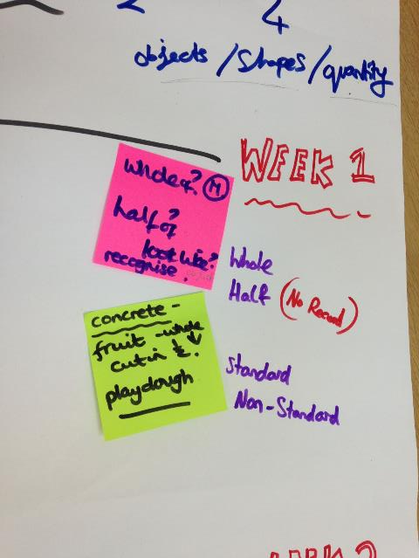
Exemplar data continued: These actors come together into a new translation: a plan of professional action
Mastery approach language (repeated phrases with attached specifications of how to teach) permeates all documents
‘our complete culture shift in our approach has been driven by change in vocabulary’

Slide 15
Obligatory passage points
an entity through which everything in the network must flow at some point
(Law 1994)

Slide 16
Leaders as obligatory passage points – documents where a leader is a key actor
National level | Multi-academy trust level | School level | Teaching team planning level | Classroom level
National curriculum and assessment documents NCETM documents, website and training materials Maths No Problem textbooks Web-based planning documents White Rose planning document | ‘Landmarks’ document ‘Small steps’ document Maths policy document(s) Teacher Research Group reflection document | Year-by year planning guidance Staff training slide-decks and handouts Reasoning icons for use across school Planning format (‘S plan’) for use across school School development and action plans | Weekly collaboratively-planned slide decks and resources Weekly planning using S planning format for small steps Team/ individual research project reflections linked to school development plans | Slide-decks used to structure lessons and ‘maths voice’ of teacher and students ‘Live marking’ concept in books Reasoning icons Paper resources and other materials represent concepts and shape learning Working wall collects language and central ideas

Slide 17
Early findings - summary
Teachers’ professional actions and beliefs have been influenced by leadership of changes to professional knowledge through attention to the material, particularly text-based, resources teachers interact with
These documents:
embody the concepts of the required knowledge, mobilising this from policy to practice
support the reframing of professional knowledge by acting as reference points for collaborative planning, delivery and reflection on teaching
include repeated phrases to which is attached specific meaning for professional action

Slide 18
Limitations Contribution and next steps
Detailed description of how a situated iteration of professionalism has been performed into being – unique view on the formation of elements such as (future analysis):
CK and PCK
Experiential knowledge
Teacher talk
Motivations
Moral aspects of professionalism
A view from which can be seen political and contextual actors, rendering teacher professionalism malleable
Infinite range of possible actor-networks to trace: it will not be possible to explore all actors or all actor-networks
An ANT approach is descriptive, not interpretative: it doesn’t explore the ‘why’

Slide 19
Thank you for your attention.
Ruth Unsworth: PhD candidate, Durham University, UK ruth.tromans@durham.ac.uk

Slide 20
Bibliography
Evetts, J., 2009. The management of professionalism: A contemporary paradox. In S. Gewirtz et al., eds. Changing teacher professionalism: International trends, challenges and ways forward. Oxon: Routledge, pp. 19–30.
Fenwick, T., 2010. Accountability practices in adult education: Insights from actor–network theory. Studies in the Education of Adults, 42(2), pp.170–185.
Hargreaves, A. & Goodson, I., 1996. Teachers’ professional lives I. Goodson & A. Hargreaves, eds., London: London : Falmer Press.
Latour, B., 2005. Reassembling the social: An introduction to actor-network-theory, Oxford university press.
Law, J., 1994. Organizing modernity, Blackwell Oxford.
Polanyi, M., 1967. The Tacit Dimension, IL: The University of Chicago Press.
Stronach, I., Pickard, A. & Jones, L., 2012. Primary schools: The professional environment. In The Cambridge Primary Review Research Surveys. Cambridge University Press, pp. 627–648.
Tummons, J., 2014. Professional standards in teacher education: tracing discourses of professionalism through the analysis of textbooks. Research in Post-Compulsory Education, 19(4), pp.417–432.

