Slide 1
Removing Barriers and Increasing Access to Higher Education
Dr Sue Jones
York St John University

Slide 2
^{Based on my case study:} Transforming Student Outcomes – the Holistic Grail
https://www.rsb.org.uk/get-involved/rsb-awards/he-teacher-of-the-year

Slide 3
Removing Barriers and Increasing Access to Higher Education
I embed transferable skills, laboratory competencies and subject-specific knowledge, emphasing personalised learning through holistic programme design
ALL of my students (regardless of their wider demographic background) are supported to achieve excellent outcomes.
This is true widening participation (WP) - removing barriers and increasing access for all and improving graduate outcomes and employability.

Slide 4
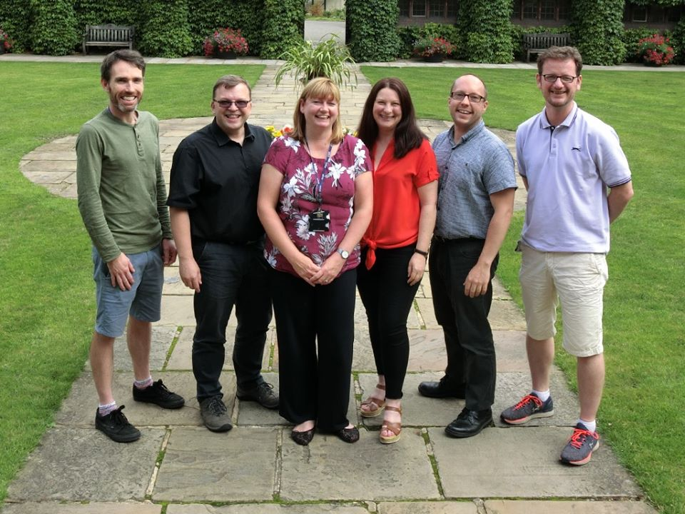
Different Starting Points / Experiences
Our students start University at different points and we need to help them to build a path to succeed

Slide 5
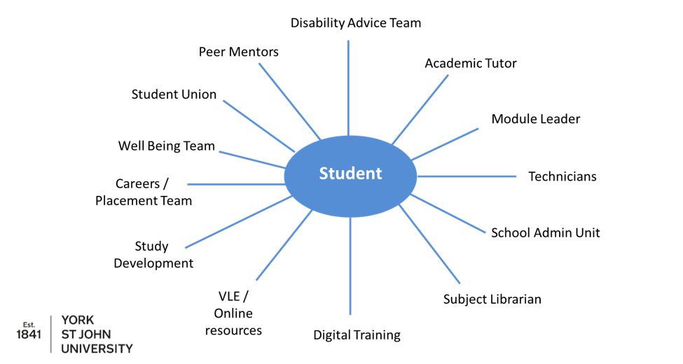
Student Support

Slide 6
Supporting the Student Journey through Personalised Learning

Slide 7
The Five Ws for Holistic Programme Design
Who is sitting the assessment – is it appropriate?
What is the purpose - LO / experiential learning
Why choose this assessment? Is it authentic / developmental?
Where does the assessment fit / level / spiral curriculum / constructivism
When is it? Clear organisation / avoid clustering

Slide 8
Assessment Strategy
Key Skills
Maths
Scientific
writing
Anatomy and
Physiology
Essay
Biological
Molecules
Portfolio
In-class test
Cell
Biology
Lab report
Exam
Biochemistry
Practical test
Microbiology and
Immunology
Presentation
Case Study
Semester 1
Semester 2

Slide 9
Level 4 Key Skills Marks for Combined Formative and Summative Assessment (4 Cohorts)
Formative
Summative
2015
2016
2017
2018
X = mean mark
Line = median

Slide 10
Level 4 Key Skills Marks for Combined Formative and Summative Assessment (4 Cohorts)
1st class marks increase from
20% to 49% of all students

Slide 11
Level 4 Key Skills Marks for Each Assessment Type (Combined Cohorts)
Maths
Essay
Sci
Comp
Lab
Report
Stats
Formative
Summative

Slide 12
Level 4 Key Skills Marks for Each Assessment Type (Combined Cohorts)
Formative
Summative
Maths
First
Essay
Upper Second
Lower Second
Scientific
Comprehension
Third
Fail
Laboratory
Report
Statistics

Slide 13
Tracking the Students through the Programme

Slide 14
Level 4 Mean Marks (2 Graduating Cohorts)
Coefficient of Determination
Model 1 – WP characteristics EXCLUDING UCAS points
Model 2 – the influence of adding UCAS points to model 1
Conclusion: WP characteristics and UCAS points do not significantly influence Level 4 performance

Slide 15
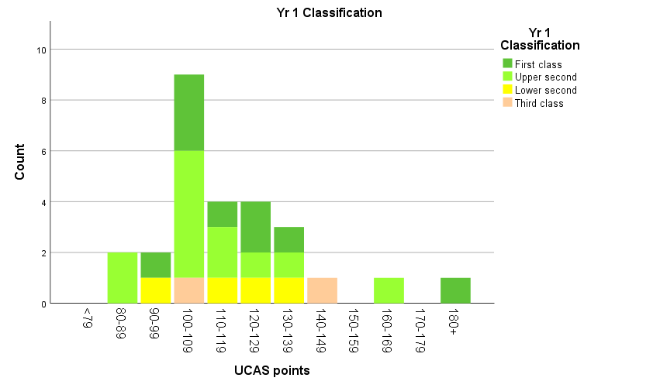
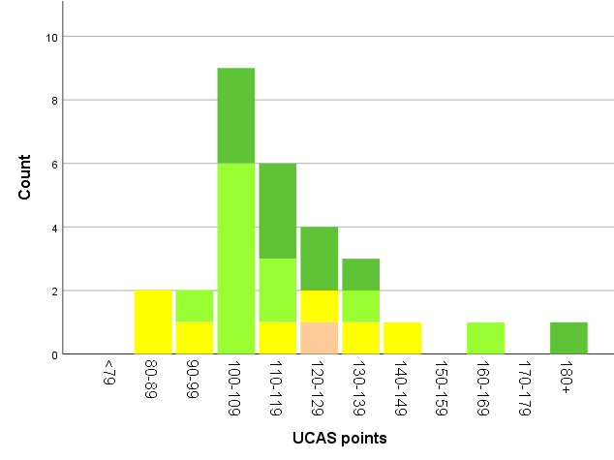
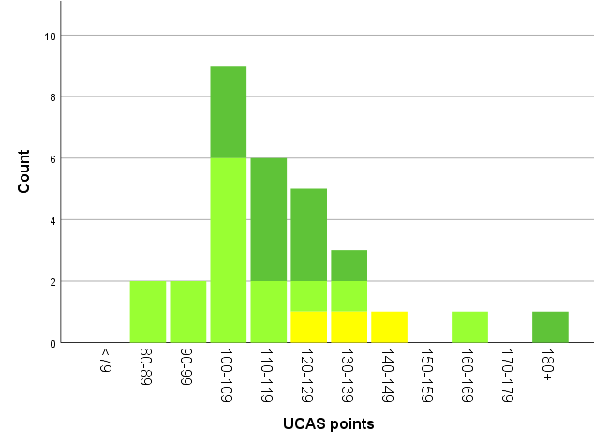
Student Marks versus UCAS Points at Entry
Level 4 Mean Marks
Level 5 Mean Marks
Final Degree Award
ALL students with <120 UCAS points achieve
2.1 or 1st class degrees
No 3rd class degrees awarded to date

Slide 16
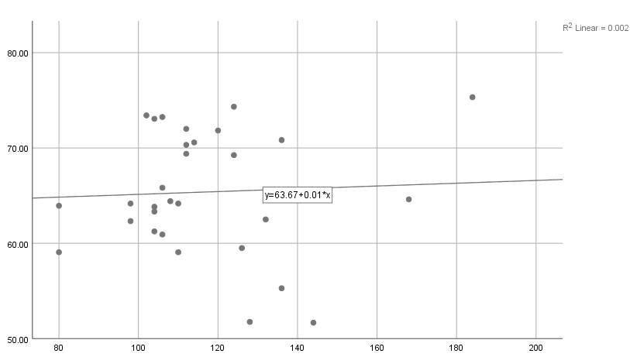
Degree Award Marks versus UCAS Points at Entry
Final Award Mark
UCAS Tariff
2019/20 Level 6 cohort:9 students with Access / BTECs
= 1x 1st
= 5x 2.1
= 3x 2.2
Model 1 – WP characteristics EXCLUDING UCAS points (Adj. R² = 0.002)
Model 2 – the influence of adding UCAS points to model 1 (Adj. R² = -0.020)

Slide 17
Degree Award Marks versus UCAS Points at Entry
Conclusion: No WP characteristics or
UCAS points
significantly influence degree award mark

Slide 18
Conclusions
Reflections
Issues / barriers: can be time intensive, but can be scaled up
Greatest impact: students who may be struggling / mid-level achievers
Not grade inflation, just uplift of mid-range marks
Benefits
Successfully identify / address barriers to transform student outcomes
>85% 1st or 2.1 degree awards to date
100% first and second cohorts in post-graduate study or graduate employment within 6 months

Slide 19
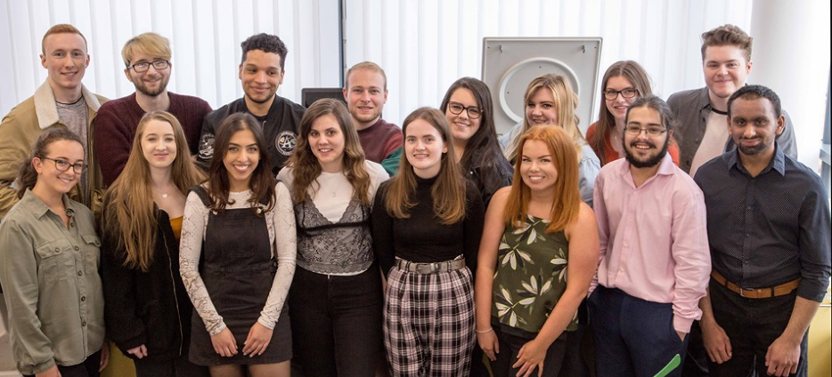
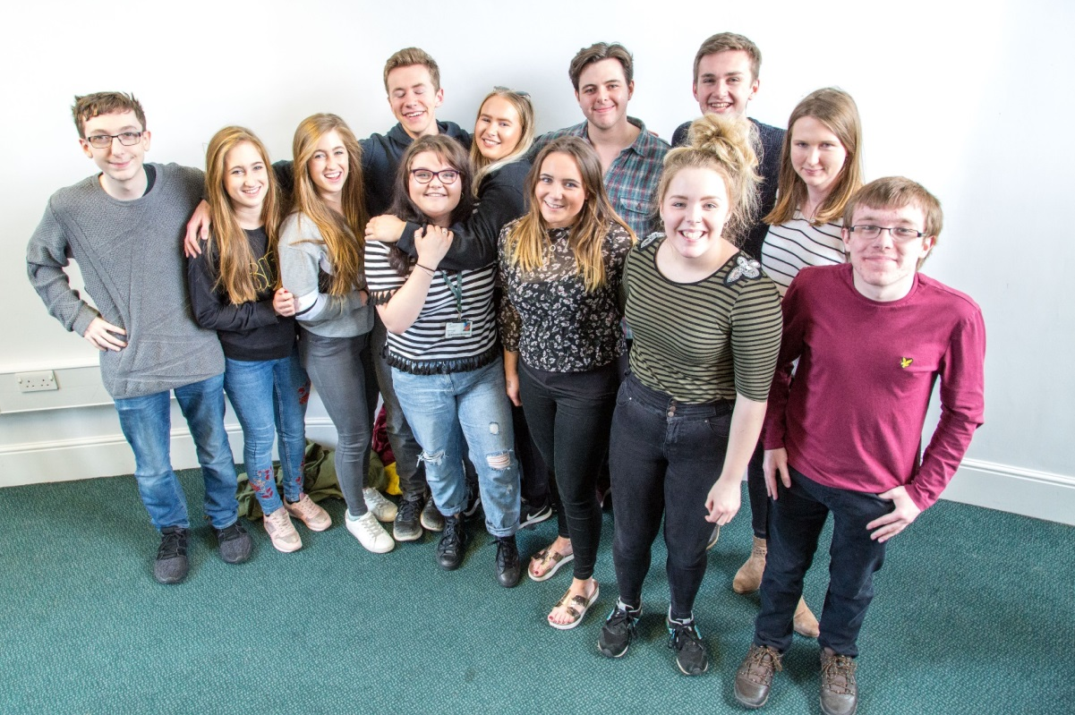
Outcomes – Happy Students! Excellent Degree Awards 100% employability

Slide 20
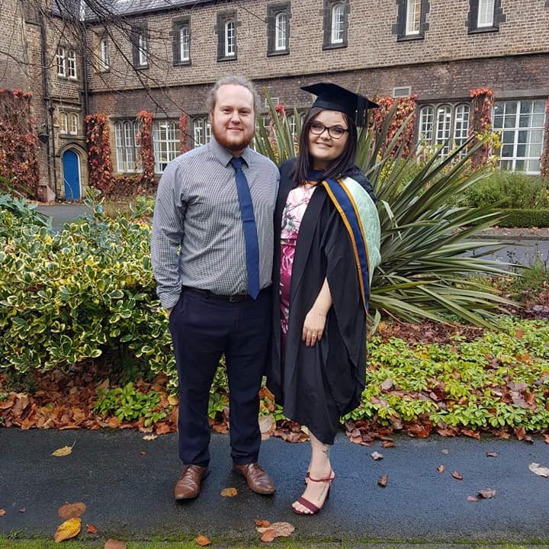
Meet Becca….
“Being one of the only women to study STEM from my school, I’d not received much support nor was I confident in my own abilities.
Sue ensured that individuals like me had different ways to express their learning other than just essay-based exams.
Without this I wouldn’t have received my first-class degree.
The skills I acquired from my BSc allowed me to progress onto my MSc and into my current job at AstraZeneca. I am now a Team Leader.”

Slide 21
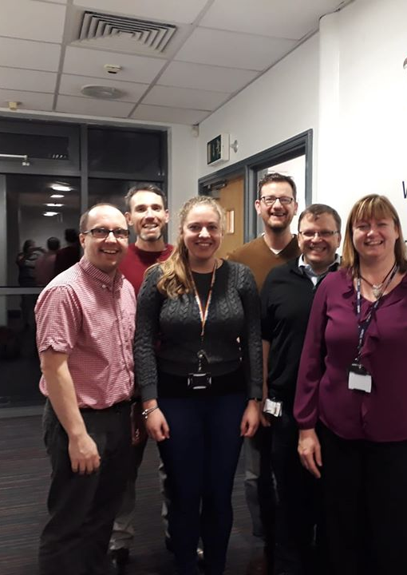
Acknowledgements
Dr Emma Stewart (University of York PhD Student and intern)
Dr Jim Taylor – statistics
Whole Biomed team at YSJ
Thank you
Any questions?

