Slide 1
Supporting Diverse Student Cohorts to Access and Thrive in Higher Education
Dr Sue Jones
York St John University

Slide 2
Overview
Access to HE
Progamme and assessment design
How students can be supported to thrive
Excellent retention, progression and academic achievement
Excellent graduate outcomes

Slide 3
Different Starting Points / Experiences
Our students start University at different points and we need to help them to build a path to succeed
Transition
Continuation
Progression
Degree Award

Slide 4
Entry Criteria
A-levels (tariff points?)
BTEC
Access Courses
International Baccalaureate
Other??

Slide 5
What Happens When Students Arrive?
Encouraging students from widening participation backgrounds to access university, then using unfamiliar lecturing styles and examination-based assessments creates unintended barriers.
It is like asking someone to go orienteering –
without a map or compass…
and in flip flops!

Slide 6
Mind the Gap!
For diverse student cohorts to achieve well, my experiences have taught me that they need to have:
a clear curriculum design (map)
regular supportive interactions with academic staff, peer mentors and alumni (compass to find a successful route)
formative assessments, regular feedback and iterative, varied, authentic and integrated assessment types (the right equipment to make the journey)

Slide 7
How do we Equip Students to Succeed?
Holistic Programme Design

Slide 8
New Programme Blank Page….
Best practice, picked up over time
What to avoid
What works
No nay-sayers!

Slide 9
My Holistic Approach to Programme Design
I embed transferable skills, laboratory competencies and subject-specific knowledge, emphasing personalised learning through holistic programme design
ALL of my students (regardless of their wider demographic background) are supported to achieve excellent outcomes.
This is true widening participation (WP) - removing barriers and increasing access for all AND improving retention, graduate outcomes and employability.

Slide 10
Supporting our Students’ Journey through Personalised Learning

Slide 11
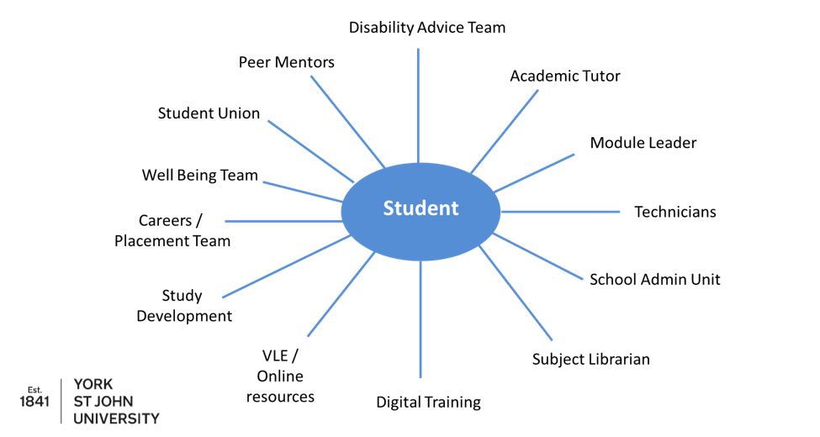
Student Support

Slide 12
Skill Development
Transferable skills
Data analysis / evaluation
Teamwork / leadership
Resolving issues
Verbal and written communication
Embedded Careers sessions
Ethics / COSHH
Mentoring
Digital competency

Slide 13
Skill Development
Entrepreneurial skills
Problem solving (case studies / data analysis)
Diagnosis - research and decide a course of treatment & justify choices
Critical data review (genetics and journal articles)
Project planning / design / co-creation
Original thinking / creativity – posters / live briefs
Outreach / citizen science / Science Club

Slide 14
Technical Skills
All modules have at least 3 practical
classes
Supported Open Learning (SOLs)
Open Badges – linked to practical
competency
Masterclasses in Research Project
GMP / GLP sessions
Covance “Boot Camp”
Summer research projects / placements

Slide 15
Recording and Displaying Competencies
We use electronic badges as evidence of laboratory competency and also transferable skills
These are scaffolded through the programme and link to taught content / practical classes and techniques
Building confidence
Adding value
Tangible skill development
Evidence for placement / employment

Slide 16
Level 4 Badges
Linked to key skills module (year long)

Slide 17
Level 5 Badges
Linked to key skills module (year long)

Slide 18
Level 6 Badges
Linked to Research Project module (year long)

Slide 19
Skills Audits and Portfolios
In Level 4, 5 and 6 our students create a portfolio of assessments, badges and skills audits (beginning and end of year) plus a self-reflective statement as part of these modules.
Their complete portfolio and engagement at timetabled tutorials and / or project supervisor meetings are included in the marking scheme.
Portfolio is worth 10% of each module
Only 100% and 0% marks available

Slide 20
Our Aim is to Facilitate
Help students to develop into autonomous and
independent learners
Develop their ability to create, analyse, interpret
Discuss and evaluate concepts, clear communication
Gain both subject specific knowledge and competency
Technical & transferable graduate skills

Slide 21
The Five Ws for Holistic Assessment Design
Who is sitting the assessment – is it appropriate?
What is the purpose - LO / experiential learning
Why choose this assessment? Is it authentic / developmental?
Where does the assessment fit / year / spiral curriculum / constructivism
When is it? Clear organisation / avoid clustering

Slide 22
Assessment Strategy – Level 4
Key Skills
Maths
Scientific
writing
Anatomy and
Physiology
Essay
Biological
Molecules
Portfolio
In-class test
Cell
Biology
Lab report
Exam
Biochemistry
Practical test
Microbiology and
Immunology
Presentation
Case Study
Semester 1
Semester 2

Slide 23
Importance of Formative Assessments and Feedback

Slide 24
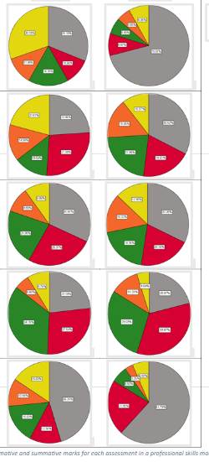
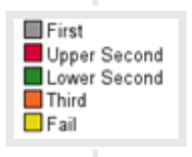
Year 1 Key Skills Marks for Each Assessment Type (Over 4 Cohorts)
Formative
Summative
Maths
First
Essay
Upper Second
Lower Second
Scientific
Comprehension
Third
Fail
Laboratory
Report
Statistics
Linked to tutorials – lower number of assessment to mark per tutor –
consistency and scalability

Slide 25
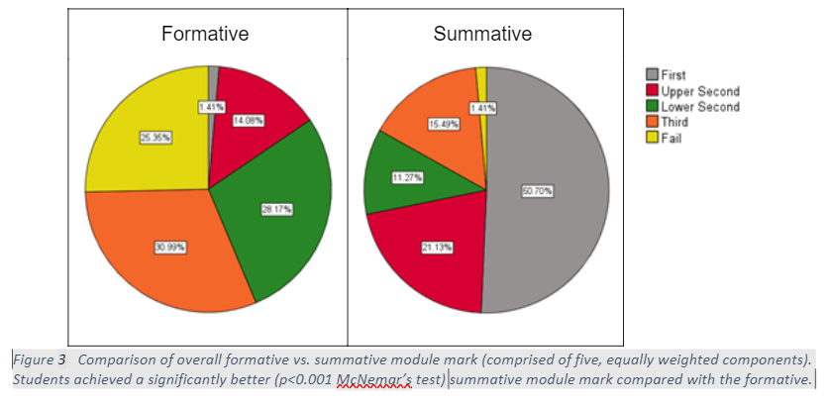
Overall Change between Level 4 Key Skills Formative and Summative marks – all assessments combined

Slide 26
Scalability?
All academic staff are tutors
Use exemplars of anonymised (and different but similar) assessments from previous cohorts to discuss and mark against grading criteria. Active learning and works well
Essays
Laboratory reports
Use peer marking / feedback on formative work

Slide 27
Tracking Students through the Programme

Slide 28
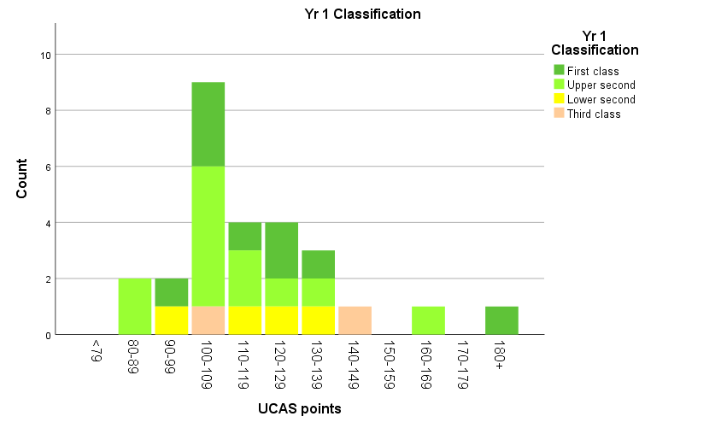
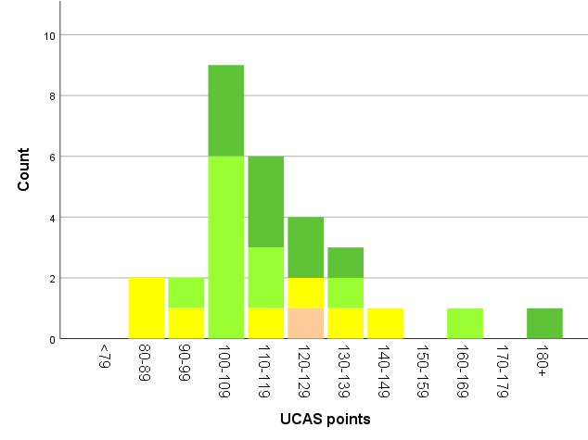
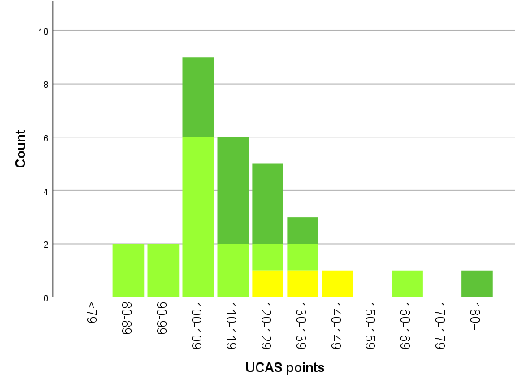
Student Marks versus UCAS Points at Entry (first 3 graduating cohorts)
Year 1 Mean Marks
Year 2 Mean Marks
Final Degree Award
Our Entry criteria = 104 UCAS points (BCC at A-level or DMM BTEC)
ALL students with <120 UCAS points achieve 2.1 or 1st class degrees
No 3rd class degrees awarded

Slide 29
Degree Awards
First 3x cohorts (pre-covid) graduated
Total of 43 students with A-level, Access / BTECs
37/43 students awarded 1st or 2.1 = 86%
Year | 1st | 2.1 | 2.2 | Total
2017/18 | 7 | 4 | 1 | 12
2018/19 | 5 | 11 | 2 | 18
2019/20 | 11 | 9 | 3 | 23

Slide 30
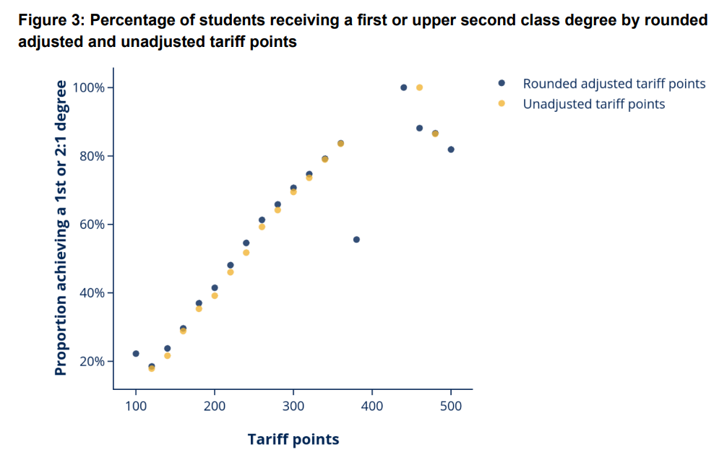
National Context
https://www.officeforstudents.org.uk/publications/helga-report/

Slide 31
YSJ Biosciences Graduate Awards

Slide 32
YSJ Biosciences Graduate Awards
100% students who self-declared as mature were awarded 1st or 2.1
100% students who self-declared a disability were awarded 1st or 2.1
YSJU Biomedical Science cohorts contain 26% mature students and 26% have a declared disability (compared with 23% and 15% respectively for national Biomedical Sciences student data
(HESA data 2021)
100% students who self-declared as any minoritized ethnic group were awarded 1st or 2.1 compared with 74% BAME students nationally
(HESA data 2021)
https://www.hesa.ac.uk/data-and-analysis/students/outcomes/characteristics

Slide 33
Reducing Awarding (or Grade) Gaps
Conclusion: detailed statistical analysis shows no differential outcomes for students with respect to any of the following –
UCAS points at entry
IMD (Index of multiple deprivation) or POLAR groups
Ethnicity
Gender
Age or declared disability
First in family status

Slide 34
Reflections
Reflections
Issues / barriers: can be time intensive, but can be scaled up
Greatest impact: students who may be struggling / mid-level achievers
Not grade inflation, just uplift of mid-range marks
Benefits
Successfully identify / address barriers to transform student outcomes
>85% 1st or 2.1 degree awards to date
100% first and second cohorts in post-graduate study or graduate employment within 6 months

Slide 35
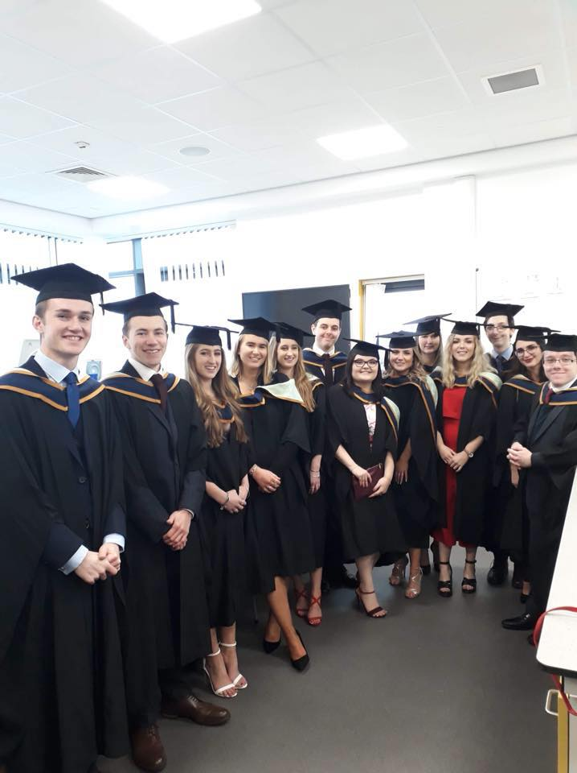
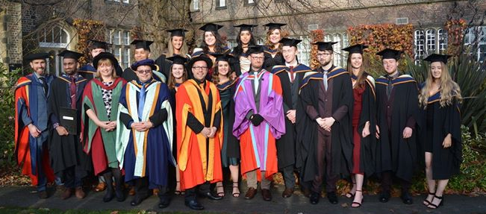
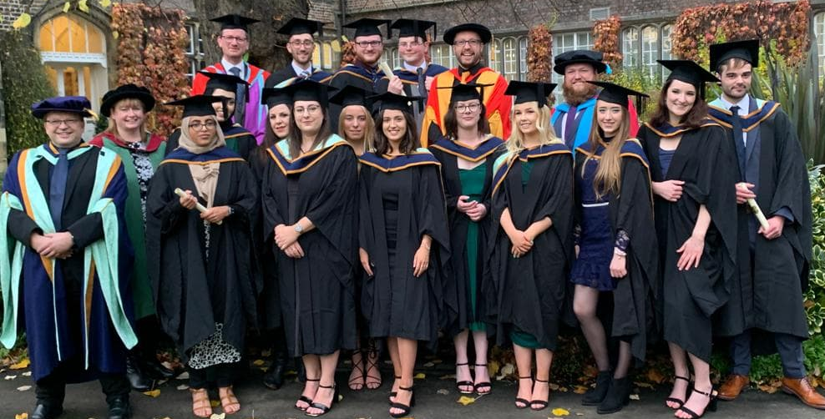
Outcomes: Happy Students! Excellent retention, degree awards and employability

Slide 36
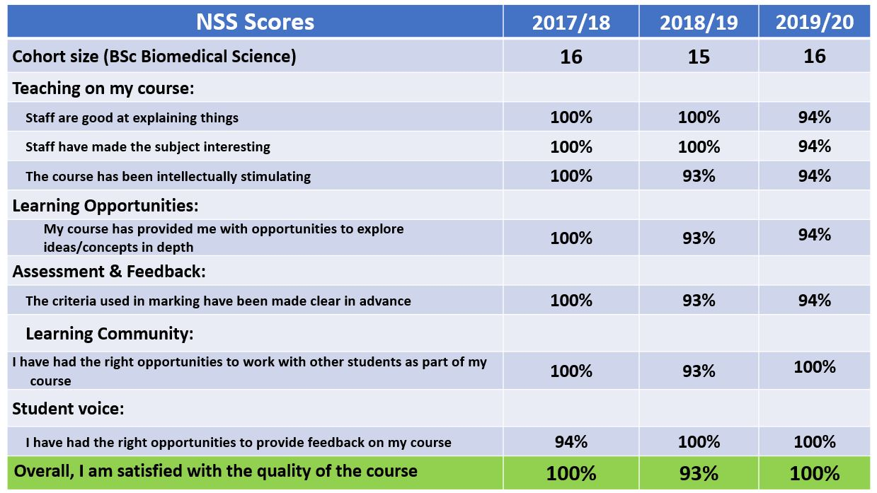
Student Experience
Note that 1 student = 6-7% in all returns. For 2018/19 and 2019/20 data do not include placement students.

Slide 37
2021 Scores
BSc Biomedical Science
NSS Question | % Satisfaction
Staff are good at explaining things | 95%
Staff have made the subject interesting | 90%
The course is intellectually stimulating | 100%
My course has provided me with opportunities to explore ideas or concepts in depth | 90%
My course has provided me with opportunities to apply what I have learnt | 100%
I have been able to contact staff when I needed to | 100%
Good advice was available when I needed to make study choices on my course | 90%
I have had the right opportunities to provide feedback on my course | 100%
Overall, I am satisfied with the quality of the course 20/23 students 100%

Slide 38
Our NSS 2021 Compared with Other UK Biosciences Programmes
Key domain (mean score) | Biosciences (CAH3) % score | Rank (out of 59)
Overall satisfaction | 87 | 7
Teaching on my course | 93 | 4
Learning opportunities | 93 | 4
Assessment & feedback | 76 | 6
Academic support | 93 | 1
Organ & Management | 84 | 5
Learning resources | 91 | 2
Learning community | 85 | 2

Slide 39
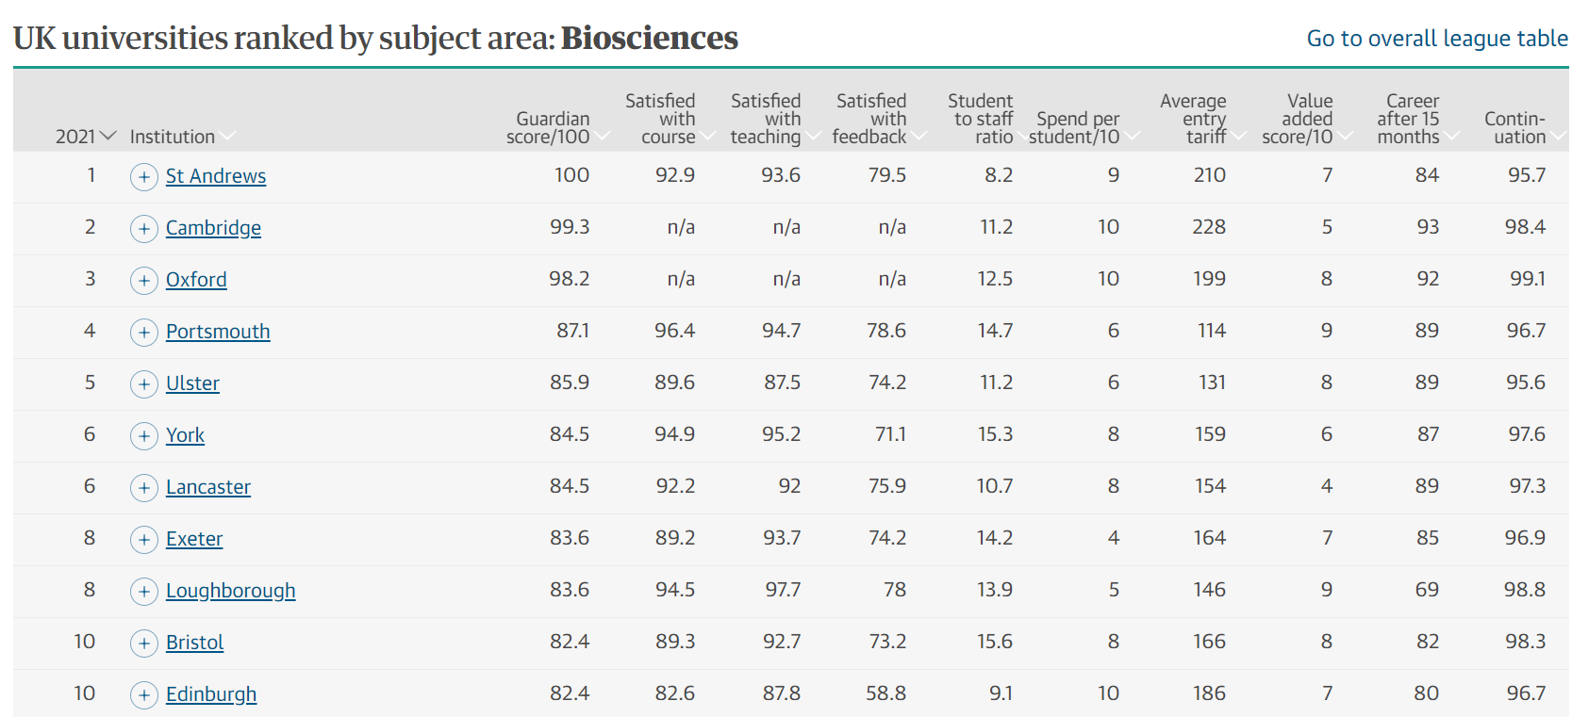
Guardian University Guide 2021
We are 16 / 105 for Biosciences

Slide 40
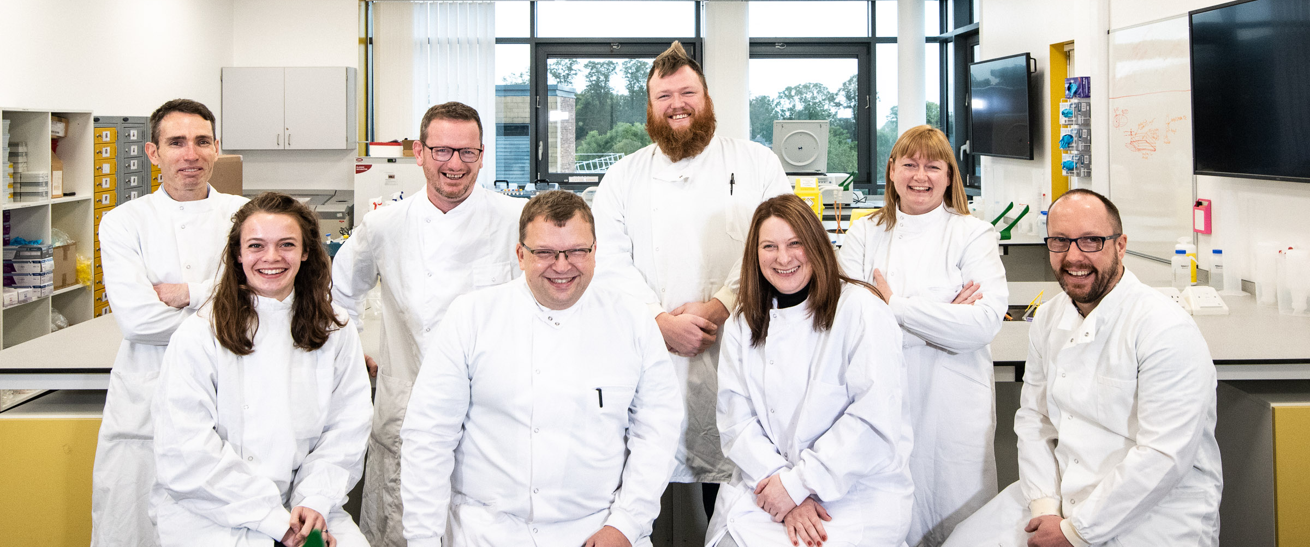
Acknowledgements
Thank you - Any questions?

