Slide 1
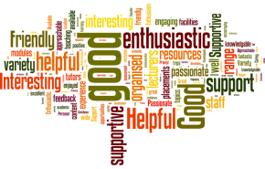
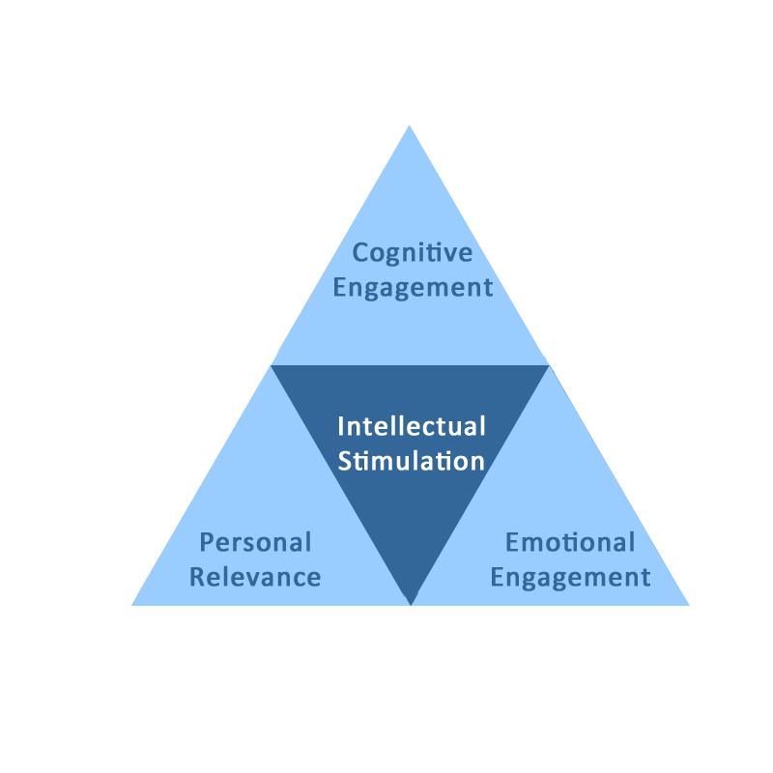
What is intellectual stimulation, and what factors determine the degree to which students are intellectually stimulated?
Mark Dransfield, Educational Developer, ADD & Glyn Littlewood, Senior Lecturer, York Business School
Introduction
Initial Findings
This research project was designed to develop a better understanding of what underpins ‘intellectual stimulation’ as used in Q4 of the NSS 2016.
Two key stakeholder groups: staff and students were the focus of this research sampling frame.
This research used existing data from the qualitative statements in the 2016 NSS and generated new data through focus groups and interviews with staff and students. In exploring the perceptions of these key stakeholder groups, it may be possible to develop insights into whether any differences in perception exist and if so, to suggest ways in which these may be aligned, for example, through curriculum design and development activities. Therefore, the primary research question was:
“What is intellectual stimulation, and what factors determine the degree to which students are intellectually stimulated?”
Using Critical Discourse Analysis (CDA) to interrogate the qualitative data we were able to identify 3 clear components of intellectual stimulation. From which we have developed the IS Triangle, below. These were:
Cognitive Engagement
Personal Relevance
Emotional Engagement
“
Staff make the subject interesting
”
The qualitative data associated with those who selected options 1 and 2 i.e those who responded positively, were extracted into a spreadsheet for analysis. 756 records were found for those who did find their course intellectually stimulating.
“
I gained a lot of skills in my degree course and these can be beneficial for my career path and objectives.
80%
The qualitative data associated with those who selected options 4 and 5, i.e those who responded negatively, were extracted into another separate spreadsheet for analysis. 72 records were found for those who said that they did not find their course intellectually stimulating.
This data has been coded and there are some clear themes emerging. The themes have informed the generation of interview questions for staff and students. It must be stated that these themes are helping to inform thinking, rather than to drive future data collection. The reason for this is because the qualitative data is generic and relates to the students’ overall university experience, rather than specifically being about their perceptions of intellection stimulation per-se.
”
Background
The National Student Survey (NSS) is seen as a valid tool for benchmarking the quality of the student experience in universities across the higher education sector in the UK. It consists of questions relating to six aspects of the learning experience.
In 2016, responses to the following Likert scale question (Q4), The course is intellectually stimulating, were particularly disappointing for YSJU moving down from an overall institutional score of 85% in 2015 to 80% in 2016 with the overall HEI average in 2016 being 86%.
The NSS data on Q4 was representative of all 27 subject areas. Within these subjects, 9 achieved above the HEI threshold of 86% and 18 were below the threshold. The range of scores was between 29 and 100.
“
Some tutors were difficult to work with (feedback not helpful and dull lessons).
”
Analysis of the NSS data as detailed above informed the questions to be explored as part of the interview and focus group strategy of the research.
Academic staff interviews took place in November 2016. Currently 4 academic staff have been interviewed and level 3 students took part in a focus group.
Data Analysis
The final section of the NSS enables students to enter qualitative comments about their overall experience on their course. These comments do not specifically relate to any individual question, rather they represent an overall viewpoint. Therefore, these comments do not always relate directly to the notion of intellectual stimulation.
Response options available to students for Q4 were as follows:
Strongly Agree [1], Agree [2], Neither Agree nor Disagree [3], Disagree [4], Strongly Disagree [5].
References
Cromby, J. (2002) Review Note: David Howarth (2000). Discourse . Forum: Qualitative Social Research [Internet], 3(2).
Available from: http://www.qualitative-research.net/fqs/fqs-eng.htm [Accessed 12th November 2016].
Blair, B., Orr, S. & Yorke, M. (2012) ‘Erm, that question… I think I probably would've just put something in the middle and sort of moved on to the next one, because I think it's really unclear’: How Art and Design Students Understand and Interpret the National Student Survey [Internet]. Available at: http://www.heacademy.ac.uk/resources/detail/disciplines/art-and-design/GLAD_report_April2012 [Accessed 14th October 2016]
Howarth, D. (2000) Discourse. [Internet] Buckingham, Open University Press. Available from https://www.dawsonera.com/readonline/9780335231836 [Accessed 28th October 2016]
Ryan, R.M & Deci, E.L (2000) Intrinsic and Extrinsic Motivations: Classic Definitions and
New Directions. Contemporary Educational Psychology, 25 (1), pp 54–56

