Slide 1
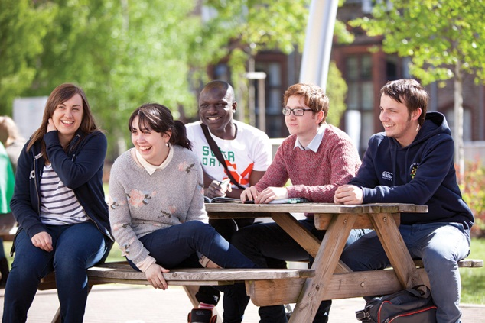
Mark Dransfield
Talking About Teaching January 2014
What’s new with iPads and electronic marking of assignments?

Slide 2
Session format
Very brief background about our use of iPads for marking
Demonstrations of apps, with a focus on TurnitinUK’s iPad app
Chance for you to give it a try yourselves

Slide 3
Adams, D. (2002), The Salmon of Doubt
Everything that’s already in the world when you’re born is just normal;
Anything that gets invented between then and before you turn thirty is incredibly exciting and creative and with any luck you can make a career out of it;
Anything that gets invented after you’re thirty is against the natural order of things and the beginning of the end of civilisation as we know it until it’s been around for about ten years when it gradually turns out to be alright really

Slide 4
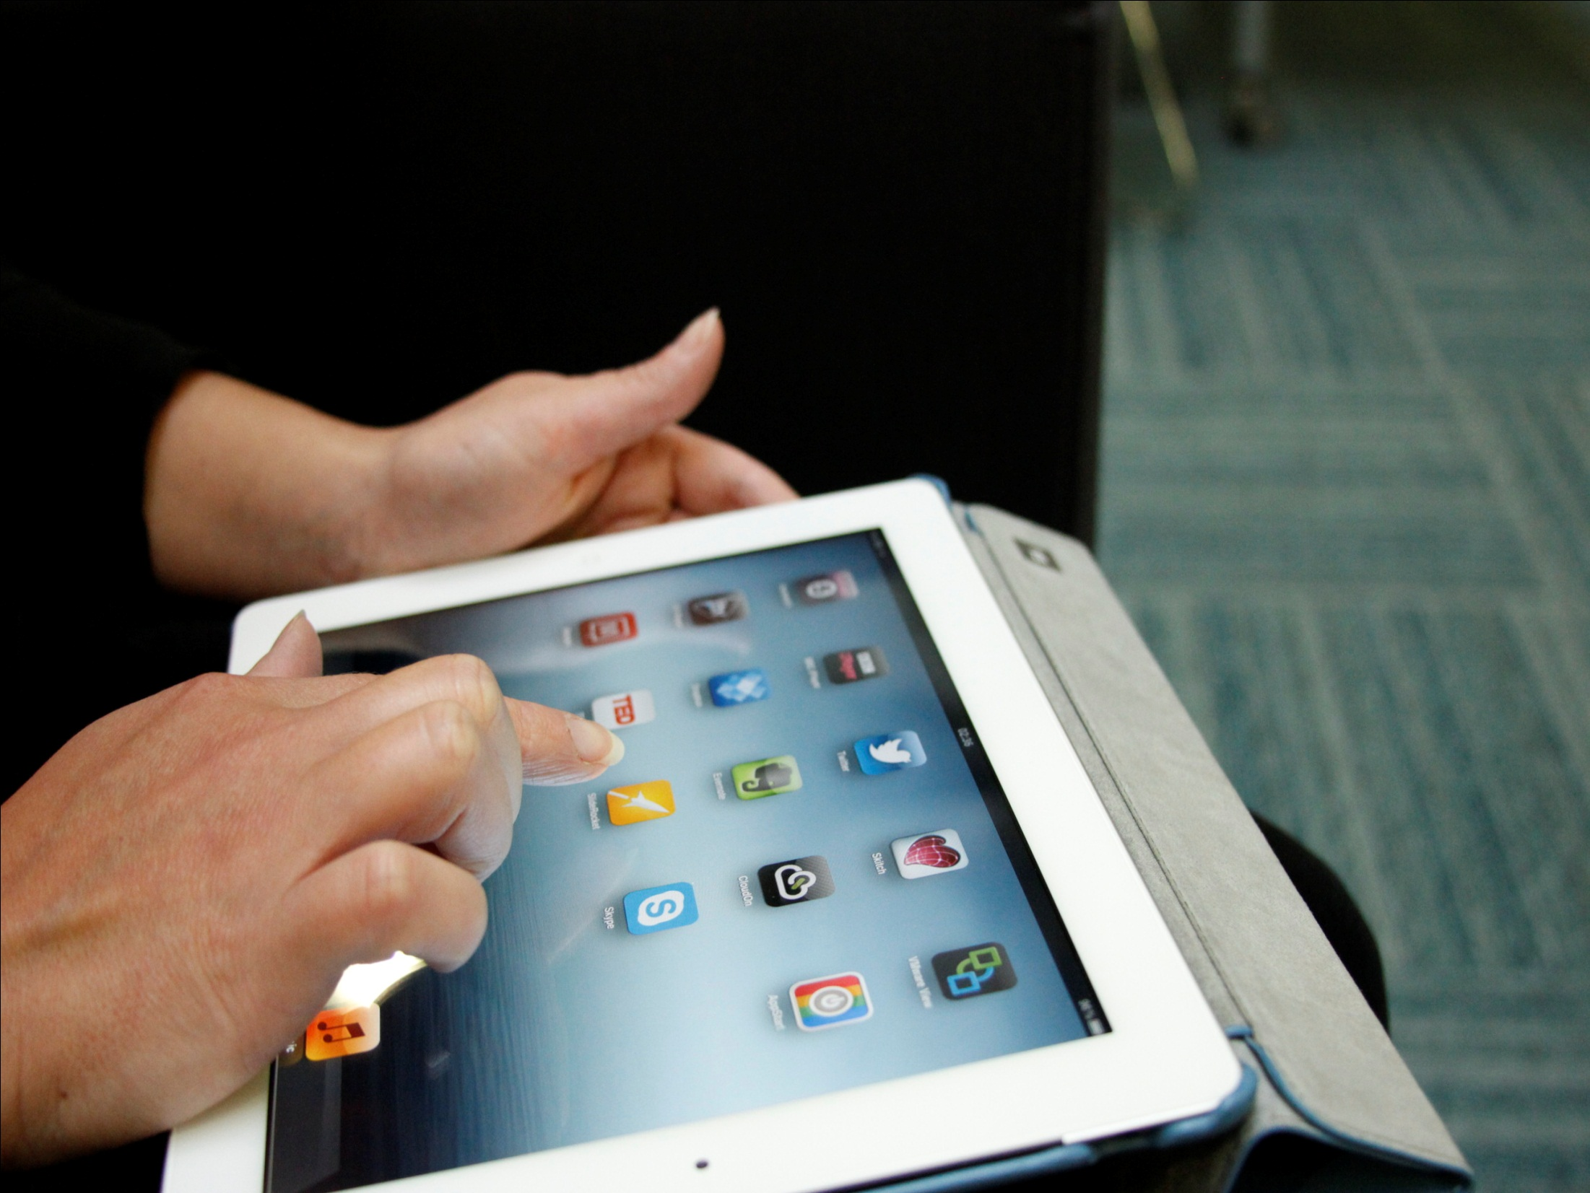
i-Pad affordances
Touch screen technology was considered to enable traditional forms of marking
i-Annotate app was used to enable tutors to mark assignments and provide feedback
Managing the process was the major problem
downloading files
getting them on the iPad
loading them back into Moodle

Slide 5
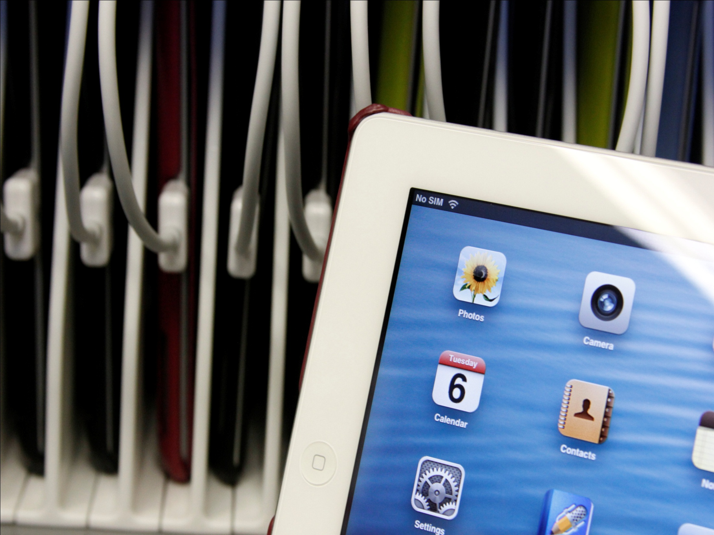
TurnitinUK’s
iPad App
Released in 2013
Potential to address lots of people’s problems with e-marking
Works with Moodle integrations
No manual downloading of files
No manual uploading of files
Simplifies the confusing management process

Slide 6
Questions & contact
Mark Dransfield email: m.dransfield@yorksj.ac.uk twitter: @dranners
L&TD iPad Project http://blog.yorksj.ac.uk/ipadproject

