Slide 1
Exploring attitudes to and facilitating cultural change around electronic assignment submission, marking and feedback
Mark Dransfield Technology Enhanced Learning Advisor & University Teaching Fellow

Slide 2
York St John University - Context
Teaching focussed
6000 FTE students
250-300 academic staff
Business School

Slide 3
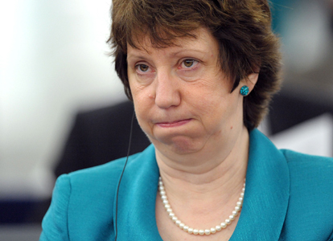
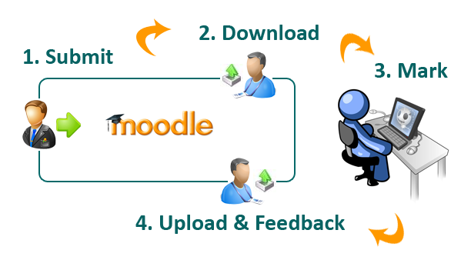
It’s nothing new to YSJ
2007/8 Pilot projects
2008 e-submission working group
2009: University Quality of the Student Experience (QSEC) committee decided to implement e-submission across the university from 2010/11
2010: The Dean of the Business School decides to implement e-feedback across the Business School
2010: STEF project funding granted through L&TD
Notes:
Individual staff across the school had been experimenting with e-feedback in a number of forms for many years, for example, using audio feedback and video feedback through 3rd party providers such as Jing. Many staff had been commenting on drafts using the commenting tools in Word, returning the work to students by email.

Slide 4
The process

Slide 5
Views of piloters (2007-09)
Comments are more legible when typed
Everything electronic
I mark slightly quicker with e-submission
All stored in one place
Administrators got a handle on it
I took to it very quickly
EE can easily be given access

Slide 6
It’s not all positive though

Slide 7
“If we’re going to move towards e-submission
and marking, then we have to think about hardware…” (Dr Chris Maunder, 2010)

Slide 8
Initial aims of the STEF project
2010 STEF Project aims
To embed e-marking and feedback in the Business School
To gain an understanding of the impact of new technologies on e-marking and feedback
To inform the University of the most efficient and practical ways of working with these technologies, potentially avoiding investing in unworkable/impractical technologies
To share knowledge with the University and the sector of attitudes to marking on screen
Investigate attitudes to e-submission, marking and feedback
How?
By working closely with teams and individuals to find the most appropriate assessment design, technologies and processes for their needs

Slide 9
Advocacy
Workshop/demo
Flyers
QEC
Team Meetings

Slide 10
Survey
Survey aims were to:
gather information related to attitudes around e-submission and marking in the Business School
identify potential advocates and disaffected members of staff
identify participants for the project
The number of responses was 24, representing a 57% response rate.
Notes:
In November 2010, a questionnaire was sent out to all members of academic staff within the Business School (41 full-time and part-time) with the aims of:
gathering information related to attitudes around e-submission and marking in the Business School
identifying potential advocates and disaffected members of staff
identifying participants for the project
The number of responses was 24, representing a 57% response rate.

Slide 11
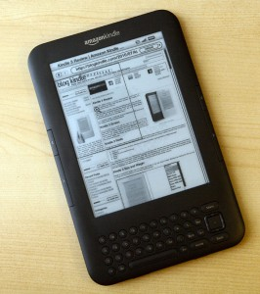
Pre-experience Interviews

Slide 12
Post-experience interviews
Notes:
(MD)

Slide 13
Equipment Used
iPads
Digital Pen & Lightweight laptop
Macbook Air
Kindle
Dual Monitors
TurnitinUK & Grademark

Slide 14
Notes:
Pros
Compact, lightweight and brilliant for portability
Excellent speed and ‘wake-up’ time
Allowed users to continue working in unexpected environments (airport lounge, train station etc.)
Ergonomic benefits
Peripheral benefits such as email, calendar, internet increased productivity

Slide 15
Pros
Compact, lightweight and brilliant for portability
Excellent speed and ‘wake-up’ time
Allowed users to continue working in unexpected environments (airport lounge, train station etc.)
Ergonomic benefits
Peripheral benefits such as email, calendar, internet increased productivity
Cons
Tied in to Apple’s iTunes model (all kinds of problems)
Steep learning curve for the apps required to successfully annotate
Very cumbersome and confusing workflow for transferring student assignments
Heavy levels of support required
Not scalable on an enterprise level
£450 - £650

Slide 16
Notes:
Pros
Brilliant for portability
Familiar environment allows exactly the same functionality as a desktop machine would (Windows or MacOS, MS Word & add comments etc)

Slide 17
Pros
Brilliant for portability
Familiar environment allows exactly the same functionality as a desktop machine would (Windows or MacOS, MS Word & add comments etc)
Cons
Depending on the laptop, they can be too heavy
Sony got hot after long periods of use, making them uncomfortable to place on lap
Small keyboard on the Sony
Macintosh laptops (MacBooks) are not as compatible with the existing university infrastructure
£1000 - £1300

Slide 18
Notes:
(NS) Pros
Great for screen-based reading, even in strong daylight.
Brilliant for portability of reading
Outstanding battery life due to digital ink technology

Slide 19
Feedback
Pros
Great for screen-based reading, even in strong daylight.
Brilliant for portability of reading
Outstanding battery life due to digital ink technology
Cons
Can’t annotate on the device itself
Cumbersome to transfer files to the device
File formatting often messed up when reading on the Kindle
£109

Slide 20
Notes:
Pros
Highest benefit in terms of managing information on screen.
Reduced eye strain because there’s more space to play with.
Lowest tech intervention and the lowest cost*
Required no support
Is scalable across the university

Slide 21
Feedback
Pros
Highest benefit in terms of managing information on screen.
Reduced eye strain because there’s more space to play with.
Lowest tech intervention and the lowest cost*
Required no support
Is scalable across the university
Cons
Users are fixed to a location
£90
“One of the key things was that it allowed me to think more effectively”.
*If user requires new graphics card and VGA adaptor, add £26

Slide 22
Common Findings

Slide 23
Threshold Concepts
“A threshold concept can be considered as akin to a portal, opening up a new or previously inaccessible way of thinking about something.” (Meyer & Land, 2003)
Hays (2008) offers the terminology, ‘penny drops’ or ‘aha moments’ to help identify the stage at which a person crosses a threshold.
Cousin (2006) comments that “Mastery of a threshold concept often allows the learner to make connections that were hitherto hidden from view.”

Slide 24
Characteristics
Transformative – once the threshold concept is understood, the potential effect of this understanding is significant in terms of changing views and understanding.
Irreversible – once grasped, the threshold concept is unlikely to be forgotten without a concentrated effort to ‘unlearn’ it.
Integrative – exposes links to other previously hidden interrelatedness of something
Troublesome –It suggests that a threshold concept is difficult to understand and may appear counter intuitive, alien or incoherent.

Slide 25
Proposed TC’s
The disruptive nature of e-submission, marking and feedback
There is no ‘one size fits all’ solution
File management
The landscape is not persistent
Training
Info
Talking
Notes:
Existing processes and procedures which have been in place for long periods of time, are fundamentally challenged. Non paper, screen marking, change of roles for admin and academic staff.
It’s not been possible to present a global solution for all staff. Although some staff might want to be told what when and how to do things, they have to engage with the process at some stage, to find out what works best for them.
Where do files live and simple file management and organisation of marked files.
This is about a general mindset, taking into account the other threshold concepts and acknowledging that options and limitations which are apparent today, won’t be the same in 12/18 months time. The technology is constantly changing and evolving, therefore the processes and procedures in place now, might not be the most appropriate in a year’s time. Also, our VLE is constantly evolving and we’re trying to address concerns and improve all the time.

Slide 26
Recent & planned developments
Dual monitors as standard in the BS (£4740 for 50x 19” monitors)
Asus Eee-Pad Android tablet devices. Usability (USB and touchpad))
Principles of e-submission document (Quality & Standard Committee)
Uni-wide policy on e-submission, marking and feedback
Uni-wide Health & Safety advice and guidance
Planned
Booklet to be produced around advice & implementation – licenced under CC
Establish an e-submission working group

Slide 27
Contact & Questions
Mark Dransfield
Technology Enhanced Learning Advisor
York St John University
Email: m.dransfield@yorksj.ac.uk
Twitter: @dranners

