Slide 1
The ideological and ontological beliefs of EAL educators
Christopher J Hall and Clare Cunningham
York St John University, UK
English Department Seminar Series, Hong Kong Polytechnic University
October 6th 2021

Slide 2
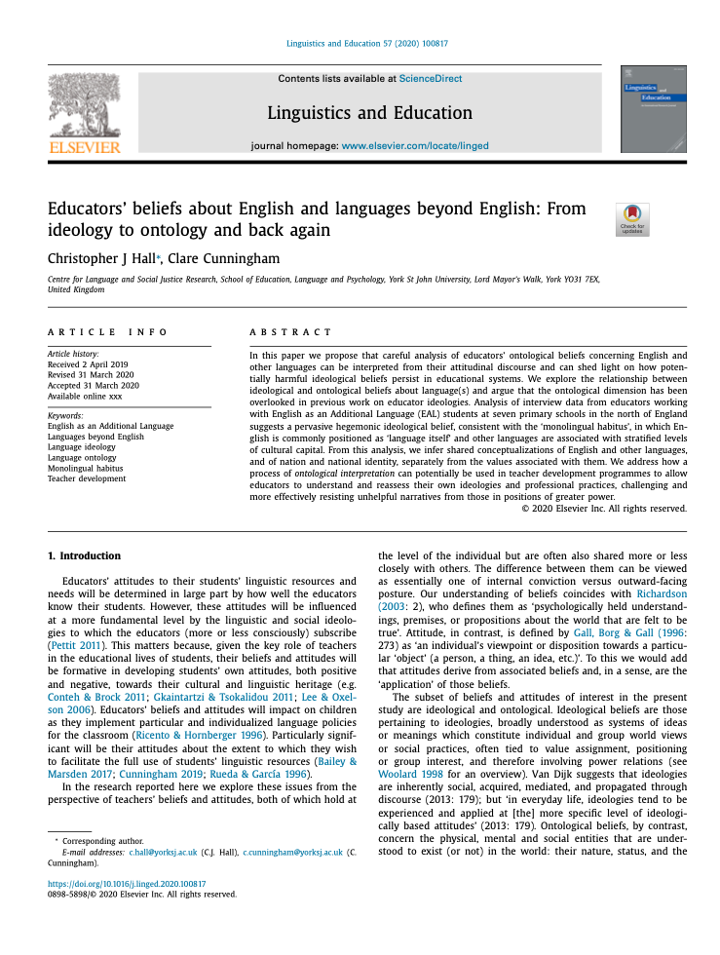
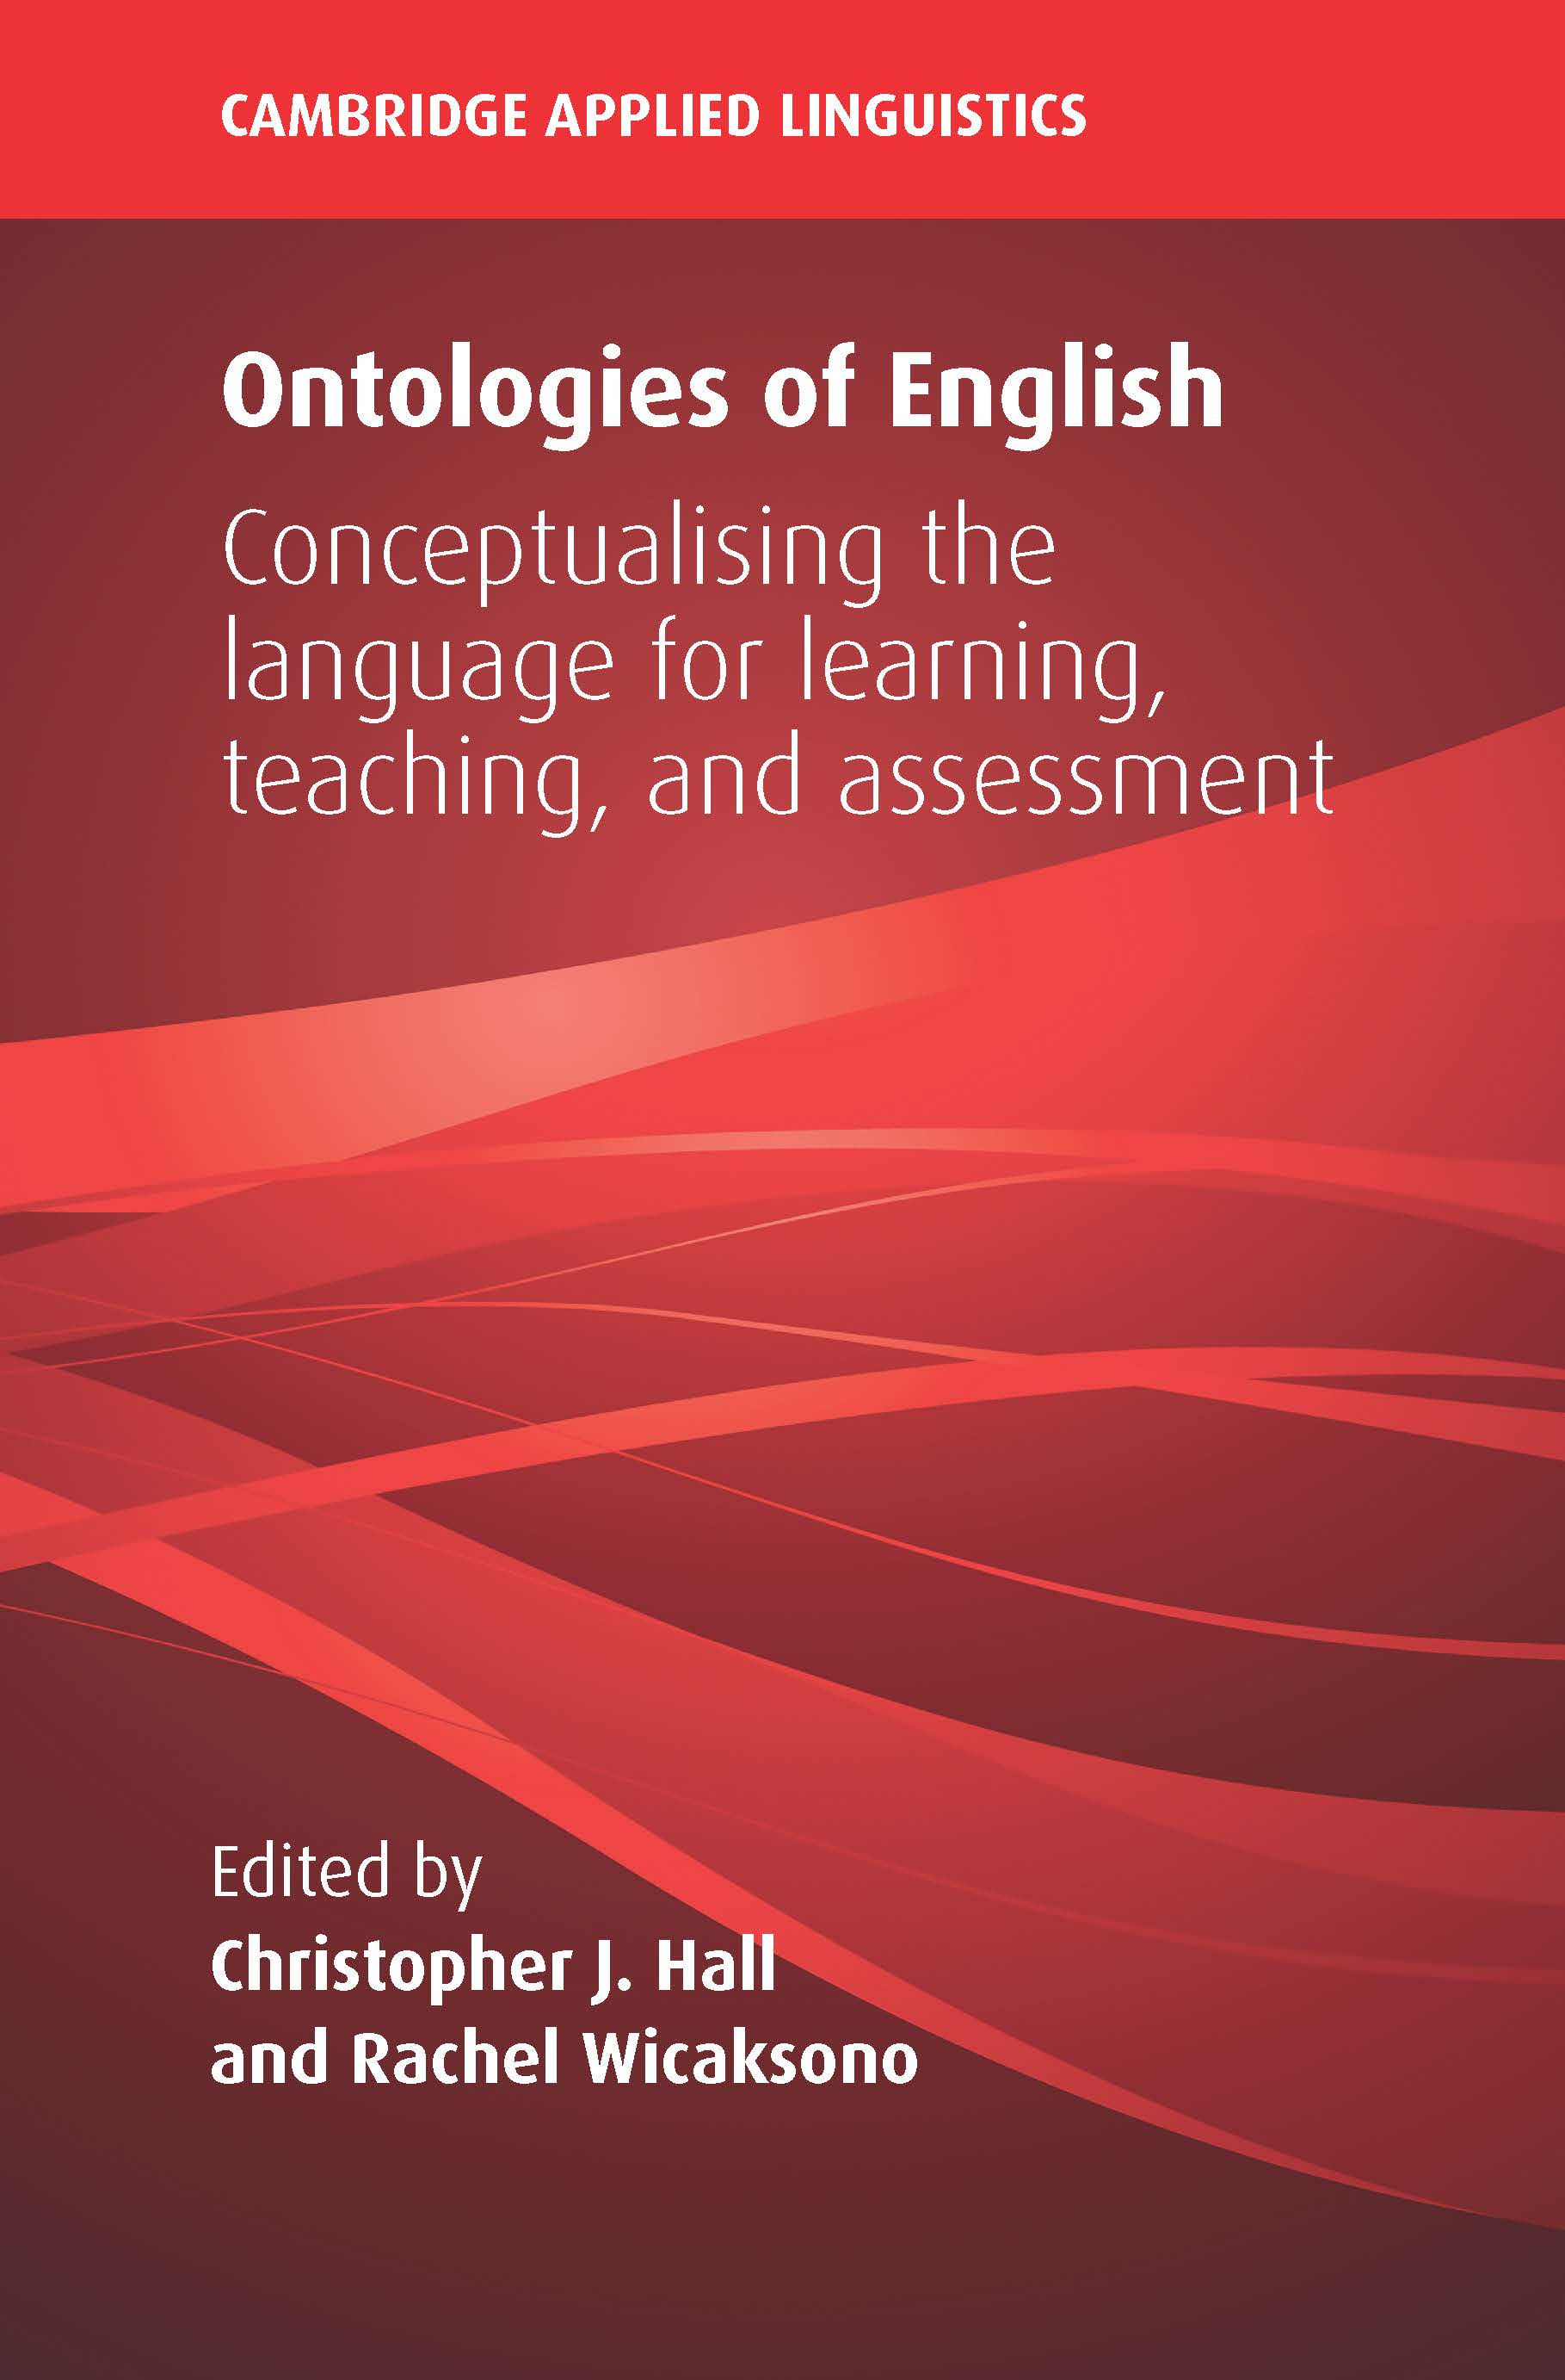
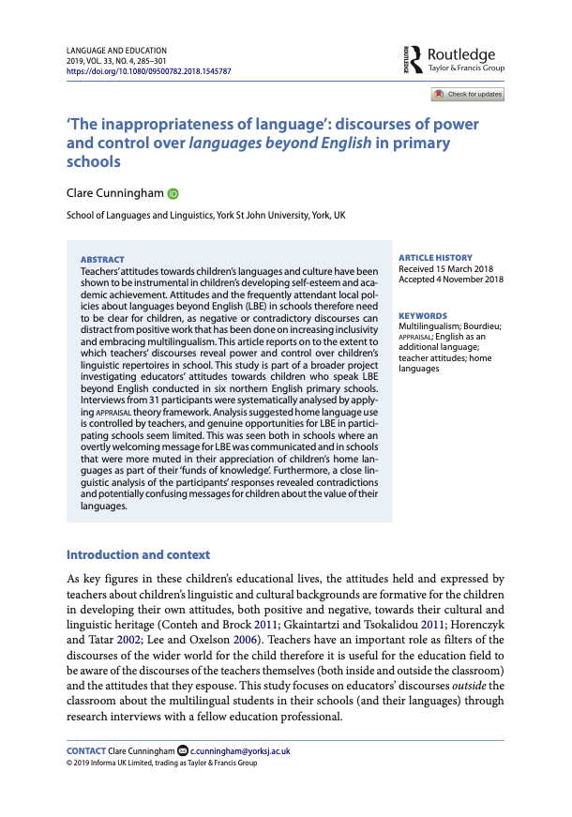
Outline
Previous research
Beliefs and attitudes
Ideology and ontology
Research context and design
Analysis
Ideological beliefs
Ontological beliefs
Discussion and implications

Slide 3
Previous research
Most work on teacher beliefs and attitudes has concentrated on learners/learning and teachers/teaching (cf. Fives and Gill, 2015), rather than linguistic resources and practices and the social realities they are embedded in.
Work on teacher beliefs about/attitudes to English increasingly focuses on issues of social (in)justice deriving from dominant language ideologies, both in NS contexts (e.g. Blake and Cutler, 2003; Baratta, 2018) and contexts of bilingualism and translanguaging (e.g. Rosa, 2016; Alfaro and Bartolomé, 2017; Fitzsimmons et al., 2017).
[T]eachers’ beliefs and attitudes tend to be treated in the literature as overly psychologized apolitical constructs that [...] reflect personality types, individual values, and personal predispositions that have little to do with the larger political, ideological, social, and economic order.
Alfaro and Bartolomé (2017, p. 16)

Slide 4
Previous research
Language ideologies are closely enmeshed with national ideologies (Anderson, 1983; Harris, 1981; Haugen, 1966; Joseph, 2004; Makoni and Pennycook, 2007).
Cunningham (2017, 2018, 2019b) has investigated ideological beliefs about English and languages beyond English (LBEs) (2019a) in the EAL context, finding an engrained monolingual habitus and an unquestioned belief in the sole legitimacy of ‘Standard’ English for schooling.
In applied linguistics, ontologies of language/s have been discussed by Seargeant (2008), Cook (2010), Makoni and Pennycook (2007), Otheguy et al. (2015), Ortega (2018).
Only Hall (2013; 2020; in press), Hall et al. (2017), and the collection edited by Hall and Wicaksono (2020) have concentrated on teacher ontologies of English.
[The national ideal] ‘demands that there be a single linguistic code by means of which communication [within the nation] can take place’.
Haugen (1966, p. 928)

Slide 5
Ideology and ontology
Ideological beliefs are those pertaining to ideologies, broadly understood as systems of ideas or meanings which constitute individual and group world views or social practices, often tied to value assignment, positioning or group interest, and therefore involving power relations (cf. Woolard, 1998; Van Dijk, 2013).
Ontological beliefs concern the physical, mental and social entities that are under- stood to exist (or not) in the world: their nature, status, and the relationships between them (cf. Searle 1995; Lawson 2014).

Slide 6
Previous research
[T]eachers’ beliefs and attitudes tend to be treated in the literature as overly psychologized apolitical constructs that [...] reflect personality types, individual values, and personal predispositions that have little to do with the larger political, ideological, social, and economic order.
Alfaro and Bartolomé (2017, p. 16)
[Language-teaching programmes] are conveying . . . a powerfully general misrepresentation of the nature of the language, what is entailed in knowing it, and what the basis for projecting and maintaining a standard language is […]
Toolan (2009, p. 11)

Slide 7
Previous research
[The national ideal] ‘demands that there be a single linguistic code by means of which communication [within the nation] can take place’.
Haugen (1966, p. 928)
The one-nation-one-language logic is shored up by the naturalised status of ‘English as an international language’, which deterritorialises English and deems it the property of the world and of whomever chooses to acquire it.
Fortier (2017, p. 5)
[T]he monolingual orientation which can be observed among teachers in [...] European schools is an intrinsic element of their professional “habitus” as members of the nation state school system
Gogolin (1997, p. 42)

Slide 8
Previous research
Since [...] individual people may be members of various ideological groups, their experiences (mental models) may feature—sometimes contradictory—personal opinions and other beliefs as influenced by different ideologies.
Van Dijk (2013, p. 179)
When considering the issue of English’s role within the world […] one has to be sensitive both to the specific circumstances in which the language operates [internal ideology] and to the character of the research process [external ideology]. These are both constrained (to some extent) by the nature of (the) language itself.
Seargeant (2008, p. 219)
Any comprehensive world-view constitutes an ideology [...]: such a world view will contain both an ontology and a set of values.
Sharpe (1974, p. 55)

Slide 9
Beliefs and attitudes
Convictions
Ontological beliefs
Values
Ideological beliefs
Postures
Attitudes

Slide 10
Research context and design
Discursive data from larger study reported in Cunningham (2017, 2019, 2020).
Semi-structured interviews with 32 educators in different roles from 7 primary schools and 1 education authority in the north of England, including teachers, head teachers, TAs, and EAL specialists.
Research questions
What does an analysis of the attitudinal discourse of primary school educators in a UK context illuminate about their ideological beliefs regarding English and the languages beyond English of their students?
What does a re-interpretation of the discourse data suggest about educators’ ontological beliefs about English and other languages in the light of their ideological beliefs?
What is the nature of the relationship between the ideological and ontological beliefs identified in the discourse data?

Slide 11
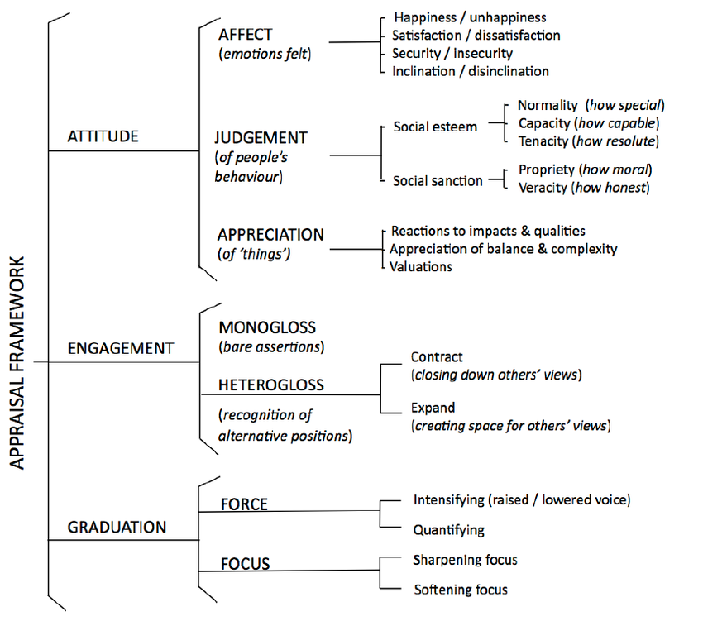
Research context and design
Transcripts were analysed using Appraisal framework (Martin 2000; Martin & White 2005), an approach that extends Halliday’s Systemic Functional Linguistics to explore, describe and explain how language is used to express attitudes, to evaluate and to judge.

Slide 12
Research context and design
Transcripts were coded as below:
Original analysis led to the inference of prevalent ideological beliefs.
Subsequent ontological re-interpretation identified implied conceptualizations of English and other languages, and of nation and national identity, and the values associated with them.

Slide 13
Analysis of ideological beliefs
Appraisal analysis suggests that two sets of inter-related ideological beliefs prevail in teachers’ discourses:
A hegemonic stance towards English, deriving from the ‘one nation, one language’ ideology (cf. Piller, 2015) and the ‘monolingual habitus’ (Gogolin, 1997), and implicit endorsement of the belief that learning and using English as an additional language is characterized by deficit.
Association of languages beyond English with different levels of cultural capital, thus implying a hierarchy of languages (with English at the top).
The attribution of relative value to languages follows from educators’ monolingual habitus, associating individual languages with individual communities in a one-to-one relationship, such that languages inherit the perceived status of their (native) speakers (Le Page & Tabouret-Keller 1985), and multilingualism as a natural state is denied.
Notes:
I now go on to discuss five key themes that prevailed during the ideological analysis phase of this study

Slide 14
Ideological analysis
1. English is (always) primary - many educators believe unquestioningly
Other languages are so excluded that they can be rendered completely invisible.
Kelly, the EAL co-ordinator at school 2, refers to ‘people who’ve got no language at all when they come’ and Irene, the Head at school 4, describes children ‘coming in in year three with no language’ (negative capacity). Similarly, Tina refers to the brother of a student who ‘accelerated learning very rapidly from no language […] to lots of languages […] within six to ten weeks’
The exclusionary stance is made explicit in the following comment:
Luke: We emphasize the importance of English because that’s the dominant language in the country and for children to make progress and to do well in their future lives they need to be good communicators.
Notes:
Our analysis of the data from the ideological standpoint suggested that many educators believe unquestioningly that English is (always) primary and, indeed, that other languages are excluded from the communicative domain in the UK, to the extent that they can be rendered completely invisible. For example, Kelly, the EAL co-ordinator at school 2, refers to ‘people who’ve got no language at all when they come’ and Irene, the Head at school 4, describes children ‘coming in in year three with no language’ (negative capacity). Similarly, Tina refers to the brother of a student who ‘accelerated learning very rapidly from no language […] to lots of languages […] within six to ten weeks’— the graduation resources of raising intensification and quantification creating a strong (possibly hyperbolic) narrative here. The exclusionary stance is made explicit in the following comment: Luke: we emphasize the importance of English because that’s the dominant language in the country and for children to make progress and to do well in their future lives they need to be good communicators. Luke made this comment in response to a question about what language he recommends for parents to interact with their children. His positioning of knowledge of English (positive capacity) as constitutive of effective communication can be interpreted as a reflex of the societal ‘one nation, one language’ ideology, marginalizing the role of children’s other languages.

Slide 15
Ideological analysis
2. English is equated with language in general.
Thomas, talks about EAL students maybe being transferred (‘bussed’) to schools where there are ‘better’ native-speaker role models and returning ‘when they’ve got more language’.
Marie speaks of the possibility of children entering school with ‘a lower level of language’
Luke mentions ‘the difficulties that EAL children have in processing language’.
Lucy’s characterization of parents’ English using the phrase ‘their language was poor’. She goes on to say:
“Dad was very good at English. Mum couldn’t speak it at all and the little boy was somewhere in the middle, so we had something, and Michael the little Polish boy - Dad could speak, Mum couldn’t. Maybe it is a cultural thing - Dads can all speak, Mums can’t, mainly”
Notes:
English is similarly accorded unique value by being equated with language in general. Thomas, for example, refers to the possibility of EAL students transferring to schools where there are ‘better’ native-speaker role models and returning ‘when they’ve got more language’. Likewise, Marie speaks of the possibility of children entering school with ‘a lower level of language’, and Luke mentions ‘the difficulties that EAL children have in processing language’. There is evidence of the ideological stance throughout Lucy’s discourse too. One example is her characterization of parents’ English using the phrase ‘their language was poor’. Another, more explicit, is contained in the following extract: Dad was very good at English. Mum couldn’t speak it at all and the little boy was somewhere in the middle, so we had something, and Michael the little Polish boy - Dad could speak, Mum couldn’t. Maybe it is a cultural thing - Dads can all speak, Mums can’t, mainly. Notice that although the earlier part of the extract refers explicitly to the mother’s knowledge of English (capacity appraisal: ‘Mum couldn’t speak it’), the later part elides reference to English completely. By dropping the pronoun required if English were still in unique focus, Lucy seems to have shifted her stance to one in which lack of English is constructed as lack of ability to speak at all (‘Dad could speak, Mum couldn’t’).

Slide 16
Ideological analysis
3. LBEs are situated within a hierarchy of languages
The distinction between ‘more valuable’ languages legitimized by being taught in schools and ‘less valuable’ languages brought to schools from home is clear here
Habib: Y’know we are working here because we’ve got another language. If I couldn’t, I might not be working here! […] so it’s an asset an’ y’know, people go an’ learn Chinese an’ you know the languages - you learn French but our children think ‘oh no, you know, first language’ (Oraiba: because they’ve all practically got it so they don’t think it’s…) (Interviewer: that it’s anything special).
Chinese and French are languages which ‘people go and learn’ (as school subjects), whereas the children’s own languages are perceived as less valuable assets in a multilingual combination.
Notes:
The distinction between ‘more valuable’ languages legitimized by being taught in schools and ‘less valuable’ languages brought to schools from home is apparent in the following extract, in which two bilingual learning assistants note the way their positive appreciation of their own (heritage) multilingualism differs from their students’: Habib: Y’know we are working here because we’ve got another language. If I couldn’t, I might not be working here! […] so it’s an asset an’ y’know, people go an’ learn Chinese an’ you know the languages - you learn French but our children think ‘oh no, you know, first language’ (Oraiba: because they’ve all practically got it so they don’t think it’s…) (Interviewer: that it’s anything special). Chinese and French are languages which ‘people go and learn’ (as school subjects), whereas the children’s own languages are perceived as less valuable assets in a multilingual combination.

Slide 17
Ideological analysis
4. Cultural heritage implicitly construed as monolingual
Lucy: I think keeping their natural language is an extremely important characteristic. It’s part of their culture, it’s who they are, it’s what they are, it’s what makes them unique.
Helen: language is a big part of your own identity […] it’s like something you pass down like the colour of your eyes an’ things like that an’ I think it’s a really important thing and for those children to not have it then I think will have an impact especially on how they’re going to fit in to wherever they belong.
The positive valuation expressions suggest almost a genetic or biological link between the children’s heritage language and their identities, emphasizing the naturalizing effect of the ideology.
Losing their first language = losing their identity
EAL children are thus constructed as being inevitably defined by their home languages
This helps explain the positioning of EAL children as essentially ‘problematic’, because they face the considerable challenge of a transition from their natural state.
Notes:
The world views that emerge from these educators’ discourse are generally consistent with the ‘one nation, one language’ ideology, according to which each country has a language with a privileged status (e.g. English in the UK, Urdu ‘in their country’) and, consistent with the monolingual habitus, each individual is a (native) speaker of one language. Individuals may wish, or be expected, to learn another language from the upper levels of the hierarchy in order to increase their cultural capital. But their cultural heritage—their core identity—is implicitly construed as monolingual, as illustrated in the following extracts, taken from responses to questioning about the desirability of children maintaining their home language(s). Lucy: I think keeping their natural language is an extremely important characteristic. It’s part of their culture, it’s who they are, it’s what they are, it’s what makes them unique. Helen: language is a big part of your own identity […] it’s like something you pass down like the colour of your eyes an’ things like that an’ I think it’s a really important thing and for those children to not have it then I think will have an impact especially on how they’re going to fit in to wherever they belong. Striking in both these extracts is participants’ use of expressions of positive valuation (alongside particularly intensifying graduation resources) which suggest almost a genetic or biological association between the children’s heritage language and their identities, emphasizing the naturalizing effect of the ideology. For Lucy multilingual students’ first language is their ‘natural language’ (implying perhaps that English is unnatural for them) and for Helen it is ‘pass[ed] down’. Losing their first language would effectively mean losing their identity, seen as tied to their ‘culture’ and ‘wherever they belong’. The typical EAL child is thus constructed as being inevitably defined by their home language and the cultural identity this is seen to naturally entail. This helps explain the positioning of EAL children as essentially ‘problematic’, because they face the considerable challenge of a transition from their natural state.

Slide 18
Ideological analysis
5. Home languages are constructed as having only qualified or subordinate worth
Kelly states that parents ‘should continue to use first language because that will improve the children’s second language’ (propriety judgement).
Sheila comments on migrants’ failure to understand that to learn English ‘they need to preserve their first language’
Marie says ‘development of language in their first language […] will help […] cos they can then reinforce that in English as well’.
Elsewhere, children’s use of languages beyond English is sanctioned for in-group rapport maintenance in the playground, especially.
The attitude expressed is that home languages are restricted to narrow social domains or subject to external Anglophone supervision, which we see below
Kelly says: they’ve got to learn to use it appropriately so in our school at the moment there isn’t a culture of it - of children being allowed to use it without there being a bilingual member of staff there to sort of oversee it
Notes:
We do not mean to suggest here that educators oppose use of the first language. Indeed, there are several instances where home language use is positively endorsed. But, crucially, it is nearly always constructed as having only qualified or subordinate worth. So, for example, Kelly states that parents ‘should continue to use first language because that will improve the children’s second language’ (propriety judgement). Likewise, Sheila comments on migrants’ failure to understand that to learn English ‘they need to preserve their first language’ and Marie asserts that ‘development of language in their first language […] will help […] cos they can then reinforce that in English as well’. Elsewhere, children’s use of languages beyond English is sanctioned for in-group rapport maintenance. Lucy, when asked about children’s use of Tamil in the classroom, responded: that would be absolutely promoted and very supported by the staff, but it would be made into a slight humour because the teacher would say they’d like to be able to understand what they’re doing but it would be done in a very sensitive way and in a well-meaning way. In another extract, she says: I think it’s heart-warming that they speak Tamil when they’re together and sometimes you can see them in the playground. The two girls when they’re together they’re having a conversation which is excluding of other people, of course, because it is Tamil but because they’re confident with it they can have such quick conversations with each other and just clear up an issue or talk about who is picking who up or who is coming for who. Then they’re off and they’re with their friends. The attitude reflected here can be interpreted as one which values Tamil as part of the exotic but inscrutable ‘other’, as long as it is restricted to narrow social domains or is subject to external Anglophone supervision. The sense of a need to supervise the use of home languages in the school domain was also articulated by Kelly who says: they’ve got to learn to use it appropriately so in our school at the moment there isn’t a culture of it - of children being allowed to use it without there being a bilingual member of staff there to sort of oversee it. Interestingly, Kelly is one of several educators to report a positive attitude to bilingualism in general terms. At an earlier point in the interview, when asked about her attitude directly, she responds ‘I’m very into it and I value it’, which in the light of her qualification above suggests the co-existence of competing ideological beliefs. But independently of educators’ recognition of the intrinsic worth of students’ home languages, transition to English is seen as a key focus by all participants in the study

Slide 19
Ontological framework
Basic distinction (cf. Hall, 2020; Otheguy, 2015) between language conceptualized as:
a general socio-cognitive phenomenon (and hence English[es] as instantiations of this);
a collection of distinct named codes associated with different nations (of which English is one).
English exists in these two senses by virtue of:
the existence of language as a human capacity, independent of our awareness of it;
the original existence of a group of people perceiving themselves as a nation, ‘the English’, and those who now trace a cultural lineage with this group.

Slide 20
Ontological propositions
Beliefs about English (1):
Proper English people speak proper English.
Thomas | ‘If you look at the school where I am, my indigenous white children also have unenriched language.’
Fiona | ‘Obviously as a teacher my aim is to make sure the children can speak English properly and there’s some children even from this country that struggle to do that.’
Kate | ‘[T]o be honest their [‘white children’s’] English was as poor as the English second language [students].’
Irene | ‘They can speak perfectly good and functional English, but you would never think they are English’
Kate | ‘[T]he women with burkas and everything else like that—y’know that [...] don’t speak any English.’

Slide 21
Ontological propositions
Beliefs about English (1):
In England, if you don’t have English, you’re linguistically impaired.
Kelly | ‘people who’ve got no language at all when they come.’
Irene | ‘[children] coming in in year three with no language.’
Tina | a student’s brother who ‘accelerated learning very rapidly from no language [...] to lots of languages [...] within six to ten weeks.’
Thomas | children returning to school ‘when they’ve got more language.’
Luke | ‘the difficulties that EAL children have in processing language’

Slide 22
Ontological propositions
Beliefs about languages beyond English:
In England, if you’re not English and have other languages, they’re components of your identity, not your linguistic ability.
Lucy | ‘I think keeping their natural language is an extremely im- portant characteristic. It’s part of their culture, it’s who they are, it’s what they are, it’s what makes them unique.’
Helen | ‘language is a big part of your own identity [...] it’s like something you pass down like the colour of your eyes an’ things like that an’ I think it’s a really important thing and for those children to not have it then I think will have an impact especially on how they’re going to fit in to wherever they belong.’
Katherine | ‘I feel it’s very important that they keep [...] who they are’ (our emphasis).

Slide 23
Ontological propositions
Beliefs about languages beyond English:
In England, other languages you learn are school subjects, independent of social identity and use.
Luke | ‘We encourage the children to swi- or- not- it hasn’t been the case over this last year, probably for several years, I’ve been er promoting French, so the children have been picking up French very easily ’specially the EAL children because they’re already used to the idea.’
Habib | ‘Y’know we are working here because we’ve got another language. If I couldn’t, I might not be working here! [...] so it’s an asset an’ y’know, people go an’ learn Chinese an’ you know the languages - you learn French but our children think ‘oh no, you know, first language’

Slide 24
Ontological propositions
Beliefs about English (2):
In England, if you learn English but aren’t English, your English is viewed in terms of how well it matches the linguistic system of the ‘standard’ variety, independently of effective use.
Luke | shared responsibility for ‘ identifying problems and then trying to find ways to remedy the problems so the interventions are something that are ongoing all the time but they’re in response to how we perceive the needs.’
Sarah | ‘Part of the identification process was actually going okay, some children are on step five who you might not notice, but when you look at their writing or when they get further up, you’re going to notice. And we just need to hunt them down somewhere and for teachers to know who they are.’

Slide 25
Conclusion
Educators conceptualize English in conflicting and inconsistent ways (cf. also Kroskrity, 2004; Van Dijk, 2013; Fitzsimmons-Doolan et al., 2017; Weaver, 2019).
Proposition A captures the default, entrenched ontological commitment, according to which the legitimate manifestation of language in England is conceptualised not as a communicative resource, but as Standard English, an index of national identity (N-English).
Proposition B reverses the ontological categories for ‘non-English’ people, viewing lack of (competence in) English in terms of lack of communicative resource altogether, rather than simply lack of regulative norms.
Propostion E holds that when ‘non-English’ people do have competence in English, then it’s conceptualised again as a set of regulative norms, i.e. in deficit terms, rather than as communicative resource.
This selective and subconscious conflation of language as resource and language as national identity marker contributes to the perpetuation of social injustice.

Slide 26
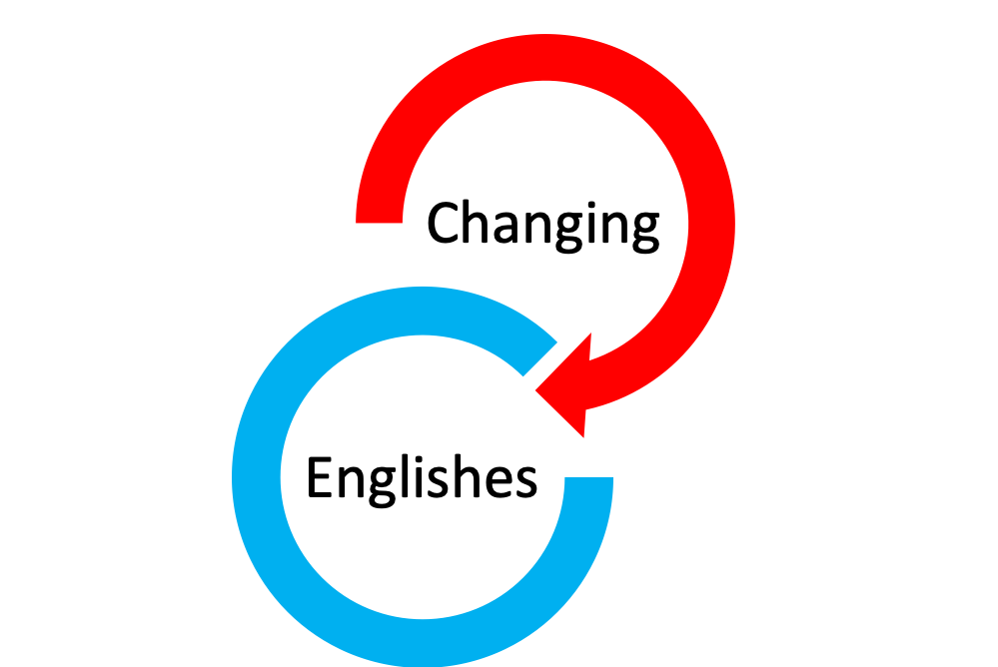
Implications
Just as Alfaro and Bartolomé (2017, p. 12) call for bilingual educators to “develop their ideological clarity in parallel with their pedagogical expertise”, we advocate the development of ontological clarity for EAL and other language educators.
Some specific goals could include:
delinking the ontological categories of language and nation;
appreciating English as plurilithic rather than monolithic;
recognising the ambiguity of the word rule (as in the rules of English).
Suggestions for activities can be found in Hall & Cunningham (2020), drawing on ideas for TESOL practitioners in Hall & Wicaksono (2020b)—an online course at changingenglishes.online—and Hall (in press).

Slide 27
References
Alfaro, C. and Bartolomé, L. (2017). Preparing ideologically clear bilingual teachers: honoring working-class non-standard language use in the bilingual education classroom. Issues in Teacher Education, 26, 2, 11–34.
Cunningham, C. (2017). Saying more than you realise about ’EAL’: discourses of educators about children who speak languages beyond English. Unpublished PhD Thesis. University of York, UK.
Cunningham, C. (2019a). ‘Terminological tussles: taking issue with 'EAL' and 'languages other than English.’ Power and Education, 11 (1): pp. 121-128.
Cunningham, C. (2019b). ‘The inappropriateness of language’: discourses of power and control over languages beyond English in primary schools. Language and Education, 33, 4, 285-301.
Cunningham, C. (2020). When ‘home languages’ become ‘holiday languages’: teachers’ discourses about responsibility for maintaining languages beyond English, Language, Culture and Curriculum, 33, 3, 213-227.
Department for Education. (2018). Schools, Pupils and Their Characteristics. Online. Retrieved 28/05/21 from https://assets.publishing.service.gov.uk/government/uploads/system/uploads/attachment_data/file/719226/Schools_Pupils_and_their_Characteristics_2018_Main_Text.pdf.
Fitzsimmons-Doolan, S., Palmer, D. and Henderson, K. (2017). Educator language ide- ologies and a top-down dual language program. International Journal of Bilingual Education and Bilingualism, 20, 6, 704–721.
Fortier, A. M. (2017). On (not) speaking English: colonial legacies in language requirements for British citizenship. Sociology, 52, 6, 1254-1269.
Gkaintartzi, A., & Tsokalidou and (2011). “She is a very good child but she doesn’t speak”: the invisibility of children’s bilingualism and teacher ideology’. Journal of Pragmatics, 43, 2, 588–601.

Slide 28
References
Gogolin, I. (1997). The “ Monolingual Habitus” as the common feature in teaching in the language of the majority in different countries. Per Linguam, 13, 2, 38–49.
Hall, C. J. (In press). Incorporating ontological reflection into teacher education about English for global learners: a rationale and some guiding principles, In Bayyurt, Y. (Ed.), World Englishes: Pedagogy. London: Bloomsbury.
Hall, C. J. (2020). An ontological framework for English. In Hall, C. J. and Wicaksono, R. (eds), Ontologies of English. Conceptualising the language for learning, teaching, and assessment (pp. 13-36). Cambridge: Cambridge University Press.
Hall, C. J. and Cunningham, C. (2020). Educators’ beliefs about English and languages beyond English: from ideology to ontology and back again. Linguistics and Education, 57, 1-14.
Hall, C. J. and Wicaksono, R. (Eds) (2020a). Ontologies of English. Conceptualising the language for learning, teaching, and assessment. Cambridge: Cambridge University Press.
Hall, C. J. and Wicaksono, R. (2020b). Changing Englishes. An online course for teachers (v.02.2). Online. Available at www.changingenglishes.online.
Hall, C. J., Wicaksono, R., Liu, S., Qian, Y. and Xu, X. (2017). Exploring teachers’ ontologies of English. Monolithic conceptions of grammar in a group of Chinese teachers. International Journal of Applied Linguistics, 27, 1, 87–109.
Haugen, I. (1966). Dialect, language, nation. American Anthropologist, 68, 922-935.
Heller, M. P. (2007). Bilingualism as ideology and practice. In M. P. Heller (ed.), Bilingualism: a Social Approach. Palgrave Macmillan.

Slide 29
References
Helot, C. and Young, A. (2002). Bilingualism and Language Education in French Primary Schools: Why and How Should Migrant Languages be Valued? International Journal of Bilingual Education and Bilingualism, 5, 2, 96–112.
Kroskrity, P. (2004). Language ideology. In A. Duranti (ed.), Companion to linguistic anthropology. Oxford: Blackwell.
Lawson, T. (2014). A conception of social ontology. In S. Pratten (Ed.), Social ontology and modern economics. London: Routledge.
Le Page, R. B. and Tabouret-Keller, A. (1985). Acts of Identity. Creole-based Approaches to Language and Ethnicity. Cambridge: Cambridge University Press.
Martin, J. R. (2000). Beyond exchange: Appraisal systems in English. In S. Hunston and G. Thompson (eds), Evaluation in Text: Authorial stance and the construction of discourse. Oxford: Oxford University Press.
Martin, J. R. and White, P. (2005). The Language of Evaluation: APPRAISAL in English. London: Palgrave Macmillan.
Milroy, J. (2001). Language ideologies and the consequences of standardization. Journal of Sociolinguistics, 5, 4, 530–555.
Otheguy, R., García, O. and Reid, W. (2015). Clarifying translanguaging and decon- structing named languages: A perspective from linguistics. Applied Linguistics Review, 6, 3, 281–307.
Pettit, S. K. (2011). Teachers’ Beliefs About English Language Learners in the Main- stream Classroom: A Review of the Literature. International Multilingual Research Journal, 5, 123–147.

Slide 30
References
Piller, I. (2015). Language ideologies. In K. Tracy (ed.), The International Encyclopedia of Language and Social Interaction. London: John Wiley and Sons.
Seargeant, P. (2008). Language, ideology and ‘English within a globalized context. World Englishes, 27, 2, 217–232.
Searle, J. R. (1995). The Construction of Social Reality. New York: Simon and Schuster.
Sharpe, R. A. (1974). Ideology and ontology. Philosophy of the Social Sciences, 4, 55–64.
Toolan, M. (2009). Introduction: Language teaching and Integrational Linguistics. In M. Toolan (ed.), Language Teaching. Integrational Linguistic Approaches. London: Routledge.
Van Dijk, T. A. (2013). Ideology and discourse. In M. Freeden, L. Tower Sargent and M. Stears (eds), The Oxford Handbook of Political Ideologies. Oxford: Oxford University Press.
Weaver, M. (2019). “I still think there’s a need for proper, academic, Standard English”: Examining a teacher’s negotiation of multiple language ideologies. Linguistics and Education, 49, 41–51.
Woolard, K. A. (1998). Introduction. Language ideology as a field of inquiry. In B. B. Schieffelin, K. A. Woolard and P. V. Kroskrity (eds), Language Ideologies: Practice and Theory. Oxford: Oxford University Press.
Thank you for listening—questions welcome!

