Slide 1
Students’ (dis)agentic and (dis)empowered discourses about ecological justice
Dr Clare Cunningham,
Centre for Language and Social Justice Research, York St John University
Ulster University’s Linguistic Research Series, May 10th 2021
Notes:
Hi and thank you for coming to my talk here today. This is the first virtual talk I’ve done outside my department, actually, due in the main to the trials and tribulations of homeschooling and online teaching during 2020, so I’m hoping not to fall into all the traps this afternoon! So, as you know, I’m Clare and I’m a Senior Lecturer in Applied Linguistics at YSJ where, alarmingly, I’ve been for over ten years now. Whilst much of my research today has been focused on multilingualism and teachers’ attitudes to it, I’m talking to you today about a brand new seam of research that I’ve become involved in that sits under the umbrella of ecolinguistics.

Slide 2
YSJU students and ecological justice: expectations, anxieties and agency
Broader funded project in collaboration with:
Dr Catherine Heinemeyer (Arts)
Dr Judith Parks (Geography)
Dr Silvia Szilagyiova (Business)
Research questions:
what do our students expect from their university education in relation to EJ issues?
what are students’ beliefs and emotional responses to these issues?
what prevents students from engaging in issues of EJ through their studies or as citizens?
Notes:
However, before I get to the linguistics and the discursive elements I want to talk about, I need to introduce you to the broader project that the data today is drawn from, which isn’t overtly linguistic in its focus. The project, internally funded (now across two stages) is seeking to explore tertiary level students’ relationship and interaction with ecological justice. Myself and my group of collaborators and eventual co-authors, are seeking to investigate what students expect from their university with regards to ecological justice, both in and beyond their curriculum areas. The project was conceived as a way of addressing the perceived gap between EJ awareness and action: students’ lack of a sense of agency over ecological problems; a ‘tacit’ curriculum which privileges ‘purely’ social over ecological components of justice problems; the interaction between ecological anxiety, the mood of political crisis, and students’ mental health; and staff’s need of time to remap programmes to incorporate EJ. So you can see from the collaborators list that we are all from different disciplines and this places this work very well, therefore, at the intersection of all these relevant fields. Today, we’ll take the data in its discursive direction, particularly picking up on the second of these research questions here.

Slide 3
YSJU students and ecological justice: expectations, anxieties and agency Research design:
Mixed methods design:
7 focus groups of 23 students from varied programmes and across all levels from Undergraduate to Doctoral
A Mentimeter survey (250 responses from YSJ students) with both closed quantitative items and open qualitative responses.
Notes:
We opted in the first stage of this study for a mixed-methods approach, with focus groups facilitated by a funded MA by Research student position. There were 23 participants and they were drawn from all over the university and from all levels of higher education. Whilst they were therefore, obviously, self-selecting, you will doubtless see later that they seemed to self-select for very different reasons. This qualitative discursive data is combined with the more quantitative in a mentimeter survey that all 23 focus group participants took, but was also sent out (repeatedly) across the university to ensure a decent uptake. We now have 250 complete responses (from over 300 partially completed ones that my co-researcher Silvia has removed from the set) and have closed the survey. I’ll use some of the qualitative responses in my discussion today whilst my main focus will be on the focus group data. In terms of the nature of participants in the survey, it is of value to note that 79/ 250 have done some volunteering related to environmental issues and only 30/ 250 have campaigned – on the school climate march, for example, so there was a very strong contingent here of what we might think is the average level of awareness and interest in these issues. There was just 1 clear climate change denier in the 250

Slide 4
Increasing urgency for universities to provide a relevant education for a future of ecological, economic and social uncertainty. Eco-anxiety (Hickman 2019) is growing but ‘psychological distance’ actually needs breaking down as it’s the lack of the direct perceived threat that limits humans’ aptitude for taking action (Pfausch and Gray, 2017) The climate crisis challenges dominant cultural narratives, values and identities (Verlie 2018)
Context
Notes:
Now I’d like to offer a little more in the way of contextualisation of the study as well as pausing to define some of the key terms here, before we take a look at the discursive data. In an era of school strikes, growing youth climate activism and increasing awareness that ecological tipping points are being breached, it is increasingly urgent for universities to provide an education which acts upon young people’s concerns and equips them to be constructive citizens and professionals in a future of ecological, economic and social uncertainty. Embedding education for sustainability into curricula has become seen as a fundamental aspect of educational quality by some early adopters. As Hickman (2019) reports, young people report feelings of grief, disillusionment and deep anxiety in relation to climate but it has also been noted in the research that it’s a lack of proximity to the threat that causes inaction on environmental issues. Verlie (2018) finds evidence that negative emotions are exacerbated by young people’s awareness that professionals and educators are living a ‘double reality’ (Norgaard 2012), understanding the depth of the climate crisis yet living and teaching as if they did not. For Verlie this is related to the challenge posed by climate crisis to dominant cultural narratives, values and identities, and it’s here we can see a role for linguistics as we’ll return to in a minute.

Slide 5
Defining: environmental justice, ecological justice, social justice
Justice:
distribution
recognition
participation
UN IPCC report (2014): “People who are socially, economically, culturally, politically, institutionally or otherwise marginalized are especially vulnerable to climate change”
SI in Risk Analysis (2020) aims to ‘examine some of the risks and disadvantages that people and communities experience as a result of environmental injustices’
Notes:
Environmental justice and ecological justice are different things and they both need connecting to social justice, as was clearly proposed back in 2001 by David Schlosberg. At the point when the definition of ‘social justice’ was shifting to acknowledge more about recognition and participation than just about distribution, he used this discursive shift to connect the environmental and ecology with it. The environmental challenges we face are now really inseparable from the concept of social justice

Slide 6
Defining: environmental justice, ecological justice, social justice
Environmental justice:
justice among humans on environmental issues
Ecological justice:
‘doing justice to nature to allow the sustainability of natural capital, the protection of irreplaceable nature, or the protection of natural ‘value’ or processes of nature generally’

Slide 7
Going a little further on ecological justice
Is it ‘a focus on the physical integrity of nature and the recognition of nature’s own processes of unfolding potential, evolution, and growth’; or we can also be more human-centric here too taking it as ‘a focus on the recognition of the importance of the respect of nature to present and future human communities’:

Slide 8
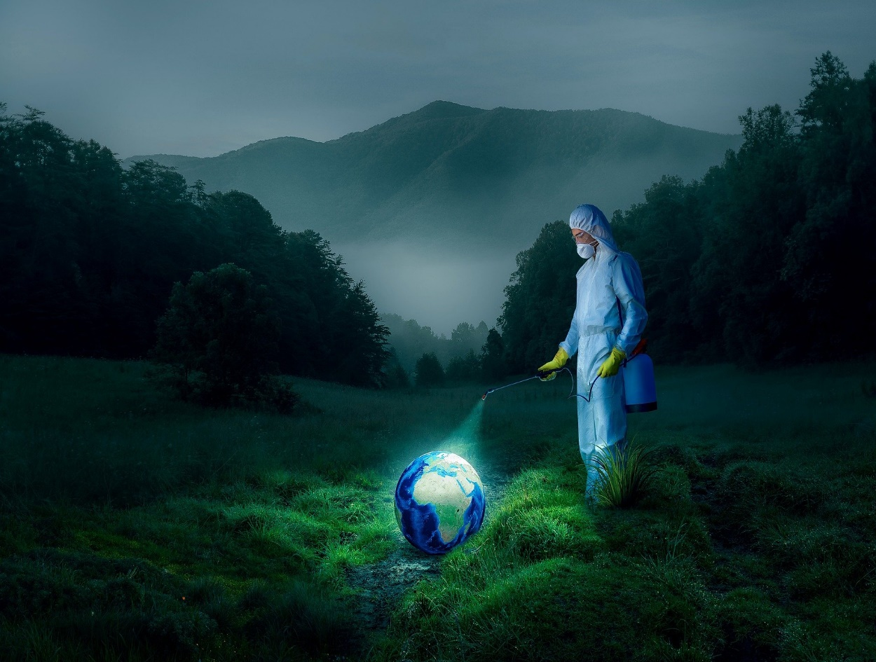
2020 has shown us how linked these concepts are in: The genesis of the virus itself: zoonotic The distribution of outbreaks The distribution of impact of lockdowns The ecological impact of Covid 19 measures: ‘anthropause’ but increased deforestation (undercover), dip in recycling and increase in disposables
Example: Covid 19
Notes:
Covid-19 is just one manifestation of the ecological emergency as a direct result of our continuous exploitation and mismanagement of the natural world (Farstad 2020, in the Ecologist online). A recent call for papers for the international journal of environmental research and public health encapsulates this so well I think I’ll just read it: COVID-19 emerged from the encroachment of human activity into habitats of other species, raising critical questions about deforestation, climate change, ecosystem disruption and the impacts of extractivism. COVID-19 also now compels new attention to extreme social and health inequities associated with racial, gender and class injustices globally—both underlying the origin and spread of such pandemics as well as the uneven consequences that ensue. For example, African-Americans have been disproportionally impacted by COVID; lower-income countries in Latin America and Africa, saddled with debt from neoliberal policies, are being devasted from weakened public health infrastructure and insufficient healthcare equipment. So too are those barely sheltered in crowded refugee camps in the Middle East and worldwide, or already suffering from widespread impacts of climate change on the environments they depend upon for their livelihood. Certain occupational groups also deserve special focus—in Spain, more than 25% of COVID-19 cases have occurred in healthcare workers. Moreover, the lockdowns and travel disruptions are themselves having unequal impacts. Food insecurities in Indigenous communities are becoming exacerbated, adding to ongoing colonial injustices. Meanwhile, government bailouts and programs can aggravate social inequities, while abandoning environmental regulations that can have dangerous public health consequences

Slide 9
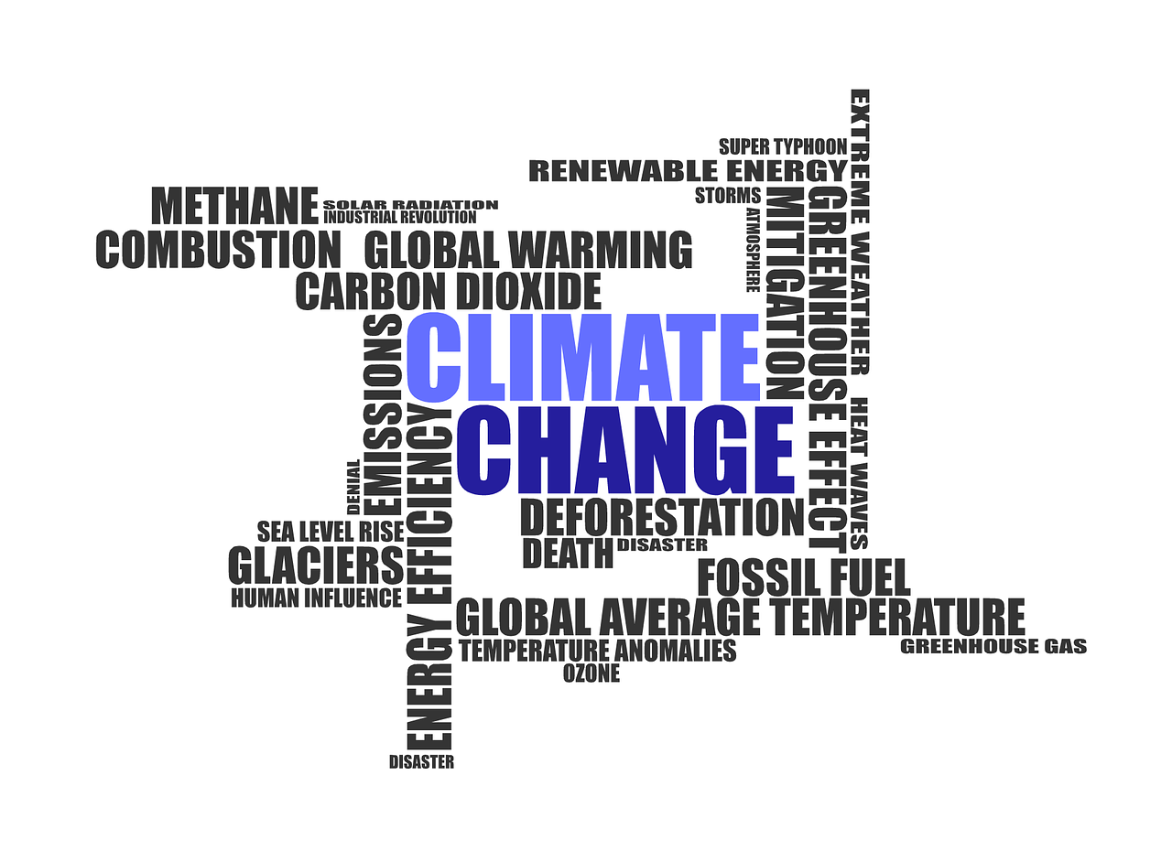
‘As with social justice generally, we need to examine structures, mores, norms, language, symbols that mediate our relation with nature’ (Schlosberg, 2001) Common discourses and assumptions about the human and natural world can be noticed, challenged and changed: risk; resilience; global warming
The role for language
Notes:
‘The UN report summary (2014) mentioned the word “risk” more than 230 times, compared to just over 40 mentions seven years ago, according to a count by the Red Cross’ - definitions of terms like resilience refined and buzzwords amended over time: global warming - climate change – climate emergency

Slide 10
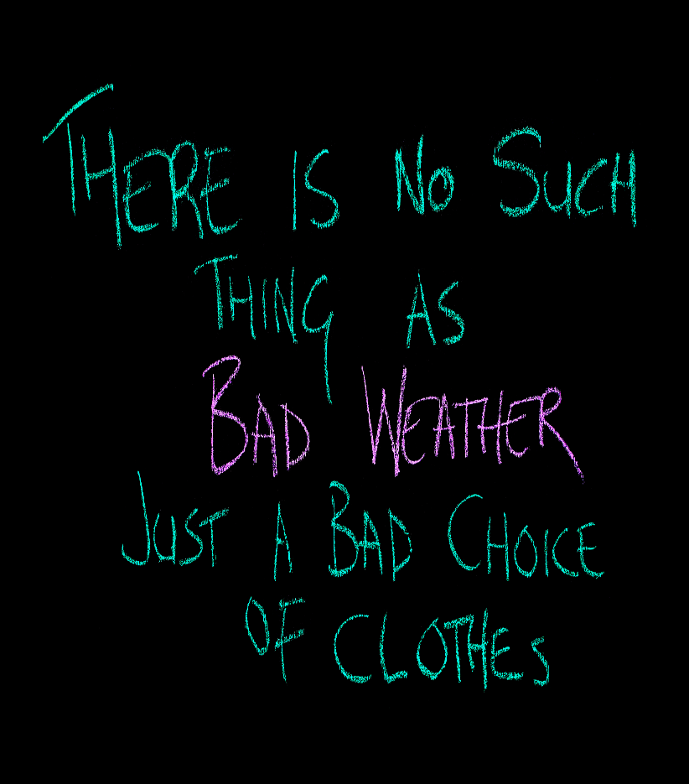
Halliday (1990): New Ways of Meaning – key message: growth is good Strands of ecolinguistics: linguistic diversity/ ecology (Haugen) – environmental knowledge being lost Stibbe (2015) continues Halliday’s legacy in focusing on the 'stories we live by’.
Enter ecolinguistics
Notes:
Stibbe continues Halliday’s legacy in focusing on the environmental analysis of language, which draws on a wide range of linguistic tools including critical discourse analysis, framing theory, cognitive linguistics, identity theory, rhetoric and systemic functional grammar to reveal underlying worldviews or the 'stories we live by. Stories which ecolinguists claim are destructive relate to consumerism, unlimited economic growth, advertising, intensive farming, and those which represent nature as a machine or a resource. Using "positive discourse analysis", ecolinguistics has also searched for new stories to live by through exploring nature writing, poetry, environmental writing and traditional forms of language around the world. I think in the data we’ll turn to now that we also see a destructive story-that-we-live-by of the construction of responsibility for environmental issues being with the individual. Some of the participants push back against this and learning to harness this may be the key to developing the type of agency that will offer some hope.

Slide 11
Data-driven and iterative approach 1st stage: Emergent themes agreed on and coded across focus group transcripts by two co-researchers (JH): Identity Positionality Agency Institutional framework Intersubjectivity Contradictions Domains of what students think are important: Consumption Environmental discourses around waste Their future lives

Slide 12
Agency in the data
The impact of other people on participants’ sense of agency and empowerment
Notes:
So this a bit of a personal reflection on how it felt as a researcher to read through the focus group data. Participants felt like they were surrounded on all sides by people who impacted on their sense of agency. It almost felt claustrophobic at times, so it was clear that agency and empowerment was central here and needed a closer look.

Slide 13
2nd stage: re-coding the data based on Fairclough’s and Van Dijk’s guiding questions for Critical Discourse Analysis (as amalgamated by Amoussou and Allagbe, 2018): (at preliminary stage) •Transitivity •Mood and Modality •Vocabulary •Interactional control features •Topicality •Presuppositions •Vagueness •Implication

Slide 14
Eco anxiety
Psychological distance
Awareness of connection SJ - EJ
Notes:
Agency was seen to be impacted in the participant data by a range of factors. They include some key psychological aspects – including the impact of eco anxiety on the desire to take action – i.e. a sense of pointlessness. However, the data shows how contradictory student discourses are here, and the range of views that educators will have to work around. The psychological distance from the threat of climate change for some participants can manifest in a strong lack of agency or desire to act on ecological justice issues. There’s a connection between participants who we might describe as activist and their understanding and awareness of the link between eco justice and social justice

Slide 15
“we're gradually desensitised to the issue, even though the issues are getting worse. The issue’s been around long enough for us to get desensitised to it. It really should be at the forefront of everyone's minds, but whether it actually is, or not is highly debatable. I don't believe it's the general consensus” “I personally really worry about climate change, like seeing pictures of like the polar bears and stuff like that. Like it's absolutely heartbreaking.[…] So I think that for me, it massively affects like my health and my wellbeing just purely from like worrying about it.[…]It makes it feel so bad that we're doing this to our planet.[...] And I think it's so scary and worrying that we're actively doing it”
Emotional reactions – eco anxiety

Slide 16
I'm confused about what behaviours to change. So, during the Covid I’ve been setting up litter picks with me and my mates because we’ve had nothing else to do. So we go around the local parks and stuff near us, picking up the crap, because people have been sitting around and just leaving crap everywhere. So we've been picking up stuff but then I'm thinking, well, am I actually doing any good. Because when you start looking for it, you start to see how much is out there, and then you feel like what you're doing is worthless, and you start to lose heart a little bit. After a few times of doing that because you constantly go back to the same place and it's just the same. And you're just doing it over and over again and then you start seeing information about, you know, plastic bottles - you know it's ultimately going to landfill anyway, that's what, that's what I think confuses me mostly is, is my own kind of annoyance that - that affects me more than confusion. Every time that I do try and do something to help, it doesn't seem like it's helping. And it just kind of grinds you down
Emotional reactions – eco anxiety
Notes:
Here we can see a repeated use of the word ‘confused’ which perhaps is being used more as a euphemism for too express a sense of hopelessness

Slide 17
I can personally state, and I know not everyone has this mindset and it's not the right mindset, but some of my friends have the same mindset, like, I'm not even gonna lie. Even though I do maybe my part, I don't care, really, that much about the climate because I know I'm probably going to be dead. Or my kid is probably going to be nearly dead by the time something bad's gonna happen. I don't mean just like rising oceans, but I mean like proper proper climate change, where it's really going to affect the world, where it's going to affect the people in Europe and stuff like that properly, and it's really gonna be affecting you every single day like... I believe, and I think a lot of people in Europe, maybe the richer parts of the world, think the exact same way, oh it's not gonna happen to us. We're going to be long dead before anything happens, so why am I going to put the effort in, so that's why I believe, firstly, not really a lot of people would care.
Psychological distance from the interlinked nature of eco and social justice
Notes:
And when they say they care, I feel like it's, it's, it's not like a proper caring, it's not like ‘I'm going to go out and I'm going to do every single thing possible’. It's I'm going to put on a, I'm not gonna say ‘facade’, a show, or I'm gonna do my little part. I don't think people truly feel they’ll be around to see any difference. That's what I personally feel anyway

Slide 18
“it's always the people that have the least rights that get hardest hit by things every time there's a crisis” “people who are disadvantaged most in the world in general, generally tend to lose most when there is an ecological disaster” “we can’t just consider eco justice as separate from class justice, you know money issues from gender equality from everything else, because money affects how climate justice affects you, gender equality affects money affects, you know, every single issue is linked together and while it can sometimes be difficult to figure out which one to focus on if you are focusing on one, you're focusing on them all”
Awareness of the interlinked nature of eco and social justice

Slide 19
I just feel equality issues have been with us a lot longer than the environmental issues, it's only lately since we've kind of been destroying the planet. You know plasticizers and plastics in the ocean, you know, major greenhouse gas issues, I think that those issues are quite recent whereas equality issues, even though they kind of fit together hand in hand, when you look at them now, the environment is more… more recent and equality issues have been ingrained in society for millennia
Lack of awareness of the interlinked nature of eco and social justice

Slide 20
Media
University
Other students
Notes:
Other factors include conflicting and biased media, ineffectual (or conversely positive) university measures and by fellow students’ actions and attitudes.

Slide 21
how the media portrays both of these as like a world stopping crisis, like every time there's flooding. It's all you hear about on the news, and then whenever there's like news from the Mediterranean regarding refugees, that's also seen as like a big crisis, but they're both compared on the same level if you compare both news reports. If you showed these two images on a news story, most British people would be more concerned about the middle aged white woman, getting safely to a little life raft with four lifeguards than they would be with a boat full of people of colour, trying to escape. I think it's really sad.
Media coverage: biased and conflicting discourses
Notes:
Note the psychological distance argument in play here in talking about how the media works and what it is playing on.

Slide 22
‘We've been 100% renewable, brackets compared to someone else, which means they actually haven't been, they're just that... I just feel like there's always an asterix and I don't have much faith in uni This university is very ‘all talk no action’, every time they put up a nice pretty poster about something, but they don't do anything about it. Say we support you and then don't do anything But then from Mentimeter: The university has done well; the ball's in my court Lots of talk on recycling and on-campus initiatives to curb waste
University contribution: contradictory
Notes:
Suspicious of motives: I think it's very easy to twist things to make them sound better, I mean they could say, I mean I haven't seen them posters, I can't comment, but I know that normally when stuff like that goes up it’s, . - The amount of handouts we get, every lecture we got like seven pages of handout, which is already on Moodle, and we’re all sat there with our laptops out, like why is that necessary? The fact that the computers are left running at all times in the library, that shouldn't be allowed, they should automatically switch off or get done in such a way where they've got the light snooze, you know you can do that with some electronics, where you'd put it in at the plug.... I'm pretty sure the roofs aren't covered in solar panels, that would cover the electricity for a year. Surely covering all the roofs on campus with solar panels

Slide 23
I mean we all watched the Al Gore thing in school, I remember, and after half the class walked out saying that it was a load of rubbish. And we had all the facts, given in front of us. It was because they weren't willing to learn it. They didn't see it as a real issue. I don’t think it's necessarily about dedicating yourself, I think it's about being willing to learn, like being willing to listen and understand someone else's point of view. And I think it's most people are just like, oh, environment is, I'm not gonna learn about it, and I am not going to waste my time because I'm never going to dedicate the time to it, when really it's just about being willing to understand there's an issue, and then using that as a jumping off point for everything you learn. I think that it would be easier for students to use the bins properly if the food bin which, when I was in halls was used the most, if it wasn’t the size of like a shoe box is ridiculous because people just didn't care. It's so tiny and you'd have to go to the bins like every two days and people in accommodation are lazy so they're not gonna do it, from my experience of who I was living with.
Those around them: peers, other students, ‘people’
Notes:
The data shows Othering happening across a number of dimensions. In the first quote here we see ‘they’ constructing the peers who just don’t care enough, despite now having the knowledge. And again ‘most people’ not wanting to know, in contrast to the participant who wants to show willing. People in student accommodations are lazy – a strong construction there!

Slide 24
Citizenship
Workplaces
Personal circs
Notes:
Discourses around agency also seem affected by participants’ sense of their role as a citizen alongside the usually negative role of politics and by the participants’ sense of place in the workplace as well as by participants’ own personal and changing circumstances (including the very key process of growing up, which is so pivotal for this group of participants in particular)

Slide 25
Even if it was like 5000 of you, etc etc. If you think about it doesn't really make a difference. Everything is just too big now. Any, any small thing to do won’t make a difference. A big initiative might make a small difference, but the majority don’t care enough to make a difference even if you do your little small part, no one else cares, they’re still throwing away everything, so you’re doing your little bit, yeah it helps because you're not adding to the problem, but it doesn't, it's not really helping the problem either, you’re just prolonging what's gonna happen. obviously, I mean hopefully we’re going to have a job, a career and work, and then we're going to be citizens. So, like, you know, I said we're going to be flooded, we might be underwater in 30 years for all we know... I don't know, I just feel that we should be more equipped to understand how we can make a difference when we enter professional life in our careers.
As a political citizen
Notes:
Participants discussed their role as a member of society – some unsure how to proceed, some keen to do their part, but not quite sure what it is, and some fairly convinced that there’s no point. The use of the passive construction in the final excerpt here is interesting as it’s not at all clear who should be doing the equipping.

Slide 26
cos the life as a citizen, it feels more in control, but I feel that the majority of jobs, cos unless you're sort of up there, what kind of impact, do you really have, when, when it comes to like wider social and environmental issues. when it comes to professional life it's a sort of company thing or like whatever work space you go into, it’s not because like, all your choice of what you're doing, Because obviously, if you work for someone else, you can hardly affect how they run things, but if you set up your own business, what, what could you do to help the climate through that stuff so yeah is. But I don’t know how to expand on that.
In the workplace
Notes:
If it feels a bit pointless as a citizen, it seems being in the workplace removes almost all sense of potential agency from the participants. They are almost all bitterly aware that in junior roles their ability to effect change for ecological justice is hugely limited. One participant tells her recent story as an example: But at work, it's a lot more difficult to sort of put those things in place. Like at the moment, I'm a support worker, so I work with people who have disabilities. And currently because of what's going on we're using a lot more gloves and masks and stuff that aren't reusable. And it's like however much it upsets me to do that I understand that I need to do that, to keep myself and the people I support safe. So, there are certain things at work that you have to do, because it's like the law and you can’t really get away from it. Whereas, as like a single person, it's a lot easier to do these things, and be able to work them into your life […] when I started, when all of the new like rules came in, it made me quite upset, and I did sort of try and talk to my managers about maybe find a way of doing it, that wasn't as wasteful, but it just didn't work. Laws more than anything, like there’s regulations in place now which mean we can’t use reusable things and we can’t take things from one house to another house sort of thing.

Slide 27
it's not necessarily confusion about what I should prioritise, it's more difficulty in prioritising it. Because, so I have a recent bit of mental health issues in terms of depression. And so like some days I don't have the energy to cook, so I need to eat a ready meal because I need to eat something, I think. But that's obviously full of fats, you know produced but probably not local, you know, trying to balance up, what I can do and not feeling the guilt, from what I sometimes can’t. And I don't have time to make myself food to take to work with me however much I'd love to do that. And I, like, I have to take a ready meal or get a takeaway or something while I'm at work and that for me is one of the things that like I get quite upset at myself about, but I also have started to sort of realise that I'm like well I actually carry a set of cutlery around with me so like I can use that instead of the cutlery from like the takeaway place and stuff like that. It's, I feel like it's not, yeah, it's more just sort of working out ways to put it into life when life changes because it changes so often like for me.
Personal circumstances
Notes:
Whilst the workplace significantly impacts on participants ability to imagine working for ecological justice, personal life isn’t always easier, despite the talk of being a good citizen earlier. Some participants have learned to accept it’s a balance – whilst upset at some decisions feeling forced on them due to financial or time or mental health constraints, they acknowledge that they can still make small changes. Another student says: With student lifestyles, there’s a big conflict. There's a lot that kind of contrast because it's like, oh, you need to like live with like a relatively low budget. But also, you need to make sure that you're recycling and composting and doing all of these like more sustainable things and you shouldn't use cars and it becomes like you're not entirely sure. Which behaviours you should adopt and which ones you shouldn’t, because everything that you kind of live with like being more environmentally sustainable can tend to be more expensive.

Slide 28
like coming to university and it should be that sort of high expectation I think especially like with university and most students are properly, probably just coming from living with their parents so they probably don't have their own, like well they might not have their own idea of, the sort of environmental, social beliefs, it get could be sort of what their parents have maybe what they used to do in the house maybe in terms of em like with environmental, in terms of recycling. Like if the parents do, they'll be following on from that. So move on, out moving in, like being quite independent. I think for me sort of moving out of my own home, and sort of having to live on my own and buy all my own produce and stuff like that has definitely sort of changed the way I think about things in a more practical way. It definitely allows me to have a bit more control about the things that I can like I do choose to use and the things I never choose to use and stuff and I think that definitely has affected the way
Personal circumstances: growing up
Notes:
Obviously some of the participants reflect on the fact they’ve recently left home and consider the impact of this. Are they just going to bring the ways of their parents (perhaps those of earlier generations and not so fit for now) with them, or will they grab control and make different decisions. In many ways, it feels that the next stage of this project is all about trying to equip participants to grab that opportunity to develop their agency with regards to ecological justice

Slide 29
my views on what I can do have massively changed. I think I've realised that I could live without a lot more than what I thought I could live without. And, like, I don't know like going to the shops, or just buy and sell for sake of buying it. I've realised that I don't need that I don't need to spend all that money, I don't need all them new things. And I think I've just learned that I can, I can live without a lot of what I thought I couldn't live without. I think I've been, I'll be more conscious of like shopping places are more and more economically friendly or more in touch with ecological justice, kind of issues, and like I'm definitely more conscious of my, the impact of me shopping at a certain place has on – how it impacts different aspects of things
Covid
Notes:
Covid has had an impact on many participants – in both focus groups and the survey. The survey highlighted comments that it’s now clear the govt don’t care, inequality has been brought into sharp focus, and environmental initiatives have stalled. Focus group participants talked about how Covid had given them time and space to notice more – both to read more political things than they had before and to notice the natural world more.

Slide 30
After initially feeling the planet was breathing a huge sigh of relief and giving us the breathing space to stop and reconnect with the planet, I feel that we have returned to unsustainable life styles with little thought for the long-term repercussions I had hope that the Corona Virus would bring people together. Trivial debates would be put into perspective, but now they have seemed to have become even more exaggerated I honestly just see it as more of an uphill battle now. I think if anything it will probably motivate me more, because it's gonna be harder now. A while before there was all the, you know, white wannabe hippie liberals […] I prioritise my selfish needs so screw the environment, let's get everything reopened. Like we've lost the voice, and yeah it was a vapid pointless voice, but they were voices backing up the call, this sort of thing. So I think now, COVID brought a lot of the selfish side out of a lot of people. And I think we're gonna see that as more of a fight for everything else to come.
Covid
Notes:
Both focus group and survey participants seem somewhat dispirited by the lack of longevity of any of the chances that the anthropause might have offered. And the final excerpt here uses quite violent vocabulary to signal that they are up for the work ahead. Does agency come from it being a hard fight?

Slide 31
YSJU students and ecological justice: agency More work needed!
Work on current data set continues – closer linguistic analysis using CDA tools
Considering the stories-we-live-by (Stibbe) that are embedded in the participants’ talk and at the role fatalistic and probabilistic stances towards the future play (Scollon and Scollon)
Next stage of the study
Notes:
There is much more work to be done here – these data excerpts are only really scratching the surface right now. I blame Covid!

Slide 32
YSJU students and ecological justice: pedagogies, practices and principles - A cross-school participatory action research collaboration, with students as co-researchers.
1) extra-curricular events and opportunities at YSJ on ecological justice issues
2) Students’ desire to understand systemic and structural approaches to address interlinked global challenges
3) The need for students and staff to consider proactively how their programmes might integrate issues of ecological justice in a way that is natural and core to the subject area.
4) The disjuncture between students’ learning and campus environmental practice
Notes:
So for the second stage we are currently attempting to create the agency! A group of 10 student researchers has been employed by the staff team following an additional funding round. They are in charge of this project around loosely predefined areas.

Slide 33
Pfautsch S. and Gray T. (2017). Low factual understanding and high anxiety about climate warming impedes university students to become sustainability stewards: An Australian case study. International Journal of Sustainability in Higher Education 18 (7).
Scollon and Scollon (2000). The Construction of Agency and Action in Anticipatory Discourse Positioning Ourselves Against Neo-liberalism Suzanne Scollon and Ron Scollon Paper presented at III Conference for Sociocultural Research UNICAMP, Campinas, Sao Paulo
Stibbe, A. (2015/ 2021). Ecolinguistics: Language, Ecology and the Stories We Live By. Routledge

Slide 34
Follow-up reading
https://blog.pachamama.org/how-social-justice-and-environmental-justice-are-intrinsically-interconnected
https://onlinelibrary.wiley.com/doi/toc/10.1111/(ISSN)1539-6924.environmental-justice-social-injustice
https://ecpr.eu/Filestore/PaperProposal/5ef89598-7149-4b8d-82b3-567750b392f6.pdf
https://sustainability.ucsb.edu/ecological-justice-is-social-justice-too
https://www.theguardian.com/environment/2020/jun/18/environmental-justice-means-racial-justice-say-activists
https://www.forestresearch.gov.uk/tools-and-resources/urban-regeneration-and-greenspace-partnership/greenspace-in-practice/practical-considerations-and-challenges-to-greenspace/social-and-environmental-justice/#:~:text=Both%20social%20and%20environmental%20justice,and%20addressing%20problems%20and%20reforms
https://www.sciencedirect.com/science/article/abs/pii/S0048969720323305
https://www.thejustice.org/article/2020/09/the-intersectionality-of-covid-19-the-environment-and-climate-justice

Slide 35
‘[we need] to unify the world as one for the collective future of mankind as alone we can’t do much’ Thank you!
Any questions?

