Slide 1
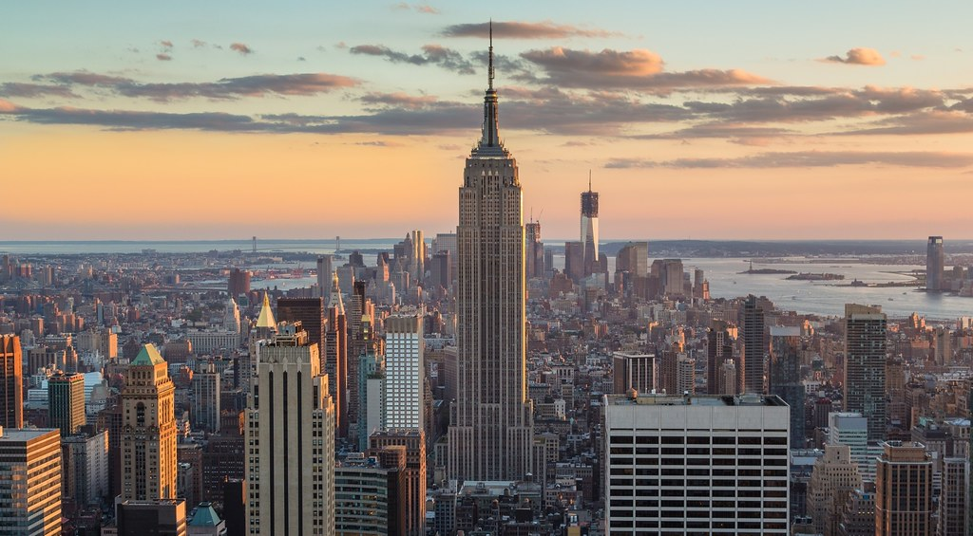
‘Entering the Labyrinth’: Walking the Streets of New York in Paul Auster’s City of Glass (1985) and Jay McInerney’s Bright Lights, Big City (1984).
By Amy McCarthy

Slide 2
Walking in the City
Jean Baudrillard: ‘Nothing could be more intense, electrifying, turbulent, and vital than the streets of New York.’
‘the soft city of illusion, myth, aspiration, nightmare, is as real, maybe more real, than the hard city one can locate on maps, in statistics, in monographs on urban sociology and demography and architecture’ (Jonathan Raban, Soft City (1974), p.2)
Michael de Certeau’s The Practice of Everyday Life (1988) walking results in ‘the indefinite process of being absent and in search of a proper’ (p.103)

Slide 3
Bright Lights, Big City
Forty-seventh Street and Fifth Avenue
Amanda and the mannequin
‘pedestrian spaces, mapped spaces, and utopian spaces […] see that thematically a relationship is established between selfhood, space, and signification’ (Alford, 1995, p.613).
Google Maps May 2019

Slide 4
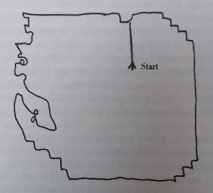
City of Glass
Tower of Babel
‘After fiddling with them for a quarter of an hour, switching them around, pulling them apart, rearranging the sequence, he returned to the original order and wrote them out in the following manner: OWER OF BAB […] the answer seemed inescapable: THE TOWER OF BABEL’ (Auster, 2006, p.70).
Quinn walking around New York without a purpose.
Source: https://www.google.com/maps/d/viewer?mid=1ovDFj7DfjLYq3dbXC6snhKqtQi4&hl=en&gl=us&ie=UTF8&oe=UTF8&msa=0&ll=40.74415710861521%2C-73.987935&z=12

Slide 5
Conclusion
Shop windows as artistic spaces – shop windows convey ‘abstract messages to induce curiosity and further encourage exploration within the store’ (Oh and Petrie, 2012, p.29).
‘New York is also the city that never sleeps but that never remembers; it is a city that is constantly rebuilding, erasing memory as soon as it forms’ (Soderlind, 2011, p.11).
Reinventing the city and the uncertainty of the future.
The city ‘invents itself, from hour to hour, in the act of throwing away its previous accomplishments and challenging the future’ but that is not a liberating act; it is, in fact, a daunting and engulfing concept for the human psyche (de Certeau, 1988, p.91).

Slide 6
Bibliography
Auster, Paul, The New York Trilogy (London: Penguin, 2006).
Banco, Lindsey Michael, ‘Mapping Authorship: Overheard Cartography in Paul Auster’s City of Glass’, Canadian Review of Comparative Literature, 36.4 (2009), 381-398.
Baudrillard, Jean, America (London: Verso, 1988).
Beville, Maria, ‘Zones of Uncanny Spectrality: The City in Postmodern Literature’, English Studies, 94.5 (2013), 603-617.
de Certeau, Michel, The Practice of Everyday Life (Berkeley: University of California Press, 1988).
McInerney, Jay, Bright Lights, Big City (London: Bloomsbury, 2006).
Oh, Hyunjoo & Petrie, Jenny, How do storefront window displays influence entering decisions of clothing stores?, Journal of Retailing and Consumer Services, 19 (2012), 27-35.
Pinkser, Sanford, ‘Soft Lights, Academic Talk: A Conversation with Jay McInerney’, The Literary Review, 30.1 (1986), 107-114.
Raban, Jonathan, Soft City (London: Hamilton, 1974).
Short, John Rennie, Imagined Country: Society, Culture and Environment (New York: Routledge, 1991).
Soderlind, Sylvia, ‘Humpty Dumpty in New York: Language and Regime Chane in Paul Auster’s City of Glass’, MFS Modern Fiction Studies, 57.1 (2011), 1-16.

