Slide 1
The Accidental Leader: A Leadership Study Exploring Volunteer Activity during Covid-19
Susan Walsh, York Business School, York St John University
Dr. Alan Johnston, York Business School, York St John University

Slide 2
Background
Step back and recall March 2020
UK was in the first ‘lockdown, little was known about Covid-19
New legislation, new ‘normal’, new behaviours
This paper contributes to an understanding of this period of time, and acknowledges the unique characteristics that produce this research and evaluates the role of the:
The Accidental Leader

Slide 3
Objectives
Explore how leadership occurred in a group made up entirely of spontaneous volunteers
Identify the role that leadership took in this group
Understand the group perception of leadership
Consider was Accidental leadership present, and if so, what impact it had on success

Slide 4
Literature
The Third Sector (TS) – a complex, dynamic, arguably unstable, mix of organisations that range in size and function
(Handy, 1988, Salamon, 1987, Eakin, 2001 and Perry, 2010)
TS Leadership is an organisation-wide collaboration, with shared accountability that possesses the capability to produce an ‘inclusive approach’ which echoes the values of the organisation.
(Terry et al, 2020)
Leading through Covid necessitated a fluid approach involving leading and unleading.
(Kars- Unuoglu et al, 2022)

Slide 5
The Challenge of Leading Volunteers
Leadership of volunteers is suggested as transactional and transformational
(Fogarty, 2020)
Spontaneous Volunteers “come together for the first time to pursue a specific task or series of tasks prompted by changing, often unexpected situations requiring immediate action”, and not always a welcomed response.
(Britton, 1991, p.405)
Formation of emergent groups that are disinterested with bureaucracy and traditional models of leadership.
(Kendra & Wachtendorf, 2002)

Slide 6
Accidental Leadership
Lack of theoretical and empirical research
Term emerges from The Peter Principle
(Peter & Hull, 1969)
Associated with poor results that cost billions to the economy each year
(CMI, 2017)
The Third Sector needs to “identify non-traditional leaders and create new pathways to leadership development.”
(The Marsh Review, 2013, p.10)

Slide 7
The Case Study
A Narrative Research approach enabling the participants to tell their stories, appropriate to the unknown and emerging research topic of Covid-19 (Edwards, 2016)
An exploratory case study
With arguably unique and interesting characteristics that can be considered an ‘intrinsic case study’, providing benefit and insight (Stake, 1995, p.3)
Considers the narratives of 8 participants alongside a variety of artefacts produced by the group
Categorical content analysis to produce patterns, connections and themes

Slide 8
Findings
“…just fell into our roles and we’d get together on a night-time (remotely) and doublecheck the lists for the next day, so no one missed anything.” Amy
I started it from a phone call…from a GP surgery and I foolishly asked if they needed anything else (laughing).” Kate
“…it mushroomed very quickly into this group who everyone thought I was the leader but in actual fact it led itself… (pause) to a point it led itself”. Kate
“ I’d never met anyone like Kate before…hit it off straight away … and got on board with the story and wanted to help.” Steve
“The more we did the simpler it became…we just evolved… because Kate was doing it”. Louise

Slide 9
The Importance of Community
Achievements included:
Over £11,000 raised
1000+ full sets of scrubs
Made to order and size
Participants aged 8 – 80+
Administrative documents and processes
Logistics Operations
Health & Safety Processes
Social Media Presence
TV/Radio/Newspaper Articles

Slide 10
Discussion
Was leadership present in the group?
What role did leadership take in the group ?
What was the group perception of leadership?
The role of culture in the group
The Accidental Leader

Slide 11
A Working Definition
‘Accidental Leaders achieve success when underpinned by the creation, and active promotion, of a community culture, within which members of the community (organisation) are inspired, motivated, empowered and facilitated to collaborate, create, and share best practice whilst working towards a mutually agreed vision.’

Slide 12
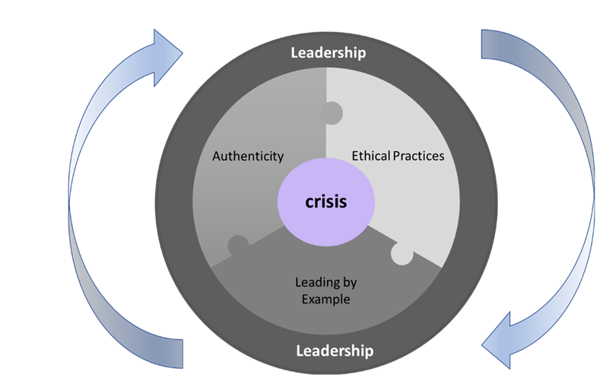
The Leadership Wheel
Walsh & Johnston, 2022

Slide 13
Conclusions
Accidental Leadership can be effective
Community Culture promotes effective behaviours
Unexpected, yet incredibly valuable, impact on volunteer wellbeing
Consider how we can use this new knowledge and develop better practice

Slide 14
Thank you!
Any questions?

Slide 15
References
Britton, N., R. (1991) ‘Permanent Disaster Volunteers: Where do they fit?’ Non-profit and Voluntary Sector Quarterly, 20, pp.395-414.
Chartered Management Institute (2017) Management Manifesto Available from: https://www.managers.org.uk/~/media/Files/insight-policy/cmi-manifesto-2019.pdf (Accessed: 14th January 2022)
Eakin, L. (2001). An Overview of the Funding of Canada’s Voluntary Sector. Ottawa, ON: Voluntary Sector Initiative Working Group on Financing. 9.
Edwards, S. L. (2016) ‘Narrative analysis: How students learn from stories of practice’, Nurse Researcher, 23(3), pp.18-25.
Handy, C. (1988) Understanding Voluntary Organisations, London, Penguin.
Kars-Unluoglu S, Jarvis C, Gaggiotti H. (2022) ‘Unleading during a pandemic: Scrutinising leadership and its impact in a state of exception.’ Leadership, 18(2), pp.277-297. doi: 10.1177/17427150211063382. PMID: 35432572; PMCID: PMC9001057.
Kendra, J. and Wachtendorf, T. (2002) Creativity in Emergency Response After the World Trade Center Attack. (324). University of Delaware: Disaster Research Center.
Marsh, M. (2013) Dame Mary Marsh Review of Skills & Leadership in the VCSE Sector. London: Cabinet Office
Perry, J. L. (2010) The Jossey-bass reader on non-profit and public leadership. San Francisco: Wiley.
Peter, L. J., and Hull, R. [1969] The Peter Principle. Pan Books.
Salamon, L. M. (1987). “Partners in Public Service: The Scope and Theory of Government Nonprofit Relations.” in Walter W. Powell. (ed.) The Nonprofit Sector: A Research Handbook. New Haven: Yale University Press, pp. 99-177.
Stake, R. E. (1995) The art of case study research. Thousand Oaks, CA: SAGE Publications.
Terry, V., Rees, J. and Jacklin-Jarvis, C. (2020) The difference leadership makes? Debating and conceptualising leadership in the UK voluntary sector. Voluntary Sector Review, 11 (1), pp.99-111.
Walsh, S. & Johnston, A. (2022) ‘Volunteering during Covid-19:Leadership Matters – The Case of Scrubs’, Voluntary Sector Review, In Press

