Slide 1
Girl in a band: gender inequality and girlhood in women’s indie music memoirs.
Amy McCarthy

Slide 2
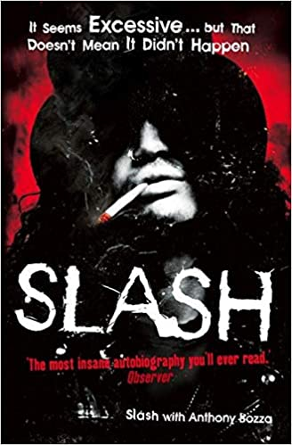

Slide 3
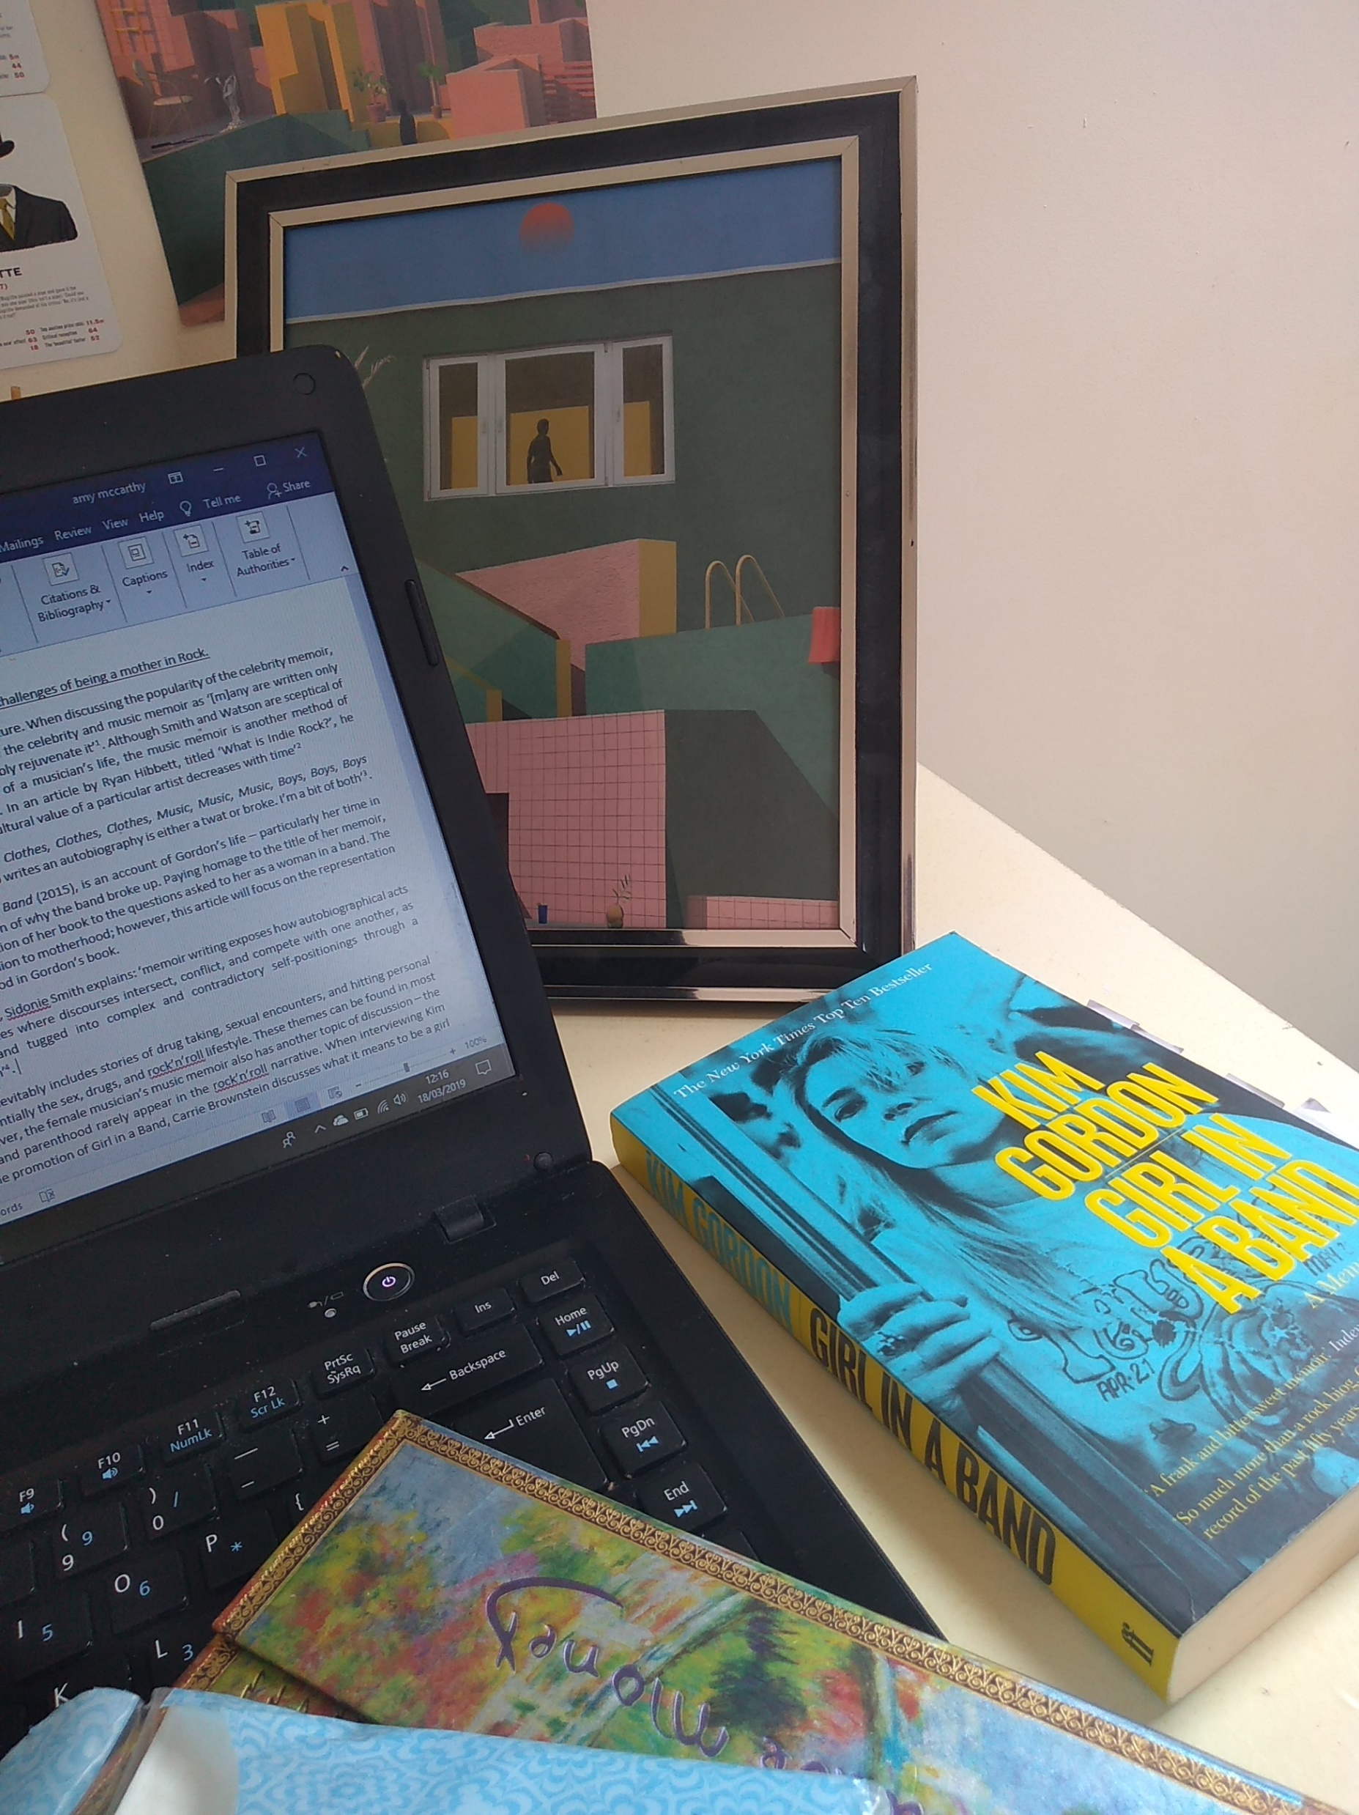
Music memoir:
Overview of childhood and adolescence
High points
Low points
Life lesson
Indie music memoir:
Humble music beginnings
Feeling like an outsider
Finding a community
Women’s indie music memoirs:
Girlhood

Slide 4
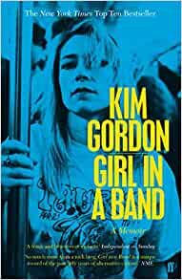
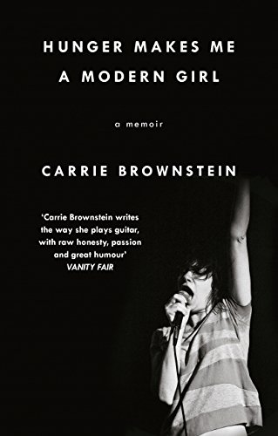

Slide 5
“It is part of the experience to be a woman in a band and asked that question [what is it like being a girl in a band?] – you can’t separate the experience from that question anymore. It becomes a very meta experience.” (Brownstein, 2015)

Slide 6
Conclusion
The problematisation of the term ‘girl in a band’ in the memoirs of the first half of the 2010s highlights one of the many issues in the white patriarchal norm of the indie music genre.
Ultimately the discussion of gender performance and what it represents in the wider genre of indie music is inevitably present in women’s music memoirs. This discussion is currently absent from indie memoirs written by men because gender is not a barrier the musicians who are currently published have encountered.

Slide 7
Bibliography
Babovic, J. (2016) Sleater-Kinney’s Dig Me Out – 33 1/3. New York: Bloomsbury.
Brownstein, C. (2015) Hunger Makes Me a Modern Girl. London: Virago Press.
Clawson, M. (11999) ‘When Women Play the Bass: Instrument Specialization and Gender Interpretation in Alternative Rock Music’, Gender and Society, 13 (2), pp.193-210.
Gardner, A. (2019) Ageing and Contemporary Female Musicians. London: Routledge.
Gordon, K. (2015) Girl in a Band. London: Faber and Faber.
Hersh, K. (2011) Paradoxical Undressing. London: Atlantic Books.
JCCSF. (2015) Sonic Youth’s Kim Gordon with Carrie Brownstein| JCCSF. 11 March. Available at: https://www.youtube.com/watch?v=DPj05HIzFEs&t=1477s (Accessed: 10 June 2021).
Kiedis, A. (2005) Scar Tissue. London: Little, Brown Book Group.
Richards, K. (2011) Life. London: Orion Publishing Group.
Slash and Bozza, A. (2008) Slash: The Autobiography. London: HarperCollins Publishers
Smith, P. (2010) Just Kids. New York: Bloomsbury.
Strong, C. (2011) ‘Grunge, Riot Grrrl and the forgetting of Women in Popular Culture’, The Journal of Popular Culture, 44 (2), pp.398-416.

