Slide 1
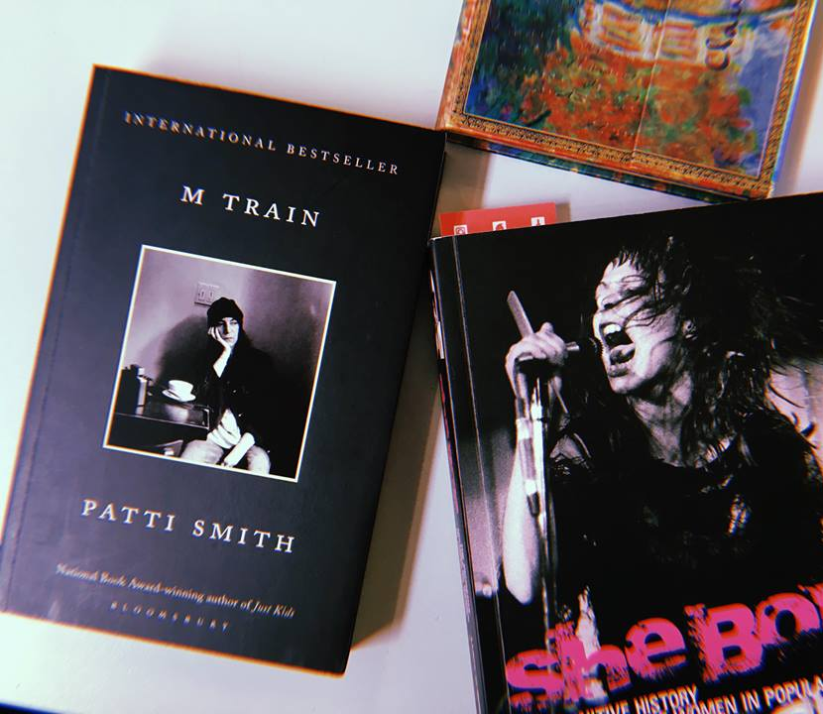
‘I drink too much coffee and think of you often’: Patti Smith’s M Train and the music memoir as a literary text.
Amy McCarthy

Slide 2
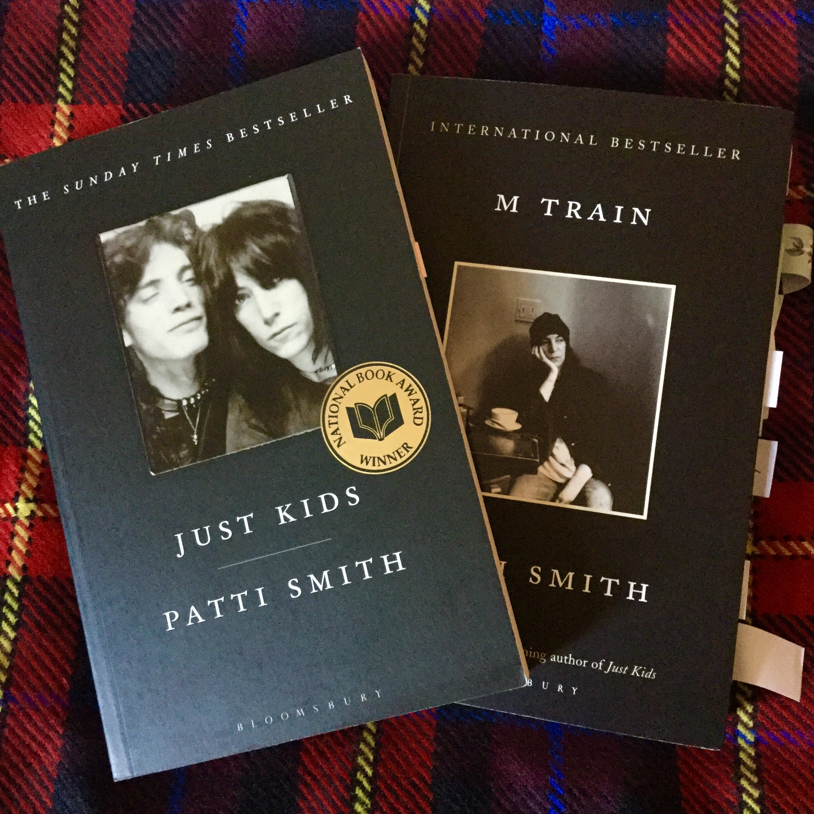
Bricolage and punk.
Punk reproduced the entire satirical history of post-war working-class youth cultures in ‘cut up’ form, combining elements which had originally belonged to completely different epochs. (Hebdige, 2003, p.26)
The ‘bricoleur’ is adept at performing a large number of diverse tasks. (Strauss, 1962, p.14)
It is common knowledge that the artist is both something of a scientist and of a ‘bricoleur’. By his craftmanship he constructs a material object which is also an object of knowledge. (Strauss, 1962, p.14)

Slide 3
Dream of Life
He pulled a notebook out of his pocket and started writing.
- You got to at least look at me, I said. After all, it is my dream.
I drew closer. Close enough to see what he was writing. He had his notebook open to a blank page and three words suddenly materialized.
Nope, it’s mine.
Well, I’ll be damned, I murmured. I shaded my eyes and stood there looking out toward what he was seeing – dust clouds flatbed tumbleweed white sky – a whole lot of nothing.
The writer is a conductor, he drawled.
I wandered off, leaving him to expound on the twisting track of the mind’s convolutions. Words that lingered then fell away as I boarded a train of my own that dropped me off fully clothed in my rumpled bed. (Smith, 2016, p.4)

Slide 4
Photography and the past.
‘Photographs are a way of imprisoning reality, understood as recalcitrant, inaccessible; of making it stand still. Or they enlarge a reality that is felt to be shrunk, hollowed out, perishable, remote.’ (Sontag, 1989, p.163).
Patti Smith: ‘I wanted to take photographs that I can take, and what I can offer is my sensibility and also the access I have. One of the most recent photographs I took was of Sylvia Plath’s grave in West Yorkshire – most people don’t travel as much as I do and so would never have the chance to see it.’ (Baird, 2013, p.43).
‘I have stacks of Polaroids, each marking my own, that I sometimes spread out like tarots or baseball cards of an imagined celestial team. […] Nothing can be truly replicated. Not a love, not a jewel, not a single line.’ (Smith, 2016, p.202)

Slide 5
Why I Write
‘Dreams beget wishes that beget lingering questions: How does one make one’s work a living thing? How can a writer place a living in the hands of the reader? Lost for words I travel backwards.’ (Smith, 2016, pp.274-275).
‘What is the dream? To write something fine, that would be better than I am, and that would justify my trials and indiscretions. To offer proof, through a scramble of words, that God exists. […] Why do we write? […] Because we cannot simply live.’ (Smith, 2017, p.93).

Slide 6
Bibliography
Baird, Daniel, ‘Patti Smith: Making the Past Present’, Border Crossings, 32.1 (2013) 38-45.
Buck, Joan Juliet, ‘The Private World of Patti Smith’, Harper’s Bazaar https://www.harpersbazaar.com/culture/features/a12479/patti-smith-1115/ [Date Accessed 20 June 2018].
Egan, Susanna, Mirror Talk: Genres of Crisis in Contemporary Autobiography (North Carolina: The University of North Carolina Press, 1999).
Hebdige, Dick, Subculture: The Meaning of Style (New York: Routledge, 2003).
Heyward, Anna, ‘The Many Magical Objects of Patti Smith’, New York Times <https://www.nytimes.com/2015/10/07/t-magazine/patti-smith-m-train-objects.html> [Date Accessed 20 June 2018].
Kakutami, Michiko, ‘Review: ‘M Train,’ Patti Smith on All the Roads She Has Taken’, New York Times <https://www.nytimes.com/2015/10/02/books/review-m-train-patti-smith-on-all-the-roads-she-has-taken.html?action=click&module=RelatedCoverage&pgtype=Article&region=Footer> [Date Accessed 20 June 2018].
Kane, Daniel, ‘‘Nor did I socialise with their people’: Patti Smith, rock heroics and the poetics of sociability’, Popular Music, 31.1 (2012) 105-123.
Levi-Strauss, Claude, The Savage Mind (Chicago: University of Chicago Press, 1962).
Noland, Carrie Jaures, ‘Rimbaud and Patti Smith: Style as Social Deviance’, Critical Inquiry, 21.3 (1995) 581-610.
Smith, Patti, Devotion: Why I Write (Yale: Yale University Press, 2017).
Smith, Patti, Just Kids (London: Bloomsbury, 2010).
Smith, Patti, M Train (London: Vintage, 2016).
Smith, Sidonie, A Poetics of Women’s Autobiography: Marginality and the Fictions of Self-Representation (Indianapolis: Indiana University Press, 1987).
Smith, Sidonie and Watson, Julia, Reading Autobiography: A Guide for Interpreting Life Narratives 2nd ed. (Minneapolis: University of Minnesota Press, 2010).
Sontag, Susan, On Photography (New York & London: Anchor Books Doubleday, 1989).
Watson, Julia, ‘Patti Smith Kicks in the Walls of Memoir: Relational Lives and “the right voice” in Just Kids’, Auto/Biography Studies, 30.1 (2015) 131-151.

