Slide 1
Ethnographically-inspired usability testing
Leah Rosenblum Emary
i3 Conference
Aberdeen, 24 June 2015

Slide 3
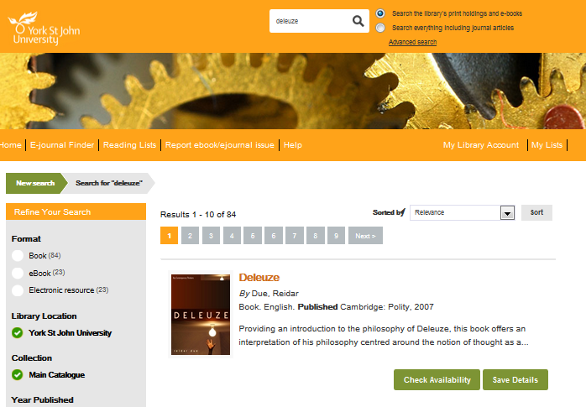
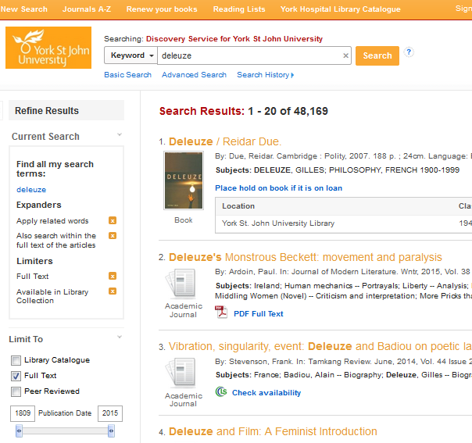
Background

Slide 4
Goals
Observe the user’s first experience of the catalog
Questions to ask:
What do they think?
What works?
What doesn’t work?
Optimize the design and functionality before launch (August 2015)

Slide 5
Test design
Ethnographically-inspired (Emary, forthcoming)
Small sample size drawn from our team’s contacts
Relationship and rapport increase the richness
Relaxed, discussion-based lab setting
Freeform test scenarios
Think aloud protocol

Slide 6
The test computer
1 moderator, 1 greeter, 1 technical support
12 participants thought aloud during individual time slots
3 scenarios (20-30 minutes)
Video capturing gesture and affect as well as their screencast.

Slide 7
Testing day(s)
Everyone showed up, engaged and enjoyed themselves
Sweets, arts and crafts and discussion
Voucher for a free hot drink from Costa Coffee
Tests took place over the course of 2 weeks
Reception area outside the testing room. Participants also created process maps while waiting for their test to begin.

Slide 8
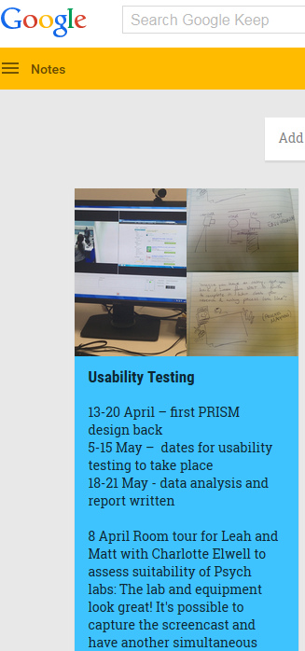
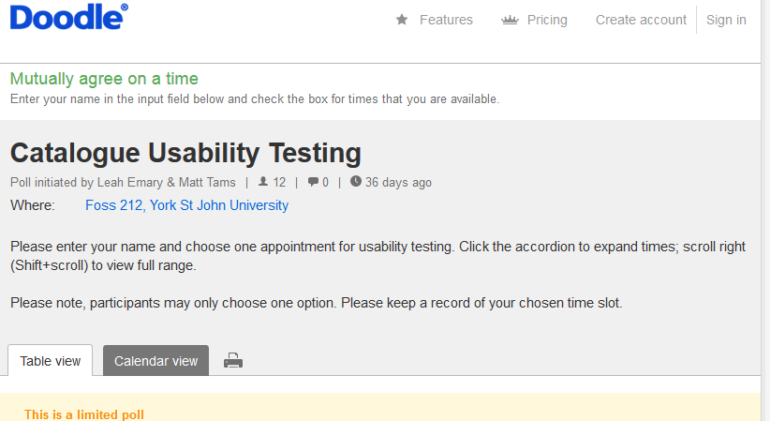
How we managed things

Slide 9
Initial results
Major and minor problems led to changes in:
layout
colours
link prominence
language
advanced search
Confident that users will like the ‘look and feel’ of the new catalogue
Comments and problems coded in NVivo

Slide 10
Initial results
The think aloud protocol is powerful
The user believing they were doing the ‘right’ thing when they had actually made an error
This happened consistently and pointed to a ‘major error’

Slide 11
Initial results
‘Thank you for testing us properly. So many times we’re asked for feedback on something in a way that’s not productive.’ –RA1

Slide 12
Challenges
Time, time, time
Qualitative data is voluminous
No undergraduate participants
Prioritizing what we change
Managing user expectations
Balancing consistency with a natural, relaxed environment

Slide 13
What next?
Through a Jungle by andywon. https://flic.kr/p/6XrXyT Used under CC BY-NC-ND 2.0

Slide 14
Want to talk or reuse?
Leah Emary
l.emary@yorksj.ac.uk
@LeahEmary
LeahEmary
Design document (CC BY 4.0) https://docs.google.com/document/d/1iXlVef_1klXZvYYIjp9azXx3UwuqhA88iOankfwQ_Ck/edit?usp=sharing
Planning document (CC BY 4.0) https://docs.google.com/document/d/1AooKerzP5w3JsPqgCWI27ZanTBBrw8rDNn9lRNoaOvw/edit?usp=sharing

Slide 15
Bibliography & reference list
Asher A.D. and Miller S. (various) ERIAL Publications. Available from http://www.erialproject.org/publications/ [Accessed 19/11/2014].
Asher A.D. and Miller S. ([2011]) So You Want to do Anthropology in Your Library? Or A Practical Guide to Ethnographic Research in Academic Libraries. Available from http://www.erialproject.org/publications/toolkit/ [Accessed 11/11/2014].
Barnum C.M. (2010) Usability Testing Essentials: Ready, Set... Test!. Burlington, MA, Morgan Kaufmann (Elsevier).
Bowler L., Koshman S., Oh J.S., He D., Callery B.G., Bowker G. and Cox R.J. (2011) Issues in user-centered design in LIS. Library Trends, 59 (4), pp.721-752.
Delcore H.D., Mullooly J., Scroggins M., Arnold K., Franco E. and Gaspar J. (2014) The Library Study at Fresno State. Fresno, CA, Institute of Public Anthropology, California State University, Fresno.
Emary L.F.R. (forthcoming) When (and when not) to use ethnography for LIS research. In: Priestner A and Borg M eds. UX in Libraries. Surrey, Ashgate. Available from http://ray.yorksj.ac.uk/id/eprint/641 [Accessed 17/06/2015].
Foster N.F. and Gibbons S. (2007) Studying Students: The Undergraduate Research Project at the University of Rochester. Chicago, Association of College and Research Libraries.
Gabridge T., Gaskell M. and Stout A. (2008) Information Seeking through Students’ Eyes: The MIT Photo Diary Study. College & Research Libraries, 69 (6), pp.510-523.
Greifeneder E. (2012) Does it Matter Where we Test? Online User Studies in Digital Libraries in Natural Environments. PhD Thesis, Institut für Bibliotheks- und Informationswissenschaft, Humboldt Universität zu Berlin.
Seadle M. (2000) Project Ethnography: An Anthropological Approach To Assessing Digital Library Services. Library Trends, 49 (2), pp.370-85.
Usability Consulting Services (2002) User Centered Design Services. Bloomington, IN, Indiana University.

Slide 16
Thank you
Especially to Matt Tams for moderating and Charlotte Elwell for her technical expertise (and patience)

