Slide 1
TRAVELLING BY CANOE: DIALOGUE IN THE CONTEXT OF PROFESSIONAL RECOGNITION
CLICK HERE TO
SEE THE VIDEO PRESENTATION
F. Smart, V. Davies, M. Dransfield, S. Floyd

Slide 2
Contact Details:
Please get in touch if you want to know more, we would also really like to here your feedback on the model and its usefulness for your own practice. Thanks!
Vicky Davies v.davies@ulster.ac.uk
Dr Mark Dransfield m.dransfield@yorksj.ac.uk
Dr Sarah Floyd s.floyd@ulster.ac.uk
Professor Fiona Smart f.smart@napier.ac.uk

Slide 3
Before starting
In answer to the question as to who or what is a pedagogue, Taylor (1993) responded:
“Traditionally the pedagogue was a servant who accompanied the learner to their place of learning [...] the essential challenge to a Freierean educator is to become a companion to the learner, to get alongside them, to encourage, to help them to be creators and not consumers of their own learning …”

Slide 4
Our Project: Curiosity, Dialogue and Us
Purpose: to pin down the essence of effective dialogic assessment
Methodology: Collective Autoethnography: A Method for Shared Learning and Supportive Challenge
Our own professional conversation - the value of talking with each other, of sharing our stories
Enabled us to explore experiences and co-create a narrative
How:
3 one-hour virtual conversations where we explored our experiences
A personal artefact that represented our individual experience as a trigger
A 4th final conversation to agree themes and where the metaphor was crystalised

Slide 5
Our context
UKPSF Fellowship
Please see Smart et al 2019 for more information on the UKPSF/ Fellowship and its categories
Our commitment to authentic assessment
assessment which is meaningful to those undertaking it, with purpose and relevance beyond passing an assignment (Sambell, 2016)

Slide 6
Things to note
Individuals seeking Fellowship recognition are practitioners in higher education
They are experienced
The decision as to whether or not the individual meets Fellowship requirements is made by experienced peers against an international benchmark
Commonly claims for recognition are made in written format and assessed at a distance from the individual
Increasingly some sort of dialogue is used to talk with the individual
Not all dialogues are the same in intention or format
The three in place in our universities share some commonalities
Conversation with a purpose, leading to a decision
We sought to better understand the conditions in which it thrives

Slide 7
In our conversation, a metaphor emerged

Slide 8
The model
1
Building the vessel
Getting on Board
Settling in & settling down
Navigating the space
Forward wash
2
3
4
5
©Davies, Dransfield, Floyd and Smart (2020)

Slide 9
TRUST
Building the vessel
Focus on strengths
Valuing their voice
Removal of linguistic barriers
Getting on board
Safe space
Can be challenging; fear of exposure
Imposter syndrome
Settling in/settling down
Critical stage
Assessors as hosts
Navigating the space
PSF focus
Gentle steerage by assessor: may need to be more exigent
Reciprocal learning
Keeping an open mind
Listening as much as talking
Forward wash
Good APC experience – continued SoTL engagement
more inclusive […] a better opportunity […] to talk about what they were doing in a way that would do justice to their experience
a ‘safe space’ in which participants ‘will not be challenged in a way which makes them feel uncomfortable’
‘where the practice starts about feeling able to open up about what is an intensely personal thing and something you don't talk about to everybody all the time’
'we've got to nudge them through the PSF slalom course...It's not just you’re steering a conversation you're actually steering something that's going to make a professional recognition decision’
'what we hope is that it's got that persistence - they carry on down the river, in the canoe’
©Davies, Dransfield, Floyd and Smart (2020)

Slide 10
Emergent Reflections
The power of the professional dialogue to transform thinking
The potential of the professional dialogue to nurture a culture of reciprocal learning
The significance of the conditions in which the professional dialogue takes place – voice, valuing, respect (it is a relational encounter)
The high degree of skill needed on the part of the assessor
The critical importance of the design, not least the intended purpose of the dialogue

Slide 11
Potential Transferability?
Mentoring Conversations
Post-graduate Certificates in Academic Practice
Apprenticeship Dialogues
Supervisory meetings
Appraisals
More generically in other oral based assessments……

Slide 12
Back to where we started
“Traditionally the pedagogue was a servant who accompanied the learner to their place of learning [...] the essential challenge to a Freierean educator is to become a companion to the learner, to get alongside them, to encourage, to help them to be creators and not consumers of their own learning …”

Slide 13
What happens if ..
You bring together a commitment to authentic assessment with the intention to enable reciprocal learning?
What then might change in the way we choose to see our place and that of the learner in the learning process?
What alters in our practice if we imagine we are travelling by canoe?

Slide 15
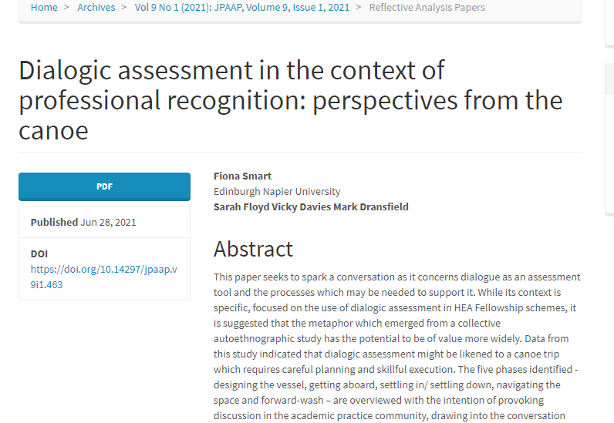
Recommended Read!
https://jpaap.napier.ac.uk/index.php/JPAAP/article/view/463

Slide 16
Key References
Adamson, J., & Muller, T. (2018). Joint autoethnography of teacher experience in the academy: exploring methods for collaborative inquiry. International Journal of Research & Method in Education, 41(2), 207-219.
Asghar, M. & Pilkington, R. (2018). The relational value of professional dialogue for academics pursuing HEA fellowship. International Journal for Academic Development, 23(2), 135-146.
Robertson, A., Cleaver, E., & Smart, F. (2019). Beyond the metrics: identifying, evidencing and enhancing the less tangible assets of higher education. QAA Scotland.
Roxå, T. & Mårtensson, K. (2009). Significant conversations and significant networks – exploring the backstage of the teaching arena, Studies in Higher Education, 34:5, 547-559
Sambell, K. (2016). Assessment and feedback in higher education: considerable room for improvement?. Student Engagement in Higher Education Journal, 1:1. Retrieved from https://sehej.raise-network.com/raise/article/view/392
Taylor, P.V. (1993) The Texts of Paulo Freire. Open University Press.

