Slide 1
Fill in the gaps question types
For mere mortals
Marcus Green
York St John University | www.yorksj.ac.uk

Slide 2
Moodle Cloze Question Type
Powerful but complex
Complete the following phrase The {1:MULTICHOICE:= cat~rat~dog} sat on the {1:MULTICHOICE:= mat~rug~hat}
Difficult even for programmers
York St John University | www.yorksj.ac.uk
Notes:
The Moodle core Cloze (Embedded answer) question type has a complex syntax that is difficult to learn even for experienced programmers. It is powerful and offers many features but the syntax for even the simplest “fill in the blank” question type is not trivial.

Slide 3
Moodle Cloze Limitations
No Drag Drop (welcome to 1996)
Hard to read/update question text
Inaccessible feedback
Oddities such as case sensitivity
{:mc:=cat} breaks without explanation
{:MC:=cat} works OK.
York St John University | www.yorksj.ac.uk
Notes:
The Moodle core Cloze (Embedded answer) question type has a complex syntax that is difficult to learn even for experienced programmers. It is powerful and offers many features but the syntax for even the simplest “fill in the blank” question type is not trivial.

Slide 4
People don’t use Close
Ask Moodle trainers if they teach Cloze?
They laugh
York St John question type usage
59641 Instances of Multiple Choice
758 Instances of Cloze
York St John University | www.yorksj.ac.uk
Notes:
The Moodle core Cloze (Embedded answer) question type has a complex syntax that is difficult to learn even for experienced programmers. It is powerful and offers many features but the syntax for even the simplest “fill in the blank” question type is not trivial.

Slide 5
Gapfill Instructions
You are now going to memorise
ALL you need to know
To use the Gapfill question type

Slide 6
Ready ?
It’s a single 7 word sentence…
Put square braces around the missing words
Got that?

Slide 7
The Gapfill Alternative
Put square braces around the missing words
The [cat] sat on the [mat]
Gapfill, Dropdowns or Dragdrop
Welcome to 2015 (it works on Mobile)
York St John University | www.yorksj.ac.uk
Notes:
The Gapfill question offers some of the functionality of the Cloze type but with a very simple to learn syntax which can be summarized in a single 7 word sentence. “Put square braces around the missing words”.

Slide 8
DragDrop (default)
York St John University | www.yorksj.ac.uk
Notes:
The way a question behaves can be changed from the settings in the editing page. This can be useful for making a copy of a question and re-purposing it. For example the students may be give a version with prompts (i.e. the words they can drag into the gaps). Then a copy is made and the Display Answer option is switched to gapfill and they will see no prompts at runtime.

Slide 9
DragDrop (default)
York St John University | www.yorksj.ac.uk

Slide 10
Dropdown
York St John University | www.yorksj.ac.uk
Notes:
Note that all dropdowns will display the same alternatives (unlike the Cloze type where you can control what is seen in each dropdown)

Slide 11
Gapfill (no prompts)
York St John University | www.yorksj.ac.uk

Slide 12
Details
Clues are shuffled for each attempt
Coded to work with touch/mobile
Accessible (type into the fields)
York St John University | www.yorksj.ac.uk

Slide 13
Unique to Gapfill
Categories (Which is canine/feline)
Marks for blank gaps
Ignore duplicates
York St John University | www.yorksj.ac.uk

Slide 14
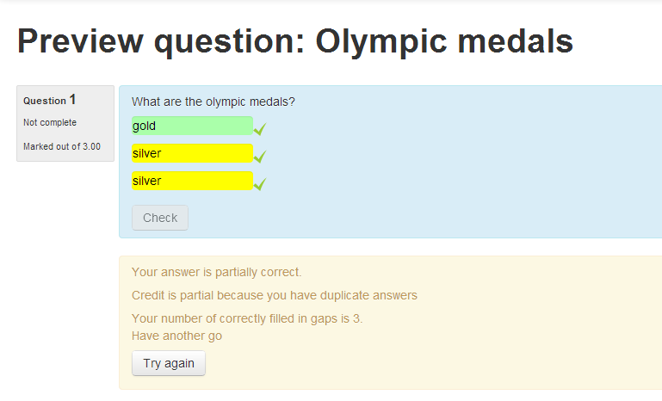
Ignore duplicates
York St John University | www.yorksj.ac.uk
Notes:
In this example the student may enter answers into any field. However they will not get marks for gaming the system. In the above example although silver is a correct answer they will only get one mark because duplicates are discarded. These fields were created using the logical or operator the “broken bar” as in
[gold|silver|bronze] [gold|silver|bronze] [gold|silver|bronze]

Slide 15
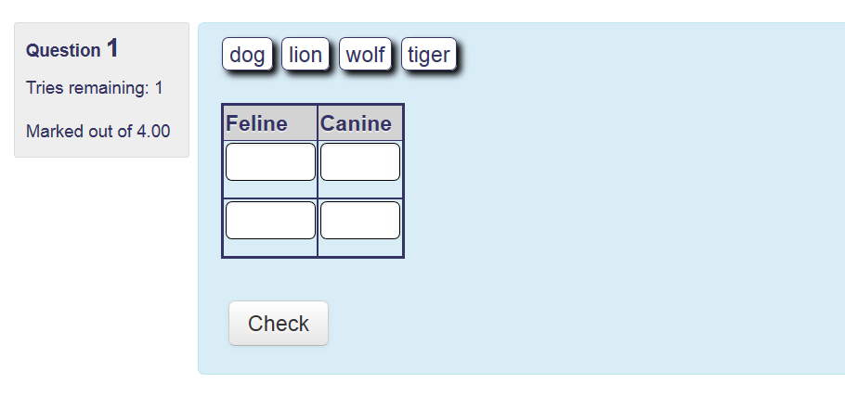
Tables with Categories
York St John University | www.yorksj.ac.uk
Notes:
The question type includes a CSS class called gapfilltable which creates the gridlines when added as <table class=gapfilltable

Slide 16
Comes with 20 Sample Questions
<table class="gapfilltable" border="2" rules="rows"> <tbody> <tr><th>Feline</th><th>Canine</th></tr> <tr><td>[tiger|lion]</td><td>[dog|wolf]</td></tr> <tr><td>[tiger|lion]</td><td>[dog|wolf]</td></tr> </tbody> </table>

Slide 17
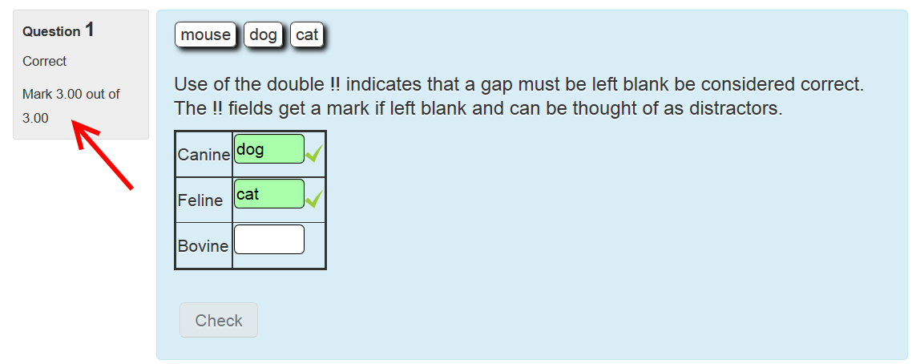
The Double Not !!

Slide 18
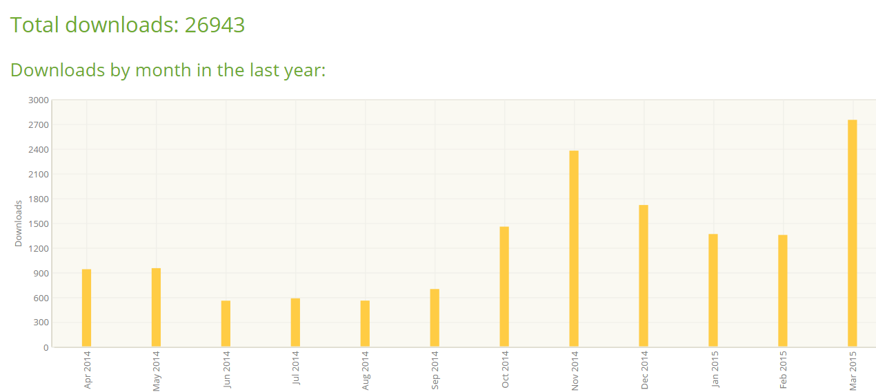
Quite Popular
York St John University | www.yorksj.ac.uk

Slide 19
Not drunk the Kook Aid?
Export to Cloze
No lock in
Limited by Cloze features ☹
https://github.com/marcusgreen/moodle-gapfill_to_cloze

Slide 20
Further information
Rapid response to bug reports
Still being improved
All development by Marcus Green
Contact details: m.green1@yorksj.ac.uk
York St John University | www.yorksj.ac.uk

