Slide 1
Towards a socio-material understanding of the formation of teachers' professional knowledge
Ruth Unsworth: PhD candidate, Durham University, UK ruth.tromans@durham.ac.uk
Assistant Head, The British School in Tokyo

Slide 2
Towards a socio-material understanding of the formation of teachers' professional knowledge
Why research how teachers’ professional knowledge has been formed?
Literature review
Theoretical framework – a sociology of associations
Ethnographic methodology and analysis through actor-network theory
Exemplar data and early findings
Limitations and next steps

Slide 3
Why research how teachers’ professional knowledge has been formed?
Expectations of teachers’ professional knowledge is in constant flux – political, societal, global influences
Constant change is often linked to a drop in teachers’ morale and wellbeing - a feeling of no longer being the expert
Being able to show teachers how professional knowledge is changed – the influences upon it – gives back certain control to teachers…
… whilst adding detail to the dialogue around professional knowledge formation

Slide 4
What is professional knowledge in teaching:
Dominant influence of Shulman’s CK, PK, PCK theory
Differences in scripted definitions - a plethora of definitions (Evetts 2009)
How it is formed:
No unifying theory
Dominant discourses highlight:
The influence of formal study of pedagogy
The influence of politics
The influence of practice: experiential knowledge
The influence of the physical world
The influence of evidence-based practice

Slide 5
Theoretical framework
As an ethnographer, we seek knowledge of ‘parts of the world more or less as they are experienced and understood in the everyday lives of people who ‘live them out’.’ (Crang & Cook, 2007, p. 1)
Explores teachers’ professional knowledge as a construction resulting from complex socio-material interactions
Interactions which involve multiple actors – both human and material
Therefore, to facilitate the tracing of these actors, I employ an actor-network theory (ANT) lens to my ethnographic data
Trend emerged for text-based actors: analysis drawn from literacy studies, which complements ANT, foregrounding of the socio-material formation of meaning

Slide 6
ANT and Literacy Studies
ANT:
A sociology of associations
Actor = anything around us which exerts influence
Actors can be both human and material
Knowledge and belief seen as performed into being by actors which work together, creating actor-networks (Latour 2005)
Literacy Studies:
Socio-material: people interact with texts to create meaning (Barton, 2017)

Slide 7
Methodology
Where?
Well-regarded three-form entry primary school (students 3-11 years old), in the north of England
Who?
Teachers, deputy principal, principal, subject leaders, National Centre for Excellence in the Teaching of Mathematics (NCETM) trainers
What?
Shadowing teachers (May-July 2018) - observational field notes
Semi-structured interviews
Documents and resources which were interacted with/ created by teachers

Slide 8
The case of reframing teacher knowledge
‘Maths mastery’ introduced as a pedagogical approach
Changes to teachers’ content knowledge (CK) and pedagogical content knowledge (PCK) for the teaching of mathematics
Using the notions of ‘following the actors’ and ‘translation’ from ANT, I traced the actors involved in this reframing
Texts played a key role in professional dialogue at every stage
Intertextual hierarchy emerged which translates the approach from policy into practice

Slide 9
The case of reframing teacher knowledge: Data
Shadowing teachers (May-July 2018) - observational field notes from instances
Semi-structured interviews with Maths leaders
Documents and resources which were interacted with/ created by teachers during the process of adopting the mastery approach

Slide 10
Translation
‘…what happens when entities, human and non-human, come together and connect, changing one another to form links. Entities that connect eventually form a web or network of action and things, and these networks tend to become stable and durable.’
(Fenwick 2010, p.182-3)

Slide 11
Photos of each tier of docs and talk over about how used and created
Drawing on theories of literacy as social practice (Barton, 2017), the interactions between teachers and networks of texts are presented as shaping collaborative negotiations of professional knowledge.
The power of these text-teacher networks as part of this inter-relational formation of professional knowledge
, highlighting inter-textual hierarchies and the translation of policy/theory into context-based professional knowledge and practice

Slide 12
Documentary data overview - Moments of translation of the mastery approach
National level | Multi-academy trust level | School level | Teaching team planning level | Classroom level
National curriculum and assessment documents NCETM documents, website and training materials Maths No Problem textbooks Web-based planning documents White Rose planning document | ‘Landmarks’ document ‘Small steps’ document Maths policy document(s) Teacher Research Group reflection document | Year-by year planning guidance Staff training slide-decks and handouts Reasoning icons for use across school Planning format (‘S plan’) for use across school School development and action plans | Weekly collaboratively-planned slide decks and resources Weekly planning using S planning format for small steps Team/ individual research project reflections linked to school development plans | Slide-decks used to structure lessons and ‘maths voice’ of teacher and students ‘Live marking’ concept in books Reasoning icons Paper resources and other materials represent concepts and shape learning Working wall collects language and central ideas

Slide 13
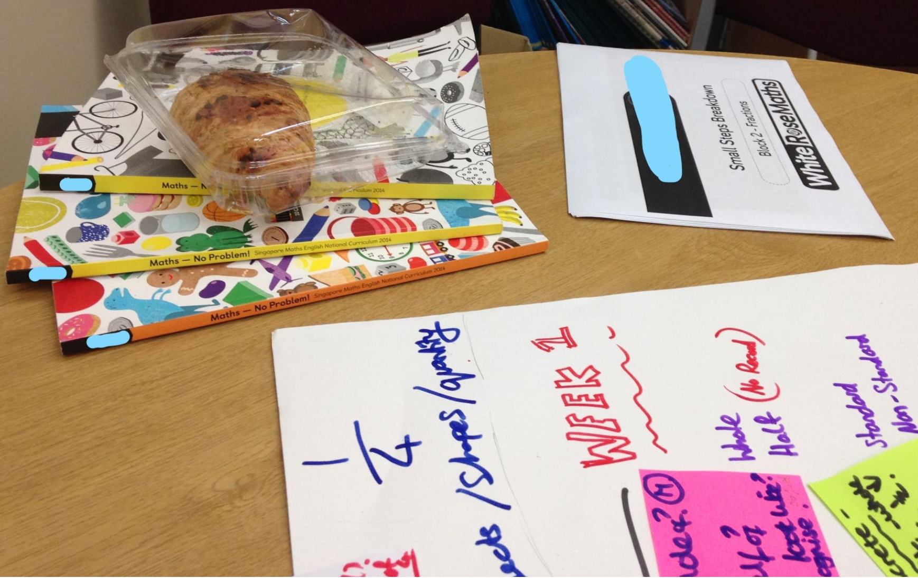
Examplar data: Planning session
Frances now directs everyone’s attention to the items on the table and files open on the screen on his PC. He introduces the task: to create an ‘S plan’ for the next Maths unit, which will last for 2 weeks. The teachers discuss aims, small steps and teaching ideas, dipping in to the different resources, comparing the ideas contained there and deciding the most relevant for their students in light of previous experiences and national expectations.
- Fieldnotes, week 3: Teaching team weekly planning session
Documents often act as reference points, mobilising knowledge into practice, reframing professional dialogue in the world of mastery

Slide 14
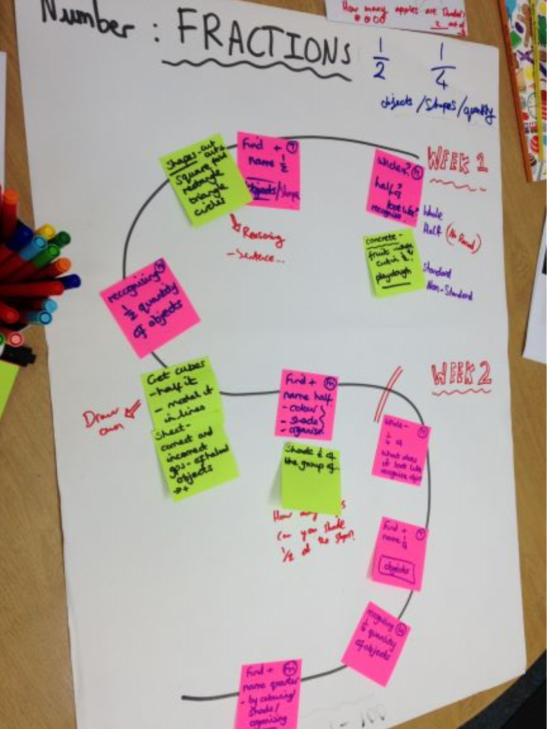
Exemplar data continued: These actors come together into a new translation: a plan of professional action
Small steps in learning (pink) referenced small steps document, national curriculum expectations and teachers’ knowledge of the students
Teaching strategies (yellow) – teachers referred to several national, MAT and school-level documents as well as their past teaching experiences

Slide 15
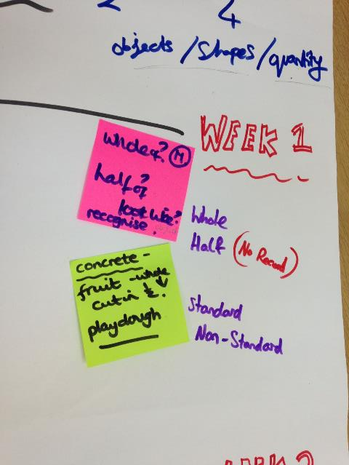
Exemplar data continued: These actors come together into a new translation: a plan of professional action
Mastery approach language (repeated phrases with attached specifications of how to teach) permeates all documents
‘our complete culture shift in our approach has been driven by change in vocabulary’

Slide 16
Obligatory passage points
an entity through which everything in the network must flow at some point
(Law 1994)

Slide 17
Leaders as obligatory passage points – documents where a leader is a key actor
National level | Multi-academy trust level | School level | Teaching team planning level | Classroom level
National curriculum and assessment documents NCETM documents, website and training materials Maths No Problem textbooks Web-based planning documents White Rose planning document | ‘Landmarks’ document ‘Small steps’ document Maths policy document(s) Teacher Research Group reflection document | Year-by year planning guidance Staff training slide-decks and handouts Reasoning icons for use across school Planning format (‘S plan’) for use across school School development and action plans | Weekly collaboratively-planned slide decks and resources Weekly planning using S planning format for small steps Team/ individual research project reflections linked to school development plans | Slide-decks used to structure lessons and ‘maths voice’ of teacher and students ‘Live marking’ concept in books Reasoning icons Paper resources and other materials represent concepts and shape learning Working wall collects language and central ideas

Slide 18
Conclusions
Emerging from this perspective is an argument for greater consideration, both in terms of political as well as theoretical contexts, of the mediating role of texts within the formation of teacher professionalism. Scripted definitions of teachers professionalism are problematised and it is posited that professionalism is instead best understood and developed from a view centred within its socio-material formation.

Slide 19
Limitations Contribution and next steps
Detailed description of how a situated iteration of professionalism has been performed into being – unique view on the formation of elements such as (future analysis):
CK and PCK
Experiential knowledge
Teacher talk
Motivations
Moral aspects of professionalism
A view from which can be seen political and contextual actors, rendering teacher professionalism malleable
Resulting knowledge/ belief/ action is seen as temporarily stabilised – can be disrupted by actor introduction/ removal/ change
An ANT approach is descriptive, not interpretative: it doesn’t explore the ‘why’

Slide 20
Thank you for your attention.
Ruth Unsworth: PhD candidate, Durham University, UK ruth.tromans@durham.ac.uk

