Slide 1
Transforming Student Outcomes – the Holistic Grail
Dr Sue Jones
York St John University

Slide 2
Holistic Programme Design
I embed transferable skills, laboratory competencies and subject-specific knowledge, emphasing personalised learning through holistic programme design
ALL of my students (regardless of their wider demographic background) are supported to achieve excellent outcomes.
This is true widening participation (WP) - removing barriers and increasing access for all and improving graduate outcomes and employability.

Slide 3
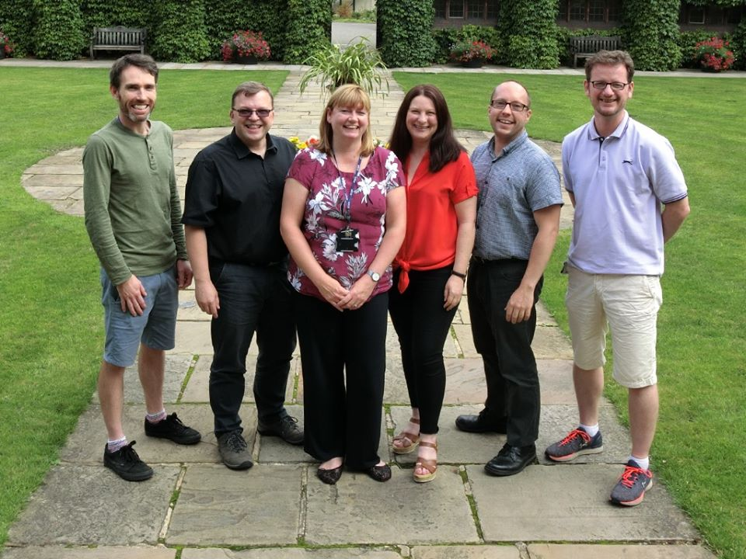
Different Starting Points / Experiences
Our students start University at different points and we need to help them to build a path to succeed

Slide 4
The Five Ws for Holistic Programme Design
Who is sitting the assessment – is it appropriate?
What is the purpose - LO / experiential learning
Why choose this assessment? Is it authentic / developmental?
Where does the assessment fit / level / spiral curriculum / constructivism
When is it? Clear organisation / avoid clustering

Slide 5
Assessment Strategy
Key Skills
Maths
Scientific
writing
Anatomy and
Physiology
Essay
Biological
Molecules
Portfolio
In-class test
Cell
Biology
Lab report
Exam
Biochemistry
Practical test
Microbiology and
Immunology
Presentation
Case Study
Semester 1
Semester 2

Slide 6
Level 4 Key Skills Marks for Each Assessment Type (Over 4 Cohorts)
Formative
Summative
Maths
First
Essay
Upper Second
Lower Second
Scientific
Comprehension
Third
Fail
Laboratory
Report
Statistics

Slide 7
Tracking the Students through the Programme

Slide 8
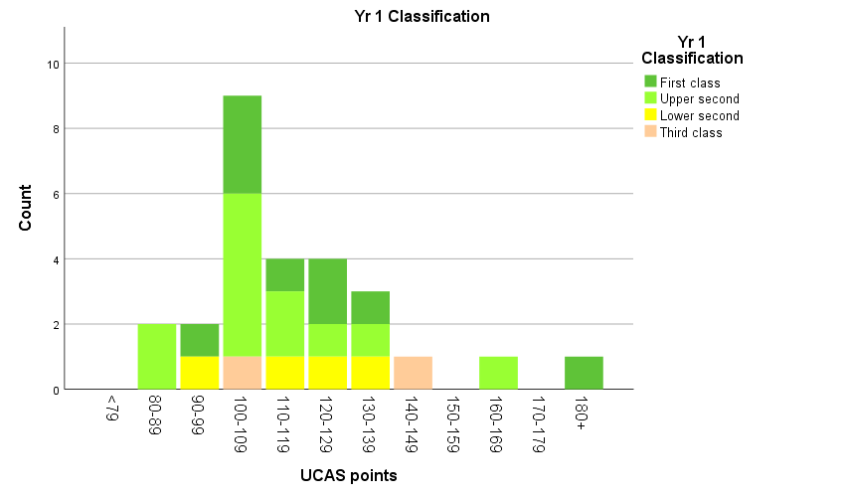
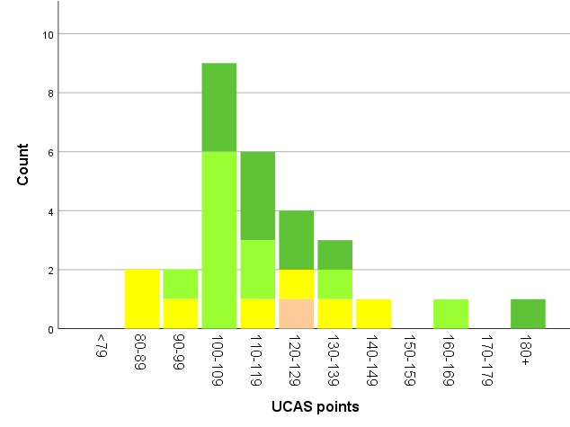
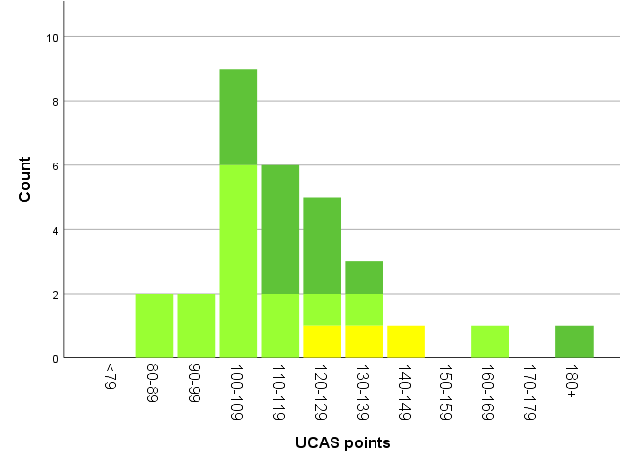
Student Marks versus UCAS Points at Entry
Level 4 Mean Marks
Level 5 Mean Marks
Final Degree Award
ALL students with <120 UCAS points achieve
2.1 or 1st class degrees
No 3rd class degrees awarded to date

Slide 9
Degree Awards
3x Level 6 cohorts graduated to date
Total of 43 students with A-level, Access / BTECs
37/43 students awarded 1st or 2.1 = 86%
Year | 1st | 2.1 | 2.2 | Total
2017/18 | 7 | 4 | 1 | 12
2018/19 | 5 | 11 | 2 | 18
2019/20 | 11 | 9 | 3 | 23

Slide 10
Removing Awarding Gaps
Conclusion: detailed statistical analysis shows no differential outcomes for students with respect to any of the following –
UCAS points at entry
IMD (Index of multiple deprivation) or POLAR groups
Ethnicity
Gender
Age or
First in family status

Slide 11
Conclusions
Reflections
Issues / barriers: can be time intensive, but can be scaled up
Greatest impact: students who may be struggling / mid-level achievers
Not grade inflation, just uplift of mid-range marks
Benefits
Successfully identify / address barriers to transform student outcomes
>85% 1st or 2.1 degree awards to date
100% first and second cohorts in post-graduate study or graduate employment within 6 months

Slide 12
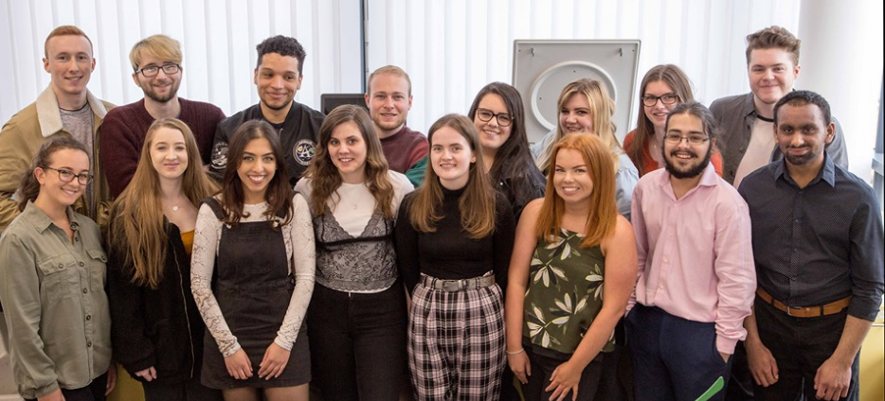
Outcomes – Happy Students! Excellent Degree Awards 100% employability

Slide 13
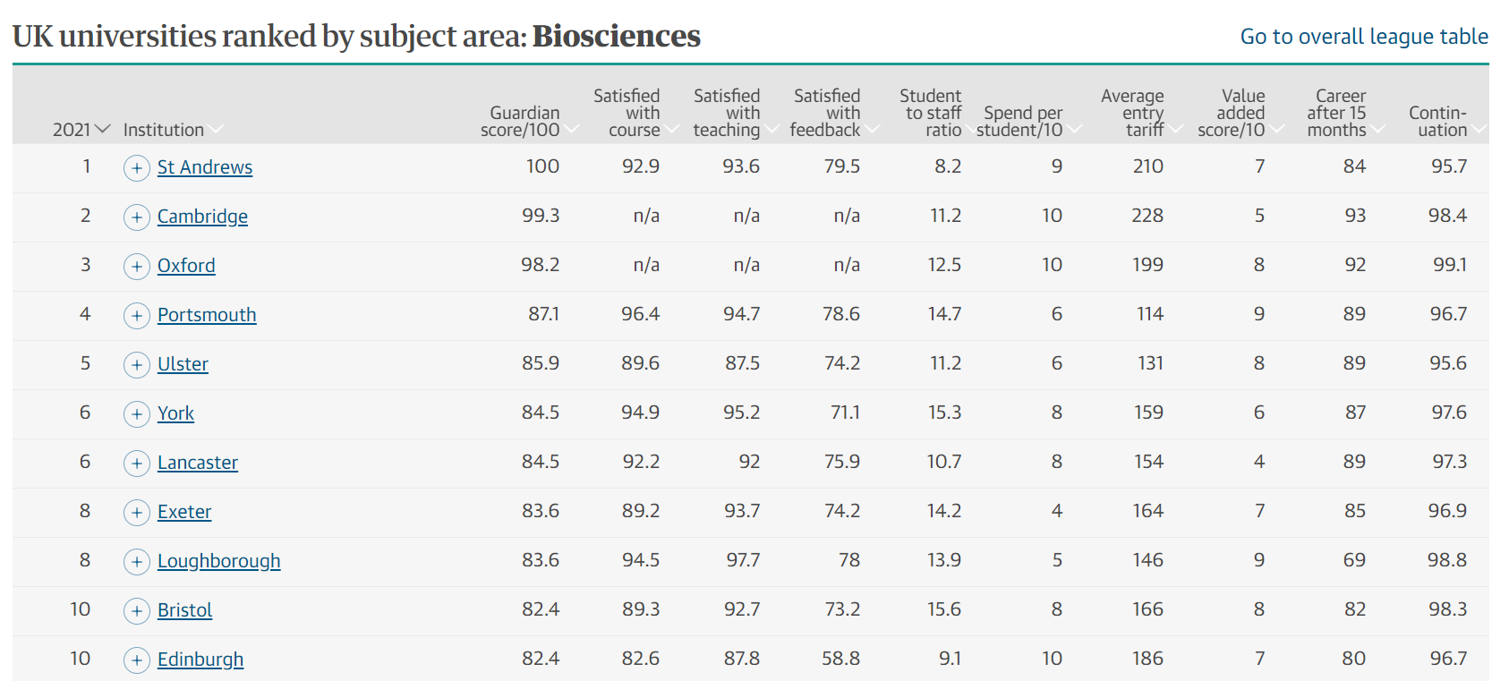
Guardian University Guide 2021
We are 16 / 105 for Biosciences

Slide 14
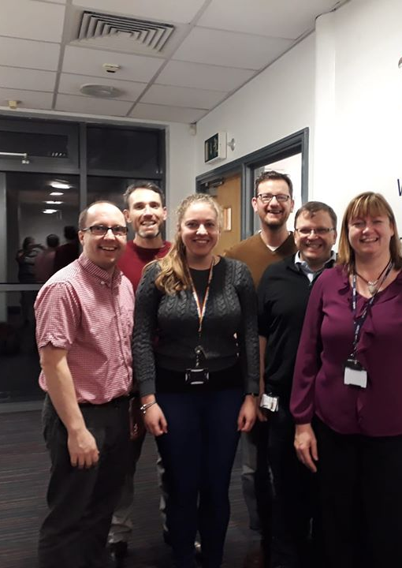
Acknowledgements
Dr Emma Stewart (University of York PhD Student and intern)
Dr Jim Taylor – statistics
Whole Biomed team at YSJ
Thank you
Any questions?

