Slide 1
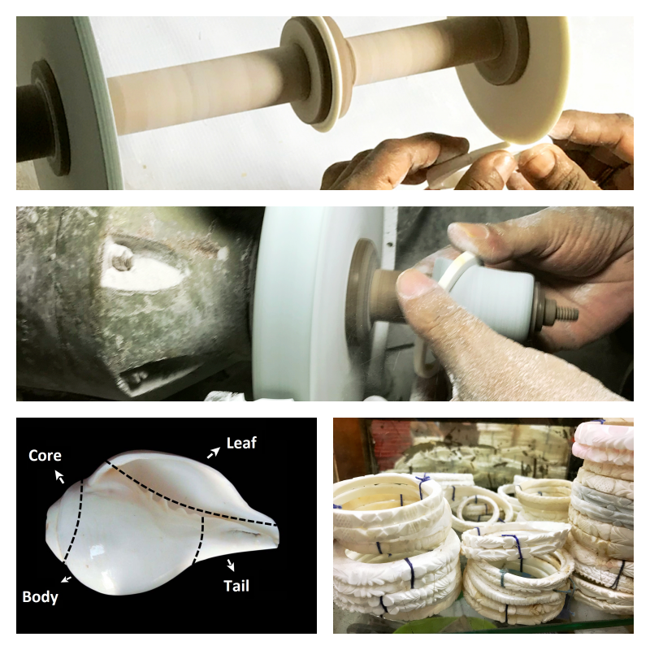
Re-establishing Conch Shell Industry in Bangladesh
Present situation of the industry
  Uses, Production Process, Sales, Profit, Price
Challenges behind the growth
  Market loss for domestic product
Strategic framework to re-establish the industry

