Slide 1
How can set effectiveness be improved by incorporating Person-Centred theory?
Dr Gary Shepherd
Senior Lecturer & Research Lead
Counselling Department, York St John University
8th International Action Learning Conference
York St John University 17-19 April 2023

Slide 2
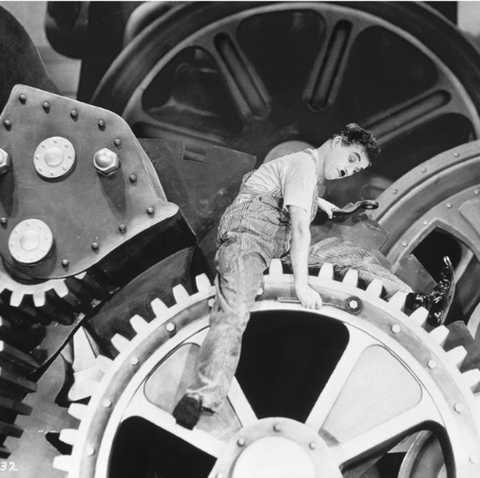
How can set effectiveness be improved by incorporating Person-Centred theory?
Could the effectiveness of an action learning set be improved through the adoption of key elements of the Person Centred Approach (PCA) developed by the humanistic counsellor and academic Carl Rogers.
Set effectiveness in this respect means how effectively set facilitators and set members can connect with one another on a humanistic level
How this behaviour may encourage greater ‘authenticity’, reflection and problem solving within the group

Slide 3
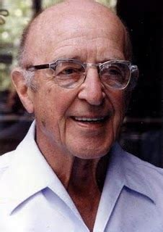
Carl Rogers
Leader of the humanistic psychology movement from the 1960s to the 1980s and the developer of person-centred therapy
Rogers was a prolific academic and practitioner who wrote sixteen books and more than two hundred articles and research studies, aimed at helping human beings lead fuller, more meaningful lives.
In terms of Rogers’ international reach, Cooper, et al. (2013, p. 496) explain there are:
“[a]round 200 national organisations and training centres … dedicated to researching and applying the principles developed by Rogers and the person-centred approach.”

Slide 4
Person Centred traits
Empathy
Congruence
Unconditional Positive Regard (Rogers 1957)
Active listening
‘Open’ questions- 5w & h
Paraphrasing
Mirroring language

Slide 5
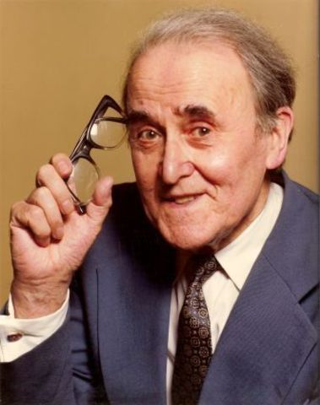
Can Action Learning and PCA coexist?
Revans was insistent that action learning was not counselling which it certainly is not, there are still a number of facets of the PCA which resonate with Revans underlying philosophy
Although some writers have proposed the use of some PCA behaviours as the basis of set development (e.g. Brockbank & McGill (2003))
No studies exploring the underlying ideas of both approaches to argue for a closer relationship between the PC approach and action learning

Slide 6
2020
2016
2020
2019

Slide 10
How can this model be developed further?
What is problematic with this model?

Slide 11
Bibliography
Boshyk, Y., & Dilworth, L. (2010). Action learning: History and evolution. Basingstoke: Palgrave MacMillan.
Boud, D., Cohen, R., & Walker, D. (1993). Using experience for learning. Maidenhead: McGraw-Hill Education.
Bourner, T., & Rospigliosi , A. (2019). Origins of the ethos of action learning,. Action Learning: Research and Practice, 16(3), 238-253.
Brockbank, A., & McGill, I. (2003). The action learning handbook: powerful techniques for education, professional development and training. London: Routledge.
Brook, C., Pedler, M., & Burgoyne, J. (2012). Some debates and challenges in the literature on action learning: the state of the art since Revans. Human Resource Development International, 15(3), 269-282.
Bugental, J. F. (1964). The third force in psychology. Journal of humanistic psychology, 4(1), 19-26.
Cooper, M., O'Hara, M., Schmid, P. F., & Bohart, A. (2013). The handbook of person-centred psychotherapy and counselling. Basingstoke, UK: Macmillan International Higher Education.
Coulson, W., & Rogers, C. R. (Eds.). (1968). Man and the science of man. Columbus, Ohio: Charles E Merrill.
de Haan, E., & Burger, Y. (2014). Person-centred coaching: Facilitating the coachee. In Coaching with colleagues (pp. 77-84). London: Palgrave Macmillan.
Dewey, J. (1916). Democracy and education. New York: MacMillan.
Dewey, J. (1933). How we think: A restatement of the relation of reflective thinking to the educative process. Boston: D.C.: Heath and company.
Dewey, J. (1986). Experience and education. The educational forum, 50(3), 241-252.
Gibbs, G. (1988). Learning by doing: A guide to teaching and learning methods. London: Further Education Unit at Oxford Polytechnic.
Husebø, S. E., O'Regan, S., & Nestel, D. (2015). Reflective practice and its role in simulation. Clinical Simulation in Nursing, 11(8), 368-375.
Joseph, S. (2014). The person-centred approach to coaching. , pp. In E. Cox, T. Bachkirova, & D. Clutterbuck (Eds.), The complete handbook of coaching (pp. 68-79). London : Sage.
Joseph, S., & Murphy, D. (2013). Person-centered approach, positive psychology, and relational helping: Building bridges. Journal of Humanistic Psychology, 53(1), 26-51.
Kirschenbaum, H., & Land Henderson, V. (Eds.). (1989). The Carl Rogers Reader. Boston MA: Houghton Mifflin.
Kolb, D. A. (1984). Experiential learning: Experience as the source of learning and development. Englewood Cliffs NJ: Prentice Hall.
Kozubska, J., & MacKenzie, B. (2012). Differences and impacts through action learning. Action Learning: Research and Practice, 9(2), 145-164.

Slide 12
Bibliography
Kutash, I., & Wolf, A. (Eds.). (1986). Psychotherapist's Casebook. New York: Jossey-Bass.
Merry, T., & Brodley, B. T. (2002). The nondirective attitude in client-centered therapy: A response to Kahn. Journal of Humanistic Psychology, 42(2), 66-77.
Mezirow , J. (1991). Transformative dimensions of adult learning. San Francisco: Jossey-Bass.
Moon, J. A. (2013). Reflection in learning and professional development: Theory and practice. New York: Routledge Falmer.
O'Connell, B. (2016). Solution-focused therapy (2nd ed.). London: Sage.
Pedler, M. (2017). Reginald Revans: The Pioneer of Action Learning. In D. B. Szabla, W. A. Pasmore, M. A. Barnes, & A. N. Gipson (Eds.), The Palgrave Handbook of Organisational Change Thinkers. New York: Palgrave Macmillan.
Revans, R. (1982). Action learning: Its origins and nature. Higher Education Review, 15(1), 20-28.
Revans, R. (2011). ABC of action learning. Farnham: Gower.
Revans, R. W. (1971). Developing effective managers. New York: Praeger.
Revans, R. W. (1982a). The origins and growth of action learning. Bromley: Chartwell-Bratt.
Rogers, C. (1942). Counselling and Psychotherapy . Boston: Houghton Mifflin.
Rogers, C. (1966). Client-centered therapy. Washington, DC: American Psychological Association.
Rogers, C. R. (1956). On becoming a person: A therapist's view of psychotherapy. Boston, MA: Houghton Mifflin Harcourt.
Rogers, C. R. (1957). The necessary and sufficient conditions of therapeutic personality change. Journal of Consulting Psychology, 21(2), 95–103.
Rogers, C. R. (1964). Toward a modern approach to values: The valuing process in the mature person. The Journal of Abnormal and Social Psychology, 68(2), 160-167.
Rogers, C. R. (1989). The carl rogers reader. (H. Kirschenbaum, & V. Land Henderson, Eds.) New York: Houghton Mifflin Harcourt.
Rogers, C., & Freiberg, H. J. (1994). Freedom to Learn. (third, Ed.) New York: Merrill.
Rud, C. (2003). Empathy: The adventure of being present/ Empathie: Das Abenteuer, gegenwärtig zu sein / Empatía: La aventura de estar presente. Person-Centered & Experiential Psychotherapies, 2(3), 162-171.
Sanders, P. (Ed.). (2012). The tribes of the person-centred nation. Monmouth: PCCS Books Ltd.
Simuforosa, M., & Loveness, C. (2017). Counselling Needs Among Primary School Learners: The Role of School Counsellor. Advances in Social Sciences Research Journal, 41(6), 88-94.
Vaughan, M. (2006). Summerhill and AS Neill. Maidenhead: McGraw-Hill Education.
Vince, R. (2008). 'Learning-in-action’ and ‘learning inaction’: Advancing the theory and practice of critical action learning. Action Learning: Research and Practice, 5(2), 93–104.
Weinstein, K. (1999). Action Learning: A practical guide (2nd ed.). Burlington, USA: Ashgate Publishing Ltd.

