Slide 1
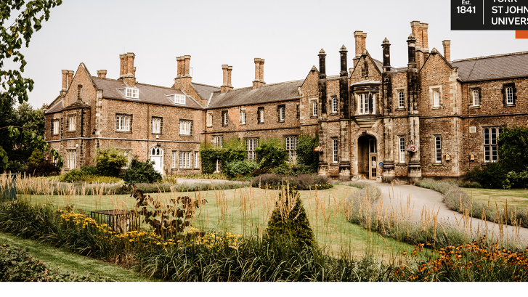
Wellies and whittle-sticks: an ethnographic study of the role of physical artefacts in establishing children’s connection to the ‘forest’.
Ruth Unsworth,
York St John University

Slide 2
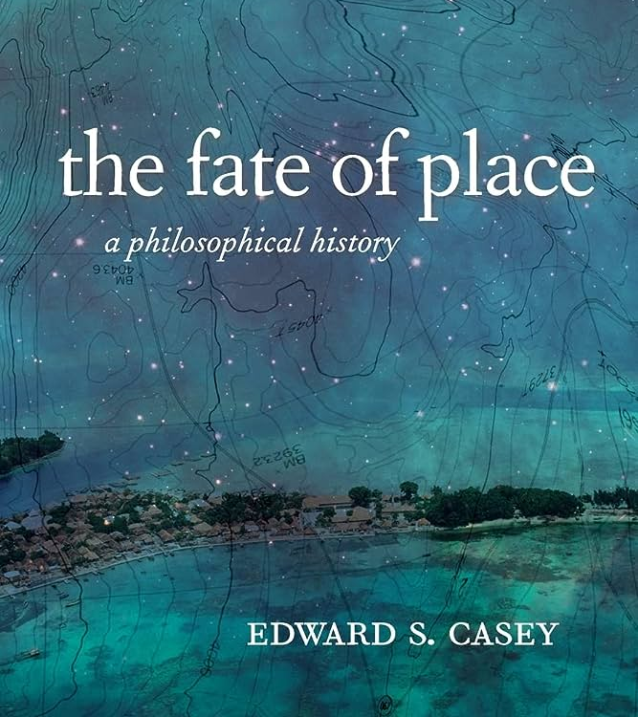
The forest as place
Tricky old ‘place’: space? time?
…by what social processes places are constructed? (Harvey, 1996).
What is ‘social’ about place? “Two things stand out: meaning and materiality” (Cresswell, 2014: 46).
… reciprocity between artefacts and people

Slide 3
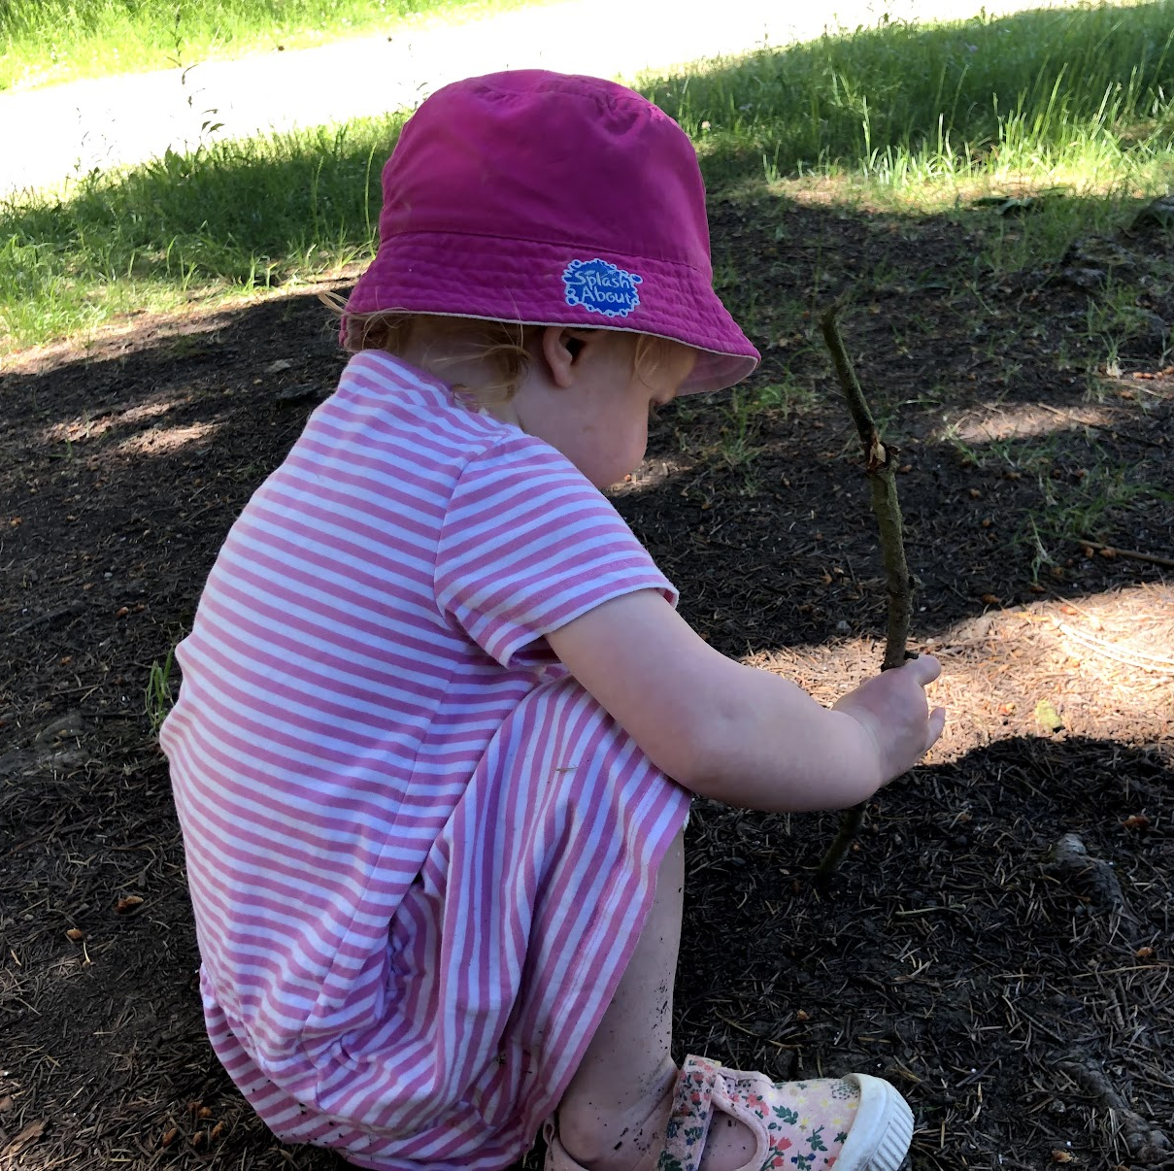
Exploring relationships with place
describe the interactions between people and materials that establish and maintain certain characteristics and ways of being in a place
ANT
… and (tentatively) AIME

Slide 4
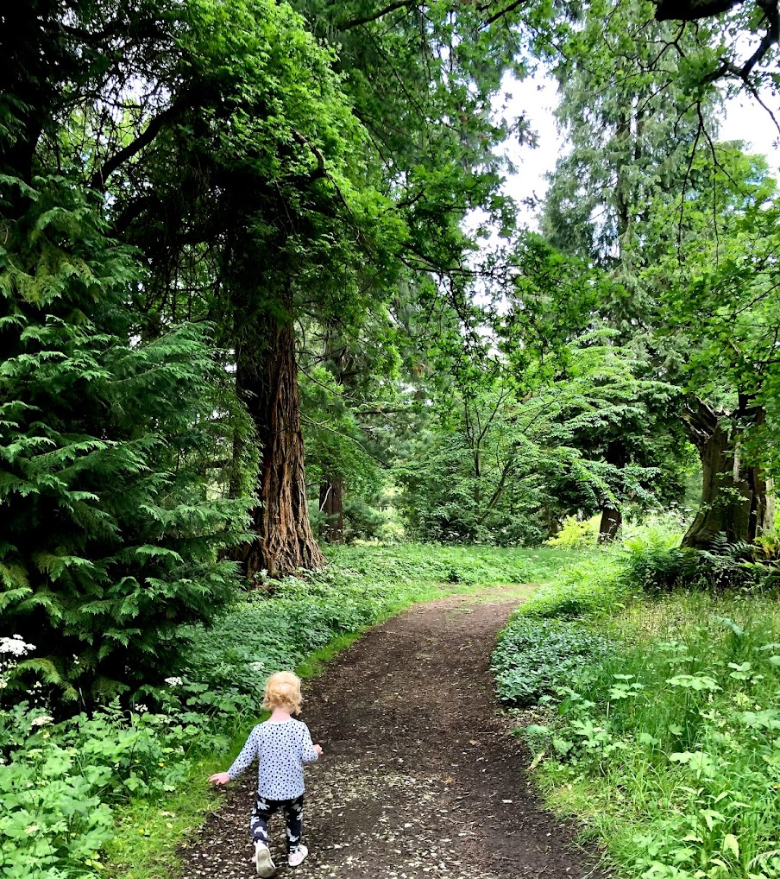
Spending time in the forest
Forest School sessions
Anomalistic data
Impressionist tale

Slide 5
Terms of veridiction: Education in the forest
Open-ended imaginative exploration: “offering interesting things for the children to connect with, interesting possibilities” (Charlie, fieldnote).
Discontinuity of objects as mediators
Plurality and freedom of association
Artefacts to sign into forest way of being
Introduction of historical/cultural uses of forest objects
A (FSA?) desire to offer children ways to connect to the sociocultural history of forests
backgrounded in favour of subjective connections and imagined, embodied worlds

Slide 6
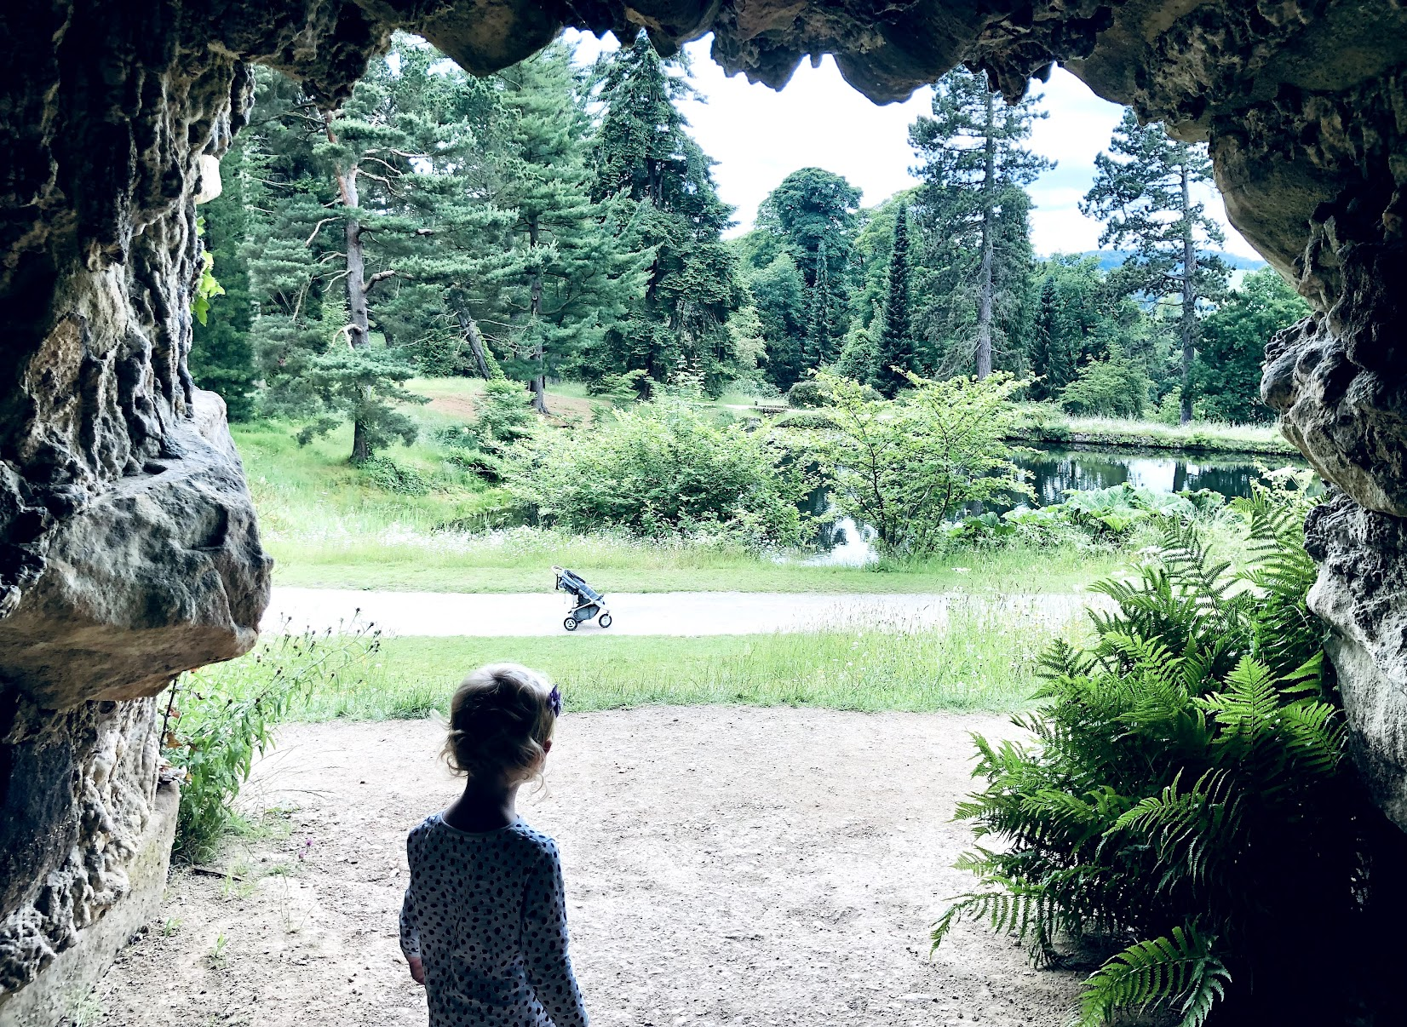
Thoughts to spark discussion
Education means different things in different ‘places’: can we extrapolate one educational mode of existence? How can this mode encompass its plurality?
Is there value in writing impressionistically?
Does the notion of ‘historical-cultural time’ work here?

