Slide 1
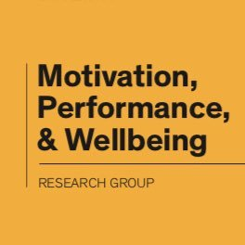
Examining the Mental and Physical Health Consequences of Burnout in Athletes
Hanna Glandorf
Supervision Team: Daniel Madigan, Owen Kavanagh, Sarah Mallinson-Howard
School of Science, Technology & Health
York St John University

Slide 2
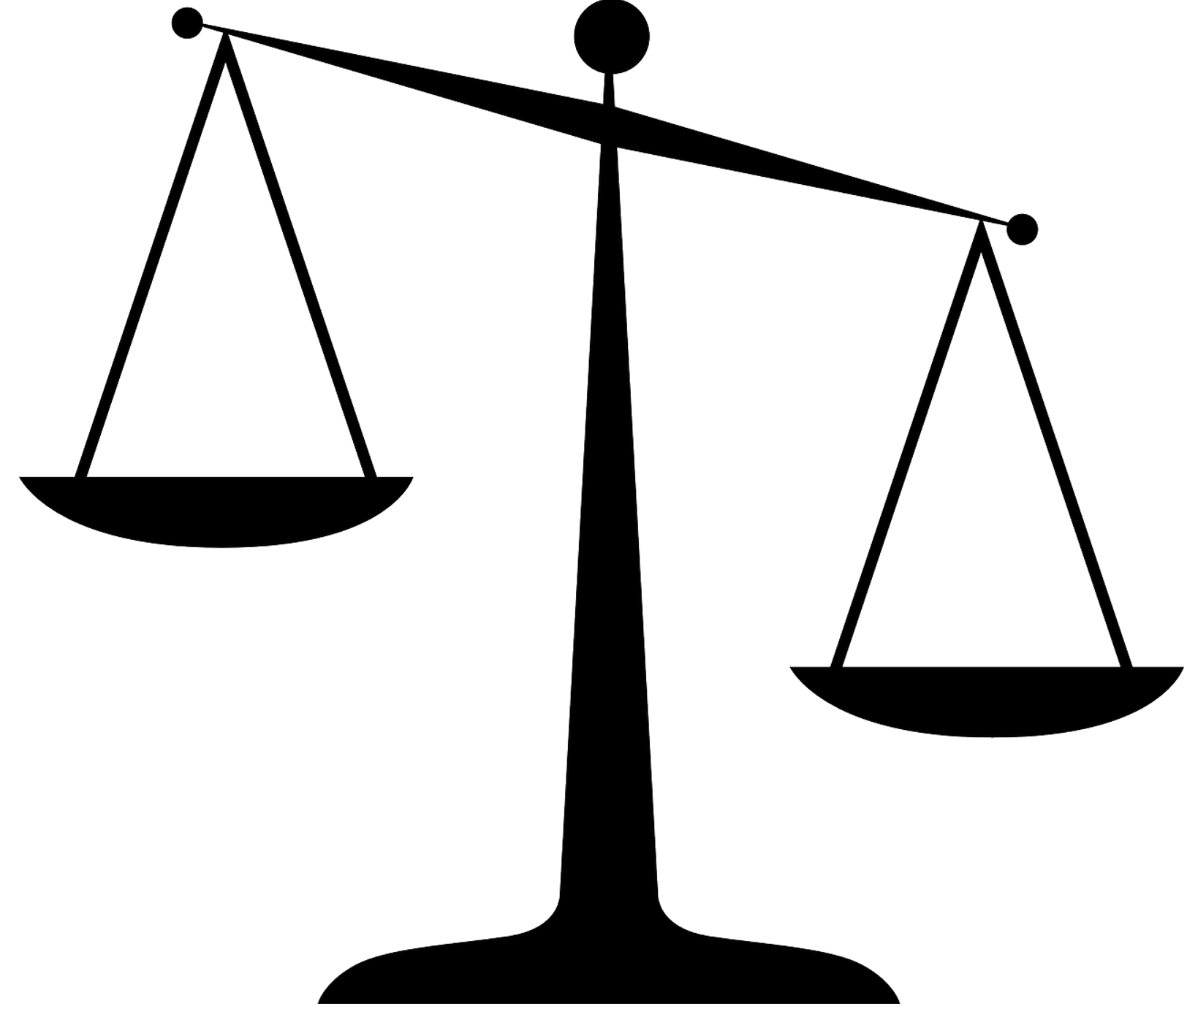
What is athlete burnout? How does athlete burnout develop?
Cognitive appraisal
Physiological responses (e.g., anxiety, insomnia, illness susceptibility)
Coping & Task behaviours (e.g., withdrawal)
Emotional and physical exhaustion
Reduced sense of accomplishment
Resources
Devaluation
Demands
Based on Raedeke & Smith (2001)

Slide 3
Is athlete burnout associated with health?
Glandorf et al. (2023): systematic review with meta-analyses
Increased Negative Mental Health Outcomes
Depression, anxiety, insomnia, worry, mood, body image dissatisfaction
Reduced Positive Mental Health Outcomes
Satisfaction, subjective vitality
Physical Health Outcomes
Physical symptoms, injury

Slide 4
Methods: Does athlete burnout predict health?
Design
Three timepoints
Fully survey-based
Participants
267 (Mage = 21) athletes who completed at least two surveys
Competing at regional level or higher
Measures
Athlete burnout
Depressive symptoms, sleep disruptions
Life satisfaction
Physical symptoms, illness
Procedure
Demographics at timepoint 1
Questionnaires at all timepoints

Slide 5
Results: Does athlete burnout predict health?
.25
.31
.58
.36
Total Burnout W1
Total Burnout W2
Total Burnout W3
Devaluation W1
Devaluation W2
Burnout W3
Devaluation W3
Burnout W2
Exhaustion W3
Burnout W1
Exhaustion W2
Exhaustion W1
.19
.23
.26
-.48
Depressive Symptoms W1
Depressive Symptoms W2
Depressive Symptoms W3
Sleep Disruptions W1
Sleep Disruptions W2
Sleep Disruptions W3
Life Satisfaction W1
Life Satisfaction W2
Life Satisfaction W3
Health W1
Health W2
Health W3
.50
.40

Slide 6
Does athlete burnout predict health?
Conclusions
Athlete burnout predicts some health variables (e.g., depressive symptoms)
Other health variables may contribute to burnout development itself (e.g., sleep, life satisfaction)
Highlights need for awareness in applied settings to prevent and intervene with burnout development in athletes

