Slide 1
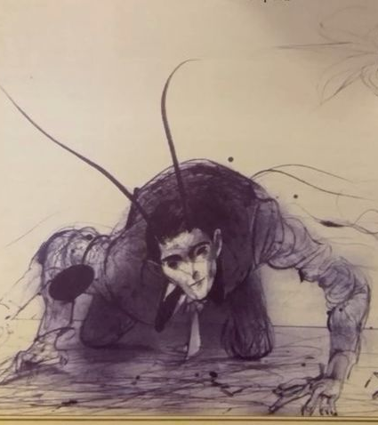
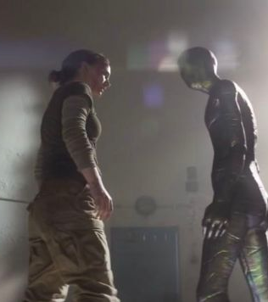
Changing Bodies, Changing Minds
Non-human Narratives and the Language Binary
Sam Pheby-McGarvey PhD Candidate York St John University

Slide 2
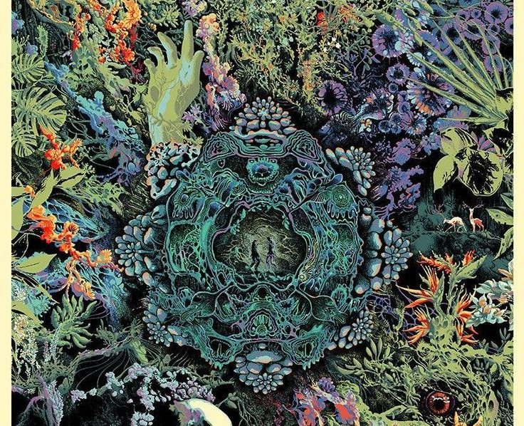
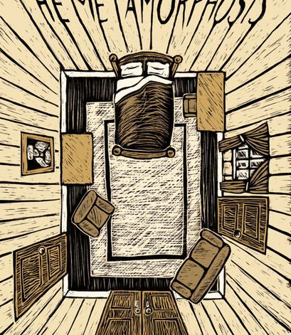
Introduction
Anthropocentric Transformations
Transformative Encounters
The Metamorphosis
Annihilation

Slide 3
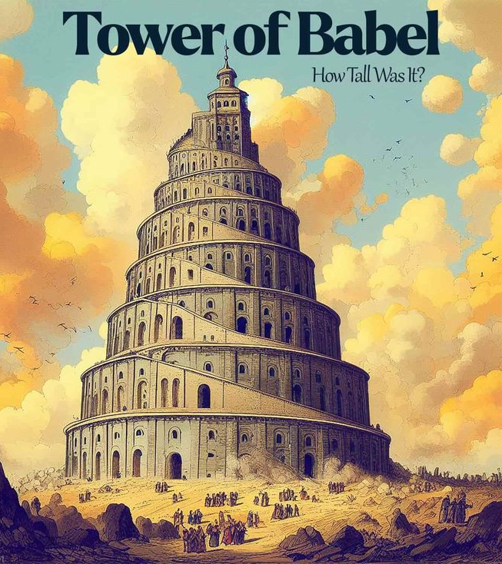
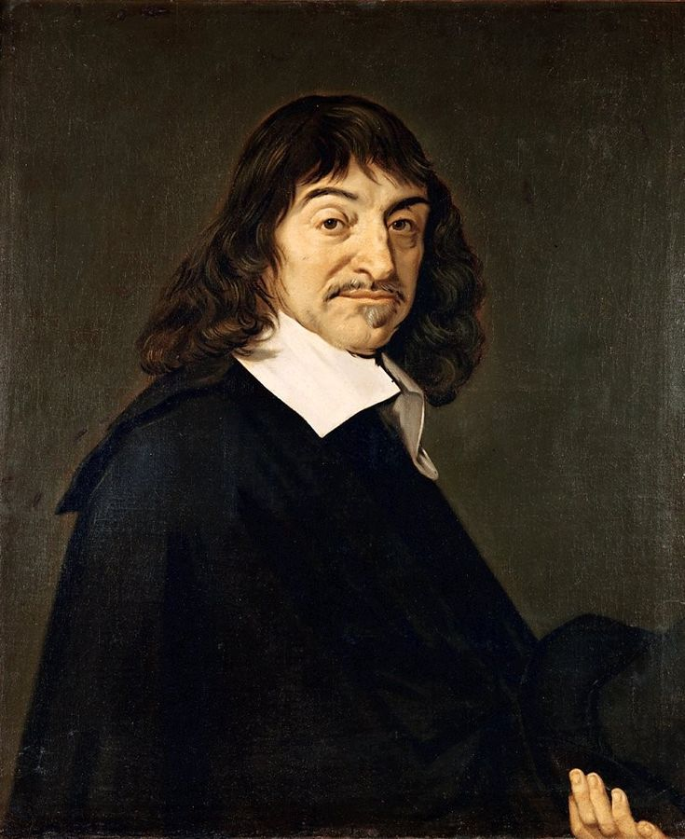
Dualism
“language has been positioned as a way of being in the world, an ontology, which sets humans apart from other animals. If indeed language acts as the basis for a mind, then those creatures’ incapable of entering into its sphere and of making sense of the world via words and syntax, are mindless.” (“Language of Detachment” 121)
Draws a clear line in the sand and erects a barrier of words around the minds of those that possess it, humans
Underpins Humanity’s, often negative relationship with the world.

Slide 4
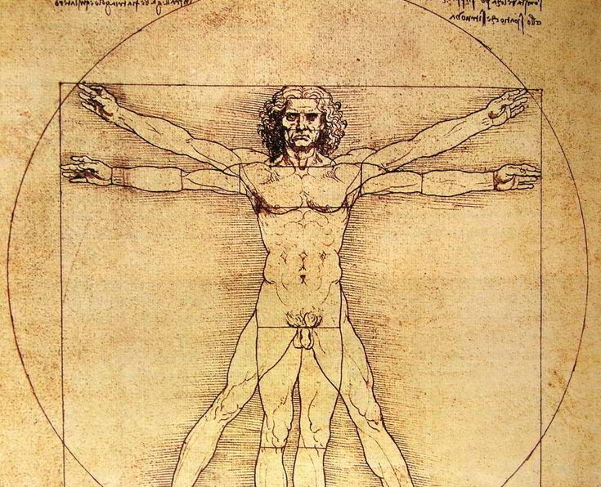
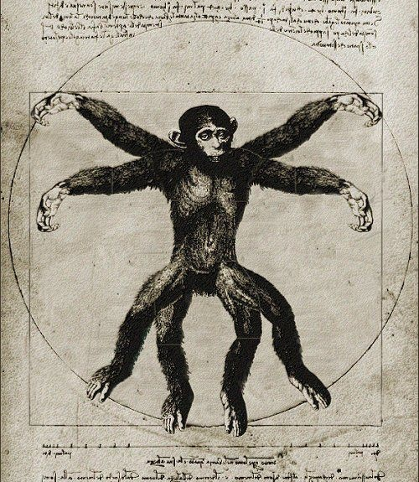
Anthropocentric Transformations
Unchanged narrative perspective
Loss of voice, language
Reinforce the human/animal boundary

Slide 5
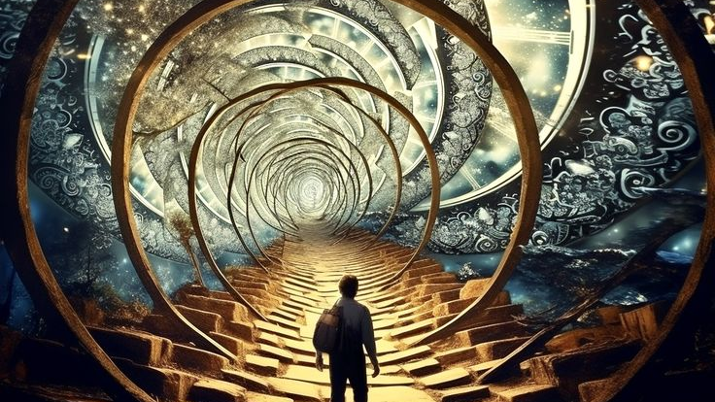
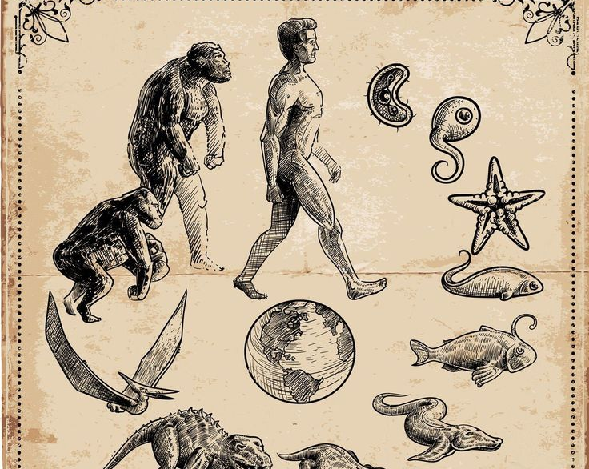
Transformative Encounters
Defined by its effect
A transformed mind and worldview, relationship to the world
“Precarity is the condition of being vulnerable to others. Unpredictable encounters transform us; we are not in control, even of ourselves. Unable to rely on a stable structure of community, we are thrown into shifting assemblages, which remake us as well as our others.” (The Mushroom at the End of the World 20)

Slide 6
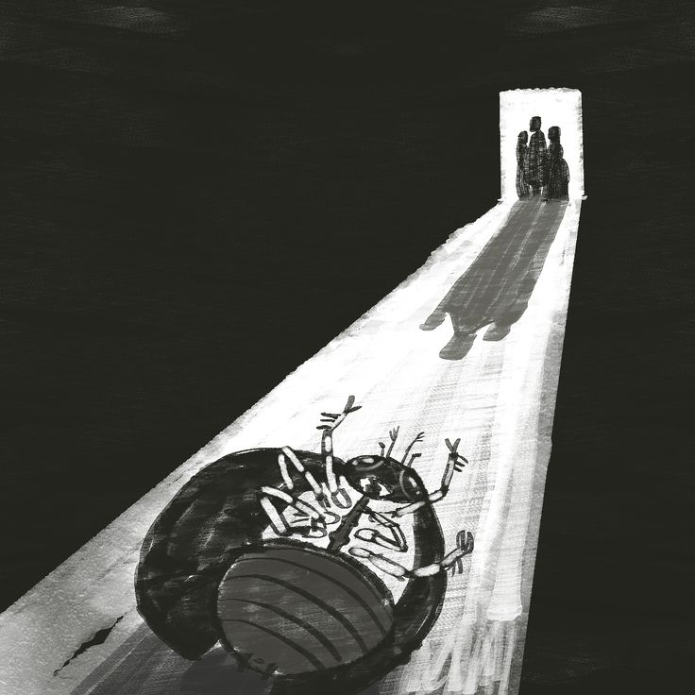
The Metamorphosis
“human thoughts are sharply contrasted with his animal body. This juxtaposition underlines the chasm between Gregor’s body and his mind” (Kafka’s Zoopoetics 35).
Gregor’s focus on work
Gregor’s loss of voice
Gregor is viewed as an animal

Slide 7
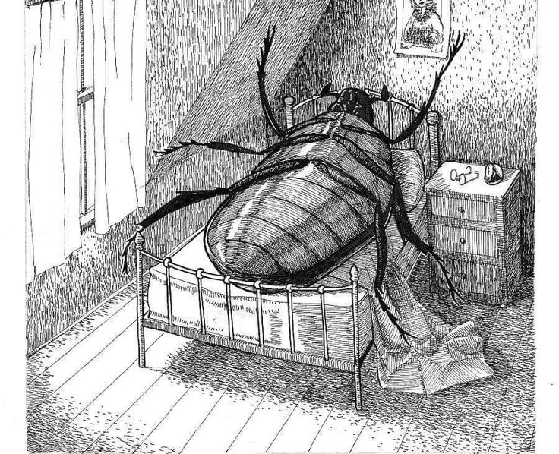
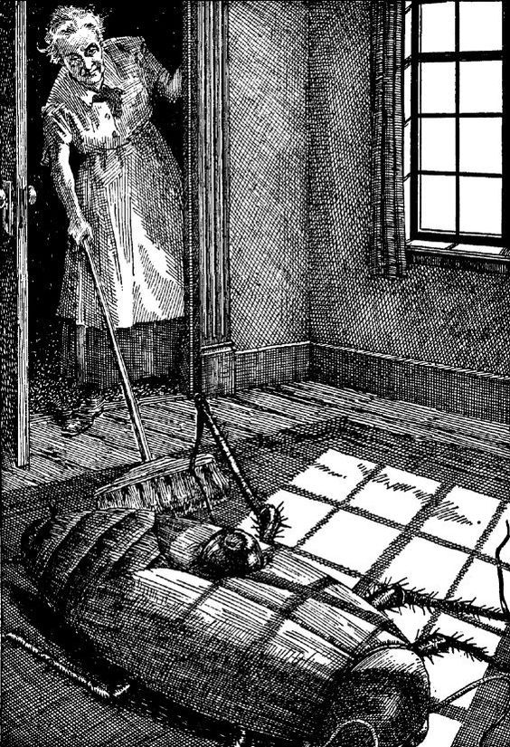
Gregor the Animal
“You’ve got to get rid of the idea that that’s Gregor” (The Metamorphosis 84).
His family construct his state as animal
“someone into something. Having heard his sister expressing a wish that he disappears from their life, Gregor expires” (Kafka’s Zoopoetics 46)

Slide 8
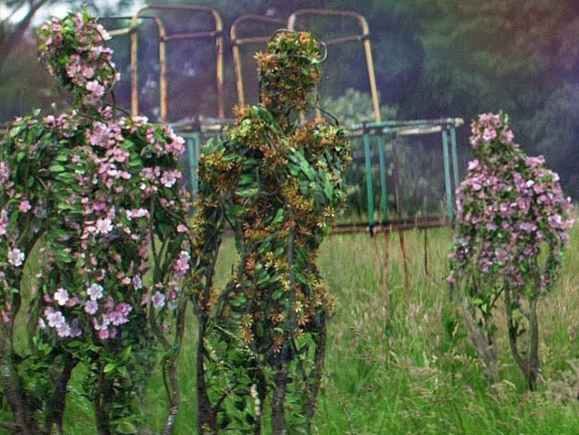
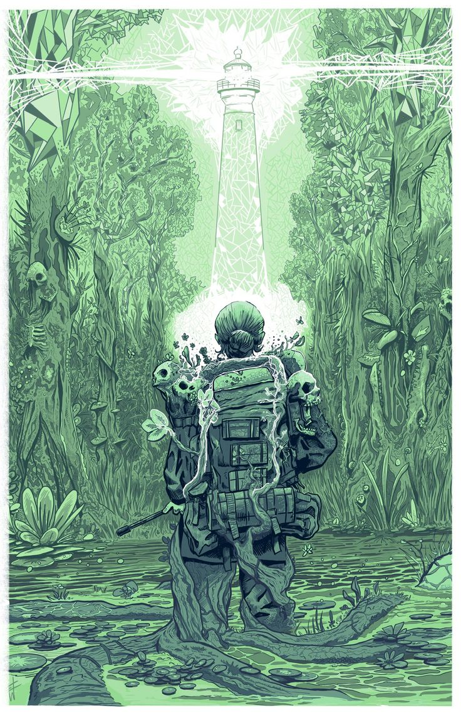
Annihilation
“as I stared, the “vines” resolved further, and I saw that they were words” (Annihilation 23).
“ “Words? Made of Fungi?” …
“There is no recorded human language that uses this method of writing,” the anthropologist said. “Is there any animal that communicates in this way?” … “No, there is no animal that communicates in this way.””” (Annihilation 25-26)

Slide 9
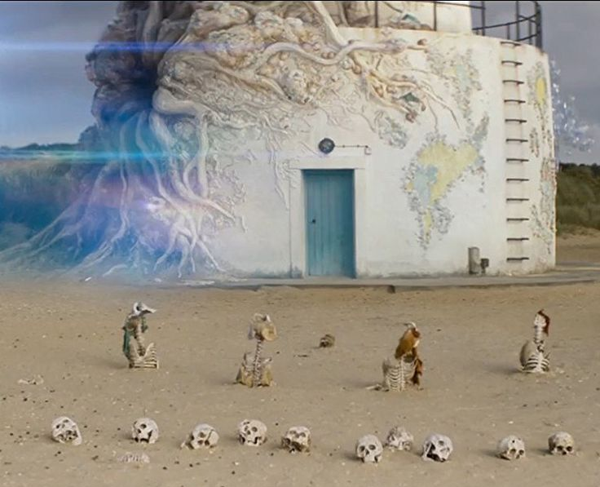
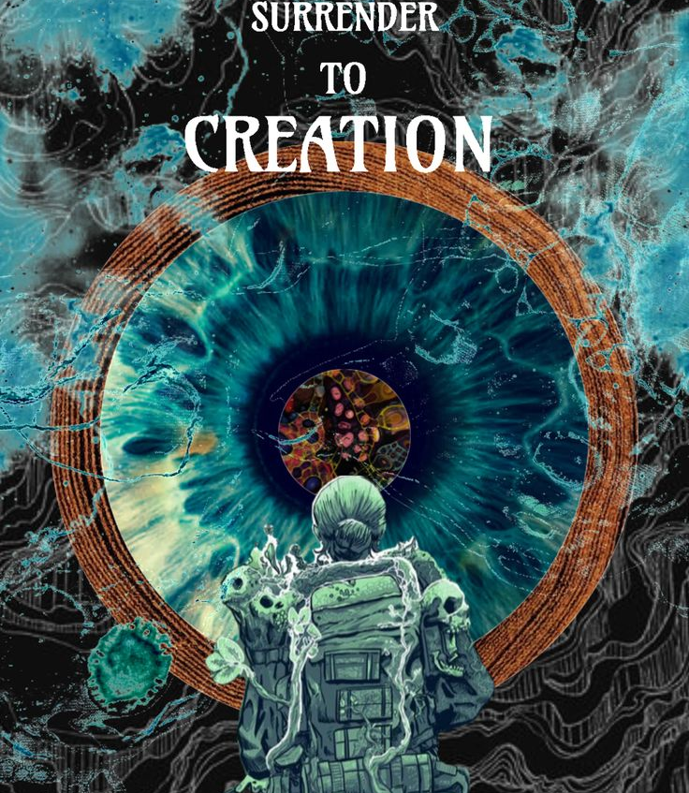
The Language of Area X
Area X possessing language breaks down the barrier between the biologist and her environment
She is contaminated by Area X
“The brightness is not done with me. It is just beginning, and the thought of continually doing harm to myself to remain human seems somehow pathetic. ... Will I melt into the landscape, or look up from a stand of reeds or the waters of the canal to see some other explorer starring down in disbelief.” (Annihilation 194)

Slide 10
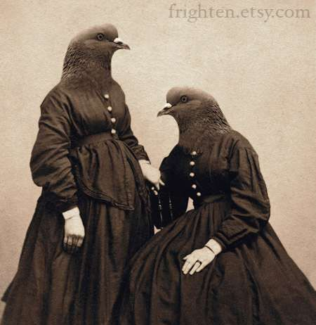
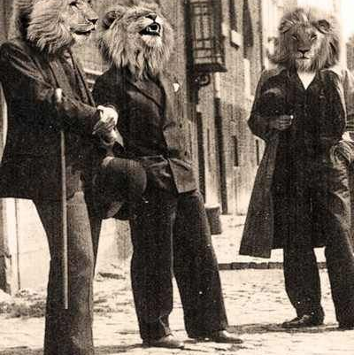
Breaking Down the Human/Animal Barrier
Annihilation embodies the concept of transformative encounters
Gregor’s transformation reinforces his family's humanity

Slide 11
Conclusion

Slide 12
Bibliography
Aaltola, Elisa. "From Language of Detachment Toward Expressiveness of Affect." History According to Cattle. Edited by Laura Gustafsson, and Terike Haapoja. Translated by Mike Garner, Sija Kudel, and Anna-Roosa Länsipuro. punctum books, 2015.
Deleuze, Gilles, and Felix Guattari. A Thousand Plateaus: Capitalism and Schizophrenia. Translated by Brian Massumi Athlone, 1988.
Tsing, Anna Lowenhaupt. The Mushroom at the End of the World: On the Possibility of Life in Capitalist Ruins. Princeton University Press, 2015.
Haraway, Donna Jeanne. When Species Meet. Minneapolis. University of Minnesota Press, 2008.
Franz, Kafka. The Metamorphosis. Translated by David Wyllie. Legend Press, 2002.
Harel, Naama. Kafka's Zoopoetics: Beyond the Human-Animal Barrier. University of Michigan Press, 2020.
Vandermeer, Jeff. Annihilation. Fourth Estate, 2014.

