Slide 1
Always Greener
Deconstructing the Nature Culture Divide
By Sam Pheby-McGarvey

Slide 2
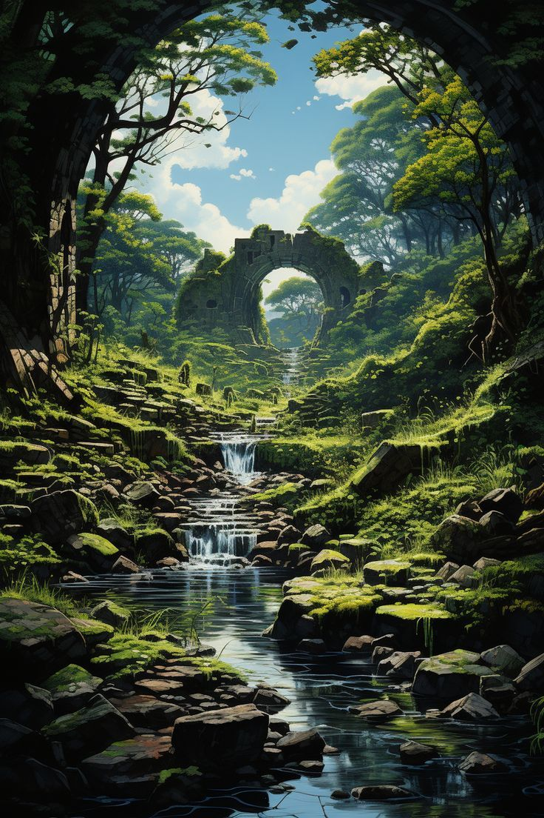
Introduction
“Now picture a valley, dense with pine and tapering cypress, called Gargaphie, sacred haunt of the huntress Diana; there, in a secret corner, a cave surrounded by woodland, owing nothing to human artifice. Nature had used her talent to imitate art: she had moulded the living rock of porous tufa to form the shape of rugged arch” (Ovid 100)

Slide 3
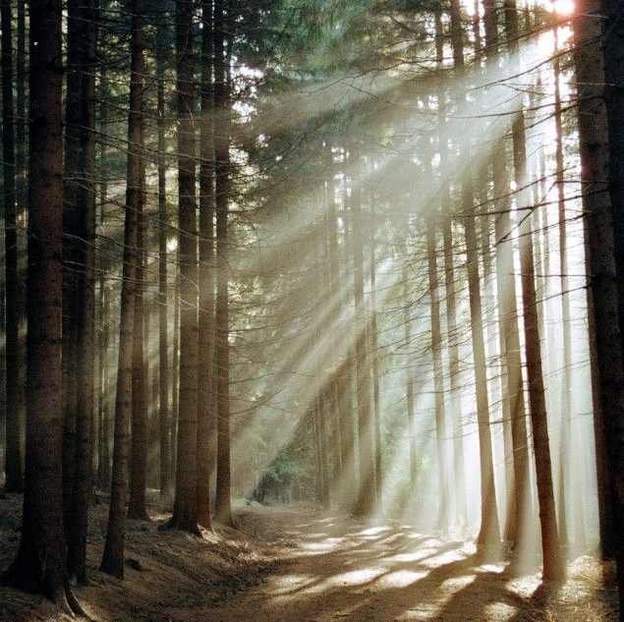
What is Nature?
Timothy Clark defines nature as, ““the other of culture, that which arises of itself without human agency.” (75)
Creates a binary, nature/culture
Implies humanity is separate from nature

Slide 4
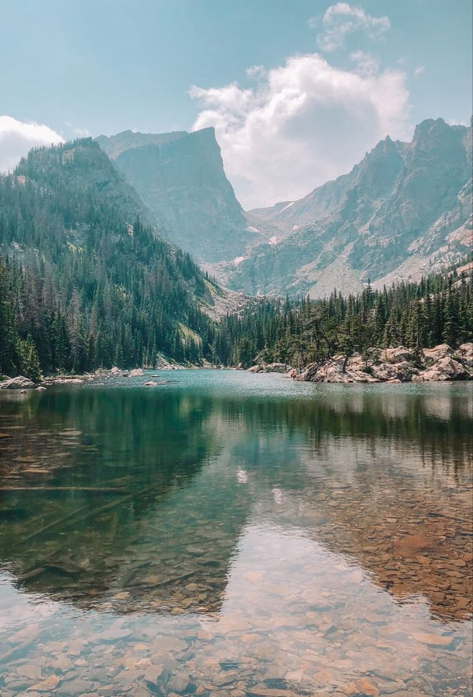
Pristine Other
Nature is viewed as far away, and pristine
Something humanity travels into
An escape

Slide 5
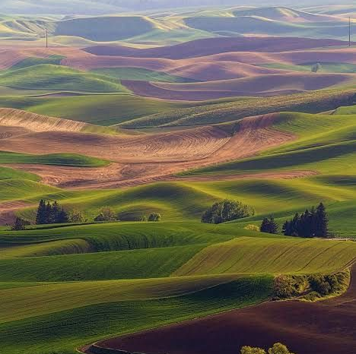
Constructing Nature
Dates back to BCE, “Thus the Idylls of Theocritus, the first pastoral text, gave us the word “idyllic” and established a sense of idealization, nostalgia, and escapism in a poetry of the countryside written for a court audience – all qualities that have come to be associated with definitions of the pastoral”. (Terry Gifford 18)

Slide 6
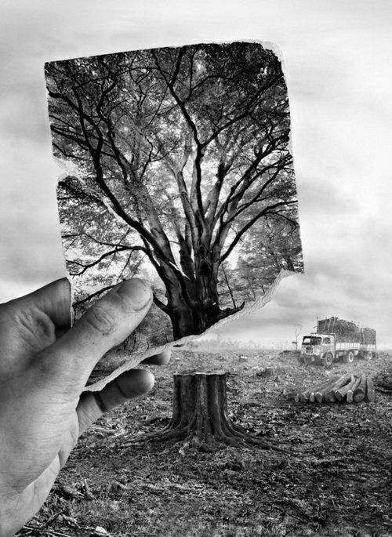
Deconstructing Nature
Recent writers have moved to a closer view of nature
Idea of ‘nature’ has come under challenge
"To be standing in the remotest desert or ocean is now, in a sense, still to be breathing the enclosed air of a vast human crowd.” ( Timothy Clark 79)

Slide 7
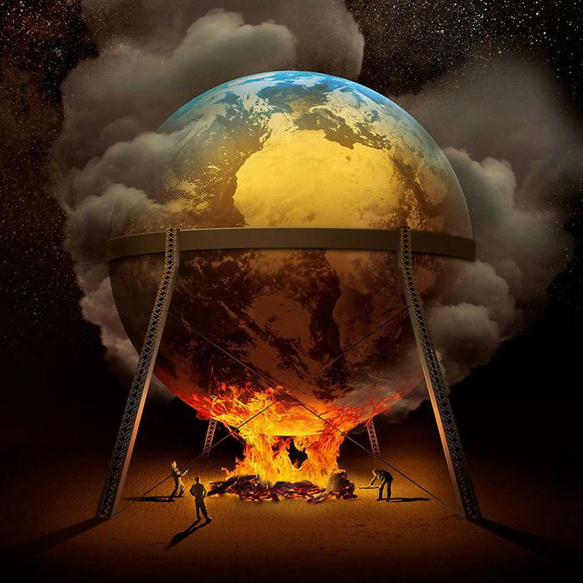
The Anthropocene
The period of history where humans are a dominant influence on the climate.
Breaks down the culture nature divide
Not felt on an individual level

Slide 8
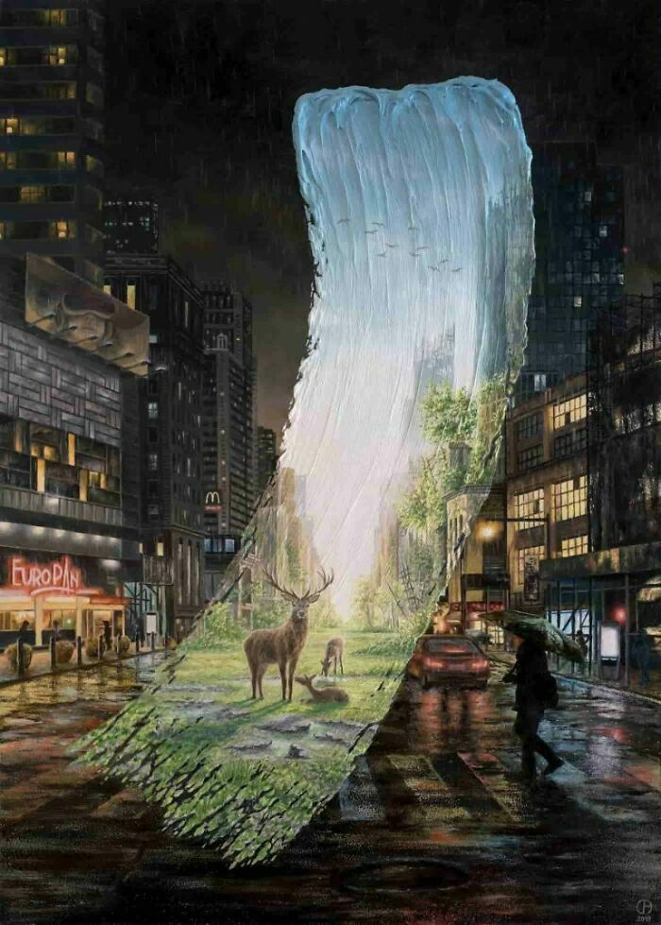
Breaking Down Nature
Climate change breaks down the nature culture divide
It infects everyday conversation
Nature should be removed from the discussion

Slide 9
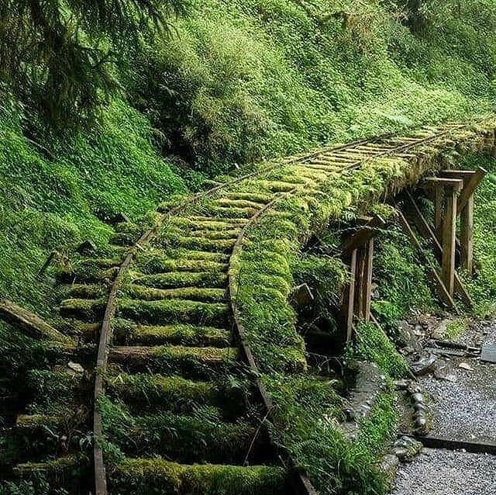
Post Nature
Beak down the idea of a natural world
Nature’s aesthetics get in the way of creating a world that does not pollute
Post nature worldview

Slide 10
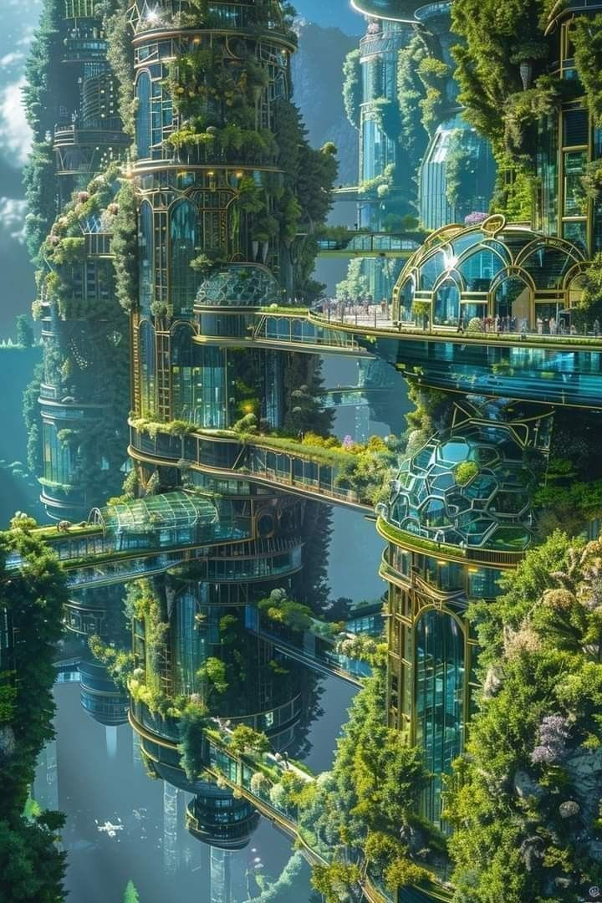
Imagined Futures: Solarpunk
Literature gives space to explore imagined futures
Solarpunk “imagines both the technological and societal complexity of energy transition, and the conditions civilisations might face in adapting to living in damaged natural environments.” (Gregory Lynall 191).

Slide 11
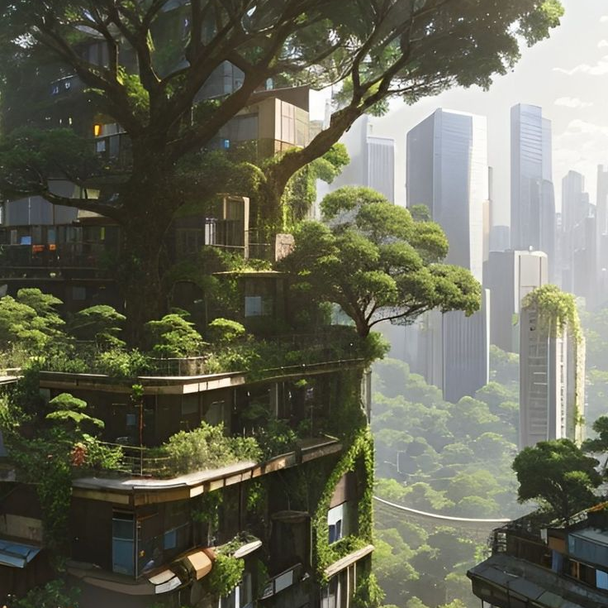
Conclusion
Do away with nature and culture and embrace a more environmental connected view of the world.

Slide 12
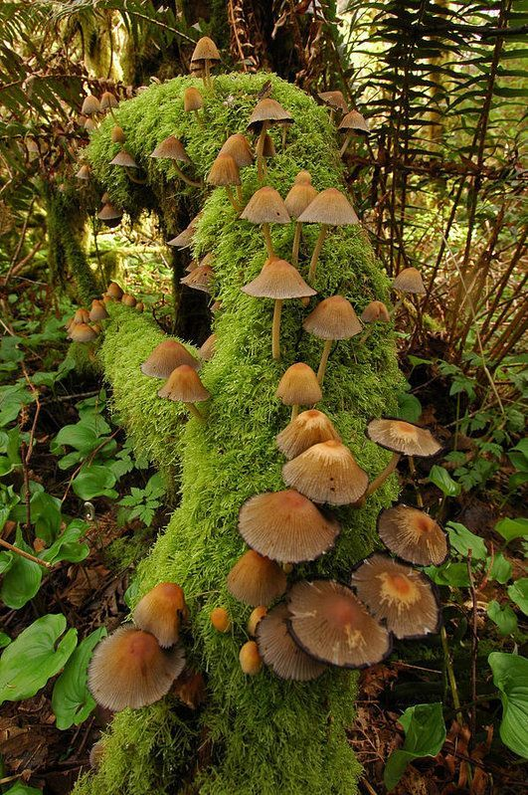
Bibliography
Clark, Timothy. “Nature, Post Nature.” The Cambridge Companion to Literature and the Environment. Ed. Louise Westling. Cambridge: Cambridge University Press, 2013. 75–89. Print. Cambridge Companions to Literature.
Gifford, Terry. “Pastoral, Anti-Pastoral, and Post-Pastoral.” The Cambridge Companion to Literature and the Environment. Ed. Louise Westling. Cambridge: Cambridge University Press, 2013. 17–30. Print. Cambridge Companions to Literature.
Lynall, Gregory. “Solarpunk.” The Cambridge Companion to Literature and Climate. Ed. Johns-Putra, Adeline, and Kelly Sultzbach Cambridge: Cambridge University Press, 2022. 191–200. Print. Cambridge Companions to Literature.
Morton, Timothy. Hyperobjects : Philosophy and Ecology after the End of the World. University of Minnesota Press, 2014.
Ovid. Metamorphoses. Translated by David Raeburn. Penguin Group, 2004.
Tyler, Tom. "The Exception and the Norm: Dimensions of Anthropocentrism." The Palgrave Handbook of Animals and Literature. Edited by Susan McHugh, Robert McKay, and John Miller. Palgrave Macmillan, 2021.

Slide 13
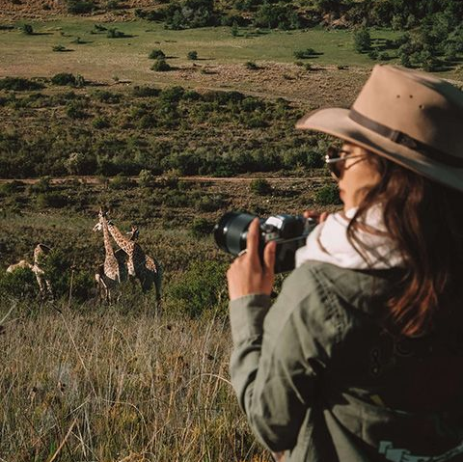
Images Used
Slide 1: https://www.pinterest.co.uk/pin/1618549858834610/
Slide 2: https://www.pinterest.co.uk/pin/21603273205672520/
Slide 3: https://www.pinterest.co.uk/pin/9148005487575376/
Slide 4: https://www.pinterest.co.uk/pin/4785143349047455/
Slide 5: https://www.pinterest.co.uk/pin/996421486294504192/
Slide 6: https://www.pinterest.co.uk/pin/74098356363384018/
Slide 7: https://www.pinterest.co.uk/pin/321655598367899983/
Slide 8: https://www.pinterest.co.uk/pin/438115870015927189/
Slide 9: https://www.pinterest.co.uk/pin/32017847344967578/
Slide 10: https://www.pinterest.co.uk/pin/3799980929163927/
Slide 11: https://www.pinterest.co.uk/pin/37576978135478293/
Slide 12: https://www.pinterest.co.uk/pin/429953095691987204/
Slide 13: https://www.pinterest.co.uk/pin/958211258195523248/

