Slide 1
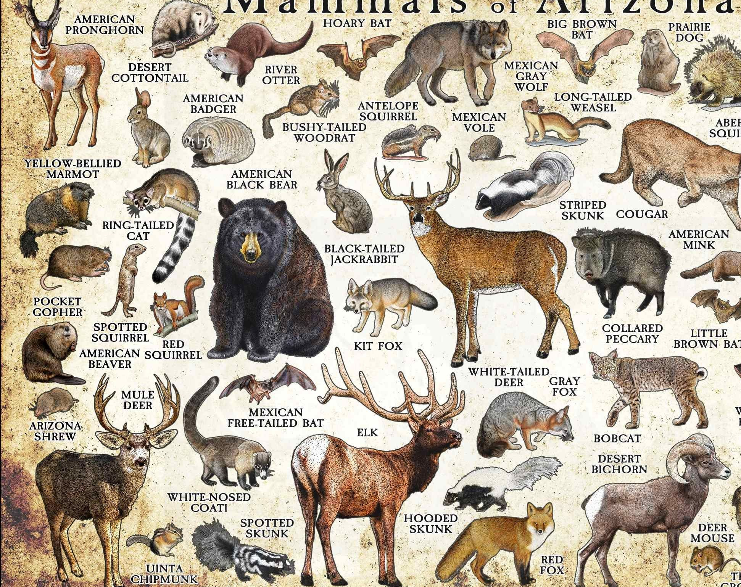
Knowledge from the Non-Human
By Sam Pheby-McGarvey

Slide 2
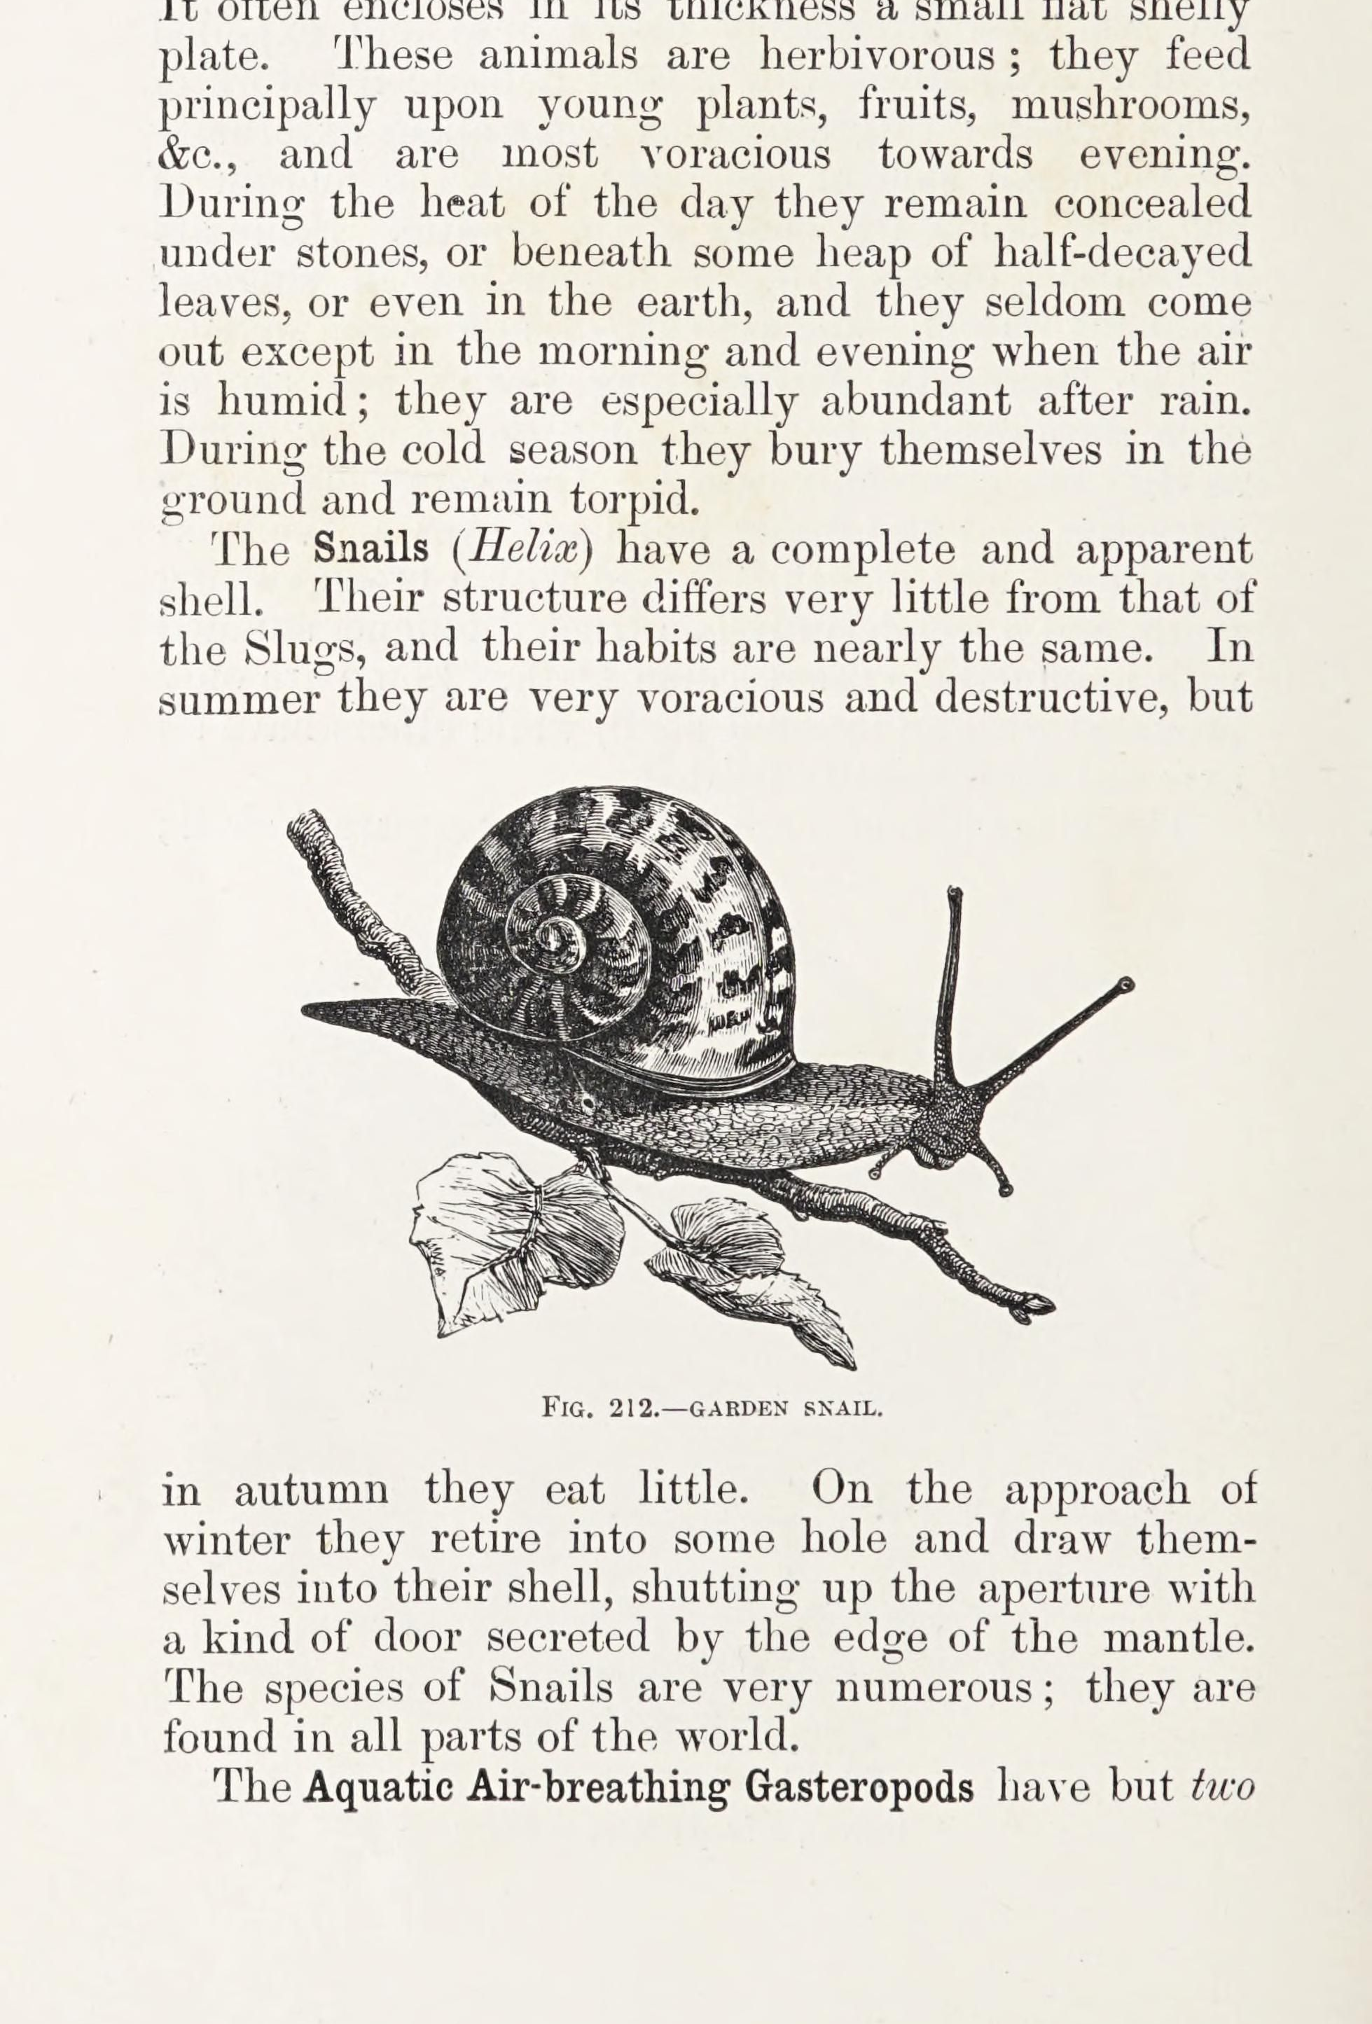
Introduction
This research paper will examine zoosemiotics as a way of transferring and recording non-human animal knowledge. Specifically, how umwelten analyse of a non-human animal can inform an authentic representation of it.
Language
Zoosemiotics
Umwelten analysis
The Bees

Slide 3
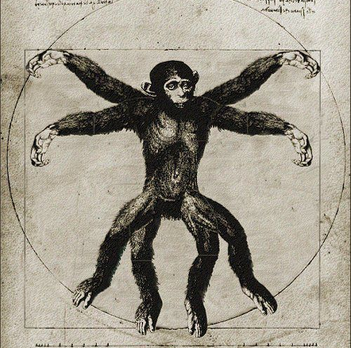
How Human-Animals Have Traditionally used Language
Language is the divider between species
It is key in Cartesian Dualism
It splits the world into those that can, and those that cannot, think

Slide 4
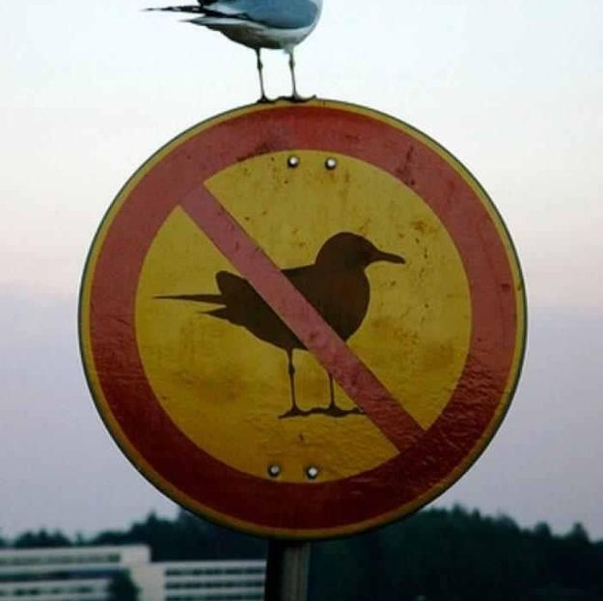
Zoosemiotics
Concerned with signs and signifiers
Studies prelinguistic signs
Views language as one method of communication among many

Slide 5
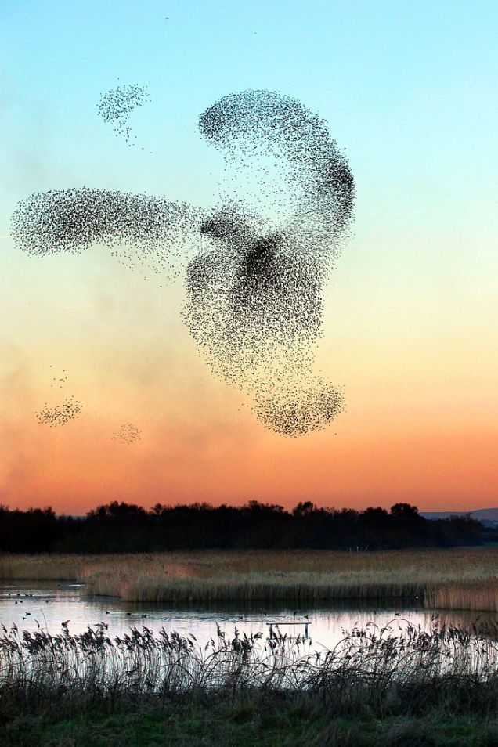
How Zoosemiotics Moves Beyond Language
Prelinguistic signs are intelligible across species
An animal’s world
A tool to unlock animal knowledge

Slide 6
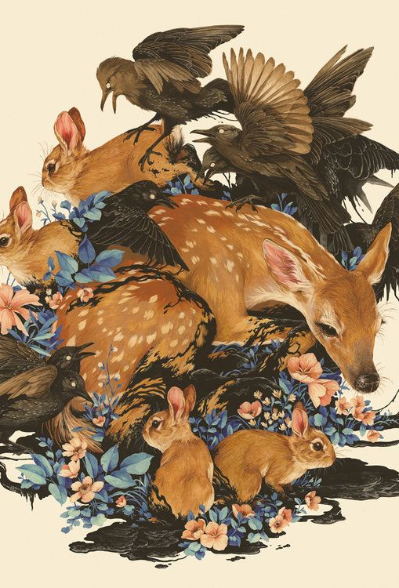
Umwelten Analysis
Used to authentically represent animals
Looks at specific animal’s worlds: food, enemies, environment, and partner.
We can form an understanding of what it sees

Slide 7
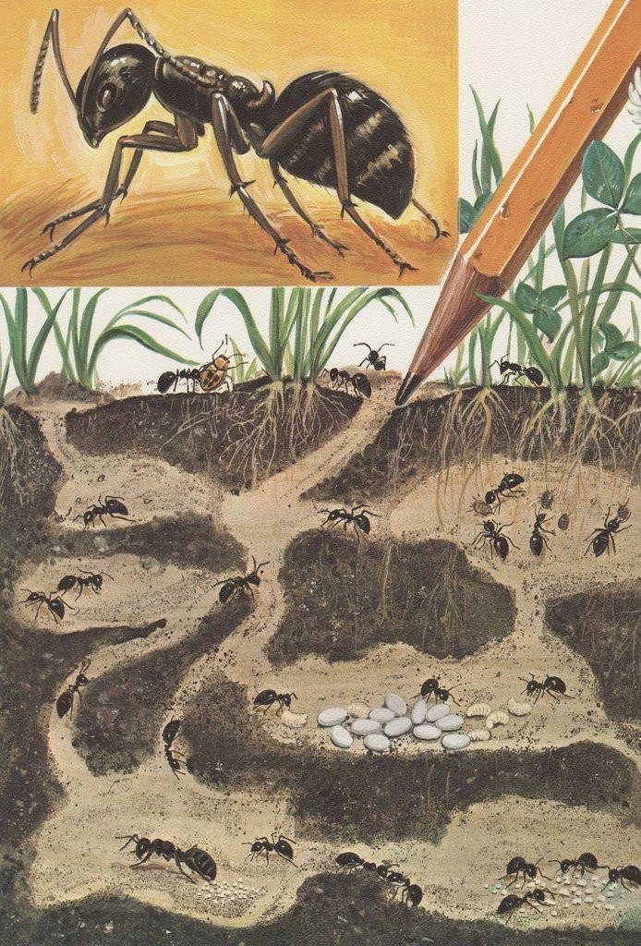
Eco-Field Analysis
Examine how different species’ worlds overlap
The effect this has on each species
How humans impact specific animal populations

Slide 8
Highlighting Climate Change
Issues such as climate change are hard to comprehend
How animals change their behaviour
Using literature to draw causal links

Slide 9
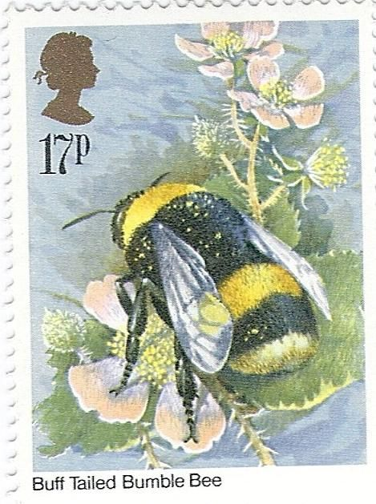
The Bees
“’Cornflower yield is poor. Even the buttercups are short- ‘
‘The foragers speak of more green deserts- ‘
‘When they fly at all, in this rain.’” The Bees (37)

Slide 10
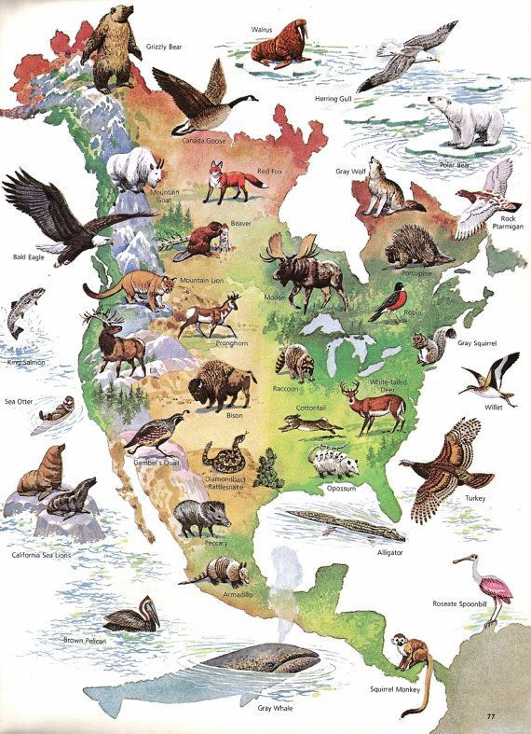
Conclusion
Dualism separates the human and non-human
Zoosemiotics seeks to democratise communication
It gains insights from how different species interact in an environment

Slide 11
Bibliography
Aatola, Elisa. “From Language of Detachment Towards Expressiveness of Affect.” History According to Cattle, edited by Laura Gustafsson, Terike Haapoja, punctum books, 2015, pp. 120-129.
Maran Timo, et al. “Introducing zoosemiotics: philosophy and historical background.” Animal Umwelten in a Changing World: Zoosemiotic Perspectives, Timo Maran et al, University of Tartu Press, pp. 10-28.
Maran Timo, et al. “Methodology of zoosemiotics: concepts, categorisations, models.” Animal Umwelten in a Changing World: Zoosemiotic Perspectives, Timo Maran et al, University of Tartu Press, pp. 29-50.
Morton, Timothy. Hyperobjects: Philosophy and Ecology after the End of the World. University of Minnesota Press, 2013.
Paull, Laline. The Bees. Fourth Estate, 2014.
Sebeok, Thomas. A Sign is Just a Sign. Indian University Press, 1991.

Slide 12
Pictures Used
Slide 1 - https://www.pinterest.co.uk/pin/816277501229614490/
Slide 2 - https://www.pinterest.co.uk/pin/894527544715685956/
Slide 3 - https://www.pinterest.co.uk/pin/20125529577013159/
Slied 4 - https://www.pinterest.co.uk/pin/261419953342535394/
Slide 5 - https://www.pinterest.co.uk/pin/333618284882579683/
Slide 6 - https://www.pinterest.co.uk/pin/1054264593999035618/
Slide 7 - https://www.pinterest.co.uk/pin/346917977548656680/
Slide 8 - https://www.pinterest.co.uk/pin/337770040813990859/
Slide 9 - https://www.pinterest.co.uk/pin/387731849184456805/
Slide 10 - https://www.pinterest.co.uk/pin/11047961579202905/
Slide 11 - https://www.pinterest.co.uk/pin/520658406933712145/
Slide 12 - https://www.pinterest.co.uk/pin/420734790201065642/

