Slide 1
The Grimm Side of Folk
The Nazi Party’s Transformation of Folktales to Indoctrinate German Youth into their Ideology

Slide 2
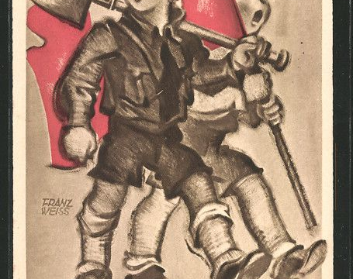
Folktales and the Nazi Party
The Nazi party valued myths and folktales
Folktales were used as evidence of a mythical German character

Slide 3
Introduction
What is a folktale?
How do folktales transform?
How did the Nazis Party use folktales?

Slide 4
The Purpose of Myths
Oral traditions
Explain how cultures see the world
Change with the society

Slide 5
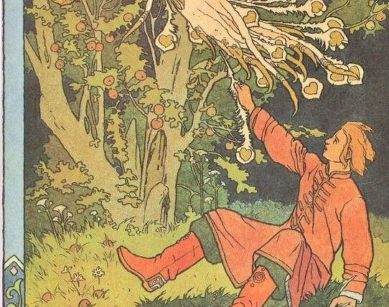
Definition of Tales
What are folk and fairy tales?
Why do they appeal to children?
Can they be used to further an ideology?

Slide 6
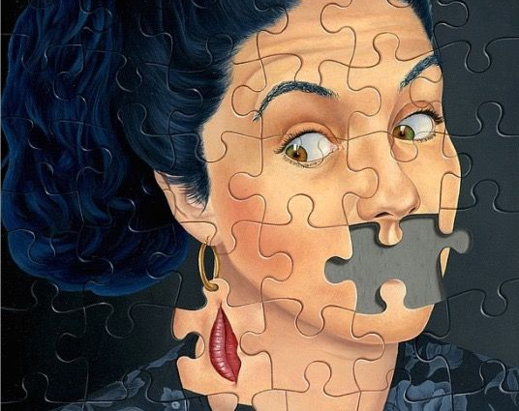
Censoring Tales
Censorship along ideological lines
Using tales that promoted characteristics
Creating “utopian” futures

Slide 7
Creating a Past Reality
From “utopian” alternative to past reality
Folktales used as historical fact
The invented German character

Slide 8
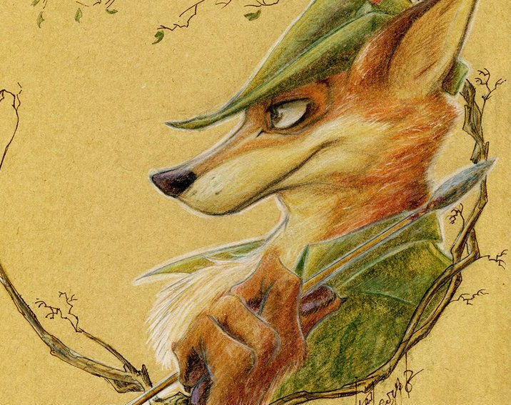
Transforming Tales
Tales can change over time
Tales can be viewed by rulers as having real power
Tales can be twisted to promote new ideals

Slide 9
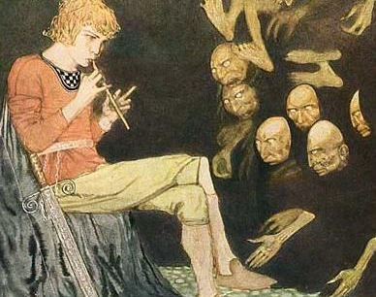
The Youth a Grimms’ Tale
A tale about a boy who is unable to feel fear
Used by the Nazi Part to promote courage
Can be viewed as comedic

Slide 10
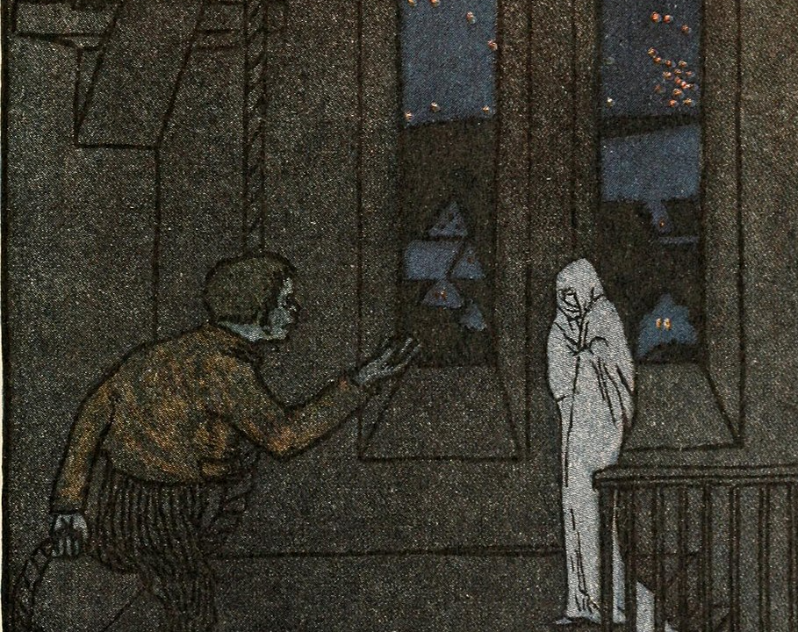
The First Challenge
The first challenge shows loyalty
A characteristic important to Hitler
Loyalty is an important quality in soldiers

Slide 11
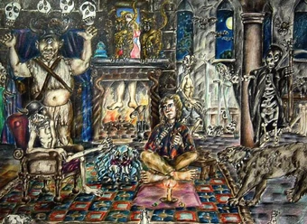
Courage in the Youth
The tale was published to promote courage
Another important quality for Hitler
Courage in soldiers is a prerequisite to fight

Slide 12
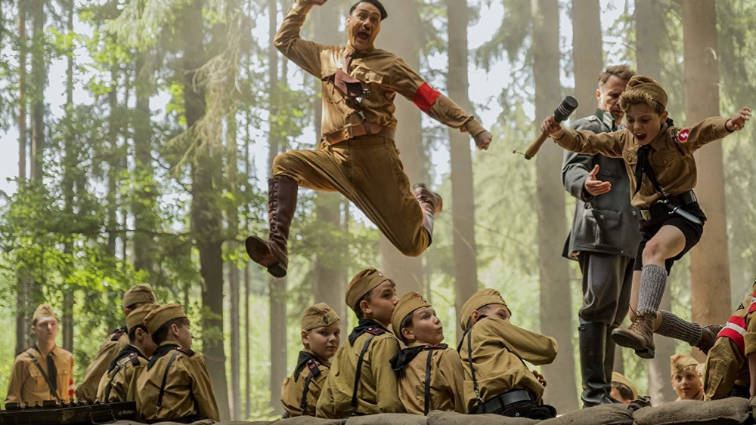
Conclusion
The Nazis transformed folktales to promote a mythical German past
They indoctrinated children into their ideology through folktales
They promoted characteristics that would make them into good soldiers

Slide 13
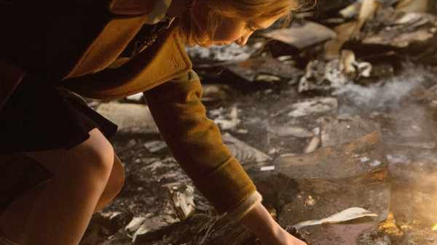
Bibliography
Bartov, Omer, Hitler's Army, Soldiers: Nazis, and War in the Third Reich (New York: Oxford University Press, 1992)
Bettelheim, Bruno, The Use of Enchantment: The Meaning and Importance of Fairy Tales (New York: Vintage Books, 1976)
Dawkins, Richard, The God Delusion (London: Transworld Publishers, 2016)
Foucault, Michel, Discipline and Punish, trans. by Alan Sheridan (New York: Vintage Books, 1995)
Grimm, Jacob and Wilhelm Grimm, Brothers Grimm Fairy Tales, trans. by Margaret Hunt (London: Flame Tree Publishing, 2019)
Grimm, Jacob and Wilhelm Grimm, Selected Tales, Oxford World’s Classics, trans. by Joyce Crick (Oxford: Oxford University Press, 2005)
Hitler, Adolf, Mein Kampf: My Struggle, trans. by James Murphy, rev. edn (New Delhi: General Press, 2018) VLeBOOKS
Kateb, George, ‘Courage as a Virtue’, Social Research, 71.1 (2004), 39-72 <https://search-proquest-com.sheffield.idm.oclc.org/docview/209670370/fulltext/FB0446C36E5C437FPQ/1?accountid=1382> [accessed 22 May 2020]
Kemenetsky, Christa, Children’s Literature in Hitler’s Germany: The Cultural Policy of National Socialism (Athens: Ohio University Press, 1984)
Myths & Monsters (Netflix, 2017) < https://www.netflix.com/gb/title/80158649> [accessed 23 May 2020]
Royce, Josiah, The Philosophy of Loyalty (New York: The Macmillan Company, 1914)
Zipes, Jack, Breaking the Magic Spell: Radical Theories of Folk and Fairy Tales, expanded and revised, edn. (Kentucky: University Press of Kentucky, 2002) ProQuest Ebook Central

Slide 14
Pictures Used
Slide 1
https://www.pinterest.co.uk/pin/560205641156966683/
Slide 2
https://www.pinterest.co.uk/pin/411657222177309728/
Slide 3
https://www.pinterest.co.uk/pin/544231936216225157/
Slide 4
https://www.pinterest.co.uk/pin/54676582967536879/
Slide 5
https://www.pinterest.co.uk/pin/48906345944257910/
Slide 6
https://www.pinterest.co.uk/pin/241927811220049534/
Slide 7
https://www.pinterest.co.uk/pin/357191814205283239/
Slide 8
https://www.pinterest.co.uk/pin/314970567696485687/
Slide 9
https://www.pinterest.co.uk/pin/322288917070392545/
Slide 10
https://www.pinterest.co.uk/pin/445434219404969645/
Slide 11
https://www.pinterest.co.uk/pin/813322013950913155/
Slide 12
https://www.pinterest.co.uk/pin/373658100341732059/
Slide 13
https://www.pinterest.co.uk/pin/15903404925814835/
Slide 14
https://www.pinterest.co.uk/pin/410320216034071459/

