Slide 1
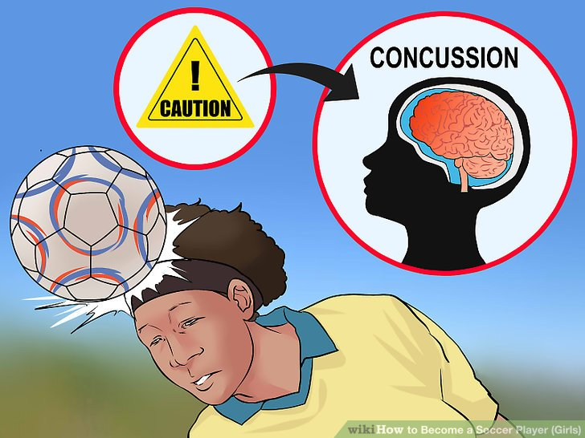
Title: Head-related Policies in Boys’ Professional Football Academy: A Figurational Analysis Name: Bright Nduka School: York St John University
Documentary Analysis
Observation
Focus groups
Semi-structured Interviews

