Slide 1
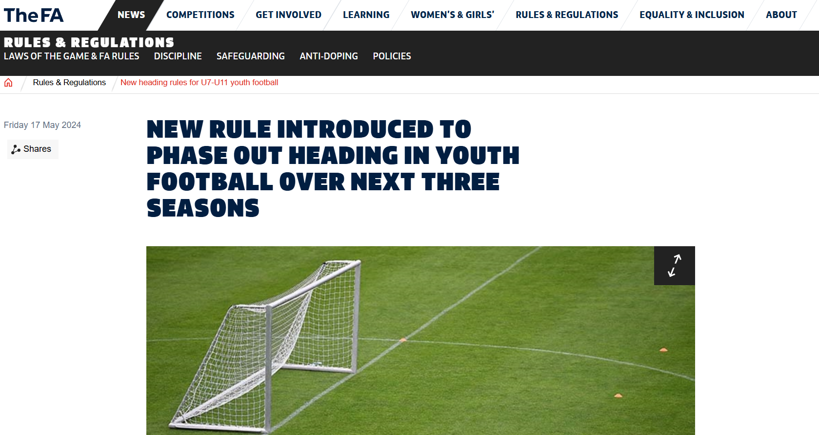
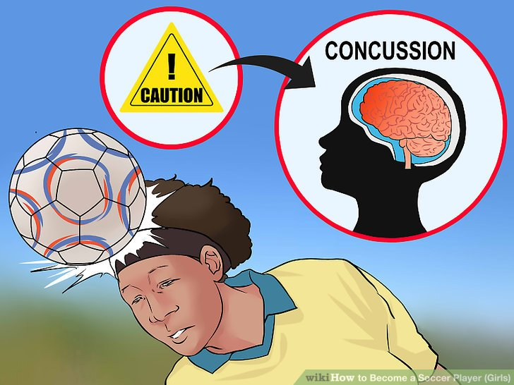
Title: A Figurational Analysis of Heading Policies in Professional Football Name: Bright Uzoramaka Nduka
Research Aims: To critically evaluate the extent of the application of head-related policies and their impact on the health and welfare of young males in professional football academies. It identifies some factors that have either promoted or hindered such policy implementation and probes into the perception of stakeholders about these policies and how they have influenced the attitudes of these players towards the sport of football.
Methods
Qualitative data will be gathered using a methodological triangulation approach (May, 2011)
Three purposively sampled U-16 professional football academies – players, coaches, parents/guardians, club doctors, and club physiotherapists (Prior, 2003; Bryman, 2012).
Documentary Analysis
Observation
Focus groups
Semi-structured Interviews
Background
Professional football has been described as a high-risk vocation with a record of injury rates exceeding those of other industries (Roderick et al., 2000).
Concussion has become prevalent with growing research interest leading to the formulation of policies (Liston et al., 2016; Malcolm, 2020).
Young people are the focus of heading policies in football (Yang and Baugh, 2016; FA, 2020; Gilbert et al., 2022)
The US Youth Soccer Concussion Policy
The English FA Youth Heading in Training Guidance
The Independent Review of Duty of Care
The UK Concussion Guidelines for Non-Elite (Grassroots) Sports
The FA Concussion Guidelines
Heading should not be introduced in training sessions for U-11
Recognise, Remove, and Return concussed players
These policies are aimed at ensuring the safety of players while encouraging more participation in sports
There is lack of awareness of these policies among coaches
These policies’ implementation requires heavy funding.
Key Policies
References
Bloyce, D. and Murphy, P. (2008) ‘Baseball in England: A case of prolonged cultural resistance’, Journal of Historical Sociology, 21(1), pp. 120–142. doi:10.1111/j.1467-6443.2008.00332.x.
Bryman, A. (2012). Social research methods. (4th ed.). Oxford, United Kingdom: Oxford University Press.
Gilbert, A. W., Bering, J. M., & Anderson, L. C. (2022). Addressing head injury risk in youth football: Are heading guidelines the answer? Science and Medicine in Football, 6(3), 340–346. https://doi.org/10.1080/24733938.2021.1967435
Malcolm, D. (2020). The concussion crisis in sport. Routledge.
May, T. (2011). Social research: Issues, methods and process (4th ed.) Maidenhead, UK: McGraw-Hill Education/Open University Press.
Prior, L. (2003). Using documents in social research. Thousand Oaks, CA: Sage.
Roderick, M., Waddington, I., & Parker, G. (2000). Playing hurt. International Review for the Sociology of Sport, 35(2), 165–180. https://doi.org/10.1177/101269000035002003
Webb, E. J., Campbell, D. T., Schwartz, R. D., and Sechrest, L. (1966). Unobtrusive Measures: Nonreactive Measures in the Social Sciences. Chicago: Rand McNally.
Yang, Y. T., & Baugh, C. M. (2016). US Youth Soccer Concussion policy. JAMA Pediatrics, 170(5), 413. https://doi.org/10.1001/jamapediatrics.2016.0338
Theoretical underpinning
Drawing from Norbert Elias (1987-1900) - Theory of figurational sociology as the theoretical framework upon which this study is premise
Key discussions/concepts: the sociology of injuries in football, policies and power, process sociology of policies, figuration, and the civilising process. (Bloyce & Murphy, 2008)
Preliminary Findings
Documentary analysis yielded the following results:
These policies, focused on children/teenagers, are formulated based on the findings of research on adults.
Focus/emphasis is on heading in training, with little attention given to activities on match day.
Policies are precautionary in nature – no substantial scientific evidence linking heading to brain injuries yet.

