Slide 1
KNOWING BETTER: KNOWLEDGE JUSTICE IN UNIVERSITIES
Margaret Meredith
Vanessa Corby
Nkosinathi ‘Nathi’ Madondo

Slide 2
Margaret Meredith
Vanessa Corby
Nkosinathi ‘Nathi’ Madondo

Slide 3
Two questions
Which knowers and which knowledges tend to be delegitimised or marginalised in universities? Which tend to be favoured?
How might academics work towards knowledge justice in their specific contexts?
….in teaching, research and outreach to the community

Slide 4
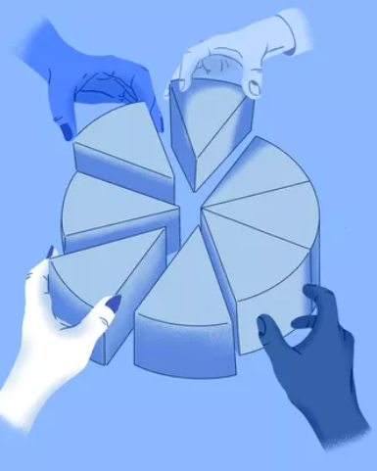
Why is this an issue of social justice?

Slide 5
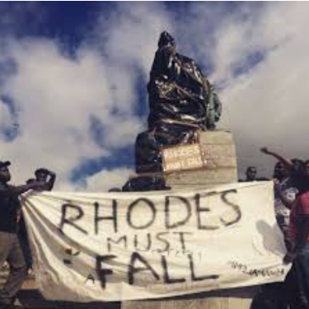
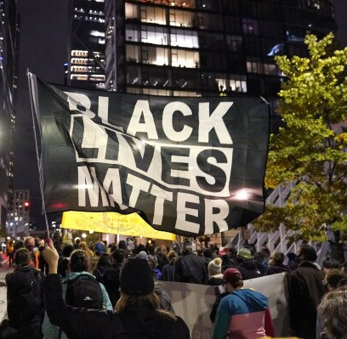
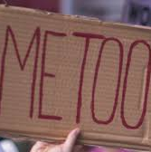
Recognition of equal difference

Slide 6
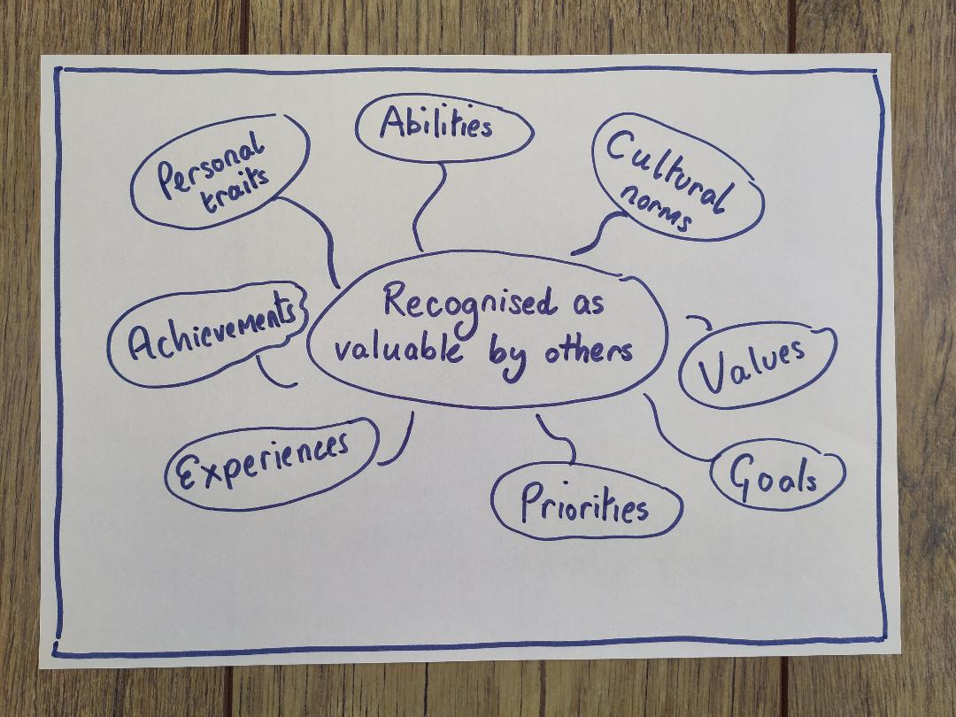
Social justice as recognition
Iris Marion Young
Axel Honneth

Slide 7
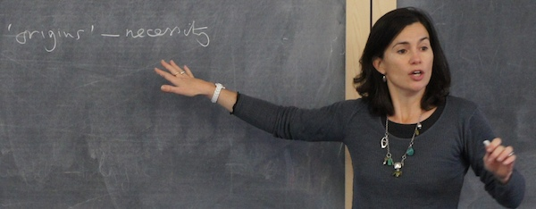
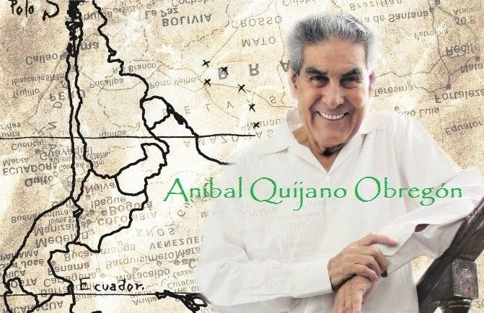
Epistemic injustice
‘People wronged in their capacity as knowers’
Miranda Fricker
Systems of knowledge are part of systems of power
‘Coloniality’ Aníbal Quijano

Slide 8
Epistemic justice
People recognised in their capacity as knowers

Slide 9
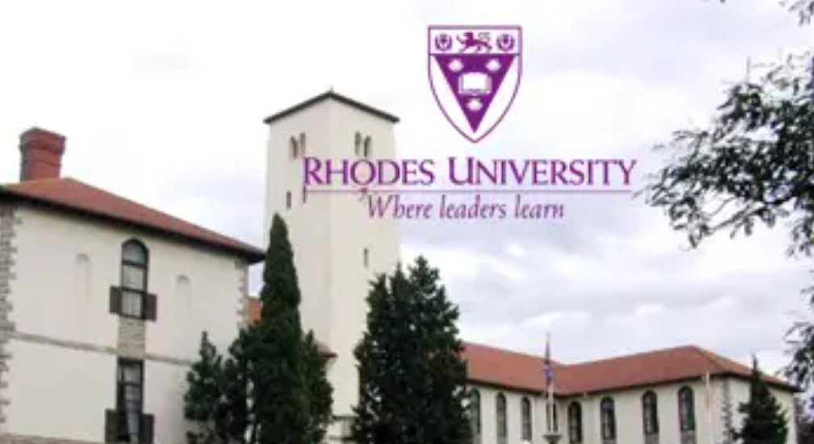
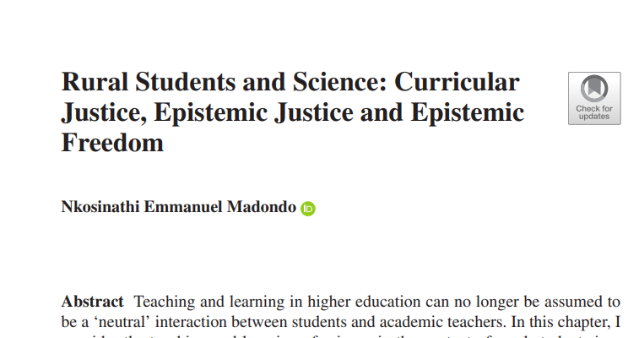

Slide 10
Any questions? Any answers?

Slide 11
Two questions
Which knowers and which knowledges tend to be delegitimised or marginalised in universities? Which tend to be favoured?
How might academics work towards knowledge justice in their specific contexts?

Slide 12
Discussion
How does the idea of epistemic justice in education resonate for you?

Slide 13
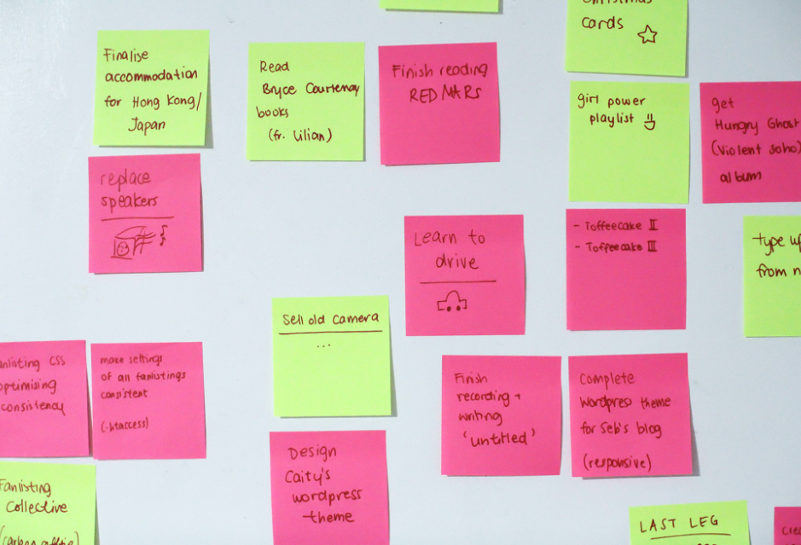
Please write:
…and place on the notice board outside
What words, phrases, ideas or thoughts will you take from this session?

