Slide 1
Desire lines and assessment
Dr Chris Whiting
Teaching and Learning Enhancement team

Slide 2
Some preliminary thoughts on analogies
They are useful to reframe an idea, concept or problem however,
They are limited and will eventually run out
They should not be taken too literally
They should be critically challenged with the pragmatics of the thing itself

Slide 3
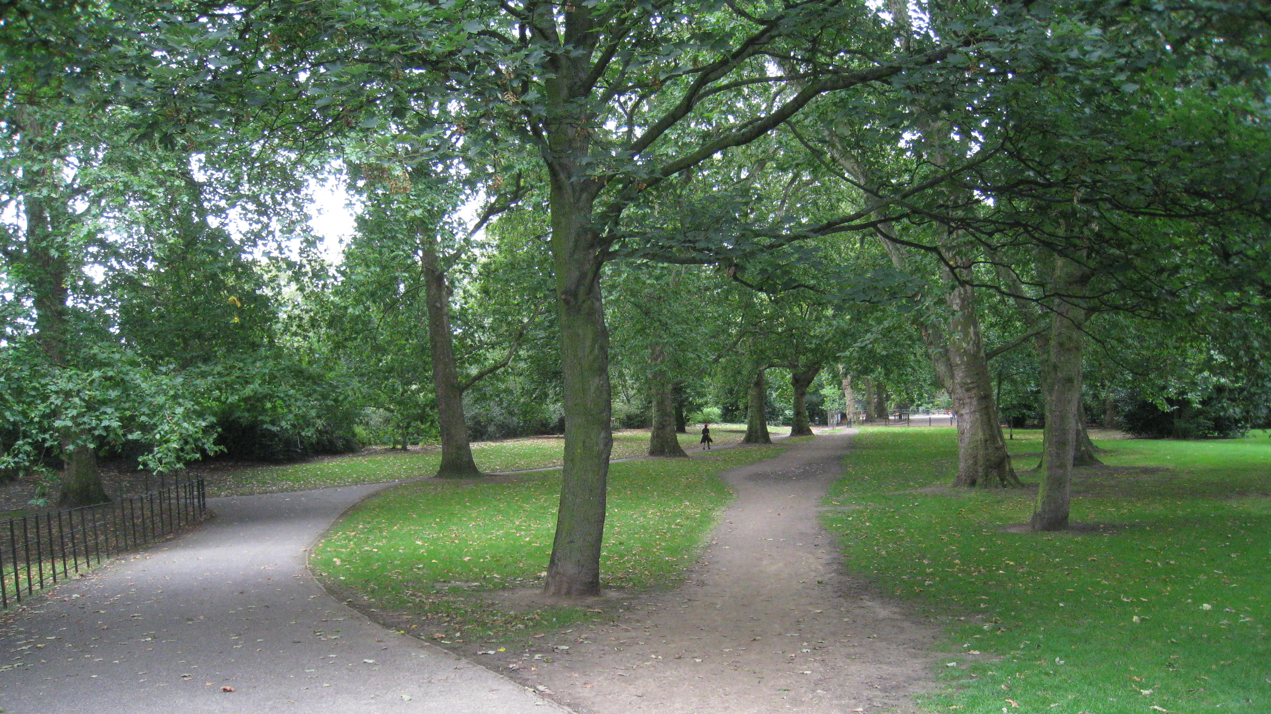
The assignment output
GenAI Tools
The Assignment Process
Notes:
The analogy:
In the distance is the assignment output such as an essay
The assignment process is the path the we expect (or would like) our students to go through to achieve that output (such as reading the literature, making notes, drafting an essay, getting feedback, proofreading, etc.)
The desire line repressents a Generative Artificial Intelligence Tool that can be used to offload those activities of the process. In other words, a short cut.
[Image by wetwebwork (2008) available at: https://www.flickr.com/photos/wetwebwork/2847766967 image located using Google search usage: Creative Commons licenses]

Slide 4
Notes:
Prohibiting the use of GenAI Tools
Axiom - People will still take the shortcut. Working smarter, not harder.
If their priority is to get to a place, the quickest, shortest route will be the obvious option.
Clearly people have taken the short cut in this image, but unless we saw them walking this desire line, we couldn’t prove who did or did not use it.
In terms of our assessment, we have no viable means of proof and no or little means of enforcement.

Slide 5
Notes:
A Proctored Exam
We can build a fence around the grass to stop people walking on it, but people still will.
Worse still, the fence will easily be overcome by able bodied people but disabled, parents with pushchairs and cyclists will be forced to taking a longer route.
We could explore and debate this option, but short of an impenetrable wall the desire line will still be used by some, meaning the cohort is split. The shortcut remains an option to some.
Axiom – it’s probably fair to say that no assessment is 100% secure. If someone really wants to “cheat”, they will find a way.

Slide 6
Notes:
Allow and encourage AI use
In this context and on the surface, this would be a sad response.
Why didn’t Gandalf get those giant eagles to fly Frodo to Mordor and throw the ring into the fires of Mount Doom? Because the story is about the journey, character development, discovering new lands and people, overcoming obstacles and achieving tasks, not about destroying the ring. [Next slide]

Slide 7
One does not simply ask GenAI
to do the assignment for you

Slide 8
Notes:
If we are focused on efficiency (and nothing else) then using GenAI makes sense. However, our job is not to simply teach students to be efficient, we must remain focused on delivering meaningful learning experiences to our students. Sometimes this means travelling the longer path to develop that meaningful learning.
And let us also bear in mind, that this “shortcut” can and will involve learning. Regardless of our personal positions on GenAI (or any other technology or policy) GenAI is going to be part of our students’ futures. To omit this from their learning with us is to disadvantage them in that future. There will, in time, be opportunities to comfortably allow the use of AI if/when we know that students can use it appropriately (I shall return to this in due course)

Slide 9
Notes:
Process-based assessment and making the non-compulsory desirable
Axiom: The learning outcome(s) must be met.
Step one: make the dog do a trick
Step two: Get a price for 99 with a flake
Additionally: make the dog do other tricks, teach the dog a new trick, go down the slide, get prices for all the ice creams, and buy an ice cream.
In other words, how do we breakdown the assignment into parts that circumnavigate either the use of or the desire to use (Gen)AI, whilst (most importantly) engage students in learning (meaningfully) the knowledge, skills and behaviours that are at the heart of the learning they need.
Practical example:
Read one of the indicative texts of a module or shorter exciting texts, depending on level of study.
Complete columns 1 and 2 of a Cornell Note taking matrix (see The Thesis Whisperer)
In small groups, students discuss how the text may (may not) be relevant to their work towards the assignment
Identify follow up questions and/or gaps to be answered/filled
Perform database search based on these questions/gaps (screen shot and annotate thoughts on the effectiveness of the search)
Refine search down to a manageable number of sources (screen shot and annotate on how this was achieved)
Screen the abstracts of the remaining papers, or, if short enough, read/watch/listen to the source
Read the most relevant papers
Create literature notes on everything read/watched/listened to (template provided)
Submit the research portfolio of the outputs above

Slide 11
A practical example:
Read one of the indicative texts of a module or shorter exciting texts, depending on level of study.
Complete columns 1 and 2 of a Cornell Note taking matrix (see The Thesis Whisperer)
In small groups, students discuss how the text may (may not) be relevant to their work towards the assignment
Identify follow up questions and/or gaps to be answered/filled
Perform database search based on these questions/gaps (screen shot and annotate thoughts on the effectiveness of the search)
Refine search down to a manageable number of sources (screen shot and annotate on how this was achieved)
Screen the abstracts of the remaining papers, or, if short enough, read/watch/listen to the source
Read the most relevant papers
Create literature notes on everything read/watched/listened to (template provided)
Repeat steps 1-7 with other indicative content as required
Submit the research portfolio of the outputs above and 1000-word report
Notes:
Once these core academic skills are accomplished, students can then explore how AI can be integrated into an academic tech stack.
For example, once students have significant number of columns in their matrix and literature notes gathered then can ask AI to act as their research assistant in reviewing these notes, developing theories and applications of these notes etc.
Such an approach avoids using AI to access the Internet, and by using the student’s notes the student is able to verify the outputs of AI.

Slide 12
Notes:
The analogy has been somewhat cruel towards desire lines that can also represent exploration and adventure, all exciting means of learning and discovery. We can come in and out of paths and trails, dipping into the bush.
In terms of learning, what makes these experiences meaningful is to be mindful of the experience and reflective of learning.
[Images all image located using Google search usage: Creative Commons licenses
Top left – by Crys Stewart (2022) available at: https://ministryofthefence.me/2022/05/29/lines-of-desire/]
Top right - by unsplash (2020) available at: https://www.unsw.edu.au/newsroom/news/2020/07/desire-lines--to-pave-or-not-to-pave-]
Bottom Left - by WalkItCornwall (ND) available at: https://www.walkitcornwall.co.uk/desire-lines-or-desire-paths/]
Bottom Right - by Geoff Holland (2020) available at: https://www.geograph.org.uk/photo/6565244]

Slide 13
Notes:
And once students have the skills to navigate and explore safely and responsibly, we can allow them to follow their own path. We may be Sherpas of the general terrain, but we have not trodden every inch. With our students we can continue to learn our disciplines.
(Gen)AI will be part of this journey for our students (as well as ourselves). We cannot dismiss it, but neither should we accept it blindly.
[Image by unknown (ND) available at: https://www.pickpik.com/woods-forest-pathway-park-trail-green-92083 image located using Google search usage: Creative Commons licenses]

Slide 14
What are the knowledge, skills and behaviours that students are currently struggling with across the programme?
How can we better scaffold this learning to ensure (Gen)AI does not become the short cut?
Module 1
Module 2
Module 3
Module 6
Module 5
Module 4
What could be a realistically acceptable / ethical / effective use of (Gen)AI? And how do we develop this practice and attitude in our teaching?
Notes:
What are the knowledge, skills and behaviours that students are currently struggling with across the programme?
How can better scaffold this learning to ensure (Gen)AI does not become the short cut?
What could be a realistically acceptable / ethical / effective use of (Gen)AI? And how to we develop this practice and attitude in our teaching?

