Slide 1



HERMENEUTICAL JUSTICE IN INTERNATIONAL PROJECTS
Catalina Quiroz-Niño, York St John University, UK and Instituto de Asuntos Culturales, Spain
Margaret Meredith, York St John University, UK
Ana María Villafuerte Pezo, Universidad San Antonio Abad de Cusco, Peru

Slide 2
Structure of the presentation
Conceptual framework
2. How have we worked these
ideas out in practice?
3. 5-day partners' strategic planning meeting: The ‘how’
4. Questions and discussion

Slide 3
Three questions
Which knowers and which knowledges tend to be delegitimised or marginalised in universities?
Which tend to be favoured?
How might academics work towards knowledge justice in their specific contexts?
….in international projects

Slide 4
1. Conceptual framework
Margaret Meredith

Slide 5

Why is hermeneutical justice an issue of social justice?

Slide 6
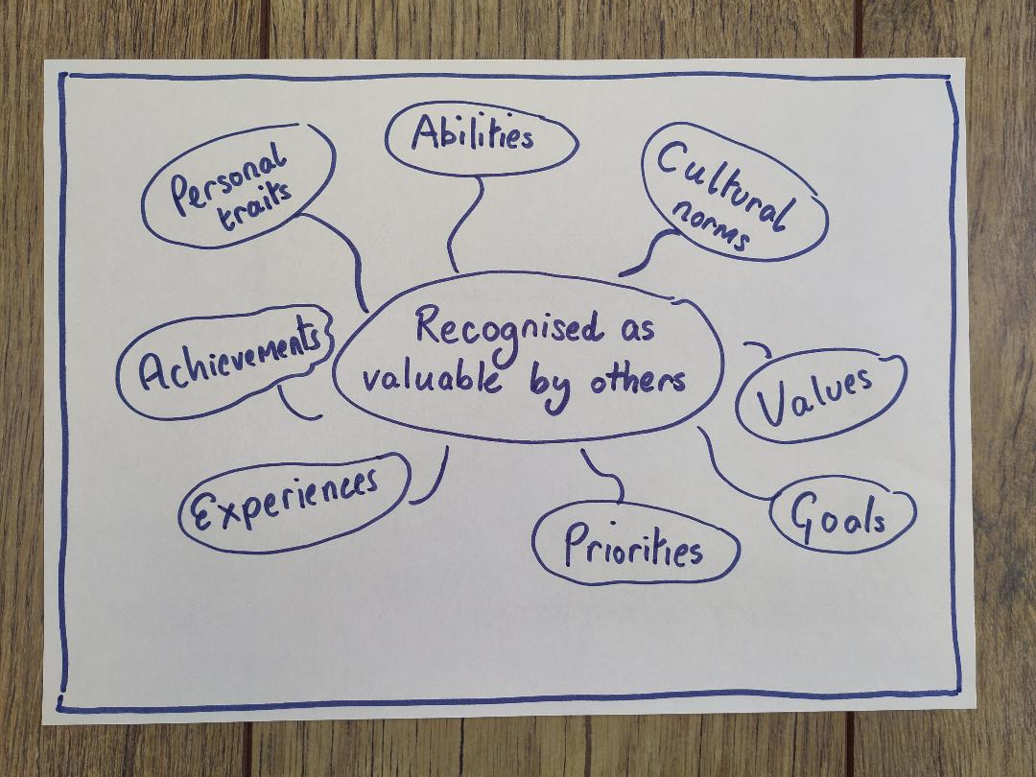
Social justice as recognition
Iris Marion Young (2011)
Axel Honneth (1996)

Slide 7
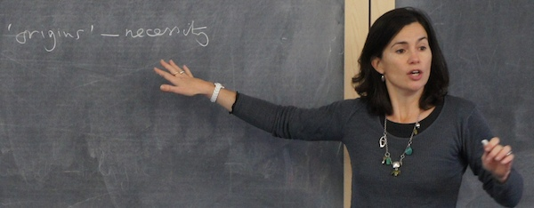
Epistemic injustice
‘People wronged in their capacity as knowers’
Miranda Fricker (2007)
Testimonial injustice
Hermeneutical injustice
'at an unfair disadvantage when it comes to making sense of their experience'

Slide 8
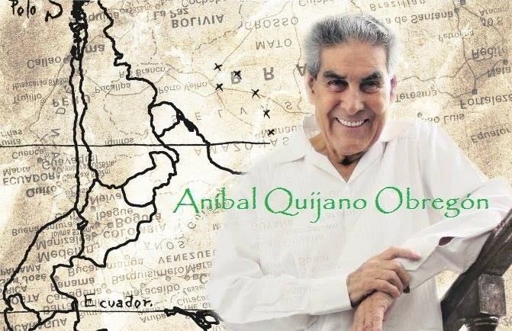
Epistemic injustice
Systems of knowledge are part of systems of power
‘Coloniality’ Aníbal Quijano

Slide 9
Hermeneutical justice
People and communities recognised in their capacity as meaning-makers

Slide 10
CONTEXT
Erasmus Mundus project
Enhancing studies and practices of Social and Solidarity Economy in higher education
4 partners from Portugal, Peru, Spain, United Kingdom

Slide 11
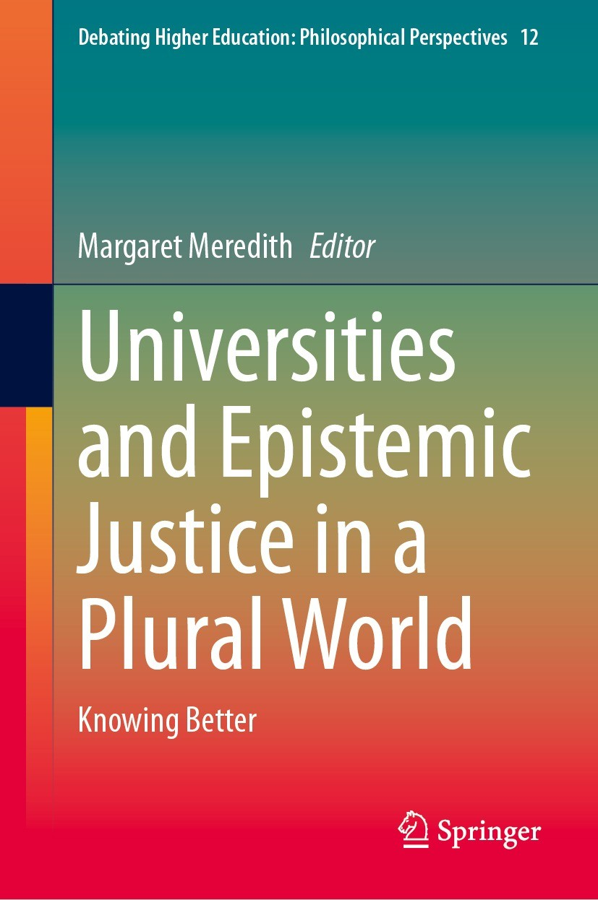
Chapter: ‘Hermeneutical justice in an international Erasmus Mundus project’

Slide 12
2. How have we worked these ideas out in practice?
Ana María Villafuerte Pezo

Slide 13
How might we work towards knowledge justice in our contexts?
What knowledge and which knowers tend to be delegitimised or favoured?
The experiential and life lessons in the Erasmus project

Slide 14

What knowledge and which knowers tend to be delegitimised or favoured?
Distinguished audience, it’s a privilege for me to be with you and share our experiences about how we live epistemic justice in practice. This leads us to the question:
In order to answer, I want to start from the backwardness-progress paradigm. Throughout the history of humanity, societies have always gone through processes of change in search of greater and better states of life. This has led to the idea of processes of change or transformation from backwardness to progress.

Slide 15
What knowledge and which knowers tend to be delegitimised or favoured?
Backwardness has always been linked to the traditional and progress to the modern. The traditional has been considered inferior, while the modern as something superior. And this, in the field of knowledge, has implied that everything that has come from the most traditional societies has been invalidated and the knowledge generated in modern societies has been validated because it has been supported by scientific knowledge.
This has led us to a kind of hermeneutical marginalisation, where the knowledge that has been generated in non-Western societies, because it lacks the scientism that today's world demands, has been assumed as ‘less than’. And it is precisely this that leads us to speak of hermeneutical marginalisation or the invalidation of knowledge that arises on this other side of the world.
The societies that have been linked to backwardness have come from non-Western epistemic systems, while progress has been associated with Western epistemic systems.
Backwardness | Progress
Traditional | Modern
Inferior | Superior
Not valid | Valid
Non-Western epistemic systems | Western epistemic systems
Hermeneutical marginalisation

Slide 16

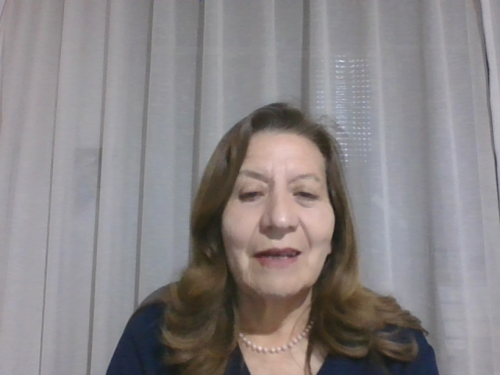
What knowledge and which knowers tend to be delegitimised or favoured?
There are implicit practices, but recurrent and that could even be contradictory to each other:
- On the one hand, we tend to assign greater value to the foreign than to the local
- And, on the other hand, we tend to assume that only our own is valid
But hermeneutical marginalisation not only between the Western/rational/scientific and the non-Western; but in everything that is different from us.
For example: Many times we consider that what comes from Europe or the United States is better than what we have in other latitudes or that what comes from capital cities is better than what comes from the interior of the country or that the urban is better than the rural, or the industrial than the agricultural.
Hermeneutical marginalisation – not just between
Western/rational/scientific | Non-Western
But also in everything that is different from us

Slide 17
What knowledge and which knowers tend to be delegitimised or favoured?
But, on the other hand, we also fall into a kind of chauvinism when we deny that everything that comes from other latitudes is not valid for our realities and that only our knowledge is enough for us. All this implies a kind of hermeneutical marginalisation.
In this context, we propose epistemic justice as the recognition and respect of difference. It is not only a matter of valuing or recognising. It's about recognising and respecting, it's about a process in which we learn from each other.
Epistemic justice = recognition of, and respect for, difference.
I learn, you learn, together we learn

Slide 18

How might we work for knowledge justice in our specific contexts?
We need an intercultural gaze that starts from otherness, instead of confrontational gazes regarding what is different from us. We need to learn to accept and not deny that which is not like us. We need to learn to recognise ourselves in the other, as human beings.
From the global South we assume that the ways of knowing and understanding the world that are directly linked to well-being and that value harmony and reciprocity between human beings and between them and their natural environment are part of what we understand as the epistemology of the South (UNESCO 2015: 31).

Slide 19

The experiential and life lessons in the Erasmus project
We were a team with researchers from different latitudes, who spoke different languages, who did not know each other, who had different ideologies, but who shared an interest in the same research topic.
At first, the epistemic superiority of some European partners, and the need the Latin Americans had to feel heard, was a bit complicated. We were engaged in long discussions in which sometimes we did not want to give in. But, little by little, this behaviour gave way to respect for the diversity of knowledge and the deconstruction of preconceived knowledge and stereotypes about others, in order to become ourselves.

Slide 20
The experiential and life lessons in the Erasmus project
We had to unlearn in order to apprehend reality. We could no longer pretend that reality conformed to theoretical assumptions or theories in general, because reality was speaking, and reality needed to be heard. But that implied getting rid of our ego and all the conceptual baggage we had behind us.
The experience is that we learned to listen, to dialogue and to agree to build the content of the manual under the horizontal leadership of Margaret and Catalina.

Slide 21
3. 5-day partners' strategic planning meeting: The ‘how’
Catalina Quiroz-Niño

Slide 22
Aim:
To share how we dealt with partners' assumptions, experiences, project
processes, outputs and outcomes
5-day partners' strategic planning
meeting: How?
​

Slide 23
CONTEXT
Who: 10 partners
4 universities
Global North: UK (2), Spain (2) and
Portugal (2)
Global South: Peru, the Andean region (4)
Where: at York St John University, York, UK
Aims: To co-create and gain collective ownership
of the 3-year Erasmus Mundus project.

Slide 24
PROJECT LEADERS' KEY ASSUMPTIONS
Roles: project partners as project leaders in their own context and facilitators.
Methodology: a participatory and dialogical approach.
Relationship: all partners to be considered and treated equally different

Slide 25
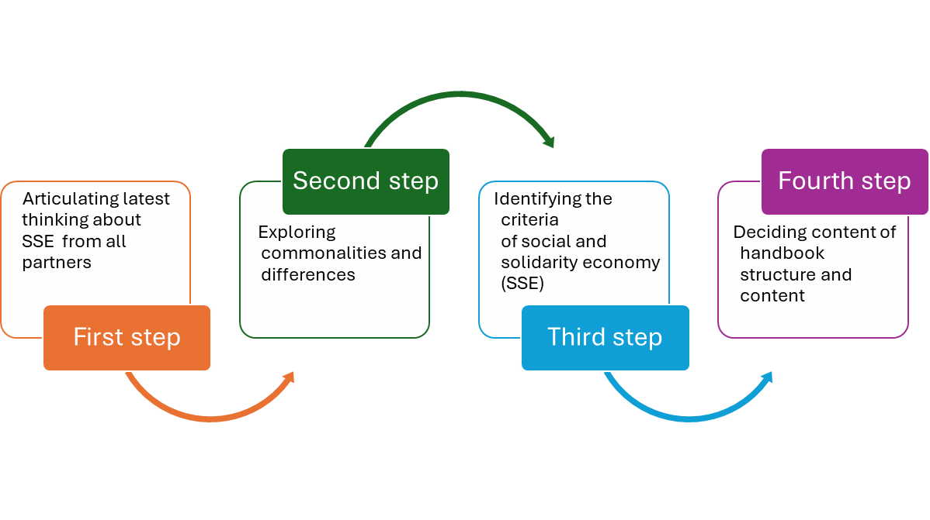

Slide 26
FIRST STEP:
Articulating latest thinking about SSE from all partners
.
Share relevant data about the social and solidarity economy (SSE)
within their own contexts.
Counteract any misunderstandings,asking for specific examples and cases

Slide 27
SECOND STEP:
Exploring commonalities and differences
Identify commonalities and differences about SSE.
Discuss what made them have commonalities and what made them different.
What political, social, cultural, environmental factors perpetuate them.
.

Slide 28
THIRD STEP:
Identifying the criteria of social and solidarity economy (SSE) organisations
Get consensus on how to proceed.
Criteria vs. definitions to adapt to all diversity of notions and practices about SSE

Slide 29
From 11 original chapters in the application, partners decided to have just 9 chapters.
The content was designed through questions.
FOURTH STEP:
Deciding on handbook structure and content

Slide 30
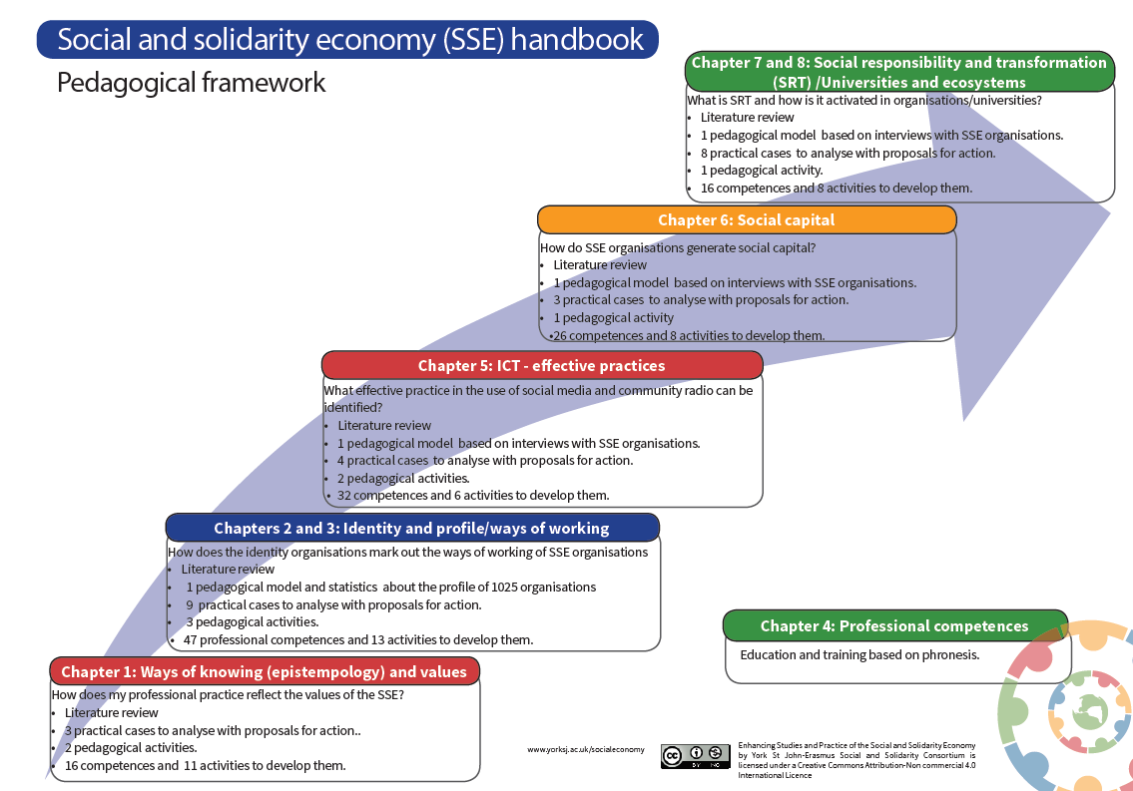

Slide 31
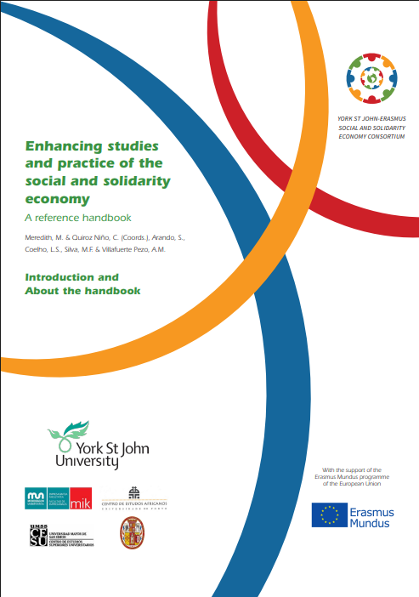
Output SSE handbook for higher education

Slide 32
References
Fricker, M. (2007). Epistemic injustice: Power and the ethics of knowing. Oxford, Oxford University Press.
Honneth, A. (1996). Struggle for recognition: The moral grammar of social conflicts. Translated by Joel Anderson. Cambridge, Polity Press.
Meredith, M. & Quiroz-Niño, C. (Coords.), Arando, S., Coelho, L., Silva, M.F. & Villafuerte Pezo, A.M. (2015). Enhancing studies and practice of the social and solidarity economy: A reference handbook. Available from http://www.yorksj.ac.uk/socialeconomy [Accessed 2nd January 2020].
Quijano, A. (2007). Coloniality and modernity/rationality. Cultural Studies, 21 (2), pp.168–178.
Quiroz-Niño, C., Meredith, M., & Villafuerte Pezo, A.M. (2024). Hermeneutical Justice in an International Erasmus Mundus Research Project. In: Meredith, M. (ed) Universities and Epistemic Justice in a Plural World. Springer, Singapore. https://doi.org/10.1007/978-981-99-9852-4_11
UNESCO (2015). Rethinking education: towards a global common good? Paris, UNESCO Publishing.
Young, I.M. (2011 [1990]). Justice and the politics of difference. With a new forward by Danielle Allen. Princeton, NJ, Princeton University Press.

Slide 33
4. Questions and discussion

