Slide 1
Co-producing men’s mental health and suicide prevention research with a charity partner
17th May 2025
Presenters: Dr Gary Shepherd & Holly Murphy
Contact details: g.shepherd@yorksj.ac.uk

Slide 2
Overview: Male Suicide
Men tend to treat symptoms of anxiety and depression differently.
Men often hide their feelings, withdraw from social life and ruminate on the stigma of experiencing mental health problems.
If left unchecked, some men may believe their loved ones would be better off if they were dead.
Others may fantasise about killing themselves.
Some men will attempt suicide; others will be successful (Oliffe et.al. 2019).

Slide 3
Overview: Male Suicide
UK men are three times more likely to die by suicide than women. Men aged 45-64 had the highest increase in suicide between 2022 and 2023;
Those at highest risk were men aged between 45-54 (Kirk-Wade, 2024)
Men also manage their mental health differently to women.
Men like to be in community with other men, to play sports, games or work on construction or craft activities.
Although they disregard formal help seeking, men improve their self-esteem and sense of identity through being with other men (Foettinger, 2022 ; Sharp et.al., 2022).

Slide 4
https://www.yorksj.ac.uk/research/institute-for-social-justice/

Slide 5
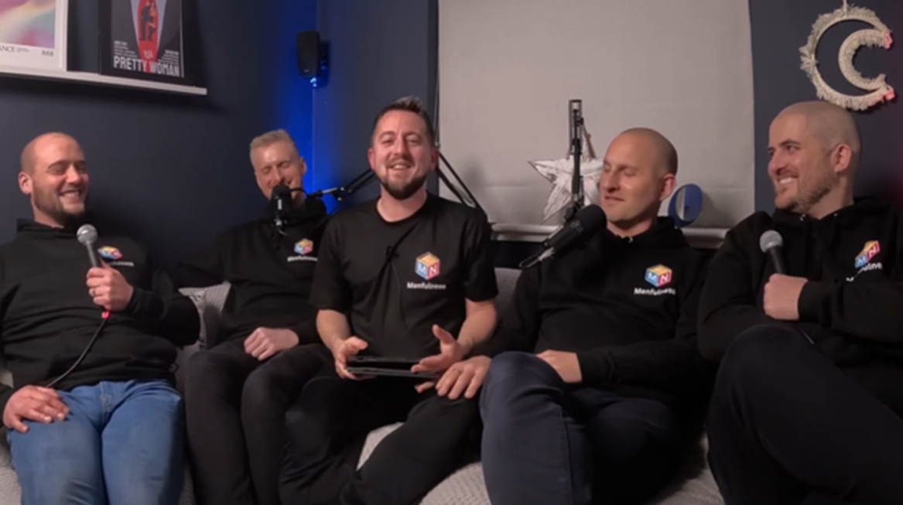
Menfulness York
York based charity
Grassroots organisation
Men’s suicide prevention and mental health wellbeing group
Online and offline support
Facebook, LinkedIn & WhatsApp
Talk group, football group, games night, running group
Menfulness.org

Slide 6
Evaluation of Service
Samaritan’s Key principles - Engaging men earlier: a guide to service design (2021)
250 member Qualtrics survey, along with one-to-one interviews & focus group discussions.

Slide 7
Samaritan’s Key principles - Engaging men earlier: a guide to service design (2021)
The Samaritan’s outline Five key principles for successful men’s wellbeing services:
Use activities to facilitate conversation
Be welcoming and accessible
Communicate clearly
Foster meaningful relationships over time
Foster a sense of achievement

Slide 8
Working with Menfulness
Five trustees
Enthusiastic & Supportive
Full-time professionals
Gatekeepers to membership
Access to WhatsApp and Offline groups
Aspirations to grow Menfulness through research

Slide 9
Researcher reflexivity
Considered personal reflexivity by examining gender dynamics
Reflecting on gender is crucial in studies focused on men and masculinity to address researcher privilege and oppression (Lefkowich, 2019)
Mixed-gender teams encourage diverse perspectives and inclusivity

Slide 10
Researcher reflexivity
Clarifying roles and experiences during initial meetings
Ensuring shared understanding and promoting open communication to mitigate potential gender-based power dynamics.
Implications of a female researcher in a male mental health service.
Holly chose not to join the male-only WhatsApp group, recognizing potential ethical problems of service users who had joined under the auspices of a safe male space.

Slide 11
Power dynamics
Interpersonal reflexivity considering the diverse backgrounds of each co-researcher and the potential for power dynamics.
Gary brings experience as both a researcher and practicing therapist
Holly a postgraduate trainee counsellor
Jack has extensive service experience, while Sam is relatively new to the service, both have personal experiences with mental health challenges.
Power dynamics were acknowledged with Gary & Holly holding academic knowledge and Jack & Sam holding practitioner knowledge and controlling participant access.
Open communication through regular research meetings and a Whatsapp group where they could address issues around the power dynamics and how these were influencing the research process (Finlay, 2002; Koopman et al., 2020; Olmos-Vega et al., 2023) .

Slide 12
Research Results

Slide 13
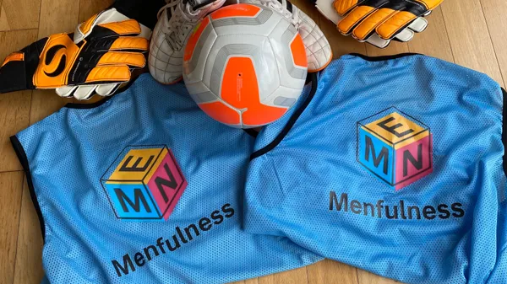
Social Football
“The football was the first thing I came down to and what struck me first about it was how welcoming everybody was. I think football has a thing of being a bit toxic at times and I've never found that down at the [Menfulness] football group and I think that just promotes such a good environment for people to chat and speak afterwards, after the footy is finished.”

Slide 14
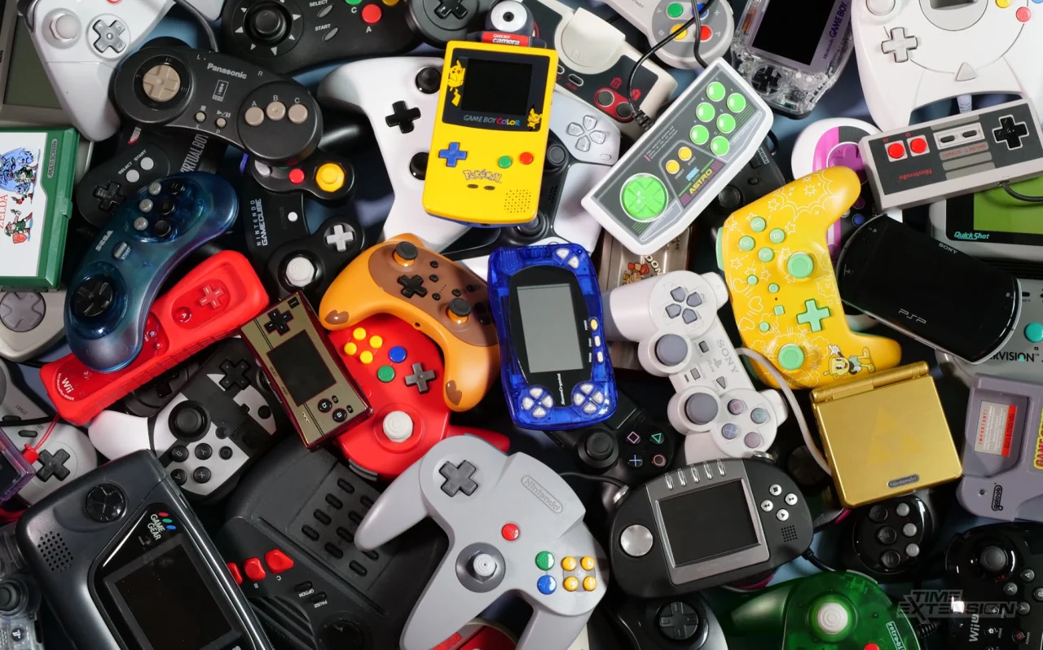
Retro Games Night
“Men generally don't want to do that competitive stuff. It's like you get that in other in other areas... I mean you compete at work, and you compete in dating and every other [aspect]. It's quite nice to have a realm where you don't have to compete. There's no pressure to come. You don't get points for coming to more events. ”

Slide 15
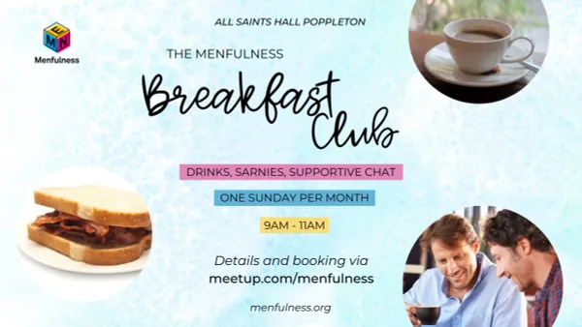
Breakfast club
“There was a few sat on one table, and I was a bit unsure, so I went to the other side and just them calling across and saying, ‘look, come sit over here. You've done it now! You're through the door, you’re here! Come on, come and join us over here’. Yeah, that was reassuring.
One of them, he pulled up the chair and said ‘come over here and can I get you anything?’ And I was like, yeah, I’ll have a coffee, please. But he was just amazing and just so reassuring. Like, you’ve done it now, you’ve made that big leap – let me look after you.”

Slide 16
Knights Talk Group
“The societal expectations and the weight that's been placed upon us as men is harmful. Is damaging individually and it's damaging to society, but the first time I walked in the door I was expecting a bunch of men and instead I saw a bunch of vulnerable human beings who [were] really talking.”

Slide 17
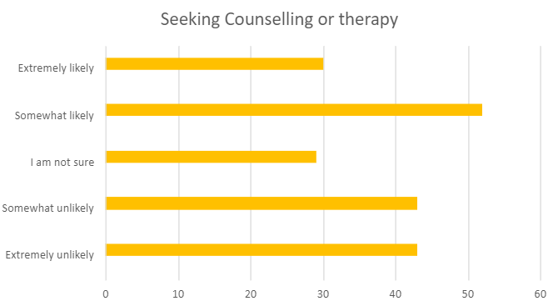
Seeking Counselling: Before Menfulness
43 participants reported being extremely unlikely to seek counselling or therapy before their involvement with Menfulness
43 participants reported being somewhat unlikely to seek counselling or therapy before their involvement with Menfulness
52 participants reported being somewhat likely to seek counselling or therapy before their involvement with Menfulness
30 participants reported being extremely likely to seek counselling or therapy before their involvement with Menfulness

Slide 18
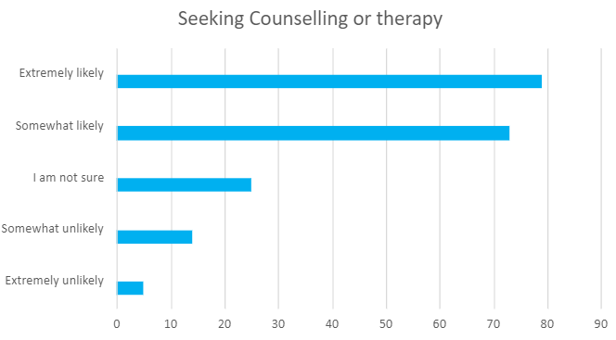
Seeking Counselling: After Menfulness
5 participants reported being extremely unlikely to seek counselling or therapy since their involvement with Menfulness
14 participants reported being somewhat unlikely to seek counselling or therapy since their involvement with Menfulness
73 participants reported being somewhat likely to seek counselling or therapy since their involvement with Menfulness
79 participants reported being extremely likely to seek counselling or therapy since their involvement with Menfulness

Slide 19
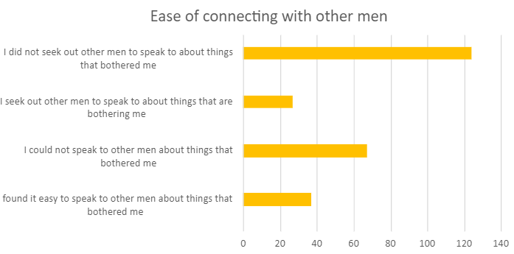
Ease of connection: Before Menfulness
Before their involvement with Menfulness 124 participants did not seek out other men to speak to
Before their involvement with Menfulness 27 participants often sought out other men to speak to
Before their involvement with Menfulness 67 participants could not speak to other men
Before their involvement with Menfulness 37 participants found it easy to speak to other men

Slide 20
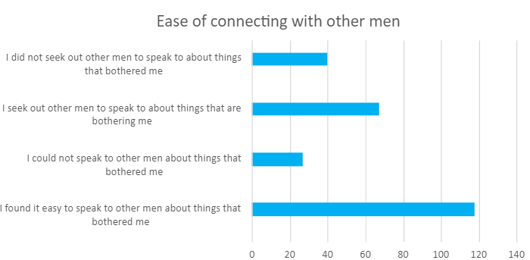
Ease of connection: Since Menfulness
Since their involvement with Menfulness 40 participants did not seek out other men to speak to
Since their involvement with Menfulness 67 participants often sought out other men to speak to
Since their involvement with Menfulness 27 participants could not speak to other men
Since their involvement with Menfulness 118 participants found it easy to speak to other men

Slide 21
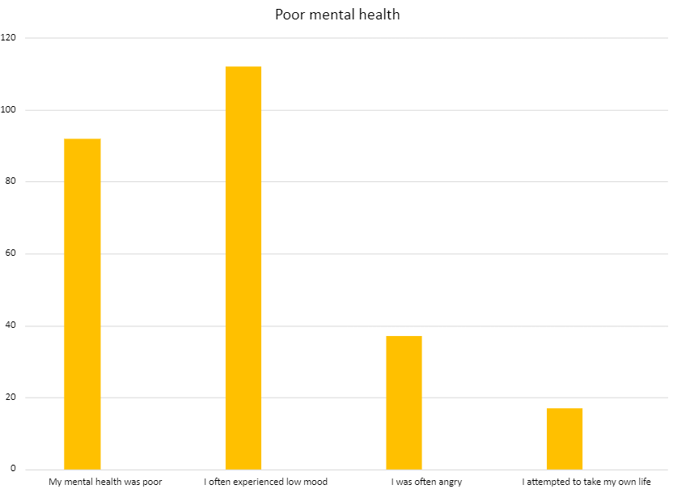
Mental Health: Before Menfulness
92 participants reported experiencing poor mental health
112 participants often experienced low mood
37 participants often experienced anger
17 participants reported having attempted to take their own life

Slide 22
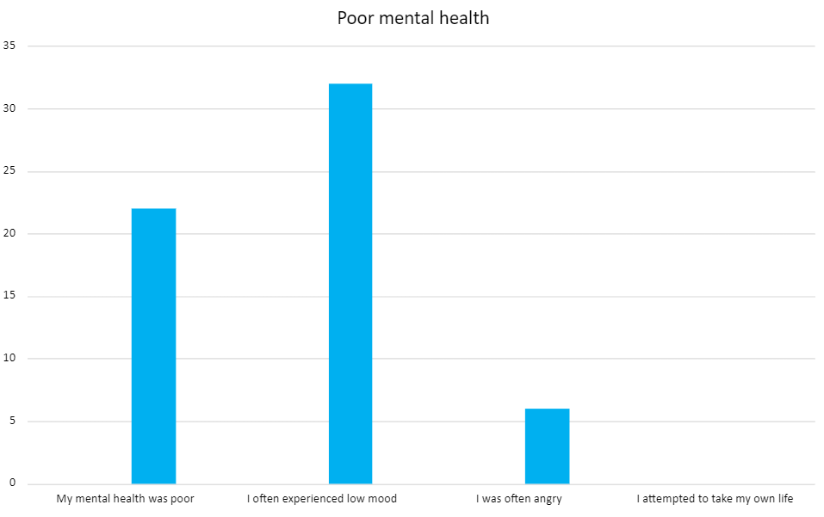
Mental Health: After Menfulness
Since becoming members of Menfulness, the data shows significant improvements in men’s mental health:
The number of participants reporting poor mental health decreased to 22
32 participants continued to experience low mood often
Reports of frequent anger dropped to 6 participants
Most notably 0 men reported having attempted to take their life

Slide 23
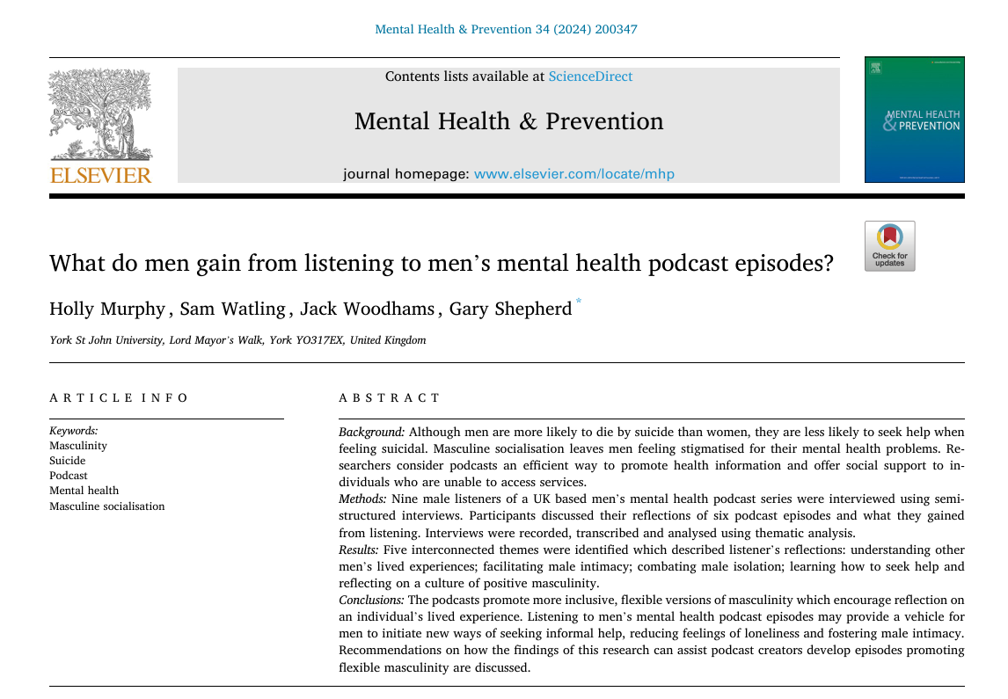
Outcomes
The project has fostered stronger community ties and opened new opportunities for collaboration.
We successfully secured further funding to extend the project until March 2025,
Successfully bid for £100,000 funding for Menfulness in Scarborough
Academic journal article asking what men gained from listening to the Menfulness podcast (Murphy et al., 2024)
Creating community impact online workshops delivered to non-profits

Slide 24
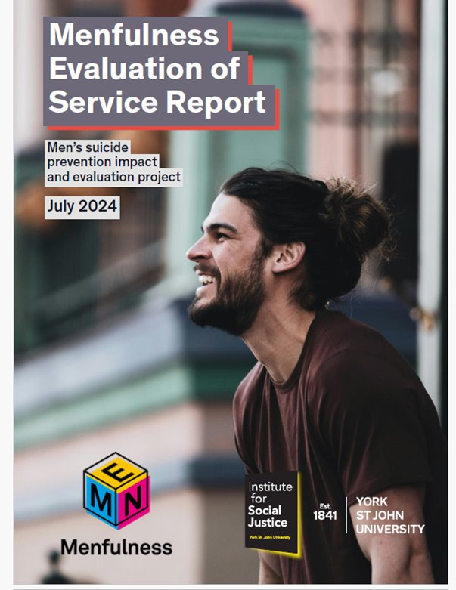
Reflections of working with a charity partner
Academic aims are slightly different to charities aims
We speak two different languages, expectations are different!
Gatekeepers are often busy!
Time management is often impacted
Being included in charity partner's social media is useful
Building trust and creating relationships on both sides
Strengthening ongoing collaboration through delivering objectives

Slide 25
References
​Finlay, L. (2002). Negotiating the swamp: the opportunity and challenge of reflexivity in research practice. Qualitative research, 2(2), 209-230.
Foettinger, L., Albrecht, B. M., Altgeld, T., Gansefort, D., Recke, C., Stalling, I., & Bammann, K. (2022). The role of community-based men’s sheds in health promotion for older men: a mixed-methods systematic review. American Journal of Men's Health, 16(2), 15579883221084490.
Kirk-Wade, E., Harker, R., & Stiebahl, S. (2024, July). NHS key statistics: England.
Koopman, J., Lin, S. H., Lennard, A. C., Matta, F. K., & Johnson, R. E. (2020). My coworkers are treated more fairly than me! A self-regulatory perspective on justice social comparisons. Academy of Management Journal, 63(3), 857-880.
Lefkowich, M. (2019). When women study men: Gendered implications for qualitative research. International Journal of Qualitative Methods, 18, 1609406919872388.
Murphy, H., Watling, S., Woodhams, J., & Shepherd, G. (2024). What do men gain from listening to men's mental health podcast episodes?. Mental Health & Prevention, 34, 200347.
Oliffe, J. L., Rossnagel, E., Seidler, Z. E., Kealy, D., Ogrodniczuk, J. S., & Rice, S. M. (2019). Men’s Depression and Suicide. In Current Psychiatry Reports (Vol. 21, Issue 10). Current Medicine Group LLC 1. https://doi.org/10.1007/s11920-019-1088-y
Olmos-Vega, F. M., Stalmeijer, R. E., Varpio, L., & Kahlke, R. (2023). A practical guide to reflexivity in qualitative research: AMEE Guide No. 149. Medical teacher, 45(3), 241-251.
Samaritan’s Key principles - Engaging men earlier: a guide to service design (2021) https://media.samaritans.org/documents/Samaritans_Handbook_for_mens_wellbeing_services_2021.pdf
Sharp, P., Bottorff, J. L., Rice, S., Oliffe, J. L., Schulenkorf, N., Impellizzeri, F., & Caperchione, C. M. (2022). “People say men don’t talk, well that’s bullshit”: A focus group study exploring challenges and opportunities for men’s mental health promotion. Plos one, 17(1), e0261997.

Slide 26
Questions?

Slide 27
Thank you
Contact details
Name: Gary Shepherd
Title: Dr.
Telephone: 01904 876103
Email: g.shepherd@yorksj.ac.uk

