Slide 1
Contribution of HRD to social justice: A bibliometric analysis
Dr. Alan Johnston

Slide 2
Agenda
Rationale for the study
Key literature
Methodology
Bibliometric Analysis
Key Findings
Research Opportunities and directions

Slide 3
Rationale and Research Questions
Byrd, M.Y. (2018) Does HRD have a moral duty to respond to matters of social justice? Human Resource Development International. 21(1) 3-11
Organisations are prone to manifestations of social injustice (Bian, 2020)
Both a social justice case and a business case for diversity (Byrd and Sparkman, 2022)
a need to embed it into HRD education (Bohonos et al., 2019)
RQ1: How has research linking HRD and social justice developed since the 2018 call for a research agenda?
RQ2:What are the potential directions for the empirical development of social justice research in the HRD field?

Slide 4
Literature Base
“social injustice can be either an overt or covert act or behaviour that is intended to demean or degrade by calling attention to the person’s social identity, or to remind emphasize and remind the person of their marginalised location in society”. Byrd (2018 p3)
marginalisation is endemic within organisations and the pandemic has reinforced social injustice (Salcedo et al., 2022).
HRD is the tool to address it
HRD has an ethical responsibility to challenge injustices both inside organisations and in wider society. (Trivedi and Ray, 2024)
Negative impact on organisational performance (Alqahtani et al., 2024; Byrd and Sparkman, 2022)

Slide 5
Literature Base (2)
Research is done to or done on marginalised groups (Bohonos, 2019; Kwon and Archer, 2022; Kwon, 2024)
White and western bias (Bohonos and James-Gallaway, 2022)
Volatile and complex operating environment – a HRD rethink (Kwon and Kwon, 2024)
Central presence (Collins and Zhang, 2021)
Adoption of learning and development techniques / activities that integrate individuals and promotes social inclusion. (Grenier et al., 2022)

Slide 6
Methodology (1)
Bibliometric Analysis
Quantitative
Bibliographic analysis
Increasingly common (Passas. 2023)
3-Rs Protocaol (Coombes, 2024)
Retrieve
Review
Report

Slide 7
Methodology (2)
Data Collection
Web of Science Core Collection Database
Search parameters
(("HRD" OR "Human Resource Development") AND ("Social Justice" OR "Moral Justice" OR "Social Injustice" OR "Moral Injustice" OR "Moral Duties"))
Source Type: Journal Articles
Language: English
Analysis through VOSviewer

Slide 8
Table 2: Top 7 journals to have published research on HRD and Social Justice between 2004-2024 (source: Web of Science)
Rank | Journal Title | Number of Articles | %
1 | HRD Review | 8 | 20
2 | Advances in Developing Human Resources | 6 | 15
3 | New Horizons in Adult Education and HRD | 6 | 15
4 | European Journal of Training and Development | 4 | 10
5 | HRD Quarterly | 4 | 10
6 | HRD International | 3 | 7.5
7 | Adult Education Quarterly | 2 | 5
8-15 | Remaining academic journals: each publishing two or one article(s) in the dataset | 7 | 17.5
Totals |  | 40 | 100

Slide 9
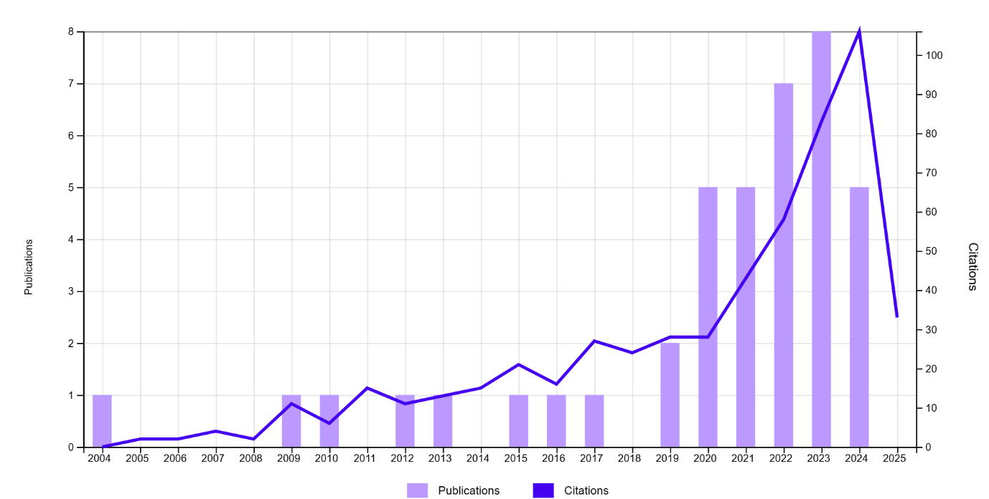
Figure 1: Number of published articles and accompanying citations per annum between 2004-2024 (Source: Web of Science)

Slide 10
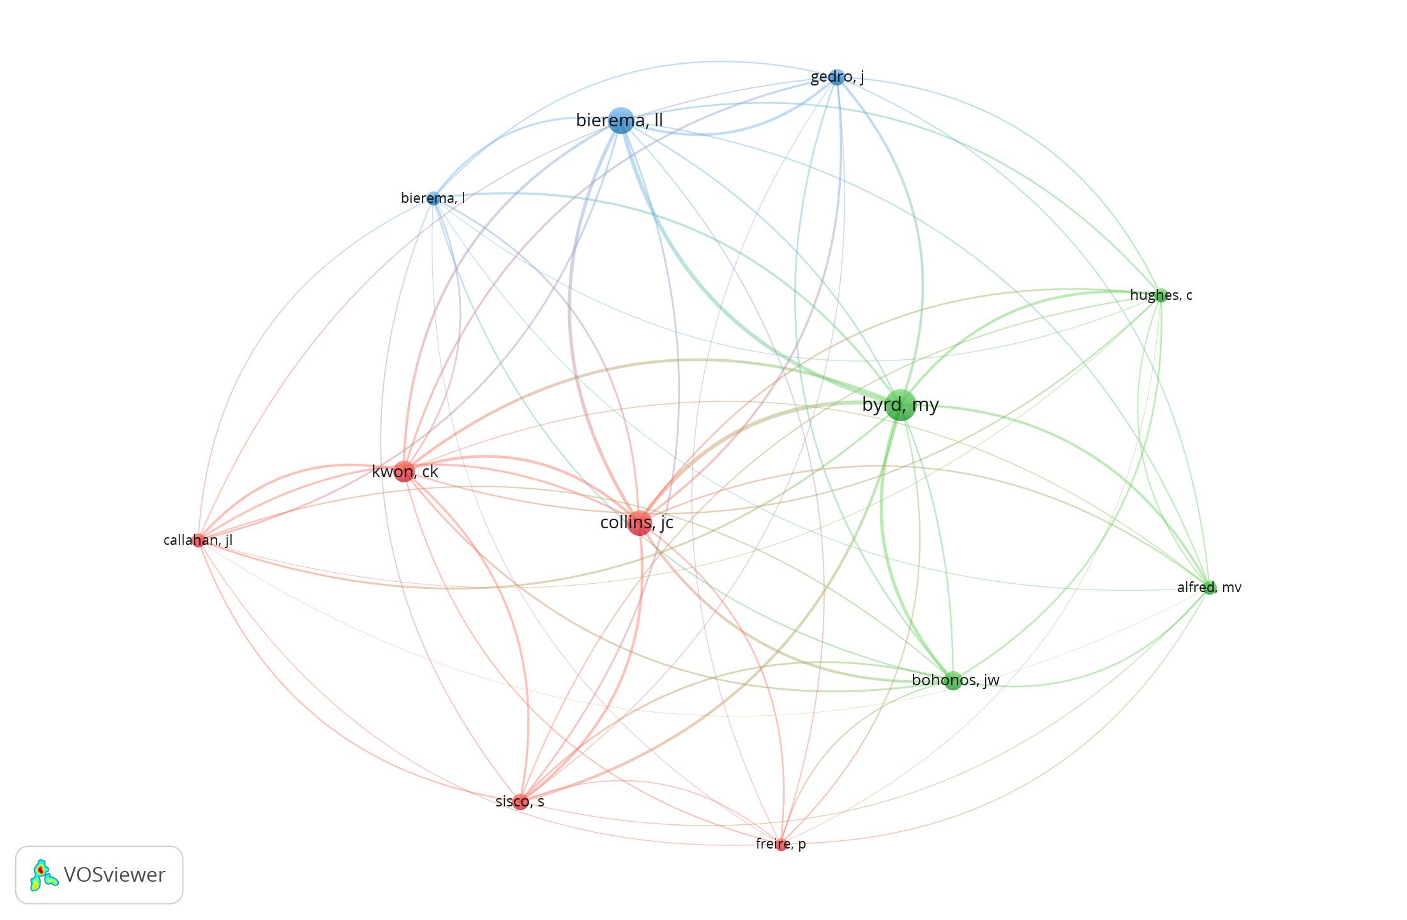
Figure 2: Author Co-citation analysis (source: VosViewer)

Slide 11
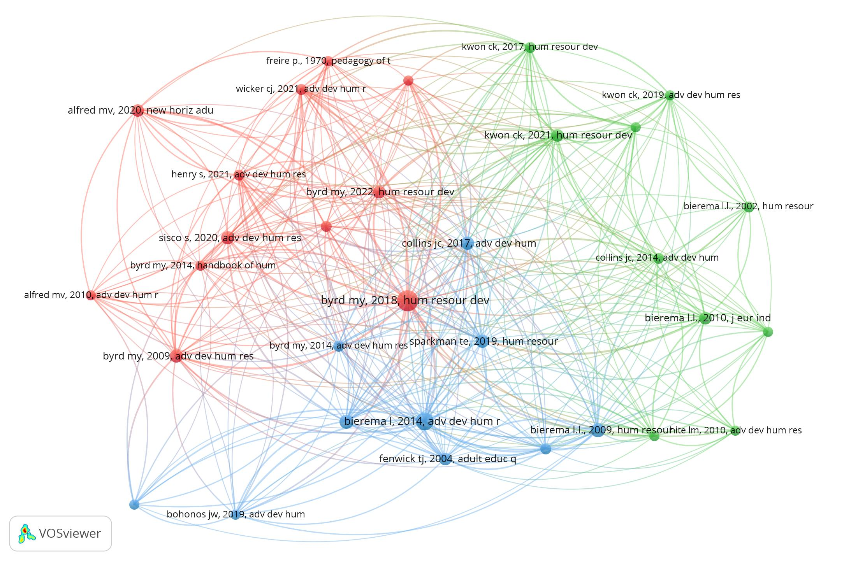
Figure 3: Co-citation analysis of references (source: VosViewer)

Slide 12
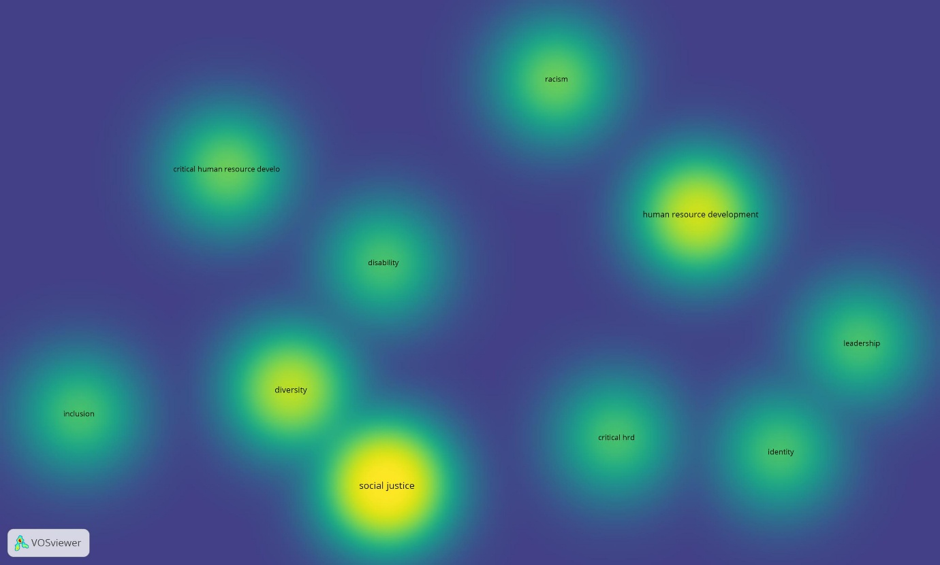
Figure 4: Density visualisation of author keywords

Slide 13
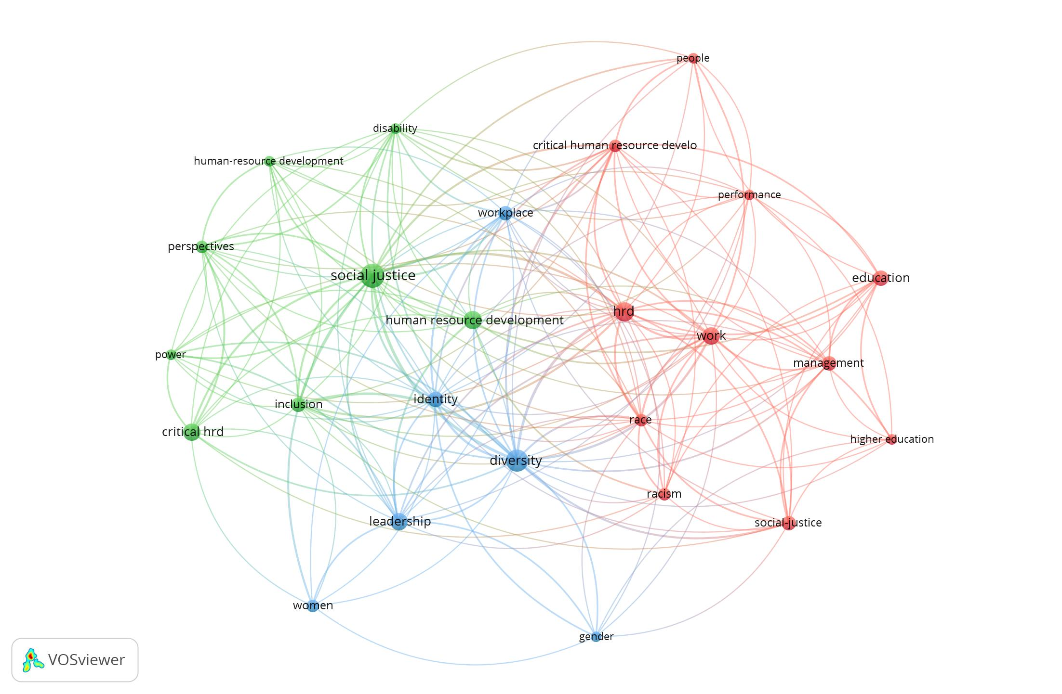
Figure 5: Co-occurrence analysis of all keywords

Slide 14
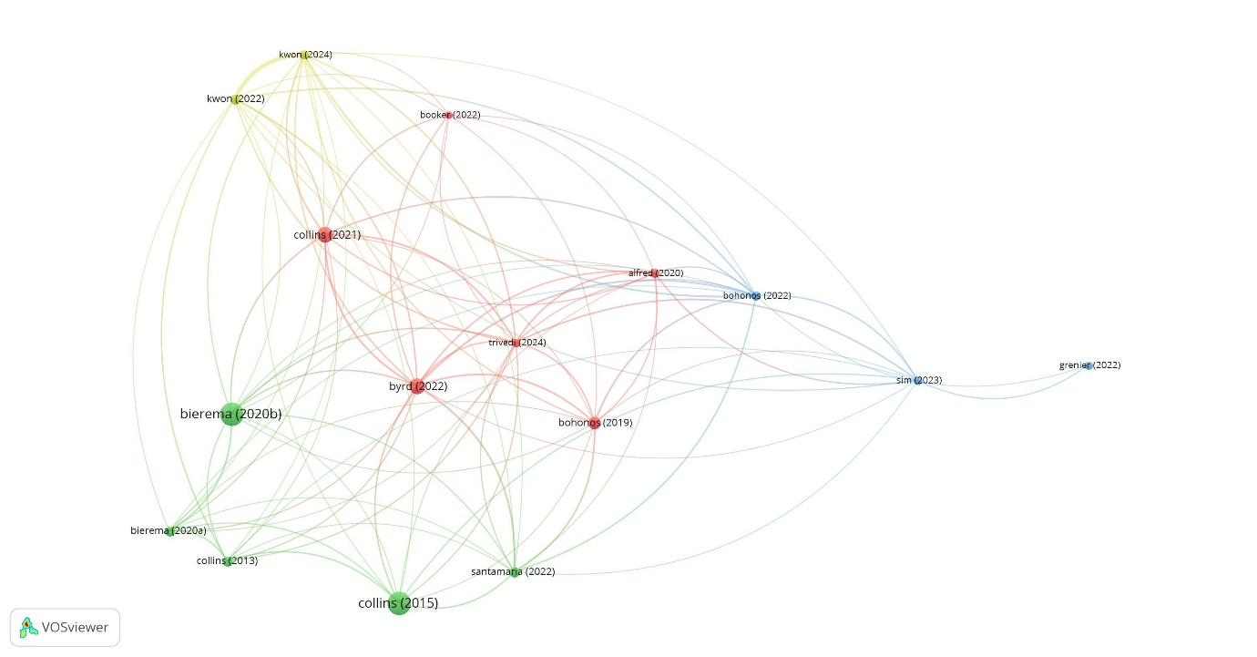
Figure 6: Bibliographic coupling of documents (Source: VOSViewer)

Slide 15
Future Research Agendas
research beyond the confines of the USA:
research by individuals impacted by social injustices perhaps through collaborative autoethnography:
wider scope of the breadth of social injustices:
impact of social injustice on aspects of psychological contract and psychological climate:
the importance of psychological capital in developing a response to the challenges of achieving and promoting social justice:

Slide 16
Thank you
Dr. Alan Johnston
a.johnston@yorksj.ac.uk
York Business School, York St John University, Lord Mayor’s Walk, York, YO31 7EX.

Slide 17
References
Bian, X.Y. (2020) Employment mismatch from a distributive justice perspective. European Journal of Training and Development. 44(8-9) 829-845
Bohonos, J.W. (2019) Including Critical Whiteness Studies in the Critical Human Resource Development Family: A Proposed Theoretical Framework. Adult Education Quarterly. 69(4) pp315-337.
Bohonos, J.W. and James-Gallaway, A. (2022) Enslavement and the Foundations of Human Resource Development: Covert Learning, Consciousness Raising, and Resisting antiBlack Organizational Goals. Human Resource Development Review. 21(2) pp160-179
Byrd, M.Y. (2018) Does HRD have a moral duty to respond to matters of social justice? Human Resource Development International. 21(1) 3-11
Byrd, M.Y. and Sparkman, T.E. (2022) Reconciling the Business Case and the Social Justice Case for Diversity: A model of Human Relations. Human Resource Development Review. 2(1) 75-100
Coombes, P. (2024). Systematic Review Research in Marketing Scholarship: Optimizing Rigor. International Journal of Market Research, 66(6), 687-693.
Grenier, R.S., Callahan, J.L., Kaeppel, K. and Elliott, C. (2022) Advancing book clubs as non-formal learning to facilitate critical public pedagogy in organizations. Management Learning.53(3) pp483-501.
Kwon, C.K. (2024) Resistance from the margin: An autoethnographic account of academic ableism. Human Resource Development Quarterly. 35(1) pp89-107. DOI: 10.1002/hrdq.21498
Kwon, C.K. and Archer, M. (2022) Conceptualizing the Marginalization Experiences of People with Disabilities in Organizations Using an Ableism Lens. Human Resource Development Review. 21(3) pp324-351.
Kwon, C.K. and Kwon, K. (2024) A conceptual framework for practicing inclusive dialogic organization development in times of uncertainty and complexity. European Journal of Training and Development. 48(5/6) pp592-608
Passas, I. (2024) Bibliometric Analysis: The Main Steps. Encyclopedia, 4(2), 1014-1025.
Salcedo, A., Williams, P., Elias, S., Valencia, M. and Perez, J. (2022) Future direction in HRD: the potential of testimonio as an approach to perturb the dominant practices in the workplace. European Journal of Training and Development. 46(7/8) pp727-739. DOI: 10.1108/EJTD-07-2021-0109
Trivedi, C. and Ray, S.M. (2024) Equity, Empowerment, and Social Justice: Social Entrepreneurship for Formerly Incarcerated Individuals. New Horizons in Adult Education and Human Resource Development. 36(1) pp48-64.

