Slide 1
Exploring Accessible and Inclusive Practices in Hospitality and Tourism through Experiential Learning
Dr Hongrui Zhu
23 June 2025

Slide 2
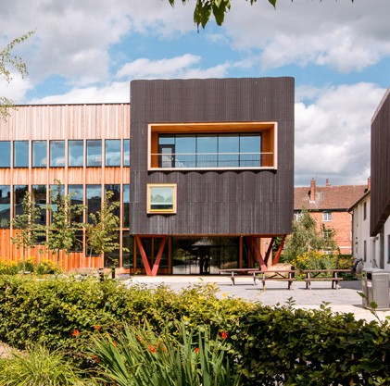
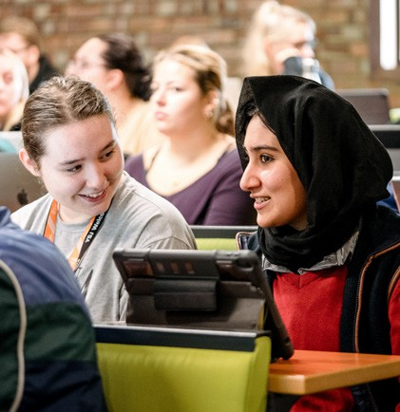
Why Accessibility Matters in Hospitality & Tourism
Ensures inclusive experiences for people with varying abilities
Addresses physical, sensory, cognitive, and temporal barriers
Focus on independence, dignity, and full participation
Increasing relevance in terms of ageing population and invisible disabilities
(Buhalis & Darcy, 2011; Lo Bianco, 2021; WHO, 2011)

Slide 3
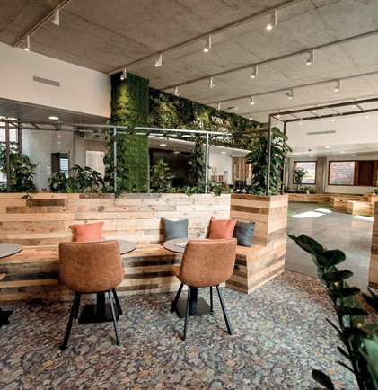
Work-Related Experiential Learning (WREL) at YSJ
Authentically grounded in hospitality contexts (e.g. site visits, field trips guest speakers)
Externally driven: collaboration with The Milner York
Encourages critical reflection in students’ work
Supports future employability and inclusive values
(York St John University, 2023)

Slide 4
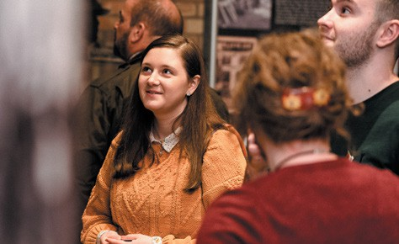
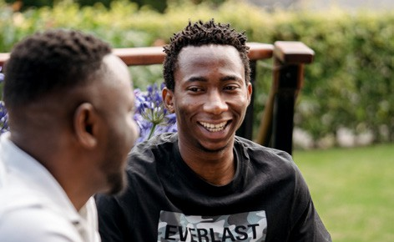
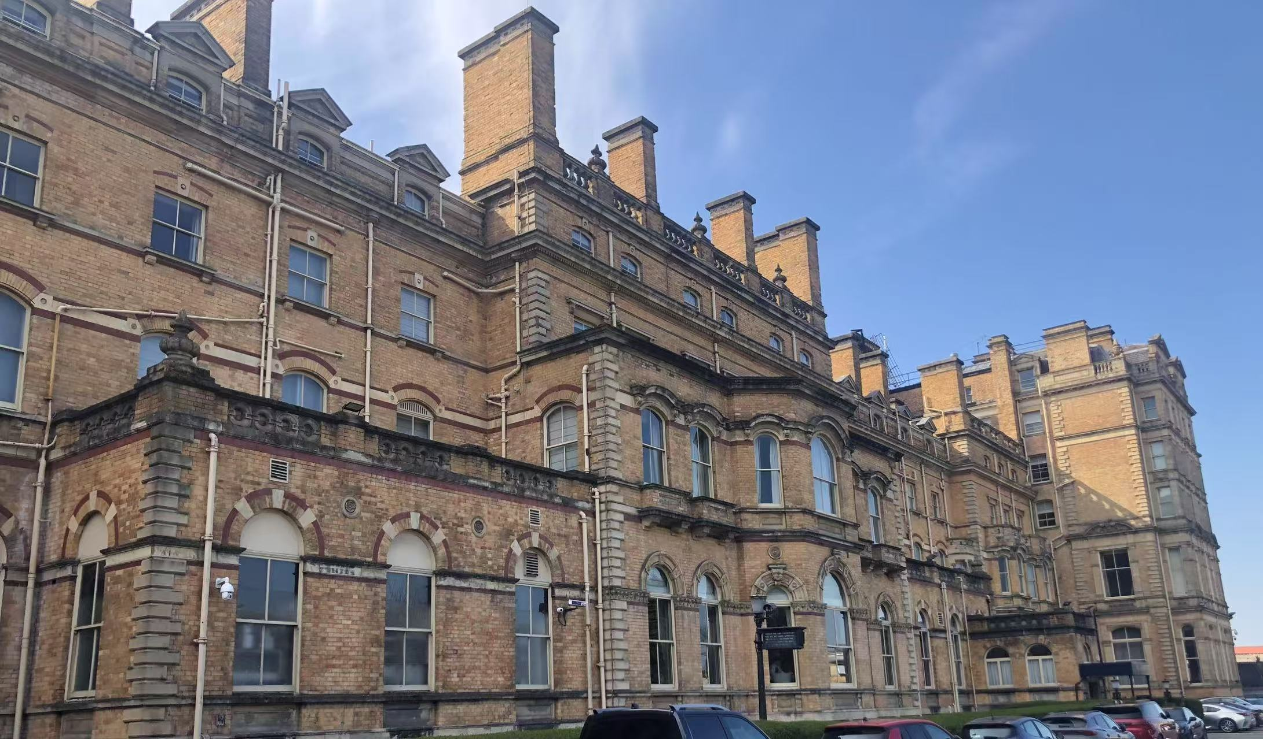
The Milner York
Boutique heritage hotel near York Railway Station
Accessibility positioned as a core value by offering services for guests with physical, sensory, and hidden disabilities
Features drawn from their Accessibility Statement (The Milner York, n.d.)
Accessible ensuite rooms & adjoining carer rooms
Pullcord alarms, dropdown rails, visual alarms in public areas
Assistive tech: vibrating pillows for hearing-impaired guests

Slide 5
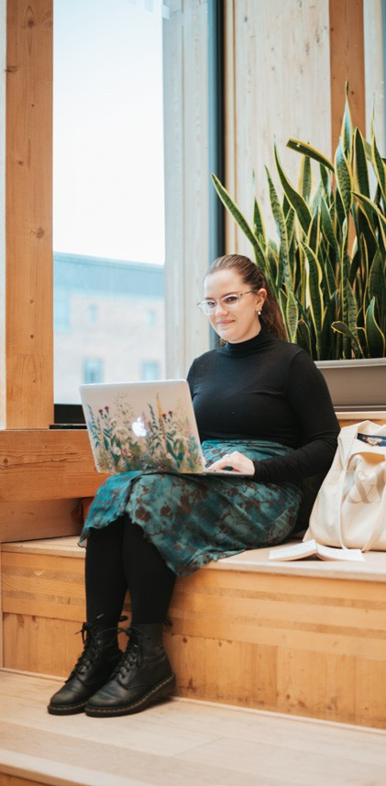
Student Assignment - Designing Customer Profile & Mapping the Customer Journey
Source: https://www.littlehotelier.com/blog/get-more-bookings/what-is-customer-journey-hotel-industry/

Slide 6
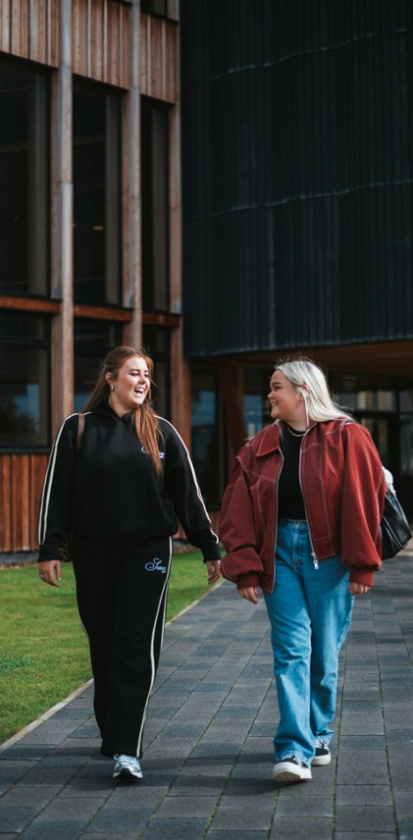
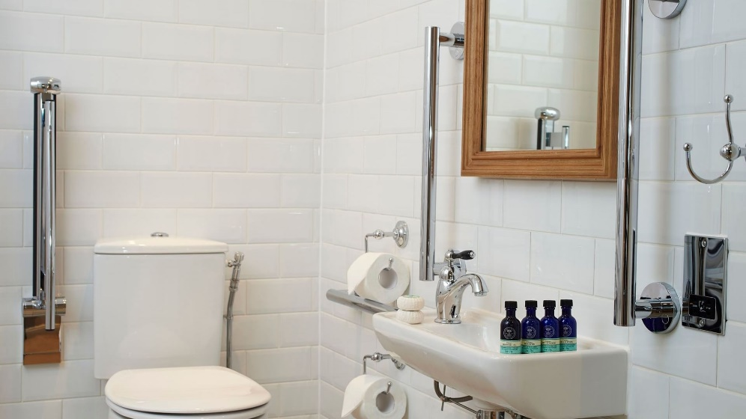
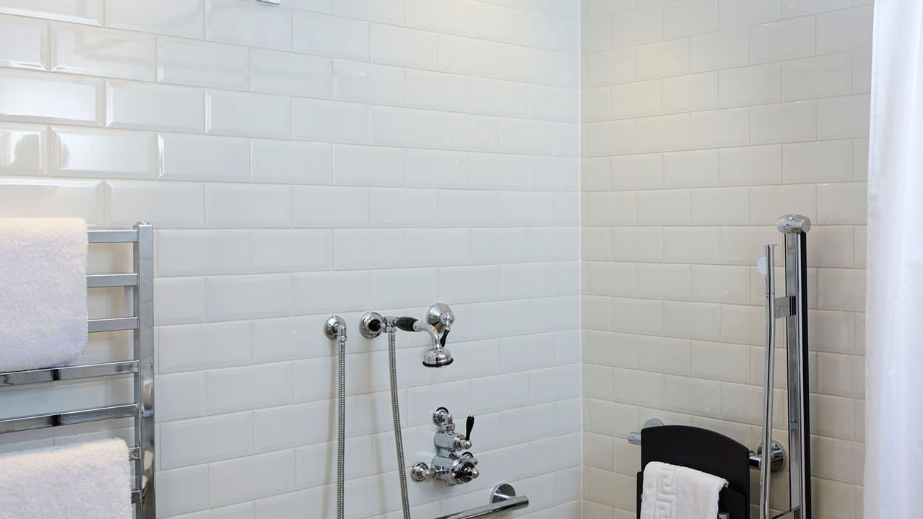
Showcase of Student Works
Customer Profile:
Sarah Middleton (55) and her daughter Kate Bennet (28) are celebrating mother's day.
They desire a relaxing weekend full of pampering and require an accessible room as Sarah uses a wheelchair.
Customer profile:
Lola (24) and her older sister Darcy (28) from Dorset are wanting to visit York for a long weekend.
Lola is deaf and has recently divorced. Recently Lola has been quite unsettled because her guide dog Rex has recently just finished training and is worried about how he will behave in a busy city.
Available on request, any guests with hearing impairments are provided with a vibrating pillow in case of fire evacuation for their bedroom (The Milner York, n.d.)
For illustration purpose only.
Sources: https://www.themilneryork.com/rooms-suites/accessible-bedroom
https://www.geofire.co.uk/2020/11/25/geofire-launches-deaf-alert-home-pillow-alarm-to-wake-hard-of-hearing-in-the-event-of-fire/
For illustration purpose only.

Slide 7
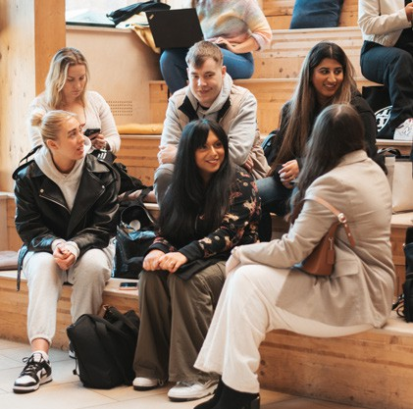
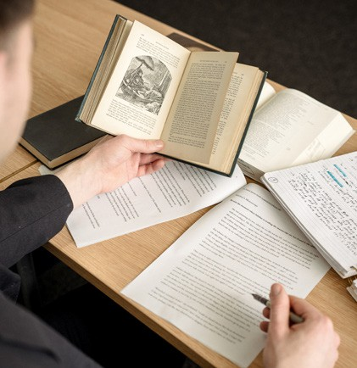
Enhancing Accessibility and Inclusivity with Technologies
Hospitality Applications
Voice-controlled hotel services improve room accessibility for visually impaired guests (Liu et al., 2024).
AI-based virtual concierges support guests with accessibility needs by offering personalized assistance through voice and text interfaces (Kuo et al., 2017).
Tourism Applications
AI-powered technologies allow virtual exploration of physically inaccessible destinations (Ryndach et al., 2021).
Apps like MonuMAI use eXplainable AI to offer visual explanations of architecture, supporting visually impaired visitors (Díaz-Rodríguez & Pisoni, 2020).

Slide 8
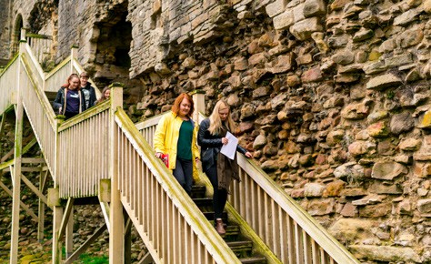
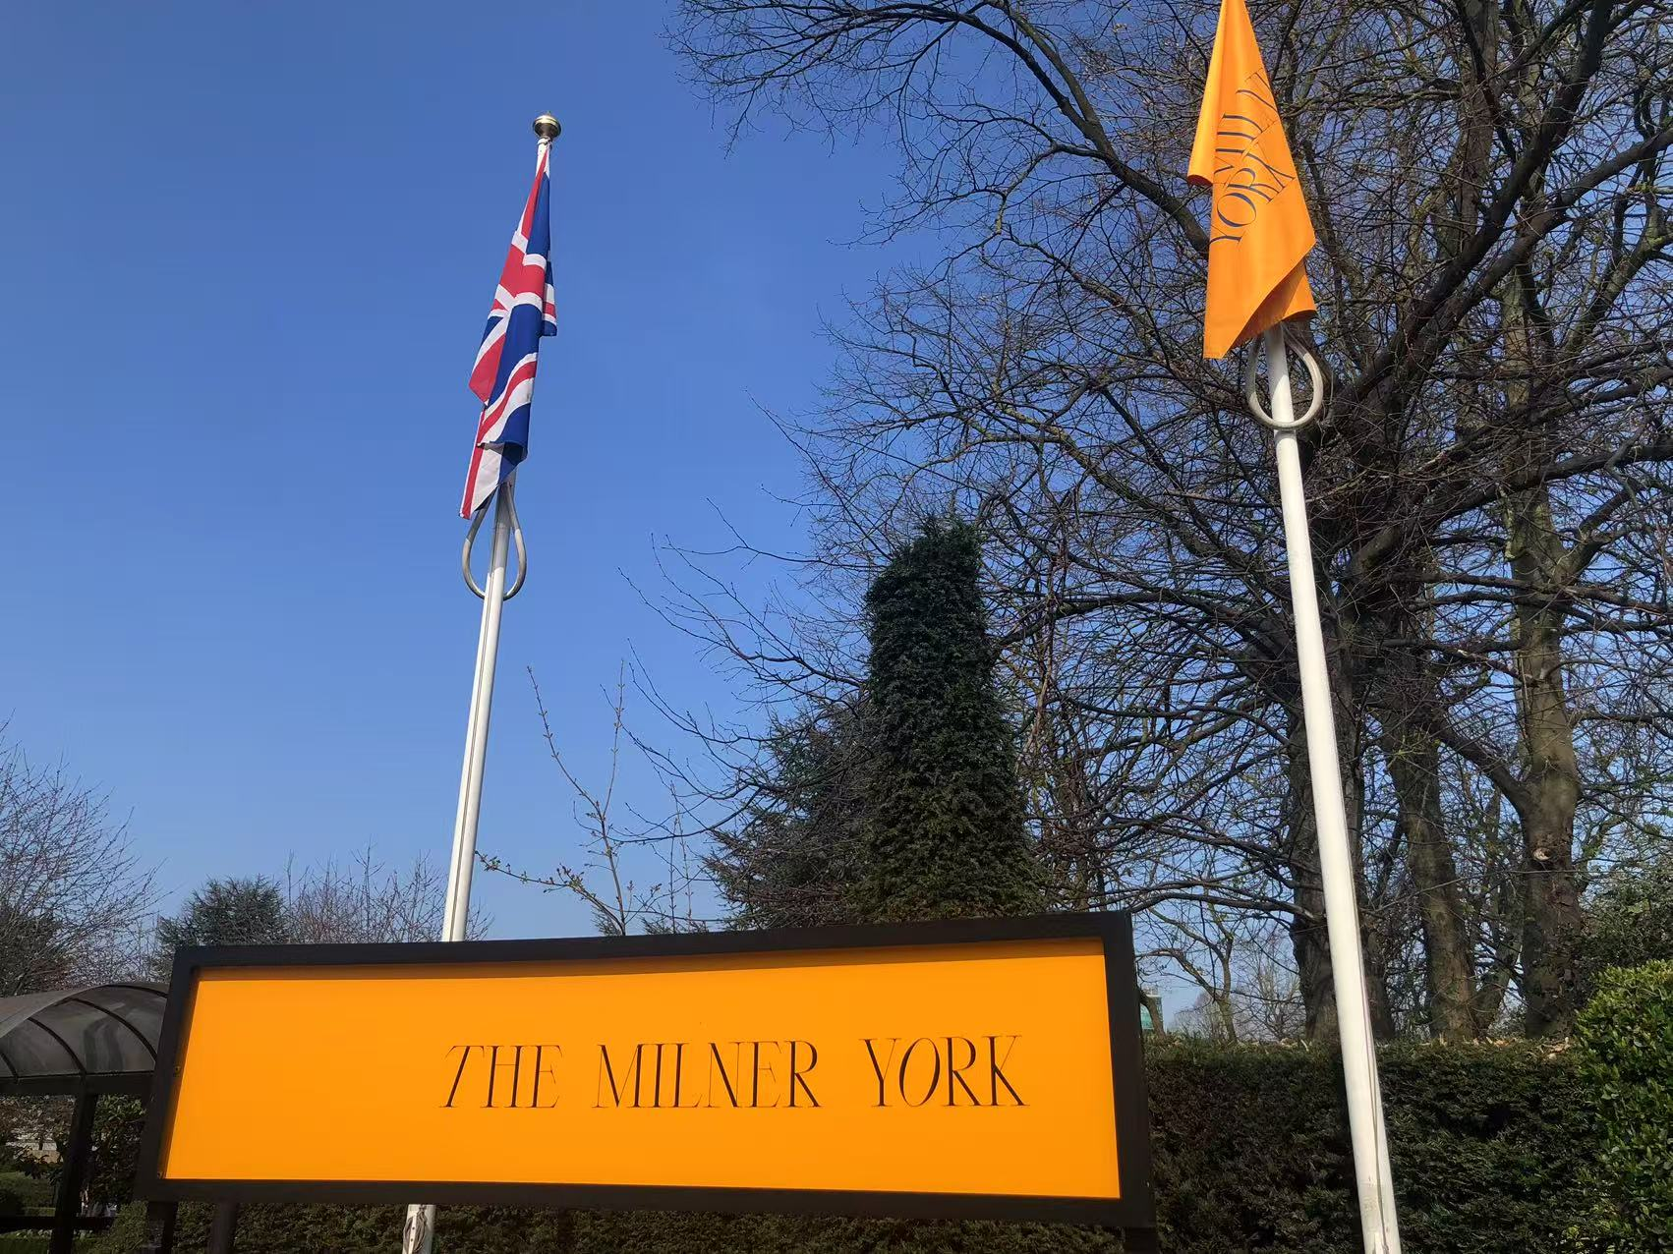
Conclusion
Experiential learning brings accessibility and inclusivity to life.
Students gain critical insight and social awareness.
Hospitality and tourism must evolve with inclusivity at its core.
Education can drive innovation in inclusive hospitality and tourism.

Slide 9
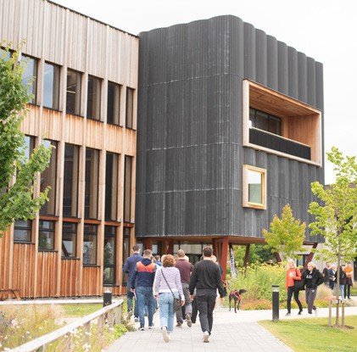
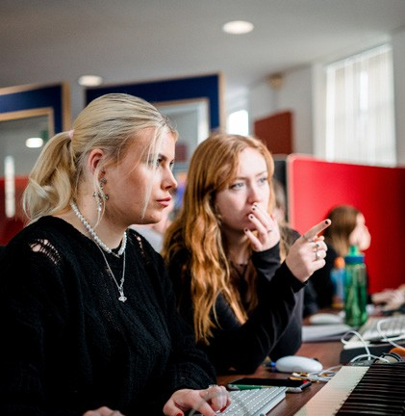
Source: https://medium.com/sales-world/not-just-thank-you-slide-205961b01b96

Slide 10
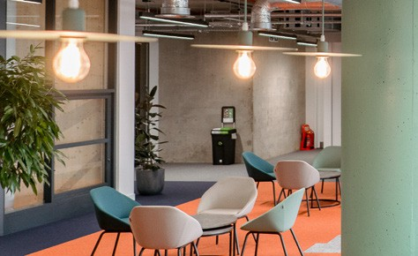
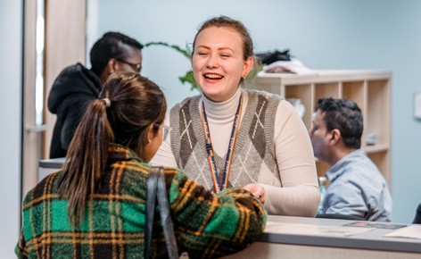
References
Buhalis, D., & Darcy, S. (Eds.). (2011). Accessible tourism: Concepts and issues. Channel View Publications, Bristol.
Díaz-Rodríguez, N., & Pisoni, G. (2020, July). Accessible cultural heritage through explainable artificial intelligence. In Adjunct Publication of the 28th ACM Conference on User Modeling, Adaptation and Personalization (pp. 317-324).
Kuo, C. M., Chen, L. C., & Tseng, C. Y. (2017). Investigating an innovative service with hospitality robots. International Journal of Contemporary Hospitality Management, 29(5), 1305-1321.
Liu, A., Ma, E., Wang, Y. C., Xu, S., & Grillo, T. (2024). AI and supportive technology experiences of customers with visual impairments in hotel, restaurant, and travel contexts. International Journal of Contemporary Hospitality Management, 36(1), 274-291.
Lo Bianco, B. (2021). For a responsible, sustainable and inclusive tourism. In Tourism in the Mediterranean Sea: An Italian Perspective (pp. 185-197). Emerald Publishing Limited.
Ryndach, M. A., Kargina, L. А., Lebedeva, S. L., & Chernyshova, L. А. (2021). Artificial Intelligence in Accessible Tourism. In CEUR Workshop Proceedings (pp. 248-258).
The Milner York. (n.d.). Accessibility Statement. Retrieved June 17, 2025, from https://www.themilneryork.com/accessiblity-statement.
World Health Organization (2011). World report on disability 2012. World Health Organization, Geneva.
York St John University. (2023). Work related experiential learning framework. Retrieved June 17, 2025, from https://staffroom.yorksj.ac.uk/Content/File/Index/c80cbefb-87ce-4f85-9974-f2622401c78d#/c3f2d07d-084c-4802-badf-eb40ba03647c.

