Slide 1
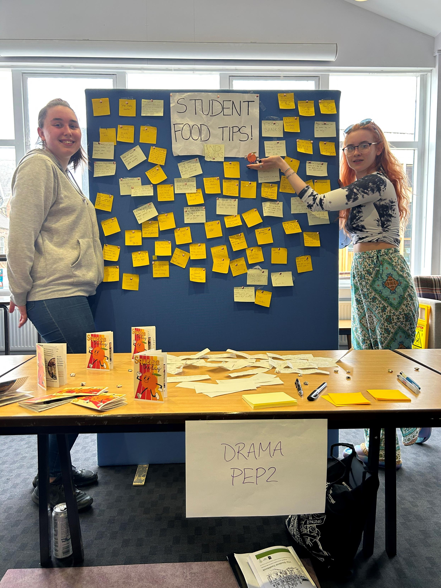
GROUNDED IMAGINARIES
Performance projects
and performing potencia
in a university Living Lab
Dr Cath Heinemeyer
Senior Lecturer in Performance/
Senior Researcher in Ecological Justice
York St John University
c.heinemeyer@yorksj.ac.uk
@adderstone.duo

Slide 2
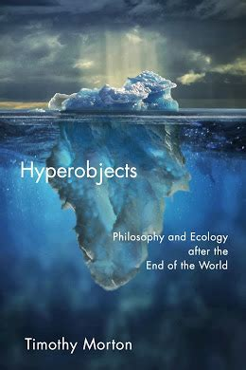
Turner-King and Smith (2024): Site-responsive performance pedagogies can create links between the local and global scales and helping people to navigate through the ‘mess’ of the climate crisis.
Heinemeyer (2026, in press): ‘We might revive our confidence as storytellers by considering the possibility that, if all scales of human action are linked, then we may not have to cast our net so wide: the most local and ‘human’ story will already contain the seeds of the same understandings.’

Slide 3
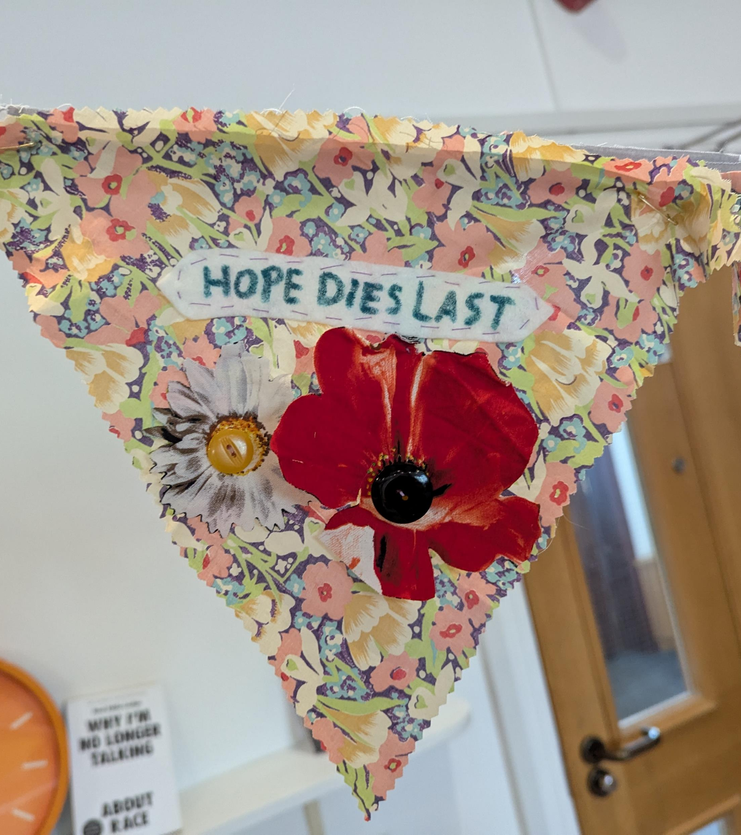
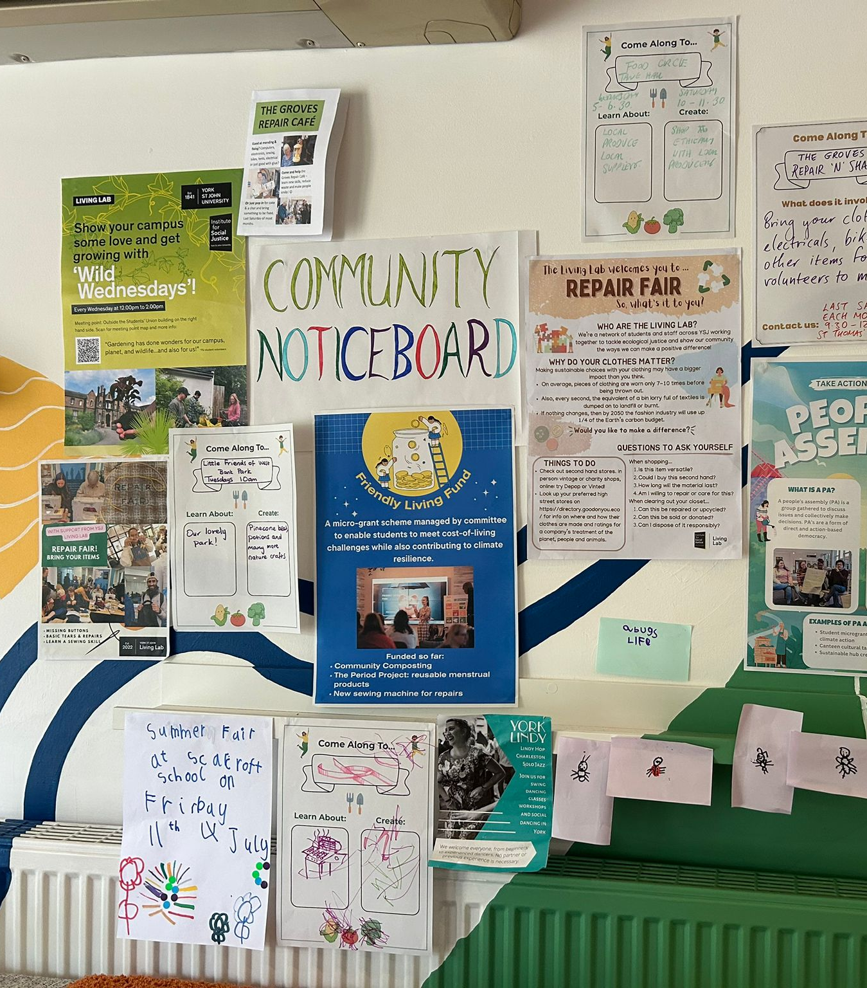
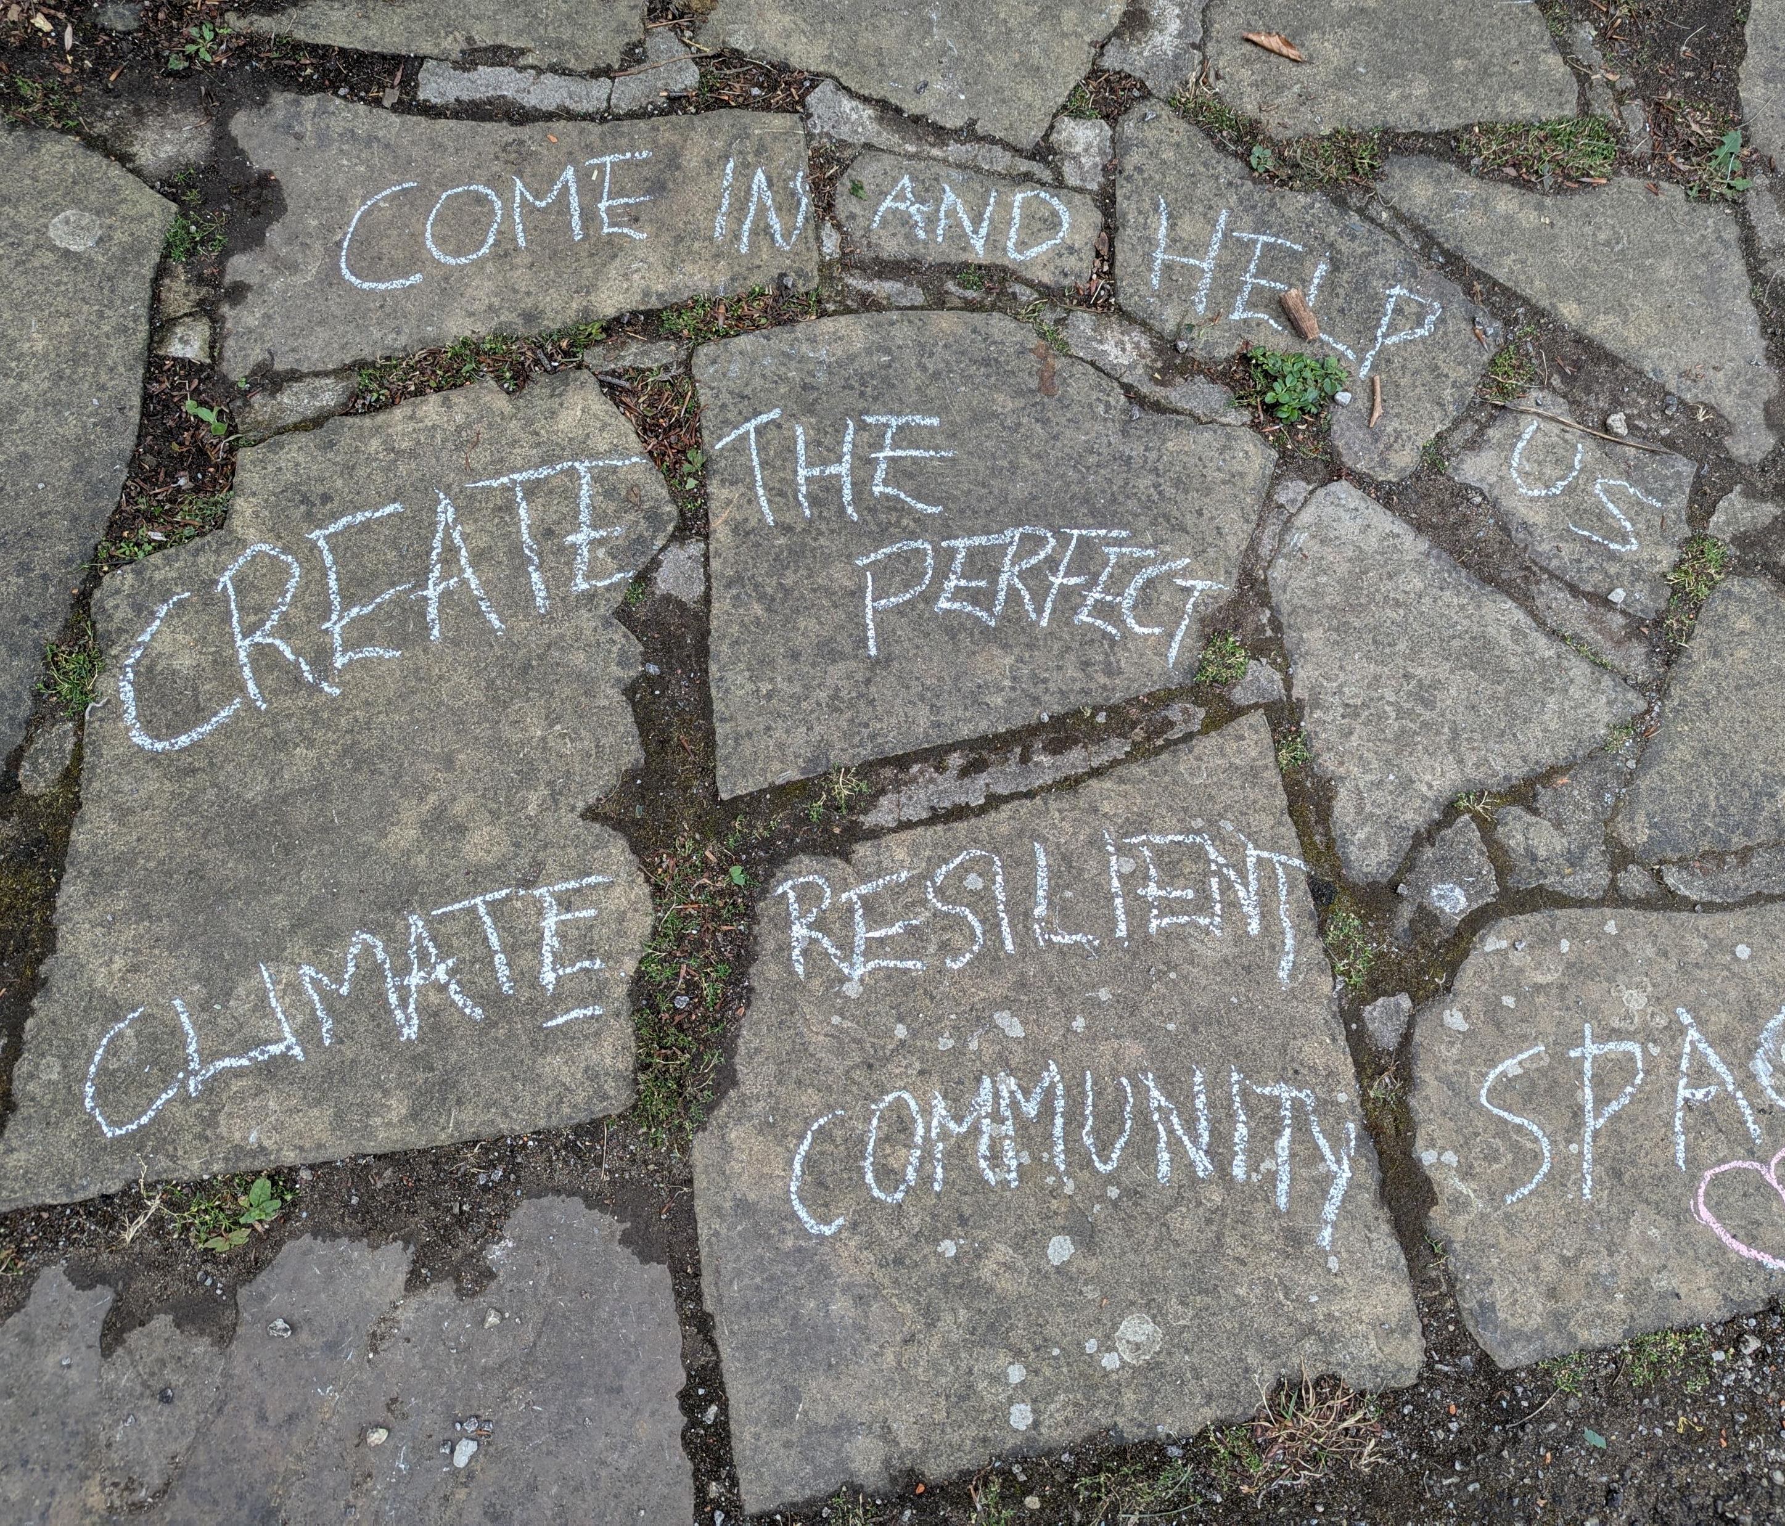
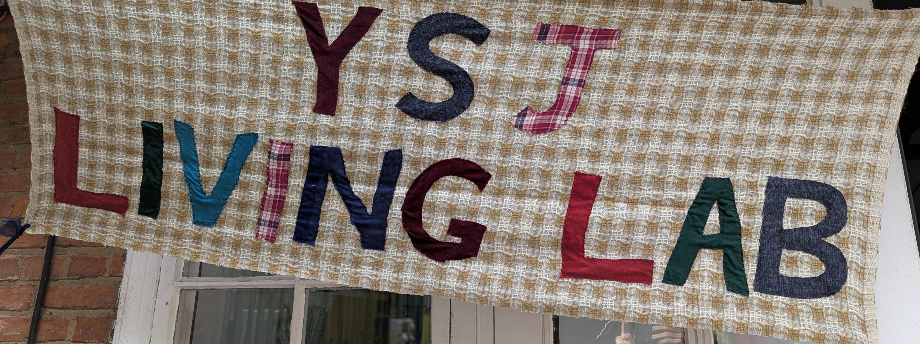
Social imagination
‘(I)magination influences the social order: politics, law, economics – the rules of the game – which in turn influence how technology and our material world are constructed. […] In short, a shift in the story realm has knock-on effects that can tip the whole codependent scheme of factors into a qualitatively different way of being.’ (Spoor and Khanna 2023)

Slide 4
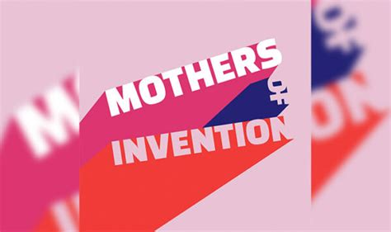
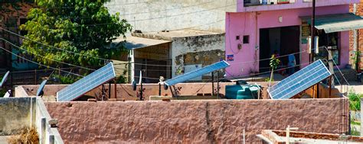
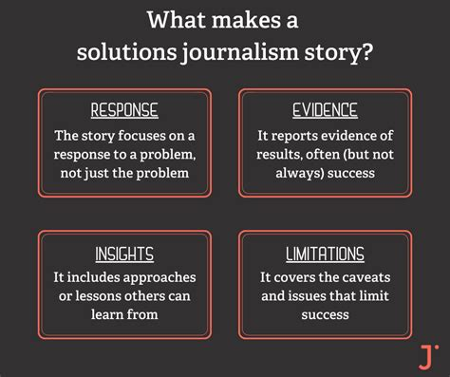
Grounded imaginaries
Social imaginaries are defined by Danielle Celermajer as ‘shared backgrounds through which we experience ourselves and the world and form our expectations and projects’ (2021) – current dominant imaginaries:
Business As Usual
Techno-Fix
Doomsday
Alternatives are needed and these must be grounded, realised, in places and communities:
“A fourth imaginary, one holding out the possibility of relational, community-building and ethical forms of life under radically climate-changed conditions is, however, already incipient in the work of communities creating different sustainabilities, systems and material flows.”

Slide 5
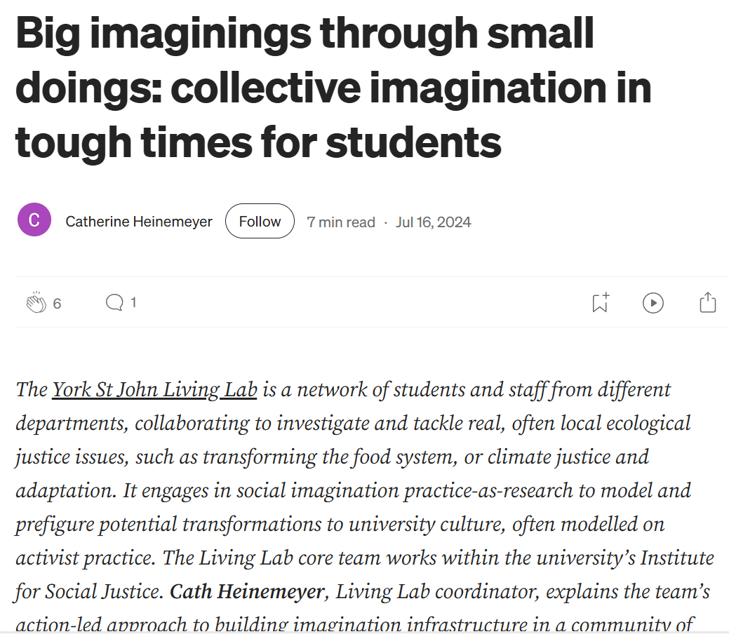
Gap between much social imagination practice and ‘grounded imaginaries’
(Heinemeyer 2024)

Slide 6

Building ‘action competence’ where it is in short supply
Action competence = the ability and confidence to undertake intentional, concerted individual or collective efforts towards a desired, perhaps complex, goal (Jensen & Schnack 1997)
A rejection of compliance-based and behaviourist paradigms of environmental education
YSJU (2024)

Slide 7
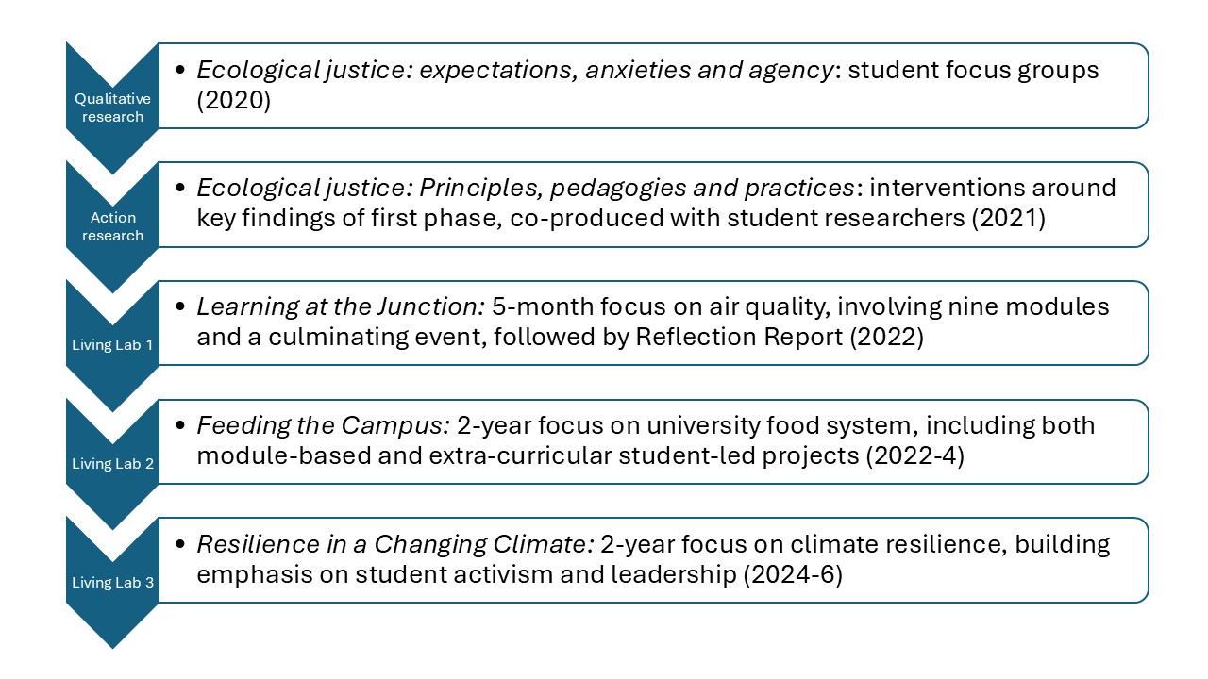
The York St John Living Lab

Slide 8
Some definitions of Living Labs
EAUC (Alliance for Sustainability Leadership in Education):
Initiatives ‘where real-world sustainability challenges are formally addressed in stakeholder partnerships. A Living Lab encourages co-creation & co-implementation of transformations through transdisciplinary efforts, over a series of learning loops, to sustainably develop a geographically-bounded testbed (Waheed 2017b: 4).
European Network of Living Labs (ENoLL):
Living Labs are ‘user-centred open innovation ecosystems’ which are ‘based on a systematic user co-creation approach, integrating research and innovation processes in real-life communities and settings’.

Slide 9
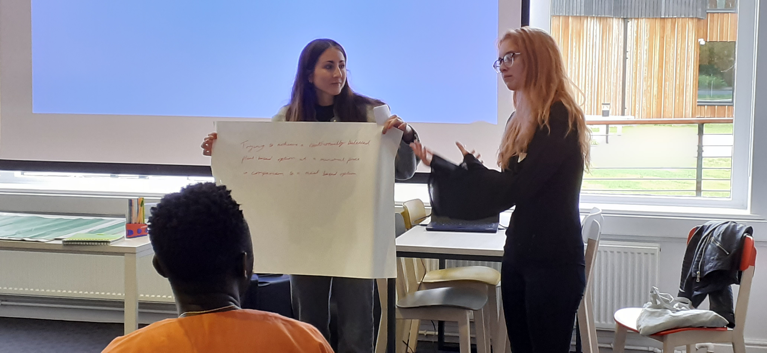
Lessons from the arts: emergence; performing the ‘university otherwise’ to itself

Slide 10
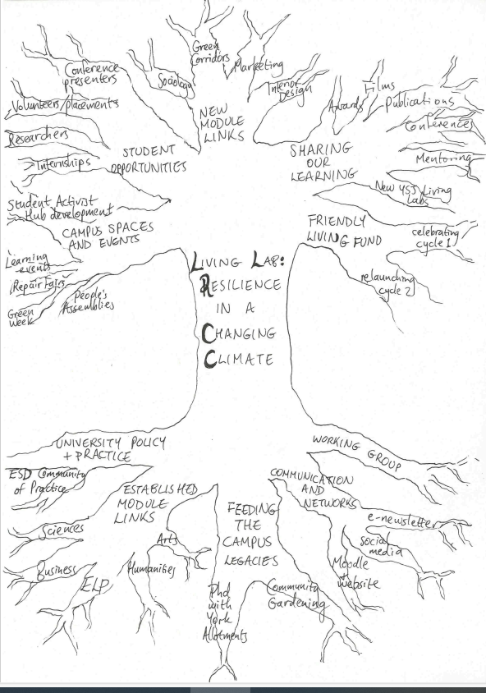
A snapshot of the YSJ Living Lab, Summer 2025

Slide 11
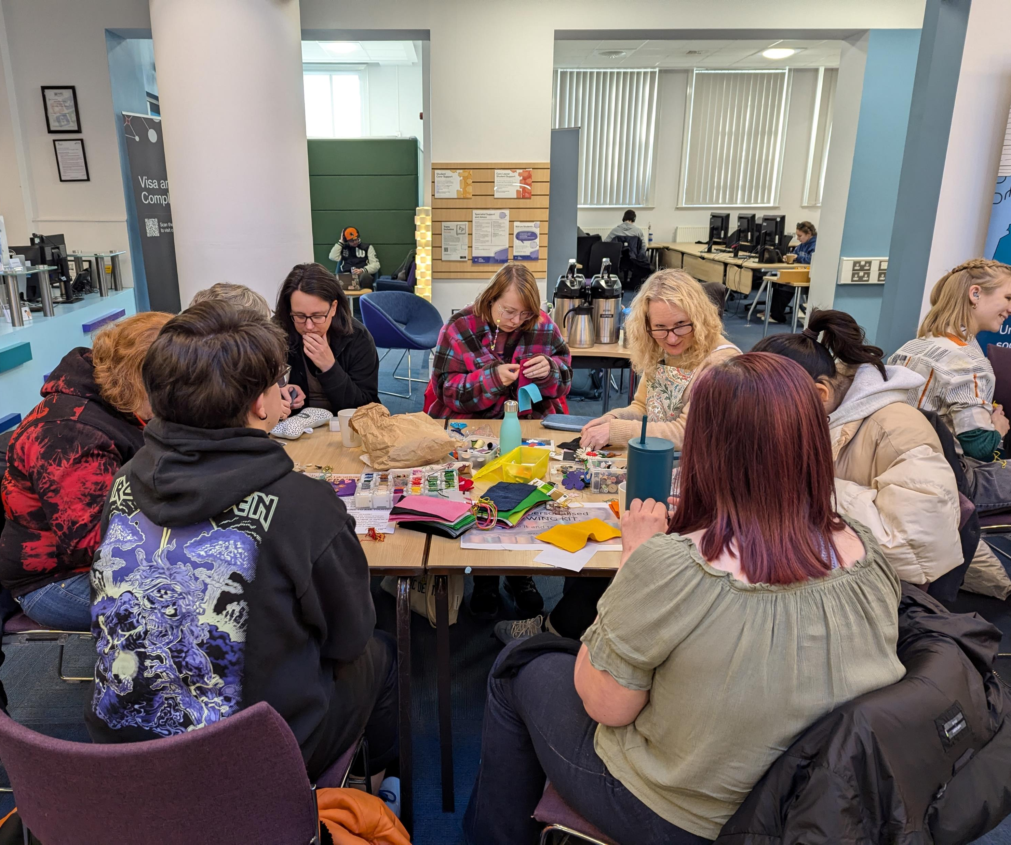
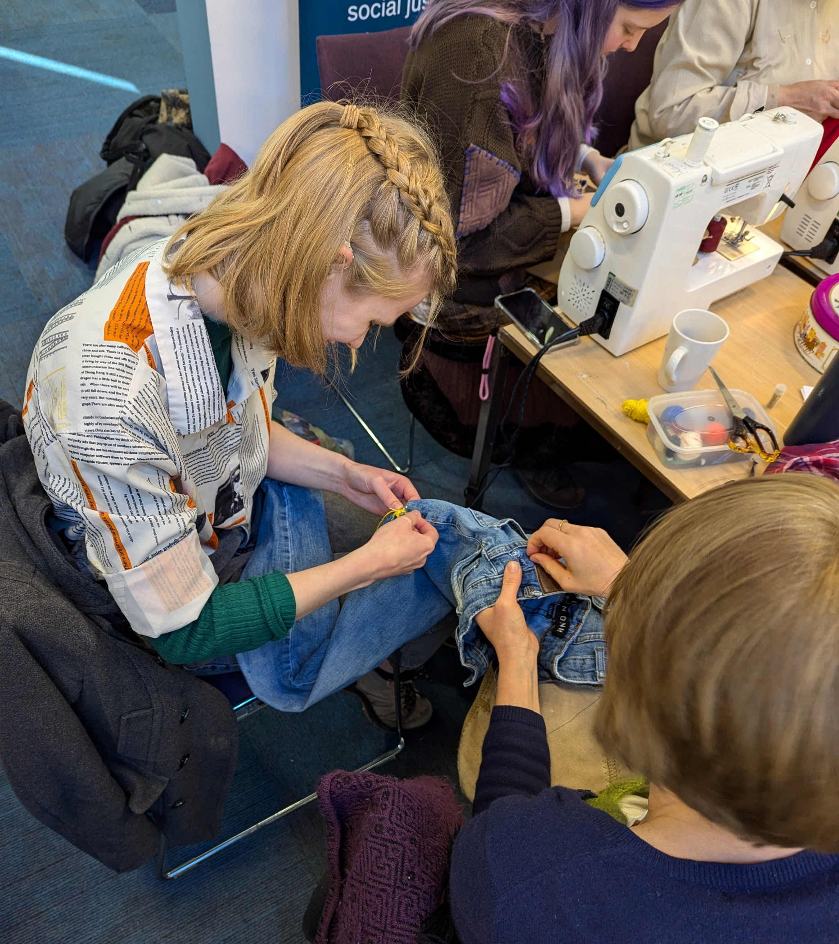
Repair Fair, Nov 2024

Slide 12
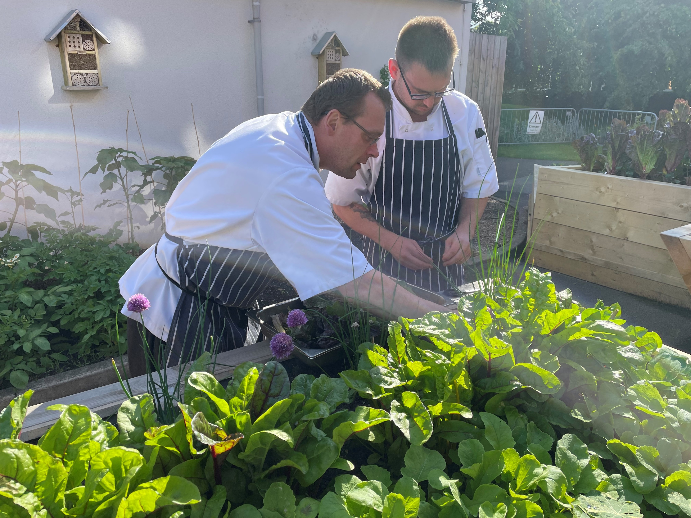
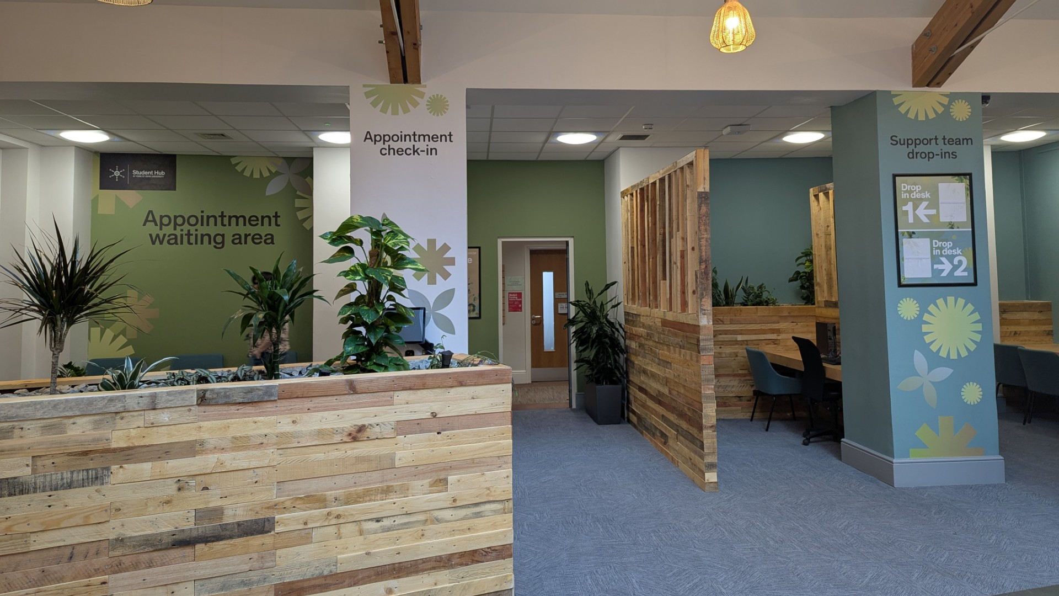
A temporary claiming of campus space

Slide 13
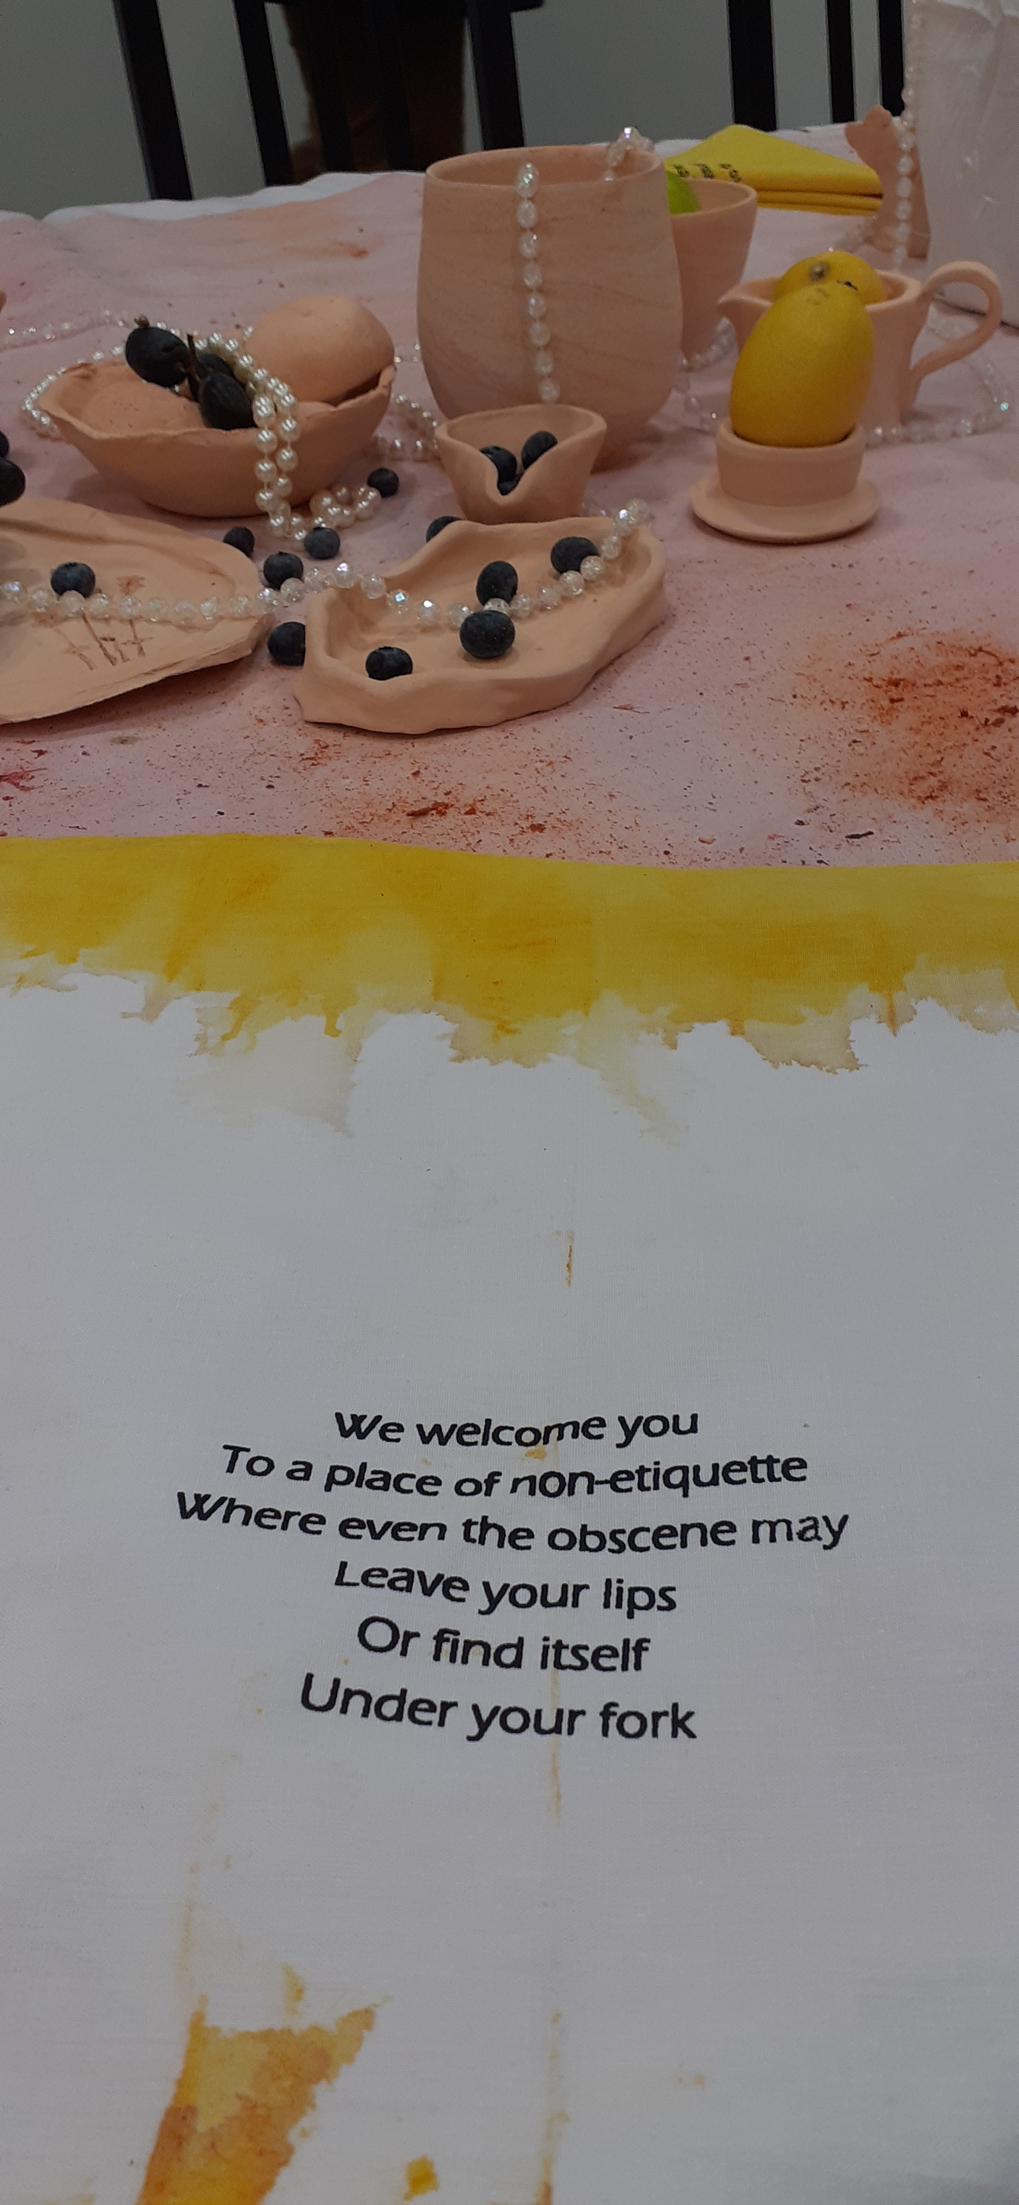
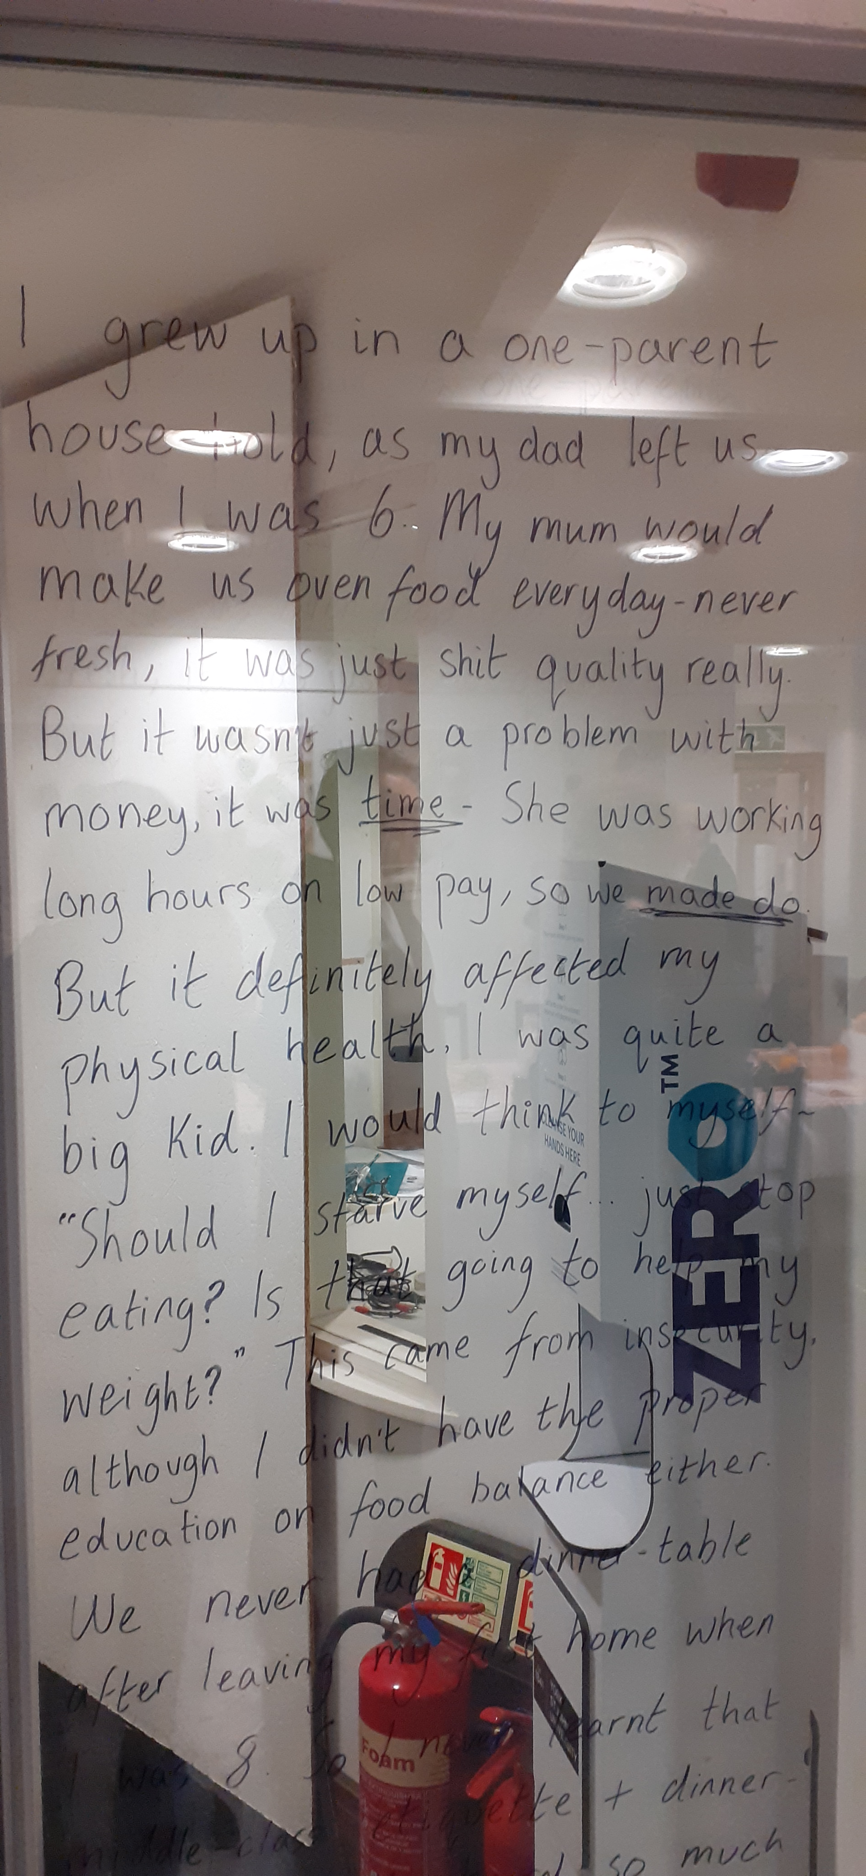
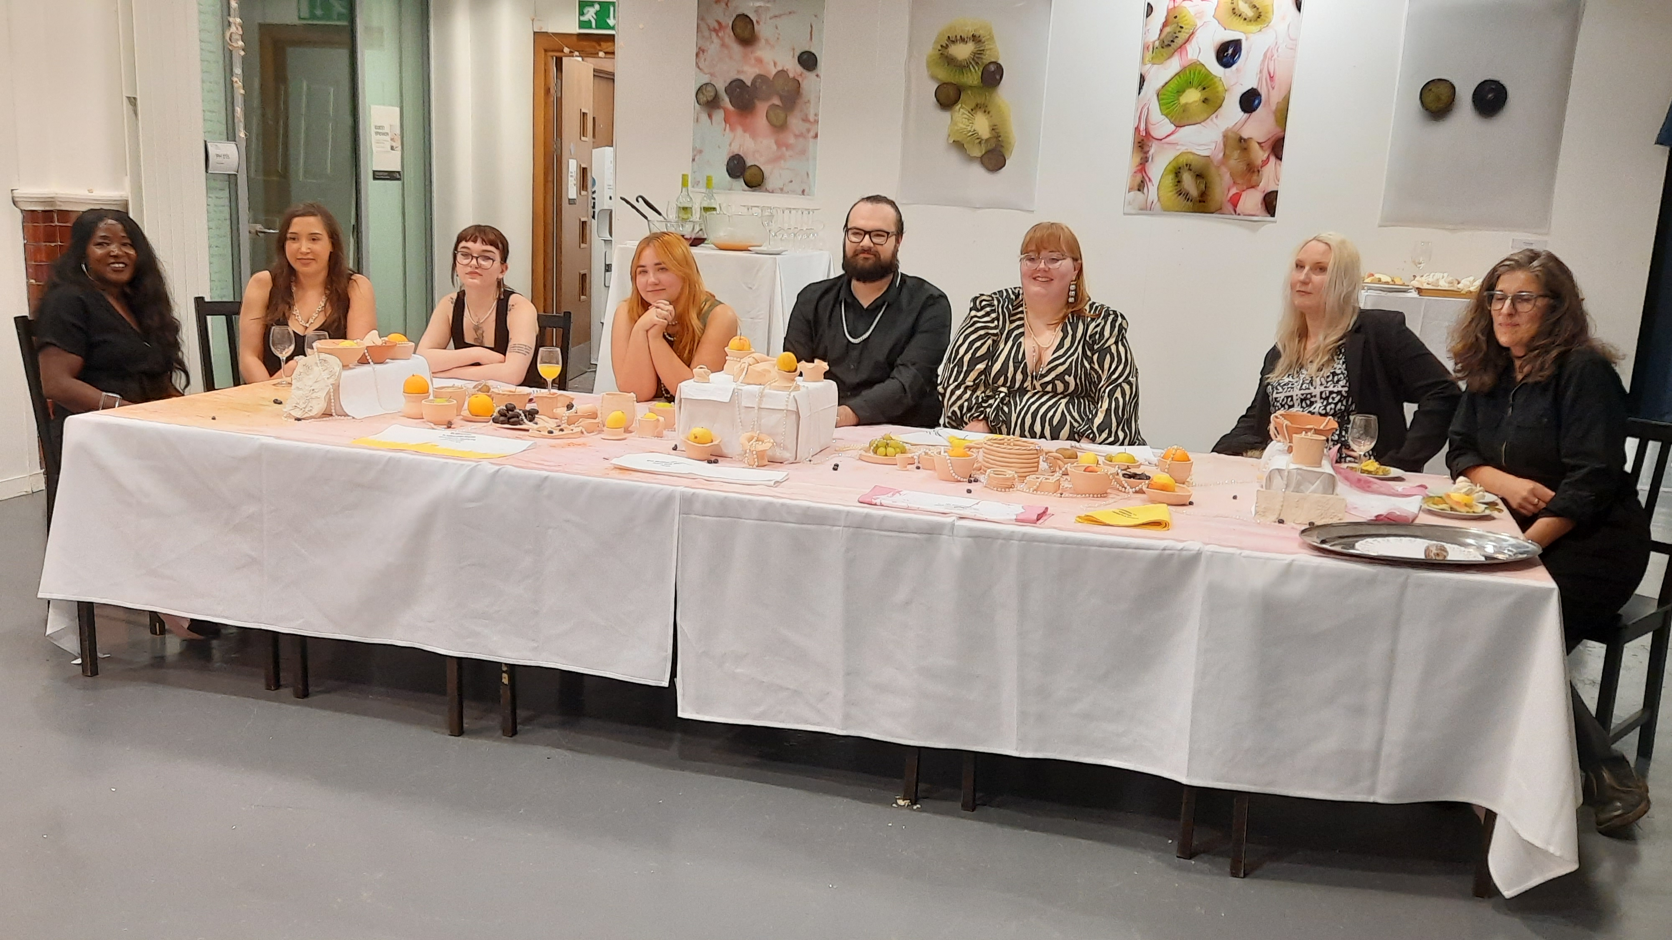
Sustenance December 2022

Slide 14
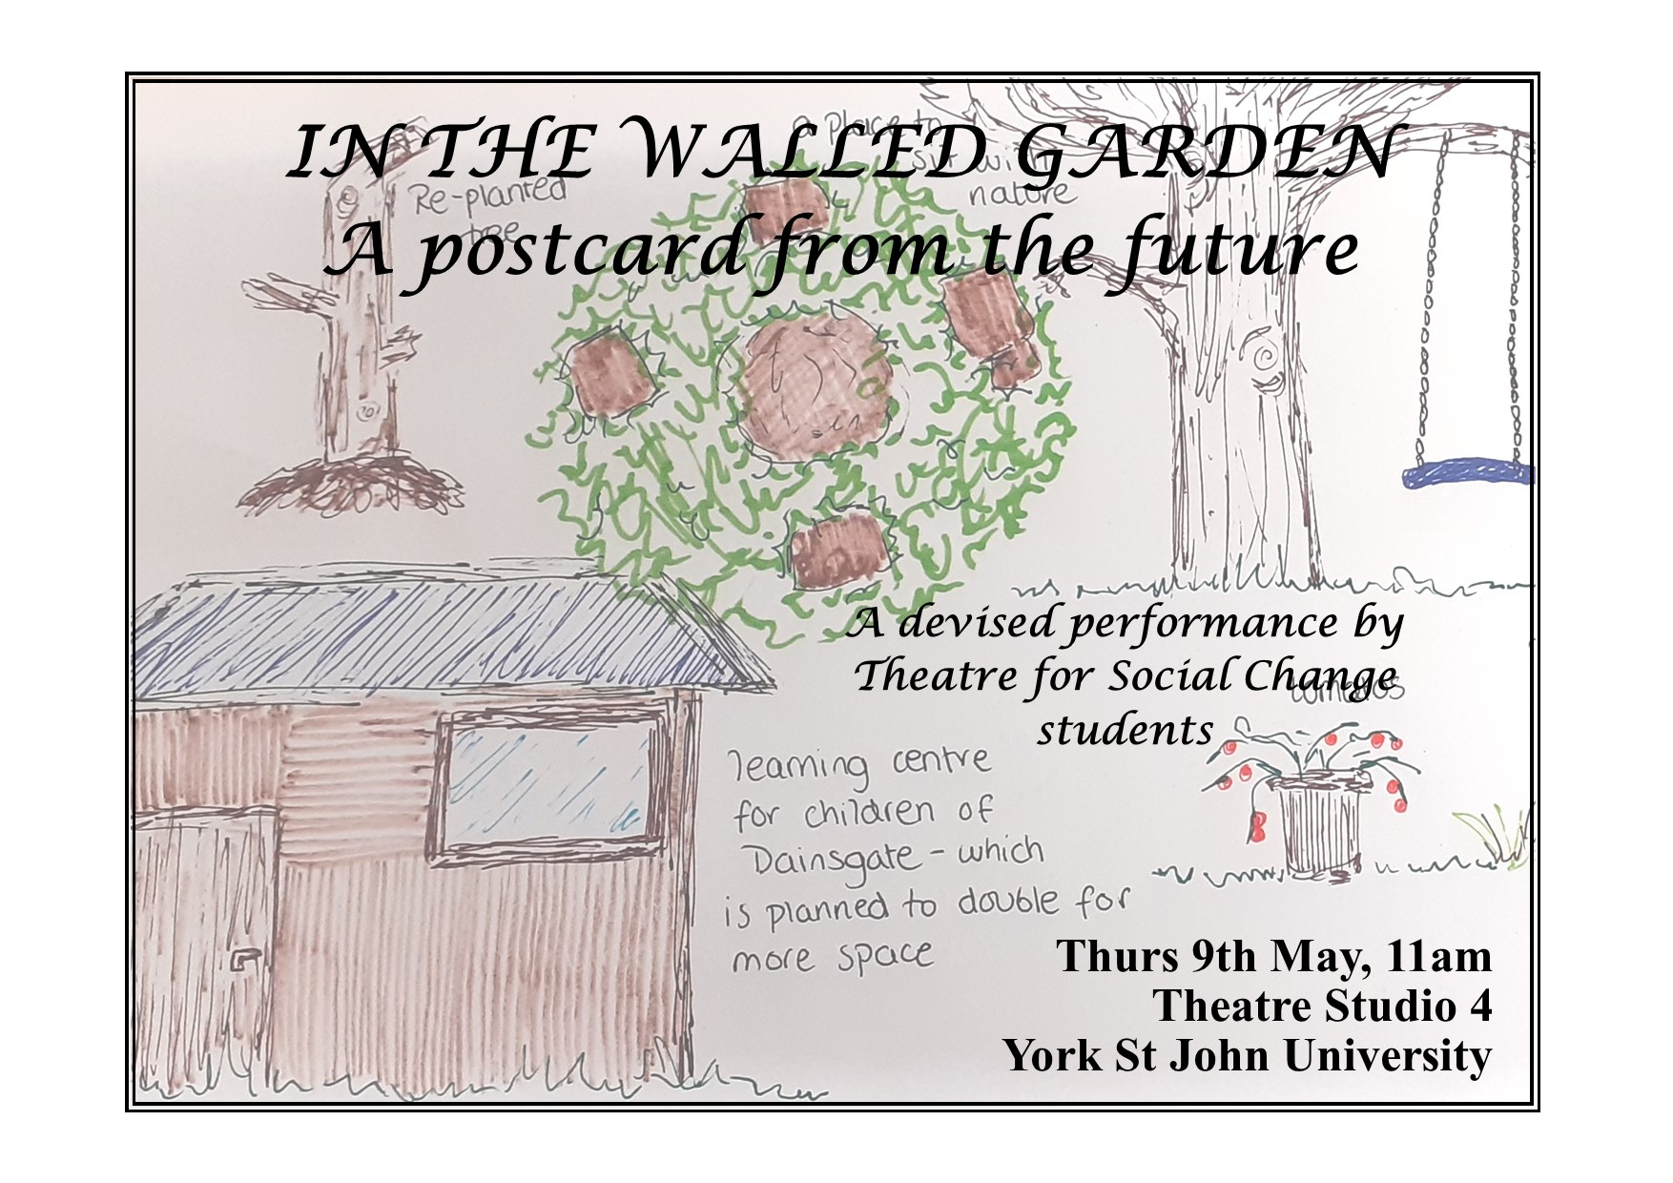
In The Walled Garden May 2024

Slide 15
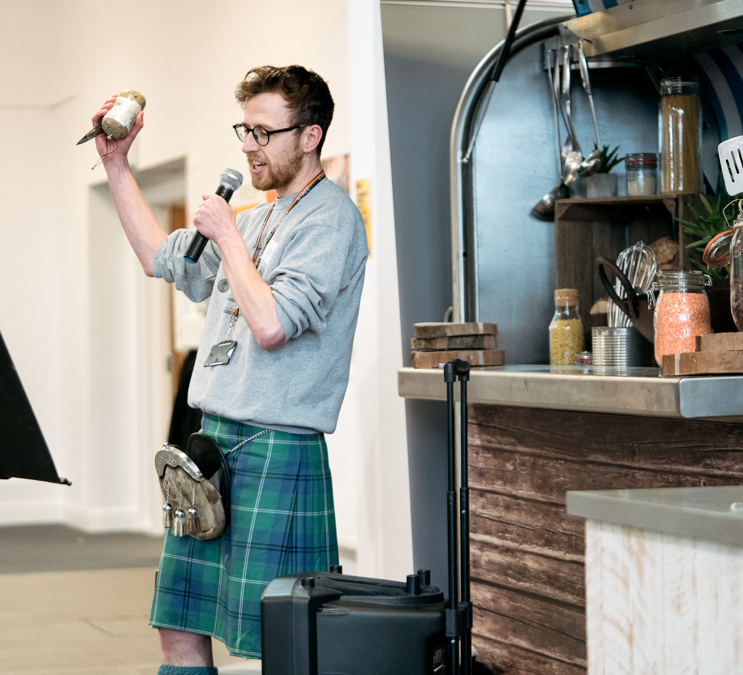
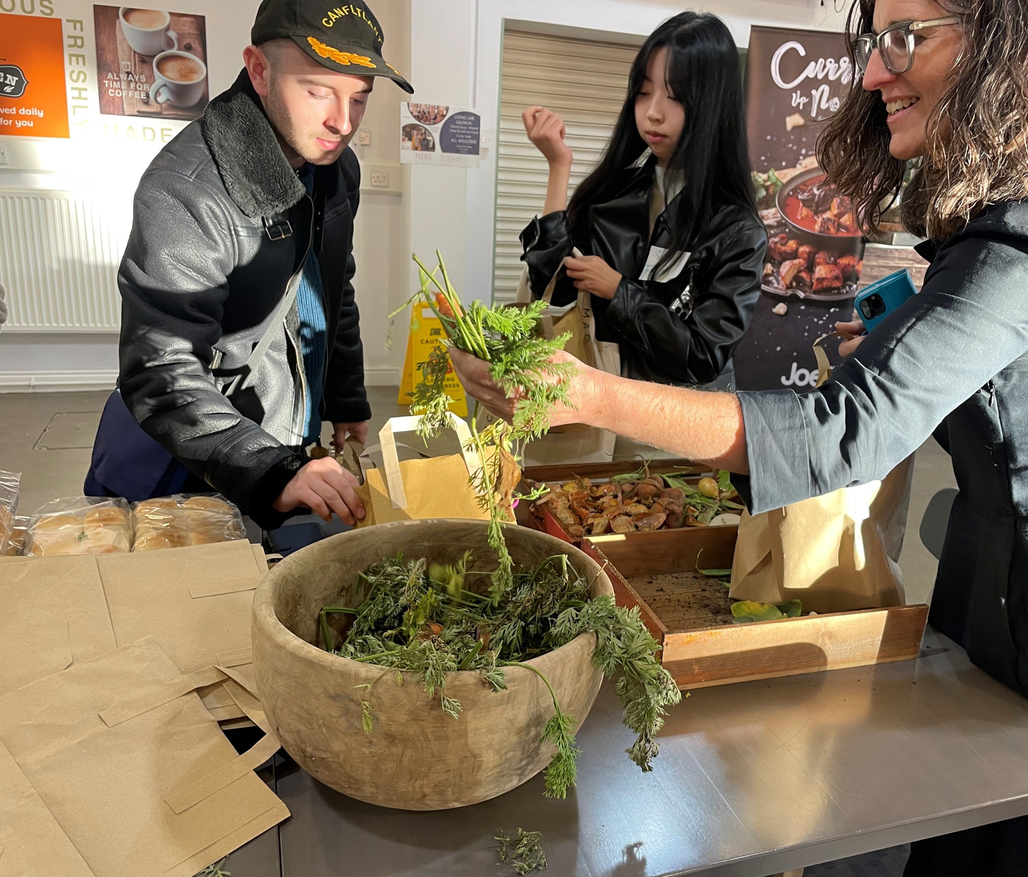
The Living Lab is a performance

Slide 16
References
Celermajer, Danielle (2021) Grounded imaginaries: Transforming how we live in climate-changed futures. Griffith Review, (73), pp.163-175.
Heinemeyer, Cath (2024) ‘Big imaginings through small doings: collective imagination in tough times for students’. Collective Imagination Practice Community Blog, 16 July 2024, Big imaginings through small doings: collective imagination in tough times for students | by Catherine Heinemeyer | Collective Imagination Practice | Medium
Heinemeyer, Cath (2026) ‘Harking to the sensitive children: making CHANGELINGS’. In Hawkes, Jodie, Jennie Klein and Pete Phillips (in press) Mothers, Mothering, Land and Nature. Demeter.
Jensen, Bjarne and Schnack, Karsten, 1997. The action competence approach in environmental education. Environmental education research, 3(2), pp.163-178.
Spoor, Gijs & Khanna, Pragnya (2023) Grounded imaginaries: storytelling and research in times of climate crisis. Grounded Imaginaries Project, file:///C:/Users/c.heinemeyer/Downloads/grounded-imaginaries---storytelling-and-research-in-times-of-climate-crisis-compressed.pdf (accessed July 2025)
Turner-King, Rachel, & Bobby Smith. “Confronting the messy complexities of the climate crisis through drama education and applied theatre.” Research in Drama Education: The Journal of Applied Theatre and Performance 29.2 (2024): 238–58.
York St John University (2024) Annual Report and Financial Statements 2023-24, yorksj.ac.uk/media/content-assets/about/documents/annual_report_and_financial_statements_2023-24.pdf

