Slide 1




Symposium
Dr Gary Shepherd (York St John University)
Sam Watling (Menfulness Trustee)

Slide 2
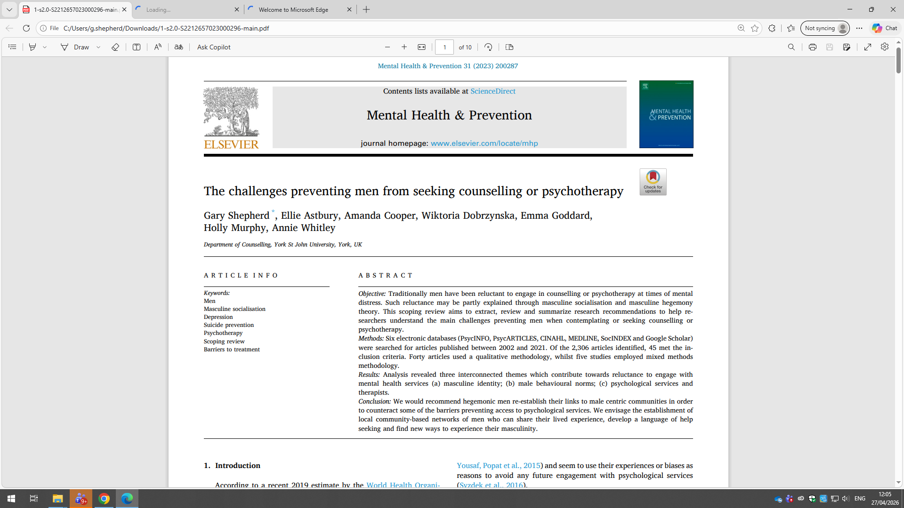

Slide 3
Introduction
Global suicide rates are significantly higher in men than women, with 12.6 male suicides per 100,000 people compared to 5.4 for females (WHO, 2021).
Male suicide rates are especially high in the Americas (5x higher than females), Europe (4x higher), and the Western Pacific region (2x higher).
Men have historically been reluctant to seek counselling or psychotherapy despite decades of research highlighting the importance of male mental health support.
Many men struggle to form effective therapeutic relationships and may feel ambivalent about engaging with counselling services.
Traditional masculine socialisation encourages traits such as stoicism, self-sufficiency, aggression, and emotional control, which can discourage help-seeking behaviours.

Slide 4
Introduction
Therapy often requires emotional openness and vulnerability, which may create feelings of shame or social stigma for men influenced by hegemonic masculinity.
Some researchers argue the issue is not men themselves, but that mental health services are not designed in ways that effectively accommodate men’s needs and identities.
Mental health campaigns targeted specifically at men have shown success, demonstrating that men are more likely to seek help when services are accessible, affordable, and gender-sensitive.

Slide 5
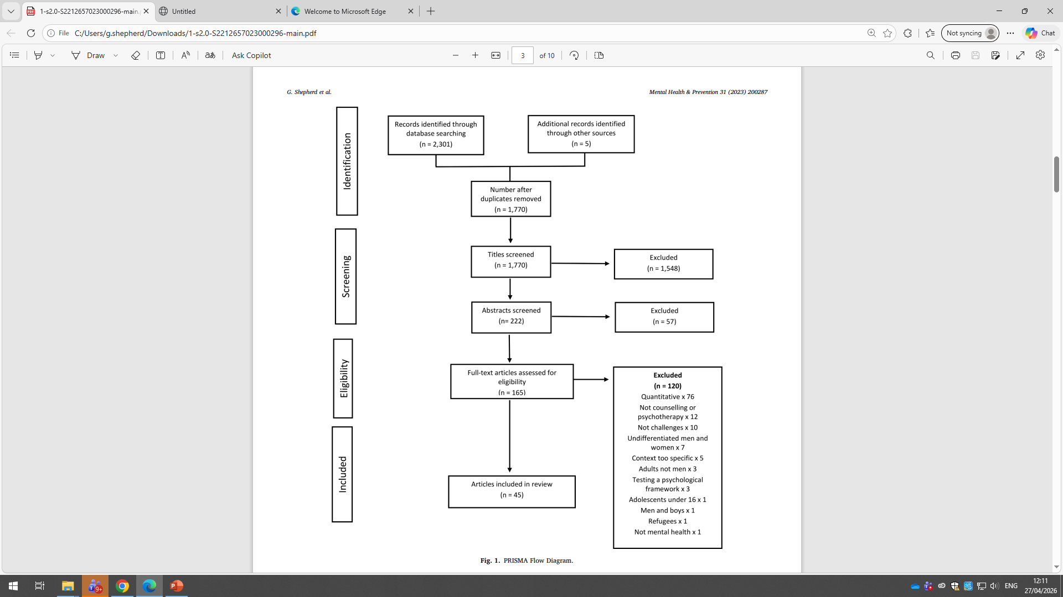
Scoping review
For the purpose of this scoping review ‘challenges’ refers to any barriers men face whilst accessing or using talking therapies including:
• the issues surrounding the attitudes, beliefs and interactions of the therapist;
• attitudes, beliefs or behaviour of men themselves;
• the issues surrounding promotion of psychological services to men;
• external factors men are under such as economic pressures and time constraints.

Slide 6
Findings
The scoping review explored the key challenges preventing men from seeking counselling and psychotherapy, highlighting continued inequality in men’s use of mental health services compared to women.
Men with hegemonic masculine traits often see help-seeking as a weakness, preferring stoicism, emotional suppression, and self-reliance.
Many men avoid discussing mental health issues with family or friends, resulting in delayed support until their condition becomes severe or chronic.
Researchers suggest healthier masculinities can be developed through emotional openness, vulnerability, and stronger interpersonal connections with other men.

Slide 7
Findings
Therapeutic group programmes, such as mentoring and men’s support groups, can provide safe, non-judgemental spaces for men to explore masculinity and mental wellbeing.
Traditional mental health promotion campaigns often fail to engage men because they are perceived as critical of masculinity and disconnected from men’s lived experiences.
Some men distrust counselling and psychotherapy because services are viewed as “feminised,” with the majority of therapists worldwide being women.
Poor mental health literacy among men means many struggle to recognise symptoms, describe emotional distress, or know where to seek appropriate support.

Slide 8

Menfulness - (Less of a Man)

Slide 9
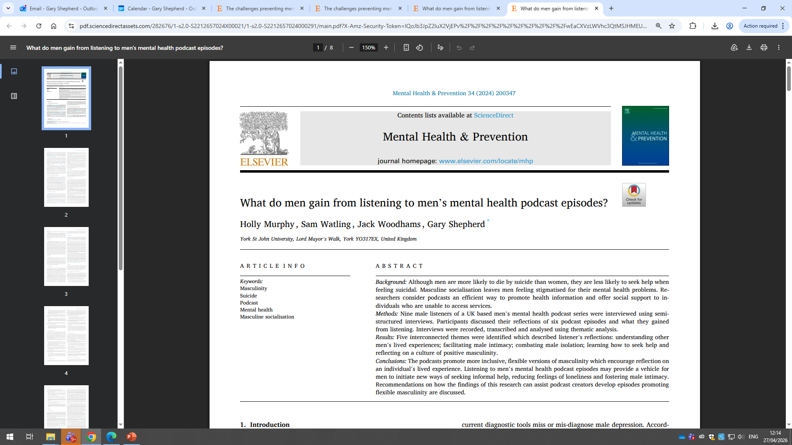

Slide 10
Introduction
Men account for approximately three-quarters of all suicides, with suicide being the fourth leading cause of death among males aged 15–29 years.
Although women attempt suicide more often, men are twice as likely to die by suicide worldwide.
Depression and suicide are closely linked, yet men are less likely than women to be diagnosed with depression due to under-recognition and gender-insensitive screening tools.
Male depression often presents through externalising behaviours such as anger, irritability, substance misuse, risk-taking, and overworking rather than emotional expression.

Slide 11
Introduction
Traditional masculine socialisation discourages vulnerability, emotional disclosure, and help-seeking, increasing stigma around accessing psychological support.
Community-based male-centred networks and gender-sensitive services can improve men’s willingness to engage with mental health support.
Strength-based approaches encourage positive aspects of masculinity, such as teamwork, responsibility, practical action, and supportive male relationships.
Mental health podcasts are an accessible, low-cost way to improve mental health literacy, reduce stigma, and provide support for men who may not engage with traditional services.

Slide 12
Podcast Clips

Slide 13
Findings
The study explored what men gain from listening to men’s mental health podcasts and identified five key themes: shared experiences, intimacy, reduced isolation, help-seeking, and positive masculinity.
Hearing other men discuss lived experiences and “taboo” topics helped listeners normalise their own struggles and feel less alone.
Podcasts increased confidence in social interaction, helping some men with anxiety feel more comfortable connecting with others in support groups.
Listening to personal stories created deeper emotional understanding and intimacy between men, even before meeting face-to-face.

Slide 14
Findings
Podcasts helped combat male isolation by fostering a sense of belonging, community, and mutual support among listeners.
Many participants viewed podcasts as an accessible first step toward seeking help, reducing fear and uncertainty about engaging with mental health services.
Podcast episodes encouraged men to adopt healthier coping strategies, become more open-minded about mental health, and explore additional forms of support.
The podcasts promoted positive masculinity by encouraging empathy, kindness, emotional openness, vulnerability, and less judgement toward others.

Slide 15
Quotations
“I do struggle with my mental health at times, and I think that listening to the show, like I said, it helps me feel that I'm not alone in facing that and that you know I'm with part of a broader group of people who are trying to speak about it”.
“Do you know if I'd have... if we turned the clocks back to last year when I had my nervous breakdown… and I turned the clocks back with the knowledge I have now - I'd have spoken up; I'd have let people know, I wouldn't have just been suffering in silence.”
“When you are sitting there listening to people tell their stories about how they've dealt with certain things, it certainly makes it an awful lot easier to understand, because there's other people that are going through it and these people have actually put their thoughts out there for everybody to listen to.”

Slide 16
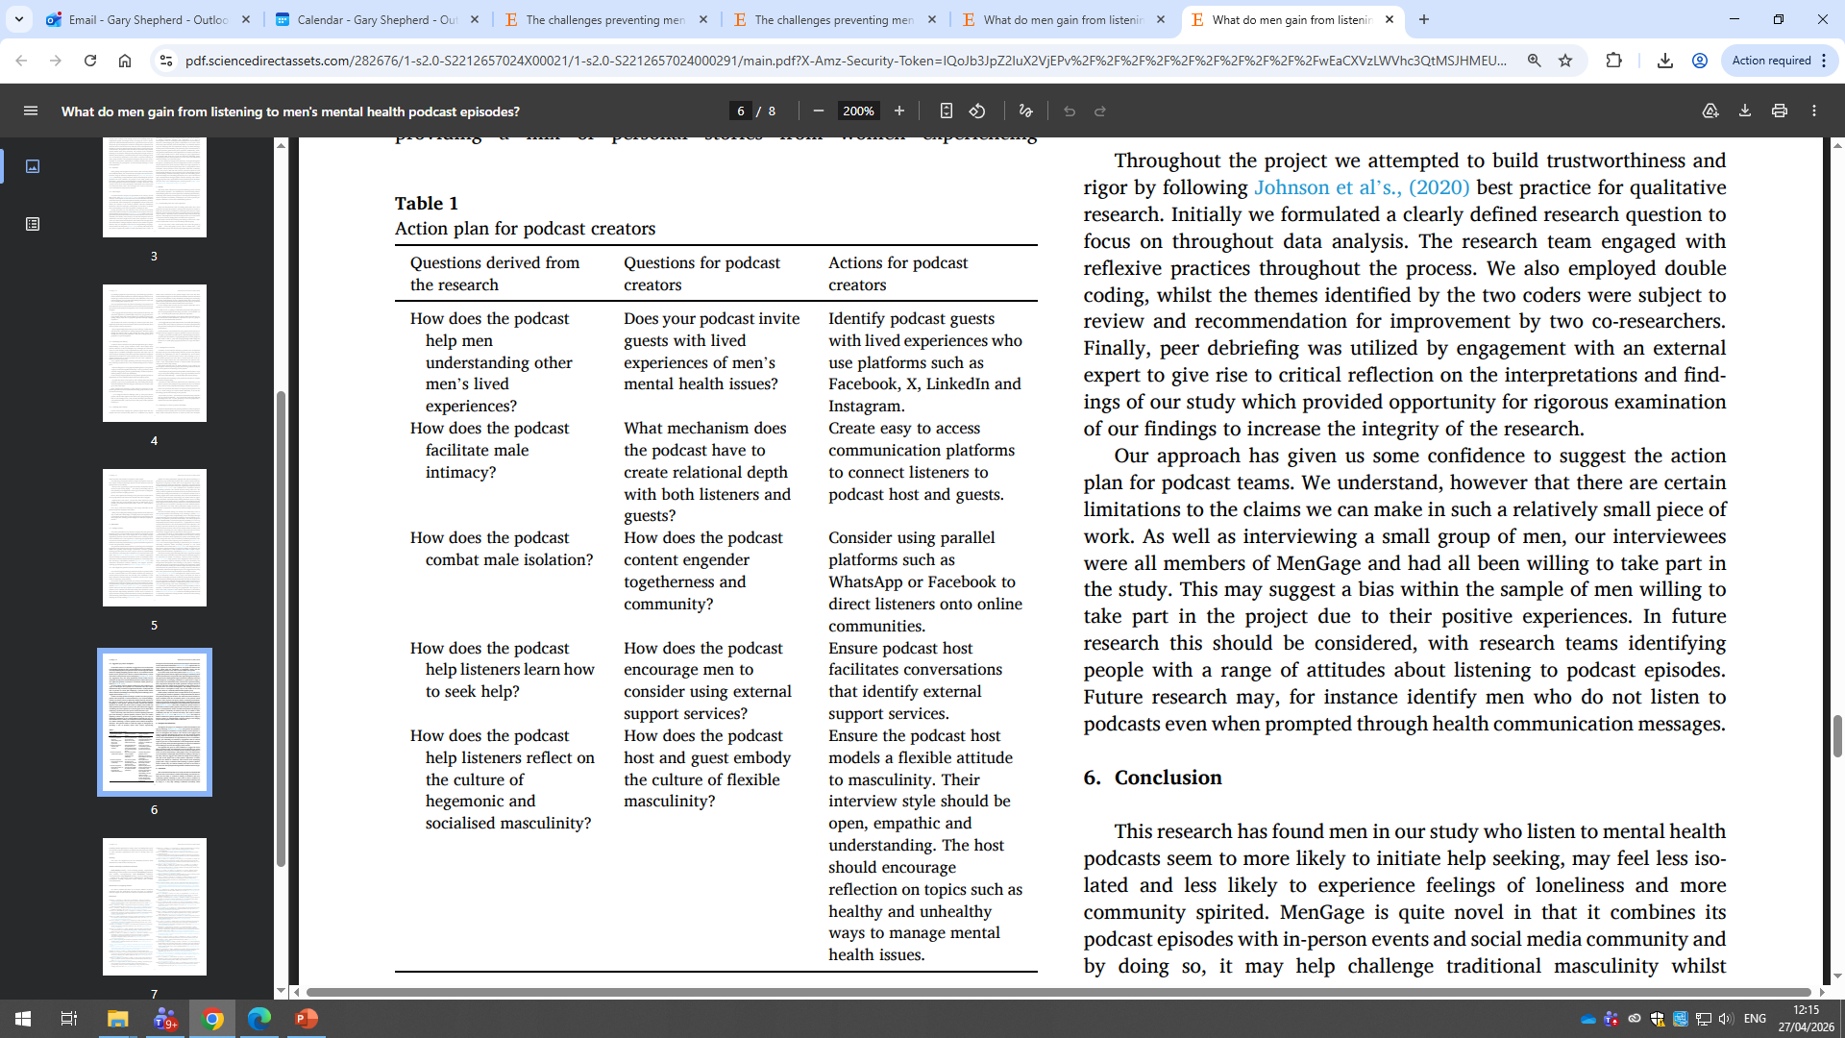
Action Plan
An action plan for podcast creators is proposed, structured around three questions: how the podcast is conceptualised, how episodes are built, and what online infrastructure supports listeners.
Lived experience matters — podcasts should actively seek guests who have personal experience of men's mental health issues, sourcing them via social media platforms.
Building connection and community is central, using platforms like WhatsApp and Facebook to reduce male isolation and foster a sense of togetherness beyond the podcast itself.
Help-seeking behaviour should be actively encouraged, with hosts guiding conversations that signpost listeners to relevant external support services.
Flexible masculinity should be modelled by the host through an open, empathic interview style that challenges hegemonic norms and encourages healthy reflection on mental health.

Slide 17
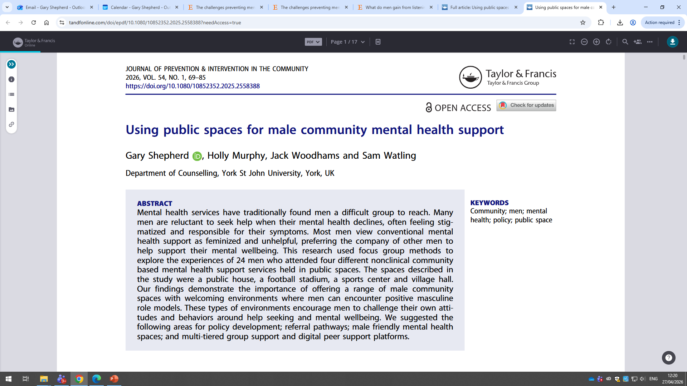

Slide 18
Introduction
Men are significantly less likely than women to seek mental health support, despite men accounting for the majority of global suicide deaths.
Male suicide rates are particularly high worldwide, with men making up around three-quarters of suicide deaths in the UK since the 1990s.
During mental health crises, men often hide emotions, withdraw socially, and experience stigma surrounding mental illness and help-seeking.
Traditional masculine socialisation encourages stoicism, self-reliance, emotional control, and dominance, which can discourage vulnerability and therapy engagement.

Slide 19
Introduction
Many men perceive counselling and psychotherapy as “feminised,” partly because the majority of therapists worldwide are women.
Some men feel traditional therapy does not meet their needs, believing therapists may lack understanding of male experiences and masculine identities.
Community-based mental health approaches, including sports groups and men’s support initiatives, can strengthen social connection, reduce isolation, and improve wellbeing.
Programmes such as Men’s Sheds demonstrate how shared activities and supportive male communities can encourage openness, friendship, and positive mental health support among men.

Slide 20
Findings
The study explored how men use public community spaces to support their mental health and identified five themes: discovering spaces, experiencing spaces, making connections, deepening vulnerable connections, and continuing conversations online.
Men often discovered support groups through doctors, family members, friends, or during periods of severe mental distress or crisis.
Participants described community spaces as relaxed, welcoming, non-judgemental, and safe environments where they felt accepted.
Informal activities such as football, video games, breakfasts, and discussion groups helped men build social connection and reduce isolation.

Slide 21
Findings
Many men valued the sense of friendship, familiarity, and emotional support developed through repeated attendance at these spaces.
Vulnerable discussion groups created deeper emotional intimacy, allowing men to openly discuss struggles, cry, and feel understood by others with similar experiences.
Men reported that hearing others share vulnerabilities helped challenge harmful masculine expectations around emotional suppression and self-reliance.
Online messaging groups extended support beyond physical meetings, providing immediate encouragement, reassurance, and a strong sense of ongoing community connection.

Slide 22
Quotations
“I was at the lowest of the low… if this doesn’t work, I’m done.”
“The first time I walked in the door I was expecting a bunch of men and instead I saw a bunch of vulnerable human beings who were really talking.”
“You just put a message up saying that I’m having a **** day… within minutes there’s gonna be 34 messages.”

Slide 23
Policy Implications
Men often accessed Menfulness through recommendations from friends, family, doctors, or social prescribing services, highlighting the importance of trusted social pathways to support.
Many participants sought help only during severe mental health crises, including suicidal thoughts, nervous breakdowns, or extreme emotional distress.
Men preferred informal, trust-based support routes rather than traditional clinical mental health services, which were often viewed as unapproachable or stigmatizing.
Menfulness spaces were valued for being relaxed, non-judgemental, flexible, and free from pressure, helping men feel emotionally safe and accepted.

Slide 24
Policy Implications
Activities such as football, gaming, and breakfast clubs acted as catalysts for building friendships, reducing loneliness, and strengthening social connections.
The stadium-based talk groups created deeper emotional vulnerability, where men openly shared experiences of depression, breakdowns, and suicidality.
Online support platforms extended the sense of community beyond physical meetings, allowing men to receive immediate peer support and maintain connections.
The study argues mental health policy should move away from a “one size fits all” model toward male-centred, community-based approaches focused on connection, camaraderie, peer support, and male-friendly spaces.

Slide 25
Menfulness in Community Spaces

