Slide 1
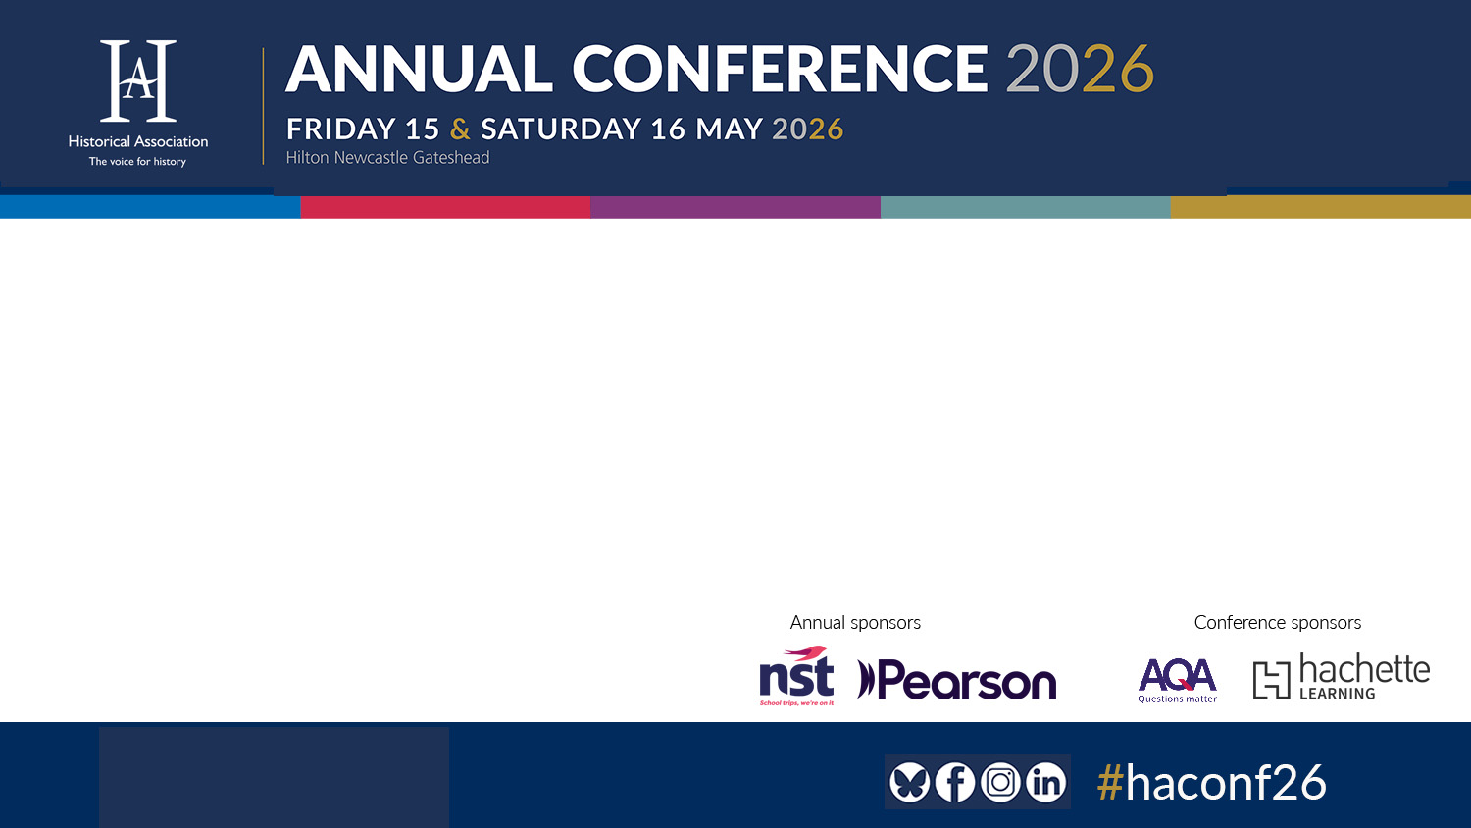
Building Historical Thinking
Stephanie Jach & Dr Jennifer Huntsley
York St John University
Notes:
Steph
Hello and welcome. I'm Steph Jach and I'm here with Jen Huntsley to introduce our session on building historical thinking.
We work in initial teacher education at York St John University where we both teach primary history to over 500 student teachers

Slide 2
Learning Outcomes
Understand how to support generalist primary teachers to develop their own and their pupils’ substantive knowledge and historical thinking.
Explore a range of subject specific teaching strategies for primary history.
Consider new directions for primary history and ITE in light of the 2025 Curriculum and Assessment
Notes:
Jen
Hello, I'm Jen Huntsley. This presentation explores how primary initial teacher education can support generalist student primary teachers in developing secure substantive and disciplinary knowledge in history, particularly in light of the 2025 Curriculum and Assessment Review.
We will share how we have made these aspects of primary history more explicit within our university curriculum, alongside emerging perspectives from primary student teachers about their confidence, historical thinking, and classroom practice. Throughout the session, we will also explore practical subject-specific approaches that aim to support both teacher development and pupils’ understanding of history.
Here you can see our learning outcomes for the session

Slide 3

Session Overview
2025 Curriculum and Assessment Review
Our approach in Initial Teacher Education (ITE)
Student teacher perspectives
Practical applications
Conclusions, Questions & Evaluation
Notes:
Our session today will begin with a focus on the 2025 Curriculum and Assessment Review and its implications for primary history.
We will then share our approach to teaching primary history within initial teacher education, alongside student teacher perspectives on historical thinking and practice.
We will also provide practical examples from our curriculum and practice before concluding with some key reflections and an opportunity for reflection and evaluation.

Slide 4
2025 Curriculum Review
Curriculum Challenges in Primary History
Overloaded curriculum & pressure on teachers
Limits depth of thinking
Importance of informed curricular decisions
Notes:
Steph
The 2025 Curriculum and Assessment Review was commissioned by the Department for Education to evaluate the effectiveness of the current curriculum and assessment system in England.
In relation to history, one key issue identified by the review was curriculum overload. In primary history, this was identified as being particularly challenging in KS2.
Teachers reported feeling under pressure to teach all curriculum components (or topics) in depth.
This may limit depth of thinking and lead to a 'rushed and shallow coverage.'
The review recommends supporting teachers (particularly generalist primary teachers) to better understand which aspects of the curriculum are essential and which can be adapted or treated more flexibly.
The review also calls for clearer guidance to help teachers decide when topics should be explored in depth and when a broader overview is more appropriate.
This is particularly important for generalist primary teachers, who may not always feel confident teaching history.
This highlights the importance of helping teachers make informed curricular decisions, rather than relying too heavily on schemes of work mechanically.
It positions teacher curricular judgement as increasingly important within primary history.
Generalist primary teachers will increasingly need secure curricular knowledge and professional judgement to teach history with confidence, depth and flexibility.

Slide 5
2025 Curriculum Review
Historical Thinking
Need to:
enhance pupils’ knowledge of how historians study the past
strengthen disciplinary knowledge
Generalist history teachers will need secure disciplinary knowledge to support deeper historical thinking.
Notes:
Steph
One consequence of curriculum overload can be “rushed and shallow coverage”.
The review highlights a need to
“enhance students’ knowledge of how historians study the past, and how they construct historical claims, arguments and accounts.”
It emphasises the need to create more space within the curriculum to explore and embed disciplinary knowledge.
The review recommends strengthening disciplinary knowledge within history teaching.
Crucially, this should happen without adding excessive additional content to an already overloaded curriculum.
Generalist primary teachers will increasingly need secure disciplinary knowledge to support deeper historical thinking.

Slide 6
2025 Curriculum Review:
Deepening Historical Thinking
Broader range of perspectives
Greater connections across times and places
Analysis of a wide and diverse range of sources
Focus on local history and contexts
Notes:
Steph
The review argues that history teaching should better reflect the inherent diversity of the past through a broader range of perspectives, experiences and sources.
Importantly, this is not presented as replacing established historical content. Instead, the review suggests enriching existing curriculum content by making wider connections across different people, places and time periods.
The review places particular emphasis on the analysis of diverse historical sources. This links strongly to disciplinary knowledge because pupils are encouraged to think about how historical knowledge is constructed and interpreted.
There is also a specific reference to local history. The review suggests that engaging with local contexts may help pupils connect more meaningfully with history and deepen their understanding of the past.
Generalist primary teachers will increasingly need confidence in:
using varied historical sources,
supporting historical interpretation,
and drawing meaningfully on local history within the curriculum.

Slide 7
Our approach to primary history in ITE
Carefully selected coverage of the National Curriculum
Concrete examples of substantive and disciplinary concepts
Local context as the narrative vehicle
Consistent approaches to subject specific pedagogies
Notes:
Steph
The Curriculum and Assessment Review appears to place increasing expectations on generalist primary teachers teaching history.
The review particularly emphasises:
secure curricular knowledge
strengthening disciplinary knowledge and historical thinking
drawing meaningful links to local history
Fortunately, we have already started to anticipate some of this work at York St John
Our approach involves:
Carefully selected coverage of the National Curriculum Programme of Study. We have only 12 hours to deliver history content to student teachers, so we study fewer topics in greater depth to support secure curricular knowledge.
Concrete examples of substantive and disciplinary concepts coherently sequenced across sessions.
Using local context as the narrative vehicle to help student teachers connect more meaningfully with the past and consider how this can support engagement and historical understanding within primary classrooms.
Consistent approaches to subject-specific pedagogy. Within ITE, student teachers require both secure subject knowledge and strong subject-specific pedagogical strategies in order to teach primary history confidently and effectively.

Slide 8
🕵️Disciplinary Concepts
🕰️Time, change, chronology​
➡️ Reasons and results​
💬Interpretations​
📸 Historical evidence ​
🏅Significance​
​
Lomas, 2019
Notes:
Steph
One way we have tried to make disciplinary knowledge more explicit within our curriculum is through the consistent use of disciplinary concepts throughout our sessions.
We explicitly teach disciplinary concepts, with a particular focus on these five, drawing on Lomas’ work for the Historical Association.
We were also inspired by Andrew Wrenn’s workshop at last year’s Historical Association conference to use Widget symbols. These provide simple and consistent visual cues for disciplinary concepts, substantive concepts, and subject-specific pedagogies.
The visual prompts help student teachers recognise recurring historical ideas and approaches across different historical topics and contexts . They also help reduce cognitive load while supporting conceptual connections, recall, and curriculum coherence.

Slide 9
Overview of our Sessions
First year (KS1 Focus):
Changes in living memory 🕰️📸
Events beyond living memory 🕰️📸➡️
Significant place in locality🕰️📸🏅
Significant individuals 🕰️📸🏅💬
Second year (KS2 Focus):
Stone Ages 🕰️➡️
Roman History 🕰️ ➡️ 📸
Anglo-Saxon & Viking Britain 🕰️💬🏅
12 hours in total
Notes:
Steph
Here is an overview of our sessions in first year and second year
While the workshops are themed by curricular topics, we ensure than disciplinary concepts recur across our curriculum and help provide coherence between sessions.
We use the Widgets shared in the previous slide to make explicit the disciplinary concepts that we teach in each session. This both provides clarity in the moment, and is helpful for the student teachers to return to at a later date, when they are reviewing their university teaching materials and thinking about how to teach history in schools.

Slide 10
🧩Substantive Concepts
🙏Religion
🤝Trade
🏡Settlement
Notes:
Steph
We also explicitly revisit substantive concepts across the curriculum so that student teachers can see how ideas develop across different historical periods and phases.
We again use Widget symbols to provide consistent visual cues, helping student teachers identify and make connections between substantive concepts across sessions.
We also use concrete local examples and familiar contexts as the narrative vehicle for learning.
This helps student teachers engage more meaningfully with the past while considering how local history can support engagement, historical understanding, and historical thinking within primary classrooms.
For example, the substantive concept of religion is explored through a range of local historical contexts.

Slide 11
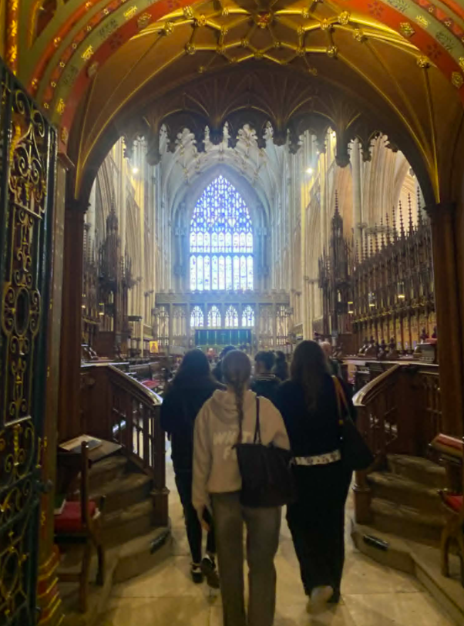
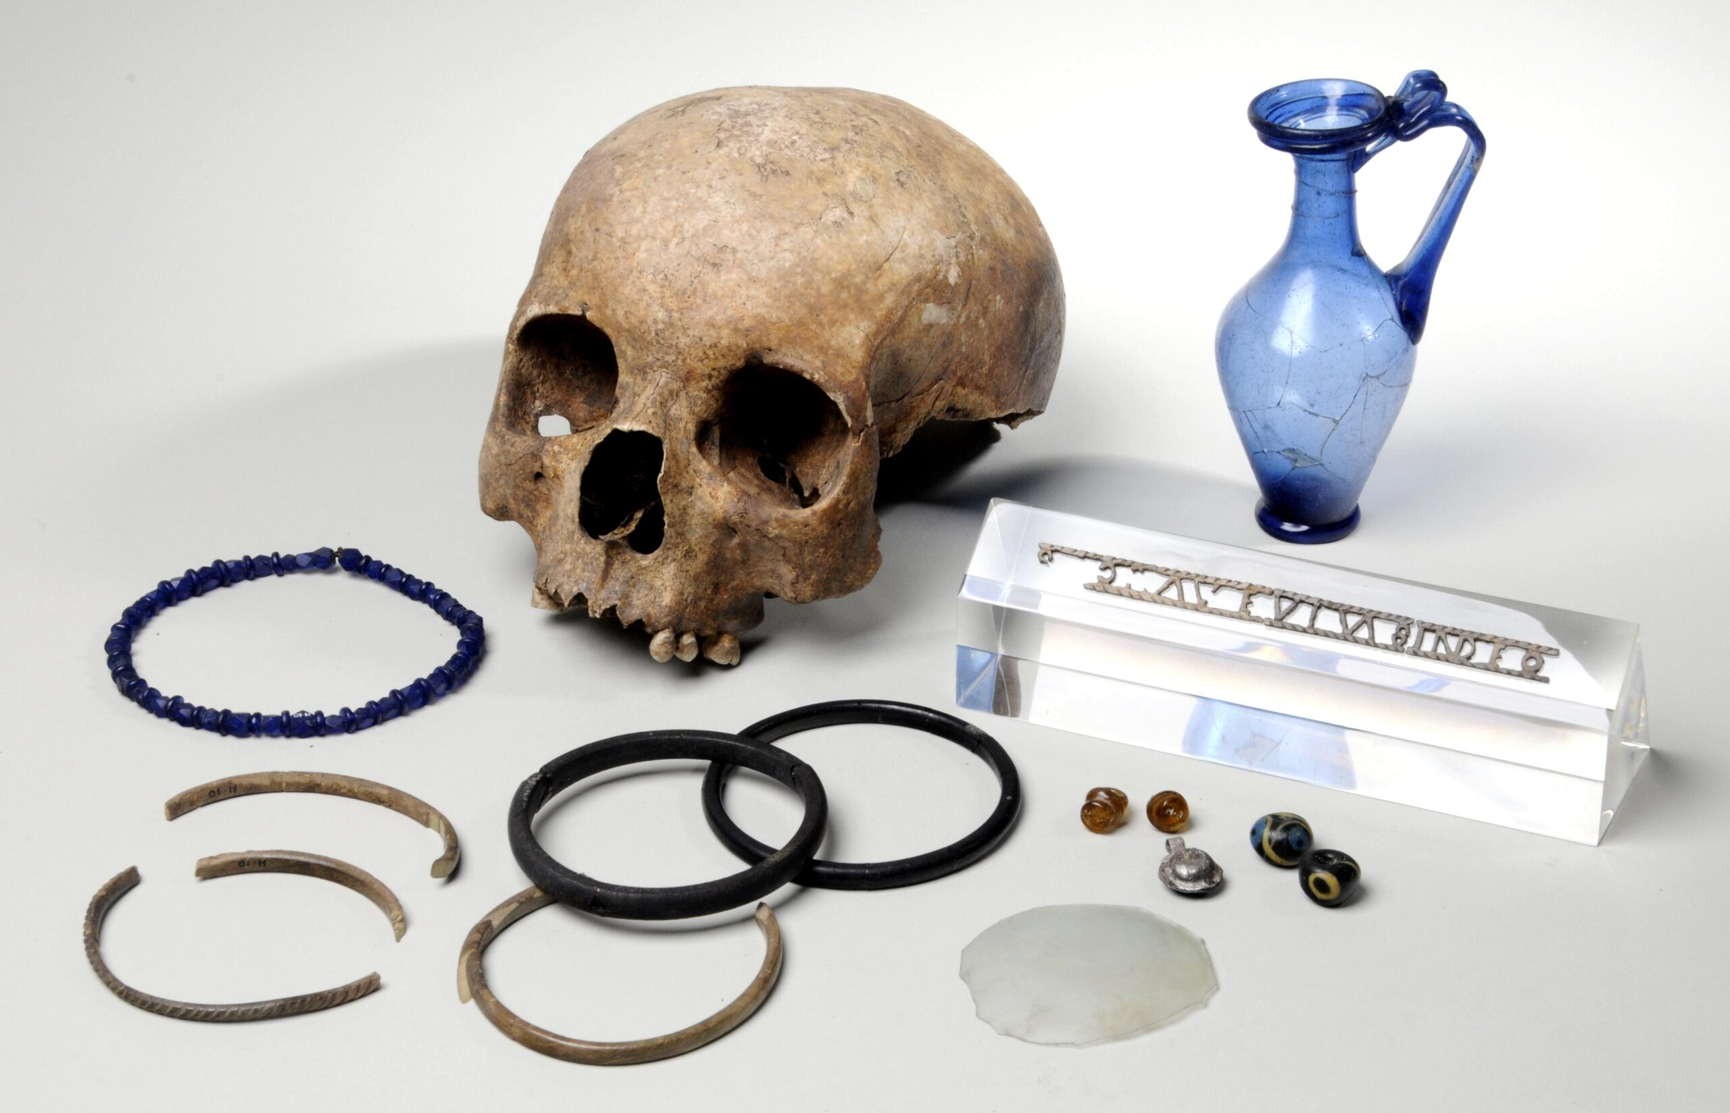
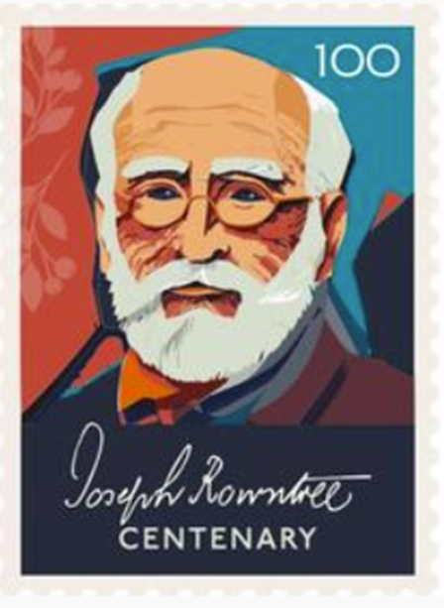

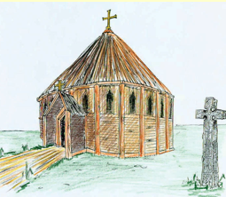
🧩Substantive Concepts
🙏Religion
Notes:
Steph
In their first year, student teachers focus on York Minster as a significant local site. They explore the history and significance of the Minster within both York and the wider country, including a visit to the site itself (which you can see in the photograph on the left)
In the second year, student teachers revisit the significance of York Minster through learning about Eoforwic (EE-or-for-wic) (Anglo-Saxon York) and considering how the Anglo-Saxons changed Britain through the spread of Christianity.
Through a study of Joseph Rowntree in first year, student teachers consider how Quaker beliefs influenced his chocolate business, philanthropy, and wider social reform both within and beyond York.
In Year 2, student teachers explore Mesolithic red deer antler frontlets discovered at Star Carr in North Yorkshire. They examine different historical interpretations surrounding their possible use, including interpretations suggesting ritual or shamanistic practices. This encourages student teachers to consider the possibility of complex belief systems and ritual practices within Mesolithic societies.
Our Roman history workshop includes a focus on the Ivory Bangle Lady, a Roman woman buried in York in the late fourth century close to our campus. Student teachers examine the objects buried with her, including an inscription reading “Hail, sister, may you live in God,” which may indicate Christian beliefs and provides insight into the spread of Christianity across the Roman Empire into York.

Slide 12
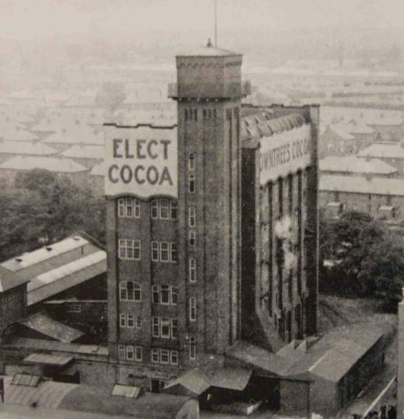



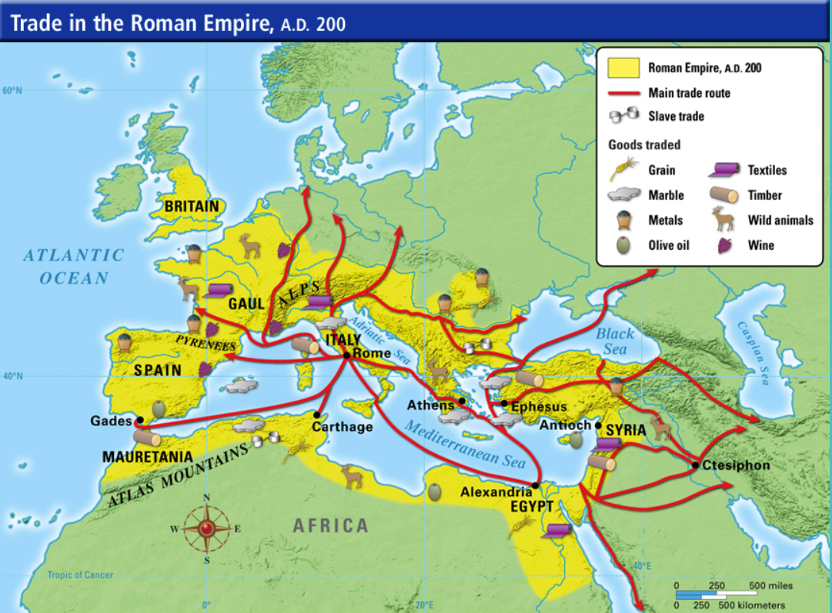
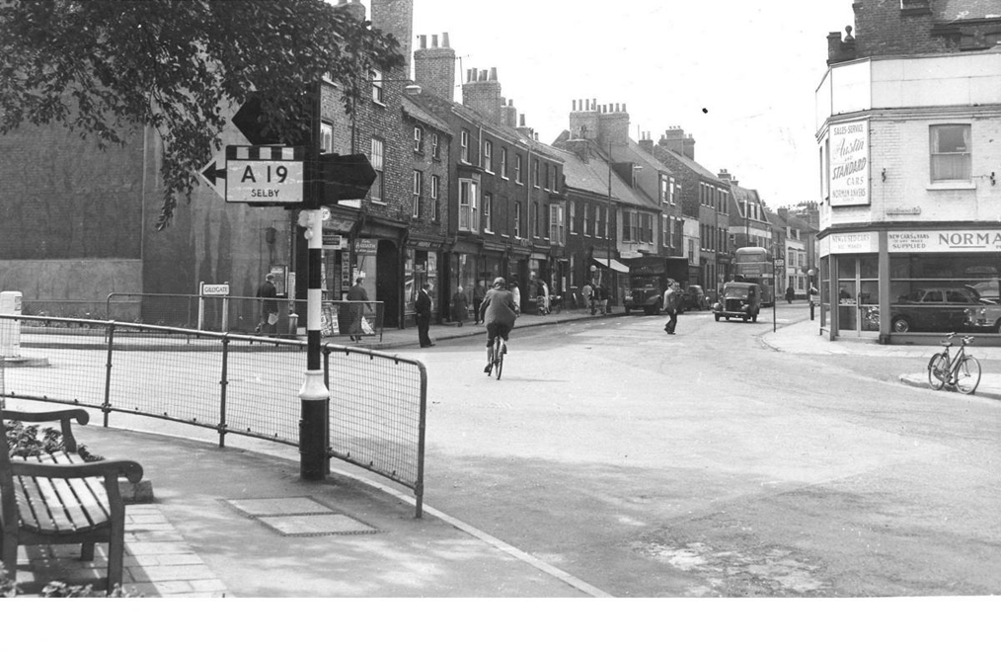
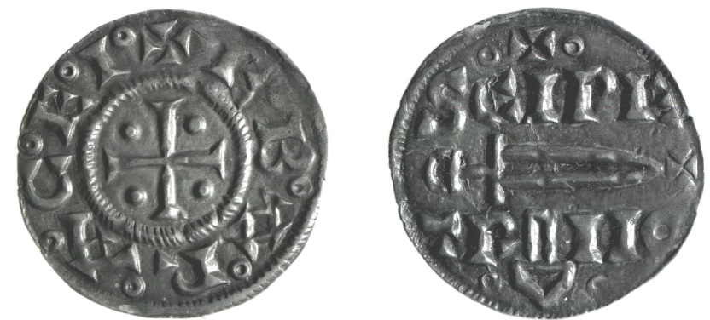
🧩Substantive Concepts
🤝Trade
Notes:
Steph
Another substantive concept we explore is trade, which begins in the first year through a KS1 focus about trade in the local high street in different time periods (this is a photo of the high street opposite our campus a site which we focus on during the session).
In later sessions we focus on York’s chocolate industry, including the work of the Rowntree family.
Using familiar places and stories helps student teachers see how history can feel more tangible and relevant for children, while also deepening their own understanding of how local contexts connect to wider historical themes.
In the second year, this conceptual understanding is extended through Roman and Viking trade links to and from York, helping student teachers explore ideas of exchange, movement, wealth, settlement, and wider connections between societies.
We use the objects buried with the Ivory Bangle Lady to illustrate trade within the Roman Empire. These include ivory bangles from central Africa and amber earrings from the Baltic region, demonstrating the extensive trade networks that connected Eboracum (Roman York) to wider parts of the Roman world and highlighting York as a cosmopolitan and internationally connected city.
St Peter’s Penny is a Viking coin which provides important evidence about both trade and religion in Jorvik (Viking-age York). Produced in the Jorvik mint, the coin demonstrates that York was a wealthy trading centre connected to wider Viking and European trade networks, with examples found across England, Ireland, and Scandinavia. Many coins feature references to St Peter, the patron saint of York Minster, while some also include Thor’s hammer, suggesting the coexistence of Christian and pagan beliefs within Viking society.
Through these York based examples, student teachers are encouraged to think beyond isolated historical topics and instead consider how meaningful local contexts can support deeper conceptual understanding and historical thinking.

Slide 13
Local context as the narrative vehicle
If you're in a school in York and you're teaching the Romans and you can talk about things that the children are seeing every day, I think having that like local link…is really helpful.
Poppy
I can link it specifically to them rather than just the whole of Britain, because…it's hard to imagine the whole of Britain, but if they could just imagine their village, then that's a little bit easier for them to do…. if I'd have learned about specifically to where I lived, it would probably have stuck a lot more. And then I think it would have been easier to understand as well.
Olivia
I work [In York]… every time I'd think this used to be where the Romans used to live. And it's things like that that makes the connection so much stronger. It just sits in your mind …So I think that was a really key part that I want to take forward in my teaching. …I think this linking it to the local area is more poignant for [pupils]
Sophie
Notes:
Jen
So how has this work shaped student teachers' perspectives? Having held a series of semi-structured interviews, we found that our student teachers were enthusiastic about using local history as a narrative vehicle and discussed how they wanted to carry this forward into their future teaching practice. These quotes exemplify the strong feeling that emerged from the interview
Poppy discussed the importance of making links to places and experiences that pupils encounter in their everyday lives. This aligns with Smith and Sobel’s (2010) place-based pedagogy, where familiar local contexts can make learning more meaningful because it is grounded in pupils’ lived experiences. Similarly, Olivia reflected on how, during a recent placement, she began with the local impact of the Romans on the village because, as she explained, “it’s hard to imagine the whole of Britain, but if they could just imagine their village, then that’s a little bit easier for them to do.” She also reflected that this approach would have helped her learn history better when she was at school.
Sophie spoke about her personal connection to York, walking through the city on her way to work thinking ‘this is where the Romans used to be’ – she described this as a “poignant” opportunity for learning. Her reflections suggest that engaging with local history can help pupils and student teachers feel more personally connected to the past.
Structuring our primary history curriculum around York’s history enabled the student teachers to understand place – specifically their pupils’ local areas - as an organising concept for the primary curriculum that they would be enacting in their placement schools.

Slide 14
Developing conceptual understanding
you've got the what and the how....... if you have the knowledge of what was going on and sort of, you know, you know the facts like the time, the dates and the sort of what was the materials used at the time or like what would they wear, if you know what sort of was going on, you can then link it to, well, how do we know this? How have we found this out? What sort of methods have we had to use?
Amelia
…substantive is, this is what happened sort of thing, like this is what we know. And then this is how, how the historians found it out and giving them [the pupils] the tools to do similar things.
Olivia
…understanding like ‘what happened when’ and like the order, but it's also been able to like think as a historian…
Jessie
…having core themes of substantive knowledge and carry them throughout the key stages so the children can see the progression from the different years or topics and then they can make links between them... Because I'm teaching history next half term and they're doing the ancient city of Baghdad… And then it links to like the Vikings… and having the same themes of trade where they can compare.​
Sophie
Notes:
We also saw that our teaching of substantive and disciplinary concepts was shaping the student teachers’ understanding of teaching and learning in primary history. That said, their understanding was often quite simplified, and frequently framed through the lens of classroom pedagogy rather than through the discipline of history itself.
Across this sample of quotes, you can see that they recognise a distinction between the “what” and the “how” of history. Amelia, for example, described substantive knowledge as the factual content — “the time, the dates… what materials were used… what would they wear” — and then links this to disciplinary thinking by asking “how do we know this?” and “what sort of methods have we had to use?”
Similarly, Olivia defined substantive knowledge as “this is what happened” and disciplinary knowledge as “how the historians found it out,” with an emphasis on giving pupils the tools to do similar things. Jessie also moves beyond seeing history as simply chronology or dates, arguing that pupils should be able to “think as a historian.”
So it seems that our student teachers are engaging with the broad distinction of substantive knowledge as ‘knowledge about the past’ and disciplinary knowledge as ‘understanding how historians have constructed claims about the past’, as set out by the DfE Research Review for History from 2021.
However, their understanding still appears relatively surface level when compared with the richer disciplinary framework outlined in the DfE review. For example, substantive knowledge is reduced largely to “facts,” dates, or contextual details, rather than being understood as interconnected second-order concepts such as trade, religion or settlements. The second order concepts were rarely talked about, but when they were, they were contextualized in terms of planning. This is exemplified by Sophie’s quote, who talked about how she would be teaching the substantive concept of trade during her ancient city of Baghdad topic, in order to make links back to the children’s previous Vikings topic.
In fact, we found that the student teachers often had a stronger understanding of subject specific pedagogies for primary history than of the concepts of substantive and disciplinary knowledge.

Slide 15
Interdependence in learning
…it wasn't just focusing on the time period of then, but like how the buildings had changed… the main point we were trying to get them to identify was like the buildings being close together and being made like made out of wood was why they'd burnt so much… having that like comparison between now and the past, which I know is another thing we've talked about quite a bit at uni ... we used a lot of visuals to support with that.
Poppy
…drama and theatre into learning, like embodying the characters at the time and playing a role of who was in charge or what sort of society was like. Because it's obviously Ancient Egypt was completely different to, you know, mediaeval England… building that understanding of change.
Amelia
…the experience of using artefacts in [the university workshop] would make me more likely to put it into my future lessons because it saw how beneficial it was for generating questions and thinking more like a historian rather than being given the fact and then working from the artefacts and then be given the information they need afterwards.
Sophie
Notes:
Jen
And we can see this illustrated by these quotes here.
Across these quotes, the student teachers recognise that substantive and disciplinary knowledge are interdependent and should be developed together — something also emphasised in the recent Curriculum and Assessment Review. So rather than teaching “facts first” and enquiry separately, they consistently describing how disciplinary thinking should be developed within substantive topics.
For many student teachers, a key takeaway from our university workshops was learning to recognize how to teach for disciplinary concepts. It seemed that had already assumed that history lessons would include substantive knowledge – which they conceptualized as factual content – but through their university workshops, they had begun to think more carefully about how pupils might investigate, question, interpret, and make sense of the past.
And the teaching approaches they most valued were those that captured pupils’ imagination and encouraged historical thinking: using visuals, artefacts, drama, comparison, and enquiry to deepen understanding. The disciplinary concepts that appeared most strongly across the data were ideas around time, change and chronology, alongside historical evidence and how we know about the past.
This leads us as teacher educators to reflect on how we have reached this cautiously optimistic place, where student teachers have a highly positive attitude to place-based approaches, emerging understandings of substantive and disciplinary concepts, and relatively confident knowledge of subject specific pedagogies.
We’re conscious that in Initial Teacher Education, we have an additional layer of complexity. For history educators in traditional primary or secondary settings, the aim is to support pupils to learn the substantive and disciplinary knowledge. But our student teachers must learn that, as well as the curriculum expectations and content, what substantive and disciplinary knowledge mean conceptually, and and how to teach those forms of knowledge effectively to children... All alongside the rest of the primary curriculum subjects.

Slide 16
Subject specific pedagogies in history​
🐘Teaching for memory ​
🔗Exposition and schema building – building on what pupils already know​
🔮 Narrative and story ​
🧱World-building – e.g., through visuals, artefacts, maps… ​
🕰️Teaching chronological knowledge ​
📚Reading extended texts ​
🔍Historical enquiry​
​🏛️ Real-life experience
adapted from Ofsted Research Review Series, 2021
Notes:
Jen
For this reason, to mitigate cognitive overload, we identified eight subject-specific pedagogies that we explicitly reference across our primary history modules. This slide acts as an anchor in each workshop, helping student teachers connect the knowledge they are developing with subject specific pedagogies they may consciously and knowingly implement in their practice.
And today, we thought we would explore some of these subject specific pedagogies from one of our second year workshops about changes in Britain throughout the Stone Ages, looking at World Building, Reading Extended Texts, Teaching For Memory, and Teaching Chronological Knowledge.

Slide 17
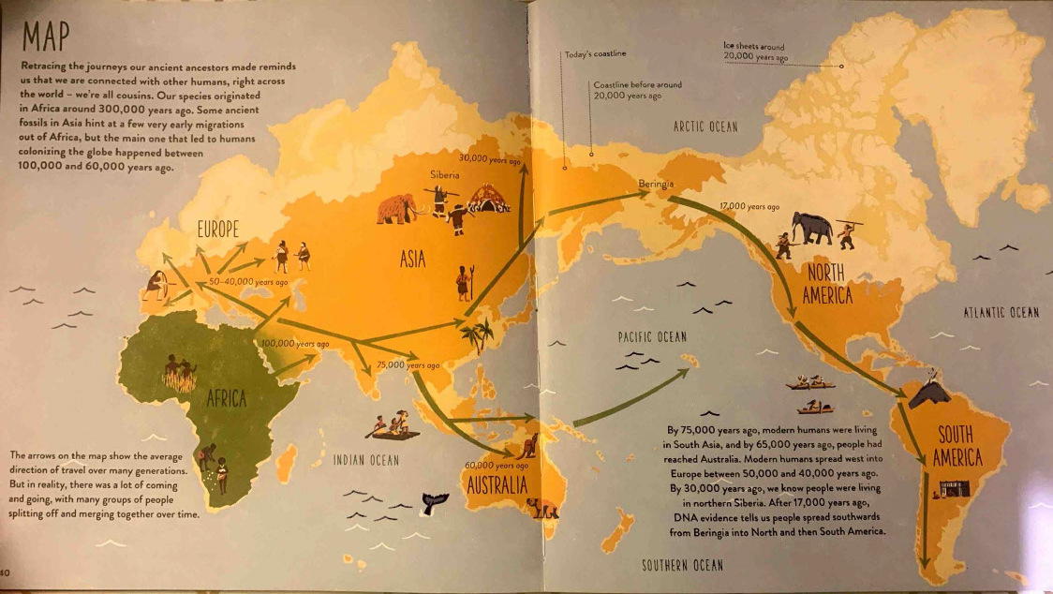
🧱World-building
Roberts, A., & Weston Lewis, J. (2020) Human Journey. London: Red Shed
Notes:
Jen
Stuart Tiffany suggests that establishing the context – a sense of period – is an important starting point for any sequence of learning in history. Part of this involves world building. The key idea is that, for successful history learning, pupils need to be able to locate historical knowledge securely within its time and place. As teachers, we therefore need to support pupils in constructing this abstract historical world in their minds, so that later substantive and disciplinary learning has something meaningful to attach to. For this to happen, Tiffany advocates for a direct-instruction approach.
When we first explore the Stone Ages with our student teachers, we introduce this idea by discussing how Homo sapiens evolved around 300,000 years ago in Africa before gradually migrating across the world. We use this wonderful book – Human Journey by Professor Alice Robers and James Weston Lewis – to track some of these migrations. We also explore the fact that many other human species existed before and alongside modern humans. Archaeologists have identified evidence of systematic stone-tool production dating back to around 2.5 million years ago, which is why historians generally use this point to mark the beginning of the Stone Ages.

Slide 18
🧱🐘 The Stone Ages
Palaeolithic era
The “old” Stone Age
Mesolithic era
The “middle” Stone Age
12,500ya - 6,000ya
Neolithic era
The “new” Stone Age
6,000ya – 4,500ya
2,500,000ya – 12,500ya
Homo sapiens evolve
Ice Age ends
Agricultural Revolution
Notes:
Having established where the Stone Ages take place, we then move into establishing the time framework of these three broad periods: the Paleolithic, Mesolithic, and Neolithic.
At this point in the workshop, we make the pedagogies really explicit to the student teachers. We discuss how this slide is doing two things simultaneously: it’s an example of both world-building and teaching for memory.
From a world-building perspective, these labels help pupils construct a mental map of the Stone Age. Rather than seeing it as one indistinct prehistoric period, pupils begin to understand it as a sequence of different worlds across millions of years. From a teaching-for-memory perspective, these categories act almost like “storybook chapters,” breaking down an enormous span of time — over two and a half million years — into manageable phases that help children grasp chronology and long-term change.
We also discuss with student teachers how these broad periods foreground major shifts that recur throughout the primary curriculum: changes in technology, from chipped to increasingly polished stone tools; changes in lifestyle, from predominantly mobile hunter-gatherer communities to more settled farming societies; and changes in landscape and settlement, particularly within early Britain. So even though these categories are broad and somewhat British-centric, pedagogically they provide memorable narrative anchors that support chronological understanding.
We then begin building substantive knowledge within each period.
In the Palaeolithic, beginning around 2.5 million years ago, we explore early human species, migration out of Africa, hunter-gatherer lifestyles, the use of fire, temporary shelters, and early stone, wood, and bone tools. We also discuss how tool-making changed very gradually over extremely long periods of time.
In the Mesolithic, after the last Ice Age around 12,000 years ago, we explore environmental change, including warming climates and the gradual separation of Britain from mainland Europe through the flooding of Doggerland. We examine how tools became smaller and more specialised, and use artefacts to ask what different tools may have been used for. We also discuss evidence of early humans in Britain dating back tens of thousands of years.
And then in the Neolithic, from around 6,000 years ago in Britain, we examine the transition towards farming and more settled communities. We explore developments in tool technology, including polished stone axes and sickles associated with cereal farming, and consider how agriculture changed settlement patterns, food production, population growth, and social organisation.

Slide 19
2,500,000ya
First early humans
Today
Palaeolithic
1 million years
300,000ya
🕰️ Stone Ages Timeline
First Homo sapiens
Notes:
Jen
We then move student teachers into thinking about chronology and timelines more explicitly. We show them this timeline and ask them to consider why, despite being technically accurate, it probably wouldn’t be especially useful in a primary classroom.
And usually they identify the issue quite quickly: the scale is simply too vast and abstract – it would be difficult for primary children to interpret it because of the sheer scale of time it covers. This invites a conversation around how we need to think carefully about the balance between disciplinary concepts and pedagogy – how might we teach a concept like chronology and using timeline accurately, but in a way that is also meaningful and purposeful for primary-aged children?

Slide 20
12,500ya
6,000ya
Today
Palaeolithic
Mesolithic
Neolithic
1000 years
What would you explain about the timeline, and in what order, to avoid pupil misconceptions?
🕰️ 🐘 ‘Zoomed-in’ Stone Ages Timeline
Notes:
Jen
We then introduce this more “zoomed-in” version and ask the student teachers to think about the pedagogical choices behind it. We then ask student teachers to think pedagogically: what would we need to do to help pupils interpret this timeline accurately? What knowledge would they need and what misconceptions might we anticipate? If you had this as a visual resource with a group of KS2 pupils, what aspects would you draw their attention to, and in what order?
***
One of the first things we discuss is the importance of orientating children to the timeline before introducing historical content. So we might begin by drawing pupils’ attention to today on the far right-hand side and asking something like, “Where are we on this timeline?” Because that immediately helps children recognise just how distant the Stone Age is from the present.
Then I’d focus on the intervals along the bottom and explain that each section represents one thousand years, perhaps practicing counting back in thousands from today.
Once that chronological framework is secure we might move into the coloured sections themselves — identifying the Palaeolithic, Mesolithic, and Neolithic periods, and noticing that they lasted for very different lengths of time. We also discuss how the Palaeolithic actually extends much further back than this timeline can fully show, which is why this is really a “zoomed-in” representation focused on the periods we are going to study most closely.
So with the student teachers, we make explicit that chronology teaching… it’s not as simple as showing the class a timeline — it’s about really carefully scaffolding how pupils interpret and make meaning from these representations of time.

Slide 21





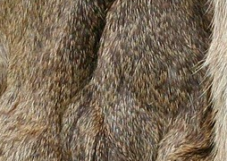
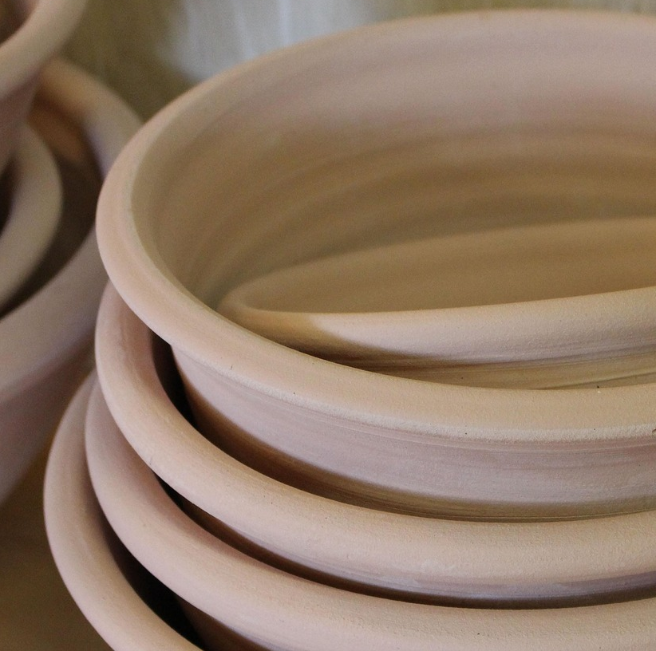
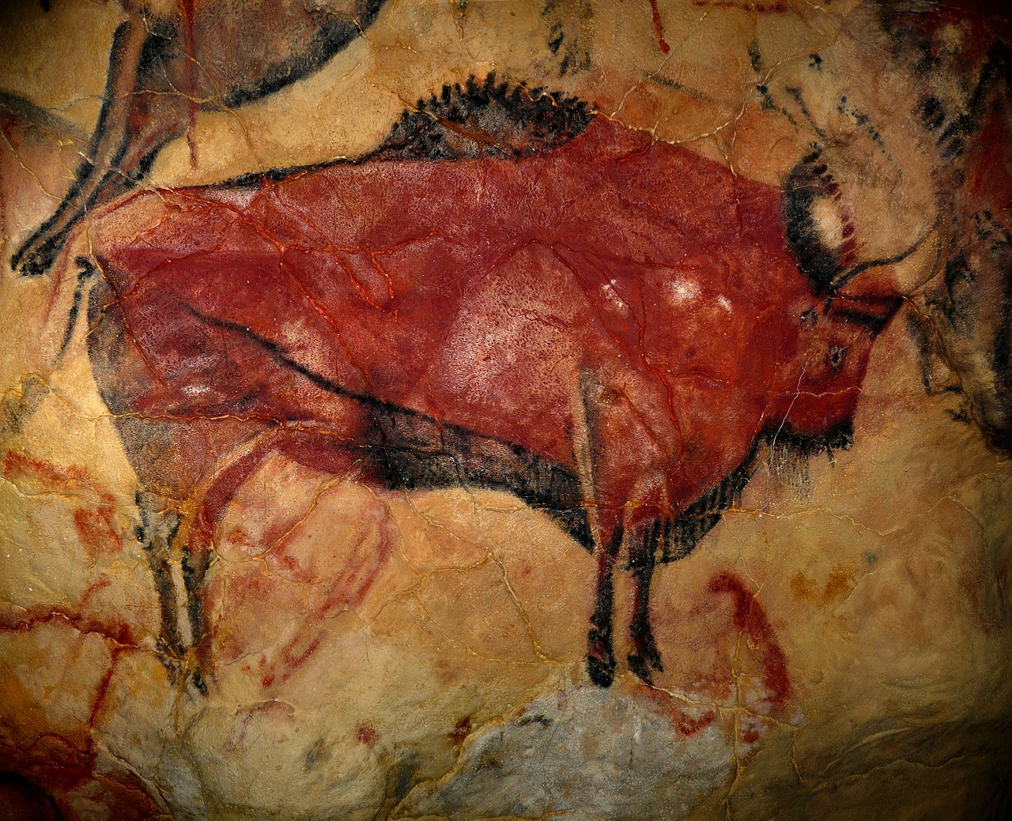

🧱 💬 Artefacts across the Stone Ages
Observations
Known facts
Thoughts & questions
Images: Pixabay, n.d.
Notes:
Jen
The next activity we explore with the student teachers is this artefact-based task, which we use early in the Stone Age sequence as a way of extending world-building. If we were face-to-face, I’d usually spread these artefacts — or images of them — around the room. We’ve got round stones, sharp stones, berries, animal fur, fire, shells, a painting or drawing of an animal on a wall, some clay pots, and some wheat. I ask the students teachers to move around in groups, between the images and artefacts, writing questions, observations, or interpretations onto post-it notes beside each one.
The purpose here is not simply to identify objects or “guess the right answer.” Instead, the activity is designed to help pupils begin constructing a richer mental world of the Stone Ages through materials, textures, foods, tools, and environments. So learners encounter these images and artefacts and begin building an abstract sense of what life may have looked and felt like across prehistoric periods.
So, I’d like you to engage with these images in the same way we ask our student teachers to during the workshop. I’m very aware that there’ll be a huge amount of historical expertise in this virtual room – and there is a wide range of knowledge and confidence in our university workshops, with some student teachers having studied history to A-level, and some having not studied it since Year 9. Therefore, this is an open-ended activity – the idea is that we all ask questions, based on the knowledge that we have. If you know, for example, that the sharp stone humans used to make hand-axes was called flint, share that fact, and then ask a question about it… for example, why was flint such as useful type of stone for making tools?
You might also think about which aspects of this activity are contributing to world-building — helping pupils construct an abstract mental picture of prehistoric life — and which aspects begin to support disciplinary thinking through questioning, inference, and interpretation from evidence.
If you’d like to, pause for a moment and jot down a few observations, questions, or possible pupil responses, just as our student teachers would during the session.
***
Following the student teachers’ time to ask questions and make interpretations of the artefacts and images, we have time for an initial discussion. During this time, the student teachers feedback on their ideas – this is often an opportunity to build their confidence in their existing subject knowledge as well as their curiosity. For example, we talk about how evidence suggests that humans — or earlier human species — were controlling fire at least hundreds of thousands of years ago, probably much earlier - certainly during the Palaeolithic.
From this, we pose questions about what fire might offer humans beyond warmth and light… we point out that cooked food is safer and easier to digest, that fire offers protection from predators, and that it may have encouraged social spaces and storytelling.
We talk about how evidence of human art has been found that is as old as 300,000 years old (not this Bison, this painting is from a cave in Spain and is only 36 kya) – we talk about why someone may have wanted to create such images.
We talk about how the fruit was an important food source, but their seasonality meant that humans lived a hunter-gatherer lifestyle. We introduce the word ‘nomad’ to describe how Paleolithic humans didn’t live in one place, but had to ‘follow the food’.
Then we compare this to the pottery, which we are more likely to see in Mesolithic and Neolithic times, when humans lived in more permanent settlements.
We also talk about wheat, and how humans have been eating bread since Paleolithic times (a great fact to remember when you eat your next sandwich!), but that the farming of wheat is a really important part of the story and marks the start of the Neolithic period.

Slide 22
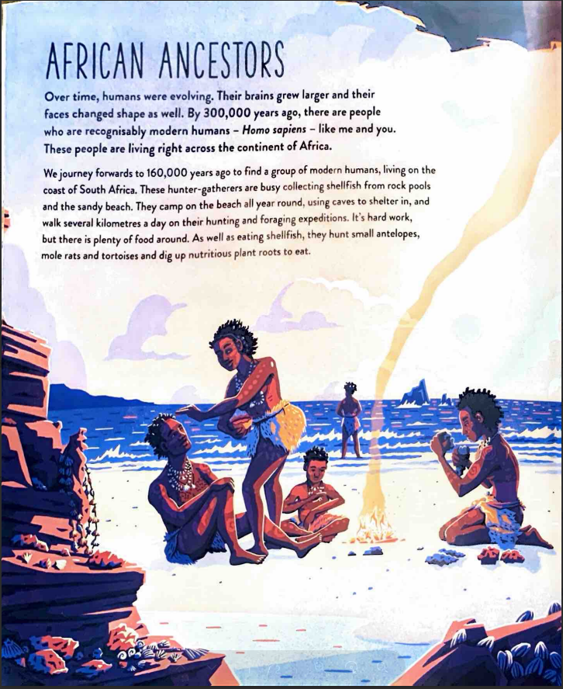
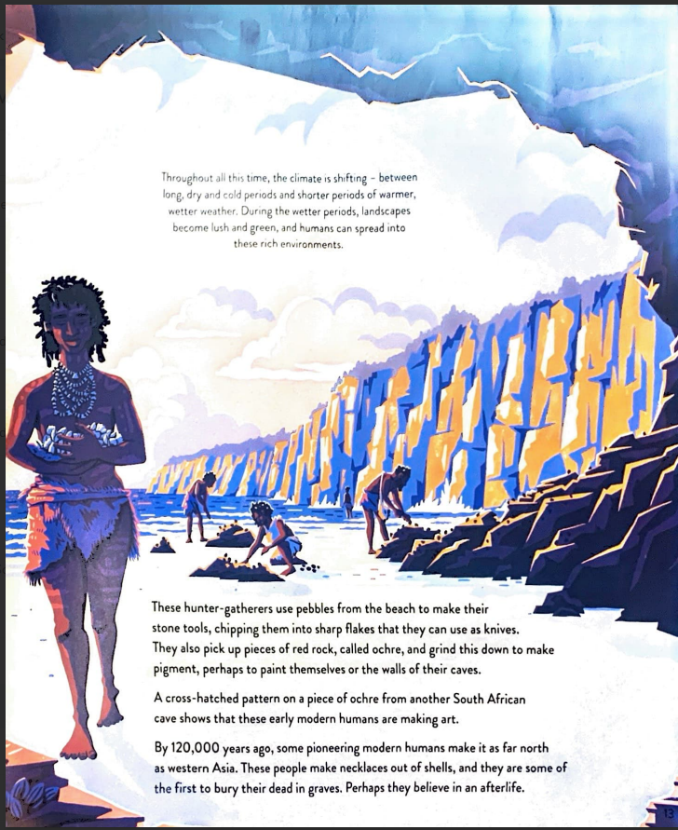
Roberts, A., & Weston Lewis, J. (2020) Human Journey. London: Red Shed
📚Reading Extended Texts ​
Notes:
Jen
After our initial discussion, we read this page from the book Human Journey, which deliberately connects to many of the artefacts and images we’ve just explored.
Read the text…
Now that we’ve read this text, we’d like to invite you to revisit your initial interpretations or questions – can you extend or refine them?
So the activity sequence models how substantive knowledge and disciplinary thinking can work together: pupils first infer and question from evidence, then use additional knowledge to deepen, challenge, or refine those interpretations.

Slide 23
12,500ya
6,000ya
Today
Palaeolithic
Mesolithic
Neolithic
How might you place the artefacts on the timeline and why?
1000 years
🕰️ 🐘 Returning to the timeline…
Notes:
Jen
So, having explored the artefacts, discussed our initial interpretations, and then deepened our understanding through the reading, we now return to the timeline.
And this is the point where we ask student teachers to think about chronology as the structure that helps organise and connect that knowledge meaningfully over time.
So I’d like you to consider: based on what we now know, what can you add to this timeline? Which artefacts or developments feel more strongly connected to the Palaeolithic world of hunter-gatherers? Which might fit more closely with the warming-up world in the Mesolithic, as the last Ice Age comes to an end? What about the Neolithic transition towards farming and settlement? And are there any that might span multiple periods? There are some images on the board that might help you.
What we’re trying to model for student teachers here is that chronology becomes much more meaningful once pupils have substantive knowledge to attach to it. The timeline is no longer just dates and labels — it becomes a way of organising changing human experiences, technologies, and lifestyles across time.
So, if you’d like to, pause for a moment and think about where you would place these images, and what kinds of discussions or misconceptions might emerge if you were doing this with a Key Stage 2 class.

Slide 24
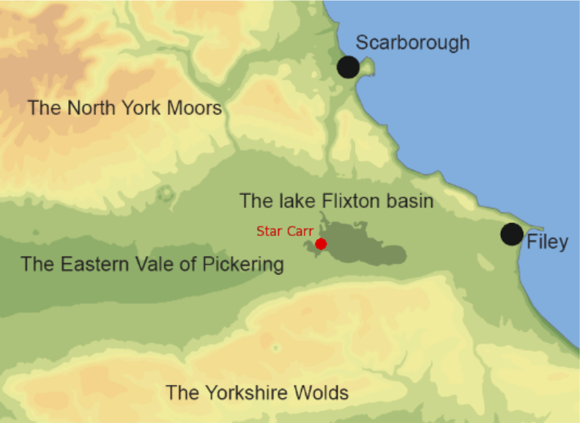
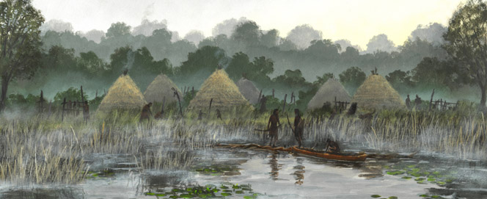
🔍 What was the most significant change during the Stone Ages?
🏡 Star Carr: local Mesolithic settlement
Images: The Star Carr Archaeology Project, n.d.
Notes:
Jen
Once we’ve established this broader chronological and conceptual framework through a range of world-building activities, we then look at a more focused local history enquiry centred on Star Carr, a Mesolithic settlement in North Yorkshire.
Here, we investigate the question: “What was the most significant change during the Stone Ages?” Using archaeological evidence from Star Carr, the student teachers begin applying both substantive and disciplinary knowledge to interpret how people lived during the Mesolithic period.
As part of the enquiry, student teachers create their own map or reconstruction of a Mesolithic settlement, encouraging them to synthesise evidence about landscape, shelter, resources, and daily life. We discuss how this acts as a form of assessment, an alternative to writing, as well as prompting discussion for talk and eliciting misconceptions.
York Museums Trust – Introduction to Star Carr: https://www.youtube.com/watch?v=RjHQnHi8imc
artefacts that were created at Star Carr (KS2 resource): https://www.youtube.com/watch?v=VTeWf_Zwq4Q
Settling: https://www.youtube.com/watch?v=6LkdAbuppGE
Believing: https://www.youtube.com/watch?v=0lC8PCd_Whk

Slide 25
A student teacher’s perspective…
…if you want children to be like historians, you have to give them questions. You can't always give them the answers. I think a lot of it is about creating the air of mystery and like making them feel like they're discovering something. Because I think it's really easy to just tell them everything they want to know. But if you want to build that engagement, you almost have to not quite give them everything in one go.
Poppy
Notes:
Jen
And I think this quote from Poppy, one of our student teachers, really captures what we were trying to do through the practical activities in our primary history workshops.
The aim wasn’t just to tell student teachers about substantive and disciplinary knowledge as abstract concepts, but to let them experience a way of teaching history where curiosity, interpretation, and questioning sit at the centre.
So through the artefacts, the timelines, the world-building, and the Star Carr enquiry, we were deliberately modelling a classroom where pupils aren’t simply handed all the answers straight away. Instead, they’re encouraged to notice things, ask questions, make interpretations, and gradually build a picture of the past over time.
And I think Poppy expresses that really nicely here — this idea that if we want children to think like historians, we sometimes have to resist the urge to explain everything immediately, and instead create space for mystery, uncertainty, and discovery.

Slide 26
Evaluating our approach
Selective approach to curriculum coverage​
Celebrate local context as the narrative vehicle ​
More explicit substantive concepts and more consistent disciplinary concepts​
Review coverage of subject specific pedagogies
Notes:
Jen​
​
Thinking back to our first two session outcomes, we asked:​
1. How do support generalist primary teachers to learn and teach primary history?​
2. What subject specific pedagogies might be implemented?​
​
Evaluate out approach: ​
a) Carefully selected coverage of the National Curriculum - we will keep this aspect, it allows less coverage in greater depth, supported by C&A review​
C) Local context as the narrative vehicle – we will keep this, student teachers connected with this aspect and were motivated to translate this into their own practice for their pupils to create meaningful learning opportunities​
​
B) Concrete examples of substantive and disciplinary concepts - this needs further work – student teachers need greater support understanding what we mean by substantive concepts (not just substantive knowledge), and a more consistent understanding of each of the disciplinary concepts.​
D) Consistent approaches to subject specific pedagogies – we will develop this – as we explored in the practical part of our workshop, making the subject specific pedagogies explicit can be helpful for student teacher learners and supports consistency across year groups. However, as with the disciplinary concepts, we need to reflect on how even our coverage is across year groups and how often we revisit each subject specific pedagogy. ​
​
​

Slide 27
Next steps in light of the Curriculum and Assessment Review
Building wider historical connections through diverse perspectives and sources.
Using source analysis to develop critical thinking and media literacy.
Notes:
Steph
At the start of the session, we also asked: what are our next steps in response to the Curriculum and Assessment Review?
In addition to the next steps Jen has discussed, we aim to continue developing opportunities for student teachers to engage with wider historical connections through more diverse perspectives, interpretations and sources.
We are particularly interested in how disciplinary approaches, such as source analysis, can support wider critical thinking and media literacy skills alongside historical thinking.

Slide 28

Evaluation & Q&A
Building Historical Thinking Evaluation and Feedback – Fill in form
https://forms.office.com/e/pwNfVZS5cW
Notes:
We would love to hear your feedback on this workshop. It helps us both reflect on our practice and support future QR funding bids – we’d be very grateful if you would take two minutes or so to share your thoughts using the link or this QR code.

Slide 29
Questions?
Continuing the Discussion
In a crowded curriculum, how do we create space for deeper historical thinking rather than superficial coverage?
Which subject-specific pedagogies seem most effective for helping pupils think historically?
What makes local history genuinely meaningful rather than simply 'nearby'?
Notes:
Steph
Continuing the discussion
These questions are intended to open up discussion around curriculum depth, subject-specific pedagogy, and the role of local history in supporting historical thinking and engagement.

Slide 30
References
Beames, S., Higgins, P. and Nicol, R. (2011) Learning Outside the Classroom: Theory and Guidelines for Practice. New York: Routledge.
Department for Education (2025) Curriculum and Assessment Review Final Report. Available at: Curriculum and Assessment Review Final Report (Accessed: 11 May 2026)
Lomas, T. (2019) ‘Getting to grips with concepts in primary history’, Primary History, Historical Association.
Ofsted (2021) History research review. Available at: Ofsted History Research Review (Accessed: 11 May 2026).
Roberts, A., & Weston Lewis, J. (2020) Human Journey. London: Red Shed
Smith, G. A. and Sobel, D. (2010) Place- and Community-Based Education in Schools. New York: Routledge.
Tiffany, S. (2023) Mr T Does Primary History. London: Corwin UK.
Notes:
Thank you so much for your time and engagement today. We hope you’ve found our workshop thought provoking and relevant in some way to your own work, and would love to hear from you via the feedback form. Do take care and thank you.

Slide 31
Image Credits
Slide 11
The Rowntree Society (2025) Joseph Rowntree Centenary stamp. Available at: https://www.rowntreesociety.org.uk/joseph-rowntree-centenary/joseph-rowntree-stamp/ (Accessed: 11 May 2026).
York Minster (n.d.) York Minster Timeline. Available at: https://yorkminster.org/discover/timeline/ (Accessed: 11 May 2026).
York Minster image: Author’s own photograph.
York Museums Trust (2022) Celebrating Ivory Bangle Lady. Available at: https://www.yorkmuseumstrust.org.uk/blog/celebrating-ivory-bangle-lady/ (Accessed: 11 May 2026).
Yorkshire Museum (n.d.) Star Carr Frontlets. Available at: https://www.yorkshiremuseum.org.uk/collections/collections-highlights/star-carr-frontlets/ (Accessed: 11 May 2026).

Slide 32
Image Credits
Slide 12
The British Museum (n.d.) Coin (Museum number 1915,0507.772). Available at: https://www.britishmuseum.org/collection/object/C_1915-0507-772 (Accessed: 11 May 2026).
Nestlé UK & Ireland (2015) KitKat® turns 80. Available at: https://www.nestle.co.uk/en-gb/aboutus/history/blog/kitkat-turns-80 (Accessed: 11 May 2026).
Roman Trade Routes (n.d.) Roman Trade Routes. Available at: https://roman12345.weebly.com/roman-trade-routes.html (Accessed: 11 May 2026).
The Rowntree Society (n.d.) Haxby Road Factory. Available at: https://www.rowntreesociety.org.uk/explore-rowntree-history/rowntree-a-z/haxby-road-factory/ (Accessed: 11 May 2026).
York Museums Trust (2022) Celebrating Ivory Bangle Lady. Available at: https://www.yorkmuseumstrust.org.uk/blog/celebrating-ivory-bangle-lady/ (Accessed: 11 May 2026).
The York Press (2016) 52 fantastic old photos of Gillygate & Lord Mayor’s Walk. Available at: https://www.yorkpress.co.uk/news/14389640.52-fantastic-old-photos-of-gillygate-lord-mayors-walk/ (Accessed: 11 May 2026).

Slide 33
Image Credits
Slide 17 & 22
Roberts, A., & Weston Lewis, J. (2020) Human Journey. London: Red Shed
Slide 24
The Star Carr Archaeology Project (n.d.) Star Carr Archaeology Project. Available at: Star Carr | A Mesolithic site in North Yorkshire | Home (Accessed: 11 May 2026)
All other images sourced from Pixabay (n.d.). Available at: 6.1 million+ Stunning Free Images to Use Anywhere - Pixabay (Accessed: 11 May 2026).

Slide 34
12,500ya
6,000ya
Today
Palaeolithic
Mesolithic
Neolithic
1000 years
🕰️ 🐘 ‘Zoomed-in’ Stone Ages Timeline
Notes:
Jen
We then introduce this more “zoomed-in” version and ask the student teachers to think about the pedagogical choices behind it. We then ask student teachers to think pedagogically: what would we need to do to help pupils interpret this timeline accurately? What knowledge would they need and what misconceptions might we anticipate? If you had this as a visual resource with a group of KS2 pupils, what aspects would you draw their attention to, and in what order?
***
One of the first things we discuss is the importance of orientating children to the timeline before introducing historical content. So we might begin by drawing pupils’ attention to today on the far right-hand side and asking something like, “Where are we on this timeline?” Because that immediately helps children recognise just how distant the Stone Age is from the present.
Then I’d focus on the intervals along the bottom and explain that each section represents one thousand years, perhaps practicing counting back in thousands from today.
Once that chronological framework is secure we might move into the coloured sections themselves — identifying the Palaeolithic, Mesolithic, and Neolithic periods, and noticing that they lasted for very different lengths of time. We also discuss how the Palaeolithic actually extends much further back than this timeline can fully show, which is why this is really a “zoomed-in” representation focused on the periods we are going to study most closely.
So with the student teachers, we make explicit that chronology teaching… it’s not as simple as showing the class a timeline — it’s about really carefully scaffolding how pupils interpret and make meaning from these representations of time.

