Slide 1
Developing
Subject Specific Pedagogies for the
Primary Foundation Subjects in
University-Based ITE ​
Dr Jennifer Huntsley & Stephanie Jach
York St John University
Notes:
Steph
Good morning
My name is Steph Jach and.....
Jen and I both work in initial education at York St John university where we teach on the primary programmes to over 500 student-teachers.

Slide 2
Aims
To explore how subject specific pedagogies can be meaningfully developed within university-based ITE across a range of primary foundation subjects
To identify shared principles underpinning subject specific pedagogies across the primary foundation subjects
To invite participants to reflect on the implications for their own practice in preparing student teachers to teach the primary foundation subjects
Notes:
Steph
Jen and I lead and teach across a range of primary foundation subjects, including history, geography, art, and design and technology.
The 2025 Curriculum and Assessment Review has increased expectations around disciplinary thinking, subject expertise, and curriculum coherence across the foundation subjects.
However, concerns remain regarding student teachers’ subject knowledge in these areas. There is evidence that foundation subjects continue to receive significantly less curriculum time than core subjects (our undergraduate student teachers receive approximately 12 hours per subject across three years).
This prompted us to reflect on the pedagogical approaches we use and how we make subject-specific thinking more explicit for student teachers.
In this session, we will explore how subject-specific pedagogies can be developed within university-based ITE, identify shared principles across the foundation subjects, and invite you to reflect on the implications for your own practice.

Slide 3
Subject-specific pedagogies
Pedagogical content knowledge: ‘that special amalgam of content and pedagogy’ (Shulman, 1986, p. 8)
‘Both trainers and mentors should have a strong grasp of subject specific pedagogy’ (Carter, 2015, p.8)
‘…inspectors will consider the extent to which… . general teaching pedagogies and subject specific aspects of the ITE curriculum are well integrated’ (Ofsted, 2025, p.9-10)
Notes:
Jen
We were interested in where the term ‘subject-specific pedagogies’ had originally come from, and we found it difficult to pin down in research literature. In terms of theory, the most significant concept seems to be Shulman’s pedagogical content knowledge (or PCK): ‘that special amalgam of content and pedagogy’ (Shulman, 1986, p. 8), where teachers transform disciplinary content knowledge into forms accessible to learner. This involves the teacher being able to evaluate the topic’s structure, anticipating likely misconceptions, and adapting teaching to pupils’ needs.
Carter Review (2015) linked to these ideas, but termed them Subject-Specific Pedagogy, rather than PCK, and emphasized the importance of student teachers and teacher educators understanding these well.
These ideas continue to be relevatnt today, with the latest iteration of Ofsted’s inspection framework emphasizing how ITE programmes will be evaluated on the basis of how well subject-specific pedagogies are integrated into their curricula.

Slide 4



Challenges of developing subject-specific pedagogies in primary foundation subjects
Research overlooks ‘the holistic nature of how primary teachers work across an extended range of curriculum subjects simultaneously, and the demands this makes of them’ (Pope, 2019, p. 294)
Primary teachers are not ‘generalists’, but need to hold ‘extensive expertise’ across many subjects (Davis & Boerst, 2014, p.6)
Notes:
Jen
We were also interested in research around the primary foundation subjects in ITE, but there is relatively little out there. It tends to focus on a specific subject, rather than what Pope (2019) calls ‘the holistic nature of how primary teachers work across an extended range of curriculum subjects simultaneously, and the demands this makes of them’ (Pope, 2019, p. 294).
For example, The Research review series from Ofsted is welcome in that it provides a detailed and relevant analysis of curriculum, knowledge and pedagogy across specific disciplines. Indeed, these have been key documents for us in developing our approaches. However, it harks back to the argument made by Davis and Boerst (2014) the how Primary teachers are not ‘generalists’, but instead are required to hold ‘extensive expertise’ (p. 6) across many individual subjects.
This underlines the challenge around the foundation subjects for teacher educators in primary ITE. With less curriculum time, with lower starting points in terms of learners’ prior knowledge, we must teach the substantive knowledge of the National Curriculum, as well as the conceptual disciplinary understanding required by each subject, and the effective pedagogies specific to that subject. Primary teachers are treated as “generalists” yet expected to be experts in every primary curriculum subject.

Slide 5
Our approach to primary history in ITE
Consistent sequence of learning
Carefully selected coverage of the National Curriculum
Concrete examples of substantive and disciplinary concepts
Consistent approaches to subject specific pedagogies
Notes:
Steph
Because of this, we’ve started to consider how we can reduce cognitive load for student teachers by identifying shared pedagogical principles across the foundation subjects.
To exemplify this approach, we will focus on primary history. We have chosen history because we both teach the subject, and our ongoing generative critical conversations have shaped our approach within ITE.
Our approach primary history involves:
Consistent sequences of learning across topics
Carefully selected coverage of the National Curriculum Programme of Study With only 12 hours available, we teach fewer topics in greater depth to support secure curricular knowledge
Concrete examples of substantive and disciplinary concepts coherently sequenced across sessions
Consistent approaches to subject-specific pedagogy
Although the examples are history-specific, many of the wider principles are transferable across the foundation curriculum. We will share how our work in primary history has begun to inform our thinking across other foundation subjects

Slide 6
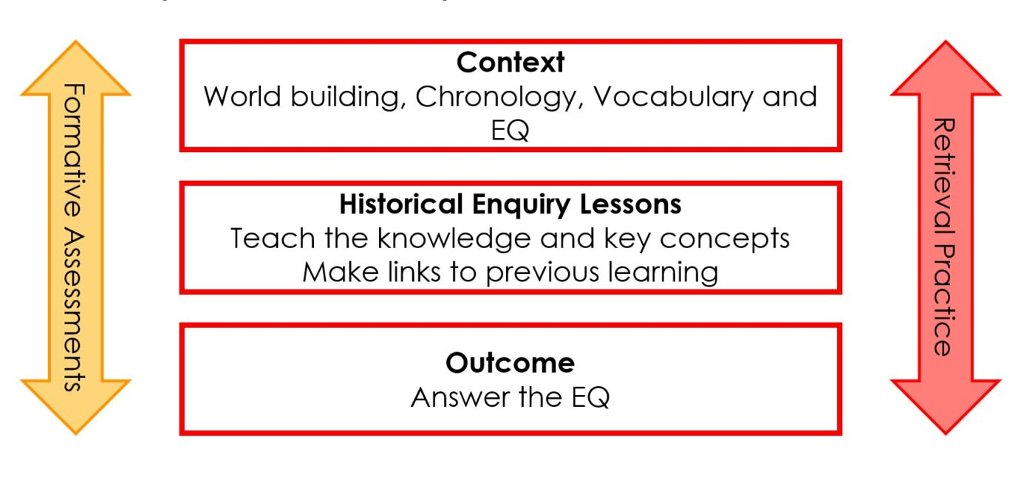
A consistent sequence of learning (Tiffany, 2023)
Notes:
Steph
We use a consistent sequence of learning within our history workshops. This helps provide coherence across different historical topics while modelling for student teachers how historical learning can be structured for pupils in schools.
Sessions may focus on different curriculum topics, but they all follow a similar enquiry-based structure which supports curriculum coherence, and the gradual development of historical understanding over time.

Slide 7
🕵️ Disciplinary and Substantive Concepts🧩
🕰️Time, change, chronology​
➡️ Reasons and results​
💬Interpretations​
📸 Historical evidence ​
🏅Significance​
Lomas, 2019
🙏Religion
🤝Trade
🏡Settlement
Notes:
Steph
Disciplinary knowledge refers to how historians investigate, interpret, and construct knowledge about the past.
Substantive concepts are recurring historical ideas, such as religion, trade, and settlement, that help pupils build deeper understanding across different historical contexts.
One way we make disciplinary knowledge and substantive concepts more explicit within our curriculum is through the consistent use of these concepts across sessions (these are the one we focus on)
We use Widgit symbols to provide simple and consistent visual prompts for disciplinary knowledge, substantive concepts, and subject-specific pedagogies.
These visual prompts help student teachers recognise recurring historical ideas and approaches across different topics and contexts, while also supporting conceptual connections, retrieval, and curriculum coherence

Slide 8
Overview of our sessions
Explicit coverage of disciplinary knowledge
First year (KS1 Focus):
Changes in living memory 🕰️📸
Events beyond living memory 🕰️📸➡️
Significant place in locality🕰️📸🏅
Significant individuals 🕰️📸🏅💬
Second year (KS2 Focus):
Stone Ages 🕰️➡️
Roman History 🕰️ ➡️ 📸
Anglo-Saxon & Viking Britain 🕰️💬🏅
12 hours in total
Notes:
Steph
Although our workshops are organised around curricular topics, the disciplinary concepts are carefully mapped and sequenced across the curriculum to provide coherence between sessions.
We deliberately revisit these concepts across different historical contexts so that student teachers can gradually build a deeper understanding of how historical thinking develops over time.
We use the Widgit symbols from the previous slide to make the disciplinary concepts explicit within each session.

Slide 9
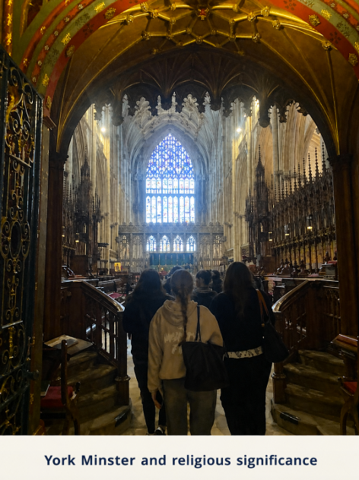
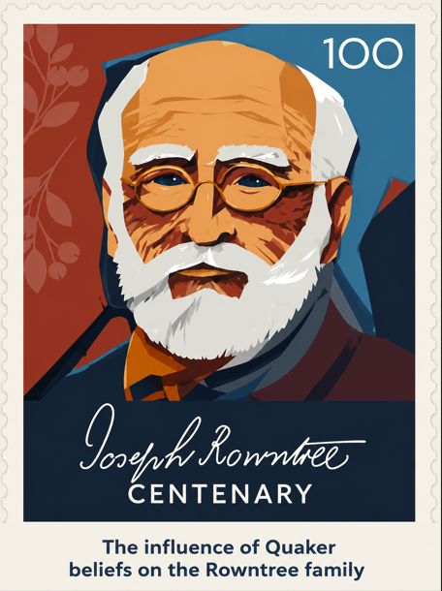
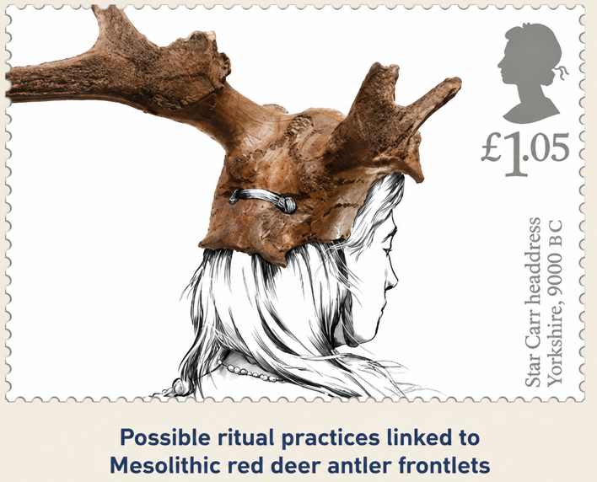


Overview of our sessions
Explicit coverage of substantive concept (🙏 Religion)
First year (KS1 Focus):
Changes in living memory
Events beyond living memory
Significant place in locality 🙏
Significant individuals 🙏
Second year (KS2 Focus):
Stone Ages 🙏
Roman History 🙏
Anglo-Saxon & Viking Britain 🙏
Notes:
Steph
We also carefully map substantive concepts across the curriculum to ensure key historical ideas are revisited and developed over time. Student teachers encounter these concepts across different historical periods and contexts, helping them build deeper and more coherent historical understanding.
For example, the substantive concept of religion is revisited across first- and second-year sessions as you can see here in our images

Slide 10
Subject specific pedagogies in history​
🐘Teaching for memory ​
🔗Exposition and schema building – building on what pupils already know​
🔮 Narrative and story ​
🧱World-building – e.g., through visuals, artefacts, maps… ​
🕰️Teaching chronological knowledge ​
📚Reading extended texts ​
🔍Historical enquiry​
​🏛️ Real-life experience
adapted from Research Review Series: History (Ofsted, 2021)
Notes:
Steph
We identified eight subject-specific pedagogies that we explicitly reference across our primary history sessions.
This slide acts as an anchor in each workshop, helping student teachers connect the knowledge they are developing with subject specific pedagogies they may intentionally implement in their practice.
And today, we thought we would explore some of these subject specific pedagogies from one of our second year workshops about changes in Britain throughout the Stone Ages

Slide 11
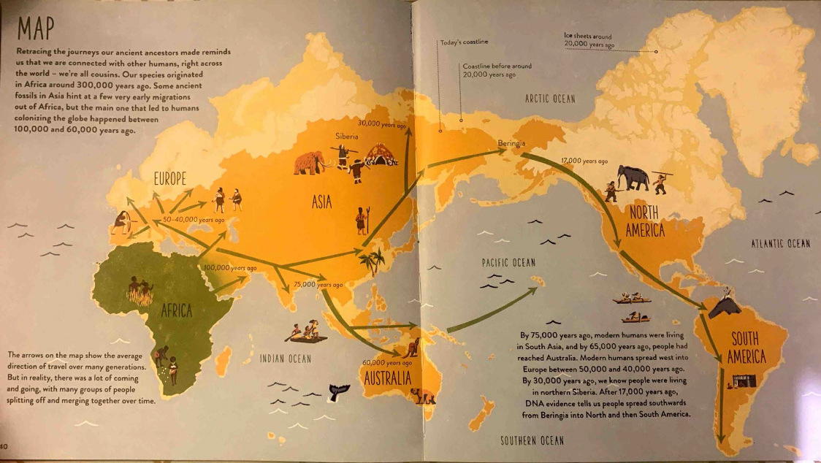
🧱World-building
Roberts, A., & Weston Lewis, J. (2020) Human Journey. London: Red Shed
Notes:
Jen
We begin by modelling world building as a subject-specific pedagogy. The purpose of this pedagogy is to support pupils to construct an abstract historical world in their minds, so that they can locate historical knowledge accurately in terms of time and place. Stuart Tiffany suggests that it is important to establish this sense of time and place early on in a sequence of learning in history, advocating for methods of direct instruction to reduce the possibility of misconceptions from forming.
So when we first introduce the Stone Ages with our student teachers, we first talk about how Homo sapiens evolved around 300,000 years ago in Africa before gradually migrating across the world. We use this wonderful book – Human Journey by Professor Alice Roberts and James Weston Lewis – to track some of these migrations.

Slide 12
🧱🐘 The Stone Ages
Palaeolithic era
The “old” Stone Age
Mesolithic era
The “middle” Stone Age
12,500ya - 6,000ya
Neolithic era
The “new” Stone Age
6,000ya – 4,500ya
2,500,000ya – 12,500ya
Homo sapiens evolve
Ice Age ends
Agricultural Revolution
Notes:
Jen
Then we continue this world building by introducing the time in which the Stone Ages take place – they began 2.5 million years ago. These terms – Palaeolithic, Mesolithic and Neolithic era – also help us demonstrate a second pedagogy which is teaching for memory. These three eras can act almost like story chapters. We can teach pupils key events and changes that happened in each era. This helps both develop the abstract framework in the children’s minds and helps them remember the new substantive knowledge we are introducing. E.g., Homo sapiens evolve, Ice Age ends, Humans begin farming in Britain.

Slide 13





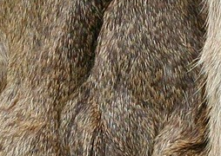

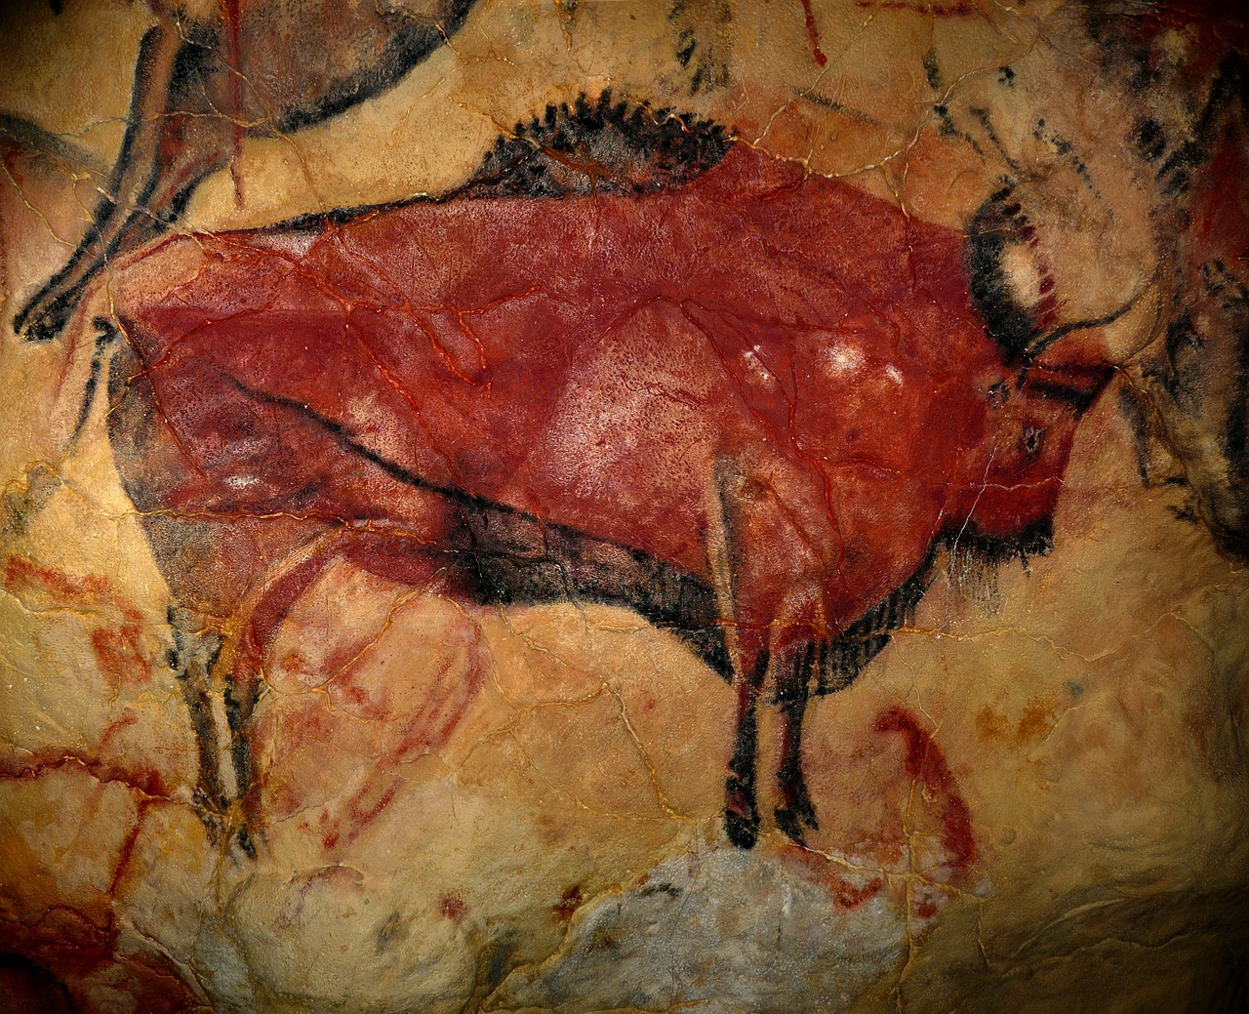

🧱 💬 Artefacts across the Stone Ages
Observations
Known facts
Thoughts & questions
Images: Pixabay, n.d.
Notes:
Jen
The next activity we explore with the student teachers is this artefact-based task, which we use early in the Stone Age sequence as a way of extending world-building, to begin to build their understanding of the disciplinary concept interpretation.
We ask them to make an observation, connect it to something they might already know, and ask a question or write down a thought – eg, flint…
From the ensuing discussion, we highlight with the student teachers how we can address pupil misconceptions, assess prior knowledge, and, possibly most importantly, build learner confidence and curiosity.

Slide 14
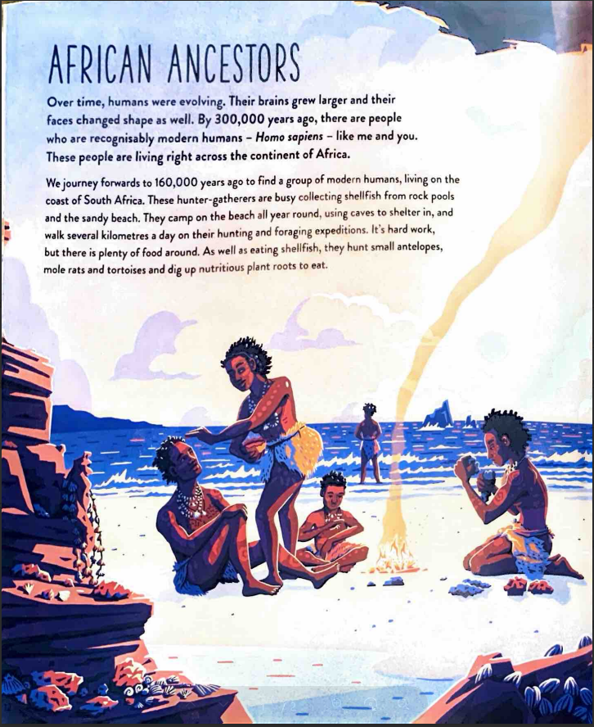
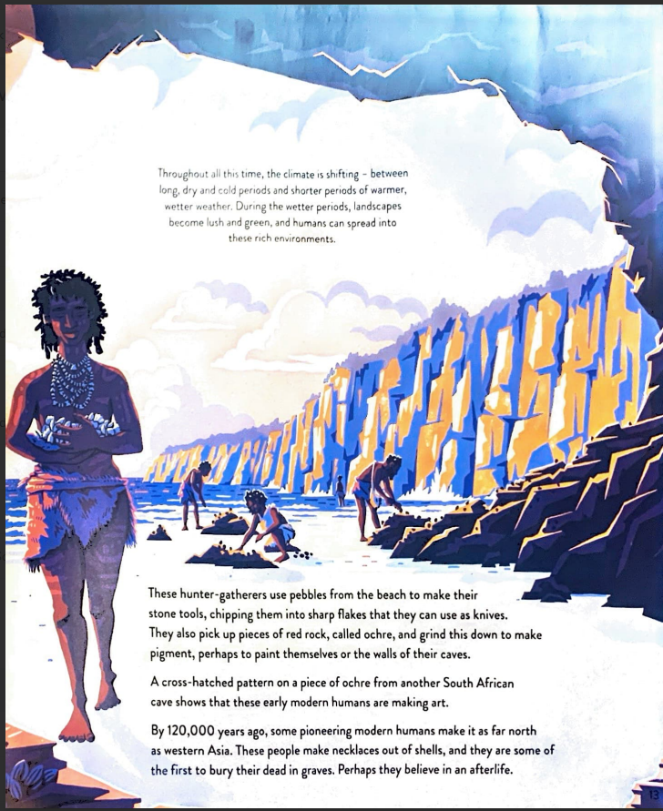
Roberts, A., & Weston Lewis, J. (2020) Human Journey. London: Red Shed
📚Reading Extended Texts ​
Notes:
Jen
After our initial discussion, we read this page from the book Human Journey, which deliberately connects to many of the artefacts and images we’ve just explored, and from this, the student teachers revisit their initial interpretations to extend and refine them in light of their new knowledge.

Slide 15
How can subject specific pedagogies be meaningfully developed in university-based ITE?
🐘Teaching for memory ​
🔗Exposition and schema building – building on what pupils already know​
🔮 Narrative and story ​
🧱World-building – e.g., through visuals, artefacts, maps… ​
🕰️Teaching chronological knowledge ​
📚Reading extended texts ​
🔍Historical enquiry​
​🏛️ Real-life experience
adapted from Research Review Series: History, (Ofsted, 2021)
Through a process of Generative Critical Conversations (Huntsley & Brentnall, 2020), we understand the SSPs to have been based on:
National Curriculum knowledge
Subject content knowledge
Pedagogical knowledge
Teaching experience & reflection
Wider reading & research
Professional development
Policy documents
Notes:
Jen
This brief example hopefully illustrates how we model the teaching of substantive and disciplinary concepts in primary history, as the first part of a coherent sequence of learning, while making the subject-specific pedagogies explicit.
One aim of this workshop was to reflect on how we developed these pedagogies in meaningful ways. Much of the wording comes from Ofsted’s Research Review Series for History. However, our history workshops were not designed around the review series alone; they existed before it was published. What the Review and other wider reading has helped us to do is make the pedagogies we teaching implicitly more explicit to our student teachers. For example, we were already teaching world-building as a pedagogy, but now we can give it a name and evaluate it as an approach. In other cases, our reading and research has helped us enhance learning opportunities – e.g., last year, I changed some of the Stone Age artefacts so that they deliberately aligned with the text from the Human Journey book, so that we could model the pedagogy of ‘Reading Extended Texts’.
We feel that the key element here has been developing the subject-specific pedagogies through our own practice and research, before identifying them and making them explicit for student teachers.

Slide 16
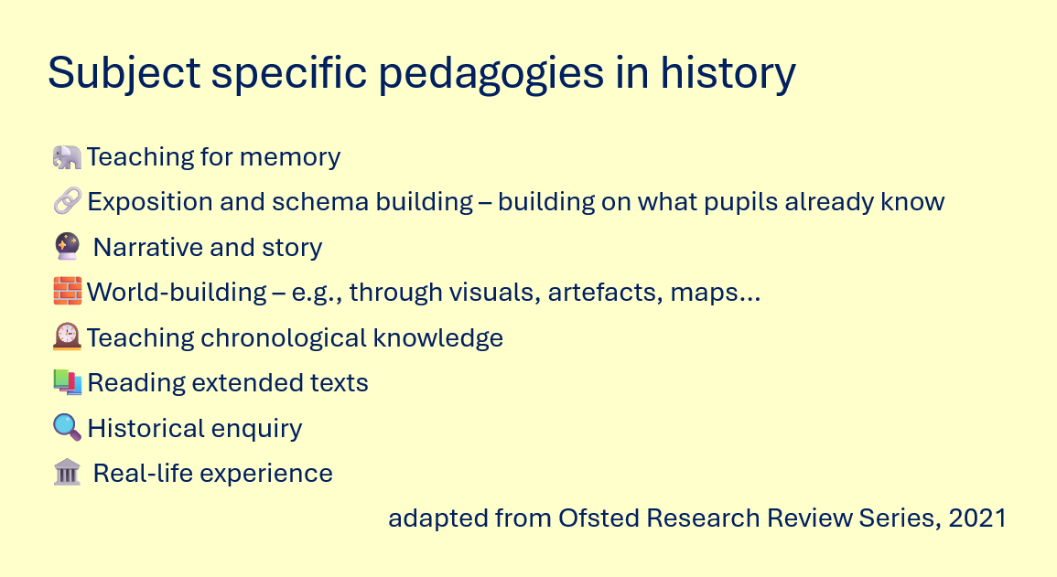
Towards shared principles underpinning subject specific pedagogies…
Disciplinary and Substantive Concepts (Ofsted, 2021)
Content knowledge
Local links; increasing complexity; coherent and sequenced timeline of British history…
National Curriculum Rationale
Sequence of Learning
Notes:
Jen
Our second aim was to identify shared principles that underpin subject-specific pedagogies. However, having thought about how our subject-specific pedagogies have been derived through reflection on our own practice and research, we thought it more helpful to identify the key aspects that led us to that practice in the first place.
So first, we were guided by the content of the National Curriculum for history – we’ve developed a coherent rationale for why we cover particular aspects in depth and we share this with the student teachers.
Second, we have developed a secure understanding of history’s content knowledge – the organising principles and structures of the subject – and we’ve demonstrated how this is mapped across our history workshops.
Third, a coherent sequence of learning, specific to history, underpins each of our workshops, so student teachers can understand why we might use a particular pedagogy and for what purpose.

Slide 17
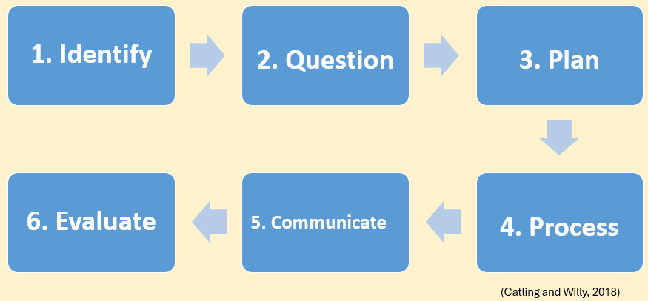
Next steps in geography…
Disciplinary and Substantive Concepts (Ofsted, 2021)
Content knowledge
Subject Specific Pedagogies in geography
?
Locational Knowledge, Place Knowledge, Human and Physical Geography, and Geographical Skills and Fieldwork (DfE, 2021)
National Curriculum Rationale
Sequence of Learning
Notes:
Steph
In geography, the rationale underpinning the National Curriculum content selected for sessions is secure.
We use a clear and consistent sequence of learning across our sessions.
Our content knowledge is carefully considered, although there is scope to make this more explicit for student teachers.
These aspects have informed the development of our subject-specific pedagogies.

Slide 18
Subject specific pedagogies in geography (in development)
🐘 Teaching for memory
🔗 Exposition and schema building
📍 Developing place knowledge and sense of place
🗺️ Spatial thinking through maps, atlases and GIS
🔎 Geographical enquiry, investigation and data analysis
🌦️ Exploring human and physical processes
🚶 Fieldwork and real-world geographical experience
🌐 Thinking across scale, connection and interdependence
adapted from Research Review Series: Geography (Ofsted, 2021)
Notes:
Steph
Our subject-specific pedagogies in geography are still evolving.
We have already been using many of these approaches implicitly, although we have not yet shared them explicitly with student teachers.
As you can see, there is overlap with primary history.
We have used the same Widgit symbols across subjects to support coherence and reduce cognitive load.
This raised important questions for us about which pedagogical approaches may be transferable across subjects, and what ultimately makes them “subject specific.
------------------------
🐘 Teaching for memory – Supporting pupils to retain and revisit important geographical knowledge over time through retrieval, repetition and meaningful connections across topics, places and scales.
🔗 Exposition and schema building – Explicitly connecting new geographical learning to pupils’ prior knowledge in order to build increasingly complex understanding of places, environments, processes and global relationships.
📍 Developing place knowledge and sense of place – Helping pupils develop meaningful understanding and connection to diverse places through rich contextual study, comparison, local geography and exploration of environmental and cultural diversity.
🗺️ Spatial thinking through maps, atlases and GIS – Teaching pupils to interpret, analyse and think spatially using geographical representations, mapping tools and patterns across different scales.
🔎 Geographical enquiry and investigation – Encouraging pupils to ask geographical questions, investigate patterns and relationships, evaluate issues and perspectives, and construct explanations using evidence.
📊 Interpreting and analysing geographical data – Supporting pupils in reading, analysing and drawing conclusions from graphs, maps, fieldwork data and other geographical evidence to identify patterns, processes and change.
🌦️ Exploring human and physical processes and their relationships – Helping pupils understand how human, physical and environmental processes interact to shape places, environments and sustainability issues across different contexts and scales.
🚶 Fieldwork and real-world geographical experience – Providing opportunities for pupils to observe, investigate and interpret geography directly through fieldwork, local studies and engagement with real places and environments.
🌐 Thinking across scale, connection and interdependence – Supporting pupils in understanding how places, people, environments and global systems are interconnected locally, nationally and globally.
🗣️ Explicit teaching of disciplinary vocabulary – Developing pupils’ ability to think, communicate and reason geographically through precise geographical terminology and conceptual language.

Slide 19
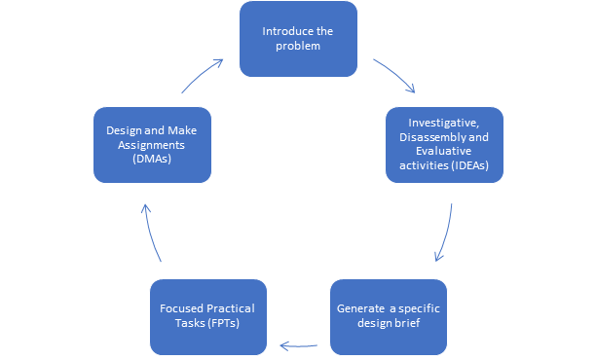
Next steps in D&T…
The Principles of D&T
(D&T Association, 2013)
Content knowledge
Subject Specific Pedagogies in D&T
?
Range of skill development; health & safety considerations; adaptations for inclusion…
National Curriculum Rationale
Sequence of Learning
Notes:
Jen
For DT, we already have a fairly secure rationale for the National Curriculum content that we cover, a secure understanding of the principles of DT underpin each workshop, and we consistently refer to this sequence of learning. So with these aspects confidently in place, I reflected on what I might consider our subject specific pedagogies to be in our DT workshops…

Slide 20
Subject specific pedagogies in D&T (in development)
🔍 Investigating and analysing the needs of users
📦 Deconstructing and evaluating existing products
🗣️ Direct teaching of vocabulary
🛠️ Tinker time – exploring limits and possibilities of the materials
✏️ Direct modelling of technical knowledge/skill
🎯 Focused skill practice – low stakes
🪜 Scaffolds – visual prompts, worked examples, prototypes
🔄 Iterative design and making approach towards final product
🧠 Metacognitive knowledge – self, task, strategy
📋 Metacognitive regulation – plan, monitor, evaluate
💬 Verbal feedback – teacher-learner / peer-peer / self-assessment
🔀 Choice – resources, material, tools, level of independence…
Notes:
Based on our current workshops, this is my current list. I think there are too many at the moment to share with the student teachers, so we need to do some pruning, but it’s a starting point. I think working with our D&T partners is probably our next step.

Slide 21
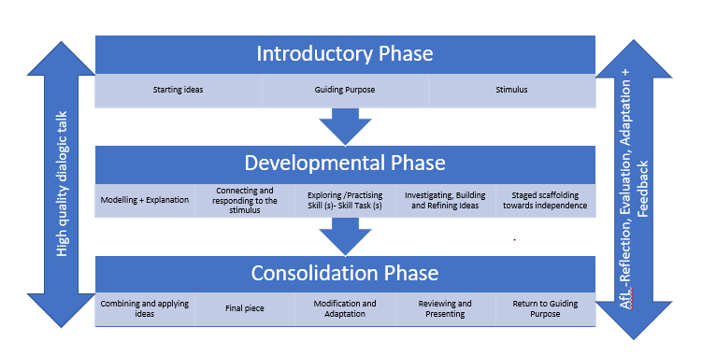
Next steps in art…
Practical knowledge, theoretical knowledge, disciplinary knowledge
(Ofsted, 2023 )
Content knowledge
Subject Specific Pedagogies in art
?
Drawing underpins other techniques; balancing personal responses with skill development; broad range of famous artists studied…
National Curriculum Rationale
Sequence of Learning
Notes:
Jen
In art, we aren’t quite as far along in our journey. Our national curriculum rationale is fairly secure, as is our sequence of learning, as is our sequence of learning. However, our content knowledge is very much centred around what the DfE call ‘practical knowledge’ with a nod to theoretical knowledge (famous art and artists)… but we may need to develop our disciplinary knowledge component for our art curriculum further.

Slide 22
Subject specific pedagogies in art (in development)
🎨Practical knowledge: developing technical proficiency
  ✏️Direct modelling of techniques
  🗣️Direct teaching of vocabulary
  🎯Low stakes opportunities to practise, explore, experiment
  🪜Scaffolding – e.g., worked examples or maquettes
  🔀 Variety and choice – medium, subject, tools, level of independence…
  🎨📓Use of sketchbooks – revisit and review over time
  📋Metacognitive regulation – plan, monitor, evaluate
  💬Verbal feedback – teacher-learner / peer-peer / self-assessment
🖼️Theoretical knowledge: cultural and contextual content that pupils learn about artists and artwork
  🗣️Direct teaching of vocabulary/concepts/artistic principles
  🗣️💬Analysis and application through talk and questioning
  🔮 Using analogy or story to compare (Ofsted, 2023)
  ↔️Highlighting connections and conflicts across artworks (Ofsted, 2023)
💭Disciplinary knowledge: what pupils learn about how art is studied, discussed and judged
  🪞Connect abstract concepts to pupils’ own experiences (Ofsted, 2023)
Notes:
Jen
So in terms of subject specific pedagogies, in terms of practical knowledge, these are identified based on what we already do….
And in terms of theoretical knowledge, these are what we already do, and those in italics are what we could begin to do, based on the Research Review Series for Art.
And you can see for disciplinary knowledge, we can start to do more still.

Slide 23
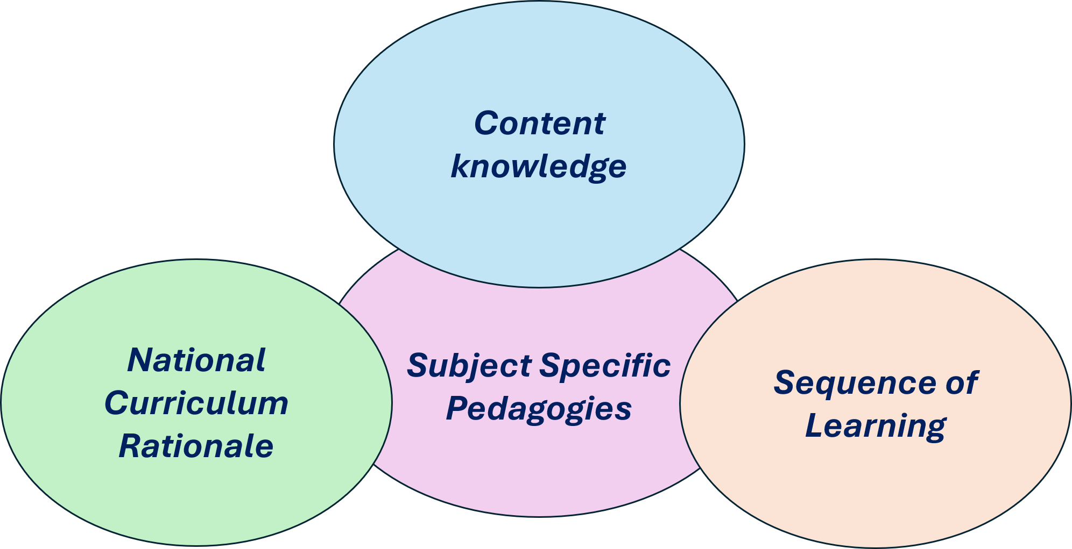
Evaluating our aims
Deepening understanding of subject’s organizing principles and structures
Wider reading and up-to-date professional development
Reflection on own PCK
How can subject specific pedagogies for primary foundation subjects be meaningfully developed within university-based ITE?
What might be some shared principles underpinning subject specific pedagogies across the primary foundation subjects?
We now invite participants to reflect on the implications for their own practice in preparing student teachers to teach the primary foundation subjects
Notes:
Jen
So to evaluate our aims.
We have explored how subject specific pedagogies can be meaningfully developed within university-based ITE across a range of primary foundation subjects – through practice based on a deepening understanding of our subject’s organizing principles and structures, alongside wider reading and developments on the subject, and ultimately, generative, critical reflection upon our own Pedagogical Content Knowledge.
What might be some shared principles underpinning subject specific pedagogies across the primary foundation subjects? – First, identify the aspects that are guiding your teaching in the foundation subjects – in our case, it was our NC rationale, content knowledge, and the sequence of learning – to ensure consistency across foundation subjects.
We now invite participants to reflect on the implications for their own practice in preparing student teachers to teach the foundation subjects

Slide 24
Reflecting on implications for your own practice
To what extent do our experiences chime with your own?
Can a subject specific pedagogy be applicable across multiple foundation subjects (e.g. modelling)? What makes it “subject specific”?
What subject specific pedagogies are communicated through your teaching? Are they taught explicitly or implicitly?
Do the shared principles for the foundation subjects resonate with your practice? Would you refine them or extend them? What’s missing?
Notes:
Steph
At this point, we will move into a 15-minute discussion and question session. The reflective questions on the slide are intended to support discussion and invite you to consider the implications for you own practice and ITE contexts
We will give you a few minutes to reflect on the questions and discuss with the people near you before opening up the discussion.

Slide 25
Further Discussion and Reflection
In limited curriculum time, how do we balance breadth and depth within university-based ITE?
What does 'subject expertise' look like for a generalist primary teacher?
To what extent should the National Curriculum programmes of study shape our teaching content in university-based ITE?
How might we support student teachers to engage in independent study/reflection in the foundation subjects beyond direct taught content?
Notes:
Steph....

Slide 26
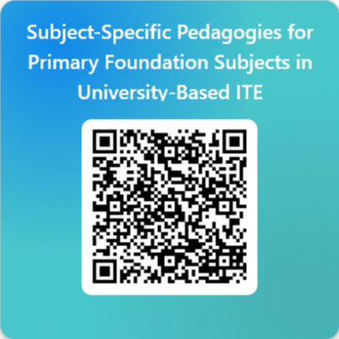
Evaluation – feedback form
Subject-Specific Pedagogies for Primary Foundation Subjects in University-Based ITE – Fill in form
Notes:
Steph
We would love to hear your feedback on this workshop. We’d be very grateful if you would take two minutes or so to share your thoughts using the link or this QR code. Your feedback supports us in our reflection and developing our thinking around this topic, and also supports our bids for future QR funding.

Slide 27
References 1
Catling and Willy, (2018) Understanding and Teaching Primary Geography. Sage
Carter, A. (2015) The Carter Review of Initial Teacher Training (ITT). Department for Education.
Davis, E. and Boerst, T. (2014) Designing Elementary Teacher Education to Prepare Well-Started Beginners. Teaching Works, University of Michigan School of Education, pp. 1–21. Available at: https://live-teachingworks.pantheonsite.io/wp-content/uploads/TeachingWorks_Davis_Boerst_WorkingPapers_March_2014.pdf (Accessed: 26 June 2025).
Department for Education (2025) Curriculum and Assessment Review Final Report. Available at: Curriculum and Assessment Review Final Report (Accessed: 11 May 2026)
Huntsley, J. and Brentnall, C. (2021) ‘Generative critical conversation: A method for developing reflexivity and criticality’, Journal of Small Business Management, pp. 1–30. Available at: https://doi.org/10.1080/00472778.2021.1938096.
Lomas, T. (2019) ‘Getting to grips with concepts in primary history’, Primary History, Historical Association.
Ofsted (2023) Research review series: art and design. Department for Education. Available at: https://www.gov.uk/government/publications/research-review-series-art-and-design/research-review-series-art-and-design#curriculum (Accessed: 6 February 2025).

Slide 28
References 2
Ofsted (2021) Research review series: geography. London. Available at: https://www.gov.uk/government/publications/research-review-series-geography/research-review-series-geography#a-curriculum-to-think-like-a-geographer-choosing-building-and-linking-knowledge (Accessed: 19 April 2025).
Ofsted (2023) Research review series: history. Department for Education. Available at: https://www.gov.uk/government/publications/research-review-series-history/research-review-series-history (Accessed: 14 July 2021).
Ofsted (2025) Initial teacher education (ITE) inspection: toolkit, operating guide and framework. Department for Education. Available at: https://www.gov.uk/government/publications/initial-teacher-education-ite-inspection-toolkit-operating-guide-and-framework.
Pope, D. (2019) ‘Subject knowledge for primary teaching: the influence of the personal dimension on beginning primary teachers’ conceptualisations and interpretations’, Education 3-13, 47(3), pp. 293–307. Available at: https://doi.org/10.1080/03004279.2018.1437199.
Roberts, A., & Weston Lewis, J. (2020) Human Journey. London: Red Shed
Shulman, L. (1986) ‘Those Who Understand: Knowledge Growth in Teaching’, Educational Researcher, 15(2), pp. 4–14. Available at: https://doi.org/10.3102/0013189X015002004.
Tiffany, S. (2023) Mr T Does Primary History. London: Corwin UK.

Slide 29
Image Credits
Slide 9
The Rowntree Society (2025) Joseph Rowntree Centenary stamp. Available at: https://www.rowntreesociety.org.uk/joseph-rowntree-centenary/joseph-rowntree-stamp/ (Accessed: 11 May 2026).
York Minster (n.d.) York Minster Timeline. Available at: https://yorkminster.org/discover/timeline/ (Accessed: 11 May 2026).
York Minster image: Author’s own photograph.
York Museums Trust (2022) Celebrating Ivory Bangle Lady. Available at: https://www.yorkmuseumstrust.org.uk/blog/celebrating-ivory-bangle-lady/ (Accessed: 11 May 2026).
Yorkshire Museum (n.d.) Star Carr Frontlets. Available at: https://www.yorkshiremuseum.org.uk/collections/collections-highlights/star-carr-frontlets/ (Accessed: 11 May 2026).
Slide 11 & 14
Roberts, A., & Weston Lewis, J. (2020) Human Journey. London: Red Shed
All other images sourced from Pixabay (n.d.). Available at: 6.1 million+ Stunning Free Images to Use Anywhere - Pixabay (Accessed: 11 May 2026).

