Slide 1

Enablers and barriers to equipping young people for political socialisation in youth work In England
Dr Carole Pugh
27th Annual CiCea International Conference 2026: Building Young People's Civic Journeys: Strengthening Democracies through Citizenship Education, 28 -30th May 2026, Porto.

Slide 2

Youth work could play a significant role in young people’s political socialisation
4.4 million young people regularly engage in youth work (UK Youth, 2022).
Many come from under resourced areas (NYA, 2025), are less likely vote and often disengage from formal citizenship education (Electoral Commission, 2026).
Findings from USA research indicate the role the informal conversations play in young people's political socialisation (Roholt et al, 2007)
Youth work shaped previous lowering of the voting age to 16 in Scotland and Wales and the UK.
BUT research and policy about political socialisation predominantly focus on role of formal school education.
Findings show the youth work does support young people’s political socialisation but faces barriers to addressing some dimensions that young people feel are important.
Notes:
We know that youth work could play a significant role in young people’s political socialisation.
4.4 million young people regularly engage in youthwork, many come from deprived background as and areas. Research shows that young people from disadvantaged backgrounds are less likely to vote, and are more likely to disengage from formal citizenship education in school.
Findings from the United States indicates the role that informal conversations that take part in youth work settings play in young people's political socialisation.
The Votes at 16 campaign has roots in good youth work, and youth shaped the lowering of the voting age in Scotland and Wales.
However, policy debates about political socialisation and citizenship education predominantly focus on the role of formal citizenship education in schools. Findings from this research demonstrates that the effective implementation of Votes at 16 in the UK must recognise youth work’s role in universal democratic education.

Slide 3

Framing the research theoretically
Youth work | A holistic approach to working with young people (10-24) which seeks to facilitate their personal, social and educational development to enable them to develop and participate fully in society (National Occupational Standards, 2020).
Politics | Access to and use of power to advance collective interests across all aspects of society (Wiley, 2016)
Political participation | Participation in any action drawn from a wide range of formal and informal activities in public or private spheres that seek to advance the interests of individuals or groups in society (Pickard, 2019).
Citizenship | Encompasses a range of different dimensions including membership of a state, engagement with rights and responsibilities, normative behaviours that determine competent membership of a society and intersubjective and affective dimensions (Kallio et al., 2020)
Political socialisation | The interaction between exposure to a range of ideas and experiences and the exertion of individual agency which enables individuals to develop political values and make decisions about participating in political activity (Haegel, 2021).
Notes:
Firstly, I want to say a little bit about the concepts that frame the research, as mast do not have clear agreed definitions.
What constitutes youth work is debated, for the purpose of this research a broad pragmatic desorption of youth work practice, taken from the NOS was used.
In terms of politics, political participation and citizenship, work that has explore young peoples’ understandings of these terms and idea was privileged. Consequently, broader definitions of politics, political participation and citizenship were used. Politics considers access to and use of power to advance collective interests across all aspects of society. Political participation includes actions drawn from a wide range of formal and informal activities in public or private spheres that seek to advance the interests of individuals or groups in society. Ideas about lived citizenship a which are drawn on which encompasses a range of different dimensions including membership of a state, engagement with rights and responsibilities, normative behaviours that determine competent membership of a society and intersubjective and affective dimensions.
Finally, the political socialisation (rather than political education) s considered. Polrical education can focus on top-down approaches, which do not fully recognize the agency of young people. Political socialisation considers interaction between exposure to a range of ideas and experiences and the exertion of individual agency which enables individuals to develop political values and make decisions about participating in political activity.

Slide 4
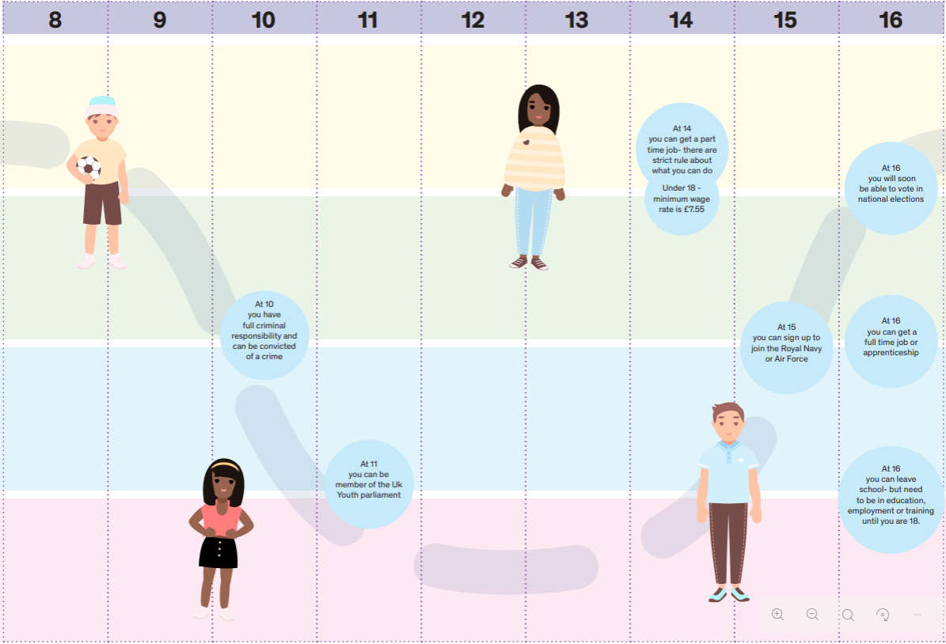
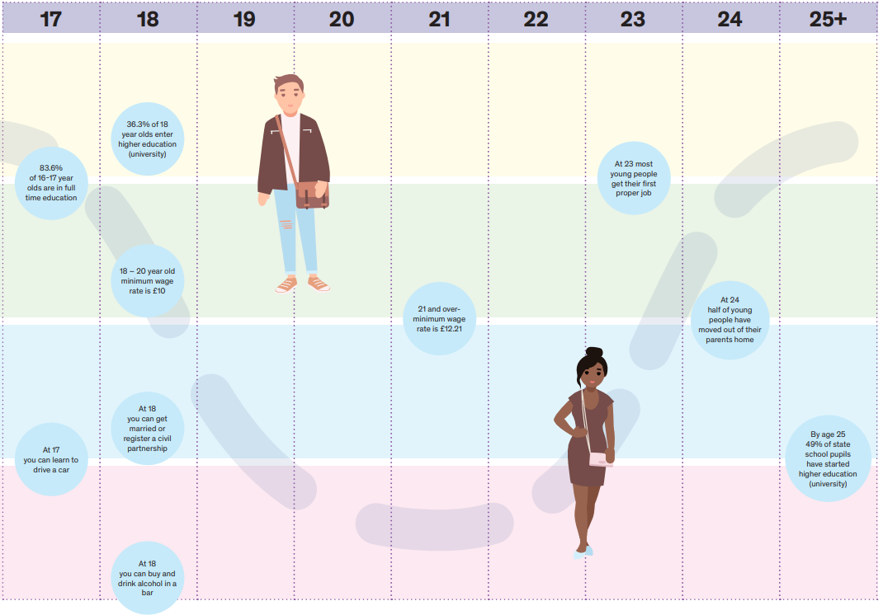
Political socialisation and civic journeys (Flinders, 2023)

Slide 5

About the research
Identifies the barriers and enablers supporting youth work to equip young people for political socialisation in England.
Focus groups with 89 young people (aged 11-22) and 21 youth workers
Participant observation of 56 youth work sessions at 4 youth projects in a northern city (Jan-March 2020/ April 2021 – Dec 2022)
Projects included:
  voluntary sector, commissioned and local authority provision
  open access projects and targeted youth voice projects
Notes:
My research addresses the gap in knowledge about the barriers and enablers supporting youth work to equip young people for political socialisation in England.
It draws on data from focus groups with young people and youth workers, and participant observation of youth work sessions. You can see more detail about the projects and timings on the slide.

Slide 6

Young people’s understandings of political citizenship
Formal politics
Getting involved
Issues
National/legal citizenship
Protest and campaigns
Rights, respect and responsibility
These reflect broader repertoires of political participation and lived citizenship identified in research (see Kallio et al, 2020; Pickard, 2019).
Notes:
Firstly the research explored the dimensions that young people felt framed their understanding of political citizenship.
Six dimensions were identified, all of which were important to young people.
Formal politics, which included political institutions and systems, political parties and politicians as well as political values.
Getting involved, through formal and informal volunteering but also opportunities to engage with and participate fully in their communities.
Issues: discussion of a wide range of things that young people felt were important, some of which directly impacted their lives.
This included ideas about debates related to national/legal citizenship.
Protest and campaigns formed a significant part of their understanding
Rights, respect and responsibility, were also important, in terms of knowing about and being able to enact their rights, and having opportunities to take responsibility and to feel respected.
These reflect broader repertoires of political participation and lived citizenship identified in research. Developing this framework allow me to map the dimensions that youth work did and did not address in practice.

Slide 7
Youth work addresses political citizenship
Notes:
The research found that Youth work addresses political citizenship.

Slide 8
Areas that youth work addresses
Youth work provides opportunities to get involved and volunteer P
Informal experiences of democratic processes P
Rights, respect and responsibility P
Gaining knowledge and experience of formal democratic processes ½
Notes:
Youth work provided many opportunities to get involved and volunteer,
Youth work provided informal experiences of democratic processes- increasing young people's knowledge and confidence.
These in turn developed young peoples knowledge and experiences of rights, feeling respected, and taking responsibility. Young people highlighted the importance for these experiences as they enabled them to feel like full citizens, which is vital for newly enfranchised 16-17 year old voters.
Finally some projects were able to develop young people’s knowledge and experiences of formal political processes and to take part in more formal voting.

Slide 9


Dimensions that were addressed less
Formal politics ?
  Engaging with politicians ½
  Discussing political issues, policies or political values O
Issues
  Work individually to address issues P
  Discuss how political policies or positions related to issues O
Protest O
Notes:
While some youth work projects were able to engage with politicians, other struggled.
When we get down to more contentious ‘political’ topics there was a real reluctance to enter these spaces.
Youth workers were reluctant to discuss politicians, political parties, policies or values.
Youth workers might discuss how individual young people were impacted by issues, but were reluctant to discuss how political policies or positions related to these issues or young people’s experiences.
Youth workers did not feel they should discuss protest with young people, despite young people seeing protest as a relevant, accessible and effective way of engaging in political citizenship

Slide 10
This limits youth work’s capacity to equip young people for political citizenship
‘Youth worker 1: There is a limit on how much we can actually support them with political development. We can support them to be good citizens, to understand different things, to have a voice, to get involved, to partake in democracy
Youth worker 2: If they want to have a political debate, we wouldn’t see that as part of what we do. (Local Youth Voice project)
Notes:
As you can see from the quote … this restricts the dimensions of political citizenship that are covered and limits young people's political socialisation.

Slide 11
Barriers
Codes | Theme
Political scepticism of youth workers | Practitioners’ knowledge and values
Young people’s and youth workers’ lack of knowledge
Inclusive environment
Unclear terminology (a/non-political, non-partisan, unbiased, impartial) | Professional and organisational culture
‘Undue’ influence
Parental concern
Funders concern
Protest not allowed
Draws on the work of Gal & Weiss- Gal (2015) that explored social workers’ capacity to address political dimensions.
Notes:
These barriers were grouped into two themes, one, which reflects the motivational themes identified by Gal & Weiss- Gal (2015) and consider practitioners’ knowledge and values. The second theme draws together the facilitation theme that Gal & Weiss-Gal (2015) identified but extends this beyond individual organisations to reflect concerns about an implementation gap, indicating that some barriers originate in weaknesses in policy and resources (Pickard, 2019; Weinberg & Flinders, 2019).

Slide 12


Political scepticism
Young people’s scepticism about formal politics and politicians was apparent across all projects- reflecting issues with the supply of political goods.
To us, or to a majority of young people who are just being able to start to vote, it's kind of boring and pointless to them because they really don't … Politics to them really … They [politicians] don't do it towards young people; they do it toward more adults than young [people]. (Young person, regional youth voice network, March 2022)
Some young people expressed a desire to be able to have political conversations, suggesting that although they may be sceptical, they were not disinterested, echoing Henn & Foard, (2013).
But I do definitely think there needs to be room to talk about party politics in its entirety. (Young person, regional youth voice network, June 2022)
Youth workers’ scepticism meant that they found it hard to express faith in the current political system and to have discussions that questioned young people’s sceptical views.
I think our opinion of politicians is probably quite low ... So, it would be difficult for us to be very like, [enthusiastically] ‘Oh yeah, yeah. Vote for this, and you will see change!’ (Youth worker, open-access youth and community project, February 2020)
Notes:
The political scepticism of both young people and youth worker’s influenced reluctance to introduce political conversations.
Young people’s scepticism about formal politics and politicians was apparent across all projects- reflecting issues with the supply of political goods, but some young people expressed a desire to be able to have political conversations, suggesting that although they may be sceptical, they were not disinterested.
Youth workers’ scepticism meant that they found it hard to express faith in the current political system and to have discussions that questioned young people’s sceptical views.

Slide 13

Lack of knowledge/ interest: a self-perpetuating cycle (Tonge et al., 2012)
[Young people] don't really know what politics it is … I feel like it definitely needs to be in more education. (Youth worker, open-access youth and community project, February 2020)
Researcher: What about you? What's the thing that makes you not get involved in politics then?
Young person: Probably maybe not knowing as much about it. (Commissioned open-access youth provision, February 2022)
Politics is not included in planned youth work activities because youth workers feel young people are not interested.
Young people’s lack of knowledge reduces interest, so they are less likely to introduce these topics in informal conversations.
Young people remain less informed about politics, as opportunities to introduce and develop this knowledge are missed.
Notes:
The research suggested that there was potentially a self-perpetuating cycle-
Politics is not included in planned youth work activities because youth workers feel young people are not interested.
Young people’s lack of knowledge reduces interest, so they are less likely to introduce these topics in informal conversations.
Young people remain less informed about politics, as opportunities to introduce and develop this knowledge are missed.

Slide 14


Youth workers lack knowledge
I guess I've always thought I don't know enough to feel comfortable educating them. Whereas we understand about the sexual health side of things, and we understand about racism, or we understand about culture (Youth worker, commissioned open-access youth provision, June 2022).
This reflects the implementation and expertise gap identified in formal citizenship education (Pickard, 2019)
Notes:
Youth workers also felt that they lacked knowledge about politics and citizenship, which meant there were reluctant to introduce these topics this mirrors limited training and resources that restrict schoolteachers' capacity to effectively deliver the citizenship curriculum.

Slide 15
Inclusive environment
Youth worker: Yeah. I dunno how politics falls into that. It's never really been said …
Youth worker: No, I don't think it has ever been said. I think we've just assumed, because we want to be welcoming and accessible in a place for everybody. It could be seen as favouring some and not others. (Commissioned open-access youth provision, June 2022)
Youth workers felt that political issues needed to be approached carefully and were worries that political discussions could leave some young people feeling excluded.
Notes:
Participants highlighted the potential for political conversation to be divisive. Conversations around political issues, where people may hold firm, differing views, needed to be approached. Youth workers are trained to handle sensitive conversations around issues like racism or sexism, but do not receive support around political issues.
Youth workers appeared to be unclear about requirements around impartiality, which increased reluctance to address more contentious ‘political’ topics.

Slide 16
Unsure about terminology
Participants conflated different terms (apolitical, nonpartisan, non-political, and unbiased).
Young person: It can be hard to talk about politics staying neutral as well …
Young person: This is the issue with being apolitical- which is why most people just go quiet. (Regional youth voice project, June 2022)
‘There is information out there, but to condense it … so you could bring it into a conversation with people and continue to be unbiased …would be hard. (Youth worker, Open-access youth and community project, February 2020)
Youth workers interpreted the non-political approach as avoiding discussing any party politics with young people.
We have had certain councillors along; they say this is why I joined blank party. Some of you would be great to join the blank party. And I say, excuse me, can I just say [project name] are a non-political organization. Please don't mention that kind of stuff to the young people (Youth worker, local youth voice project, November 2022)

Slide 17
Youth workers unsure about remit
‘I don’t know where I’ve got this, but we shouldn’t really educate [young people] about politics’ (Youth worker, commissioned open-access youth provision)
But I do definitely think there needs to be room to talk about party politics in its entirety. (Young person, regional youth voice network, June 2022)
Maybe we should bring it up and be like if you could vote, who would you vote for? Actually start those conversations and start them thinking now before they get to voting, and they are like, ‘I wish I'd have learned this’. (Youth worker, open-access youth and community project, February 2020)
There is a need for clear national guidance, like the guidance available for schools (Department for Education, 2022) that outlines youth work’s remit around political education.
Notes:
One of the key barriers that restricted youth worker’s ability to address political issue was a lack of clarity about their remit to do this.
As the top quote indicates.
However it was also clear that both young people and youth workers felt that discussing these areas would be beneficial and could help better equip young people for political citizenship. They were also clear that restricting conversations about political issues impeded youth work’s capacity to support political socialisation, as you can see from the bottom two quotes.

Slide 18

Undue influence
I know that for us, we're not really allowed to because, again, that thing where it's like if you talk to an adult as a young person around party politics, it could be kind of like swaying you. So, we try to stay away from that conversation with workers, and that's why [the conversation] we have around party politics is all informal outside of meetings. (Young person, regional youth voice network, June 2022)
And if they like you as a youth worker. They might think, ‘They’ve got it good … they know it’s Labour that I should be voting for, so I should vote Labour’ or ‘voting for the Green party is a waste of a vote because there are not as many’ … I don’t know- I’m trying not to say my own … but it is difficult if you don’t want to be biased. (Open-access youth and community project, February 2020)
Youth workers and young people were concerned about young people's vulnerability to political influence.
However, these concerns are not supported by recent research about young people’s political socialisation (Haegel, 2021).

Slide 19
Concern about parents and funders
one of my worries… if they've come with the strong political view from home, and we then try and influence that, are the parents gonna be cross? Because they would be like, how dare you? If we are not … we don't have that role as a structured role, in lots of ways, like a teacher is teaching a lesson … You start the conversations, ‘Is that what you think?’ and, ‘Where did you pick that up from?’ But I don't know. I don't suppose we'd really ever challenge them. I probably wouldn't. Because as it is all about relationships with them and if that relationship with them is rocketed because of something they've taken home. (Youth worker, Commissioned open-access youth provision, June 2022)
Youth workers’ concerns were linked to uncertainty about their remit to address politics.
Let's face it, we get support from different local councillors? So, we'll go to different ward budgets, and the different councillors will be different parties. Yeah. So, it's better for us to just be like, ‘This is what we do. This is our statement of purpose. These are our aims and not … [discuss party politics] (Youth worker, Open-access youth and community project, February, 2020)
Voluntary sector projects can engage in political activity but their reliance on ward council funding reduced their willingness to discuss party politics.

Slide 20
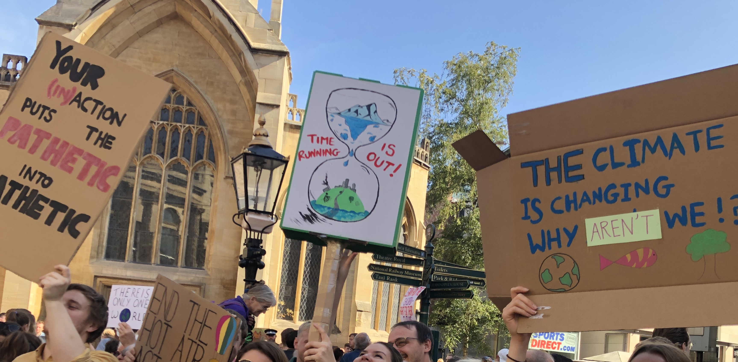
Protest not allowed
Researcher: Which of this stuff [different types of political participation] are you going to look at and go, ‘Well, that wouldn't be acceptable [to funders]’.
Youth worker: Protesting [agreement from the group]
(Regional youth voice network, May 2022)
Because I was thinking about yesterday's queen’s speech. Where they have just outlawed people protesting.
Concerns about funders and the policy environment which is seeking to repress young people’s participation in protest and dissent influenced youth worker’s reluctance to address protest.

Slide 21
Enablers to strengthen youth work’s contribution :
National policy need to recognise youth work’s role in political socialisation.
Clear policy for youth work about political education needs to be developed at national and organisational levels.
Politics and citizenship education, training and resources need to be developed for youth workers.
Develop guidance about if and how protest can be explored.
Notes:
So, based on the findings from this research there are a number of recommendations that could maximise youth work’s potential to support young people’s political socialisation.
Past citizenship education policy has tended to focusses solely on formal education, my research clearly demonstrates the role the informal opportunities, like those presented through youth work play in supporting young people’s political socialisation. The first recommendation is that national policy needs to recognise that vital role the youth work plays, particularly at reaching and engaging young people from marginalised and disadvantaged back grounds who are less like to engage in formal citizenship and education and are less likely to vote. Knowledge about democratic systems and structures needs to be accompanied by opportunities for young people to take part and feel like citizens if newly enfranchised young voters are going to feel sufficiently politically socialised to vote for the first time. Youth work is ideally placed to provide these opportunities.
The second recommendation addresses the need for clarity about youth worker’s remit to address political issues, as there is currently a policy void. My research found that youth workers were unsure about the place of political education in practice, reviewing youth work policy demonstrated that while citizenship was mentioned more frequently, the role of political discussions was not directly addressed. Therefore, there is a need for clear national guidance that outlines youth work’s remit around political education.
In addition to this youth work organisations need to develop their own policies that clearly outline why, if, when and how youth workers should address political issues.
The third recommendation is that education, training and resources are needed to help develop youth workers knowledge, skills and confidence around political socialization.
The fourth recommendation is that democratic education needs to address protest. My research showed that young people draw on a broad range of dimensions to inform their understanding of political citizenship, and that currently youth workers, and other educators appear to be very cautious about exploring some of these dimensions particularly around protest. Limiting discussion about protest does not reduce young people's engagement with it, but does reduce opportunities for young people to critically evaluate their involvement.

Slide 22
Conclusion
Policy efforts aimed at enhancing young people’s democratic participation must recognise and support the experiential and informal approaches embedded in youth work, ensuring that youth work’s capacity to equip young people for political citizenship can be more fully realised.

Slide 23
References
Conge, P. (1988). The concept of political participation: Toward a definition. Comparative Politics, 20(2), 241–249. https://doi.org/10.2307/421669
Department for Education. (2022, February 17). Political impartiality in schools. GOV.UK. https://www.gov.uk/government/publications/political-impartiality-in-schools/political-impartiality-in-schools Gal & Weiss-Gal (2015)
de St Croix, T. (2016). Grassroots youth work: Policy, passion and resistance in practice. Policy Press. https://doi-org.yorksj.idm.oclc.org/10.2307/j.ctt1t88zhj
Flinders, M. (2023) The Civic Journey: introducing the idea. Research Report. Institute for Community Studies available at https://www.youngfoundation.org/institute-for-community-studies/repository/the-civic-journey-introducing-the-idea/
Gal, J., & Weiss-Gal, I. (2015). The ‘Why’ and the ‘How’ of policy practice: An eight-country comparison. The British Journal of Social Work, 45(4), 1083–1101.
Haegel, F. (2021). Political socialisation: Out of purgatory? European Journal of Sociology, 61(3), 333–364. https://doi.org/10.1017/S000397562000017X
Kallio, K. P., Wood, B. E., & Häkli, J. (2020). Lived citizenship: Conceptualising an emerging field. Citizenship Studies, 24(6), 713–729. https://doi.org/10.1080/13621025.2020.1739227
Kessler, S. (2022). Political actions of youth workers. Journal of Policy Practice and Research, 3(4), 316–333. https://doi.org/10.1007/s42972-022-00067-0
Mycock, A. (2026), February 23rd) Votes at 16: the UK government has a fight on its hands – but are politicians all missing the point? The Conversation, https://theconversation.com/votes-at-16-the-uk-government-has-a-fight-on-its-hands-but-are-politicians-all-missing-the-point-275476
National Occupational Standards. (2020). National Occupational Standards for youth work. Lifelong Learning UK. http://www.youthworkessentials.org/media/2859/national_occupational_standards_for_youth_work.pdf
National Youth Agency. (2025) UK Youth Parliament. https://nya.org.uk/ukyp/
Pickard, S. (2019). Politics, protest and young people: Political participation and dissent in 21st century Britain. Palgrave Macmillan UK.
Roholt, R. V., Hildreth, R. W., & Baizerman, M. (2007). Becoming citizens: Deepening the craft of youth civic engagement. Routledge.
Spence, J. (2010). Collecting women’s lives: The challenge of feminism in UK youth work in the 1970s and 80s. Women’s History Review, 19(1), 159–176. https://doi.org/10.1080/09612020903444734
Tonge, J., Mycock, A., & Jeffery, B. (2012). Does citizenship education make young people better-engaged citizens? Political Studies, 60(3), 578–602. https://doi.org/10.1111/j.1467-9248.2011.00931.x
UK Youth, & Frontier Economics. (2022). The economic value of youth work: A report for UK Youth. https://www.ukyouth.org/wp-content/uploads/2022/11/Economic-Value-of-Youth-Work-Full-Report.pdf
Wiley, J. (2016). Politics and the concept of the political: The political imagination. Routledge.

Slide 24
Enablers
Notes:
The research found that Youth work addresses political citizenship.

Slide 25
Interest and knowledge of workers and young people
I definitely sprinkle in politics a little bit more, but I am personally quite interested in it. I do try and get in. (Youth worker, open-access youth and community work project, March 2020)
We tend to avoid party politics most of the time. But in lockdown then we did have some private debates, so not linked to any campaigns we were doing about topical issues. So, we did have a few political debates. (Young person, regional youth voice network, June 2022)

Slide 26
Flexibility in organisational policy
Space can be found for political conversations in organisations where there is no overt restriction on political conversations, for youth workers who are interested and confident.
Reflects other research that found there are opportunities for political discussions in some youth work environments (de St Croix, 2016; Gal & Weiss-Gal, 2015; Kessler, 2022).

