Slide 1

Youth work and political socialisation: Recognising the role of informal democratic education.
Dr Carole Pugh
Young People's Politics - Political socialisation and inclusivity panel, PSA 76th International Annual Conference: Political Studies Futures, 30 March-1st April 2026, Oxford.

Slide 2

Youth work could play a significant role in young people’s political socialisation
4.4 million young people regularly engage in youth work (UK Youth, 2022).
Many come from under resourced areas (NYA, 2025), are less likely vote and often disengage from formal citizenship education (Electoral Commission, 2026).
Findings from USA research indicate the role the informal conversations play in young people's political socialisation (Roholt et al, 2007)
Youth work shaped previous lowering of the voting age to 16 in Scotland and Wales and the UK.
BUT research and policy about political socialisation predominantly focus on role of formal school education
Notes:
We know that youth work could play a significant role in young people’s political socialisation.
4.4 million young people regularly engage in youthwork, many come from deprived background as and areas. Research shows that young people from disadvantaged backgrounds are less likely to vote, and are more likely to disengage from formal citizenship education in school.
Findings from the United States indicates the role that informal conversations that take part in youth work settings play in young people's political socialisation.
The Votes at 16 campaign has roots in good youth work, and youth shaped the lowering of the voting age in Scotland and Wales.
However, policy debates about political socialisation and citizenship education predominantly focus on the role of formal citizenship education in schools. Findings from this research demonstrates that the effective implementation of Votes at 16 in the UK must recognise youth work’s role in universal democratic education.

Slide 3

Framing the research theoretically
Youth work | A holistic approach to working with young people (10-24) which seeks to facilitate their personal, social and educational development to enable them to develop and participate fully in society (National Occupational Standards, 2020).
Politics | Access to and use of power to advance collective interests across all aspects of society (Wiley, 2016)
Political participation | Participation in any action drawn from a wide range of formal and informal activities in public or private spheres that seek to advance the interests of individuals or groups in society (Pickard, 2019).
Citizenship | Encompasses a range of different dimensions including membership of a state, engagement with rights and responsibilities, normative behaviours that determine competent membership of a society and intersubjective and affective dimensions (Kallio et al., 2020)
Political socialisation | The interaction between exposure to a range of ideas and experiences and the exertion of individual agency which enables individuals to develop political values and make decisions about participating in political activity (Haegel, 2021).
Notes:
Firstly, I want to say a little bit about the concepts that frame the research, as mast do not have clear agreed definitions.
What constitutes youth work is debated, for the purpose of this research a broad pragmatic desorption of youth work practice, taken from the NOS was used.
In terms of politics, political participation and citizenship, work that has explore young peoples’ understandings of these terms and idea was privileged. Consequently, broader definitions of politics, political participation and citizenship were used. Politics considers access to and use of power to advance collective interests across all aspects of society. Political participation includes actions drawn from a wide range of formal and informal activities in public or private spheres that seek to advance the interests of individuals or groups in society. Ideas about lived citizenship a which are drawn on which encompasses a range of different dimensions including membership of a state, engagement with rights and responsibilities, normative behaviours that determine competent membership of a society and intersubjective and affective dimensions.
Finally, the political socialisation (rather than political education) s considered. Polrical education can focus on top-down approaches, which do not fully recognize the agency of young people. Political socialisation considers interaction between exposure to a range of ideas and experiences and the exertion of individual agency which enables individuals to develop political values and make decisions about participating in political activity.

Slide 4

About the research
Addresses a gap in knowledge about the role of youth work in supporting political socialisation in England.
Focus groups with 89 young people (aged 11-22) and 21 youth workers
Participant observation of 56 youth work sessions at 4 youth projects in a northern city (Jan-March 2020/ April 2021 – Dec 2022)
Projects included:
  voluntary sector, commissioned and local authority provision
  open access projects and targeted youth voice projects
Notes:
My research addresses the gap in knowledge about the role of youth work in supporting political socialisation in England.
It draws on data from focus groups with young people and youth workers, and participant observation of youth work sessions. You can see more detail about the projects and timings on the slide.

Slide 5

Young people’s understandings of political citizenship
Formal politics
Getting involved
Issues
National/legal citizenship
Protest and campaigns
Rights, respect and responsibility
These reflect broader repertoires of political participation and lived citizenship identified in research (see Kallio et al, 2020; Pickard, 2019).
Notes:
Firstly the research explored the dimensions that young people felt framed their understanding of political citizenship.
Six dimensions were identified, all of which were important to young people.
Formal politics, which included political institutions and systems, political parties and politicians as well as political values.
Getting involved, through formal and informal volunteering but also opportunities to engage with and participate fully in their communities.
Issues: discussion of a wide range of things that young people felt were important, some of which directly impacted their lives.
This included ideas about debates related to national/legal citizenship.
Protest and campaigns formed a significant part of their understanding
Rights, respect and responsibility, were also important, in terms of knowing about and being able to enact their rights, and having opportunities to take responsibility and to feel respected.
These reflect broader repertoires of political participation and lived citizenship identified in research. Developing this framework allow me to map the dimensions that youth work did and did not address in practice.

Slide 6
Youth work addresses political citizenship
Notes:
The research found that Youth work addresses political citizenship.

Slide 7
Youth work provides opportunities to get involved and volunteer P
The youth worker was thinking of nominating one of the young people for a community award for the work they had done in the community over the past year: gardening project, getting involved in the history project. (Participant observation, commissioned open-access youth provision, May 2022)
So, we have that sense of responsibility and knowledge that we actually are providing for our local area … we know that other people are having, other young people are feeling, are receiving, gaining benefits and feeling better due to something that has been done by us as a group. (Young person, regional youth voice network, June 2022)
Notes:
Youth work provided many opportunities to get involved and volunteer,

Slide 8
Informal experiences of democratic processes P
So, we do the session plans; that's what we did last week … I go around, I say, ‘Well, what do they want to do?’ They chuck ideas out, and then I say, ‘Right, let's fit these in’. In a way, they have the democracy to … They'll decide what they do in the session, but as well, they get that responsibility. (Youth worker, open-access youth and community project, March 2020)
I feel like a lot of the time in our society, in schools and stuff, we might not necessarily be heard. Or if we are, it's not really taken seriously. Whereas … [at project name], which is sort of designed for young people, it's just sort of a way to not only get your opinion across but also to sort of be a part of the people that get to make the rules and the things we abide by.’ (Young person, regional youth voice network)
Notes:
Youth work provided informal experiences of democratic processes- increasing young people's knowledge and confidence.

Slide 9
Rights, respect and responsibility P
I think when you engage at this level with [project name], you realise you have got rights, and you've got that right to be heard, and you've got that right to say what you need to say to get what you need to across’ (Young person, regional youth voice network, June 2022)
We have our community open days and stuff. I think that allows local people to meet … our young volunteer teenagers, but they see our teenagers in a different light to just wearing a hood in the dark. (Youth worker, the open-access youth and community work project, February 2020)
So, they can feel that they, they're actually treated as they are responsible. Well, we look at them like equals; we take it seriously. (Youth worker, local youth voice project, November 2022)
Notes:
These in turn developed young peoples knowledge and experiences of rights, feeling respected, and taking responsibility. Young people highlighted the importance for these experiences as they enabled them to feel like full citizens, which is vital for newly enfranchised 16-17 year old voters.

Slide 10
Gaining knowledge and experience of formal democratic processes ½
Locally, I've learned a lot because I didn't know much about the structure, how decisions were made and different branches of local politics (Young person, regional youth voice network, June 2022)
The meeting began with voting for the new chair and vice chair. The youth worker explained the role of chair and vice chair, and then formal voting slips were handed out, and the young people voted (although only one person was standing for each position). … but one of the young people did not understand and had only voted for one of the positions. The process was explained in a bit more detail, and the young people voted again- resulting in full support for each person who had stood. (Participant observation, local youth voice project, October 2022)
Notes:
Finally some projects were able to develop young people’s knowledge and experiences of formal political processes and to take part in more formal voting.

Slide 11


Dimensions that were addressed less
Formal politics ?
Issues ?
Protest O

Slide 12
Engaging with politicians
We don't get interacted with by the [national] politicians, but with [local] councillors, you sort of see them in the local area a lot, and when you go to [project name] meetings, you speak to a lot of them. (Young person, regional youth voice network, June 2022)
… to some extent?
The young people had written to an elected member who held the environment brief asking for support with a project around creating eco-bricks, but there was no response. (Participant observation, local youth voice project, October 2022).
We have talked about having maybe a question-and-answer session with some of the local councillors … [local councillors] are trying to do their surgeries as such in the mornings … over the holidays, how many [young people] are gonna get up on a morning to … <laughs> (Youth worker, commissioned open-access youth provision, November 2022)
Notes:
While some youth work projects were able to engage with politicians, other struggled.

Slide 13
Formal politics?
We don't have something on the activity plan that goes, ‘Right, we're going to chat about politics today’ (Youth worker, open-access youth and community project, May 2020).
One young man who is studying agriculture was clear about how politics (Brexit-related) was impacting farming and land use. He was quite vocal- but this wasn’t followed up … [later on] there was a conversation linked to the ‘family’ guy show that talked about suicide and discussions about the lack of provision of mental health facilities … reasons for this were not explored (Participant observation, open-access youth and community work project, January 2020)
Because we are apolitical, there are quite strong rules on that kind of conversation. So, they don't really happen. Or if they do happen, they're done discreetly. (Young person, local youth voice project, June 2022)
Notes:
When we get down to more contentious ‘political’ topics there was a real reluctance to enter these spaces.
Youth workers were reluctant to discuss politicians, political parties, policies or values.

Slide 14
Issues
There were different issues discussed: refugees, war, environment, poverty, street safety, PSH(c)E curriculum. (Participant observation, commissioned open-access youth provision, April 2022)
Researcher: So, you sometimes talk about what's going on [in the world]?
Young person: Yeah, sometimes. (Commissioned open-access youth provision, May 2022)
… to some extent?
Obviously, politics affects your everyday life more than most people understand. But there are some other issues that are much more immediate right now that are far more important for us. Where are they sleeping tonight? What food are they gonna have? How are they getting home? That are more important to talk about than the overall umbrella topic of politics. Of how this party might make your life better? (Youth worker, open-access youth and community work project, March 2020)
Notes:
Youth workers might discuss how individual young people were impacted by issues, but were reluctant to discuss how political policies or positions related to these issues or young people’s experiences.

Slide 15
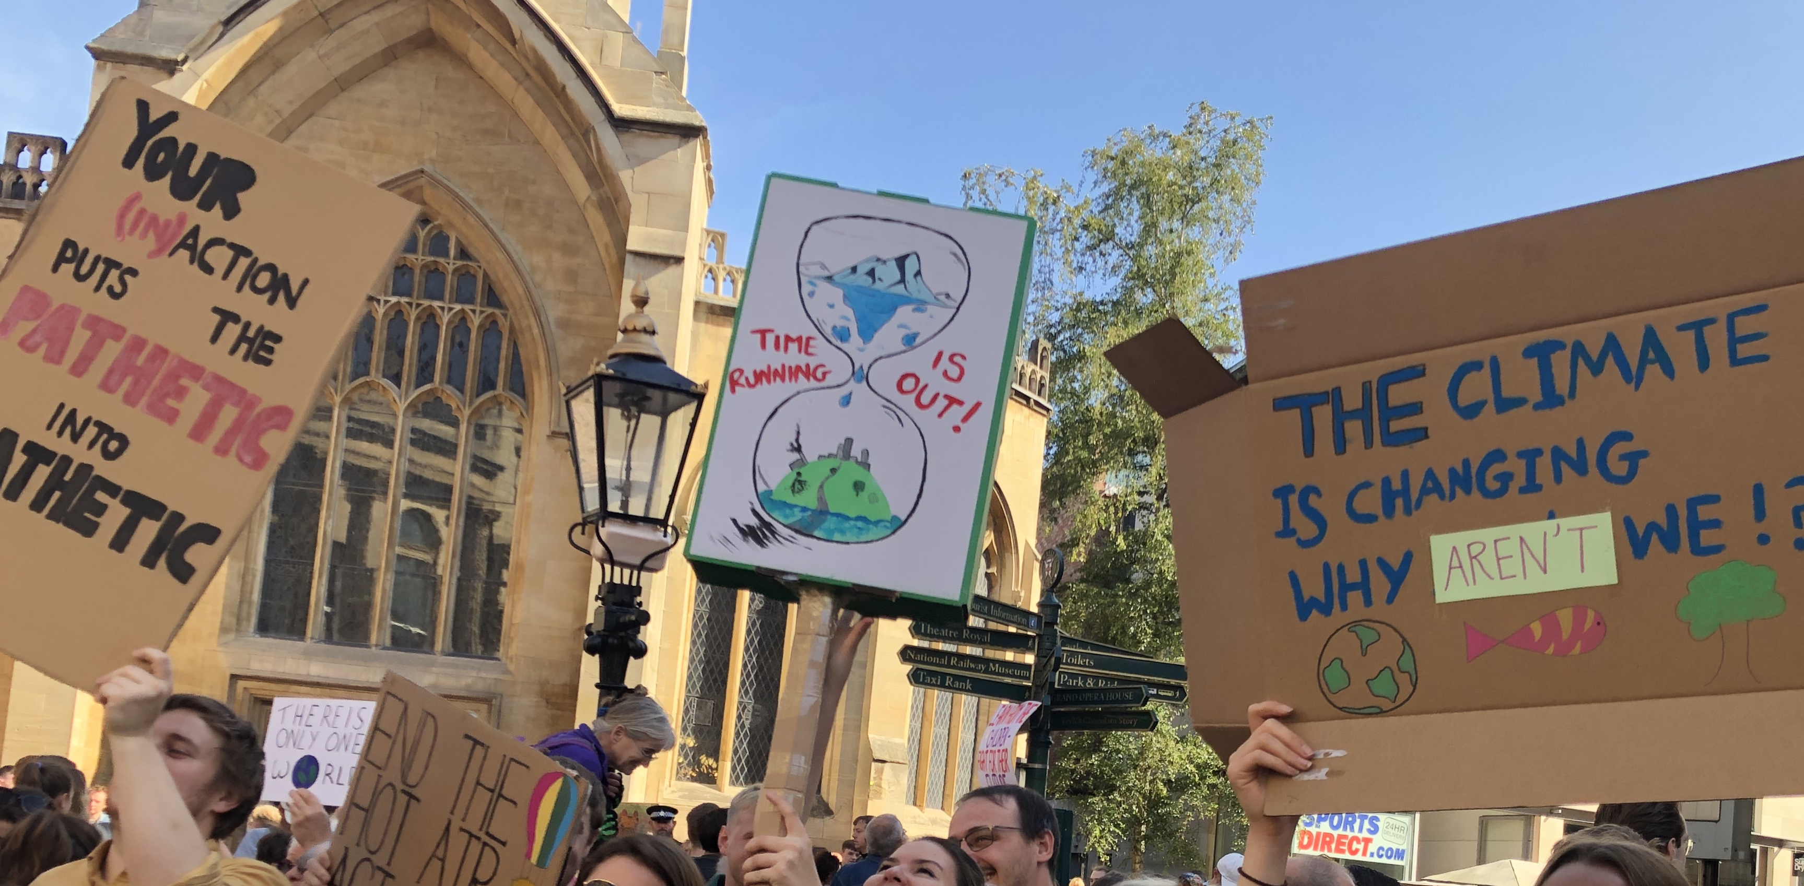
Protest O
I think the school strike for climate action] … is one of the biggest ways that I got into proper politics. So, I think that it's special to a lot of young people, especially young people because it's been the only way that they could get involved in politics. (Young person, regional youth voice network, March 2022)
Despite young people seeing protest as a relevant, accessible and effective way of engaging in political citizenship (Pickard, 2019), youth workers did not feel it as a topic they should or could discuss.
As we packed up, one youth worker talked about a protest that young people had done against the Rwanda immigration scheme … they said it would be hard to support this from within their paid role (Participant observation, May 2022)
Notes:
Youth workers did not feel they should discuss protest with young people, despite young people seeing protest as a relevant, accessible and effective way of engaging in political citizenship.

Slide 16
This limits youth work’s capacity to equip young people for political citizenship
‘Youth worker 1: There is a limit on how much we can actually support them with political development. We can support them to be good citizens, to understand different things, to have a voice, to get involved, to partake in democracy
Youth worker 2: If they want to have a political debate, we wouldn’t see that as part of what we do. (Local Youth Voice project)
Notes:
As you can see from the quote … this restricts the dimensions of political citizenship that are covered and limits young people's political socialisation.

Slide 17
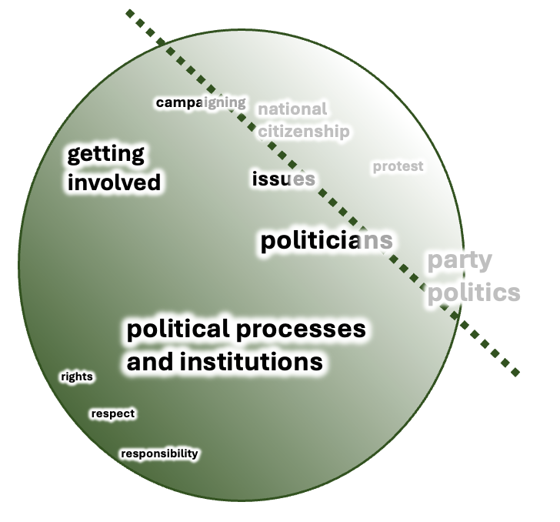
Conceptualizing the ‘political issues’ the youth work struggles to address
Where connections are made between issues, ideas or actions and positions of decisions taken by the state (Conge, 1988)
Notes:
When the areas are plotted a clear line could be identified that indicated the area that youth workers were reluctant to enter- which involved making connections between issues, ideas or actions and positions or decisions taken by the state.

Slide 18


Political scepticism
Young people’s scepticism about formal politics and politicians was apparent across all projects- reflecting issues with the supply of political goods.
To us, or to a majority of young people who are just being able to start to vote, it's kind of boring and pointless to them because they really don't … Politics to them really … They [politicians] don't do it towards young people; they do it toward more adults than young [people]. (Young person, regional youth voice network, March 2022)
Some young people expressed a desire to be able to have political conversations, suggesting that although they may be sceptical, they were not disinterested, echoing Henn & Foard, (2013).
But I do definitely think there needs to be room to talk about party politics in its entirety. (Young person, regional youth voice network, June 2022)
Youth workers’ scepticism meant that they found it hard to express faith in the current political system and to have discussions that questioned young people’s sceptical views.
I think our opinion of politicians is probably quite low ... So, it would be difficult for us to be very like, [enthusiastically] ‘Oh yeah, yeah. Vote for this, and you will see change!’ (Youth worker, open-access youth and community project, February 2020)
Notes:
The political scepticism of both young people and youth worker’s influenced reluctance to introduce political conversations.
Young people’s scepticism about formal politics and politicians was apparent across all projects- reflecting issues with the supply of political goods, but some young people expressed a desire to be able to have political conversations, suggesting that although they may be sceptical, they were not disinterested.
Youth workers’ scepticism meant that they found it hard to express faith in the current political system and to have discussions that questioned young people’s sceptical views.

Slide 19
Lack of knowledge/ interest: a self-perpetuating cycle (Tonge et al., 2012)
[Young people] don't really know what politics it is … I feel like it definitely needs to be in more education. (Youth worker, open-access youth and community project, February 2020)
Researcher: What about you? What's the thing that makes you not get involved in politics then?
Young person: Probably maybe not knowing as much about it. (Commissioned open-access youth provision, February 2022)
Politics is not included in planned youth work activities because youth workers feel young people are not interested.
Young people’s lack of knowledge reduces interest, so they are less likely to introduce these topics in informal conversations.
Young people remain less informed about politics, as opportunities to introduce and develop this knowledge are missed.
Notes:
The research suggested that there was potentially a self-perpetuating cycle-
Politics is not included in planned youth work activities because youth workers feel young people are not interested.
Young people’s lack of knowledge reduces interest, so they are less likely to introduce these topics in informal conversations.
Young people remain less informed about politics, as opportunities to introduce and develop this knowledge are missed.

Slide 20

Youth workers lack knowledge
I guess I've always thought I don't know enough to feel comfortable educating them. Whereas we understand about the sexual health side of things, and we understand about racism, or we understand about culture (Youth worker, commissioned open-access youth provision, June 2022).
This reflects the implementation and expertise gap identified in formal citizenship education (Pickard, 2019)
Notes:
Youth workers also felt that they lacked knowledge about politics and citizenship, which meant there were reluctant to introduce these topics this mirrors limited training and resources that restrict schoolteachers' capacity to effectively deliver the citizenship curriculum.

Slide 21
Inclusive environment - managing impartiality
Youth worker: Yeah. I dunno how politics falls into that. It's never really been said …
Youth worker: No, I don't think it has ever been said. I think we've just assumed, because we want to be welcoming and accessible in a place for everybody. It could be seen as favouring some and not others. (Commissioned open-access youth provision, June 2022)
Youth workers felt that political issues needed to be approached carefully. However, the language varied and appears to conflate different terms (nonpartisan, non-political and unbiased). Youth workers interpreted the apolitical approach as avoiding discussing party politics with young people
Young person: We used to do something called the group debate and we talked about politics there.
Young person: It can be hard to talk about politics staying neutral as well …
Young person: This is the issue with being apolitical- which is why most people just go quiet. (Regional youth voice project, June 2022)
Notes:
Participants highlighted the potential for political conversation to be divisive. Conversations around political issues, where people may hold firm, differing views, needed to be approached. Youth workers are trained to handle sensitive conversations around issues like racism or sexism, but do not receive support around political issues.
Youth workers appeared to be unclear about requirements around impartiality, which increased reluctance to address more contentious ‘political’ topics.

Slide 22
Youth workers unsure about remit
‘I don’t know where I’ve got this, but we shouldn’t really educate [young people] about politics’ (Youth worker, commissioned open-access youth provision)
But I do definitely think there needs to be room to talk about party politics in its entirety. (Young person, regional youth voice network, June 2022)
Maybe we should bring it up and be like if you could vote, who would you vote for? Actually start those conversations and start them thinking now before they get to voting, and they are like, ‘I wish I'd have learned this’. (Youth worker, open-access youth and community project, February 2020)
There is a need for clear national guidance, like the guidance available for schools (Department for Education, 2022) that outlines youth work’s remit around political education.
Notes:
One of the key barriers that restricted youth worker’s ability to address political issue was a lack of clarity about their remit to do this.
As the top quote indicates.
However it was also clear that both young people and youth workers felt that discussing these areas would be beneficial and could help better equip young people for political citizenship. They were also clear that restricting conversations about political issues impeded youth work’s capacity to support political socialisation, as you can see from the bottom two quotes.

Slide 23
Findings:
Youth work plays a vital role in supporting young people’s political citizenship. The effective implementation of Votes at 16 in the UK must recognise youth work’s role in universal democratic education.
Youth work could increase its capacity to support young people's political socialisation if some barriers were addressed.

Slide 24
Recommendations:
Policy that supports Votes at 16 needs to cross sectors and departments (Department of Culture Media and Sport/ Ministry for Housing Communities and Local Government/ Department for Education).
Clearer policy for youth work about political education needs to be developed at national and organisational levels.
Politics and citizenship education, training and resources need to be developed for youth workers.
The supply of civic and political goods to young people needs to be improved.
Notes:
So, based on the findings from this research there are a number of recommendations that could maximise youth work’s potential to support young people’s political socialisation.
Past citizenship education policy has tended to focusses solely on formal education, my research clearly demonstrates the role the informal opportunities, like those presented through youth work play in supporting young people’s political socialisation. The first recommendation is that policy that support the roll out of Votes at 16 needs to recognise that vital role the youth work plays, particularly at reaching and engaging young people from marginalised and disadvantaged back grounds who are less like to engage in formal citizenship and education and are less likely to vote. Knowledge about democratic systems and structures needs to be accompanied by opportunities for young people to take part and feel like citizens if newly enfranchised young voters are going to feel sufficiently politically socialised to vote for the first time. Youth work is ideally placed to provide these opportunities.
The second recommendation addresses the need for clarity about youth worker’s remit to address political issues, as there is currently a policy void. My research found that youth workers were unsure about the place of political education in practice, reviewing youth work policy demonstrated that while citizenship was mentioned more frequently, the role of political discussions was not directly addressed. Therefore, there is a need for clear national guidance that outlines youth work’s remit around political education. I am working with the National Youth Agency to develop an Informal Democratic Education standard that offers guidance to youth workers about their role and remit. In addition to this youth work organisations need to develop their own policies that clearly outline why, if, when and how youth workers should address political issues.
The third recommendation is that education, training and resources are needed to help develop youth workers knowledge, skills and confidence around political socialization.
The fourth recommendation is that democratic education needs to address protest. My research showed that young people draw on a broad range of dimensions to inform their understanding of political citizenship, and that currently youth workers, and other educators appear to be very cautious about exploring some of these dimensions particularly around protest. Limiting discussion about protest does not reduce young people's engagement with it, but does reduce opportunities for young people to critically evaluate their involvement.
Finally, the supply of civic and political goods to young people also needs to be considered. Increasing opportunities for young people to engage with politicians and civic society is important., but the quality of these engagement matter. If young citizens are not responded to, listened to and their concerns are ignored this can re-enforce negative views.

Slide 25
Further information about the research:
Pugh, C. (2025) Reconsidering the approach to political citizenship in youth work in England, Youth and Policy Available at https://www.youthandpolicy.org/articles/political-citizenship-in-youth-work/
Pugh, C. (2025) Youth work and political education: Maximising opportunities to support young people’s political socialisation, York St John University; https://doi.org/10.25421/yorksj.29617010.v1
If you are interested in finding out more, please get in touch!
Email: C.Pugh@yorksj.ac.uk
Notes:
If you are interested in finding out more, please get in touch!

Slide 26
References
Conge, P. (1988). The concept of political participation: Toward a definition. Comparative Politics, 20(2), 241–249. https://doi.org/10.2307/421669
Department for Education. (2022, February 17). Political impartiality in schools. GOV.UK. https://www.gov.uk/government/publications/political-impartiality-in-schools/political-impartiality-in-schools Gal & Weiss-Gal (2015)
Haegel, F. (2021). Political socialisation: Out of purgatory? European Journal of Sociology, 61(3), 333–364. https://doi.org/10.1017/S000397562000017X
Kallio, K. P., Wood, B. E., & Häkli, J. (2020). Lived citizenship: Conceptualising an emerging field. Citizenship Studies, 24(6), 713–729. https://doi.org/10.1080/13621025.2020.1739227
Mycock, A. (2026), February 23rd) Votes at 16: the UK government has a fight on its hands – but are politicians all missing the point? The Conversation, https://theconversation.com/votes-at-16-the-uk-government-has-a-fight-on-its-hands-but-are-politicians-all-missing-the-point-275476
National Occupational Standards. (2020). National Occupational Standards for youth work. Lifelong Learning UK. http://www.youthworkessentials.org/media/2859/national_occupational_standards_for_youth_work.pdf
National Youth Agency. (2025) UK Youth Parliament. https://nya.org.uk/ukyp/
Pickard, S. (2019). Politics, protest and young people: Political participation and dissent in 21st century Britain. Palgrave Macmillan UK.
Roholt, R. V., Hildreth, R. W., & Baizerman, M. (2007). Becoming citizens: Deepening the craft of youth civic engagement. Routledge.
Spence, J. (2010). Collecting women’s lives: The challenge of feminism in UK youth work in the 1970s and 80s. Women’s History Review, 19(1), 159–176. https://doi.org/10.1080/09612020903444734
Tonge, J., Mycock, A., & Jeffery, B. (2012). Does citizenship education make young people better-engaged citizens? Political Studies, 60(3), 578–602. https://doi.org/10.1111/j.1467-9248.2011.00931.x
UK Youth, & Frontier Economics. (2022). The economic value of youth work: A report for UK Youth. https://www.ukyouth.org/wp-content/uploads/2022/11/Economic-Value-of-Youth-Work-Full-Report.pdf
Wiley, J. (2016). Politics and the concept of the political: The political imagination. Routledge.

