Slide 1
Workshop 1A: Primary
Making the Past Real Through Local Places KS1-2
Steph Jach and Dr. Jen Huntsley
Every community carries its own stories, yet these are often overlooked in history teaching. This workshop shows how local places can help children grasp key historical ideas such as chronology, change, and cause and consequence. Drawing on work with primary student teachers, we demonstrate how stepping into familiar environments can spark curiosity and deepen understanding. The session is designed for teachers, student teachers and teacher educators.

Slide 2
Making the Past Real Through Local Places
Steph Jach and Dr Jen Huntsley
Initial Teacher Education
School of Education, Language and Psychology
York St John University
Notes:
Steph
Hello & welcome
I'm Steph Jach....
We both work in Initial teacher education at YSJ where we teach primary history to UG and PG student teachers.
Our focus for today is how we use local places to understand the past and bring history to life.

Slide 3
By the end of this workshop, we will:
Recognise the value of local places as historical evidence for developing pupils' historical understanding.
Experience a structured historical enquiry that connects local evidence to wider historical themes and concepts.
Consider how this enquiry approach could be adapted within our own contexts.
Notes:
Jen
The workshop has three parts.
First, why local places matter.
Then how we can use them through a structured historical enquiry.
Finally, what's next—how you might adapt this approach for your own context.

Slide 4
Why use local places?
A place-based approach
Grounds learning in local cultural, environmental and historical contexts (Gruenewald, 2003; Smith,2002)
Uses first-hand, experiential engagement with places and communities (Isreal, 2012; Waite 2013; Yemini et al. 2023)
Draws on learners' lived experiences and local environments (Beames et al. 2011;Gruenewald, 2003; Smith, 2002)
Can foster sense of place, belonging and connection to community (Beames et al. 2011; Beames et al, 2023; Sobel, 2004)
Notes:
Steph
Before we begin the enquiry, it's worth spending a minute on why local places can be such powerful resources for learning history.
This workshop draws on a place-based approach, using the local environment as the starting point for learning.
By investigating local places, learners engage with historical evidence, connect local stories to wider historical themes, and develop richer historical understanding.
Research also suggests this can strengthen learners' sense of place and belonging.
But what does this look like in practice? We'd like to share a few examples from our own teaching.

Slide 5
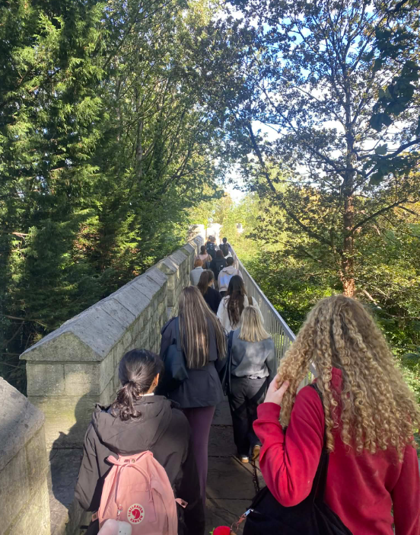
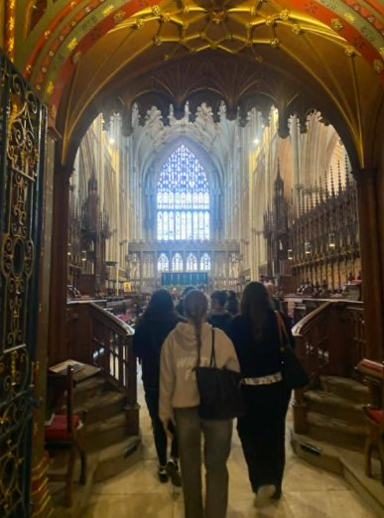
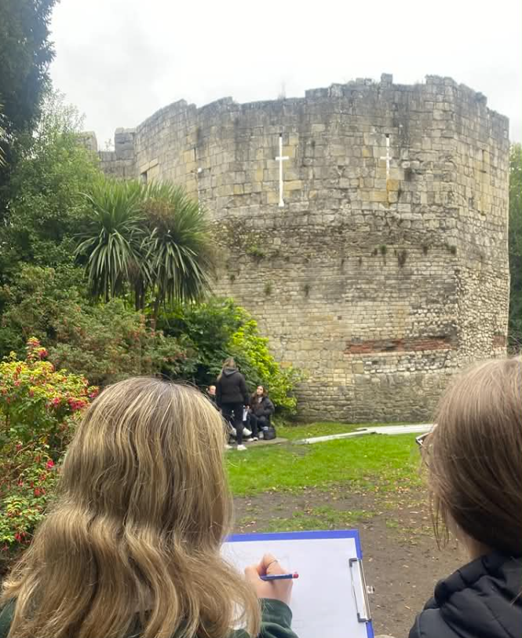
Our Approach
Foundation Year:
Historical Contexts of Education, Childhood and Counselling
Primary Education:
Year 1 & 2, Wider Curriculum, Primary History
Primary Education:
Year 3, Learning Outside the Classroom
Notes:
Steph
We've been incorporating place-based approaches across several programmes at York St John.
For example, Foundation Year students explore the historical contexts of education and childhood through local sites and stories, including walking tours of the city centre and locations associated with Joseph Rowntree.
Within Primary Education, place-based approaches are embedded throughout the history curriculum, where local contexts are used to make historical concepts more tangible and meaningful. This includes visits to sites such as York Minster.
Students revisit these ideas again in a Year 3 Learning Outside the Classroom module, where they design and lead history micro-teaches in locations across the city, including the Museum Gardens.

Slide 6
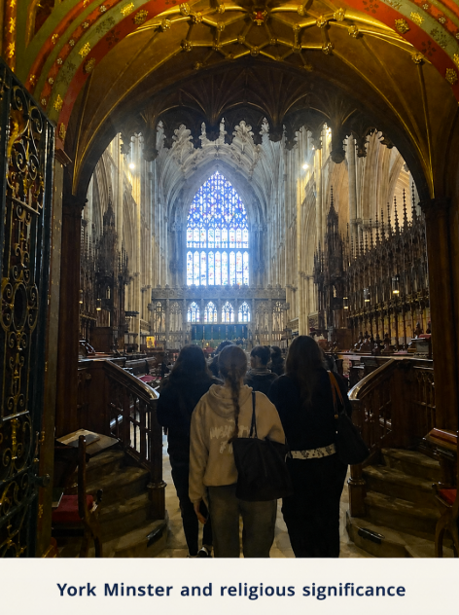
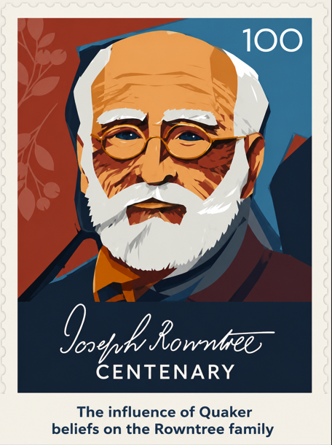
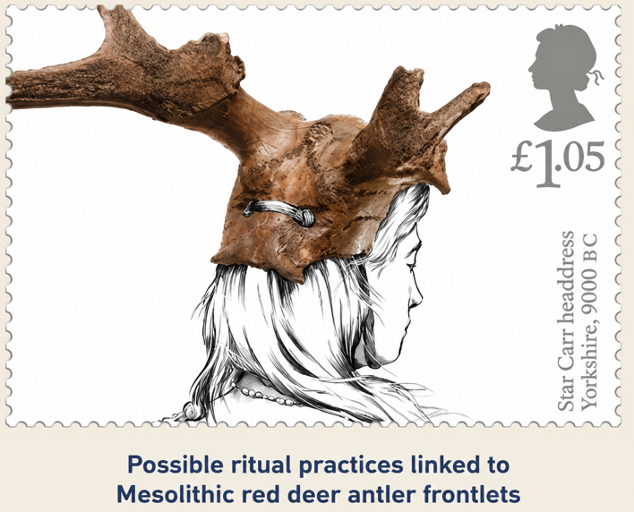
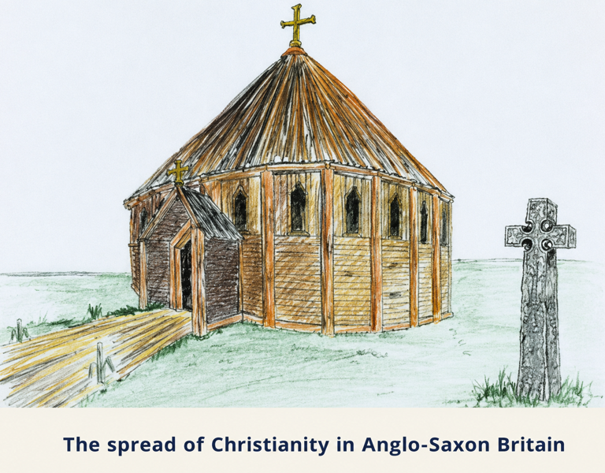
🕵️ Building Historical Thinking Through Local Places🧩
🙏Religion
🤝Trade
🏡Settlement
🌍Empire
🎓 Education
🕰️Time, change, chronology​
➡️ Reasons and results​
💬Interpretations​
📸 Historical evidence ​
🏅Significance​
Lomas, 2019​
Notes:
Steph
As we move into the enquiry, it's useful to highlight two types of historical knowledge we'll be developing.
Disciplinary concepts are the ways historians think and work—for example, using evidence, considering interpretations, understanding significance and making sense of chronology.
Substantive concepts are the recurring ideas that appear across different periods of history, such as religion, trade, settlement, empire and, in this enquiry, education.
We'll return to these concepts because they're what help pupils move beyond simply learning about a place to developing richer historical understanding.
The examples on this slide are all rooted in local places, but they're not just about learning local history. Each uses a familiar place to explore the broader historical concept of religion, showing how the local can become a gateway to understanding the wider past.

Slide 7
Student Voice – place-based approaches
If you're in a school in York and you're teaching the Romans and you can talk about things that the children are seeing every day, I think like having that like local link…is really helpful.
Poppy
I can link it specifically to them rather than just the whole of Britain, because…it's hard to imagine the whole of Britain, but if they could just imagine their village, then that's a little bit easier for them to do…. if I'd have learned about specifically to where I lived, it would probably have stuck a lot more. And then I think it would have been easier to understand as well.
Olivia
I work [in York]… every time I'd think this used to be where the Romans used to live. And it's things like that that makes the connection so much stronger. It just sits in your mind …So I think that was a really key part that I want to take forward in my teaching. …I think this linking it to the local area is more poignant for [pupils]
Sophie
Notes:
Jen
Having held a series of semi-structured interviews, we found that our student teachers were enthusiastic about using local history as a narrative vehicle and discussed how they wanted to carry this forward into their future teaching practice.
Poppy discussed the importance of making links to places and experiences that pupils encounter in their everyday lives. This aligns with place-based approaches, where familiar local contexts can make learning more meaningful because it is grounded in pupils’ lived experiences (Smith & Sobel, 2010, cited in Beames et al., 2011).
Olivia reflected on how, during a recent placement, she began with the local impact of the Romans on the village because, as she explained, “it’s hard to imagine the whole of Britain, but if they could just imagine their village, then that’s a little bit easier for them to do.” She also reflected that this approach would have made history more understandable when she was at school. We can see here how local contexts can help anchor more abstract historical ideas in something tangible and familiar.
Sophie spoke about her excitement at discovering the historical significance of places she encountered every day, and how this strengthened her connection to the local area. She also discussed the poignancy of helping pupils make meaningful links between history and the places around them.
Sophie’s reflections also suggest the beginnings of a developing sense of place: a deeper personal and emotional connection to local places shaped through historical understanding and lived experience.
This is significant within primary history because it moves local history beyond simply studying what is “nearby”. Instead, local contexts become meaningful narrative vehicles for developing historical thinking, engagement, and wider connections across people, places, and time periods.
This also reflects our wider approach across the curriculum: using familiar local contexts to help student teachers think more deeply about how substantive knowledge, disciplinary thinking, and meaningful historical enquiry can be developed within primary classrooms.

Slide 8
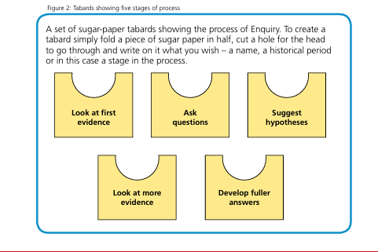
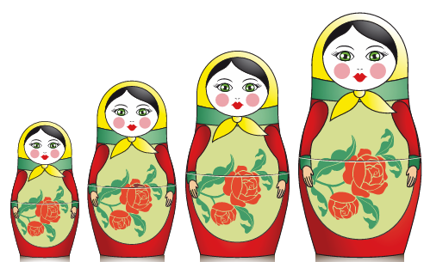
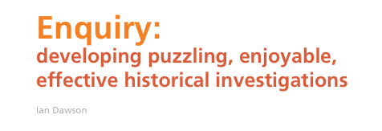
How do we use local places?
Our enquiry process
Notes:
Jen
This enquiry process based on Dawson’s 2015 HA article which focused on Roman Colchester

Slide 9
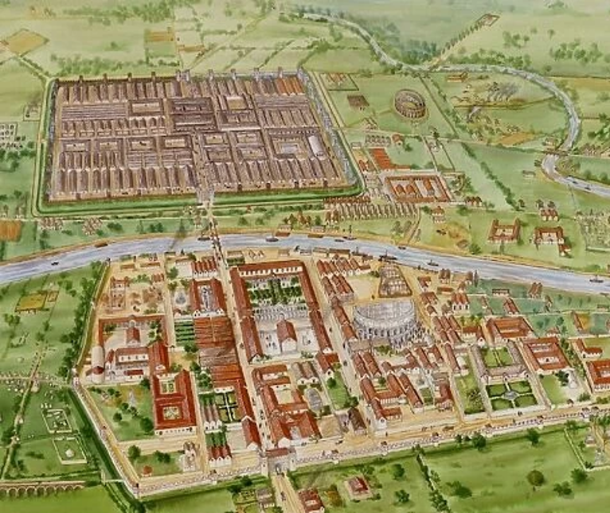
Hidden Story 1:
What can one burial tell us about life in Eboracum?
Notes:
Jen
Here's an enquiry we've used successfully with student teachers and which could be adapted for primary pupils

Slide 10
Historical Context
Key Substantive Knowledge
As part of this history scheme of work, pupils will already have learned:
• Roman Britain was a province of the Roman Empire from 43 to 410 CE.
• The Roman invaders transformed life through introducing new developments in agriculture, urbanisation, industry, and architecture.
• A distinctively Romano British culture developed with trade links across the Empire.
• Eboracum (founded in 71 CE) grew from a fortress at the Ouse and Foss into a larger settlement of global significance.
Notes:
Jen

Slide 11
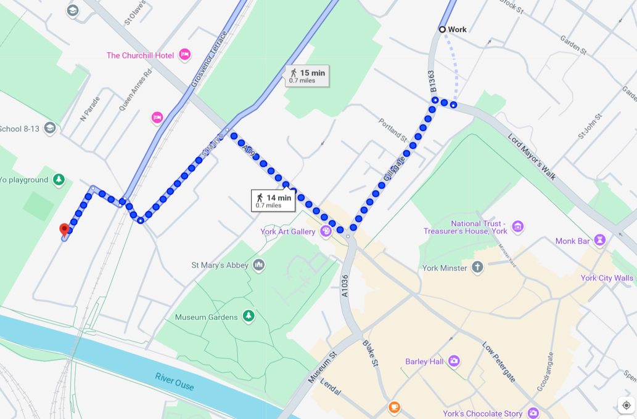
An archaeological discovery in 1901....
Notes:
Steph
In 1901 on there were works to expand Sycamore Terrace ( a street less than a mile from campus, which many students are familiar with.)
We ask students to close their eyes and imagine they are archaeologists on a dig in Sycamore Terrace in 1901.
You are welcome to join in!
We are going to carefully excavate the soil with an imaginary trowel and brush.
A glint appears beneath the soil and the objects are finally uncovered.
Our enquiry is underway!
[ Reveal images of the first two Roman artefacts]

Slide 12
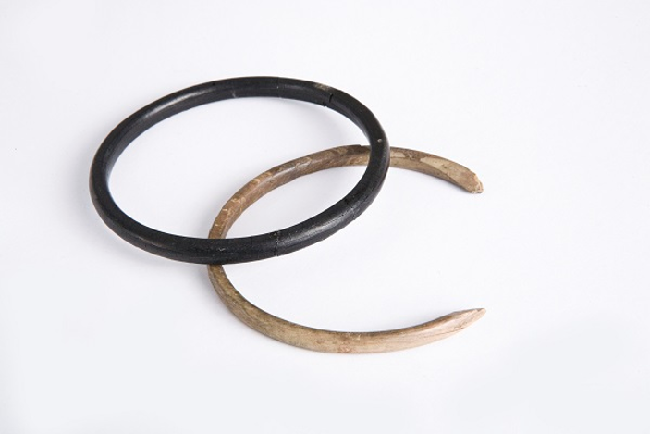
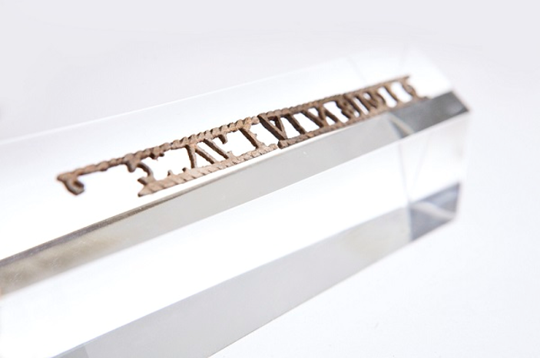
Stage 1: What do we notice?
Stage 2: What questions do we have?
Stage 3: Hypothesis
Can you answer your questions?
Based on the evidence you've seen, what story do you think these objects tell?
I think.........because.......
Notes:
Steph
Stage 1
Show children one or two pieces of evidence
Examine the images closely as historians and archaeologists, carefully observing the objects and looking for clues.
What can you see?
• Which adjectives can you use to describe them?
• What materials do you think these objects are made from?
• Which object catches your attention first? Why?
• Do any of the objects look valuable? What makes you think that?
• What can we tell from these objects and what can't we tell?
Stage 2 Prompt children to ask questions about this evidence
Stage 3: A hypothesis is our best explanation based on the evidence available at this point.
Discussion on tables- what is our hypotheses?
For example – perhaps it was owned by someone rich, a woman.

Slide 13
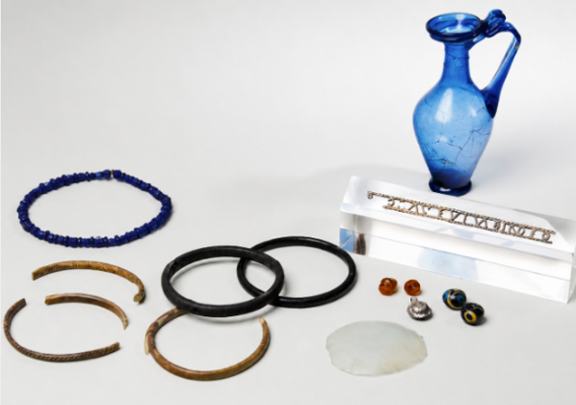
Stage 4: Investigating further evidence
Provide more information and evidence for children to explore to see if they can find answers to their questions (evidence pack).
The Ivory Bangle Lady
Inscription: ‘Hail sister, may you live in God’
Other items buried with her:
some blue glass beads,
Jet bracelets
fragments of five bone bracelets,
silver and bronze lockets,
amber earrings,
two marbled glass beads,
a small round glass mirror
a blue glass jug
Use Box 4 to record any evidence you think is important or relevant for your questions.​
Notes:
Steph
Please look at the photographs of these objects
The objects were from the burial of Roman woman who was buried with a range of objects. Most of Eboracum’s residents were modestly buried, without grave goods.
She became known as the Ivory Bangle Lady (because of the ivory bangles with which she was buried).
A shard of bone was discovered inside her stone coffin. It had an inscription which translates as ‘Hail sister, may you live in God’.
A number of other goods were also buried with her
Use Box 4 to record any evidence you think is important or relevant to your questions.

Slide 14
Stage 4: Further evidence – Chronological Context
Early 3rd Century Eboracum made capital of Britannia Inferior and granted colonia status
Sometime in the 4th Century
Ivory Bangle Lady lives, dies, and is buried in Eboracum
71 CE Roman army marches north and establishes military fortress at Eboracum
1 CE | 100 CE | 200 CE | 300 CE | 400 CE
Roman Britain
43 CE Roman army invades the south of Britain
306 CE Constantine made Emperor at the military fortress at Eboracrum
410 CE Roman Army leaves Britain
Notes:
Jen

Slide 15
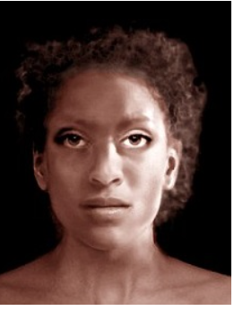
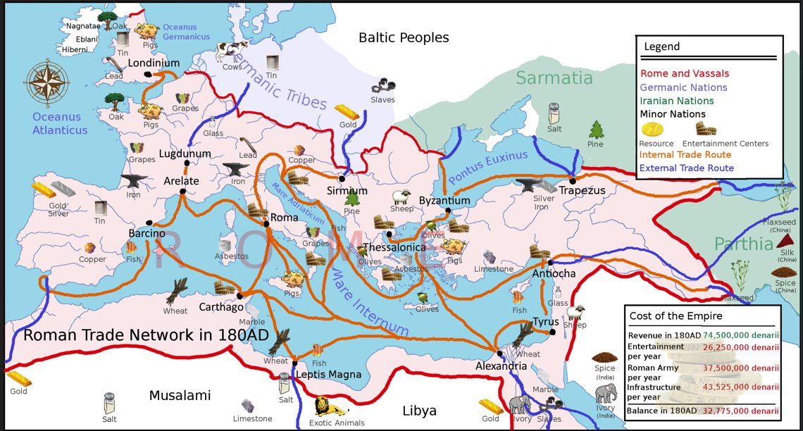
Stage 5: Stronger Conclusions
Develop stronger conclusions supported by evidence.
What have we learned about the person buried here?
What does this burial tell us about Roman York as a place?
What can this burial tell us about life in Roman Britain?
Notes:
Steph
At this point, Stages 4 and 5 can be repeated, allowing children to revisit and refine their answers to the enquiry question as they encounter new evidence.
You have seen further evidence from the burial and the wider timeline.
Take a few minutes on your tables to discuss how has this new evidence changed or strengthened your conclusions?
Use Box 5 to record any stronger conclusions to your questions [Give 2 mins]
For example, you might have initially concluded that the luxury grave goods suggested she was a wealthy Roman woman.
After written in boxes
Archaeological analysis reveals that she had ancestral links to North Africa and spent her childhood in a warmer coastal region before later moving to York. HOW SHE LOOKED
You can see here a map some of the trade links across the Roman Empire which are brought to life through Ivory Bangle Lady's story
North Africa- Ivory Bangle lady born/grew up
ivory bangles – imported from Africa
Baltic- amber earrings
Perfume – the Rhineland
Jet bracelet – Whitby
Christian – religion recently arrived from the east
Through this we begin to see that this burial tells us much more than the story of one individual.
It reveals Eboracum as a cosmopolitan city with people, goods and ideas moving across the Roman Empire.
Take a few minutes on your tables to discuss how has this new evidence changed or strengthened your conclusions?
Use Box 5 to record any stronger conclusions to your questions [Give 2 mins]

Slide 16
Stage 6: The Bigger Picture:
Developing a more substantial enquiry
What does this evidence tell us about Ivory Bangle Lady?
What does this burial reveal about connections across the Roman Empire?
What does this burial reveal about historical concepts such as empire, trade and religion that appear across different periods of history?
What does this evidence tell us about life in Eboracum & Roman Britain?
Notes:
Jen
Her story represents wider issues/connections of international trade, opportunities, travel.
Abstract concepts become tangible through real stories in the locality.
You can start with 1 person then go onto think of the city, country and world.
Examples:
What was discovered in Sycamore Terrace in 1901? Who was the lady buried? What were the items buried with her? What do they tell us about her?
2. Where was she from? Where were the items buried with her from?
What does Ivory bangle lady tell us about life in York in AD400? How cosmopolitan was Roman York? What does she tell us about the people in York and its global links AD400?
3. What were the connections between Roman York/Roman Britain and the rest of the world?/ How did the global connections change York/Britain?
How/Why did the Romans travel/trade/invade Britain/other countries? What did they bring to Britain? What did they take from Britain?
What were the global trade links in the Roman Empire? How did Christianity spread in the Roman era?
4. Compare Roman and different empires e.g. British empire. Compare their global connections and trade links
Look at spread of religions,
What were Roman attitudes to race and nationality? How are they different from other periods studied?

Slide 17
Stage 6: Connecting to the Bigger Picture
(Situating the enquiry within substantive and disciplinary concepts)
How can this burial help us understand:
Religion What does this burial reveal about religion in Roman Britain?
Roman Britain How does this burial help us understand life in Roman Britain?
Empire How does this burial help us understand the Roman Empire?
Trade What does this burial reveal about trade and connections across the Roman Empire?
Chronology
What does this burial tell us about Eboracum, a city in the late stages of the Roman Empire?
Change and Continuity
What does this burial tell about the similarities and differences between Roman Eboracum and modern day York?
Significance What makes this worthy of being studied today?
Notes:
Jen
Roman Britain How does this burial help us understand life in Roman Britain?
Religion What does this burial reveal about religion in Roman Britain?
Empire How does this burial help us understand the Roman Empire?
Trade What does this burial reveal about trade and connections across the Roman Empire?
Significance What makes this worthy of being studied today? - the quality of the evidence, the stories we've been able to tell
Chronology
What does this burial tell us about Eboracum, a city in the late stages of the Roman Empire? - the power of the empire, the military background of the city..
Change and Continuity
What does this burial tell about the similarities and differences between Roman Eboracum and modern day York? Diversity, trade, socialising, culture... changes my perceptions of the history of York (not just a dingy Viking hovel!)
How can this local place help us understand wider history?
What evidence did we collect that helps us understand this?
For example:
Post-war Britain → Which features of the campus helped us make that connection?
Religion → Which evidence suggested the university's religious heritage?
Historical significance → What made you think these people were important enough to be remembered?
Local places become meaningful when we use evidence from them to construct wider historical interpretations. I think that's the distinctive strength of your session.
Extra questions:
Education: what did you notice that told you this was originally a teacher training college?
Evidence & Interpretation: What can this place tell us—and what can't it tell us?
Another historical theme?
Britain needed more teachers → new teacher training colleges were established → Leeds Trinity is one example of this national story.
That's the connection between the local and the national.
Our enquiry was about using one local place to understand wider historical change."
"Looking back at the evidence you collected, which pieces of evidence helped you make that connection?"

Slide 18
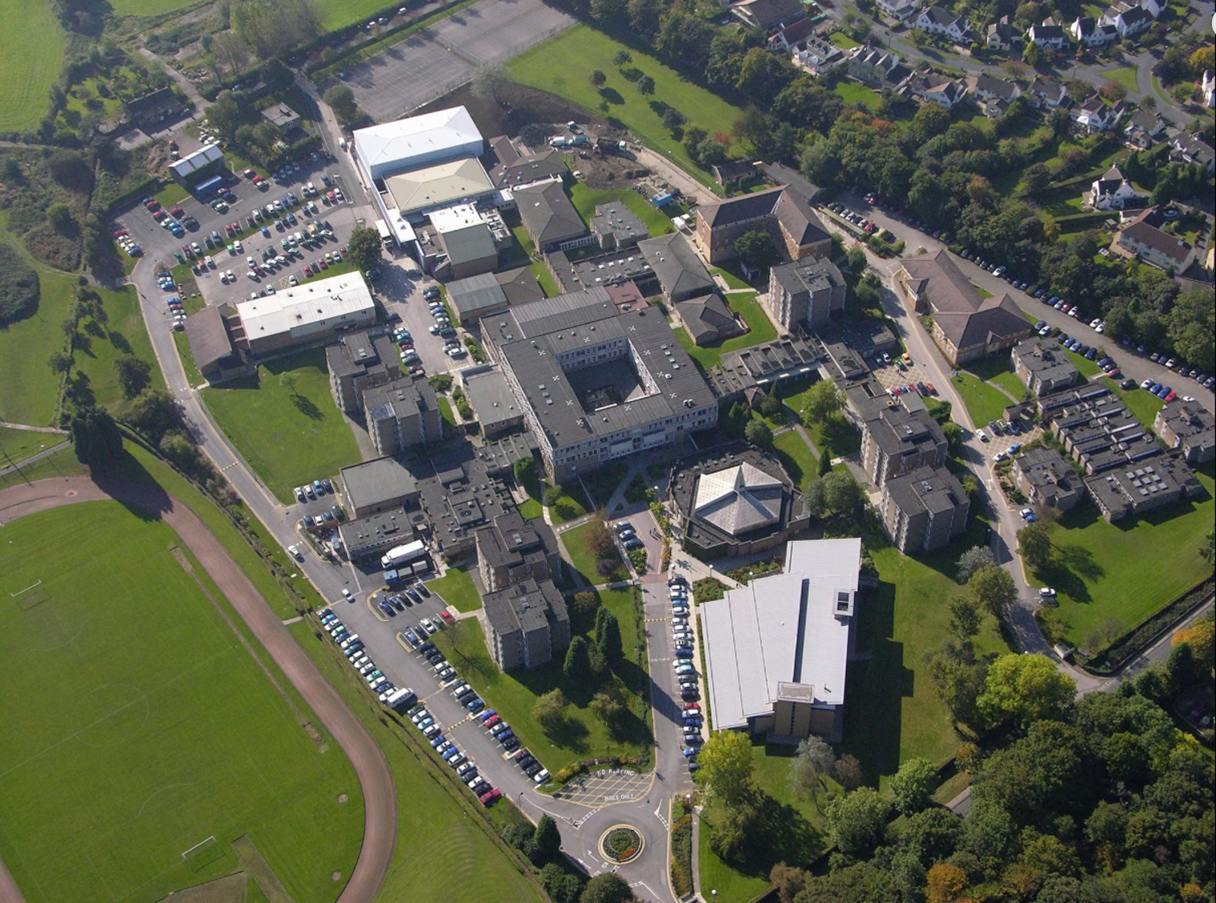
Hidden Story 2: Leeds Trinity
How can Leeds Trinity help us understand education in post-war Britain?
Notes:
Jen
Challenged ourself to take this model to apply it to this local place (students, Emily, ourselves_
Let's experience the enquiry process ourselves using the place we're in (Leeds Trinity).
We're using Leeds Trinity because we're here and it allows us to experience the enquiry process together. With primary pupils, the process would remain the same, but the historical context, evidence and questions would be adapted to suit their age and curriculum.
This isn't intended as a primary history lesson. Instead, we're using the campus as a live case study to experience the enquiry process ourselves. The same principles can then be adapted to places and historical contexts that are appropriate for primary-aged children

Slide 19
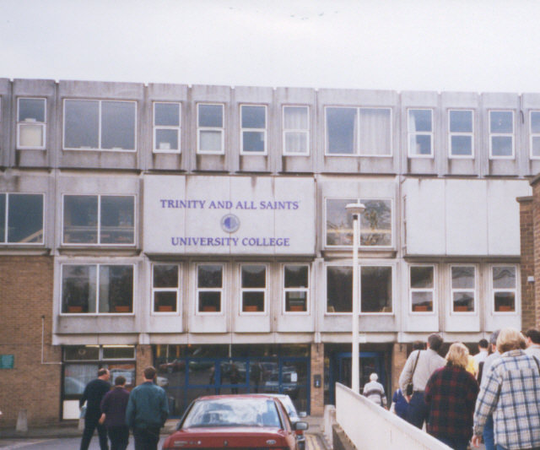

Historical Context
Key substantive knowledge:
Following the Second World War, Britain experienced a baby boom, creating a growing demand for teachers.
During the 1960s, teacher training colleges were established across Britain.
Leeds Trinity opened in 1966 as two Catholic teacher training colleges: Trinity College for women and All Saints College for men.
Late 1970s the SHP moves to Trinity All Saints.
Notes:
Steph
Before we begin the enquiry, it's helpful to understand a little of the historical context.
After the Second World War, Britain faced a growing demand for teachers. The post-war baby boom meant more children in schools, leading to a rapid expansion of teacher training colleges during the 1960s.
Leeds Trinity was founded in 1966 as two Catholic teacher training colleges—Trinity College for women and All Saints College for men. They merged in 1980 and have since evolved into the university we see today.
The exciting part is that the campus isn't just the venue for today's workshop—it's our historical source.
So rather than me telling you the story, we're going to investigate it as historians.
We'll begin by examining historical photographs, making observations, asking questions and developing hypotheses before heading out onto campus to gather further evidence and refine our conclusions.

Slide 20
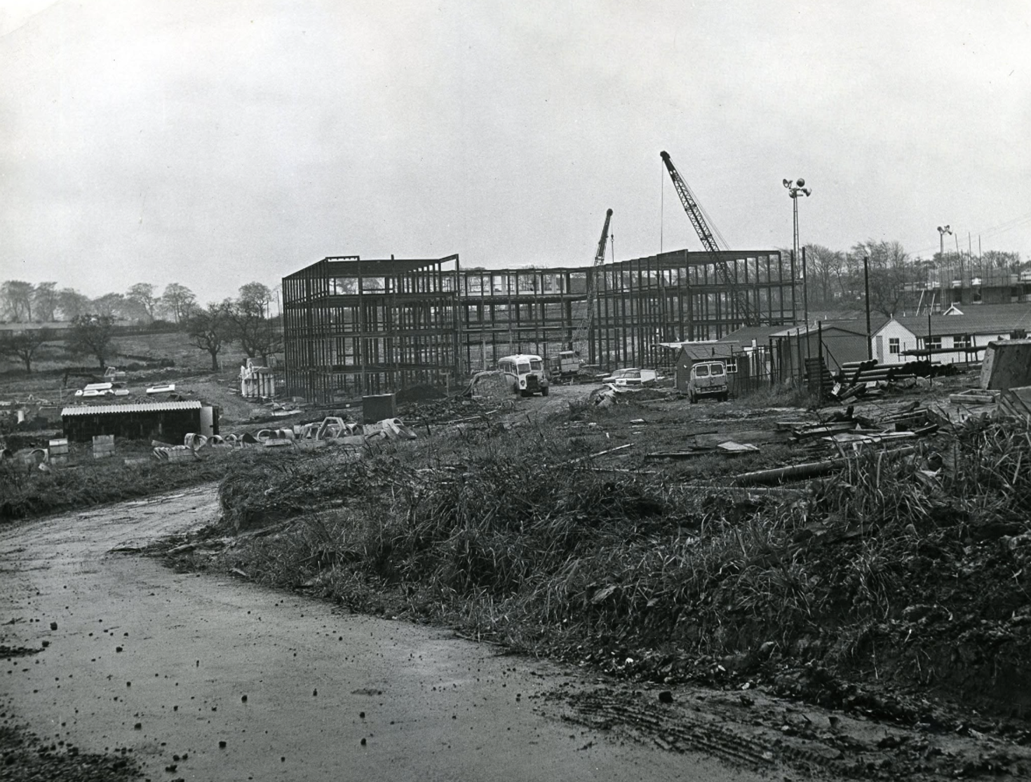
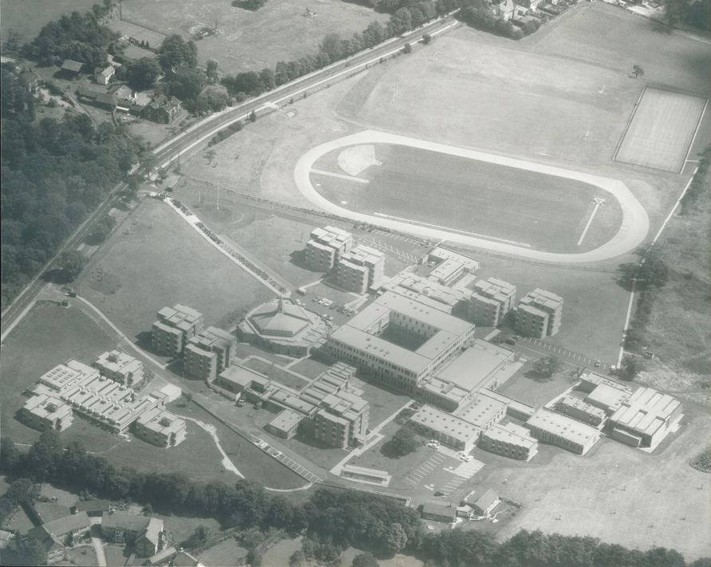
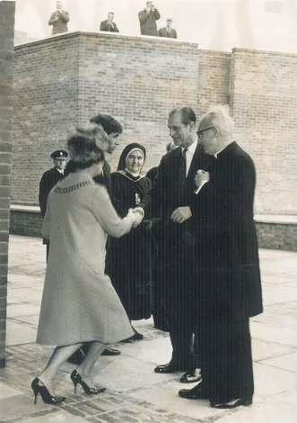
Stage 1: What do you notice?
Stage 2: What questions do you have?
Stage 3: Hypothesis
Can you answer your questions?
Based on the evidence you've seen, what story do you think this place tells?
I think.....because......
Notes:
Steph
Hand out photo pack 1
Stage 1 : What do you notice?
What details stand out?
What similarities/differences do you see?
What seems important?
Stage 2: Questions
Why was the university built?
Why separate colleges?
Why are there priests and nuns?
What happened to the separate colleges?
Why has the campus changed?
What values did the founders have?
What can we still see today?
Stage 3 Hypothesis
It was built because more teachers were needed.
Religion played an important role.
The university has changed considerably.
Some original values remain.
The buildings may reflect different periods.

Slide 21
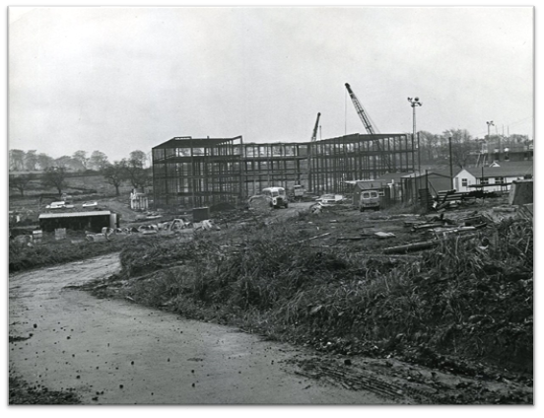
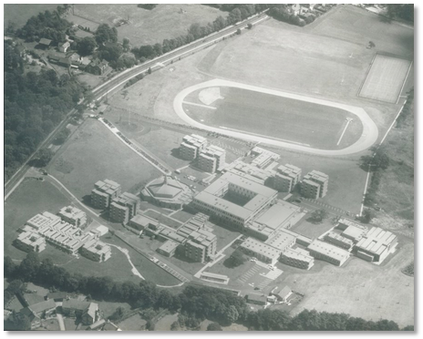
Stage 4: New Historical Evidence
Provide more information and evidence for children to explore to see if they can find answers to their questions.
Construction of Trinity and All Saints colleges 1965
Campus in 1960s
Use Box 4 to record any evidence you think is important or relevant for our enquiry & your questions.​
Notes:
Steph
Let's add another layer of evidence.
As each new piece of evidence is revealed, use Box 4 to record what you think is significant and why.
These photographs show the construction of the campus in 1965 and what it looked like shortly after it opened.
What do these photographs suggest about the scale of investment in teacher education?
What questions do they raise about why Britain was building colleges like this during the 1960s?

Slide 22
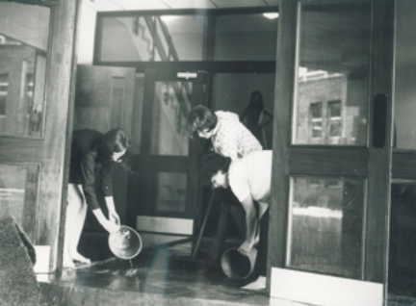
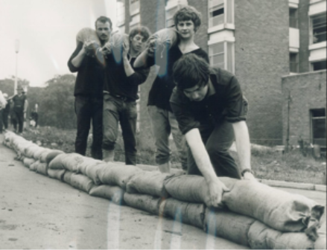
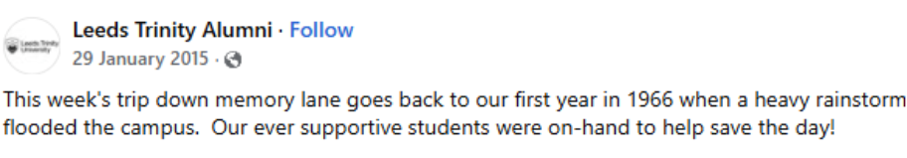
Stage 4: New Historical Evidence
Notes:
Steph
Here's another piece of evidence from the college's first year.
Soon after opening, heavy rain flooded the campus and students helped protect the buildings.
Although this isn't a major historical event, it tells us something about life here and the sense of community that developed within the college.
How does this add to your understanding of the people who studied here?

Slide 23
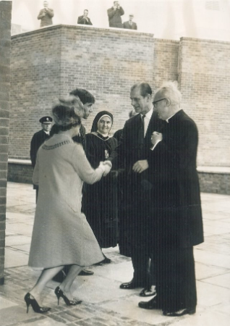
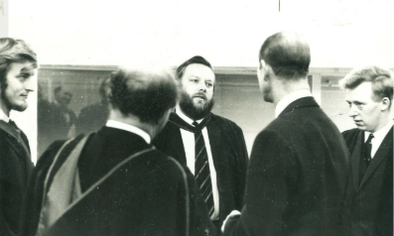
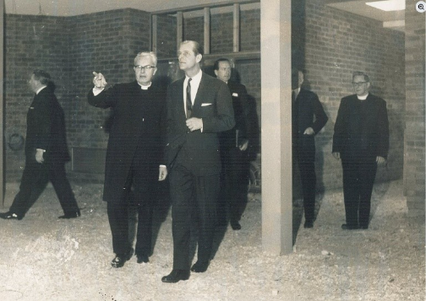
Stage 4: New Historical Evidence
Tom (Roy) Tucker worked as a Media Lecturer in Instructional Modes and Media at Leeds Trinity from 1967 to 1974.
One of Roy’s stand out memories was the Royal visit in 1968. Roy was responsible for enthusing the Duke of Edinburgh on the power of the moving visual image.
Reflecting on the visit, Roy said: “The Prince turned up seemingly without a big security detail by the chapel. Before visiting my area, he inspected the Spanish department, which was something that no other training college offered at the time. The Prince was then taken to the Control Room on campus, where he was expecting to see TV cameras, but they hadn’t been delivered yet.”
Notes:
Steph
In 1968, the Duke of Edinburgh visited the college. A member of staff later recalled proudly showing him around the campus, including the television studio—something that was considered quite innovative at the time.
What might a royal visit suggest about the ambitions of the new college?
Who else can you see in the photos? (What does the clergy presence suggest?)
You've now seen several different pieces of evidence. Take a couple of minutes to revisit your hypotheses. Has your thinking changed?
What does this evidence suggest about Leeds Trinity, and what wider story about education in post-war Britain does it help us understand?

Slide 24
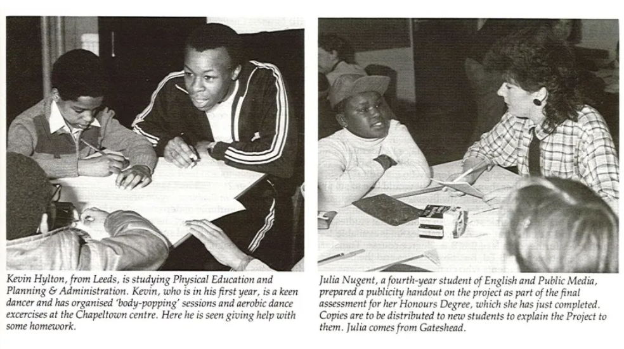
Stage 4: New Historical Evidence
Leeds Trinity pioneered an emphasis on school-based experience in teacher education. This approach continues today.
Notes:
Steph
What do these photographs suggest about the way teachers were being prepared?
They show Leeds Trinity's emphasis on practical, school-based learning—an innovative approach at the time that continues to shape teacher education today.
You've now seen several different pieces of evidence. Take a couple of minutes to revisit your hypotheses. Has your thinking changed?
What does this evidence suggest about Leeds Trinity, and what wider story about education in post-war Britain does it help us understand?
Use Box 4 to record any evidence you think is important or relevant to the enquiry question.
You've now examined a range of historical sources. The next stage of the enquiry is to investigate the campus itself and see what additional evidence it provides.

Slide 25
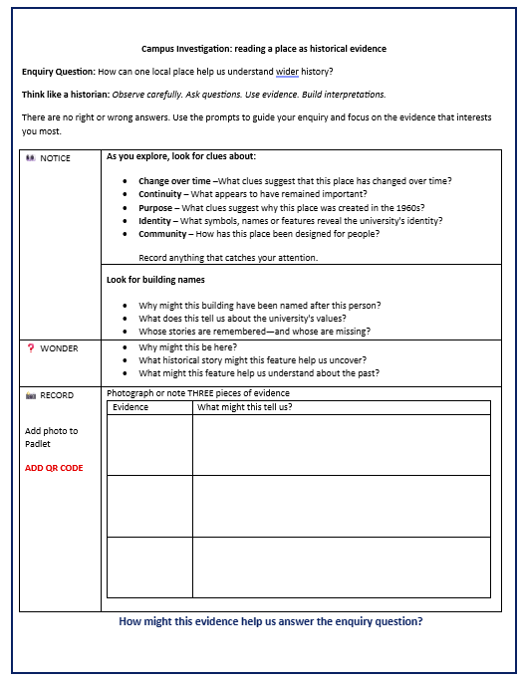
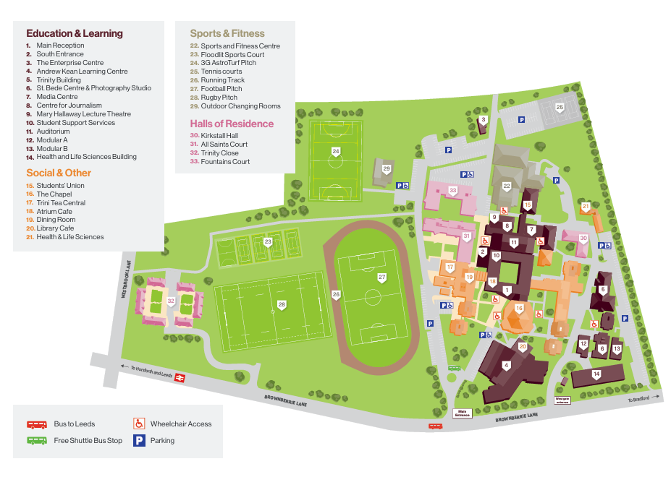

Notice things that surprise you.
Ask historical questions about what you see.
Collect three pieces of evidence that you think tell an interesting story.
Don't try to answer every question. They're there to help you look more carefully. Choose the prompts that help you investigate the campus.
Stage 4: Investigating New Evidence​
​
Campus Exploration (20 minutes)​
Notes:
Steph
We're now moving from historical photographs to the place itself as our historical source.
Your task is to investigate the campus like a historian.
As you explore, don't just look—ask historical questions. What evidence can you find about the history of this place and what it tells us about the past?
That evidence might come from building names, architecture, religious symbols, historical photographs, maps or memorials. None of these tell the story on their own, but together they help us build a picture of the past.
Use the prompt sheet to guide your observations—there's no expectation that you'll answer every question. They're simply there to help you notice things you might otherwise overlook.
We'll each notice different things, so use the QR code to add photographs and observations to the Padlet. Together, we'll build a shared evidence base to help answer the enquiry question.

Slide 26
Stage 4
Campus Exploration: Making Sense of Our Evidence
Let's use the Padlet to explore the photographs, observations and interpretations we've collected.
Why might this be here?
What historical story might this feature help us uncover?
Looking across all of these photographs, what stories do you think this place might tell?
Notes:
Steph
Welcome back!
Let's use the Padlet to share & compare the evidence you've collected.
We'll use your photographs, notes and interpretations to build a shared understanding
Which pieces of evidence seem most significant? What stories do they help us uncover?
What do they reveal about Leeds Trinity, and education in post war Britian?
https://padlet.com/yorksj/leeds-trinity-history-enquiry-s1ul2qfx35j05sgt

Slide 27
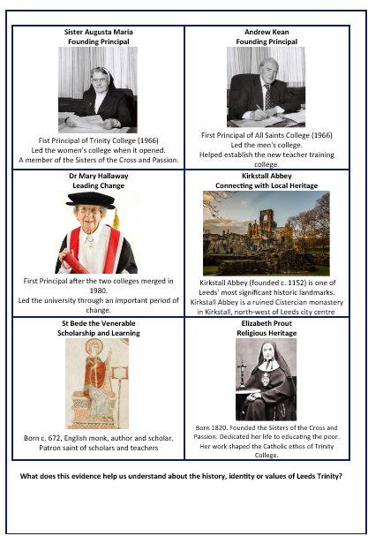
Stage 4: New Historical Evidence
What do these sources reveal about the history, identity and values of Leeds Trinity?
Notes:
Steph
Evidence pack 2
Historians rarely rely on a single type of evidence—they look for additional sources that help them refine their interpretations.
Your handout gives you two more sources: the Leeds Trinity shield and a selection of building biographies.
Working with the people around you, look closely at the shield. What do you notice? What might the symbols represent? What do they suggest about the history, identity or values of Leeds Trinity?
Then use the building biographies to test and develop your ideas. How do these additional sources strengthen, challenge or add to your interpretation?
[After time to look at evidence pack 2]
The three stars represent the Holy Trinity, while the ship is the Barque of Peter, an important Catholic symbol representing the Church.
Together, these remind us that Leeds Trinity was founded as a Catholic teacher training college and that religion played a significant role in its identity and purpose.

Slide 28
Stage 4: New Historical Evidence
Chronological Context
University status (2012) 🎓
1944 Free secondary education introduced; teacher marriage bar abolished. 📜
Post-war baby boom 👶
Growing demand for teachers 👩‍🏫
Leeds Trinity founded (1966)
Merger (1980) 🔗
Expansion of teacher training colleges 🏫
⛪ Churches have long played a major role in education in England
Notes:
Steph
This timeline helps us place Leeds Trinity within the wider story of post-war Britain.
Leeds Trinity wasn't founded in isolation. It was part of a much bigger story.
Religion has played a long-standing role in English education, with churches establishing and running many schools before and alongside state provision. Catholic teacher training colleges like Leeds Trinity grew out of this tradition, preparing teachers for Catholic schools and the wider education system.
The 1944 Education Act. It introduced free secondary education for all pupils, meaning many more young people stayed in education. It also abolished the teacher marriage bar, allowing married women to remain in the profession.
Compulsory secondary education combined with the post-war baby boom created an urgent need for more teachers.
The expansion of teacher training colleges was Britain's response to that challenge, and Leeds Trinity was one of those new colleges.
Since then, the institution has continued to evolve—from two separate colleges, to a merged institution, and eventually to university status.
But you can still see evidence of its original purpose and identity across the campus today.
Use Box 4 to record any evidence you think is important or relevant for our enquiry & your questions.

Slide 29

Stage 4: New Historical Evidence
Wider Historical Context
What does this source tell us about teaching and teacher education in the early 1960s?
What does it reveal about expectations and opportunities for young women?
How does it help us understand the history of Leeds Trinity?
Notes:
Steph
We've explored the campus itself. Now let's widen the lens again with another source from 1962, just a few years before Leeds Trinity opened.
This isn't about Leeds Trinity directly, but it helps us understand the society in which it was founded.
Take a couple of minutes to look through the extracts. What do they suggest about teaching, women's careers and expectations at the time? How might this source help us understand why colleges like Leeds Trinity were established?
[After time to read]
What does this source tell us about teaching as a profession?
Who does it appear to be aimed at?
What opportunities and expectations does it present for young women?
How does it add to your understanding of Britain in the early 1960s?
How does it help us understand the purpose of Leeds Trinity when it opened?
This source reminds us that, in the early 1960s, teaching was seen as an attractive and respected career for young women.
It also shows that teacher training colleges were more than places to gain qualifications—they offered residential communities, wider educational opportunities and preparation for a profession that Britain urgently needed.
Use Box 4 to record any evidence you think is important or relevant for our enquiry & your questions.

Slide 30
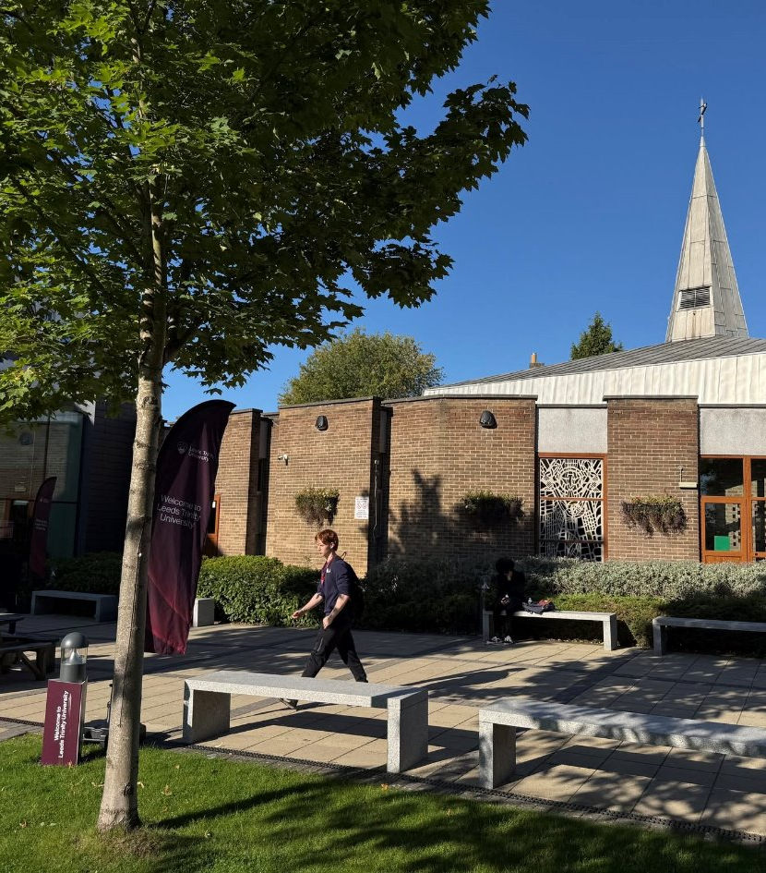
Stage 5: Stronger Conclusions
What have we learned about the history of Leeds Trinity?​​
What does the history of Leeds Trinity reveal about teacher education​​?
What can our evidence tell us about education in post-war Britain?​​
Remaining questions?
Notes:
Steph
We've now reached the point where historians bring all of their evidence together.
Throughout this enquiry, we've explored the campus, examined historical photographs, investigated the university shield and building biographies, considered contemporary publications and placed Leeds Trinity within its wider historical context.
Now it's time to return to your questions & develop stronger conclusions using evidence
[Time for discussion and making notes. Then share as a group].
With these conclusions in mind....(go to questions on the slide)
So we've developed stronger conclusions about Leeds Trinity itself. The final step is to ask what this local enquiry helps us understand about the wider past

Slide 31
Stage 6: The Bigger Picture:
Developing a more substantial enquiry
What does this evidence tell us about Leeds Trinity University?
What connections does this place reveal between education, religion and the local community?
What does this reveal about broader historical concepts?
What does this evidence tell us about English education during this period?
Notes:
Jen
Starting small and broadening outwards (how can one small thing tell a bigger story?)
THEN – connecting into the substantive and disciplinary concepts
So, by investigating one local place, we've explored much bigger historical themes: education, religion, post-war Britain, continuity and change, and the relationship between local evidence and national history.

Slide 32
Stage 6: Connecting to the Bigger Picture
(Situating the enquiry within substantive and disciplinary concepts)
How can this place help us understand:
Change & Continuity How do places change while retaining aspects of their identity?
Post-war Britain How does Leeds Trinity help us understand educational change in post-war Britain?
Significance Why have these people, places and traditions been remembered?
Cause & Consequence
What historical developments made the foundation of Leeds Trinity possible?
Chronology
How does placing Leeds Trinity within a historical timeline help us understand its story?
Religion What does Leeds Trinity reveal about the role of religion in education?
Notes:
Jen
How can this local place help us understand wider history?
What evidence did we collect that helps us understand this?
For example:
Post-war Britain → Which features of the campus helped us make that connection?
Religion → Which evidence suggested the university's religious heritage?
Historical significance → What made you think these people were important enough to be remembered?
Local places become meaningful when we use evidence from them to construct wider historical interpretations. I think that's the distinctive strength of your session.
Extra questions:
Education: what did you notice that told you this was originally a teacher training college?
Evidence & Interpretation: What can this place tell us—and what can't it tell us?
Another historical theme?
Britain needed more teachers → new teacher training colleges were established → Leeds Trinity is one example of this national story.
That's the connection between the local and the national.
Our enquiry was about using one local place to understand wider historical change."
"Looking back at the evidence you collected, which pieces of evidence helped you make that connection?"

Slide 33
How could this enquiry process help us uncover the hidden stories in our own communities?
What place could you investigate?
What evidence might children investigate?
What wider history could it help children understand?
Notes:
Steph
I'd like to finish by looking ahead.
One of the key messages from today is that every community has its own stories waiting to be uncovered.
Take a couple of minutes to think about your own context.
Write down one local place you could investigate, one possible enquiry question, and the wider historical story or concept it could help children understand.
There doesn't have to be a 'right' answer. The aim is simply to start thinking about how this enquiry process could be adapted for your own setting.
If you'd like to, you can also use the QR code to share your ideas so we can leave today with a collection of enquiry ideas from different places
https://padlet.com/yorksj/leeds-trinity-history-enquiry-s1ul2qfx35j05sgt

Slide 34
A student teacher's perspective...
…if you want children to be like historians, you have to give them questions. You can't always give them the answers. I think a lot of it is about creating the air of mystery and like making them feel like they're discovering something. Because I think it's really easy to just tell them everything they want to know. But if you want to build that engagement, you almost have to not quite give them everything in one go.
Poppy
Notes:
Jen
And I think this quote from Poppy, one of our student teachers, really captures what we were trying to do through the practical activities in our primary history workshops.
The aim wasn’t just to tell student teachers about substantive and disciplinary knowledge as abstract concepts, but to let them experience a way of teaching history where curiosity, interpretation, and questioning sit at the centre.
So through the artefacts, the timelines, the world-building, and the Star Carr enquiry, we were deliberately modelling a classroom where pupils aren’t simply handed all the answers straight away. Instead, they’re encouraged to notice things, ask questions, make interpretations, and gradually build a picture of the past over time.
And I think Poppy expresses that really nicely here — this idea that if we want children to think like historians, we sometimes have to resist the urge to explain everything immediately, and instead create space for mystery, uncertainty, and discovery.

Slide 35
Conclusions
Every community carries its own stories. Our role as history educators is to help children uncover them.
Local places are powerful sources of historical evidence.
Structured historical enquiry helps children connect local evidence to wider historical themes and concepts.
This approach can be adapted to your own places, learners and curriculum contexts.
Questions​ & Discussion
Notes:
Steph
We've explored two very different places today—a Roman burial in York and a university campus here at Leeds Trinity. What links them isn't the history itself; it's the enquiry process.
Both enquiries began with one local place but led us to much bigger historical ideas.
Our hope is that you'll leave today thinking about the places in your own community and the wider history they could help children understand
Local places aren't the end of the story—they're the starting point for understanding wider history

Slide 36
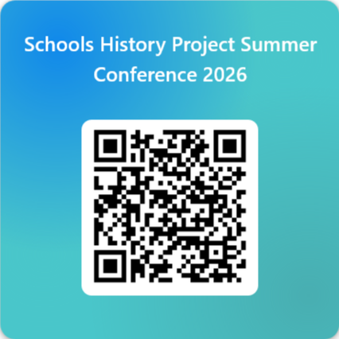
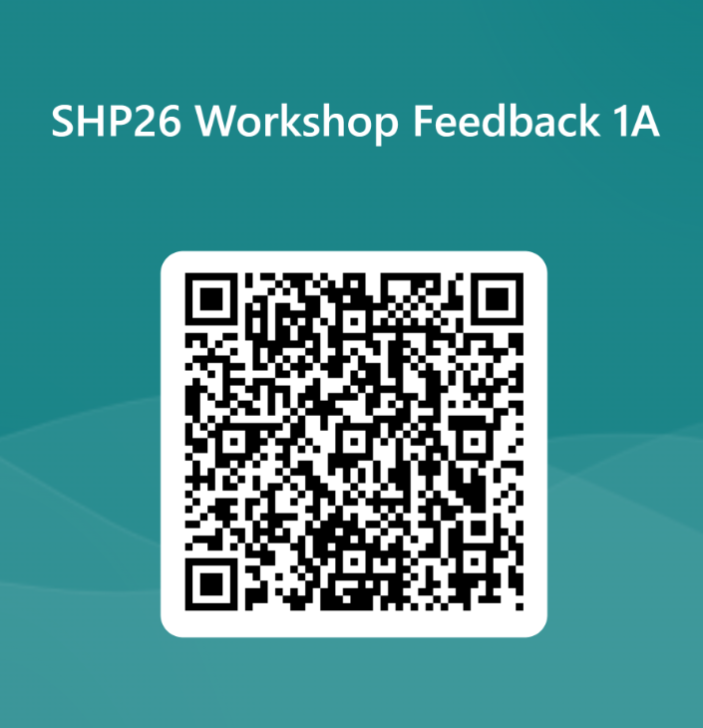
s.jach@yorksj.ac.uk
j.huntsley@yorksj.ac.uk

Slide 37
Feedback
Acknowledgements
Many of the historical images, archival material and background information used throughout this presentation were drawn from the resources made available by:
Leeds Trinity University Alumni
York Museums Trust
The University of Reading
Many thanks for their commitment to making local history accessible.
Notes:
Jen
Schools History Project Summer Conference 2026 – Fill in form
Before we finish, I'd just like to acknowledge and thank Leeds Trinity University Alumni, York Museums Trust and the University of Reading. Many of the historical images, archival material and background information used throughout today's workshop came from the resources they've made available.

Slide 38
Image Credits
Slide 4
Author’s own photograph.
Slide 6
The Rowntree Society (2025) Joseph Rowntree Centenary stamp. Available at: https://www.rowntreesociety.org.uk/joseph-rowntree-centenary/joseph-rowntree-stamp/ (Accessed: 11 May 2026).
York Minster (n.d.) York Minster Timeline. Available at: https://yorkminster.org/discover/timeline/ (Accessed: 11 May 2026).
York Minster image: Author’s own photograph.
York Museums Trust (2022) Celebrating Ivory Bangle Lady. Available at: https://www.yorkmuseumstrust.org.uk/blog/celebrating-ivory-bangle-lady/ (Accessed: 11 May 2026).
Yorkshire Museum (n.d.) Star Carr Frontlets. Available at: https://www.yorkshiremuseum.org.uk/collections/collections-highlights/star-carr-frontlets/ (Accessed: 11 May 2026).
Slide 9
History of York (no date) The Roman Civilian Settlement. Available at: History of York – The Roman Civilian Settlement (Accessed: 6 July 2026)

Slide 39
Image Credits
Slide 11
Google (no date) Google Maps. Available at: https://maps.google.com (Accessed: 6 July 2026).
Slide 12, 13 &15
York Museums Trust (2022) Celebrating Ivory Bangle Lady. Available at: https://www.yorkmuseumstrust.org.uk/blog/celebrating-ivory-bangle-lady/ (Accessed: 11 May 2026).
Slide 16
Adhavoc (2010) Europe 180AD Roman trade map [map]. Wikimedia Commons. Available at: https://commons.wikimedia.org/wiki/File:Europe_180ad_roman_trade_map.png (Accessed: 6 July 2026).
Slide 19, 20, 21,22,23, 24, 25 & 33
Leeds Trinity University Alumni (no date) Facebook. Available at: https://www.facebook.com/LeedsTrinityAlumni (Accessed: 6 July 2026).
Leeds Trinity University (no date) Our history. Available at: https://www.leedstrinity.ac.uk/about/history/ (Accessed: 6 July 2026).

Slide 40
References
Beames, S., Higgins, P., & Nicol, R. (2011). Learning outside the classroom: Theory and guidelines for practice. Routledge.
Beames, S., Higgins, P., & Nicol, R. (2023). Learning outside the classroom: Theory and guidelines for practice (2nd ed.). Routledge.
Dawson, I. (2015) Enquiry: developing puzzling, enjoyable, effective historical investigations. Primary History, 70, pp. 8–14. Available at: Thinking History (Accessed: 6 July 2026).
Gruenewald, D. A. (2003). The best of both worlds: A critical pedagogy of place. Educational Researcher, 32(4), 3–12. https://doi.org/10.3102/0013189X032004003
Israel, A. L. (2012). Place-based education: A review of historical precedent, promise, and practice. Journal of Sustainability Education, 3.
Lomas, T. (2019) ‘Getting to grips with concepts in primary history’, Primary History, 82. Historical Association. Available at: Historical Association (Accessed: 8 July 2026).
Smith, G. A. (2002). Place-based education: Learning to be where we are. Phi Delta Kappan, 83(8), 584–594. https://doi.org/10.1177/003172170208300806
Sobel, D. (2004). Place-based education: Connecting classrooms and communities. Orion Society.
Waite, S. (2013). Knowing your place in the world: How place and culture support and obstruct educational aims. Cambridge Journal of Education, 43(4), 413–433. https://doi.org/10.1080/0305764X.2013.792787
Yemini, M., Engel, L., & Ben Simon, A. (2023). Place-based education—A systematic review of literature. Educational Review, 75(4), 685–702. https://doi.org/10.1080/00131911.2021.1965395

