Slide 1
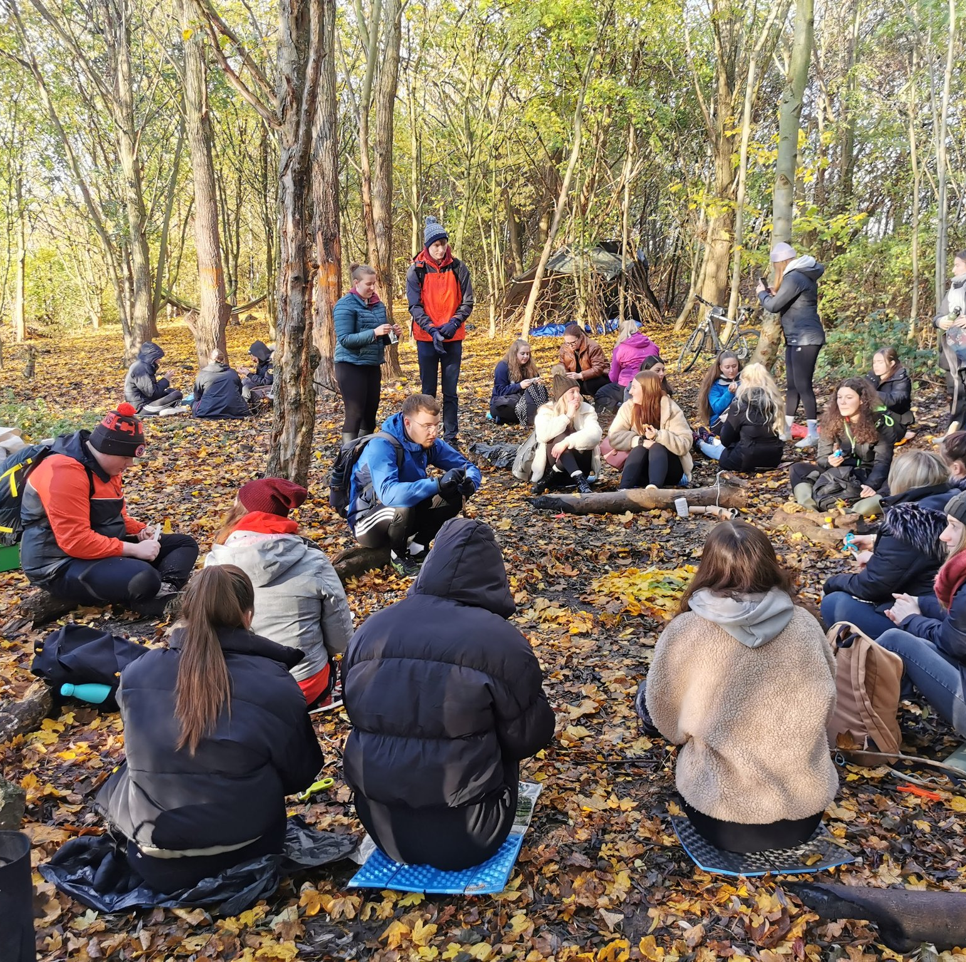
From Campus to Community
Exploring creative pedagogies in outdoor learning to engage with place, inclusion and environmental justice
Lucy Sors – Dr. Jen Huntsley
York St John University
l.sors@yorksj.ac.uk j.huntsley@yorksj.ac.uk
Notes:
Welcome, introductions, explain undergraduate degree with QTS – elective module in third year.

Slide 2
Workshop Objectives
To explore experiential, contextual place-responsive pedagogy as an innovative educational approach
To illustrate how collaborative and responsive curriculum design in Higher Education can effectively interweave research with authentic learning experiences
To reflect on future implementation of pedagogies supporting incidental learning and opportunities for connection with nature, place, community and self
Notes:
LS Purpose: To share our objectives for this audience in this workshop
World
Place is an active part of the learning experience
Not just about doing what we do indoors, outdoors, it’s about doing things in new ways and we’d like to share some of those ways that we have been exporing with our STs
One of the biggest challenges is that teachers often carry classroom culture outdoors,
To avoid this, the chapter suggests looking at learning through two complementary lenses:
showing how learning happens in the dynamic space between self, others, (community and wider world) and place.

Slide 3
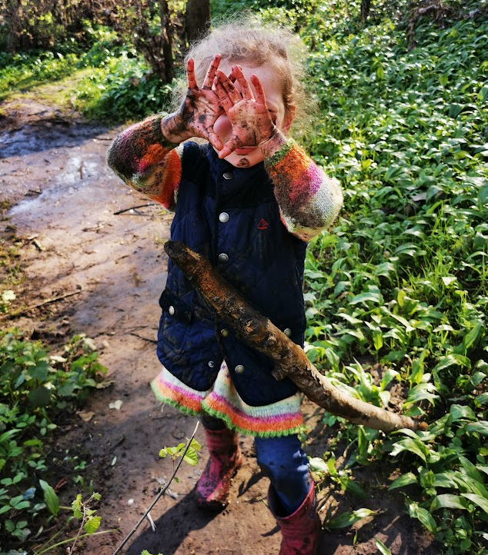
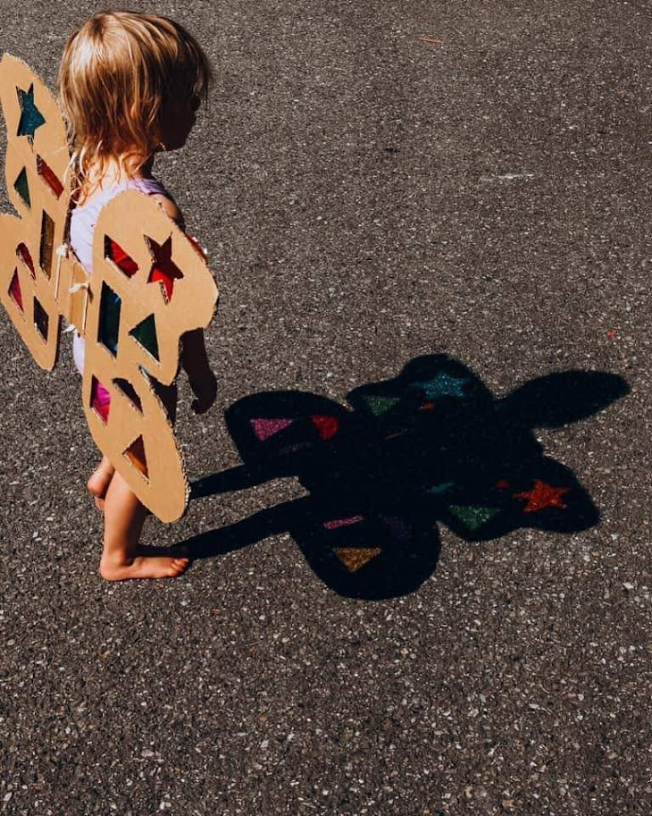
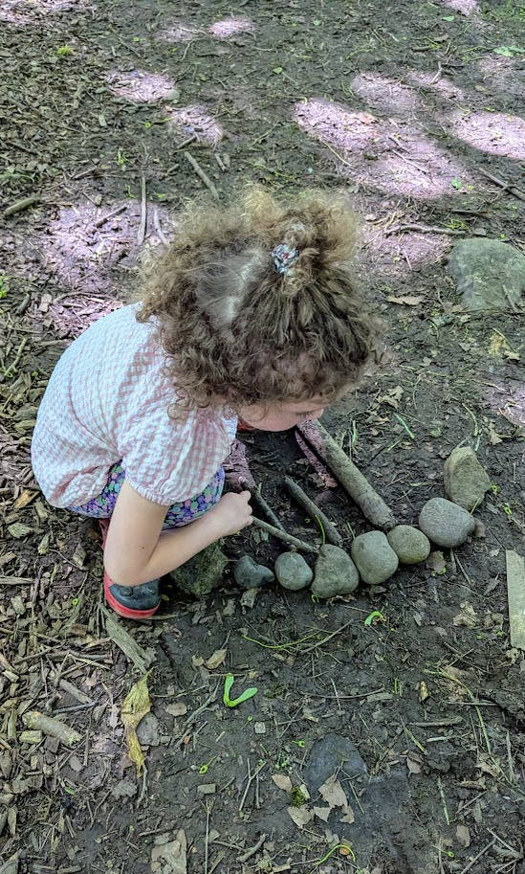
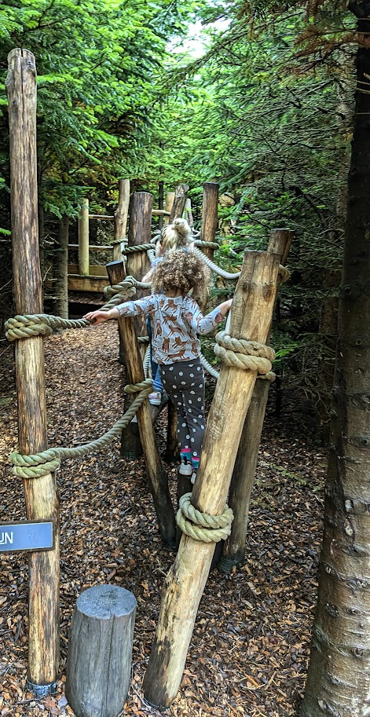
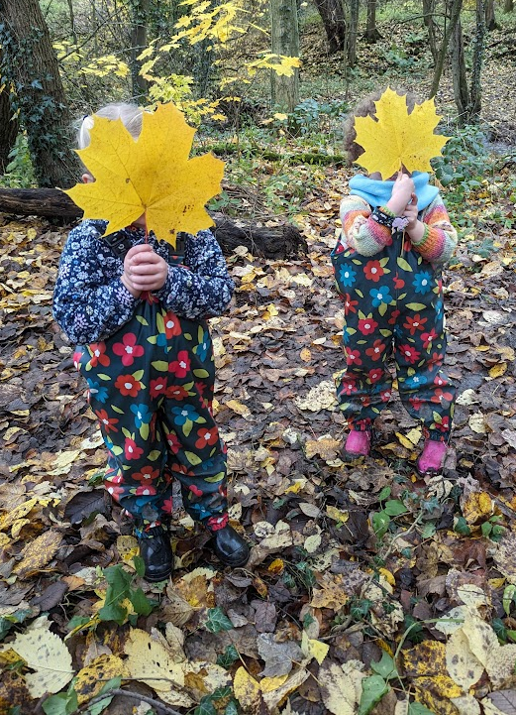
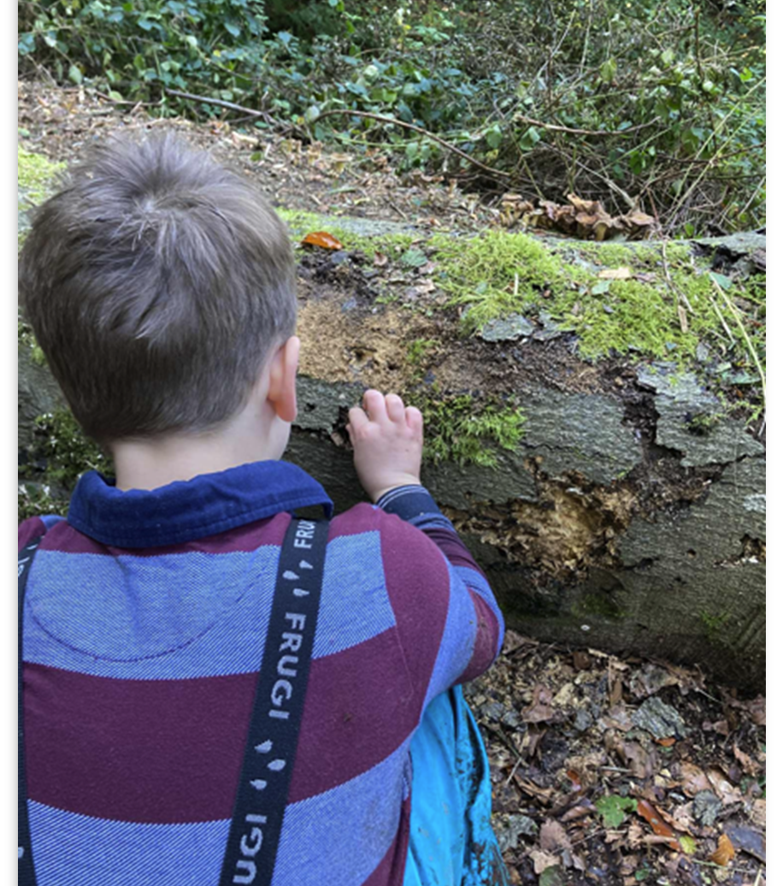
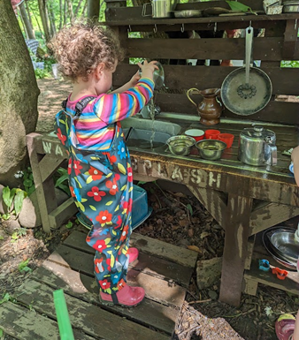
Origins in the Early Years
Learning cannot be 'compartmentalised'
Play
Whole Child
Flow
Slow pedagogy (Clark, 2023)
Curiosity-driven approaches
Notes:
JH then LS Purpose: To explain where OL comes from and the Early Years principles that are embedded within it
For the facilitators of the outdoor learning module, as we grew into parenthood of young children, alongside reflecting on our experiences as teachers where we used the outdoors as the ‘third teacher’ – has greatly supported the evolution of the module. for example we attend forest schools with our own children, play in mud and go on adventures outside that involve us applying principles such as slowness, creativity and curiosity in practice with small people every day. This learning enhances our practice on the module, as we share with each other what we have learnt form our own experiences with children.
“our children re-connected us with nature, imagination, creativity, curiosity, knowledge and thoughtfulness” Jen Huntsle yBecause something magic happens when we learn outdoors!
To connect pupils to the world through memorable, meaningful experiences. However, Outdoor play advocated (and stipulated) in the EY but declines throughout Primary school
Research by theorists in child development, like Piaget and Froebel, emphasises the importance of active play, communication and exploration. Researchers argue that young children should be encouraged to explore their world in a range of indoor and outdoor settings.
The EYFS Framework promotes outdoor learning, stating that 'Providers must provide access to an outdoor play area. If that is not possible, they must ensure that outdoor activities are planned and taken on a daily basis', however, this trend does not continue throughout Primary school with the majority of time spent outside being for break times are lunch time rather than focussed within lesson time.
The EYFS framework advocates for free flow activities through play and describes Play as 'essential for children’s development, building their confidence as they learn to explore, relate to others, set their own goals, and solve problems.
One of the principles of EYFS practice is that every child is unique and as such they will have different interests, needs and abilities. They should be able to follow these interests in an enabling environment that allows freedom to play and explore.
This approach to learning also recognises that learning cannot be compartmentalised and that children should be allowed sufficient time, space and freedom. This contrasts to the need for an accelerated childhood or fast pedagogy needed to get somewhere at a certain time i.e. meeting age or phase related expectations but instead lends itself to what is termed 'Slow pedagogy'. Alison Clarke states that in EYFS settings this involves:
Valuing the moment
Being attentive to children's pace, rhythm
Enabling children to revisit their ideas & creations, places and stories
Creating opportunities for children to go deeper in their learning
Supporting time for observation, listening, reflection
Encouraging unhurried everyday routines with time for wonder & care
(Clark, Froebel Trust)

Slide 4
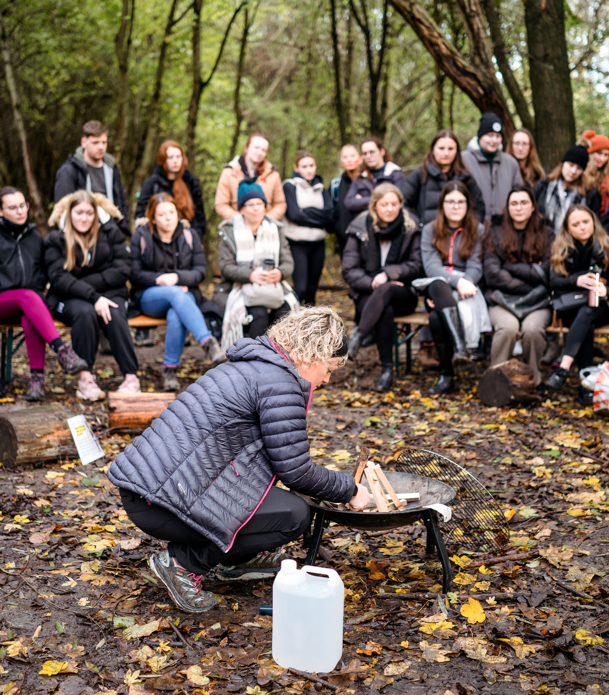
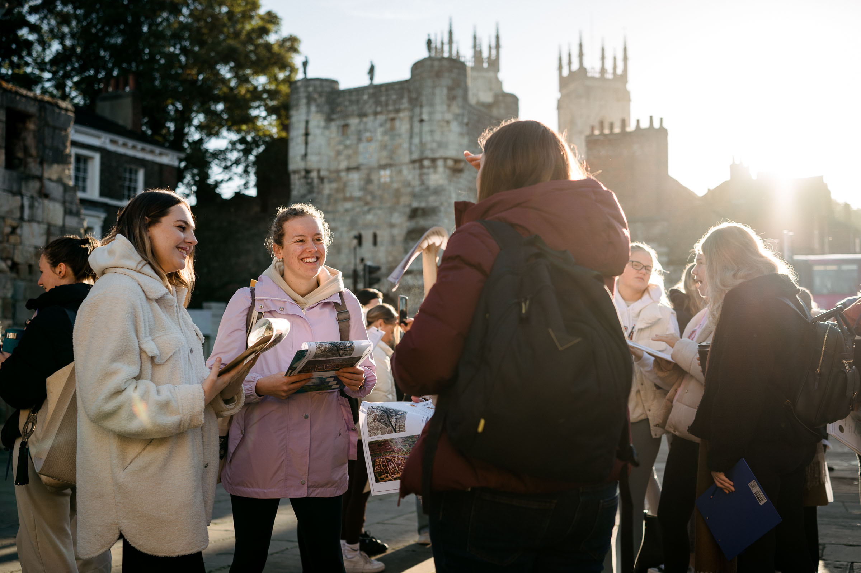
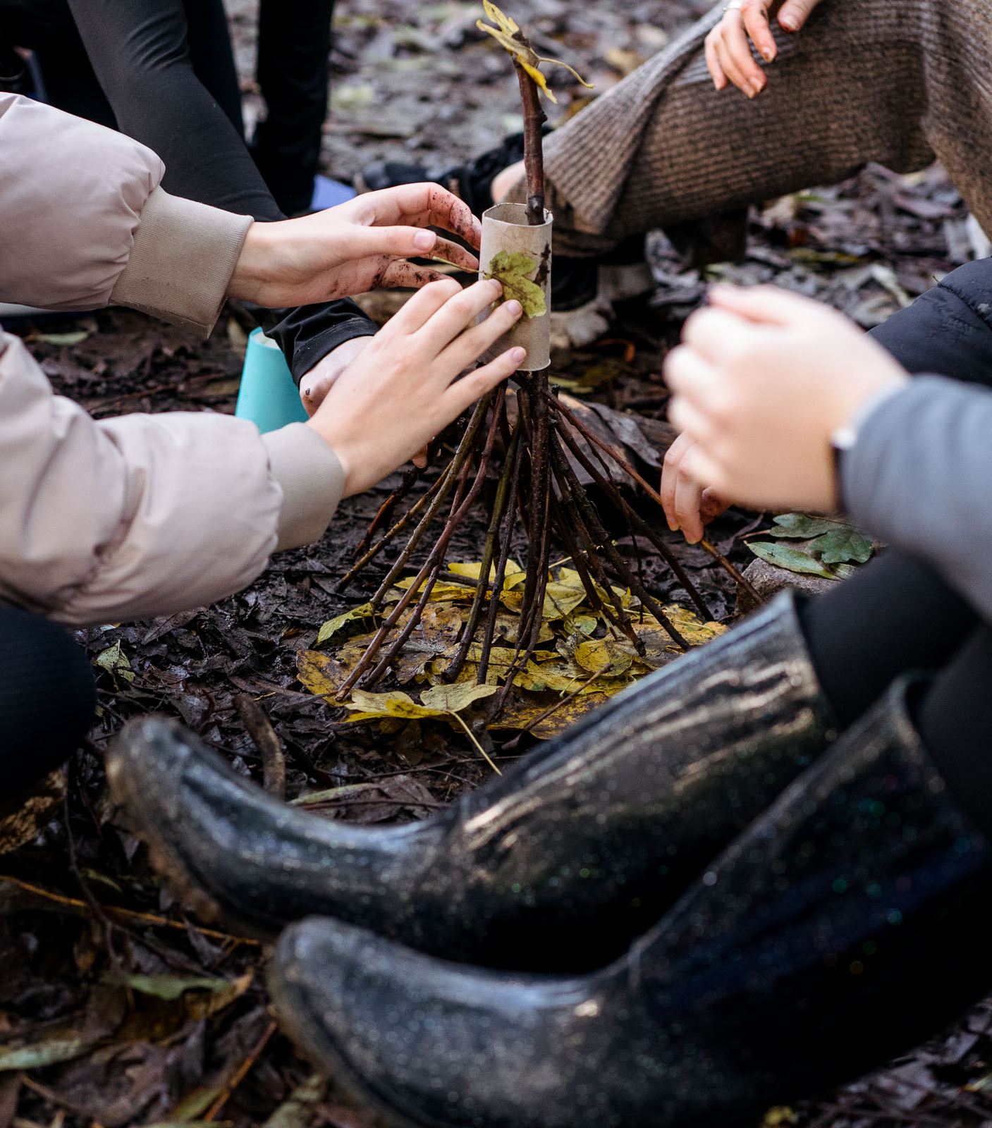
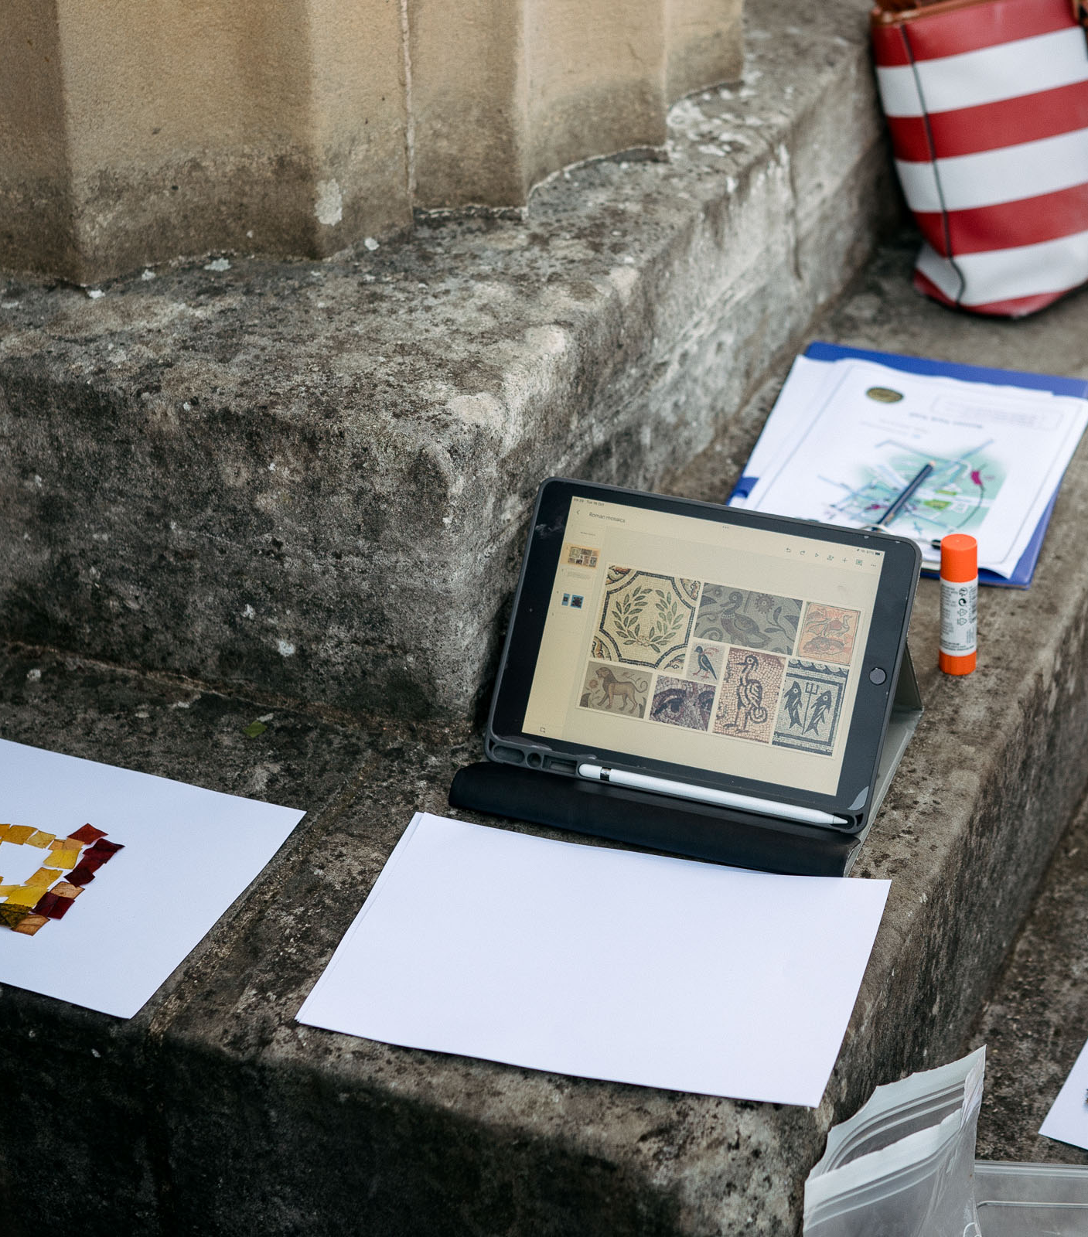
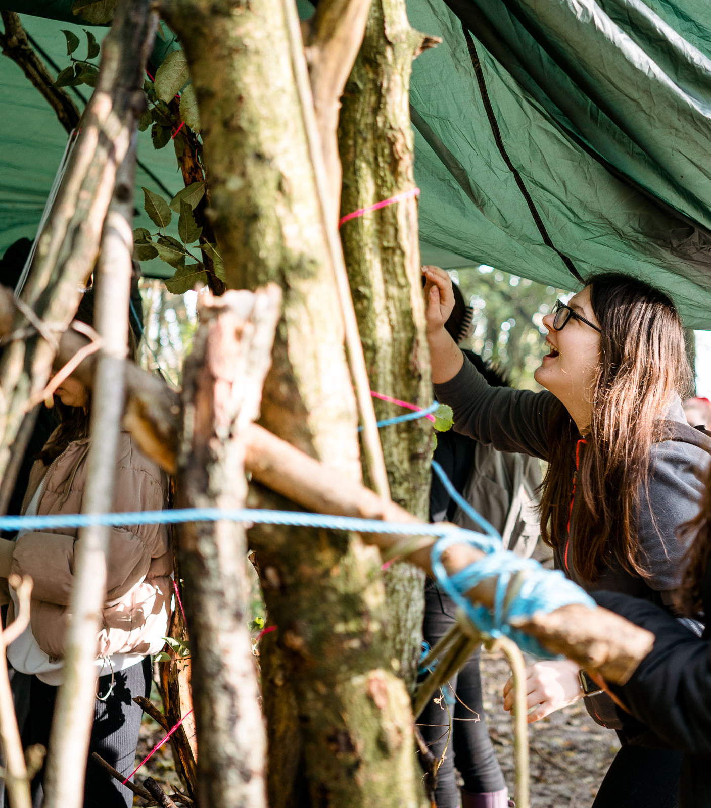
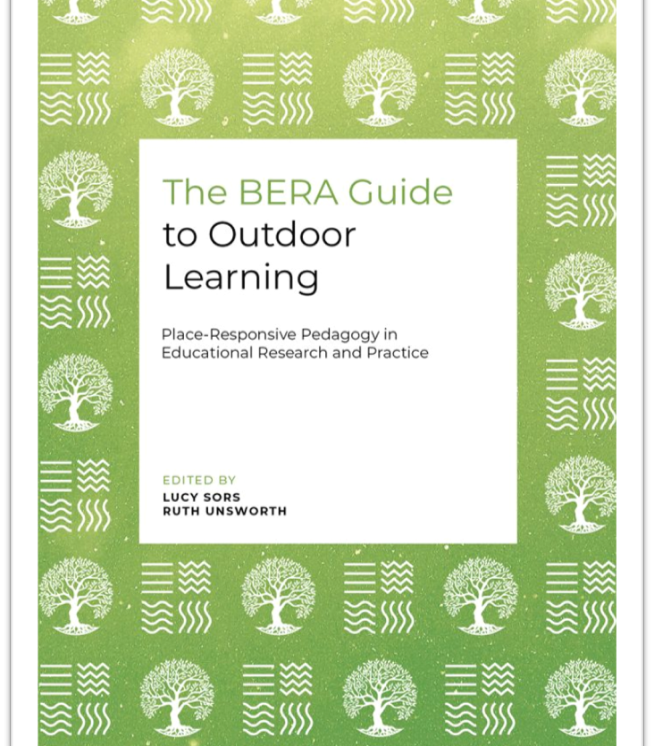
Outdoor Learning with Student Teachers
Playful connections with people, places and things’ (Woods, 2017).
‘Representing how you could do it with children’;
‘Actually get out and be practical’ to experience ‘what we would be trying to implement with children’.
Notes:
JH Purpose: To show how this translates into our module for student teachers in primary ITE through facilitations of interactions
Summaries from research - student voice –
Repeated outdoor visits help develop strong relationships with places by focusing on their interactions in and beyond those spaces.
Person-place connections - Feeling comfortable in a place and having a deep engagement over time leads to ‘noticing’ small details and having ‘magical moments’ of deep engagement.
Cumulative experience, together with reflective practice on experiences that are new and different can result in ‘a drastic re-appraisal of what we think we know’ (Waite, 2017). In this sense, student–teachers experienced transformative processes both on a personal level and as developing professionals
Student teachers developed meaningful relationships with outdoor learning which supported their personal knowledge and allowed them to explore at their own pace, take ownership, and dive deeply into topics that interested them.
They enjoyed creating their own activities and following personal learning journeys.
Activities like gardening, writing, and microteaching helped connect personal feelings, research, and subject knowledge into long-term memory.
This personal knowledge influenced their developing identities and teaching philosophies.

Slide 5
Outdoor Learning as an evolving and responsive process
Self
World
Others
“…an educational process that allows a learner to develop knowledge, skills, attitudes, and behaviours through direct engagement with outdoor environments, and which provides the learner with a range of personal, educational, and social benefits, which may have wider value for society and the planet.”
(Beames et al., 2024, p. 2
Notes:
JH Purpose: To introduce definition and underpinning theory of OL
Multifaceted interdisciplinary concept. An evolving and responsive process
Outdoor learning is not simply taking learning outside. Nor is it solely limited to outdoor and adventurous activities such as orienteering, rock-climbing or kayaking – although it is, of course, all of these things. When we learn outdoors, experiences are multisensory, encountered on different corporeal, temporal and spatial planes. I find it difficult to process the meaning of each of these terms in one go! An short illustration might be helpful maybe? E.g – it might be encountered corporeally in…. Etc?
Experiences of Outdoor Learning transcend traditional curriculum outcomes (we perhaps need to emphasise just how revolutionary/rebellious this is in the current educational climate in primary schools in England!!), although many of these can be met, and enhanced, by experiences outdoors. The multifaceted nature of OL reflects its interdisciplinary background, particularly notable in the field geography, anthropology, health and psychology. Beyond narrow curriculum outcomes. Benefits are widely recognised such as positive impacts on mental, health and physical well-being and supports holistic, cultural and sustainable development.
Within education research, interest in OL has grown, recognising benefits to mental health and well-being, physical wellness, cultural and cognitive development, as well as supporting growing momentum in sustainability and environmental education. Establishing connection between the self and the world, both the human, natural and more-than-human world, supports empathy, insight and understanding of what the world is asking of us and how we can interact within the world, with others, to secure its future. Learning outdoors is evolving and responsive and steps outside of prescribed curriculum outcomes.
<<QUOTE>> This vision of OL places importance on open-ended encounters with the world and the importance of unintended learning alongside planned curriculum outcomes.

Slide 6
The Urgency of Outdoor Learning
“In an age marked by increasing disconnection from the natural world, the urgent need for holistic, place-responsive outdoor learning has never been more apparent” (Mark Leather)
Neoliberal crises of performativity, lack of autonomy, ‘age of evidence’, health, care, education …
Sustainability and environmental stewardship: ‘World Centred Education’ (Biesta, 2021)
Notes:
LS – very quick signposting
Purpose: To demonstrate the need for OL in current educational & wider contexts
'In an age marked by increasing disconnection from the natural world, the urgent need for holistic, place-responsive outdoor learning has never been more apparent' (Mark Leather – foreword)
Antidote to curriculum demands/ performance metrics
Address lack of teacher and learner autonomy
Support mental and physical health
Despite recognition of its benefits, OL is consistently overshadowed by the government's neoliberal agenda with a focus on attainment and performance. Education has become a 'data delivery chain' (Roberts-Holmes & Bradbury, 2017) with constant targets, milestones and age-related expectations. The government's latest agenda sees a greater push to formalising early education with a focus on reading and writing expectations and school readiness. Performativity conflicts with children's natural will to explore, experience and 'be' in a place.
The curriculum leaves little room for teacher and learner autonomy with high expectations in terms of content and outcomes. This had led to a growing loss of ontological security for teachers (Ball, 2013) with a loss of both sense of meaning in what they do & what is important in their role.
Mental & physical health crises create extreme challenges within education. Time spent outside for children is on the decline, both at home and at school (Baines & Blatchford, 2019), however, national surveys (Natural England, 2023) show that being with nature has a positive impact on emotional health & cognitive well-being. The decline in active experiences & disconnection to the world are associated with a real risk that 'the next generation of UK adults will be the least healthy in living memory (D'Souza, Children's Commissioner).
Nature connection is linked to developing awareness of environmental issues. This supports Biesta's (quote)... World-centred education’ that seeks to situate learning for the future in the here and now (Biesta, 2021).

Slide 7
Signposting...
Underpinning theories
Place-responsive pedagogy (Sors, 2025)
Inclusive practice
Authentic, collaborative, responsive curriculum design
Slow pedagogy (Clarke, 2021)
Experiential learning (Dewey, 1938)
World centred, sustainable education (Biesta, 2021)
Putting theory-into-practice and reflection (going outdoors!)
Notes:
JH
So, we’d now like to share four of the key theories that underpin our approach to the outdoor learning module, as these are the principles that inform our pedagogies – and it may be that they can offer you opportunities to consider creative pedagogies in new ways as well.
Following this, we’ll discuss how we envision inclusion within the module, which is part of the authentic, collaborative and responsive design of our curriculum. After sharing some of these ideas with you, we’ll go outside and have a go at putting some of the theory into practice!

Slide 8
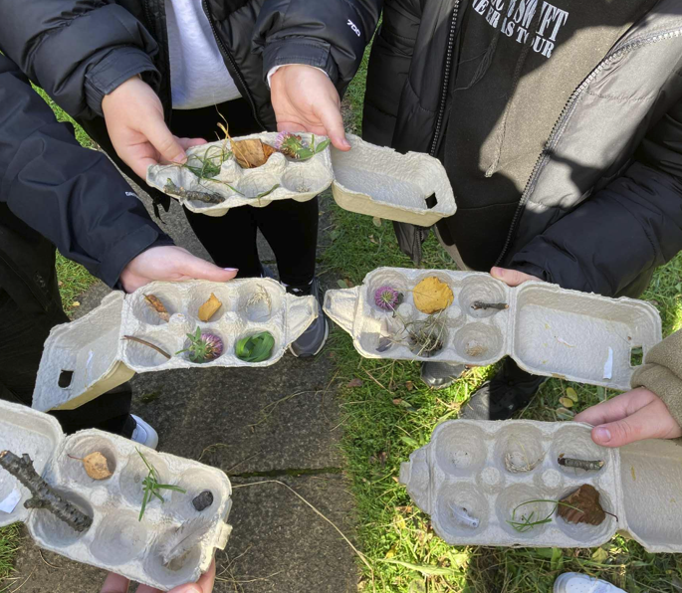
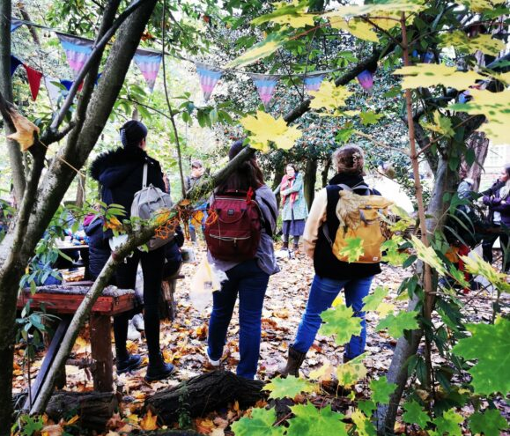
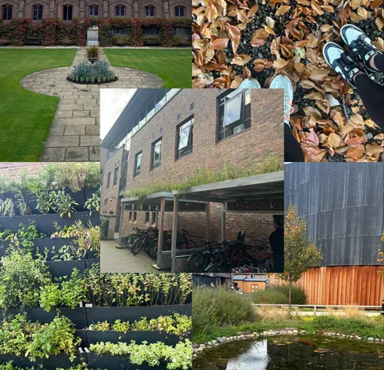
Place-responsive pedagogy
Positions place at the heart of pedagogy within different temporal and spatial planes
Critical engagement in the 'here and now' and in the 'there and then' (Biesta, 2021).
'In the moment' responsive, active noticing (Mason, 2002) of connections and interactions.
Inclusive and holistic approaches that respond to people and places (Sors, 2025)
From the ‘safe and familiar’ to the ‘distant and strange’ (Sobel, 2013)
Notes:
LS Purpose: To demonstrate the need for OL in current educational & wider contexts
Underpinning throughout Place connection is beyond the present and involves interaction between different temporal and spatial planes.
Active responses between people and places facilitate metacognition and transversal skills development.
Responses are informed by critical engagement with place in the 'here and now' and in the 'there and then' (Biesta, 2021).
Asking critical questions and interrogating 'capital': Practice past – present – future – drawing on temporal and spatial journeys.
Mason's 'active noticing' developed in The Discipline of Noticing askes us to attune ourselves to the possibilities of experience, developing sensitivity and awareness of what is happening at any given time. This accounts for memory, sociocultural background and context, cognitive and affective responses, of connections and interactions between person – place – space – time – objects – context. This asks us, as teachers, to engage in responsive active noticing (Mason, 2002) Foss Fairies – noticing the responses of student-teachers and fostering creativity as response to place.
In place-responsive pedagogy, we look at how these 'happenings' transcend place and time, to inform how noticing a possibility in the present moment, reflecting back on what has been noticed, or known, before in order to prepare for the future.
Lived experiences of students support development of philosophy that is socially, culturally and environmentally aware.
Pedagogy of place – Biesta – ‘key pedagogical approaches – education has to take place in the here and the now’ (Contrast with Gruenwald -critical approach -decolonisation through history and geography e.g. Constantine)

Slide 9
Slow pedagogy
Encourages ‘meaning-makers to experientially and reflectively access and address their corporeality, intercorporeality, sensations, and perceptions of time, space, and, perhaps, the place’ (Payne and Wattchow, 2009, p.30)
Consciousness of body, mind and environment
Allowing whatever ‘learning’ emerges through time, space and freedom.
Deeper learning and revisiting ideas
Valuing the moment
Enabling wonder, curiosity, questioning and enquiry
Belonging and connection to places, people and processes
Link to films and training on slow pedagogy 'the Urgency of Slow' on the Froebel Trust website (Clark, 2021)
Notes:
LS – summary
1.6.26.Original title – Reasons to be slow…
Slow approaches to learning are, according to Payne and Wattchow, an antidote to ‘fast pedagogy’ in ‘increasingly intensified and fast pedagogical times’
also recognises that learning cannot be compartmentalised and that children should beallowed sufficient time, space and freedom. This contrasts to the need for an accelerated childhood or fast pedagogyneeded to get somewhere at a certain time i.e. meeting age or phase related expectations but instead lends itself to whatis termed 'Slow pedagogy'. Alison Clarke states that in EYFS settings this involves:
Valuing the moment
Being attentive to children's pace, rhythm
Enabling children to revisit their ideas & creations, places and stories
Creating opportunities for children to go deeper in their learning
Supporting time for observation, listening, reflection
Encouraging unhurried everyday routines with time for wonder & care
(Clark, 2021, Froebel Trust)
Payne and Wattchow’s paper examining the impact of place-based experiential learning with undergraduated geography students note that by slowly and connectedly encountering the Aboriginal outback, students emerged from the program with a better sense of the “place” and of their still untamed, wild bodies in and against increasingly intensified and fast pedagogical times and cultural-ecological baggages.

Slide 10
Experiential learning (Dewey, 1938)
Learning
Interaction
Continuity
A social and democratic, reflective endeavour in and with the environment
Co-construction of meaning through dialogue and participation in and with social and cultural environments
(Re) interpretation of prior experiences shape meaning of new ones
Notes:
JH
Dewey’s (1938) experiential learning is embedded in social constructivist principles (Beard, 2018). Dewey (1938) describes education and experience as ‘intimate and necessary’ (p. 20), characterised by principles of interaction and continuity. Interaction refers to socially constructive transactions between learners (Mayer, 2015), where meaning is co-constructed through dialogue and participation in and with social and cultural environments (Harfitt & Chan, 2017). However, distinctively, Dewey (1916) frames interaction as a democratic endeavour, where education cultivates participation, mutual respect, and shared community values.
Importantly, for Dewey, experience alone does not constitute learning; it is the learner’s reflection on interactive experience that enables interpretation and reframing (Korthagen et al., 2006; Ord & Leather, 2011). Continuity describes how prior experience shapes the meaning of new ones, leading to growth in cultural sensitivity and expertise (Beard, 2018; Mayer, 2015). Learners thus generate new conceptions through cycles of experience and (re)interpretation (Miettinen, 2000). For teacher educators, this underscores the need to work with student teachers’ prior experiences to transform them into meaningful learning opportunities (Harfitt & Chan, 2017).
Alignment with ISJ principles
Participation
Mutual respect
Community values
Meaningful learning

Slide 11
Theory underpinning module design
Lived experiences of students in different places generates "making-meaning in, about, and for various environments" (Porter & Couper, 2021)
Response, risk, resourcefulness and challenge (Beames et al, 2024).
Seek to connect students with the physical place in which learning happens (Rawlings Smith & Pike, 2024).
Cultural and 'world-centred' capital within 'transformative' practice (Bourdieu; Biesta, 2021; Smith, 2002; Gruenewald, 2003).
Connectivism, learner agency, communities of learning, adaptability to change.
Notes:
JH – summary of research ideas feeding into module design
Relationships
Place – Time – Experience (body and self) – World (community)
Place-responsive pedagogy aligns with contemporary educational theory which places value on connectivism, learner agency, communities of learning and adaptability to change – challenging neoliberal educational agendas which emphasise individual performativity.
In place-responsive pedagogies with teacher-education students, we introduce responsiveness, risk and challenge; and supports students, teachers and groups to build resilience and resourcefulness in varying contexts (Beames et al, 2024).
Place-based education fosters resilience, creativity, and a sense of belonging, with approaches in which culture, belonging and human behaviour pivot around place.
Connection and responsiveness lie at the heart of this practice, to address feelings of 'disconnect’ (be that ‘nature-deficit’ – Louv, or feelings of exclusion, nature-disconnection or lack of belonging), which can lead to withdrawal or disengagement with community and university.
Place-based pedagogy aims to cultivate stronger communities by nurturing a sense of place and belonging (Smith, 2002). For student teachers navigating new and unfamiliar environments, developing a sense of place is crucial.
It can therefore be considered as part of an alternative vision for the development of cultural and world centred capital, which has the potential to transform mainstream educational practice to redirect us to the process of education, which visualises teaching
as a variety of encounters between people, histories – past, present and future- and place.

Slide 12

Place-responsive pedagogy as inclusion (Sors, 2025)
Barriers to place-connection
Diversity-affirming practice – value diverse responses
Interactions between self-place-others
From ‘access’ to meaningful participation
Relationships and connections
Anticipatory, strengths-based, person-centred planning
Notes:
Pedagogical choices should be informed by recognising individuals’ access, experiences and encounters with nature and the outdoors. Co-construction: Planning meaningful involvement in environment.
Responsive practice in different places.
Anticipatory planning built on learners’ interests, strengths and supporting their needs.
Supporting learners to make effective use of outdoors through a range of opportunities and resources.
This draws attention to noticing barriers to place-connection or relationships with the natural world, or others. Engagement with place on diverse spatial and temporal planes
Start with situating the idea of adaptive critical pedagogy within concepts of place and place-responsive pedagogy. Education happens in places –whether inside, outdoors, online, in urban, natural or wild environments, in familiar or strange places… Therefore how we notice and respond to learners in a critical, adaptive way, needs to be informed by an understanding that the site of learning or experience - place - extends beyond space and time: Experiences in any place transcend that place and go beyond the present – into the past, and into the future
If we are to understand that the site of experiences indoors, outdoors or elsewhere extends beyond geographical sites and moments in time, then we can begin to understand the complexities of individual encounters in diverse places.
This approach moves beyond measureable components and outcomes to centre practice on relationships, connections and interactions. In the present, these may develop through different sensory experiences, being with others, activities, or simply ‘being and doing’ in a place that enables uninhibited corporeal, social, personal and natural responses. This means that as practitioners, we understand that perceptions of place are informed by temporal and spatial connections that are unique to the individual as they meet themselves in the world.
A sense of belonging must not be assumed, nor taken for granted, and, for many, this needs to be explicitly fostered through attention to how we can develop relationships and connections through sensitive, compassionate and respectful practice that values all and every interaction and the diverse responses from individuals that result from this.
Place-responsive pedagogy unshackles from restrictive definitions to refocus on the facilitation of interactions between the self – the place (or the world) and others in different spaces, applying different concepts of time. This underpins critical adaptive pedagogy, as we move beyond accessibility to deeper inclusion.

Slide 13
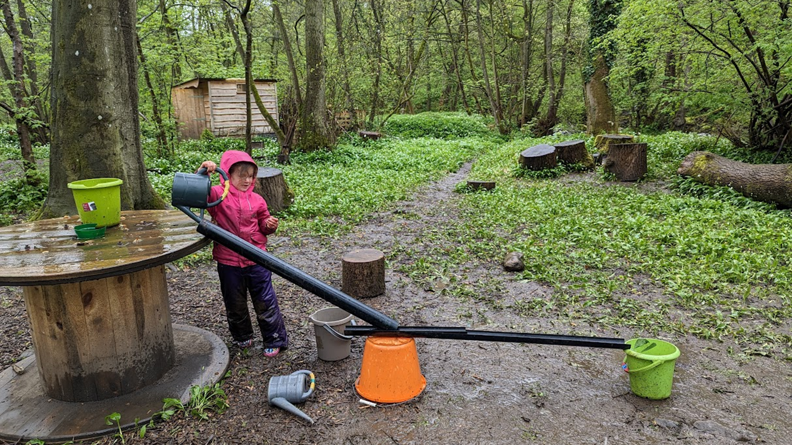
Pedagogy adapts to the learner.
Notes:
LS – JH annotations
This is beautiful example of outdoor learning - in the first explaining of this, Jen actively actively noticed the application to practice demonstrates inclusive principles
Fundamentally - Pedagogy adapts to the learner. METAPHOR for inclusion – not just practice – inclusive practice principles – active noticing
Meaningful participation
Finding a ‘way in’ – ensuring accessibility and recognising barriers
Person-responsive practice in different places
Anticipatory practice that accounts for different starting points
Recognition of diversity, celebration of difference
Adaptive Critical Pedagogy (Sors, 2025)
Place is provocation which holds a potential challenge - (scenario, place, space and equipment), has been set out by the adult.
Green bucket – goal and expectation –The child has decided that they want water to flow into this bucket – the adult steps back. Invite a questions – what might your learners’ green buckets be?
Orange Bucket – solid support – safety and belonging, supporting practice – this has been chosen by the child out of all the other things they could have chosen, this is the one they know will work the best from the selection laid out from the adult, (Co-construction – we offer options, information, we collaborate). What are the choices that your learners make for the supports?
Pipes – pedagogy – again, the child has had a choice in how they are positioned and has placed them themselves, with support from the adult in the right place, at the right time. This forms the scaffolded structure through which the water (action and learning) will flow. What support choices can your students make for themselves? What may you choose to put to them as scaffolds?
What are the scaffolds that they need? What might their orange buckets look like?
Watering Can is the knowledge and understanding – this holds action, informs the ‘pipes of pedagogy’ – notice the discarded watering can on the floor – this is now empty and has been replenished and renewed with new ideas
Water – (action or learning) – this comes from knowledge and understanding is dynamic and flows through practice, responding to practice and how it is positioned. If practice is not adequately supportive, the water will spill out, the support may shift or the water will flow in the wrong direction. It only flows because of the interrelationships between body and place, learner and scaffold, but … what would happen if, the pipes hadn’t been positioned? What would happen if it were a different bucket? What if the child wasn’t motivated enough to pour the water into the bucket? What would we do about it?
People – two people, the photographer (adult) and child – the child is taking ownership of how learning takes place, the adult has provided the scaffolds and pedagogy – however it is the child who has positioned themselves in relation to their goal. The adult is actively noticing the situation and will offer additional support and adapt practice – the pipes – as needed. We also notice success, celebrate problem-solving. Together we will reflect on ‘what worked’ and why to take forward into our next challenge – perhaps with different pipes.

Slide 14
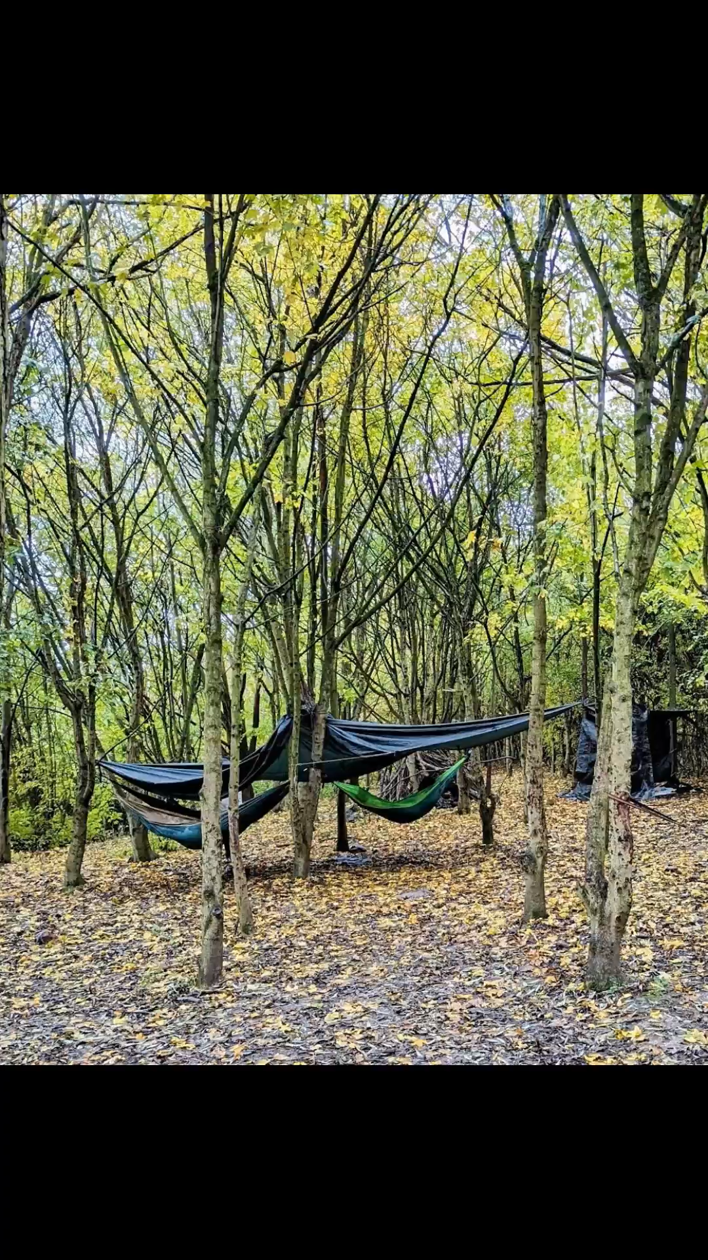
Collaborative and responsive curriculum design in HE
Impactful, memorable learning experiences
Developing ‘personal teaching philosophy’
Challenges familiar indoor teaching strategies to bravely explore wilder realms of discovery.
Go beyond the curriculum to advocate for alternative approaches to education.
Pushes the “pedagogical possibilities of (re)imagining and practicing a sense of space in experiential learning” (Payne & Wattchow, 2009, p.24).
Notes:
JH and LS
How we’ve put all of this into an evolving module
We are advocates for a curriculum design in ITE that is formed through collaborative approaches and demonstrates how experiential and authentic learning experiences can be effectively interwoven with study in Higher Education.
Recognise and deal with ‘unknown unknowns’.
We want our student teachers to have teacher agency & ownership in classroom & to have the confidence and flexibility to go beyond the curriculum. Outdoor learning is an example of this and allows for Impactful, memorable learning experiences both for our student teachers but also for the children who they will go onto teach in the future.
We encourage our student teachers to reflect upon their own personal teaching philosophy, to consider what is important to them as a teacher and what they will become advocates for in their own practice.
This aligns with UCET's paper on the intellectual base of Teacher Education. UCET values teacher education that works within a model of professional collaboration to produce teachers who are:
competent and confident professionals who recognise and understand that educating is a professional, thoughtful and intellectual endeavour. They learn from research, direct experience, their peers and other sources of knowledge.
epistemic agents, who act as independent thinkers, recognising that knowledge, policy and practice are contestable, provisional and contingent. As such, teachers search for theories and research that can underpin, challenge or illuminate their practice.
able to engage in enquiry-rich practice and have a predisposition to be continually intellectually curious about their work with the capacity to be innovative, creative and receptive to new ideas
responsible professionals who act with integrity and recognise the social responsibilities of education, working towards a socially just and sustainable world.
Intellectual Base of Teacher Education report (updated February 2020) | UCET

Slide 15
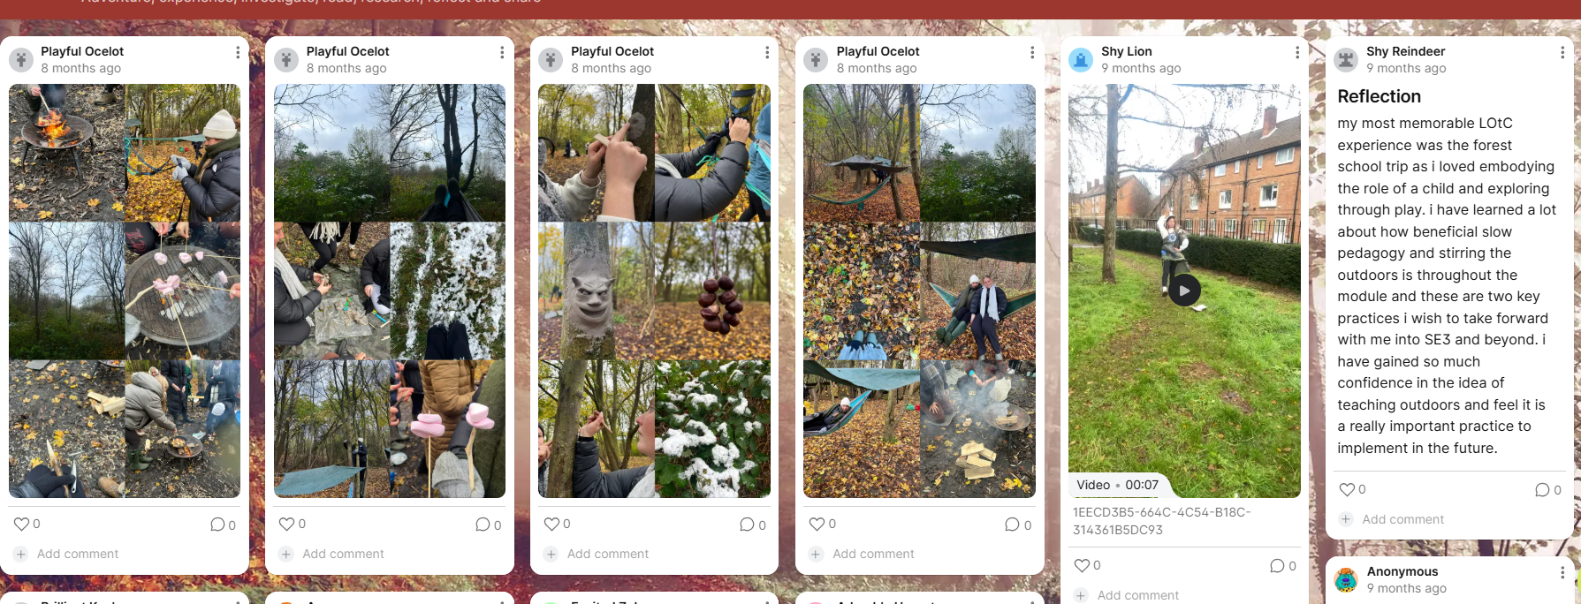
Authentic and responsive curriculum design
Open pedagogical approaches foster a range of responses as student-teachers explore theories, perspectives and worldviews
Module has evolved through interaction and response.
Student choice and ownership
Genuine, connected pedagogies
Self – world - community
Authentic experiences connected to working lives of teachers.
Notes:
LS
Creation and Evolution of the Module – different temporal and spatial plane, which demonstrates students corporeal responses in real-time
Show and scroll through the Padlet – narrate examples
Co-constructive approach to its formation has evolved through interaction and response.
student choice and ownership over their learning has been central to module design, providing examples of practice to exemplify student responses to teaching stimuli.
Genuine, connected experience is central in the workshops’ design and delivery as part of an ongoing process of embedding world-centred education (Biesta, 2021), through pedagogies that seek to reconnect learners with themselves, community and the world
Open pedagogical approaches foster a range of responses throughout the module as student-teachers explore theories, perspectives and worldviews (Beames et al, 2024, p.17).
Authentic experiences connected to working lives of teachers
As pedagogues, our shared values are driven by finding ways to support students in forming 'deep, personal, and emotional connections' to the locality through exploration and engagement with the local environment’ (Sobel, 2004), with our teaching methodologies emphasising first-hand, experiential learning that can be incorporated into daily practice as teachers.
A key aspect of this is the introduction of slow pedagogical approaches (Clark, 2022), fostering incidental learning and nature/place/people/self-connection opportunities, for example student-teachers gently rock in hammocks or whittle writing tools around a softly burning fire in the woods.
(Steph - Photos) Ownership of learning is evident in the array of interpretations of campus; some through the creation of ‘pigeon-eye view messy-maps’, others through Tik-Toks of ‘the journey of a snail’ in a micro-exploration of small spaces in familiar places. Further afield, student–teachers engage in the stimulus of a ‘Roman Tour of York’ to plan and deliver a microteach; an ‘approximation of practice’ (Grossman et al., 2009), to rehearse teaching skills in a low-stakes environment with their peers. Applying a range of pedagogical approaches in their city has led to joyful, playful encounters (Woods, 2017): a dramatic re-enactment of marching Roman soldiers in tortoise formation; a peaceful creation of a mosaic made from natural materials near York’s Roman ruins. Other experiences introduce student-teachers to OL and nature-connection, such as exploring the university allotment; designing outdoor spaces; ‘storying the outdoors’ river walks to uncover the secrets of fairies and an introduction to Forest School activities in a local woodland.

Slide 16
Research:
Student-teacher voice
Place
Learner
Person
Teacher
Authentic teaching experiences
Values
(gestalt)
Belonging and participation
Community of learning
Pace
Connection
Holistic and Inclusive
Personal knowledge
Experiential, embodied learning
Play
Responsive and adaptive
Reflexive
Staff and student-teacher perspectives gathered through interviews and critical narrative enquiry (Clandinin & Connelly, 2000)
Experiences are connected to place on different levels
Emerging as teachers
‘Level reduction’ Mindmap of the Outdoor Learning module. Taken from Sors, L. Huntsley, J. and Jach, S. (2025) 'The Next Generation of Learning Outside: Fostering Place-responsive Pedagogy in Initial Teacher Education' in Sors, L. and Unsworth, R. (Eds.) (2025). The BERA Guide to Outdoor Learning: Place-responsive Pedagogy in Educational Research and Practice
Notes:
LS – brings us onto our research which you can read about in Chapter 7 of the book
Introduce how we gathered student teacher voice
Narrative interviews with former student-teachers
Discussion included:
The module
Outdoor learning in school placements
Teaching philosophy going forward
Through joint thematic analysis, key themes emerged.
Lucy – discuss mindmap
This framework distills the connections that are developed by students interactively responding in different places they experience.

Slide 17
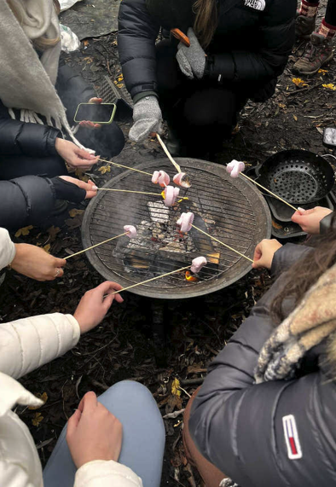
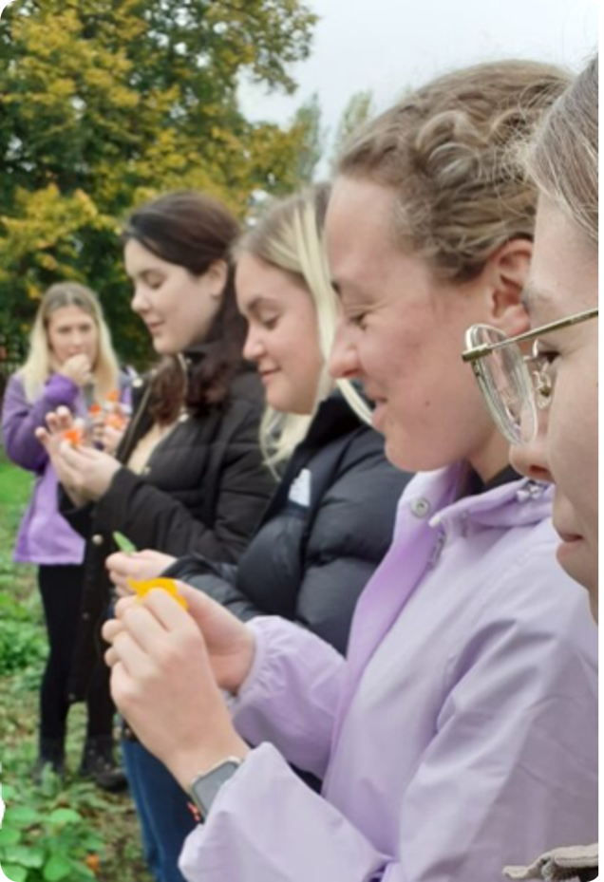
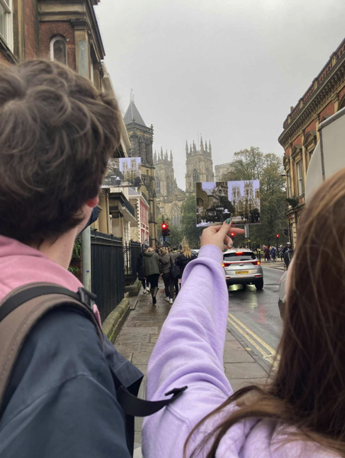
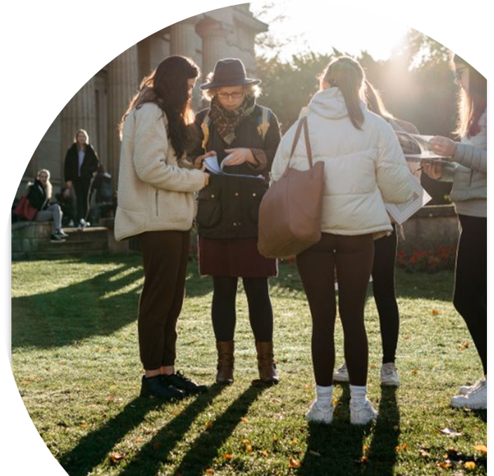
Embodied learning and sensorial connections
Learning about history by ‘going to a certain place....to stand where the Romans had once stood’.
‘She realised that we were interested so she was just, like give it a go. Try it! I like that flexibility’.
Notes:
Purpose: To demonstrate the need for OL in current educational & wider contexts
Underpinning throughout Place connection is beyond the present and involves interaction between different temporal and spatial planes.
Active responses between people and places facilitate metacognition and transversal skills development.
Responses are informed by critical engagement with place in the 'here and now' and in the 'there and then' (Biesta, 2021).
Asking critical questions and interrogating 'capital': Practice past – present – future – drawing on temporal and spatial journeys.
Mason's 'active noticing' developed in The Discipline of Noticing askes us to attune ourselves to the possibilities of experience, developing sensitivity and awareness of what is happening at any given time. This accounts for memory, sociocultural background and context, cognitive and affective responses, of connections and interactions between person – place – space – time – objects – context. This asks us, as teachers, to engage in responsive active noticing (Mason, 2002) Foss Fairies – noticing the responses of student-teachers and fostering creativity as response to place.
In place-responsive pedagogy, we look at how these 'happenings' transcend place and time, to inform how noticing a possibility in the present moment, reflecting back on what has been noticed, or known, before in order to prepare for the future.
Lived experiences of students support development of philosophy that is socially, culturally and environmentally aware.
Pedagogy of place – Biesta – ‘key pedagogical approaches – education has to take place in the here and the now’ (Contrast with Gruenwald -critical approach -decolonisation through history and geography e.g. Constantine)

Slide 18
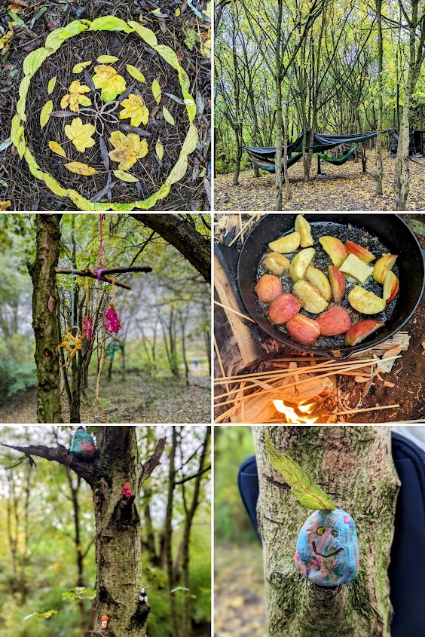
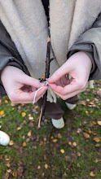
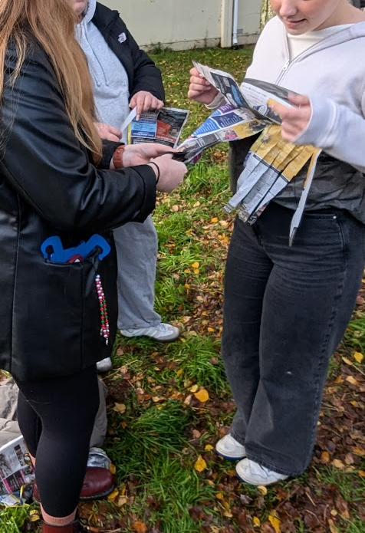
Collaboration and connection within a community of learning
‘People implemented it all differently. ... I think it was a big aspect of the module, that you learn a lot from others’.
Connections had a ‘real long-term impact’ on student-teachers.
Notes:
Purpose
We want to share this with you now as part of an experiential insight into teaching and learning in the outdoors
Many student–teachers discussed the group ethos and how personal knowledge, passion and enthusiasm of facilitators had a positive influence on responses to OL. As you can see from the quote on the slide from one of our STs. Student–teachers participate differently (conceptually and experientially), encountering ‘a highly personal but social and ecological meaning-making and learning journey that slowly unfolds’
Student teachers experience outdoor learning (OL) on a corporal level - noticing their thoughts, feelings, and values about it.
Connecting with these experiences helps them understand themselves and the world better.
They are encouraged to feel connected with nature and places, not just to be in them, linking to ideas of ecological justice.
Storytelling and activities like exploring myths fairy houses and river ecology along a local river helped build this connection and create stories of placefulness(Witt, 2017).
(Payne & Wattchow, 2009, p. 28).
Connected with nature and places, not just to be in them (Payne & Wattchow, 2008).
Lily explained that ‘placemaking’ and nature-connection experiences would support children to grow into ‘adults who are more likely to be environmentally conscious’ with ‘real long-term impact’.
This demonstrates the importance of the social context for learning to take place, cementing a socio-cultural perspective within OL that views ‘understanding’ not as an ‘individual affair (...) but can be seen as being linked more closely to context and experience’ (Waite, 2017, p. 17).
As discussed earlier we don't want our teachers to feel those ontological insecurities but to be epistemic agents. We don’t want robots, we want responsiveness. Through OL we see learning at different levels this can come in many different forms, sometimes observable, sometimes a transition in beliefs.
.
Throughout the module, student-teachers have opportunities to engage with ‘micro-teaches’ – authentic practice that is planned and delivered by student-teachers to their peers to apply theory and practical skills in action. They may respond to ‘place’ explicitly, as on the Foss Fairy Trail, where student teachers engage in storytelling based on different fairy houses and spaces along the river. Narrating their stories has developed in different forms – poetry, prose, drama, mime and even rap. On the Roman tour of York, student teachers choose places to pause and engage with the Roman history of that place through different forms of teaching and learning. In the final session on the module, student-teachers plan and deliver a short CPD to develop outdoor learning in schools – this is targeted at teacher development and helps to support the development of their assessment – a creative artefact designed to advocate for Outdoor Learning in schools.

Slide 19
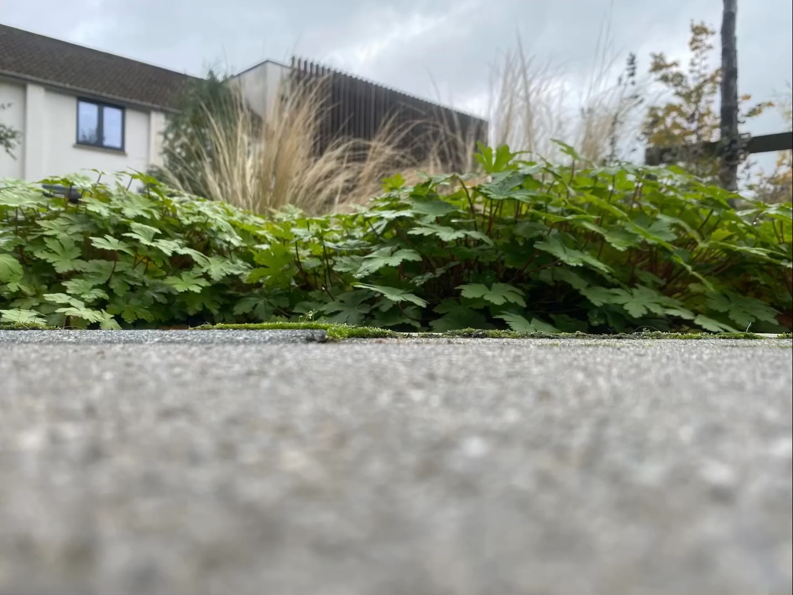

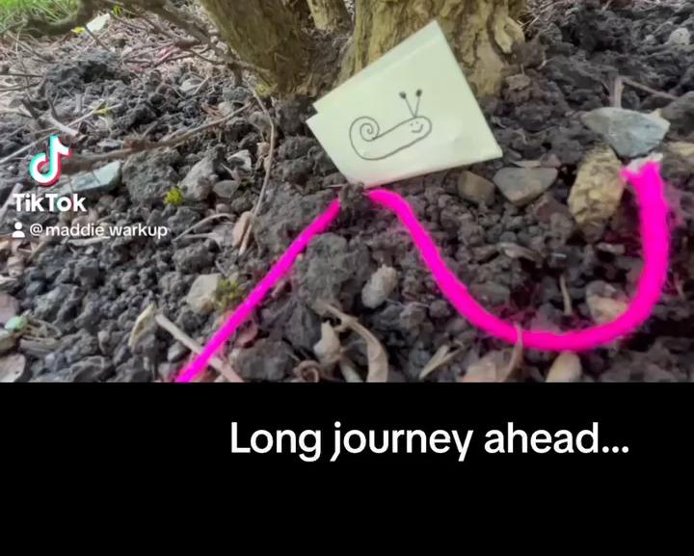
Micro-exploration – perspectives of a snail
Notes:
TEMPORAL and SPATIAL
This is an activity from early in the module, in a workshop called 'The Pigeon and the Snail'. The aim of this workshop is to consider our shared place – YSJ campus – at different levels. We are 'gradually moving learning beyond familiar, immediate, intimate spaces, to places that could be distant and strange (Sobel, 2013)' (S, H & J, 2025, p.49)
Initially, we ask the student teachers to think carefully about mapping, creating their own 'messy map' of a nature walk they have experienced on the YSJ campus, led by other student teachers on the module. From this, we compare our maps, evaluating and interpreting the values of the map-maker, considering the educational possibilities in terms of experience, empathy and cognition.
Following this, we introduce the work of Payne and Wattchow (2009), and Clark (2022) to explore the notion of slow pedagogy. Clark suggests there are 'three interconnected themes that relate to slow pedagogies. The first theme is ‘Being with’ that relates to giving attention to the rhythm and pace of young children and the key concepts of listening and lingering. The second theme, ‘Going off track’, points to the valuing of the unexpected and children as ‘wayfarers’. The third related theme to emerge from these discussions about a slow pedagogy is the possibility of exploring in depth with children and adults, creating the time for ‘diving deep’ or ‘digging deep’ together.' (Clark, 2022, p. abstract of chapter 4).
This activity, which closes our workshop about our shared place, exemplifies ​encounters related to each of these three strands.
First, we all make a snail.
Next, we create a series of images or a video from the snail's perspective – we show the journey of the snail. This is what we'd like to ask you to do now, using your phones.
E.g: https://padlet.com/lsors1/lotc-2024-25-2d9mmcsytcmskytl/wish/MbejW1lpVJq3ZNkG
From workshop slide:
Application of ‘the urgency of slow’ (Clark, 2021) in principles and practice by providing time to absorb new knowledge
You will apply enquiry and mapping skills from a different perspective – the perspective of a snail …
In this activity you will engage in ‘deep play’ (Tovey, 2017) to create a micro-adventure for a snail
Move away from the ‘pre-specified’ “learning outcomes” (Biesta, 2021)

Slide 20

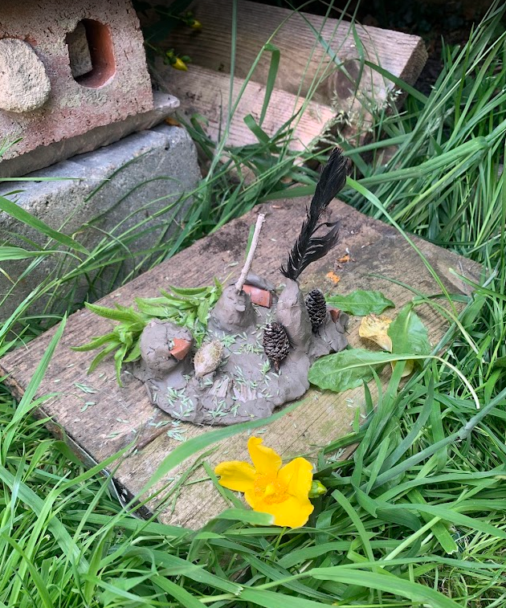
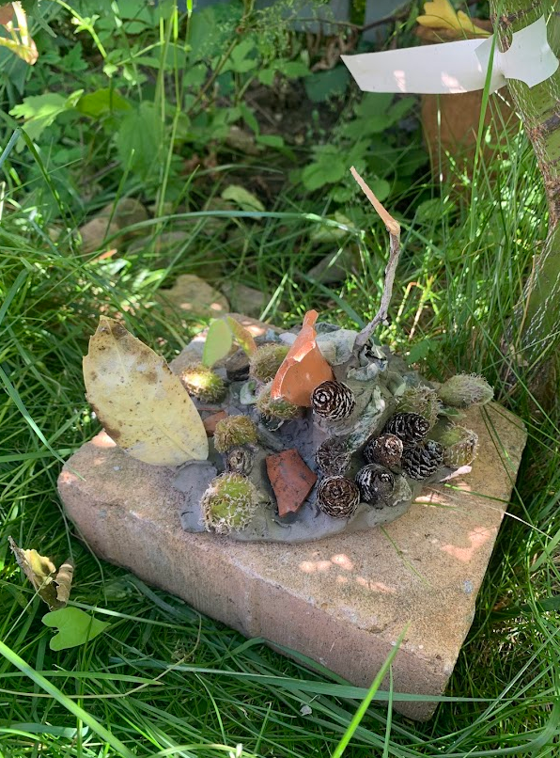
Being in a place
Sensory mapping
Place-responsiveness
Loose parts
Meaning, continuity and interaction
Meaning is co-constructed through dialogue and participation in and with social, natural and cultural environments (Hunstley, 2026)
Notes:
CORPOREAL and SPATIAL
With a partner​ or by yourself, gather natural materials. Work in small groups to create a map of the space.
Reflection: compare maps across groups – what are the differences and similarities? What did you notice and why, and how did you notice it? How did people respond differently to place?
Notice how diverse responses are celebrated through place responsiveness.
Loose parts play is a key part of Early Years curriculums that encourage curiosity, exploration and creativity. We link this activity to inherent human exploration of the natural world – as we return to ‘elemental play’ (woods) that combines sensorial, corporeal, emotional and social responses through an experience. Early years theorists such as Froebel, Montessori, Steiner and highlight the importance of sensory play, using loose parts such as mud, sticks, and leaves, as a way of helping to promote young children’s understanding of the world, mathematical and literacy development as well as their emotional health and well-being. The architect and theorist Simon Nicholson noted that ‘purposeful tinkering’ through transforming items like sticks, stones, leaves, and mud, help children develop imagination, construct new ideas, and explore possibilities in a dynamic, self-directed way.
This activity therefore has no predetermined purpose – instead, we encourage you to explore imaginative worlds through the materials you may find in the forest. You may choose to construct, build or plan something. You may explore creative avenues of art, role-play, poetry or music … perhaps, with these treasures found in our local forest, you may explore other, more abstract concepts such as number or critical thinking about something else. Please use these loose parts to experiment, make choices, and solve problems, and consider how they may lead to deeper thinking and new concepts

Slide 21

Beach floor
Exploring the possibilities of episodic and semantic memory. (Tulving, 1972)
Interact and explore with each treasure.
What do they ‘mean’ to you?
What words, ideas, questions are triggered by your ‘mental thesaurus?
What memories do you associate with?
Explore details from memories of past events to design your own pebble memory.
Notes:
CORPOREAL and TEMPORIAL
Individual responses to different stimulus are activated by a range of factors that might be intangible or difficult to describe to others. The fields
of psychology and neuroscience can inform what is happening as our brain responds to any given experience, object or interaction. Beyond the
‘live’ experience of a place, mental imagery spans across the senses and transcends space and time, as we switch between past and present encounters. We access, form and retrieve the temporal–spatial details from different memories of specific past events; our episodic memory (Tulving, 1972). This can be triggered by a place, object, or sensory experience, drawing on past experiences and creating meaning – or, as Tulving terms it, a ‘mental thesaurus’; our semantic memory (Tulving, 1972,p. 386). During this conference, you have all had different, unique experiences. This activity provides an opportunity to interact with objects you may find here on the beach, to consider your semantic memory (your ‘mental thesaurus’) around these objects as well as the episodic memories that may be attached to them. Once you have done that, either as an individual or a shared activity, we invite you to take the opportunity to record an episodic memory on a pebble to take home with you. This could be an episode from the past, present (i.e. BERA 2025) or even an imagined episode, spanning into the future.

Slide 22
Reflection and discussion
What strengths and contestations arose for you, experiencing these ideas in practice?
How might these ideas inform your own practice?
Place-responsive pedagogy
Slow pedagogy
World-centred, sustainable education
Collaborative, responsive curriculum design
Accessibility and inclusion
Authentic and experiential learning
Notes:
BODY _ TIME_ SPACE - COMMUNITY
BUCKETS and PIPES – ACTIVE NOTICING
Critical discussion around the strengths and contestations of theoretical frameworks presented; opportunities and barriers to translating theory into practice; implications for teacher education and implications for individuals’ personal knowledge
From original slide;
Critical discussion ideas:
Outdoor Learning and place-responsive pedagogy
Application to practice
Strengths and opportunities
Barriers and contestations
Implications for teacher education
Personal experiences
ALLOW 10 MINS

Slide 23
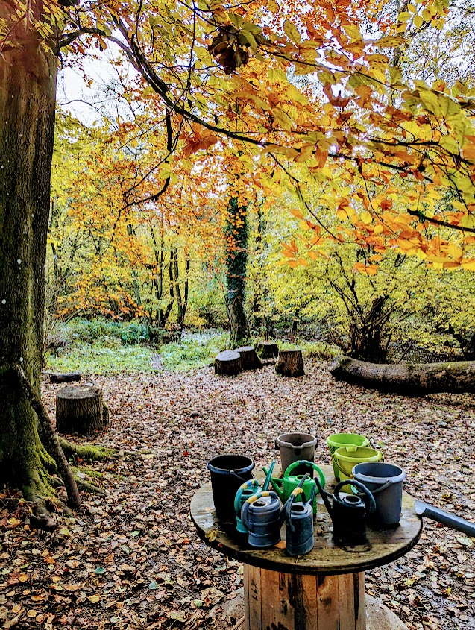
Inclusive, Responsive and Adaptive Practice
Working at students' own pace: ‘it’s about responding to the needs of children and allowing...[them] to build their own learning and understanding. That’s inherently inclusive because you’re meeting the needs of that child’.
Reflexive practice to provide ‘opportunities for children to be more central in the learning, so that you can be more child-led and listen to what the children are telling you’.
Notes:
Take a bullet point each – Louise, Steph then Lucy
Louise
Student–teachers develop a strong understanding of ‘context specific, tailored approaches’ and adaptively respond to learners (their peers) with meaningful interactions.
Underpinning this are holistic and inclusive values
Eve reflected on the importance of student–teachers working at their own pace and recognised that this would be particularly helpful for pupils with special educational needs and/or disabilities (SEND).
Lily concurred, explaining ‘it’s about responding to the needs of children and allowing...[them] to build their own learning and understanding. That’s inherently inclusive because you’re meeting the needs of that child’.
Steph
Emily discussed the benefits of OL for pupils with English as an additional language (EAL). In her teaching practice, she supported pupils with EAL to explore a woodland area, prompting them to communicate with peers and integrate new vocabulary. She noted how outdoor, experiential learning afforded more opportunity for collaboration and argued that experiential approaches were a better way to develop language skills than more abstract methods such showing pupils pictures and words in the classroom. This had been effective because ‘they needed the physical connections’, encountering vocabulary in real world contexts and learning with and from others through meaningful experiences and engagement with the natural world.
Lucy
Lily explained the importance of adapting practice to provide ‘opportunities for children to be more central in the learning, so that you can be more child-led and listen to what the children are telling you’.
This enables pupils to explore the world in their own time at their own pace to their own level but also highlights the importance of teachers ‘stepping back’ to support children to develop their own responses to the world around them

Slide 24
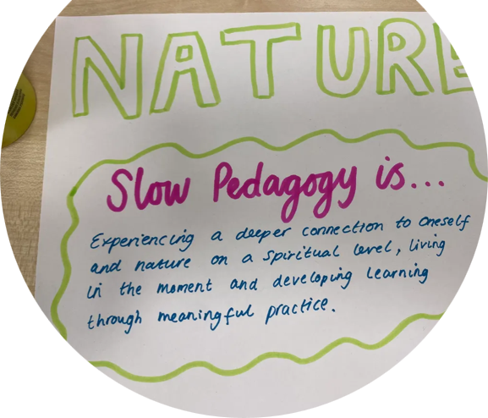
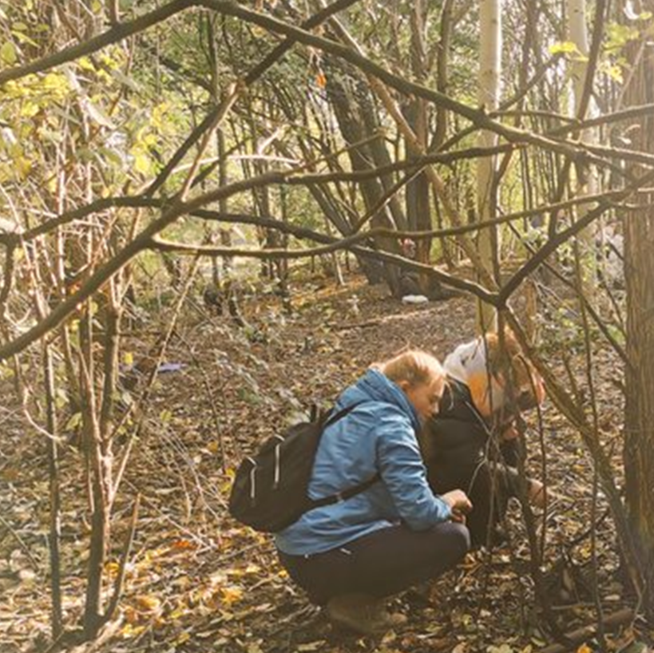
Transformative values
Pupils should be taken outside “repeatedly and constantly”
“It’s about the depth and making sure that each child understands and accesses the learning so they can build at their own pace.”
“magical moments”, becoming “engrossed in the environment and noticing smaller details.”
“I know for a fact that I’ve now got a lot of Roman knowledge that I’m just not going to forget because I’ve got ownership of that knowledge and that activity.”
Notes:
Steph – student voice – what students said
Repeated outdoor visits help pupils develop strong relationships with places by focusing on their interactions in and beyond those spaces.
Person-place connections - Feeling comfortable in a place and having a deep engagement over time leads to ‘noticing’ small details and having ‘magical moments’ of deep engagement.
Cumulative experience, together with reflective practice on experiences that are new and different can result in ‘a drastic re-appraisal of what we think we know’ (Waite, 2017). In this sense, student–teachers experienced transformative processes both on a personal level and as developing professionals
Student teachers developed meaningful relationships with outdoor learning which supported their personal knowledge and allowed them to explore at their own pace, take ownership, and dive deeply into topics that interested them.
They enjoyed creating their own activities and following personal learning journeys.
Activities like gardening, writing, and microteaching helped connect personal feelings, research, and subject knowledge into long-term memory.
This personal knowledge influenced their developing identities and teaching philosophies.
Read last quote

Slide 25
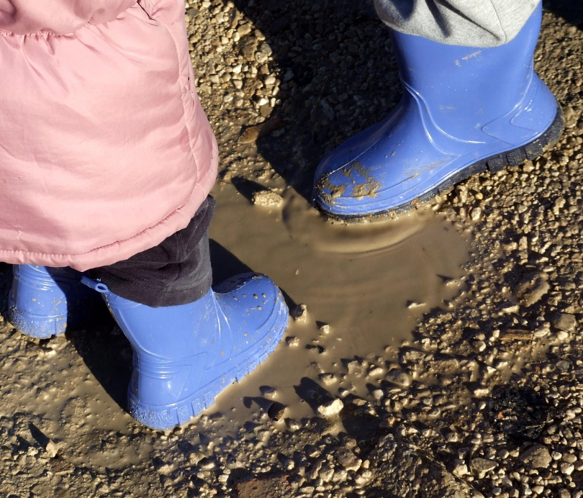
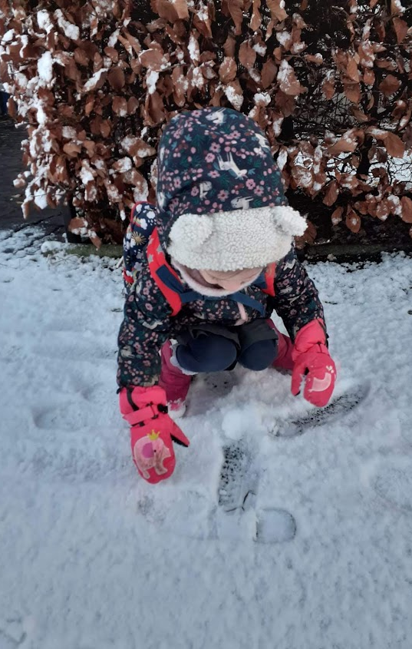
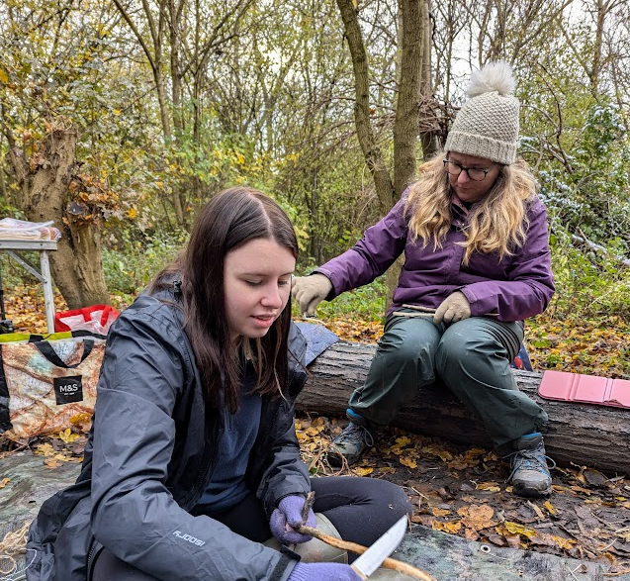
Reflexive and authentic practice
Ownership and empowerment
Risks, resilience and responsiveness
Experiential, slow pedagogical approaches
Fostering curiosity
Authentic teaching
Overcoming barriers and limitations in practice
Children were ‘looking out of the window longingly’ at the snowfall
Notes:
Student–teachers reflected on how using the outdoors put into practice the principles, theory and philosophies they had developed through the module.
This including taking risks, developing resilience and being responsive to ‘in the moment’ opportunities, to allow this time through slow pedagogical approaches. This aligns with research by theorists in child development, such as Froebel, mentioned earlier, who emphasises the importance of active play, communication and exploration. Researchers argue that young children should be encouraged to explore their world in a range of indoor and outdoor settings and should have ownership of their own learning.
Emily discussed a science lesson for a Year 3 class, using free-flow investigation of soil outside.
She felt that the topic of soil could be quite ‘boring’ when taught via slide decks in the classroom, but an experiential, slow pedagogical approach outdoors engaged pupils.
She described how pupils made connections and explored which types of soil made the best mud bowl, which absorbed the most water and which was the best to paint with.
Children were allowed time to become absorbed in the activity and explore different possibilities beyond those defined in ‘schemes of learning’ or mandated curriculum outcomes.
An immersive, curiosity-driven approach resulted in ‘intense motivation’ through which pupils demonstrated ‘flow’ and drive to deepen their learning
Student–teachers illustrated examples on how valuing discovery and play had a positive impact on pupils’ social and emotional development and wellbeing.
One student–teacher explained how she came away from an indoor writing lesson to embrace heavy snowfall, responding to ‘children looking out of the window longingly’.
She fostered pupils’ curiosity by providing cups for them to collect snow outside and observed how they experimented and marvelled as it melted on return to the classroom.
FLOW – discuss how student-teachers become fully immerged in activities – e.g. Whittling
In these and other examples, student–teachers played a part in transformation and empowerment within educational settings, overcoming curriculum pressures.
Snow (last year's forest school – why ignore the snow).
Some universities won't allow forest school visits for student-teachers.
Interviews with student–teachers post school experience revealed barriers to OL which conflicted with the conviction of its benefits (gestalt) that they had developed through the module.
Agendas of performativity within set parameters of ‘success’ impacted greatly on student–teachers’ ability to enact OL in the way they aspired to.
Several discussed how academic pressures had a negative impact on them being able to spend time outside with their pupils.
Emily reported her class was thought to be ‘massively behind’ and that the school was under pressure from Ofsted. Consequently, there was a ‘huge push’ which centred on delivery of prioritised (core) subjects inside classrooms.
Lily described how her placement school followed curriculum schemes ‘very, very strictly, so there was no deviation’, with no possibility to adapt mandated lesson plans to OL.
Other barriers such as lack of teacher confidence, access to outdoor spaces, funding and lack of understanding of the value of OL by school leaders and teachers, were also mentioned as impacting on student–teachers enacting OL in practice on school placements.
Time
Space
Structures
Place
Neo-liberal educational agenda
Macro constraint of the conference

Slide 26
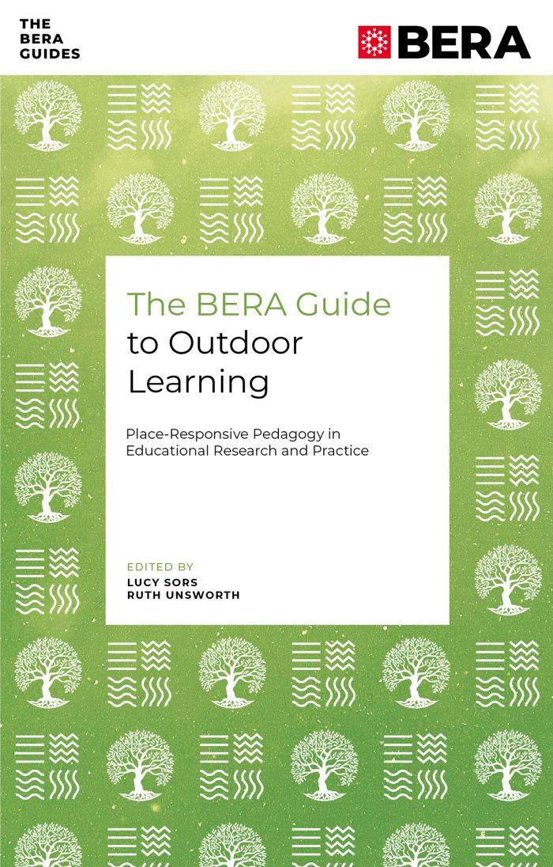

Where to find our research
The BERA Guide to Outdoor Learning: Place-responsive Pedagogy in Educational Research and Practice
Notes:
Explain that we’ve developed our work on LOTC/OL into the BERA book, then move on to the workshop objectives…
The BERA Guide to Outdoor Learning: Place-responsive Pedagogy in Educational Research and Practice reignites an educational focus on the role of place in outdoor learning. The book offers a timely and relevant response to contemporary societal, environmental and educational issues. It explores how outdoor learning can renew children and young people’s relationships with the world around them.
This collection demonstrates how place-responsive pedagogy can support diverse teaching and learning opportunities in all educational contexts from the Early Years to Higher Education.

Slide 27
References
Beames, S., Higgins, P., Nicol, R. and Smith, H. (2024) Outdoor Learning Across the Curriculum: Theory and Guidelines for Practice. Routledge.
Biesta, G.J.J. (2021). World-Centred Education: A View for the Present. Routledge.
Clark, A. (2021). Slow Knowledge and the Unhurried Child: Time for Slow Pedagogies in Early Childhood Education (1st ed.). Routledge. https://doi.org/10.4324/9781003051626
Dewey, J. (1938). Experience and Education. Macmillan.
Donison, L., & Halsall, T. (2023). ‘I’d rather learn outside because nature can teach you so many more things than being inside’: Outdoor learning experiences of young children and educators. Journal of Childhood, Education & Society, 4(3), 373–390. https://doi.org/10.37291/2717638X.202343281

Slide 28
References Cont.
Korthagen, F.A.J., Kessels, J., Koster, B., Lagerwerf, B., & Wubbels, T. (2001). Linking Practice and Theory: The Pedagogy of Realistic Teacher Education (1st ed.). Routledge.
Learning through landscapes, (2022). Teaching the Primary Curriculum Outdoors. Sage.
Patchen, A. K., Rakow, D. A., Wells, N. M., Hillson, S., & Meredith, G. R. (2022). Barriers to children’s outdoor time: teachers’ and principals’ experiences in elementary schools. Environmental Education Research, 30(1), 16–36. https://doi-org.yorksj.idm.oclc.org/10.1080/13504622.2022.2099530
Payne, P.G., Wattchow, B. (2009). Phenomenological Deconstruction, Slow Pedagogy, and the Corporeal Turn in Wild Environmental/Outdoor Education. The Canadian Journal of Environmental Education (14).
Rawlings Smith, E., & Pike, S. (Eds.). (2023). Encountering Ideas of Place in Education: Scholarship and Practice in Place-based Learning (1st ed.). Routledge. https://doi.org/10.4324/9781003386162
Sobel, D. (2013). Place-based Education: Connecting Classrooms and Communities. Routledge.
Sors, L. & Unsworth, R. (Eds). (2025). BERA Guide to Outdoor Learning: Place-responsive pedagogy in educational research and practice. Emerald.
Waite, S. and Pratt, N. (2017) Chapter 1: ‘Theoretical perspectives on learning outside the classroom – relationships between learning and place’, in Waite, S. (2017) Children learning outside the classroom: from birth to eleven. 2nd edition. Sage.

