Slide 1
Citizens Not Tourists: Place-Based Pedagogy in Primary Initial Teacher Education
A profound connection between a sense of history and a sense of place underscores the essence of place-based pedagogy. This approach integrates learning with local cultural, environmental, and historical contexts, fostering a deeper attachment to one's community and heritage (Gruenewald, 2003; Smith, 2002).
Place-based pedagogy aims to cultivate stronger communities by nurturing a sense of place and belonging (Smith, 2002). For student teachers navigating new and unfamiliar environments, developing a sense of place is crucial. This presentation explores how primary history education can foster a sense of place for both student teachers and the primary pupils they instruct.
We will present case studies from our initial teacher education program, demonstrating how we support students in forming 'deep, personal, and emotional connections' to the locality through exploration and engagement with the local environment, emphasizing first hand, experiential learning. Additionally, we will discuss the incorporation of student-teachers' lived experiences and histories, recognizing the value of their cultural capital (Smith, 2002; Gruenewald, 2003).
The session will also address strategies for effectively supporting primary teachers in utilizing their immediate surroundings to teach history, geography and the wider curriculum, ensuring that both student teachers and pupils develop a meaningful understanding of their local heritage.

Slide 2
Citizens Not Tourists: Place-Based Pedagogy in Primary Initial Teacher Education
Professional Values
Practice
Theory
Steph Jach, Lucy Sors and Jen Huntsley
Notes:
JH:
A profound connection between a sense of history and a sense of place underscores the essence of place-based pedagogy. This approach integrates learning with local cultural, environmental, and historical contexts, fostering a deeper attachment to one's community and heritage (Gruenewald, 2003; Smith, 2002).
Why have we called our presentation C not Ts? This reflects our aim that we want our students to feel like they are a part of YSJ, a part of the story of York – they are not passing through, they have a sense of belonging and connection to this community.
We're talking about how we used PBP to create a sense of belonging for our student teachers in primary ITE.
The three of us began working together on an Outdoor Learning module for our 3rd year BA Primary Education students, where one of the things we think about is how to teach the curriculum outdoors.
Steph and I also work with the first and second years to teach history, and Steph teaches a module to our Level 3 foundation year students about historical contexts of education, childhood and counselling.
So between us, we're fortunate enough to work with some of our student teachers over four years, and we've developed an approach where we use place based pedagogy to both build their sense of belonging, and hopefully enable them to do the same for their future pupils. This presentation explores how primary history education can foster a sense of place for both student teachers and the primary pupils they instruct.
The session will address strategies for effectively supporting primary teachers in utilizing their immediate surroundings to teach history, geography and the wider curriculum, ensuring that both student teachers and pupils develop a meaningful understanding of their local heritage.
This work all began with our professional values, which we shared and used to inform our practice. From this, we then situated our practice in theory, and we'd like to share this with you now to prompt thoughts and ideas that might relate to your own values and teaching practice.

Slide 3
The Value of Belonging
“Inclusive institutions will build cultures which positively foster a strong sense of community and belonging." (Inclusive Education Framework [IEF] https://www.inclusiveeducationframework.info/framework/community-belonging/)
Belonging within a community supports students’ security, positive outlook, and increased sense of self-worth.
Engagement on an academic and a social level reduces likelihood of withdrawal
Notes:
LS.
The Inclusive Education Framework includes ‘community and belonging’ as one of the key 5 strands of effective inclusive practice in Higher Education.
As pedagogues, our shared values are driven by finding ways to support students in forming 'deep, personal, and emotional connections' to the locality through exploration and engagement with the local environment’ (Sobel, 2004), with our teaching methodologies emphasising first-hand, experiential learning that authentically reflect the working lives of teachers.
We consider the incorporation of student-teachers' lived experiences and histories, which recognises the value of their cultural capital and supports a sense of belonging.
A sense of belonging has also been demonstrated to be positively associated with student motivation, and academic success. It supports them to feel part of a community and invokes feelings of security, positive emotions, and increased self-worth
Additionally, research findings indicate that Students are less likely to withdraw from programmes or leave if they are engaged both on an academic and a social level; such engagement is motivated by feeling ‘part’ of something, feeling valued, and becoming part of a community.
Place-based education fosters resilience, creativity, and a sense of belonging, with approaches in which Culture, belonging and human behaviour pivot around place.
Feelings of 'disconnect' result in a lack of belonging = withdrawal or disengagement with community and university.
Place-based pedagogy aims to cultivate stronger communities by nurturing a sense of place and belonging (Smith, 2002). For student teachers navigating new and unfamiliar environments, developing a sense of place is crucial.

Slide 4
Place- Based Pedagogy (PBP)
Grounding learning in local cultural, environmental and historical contexts (Gruenewald, 2003; Smith, 2002)
Understanding your place in the local story (Beames and Ross, 2010)
Creating a greater attachment to local community and context (Nichols et al. 2016; Yemini et al. 2023)
Notes:
SJ
It uses the local environment as a starting point for learning.
‘situated’ in the unique local context. (Beames et al. 2011)
Aims to understand the story of the local area . (Beames and Ross, 2010)
Considers how we can connect the curriculum content to the unique stories of the place.
2. Engaging with local landscapes allows learners to explore and appreciate the unique cultural, historical, and environmental aspects of their communities,
this contributes to a deeper understanding of themselves and their place in the world.(Beames and Ross, 2010).
3. Fosters a genuine appreciation for your own environment & community..
Directly interacting with ‘place’ will foster an appreciation of, & care for the place and community
Students become custodians of their place.

Slide 5
Place Based Pedagogy in History
sense of place (Beames et al, 2024).
belonging and place-connection (Sobel, 2004; Beames et al. 2011)
stronger, engaged communities (Smith and Sobel 2010; Mannion, 2012; Waite, 2017)
cultural and 'world-centred' capital within 'transformative' practice (Bourdieu; Biesta, 2021; Smith, 2002; Gruenewald, 2003).
Notes:
SJ & LS
Sense of place -
Deep, personal, and emotional connection with a particular location through lived experience, cultural meaning, and engagement.
about understanding:
The history, stories, and people connected to a place
The values, meanings, and emotions associated with it
having students come to know ‘their places’ is the starting point for most meaningful learning .(Smith and Sobel, 2010 in Beames et al. 2011)
Leads to
Developing sense of belonging & identity (Sobel, 2004; Beames et al. 2011)
Leads to
Caring for your community & local environment (Sobel, 2004)
For teachers of primary history – developing empathy, emotional connection.
Responsibility to carry forward the stories of the places they are connected to.
Place-based-pedagogy is therefore aligned with contemporary educational theory which places value on connectivism, learner agency, communities of learning and adaptability to change – challenging neoliberal educational agendas which emphasise individual performativity.
PBP introduces responsiveness, risk and challenge; and supports students, teachers and groups to build resilience and resourcefulness in varying contexts (Beames et al, 2024).
It can therefore be considered as part of an alternative vision for the development of cultural and world centred capital, which has the potential to transform mainstream educational practice to redirect us to the process of education, which visualises teaching
as a variety of encounters between people, histories – past, present and future- and place.

Slide 6
PBP Approaches in Practice:
Exploring the local environment (Isreal, 2012)
First-hand, real-world learning (Waite, 2013)
Incorporates students lived experiences
Enriching
Interdisciplinary (Sobel, 2004; Gruenewald, Koppelman and Elam, 2007).
Notes:
SJ
Exploring the local environment . Learning that take place in local environment. Direct physical engagement (Beames & Atencio, 2008; Maeda, 2005; Rickinson et al., 2004; cited in Beames and Ross, 2010).
First-hand, real-world learning (Waite, 2013). Getting outside in the environment. It's not passive- you're experiencing things first hand. Direct interaction builds a sense of place (Sobel, 2004).
Experiential, active learning (Isreal, 2012; Waite 2013; Yemini et al. 2023) Encourages learners to investigate and question their environment. Why is this place like it is? Why is this place important?
Incorporating students lived experiences. As we did in our starter activity, we incorporate student-teachers own experiences. Our connections to place and personal histories are entwined.
Interdisciplinary (Gruenewald, Koppelman and Elam, 2007). Weaves local history, culture and environment together –seeing connections. History - the story of the land you are standing on (Sobel, 2004).

Slide 7
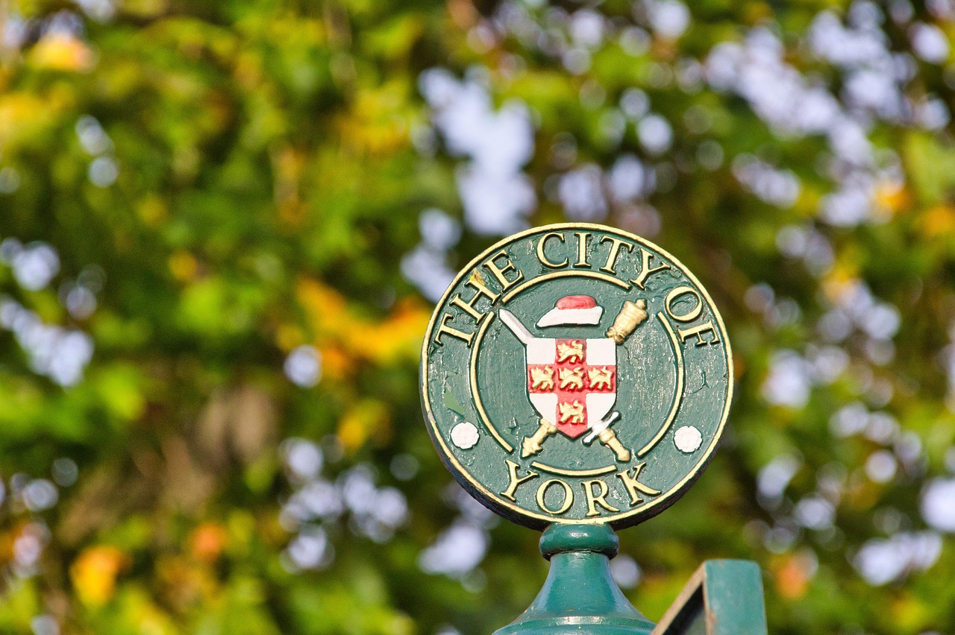
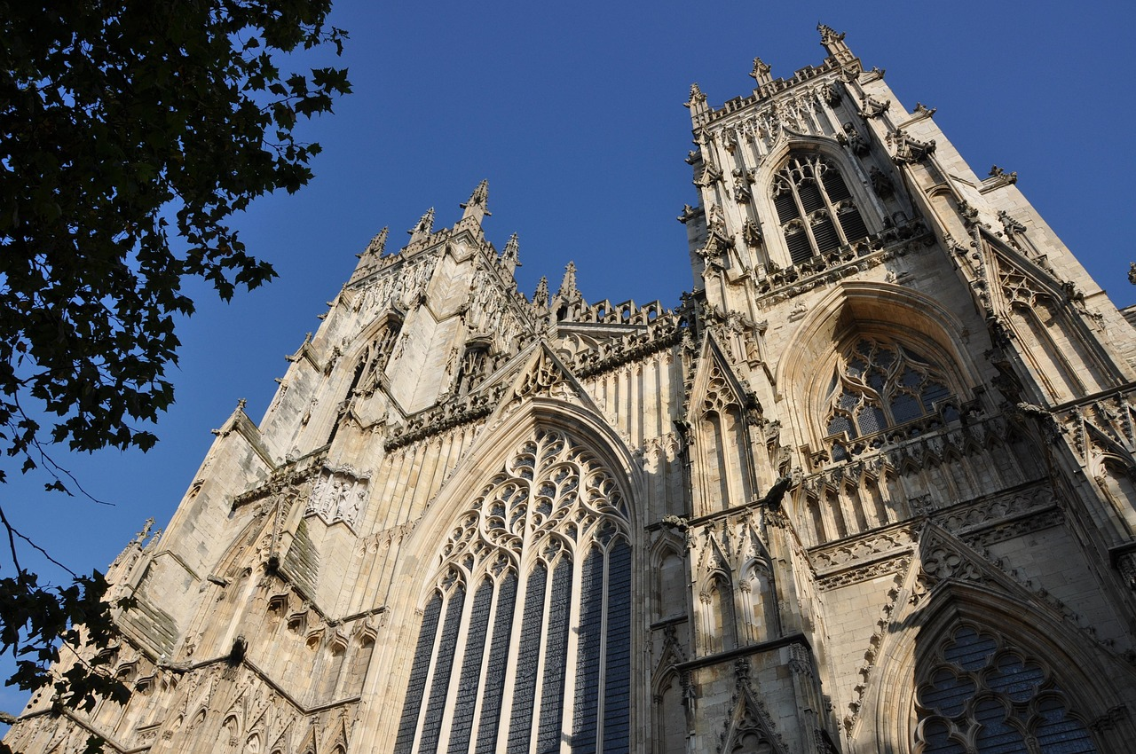
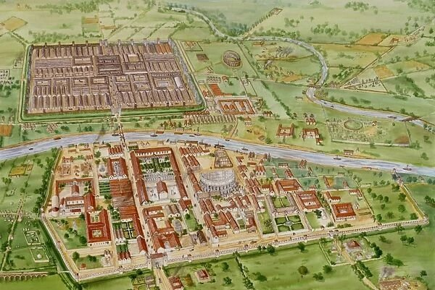
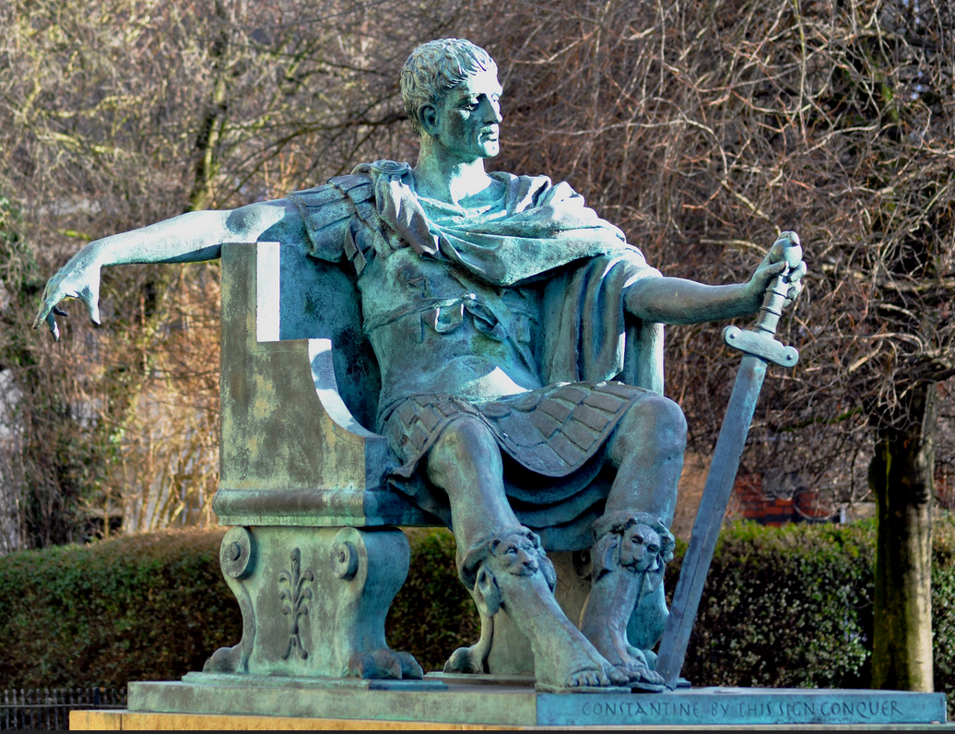
Practice
Foundation Year
ITE Y1
ITE Y2
ITE Y3
Notes:
SJ
What we do and why.
Case studies – exemplifying practice
Describing our teaching journey – thinking it’s a good thing – acting in line with our values then reflecting and understanding theory underpinning it. Theorising the practice

Slide 8
Foundation Year
Historical contexts of education, childhood and counselling
key aspects of York's history as a vehicle for exploring how education, childhood, family and mental health have changed over time
focus on York - an introduction to the city and YSJ’s place within it
Notes:
This module uses key aspects of York's history as a vehicle for exploring how experiences of, and attitudes to, education, childhood, family and mental health have changed over time. With a central focus on York the module will also provide an introduction to the city and the University’s place within it. You will consider cultural and social change, discussing mental health, wellbeing, leisure, family and community support and education. In addition, the module will look at how life for people has changed and consider the influence of Joseph Rowntree.

Slide 9
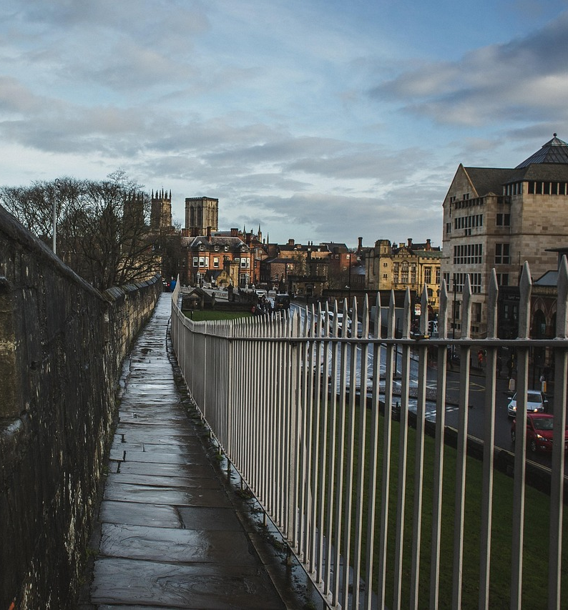
Foundation Year
Historical contexts of education, childhood and counselling
Rowntree family and social change (employment, poverty, housing, New Earswick walking tour)
education in York ( St Peter’s, the Bar Convent, Bootham School York School for the Blind, York St John)
mental health provision (the Retreat, the Tuke Family)
Notes:
Explore the local environment, Tangible, immediate First-hand & experiential
The Rowntree name is part of York’s civic identity — many local sites (schools, housing estates, community centres) reflect their legacy.
They are a powerful example of place-based social action — using local industry, philanthropy, and research to bring about national change.
Their story is a useful lens through which to explore Victorian and Edwardian social history, industrialisation, class, and the roots of the modern welfare state.
Key buildings, people and movements that illustrate how life for York’s people, children and families have changed over time:
Joseph Rowntree and his successors
The New Earswick community
Mental health provision from The Retreat onwards
Leisure and culture
The Workhouse
York industry: the railways and chocolate factories
Housing and census data
Local history groups
York St John archive
The history of York St John
Goddards
York library archives

Slide 10
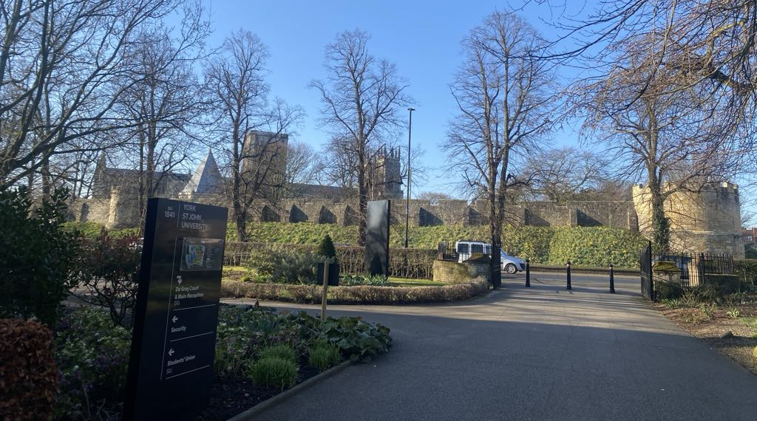

ITE Year 1
Wider Curriculum: History
York Minster Visit
Barriers to visiting – cultural distance
Immersive environment develops:
broader understandings of history
awe and wonder
understanding of significance
sense of meaningful connection
Notes:
Over 50% of YSJ students come from backgrounds traditionally underrepresented in higher education
Many students had never been to the Minster.
Barriers: Cost & sense of Cultural Distance ( Feeling that it is “not for them”)
Help student teachers develop broader understandings of history in this immersive environment and through this expanding their cultural horizons. (Hein, 1998; Hooper-Greenhill, 2007)
Stop, pause, look around. Sense of awe and wonder
Consider emotional response. Grounds students in the place and present moment
helps them feel the significance of the place
Deepens connections & begin to see the place as meaningful

Slide 11

ITE Year 1
Wider Curriculum: History
Relevant
Meaningful connection -belonging
Students to see themselves as part of the story of York Minster and York
Image: Graduation 2024 | York St John University
Notes:
The history of this site is 2000 years old.
It's still a working building and the story goes on.

Slide 12
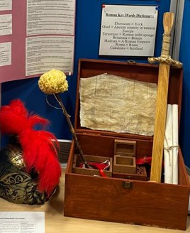
ITE Year 2
Wider Curriculum History
  EYFS: place, provocation & play
  KS2: British chronology Stone Ages – 1066
  Relevance and inclusion
  Authentic assessment
  Susan Isaacs’ use of ‘big ideas’ in learning environments which contain ‘rich treasure chests’ of exploration (Woods, 2017, p. 12)
Notes:
In the second year, we continue to build on the first year.
Our student teachers who specialise in EYFS learn how to teach KUW through place, provocation and play.
On the General Primary route, we prepare the student teachers to teach primary history in KS2. An important aspect of this involves developing a chronological undrerstanding of the history of Britain from Stone Age to 1066, which is something our student teachers often struggle with – this makes it relevant, in that it's what the STs need to know.
The City of York provides a powerful context for learning about the chronology of Britain, from its founding in Roman times, through Anglo-Saxon times into the Viking era. For example, we look at this map of Roman York and compare to the modern day place – e.g, finding the Minster, Betty's, and some of the pubs! This is part of our inclusive practice – it starts with what the STs already know.
The assessment for this module then mirrors the authentic work of a teacher, where they have to create resources and sequences of learning that support their teaching of the primary foundation subjects –here's a Roman time capsule that might have been found in York, made by one of our student teachers, which allows them to also demonstrate their understanding of learning theory – e.g., Susan Isaacs rich treasure chests.

Slide 13
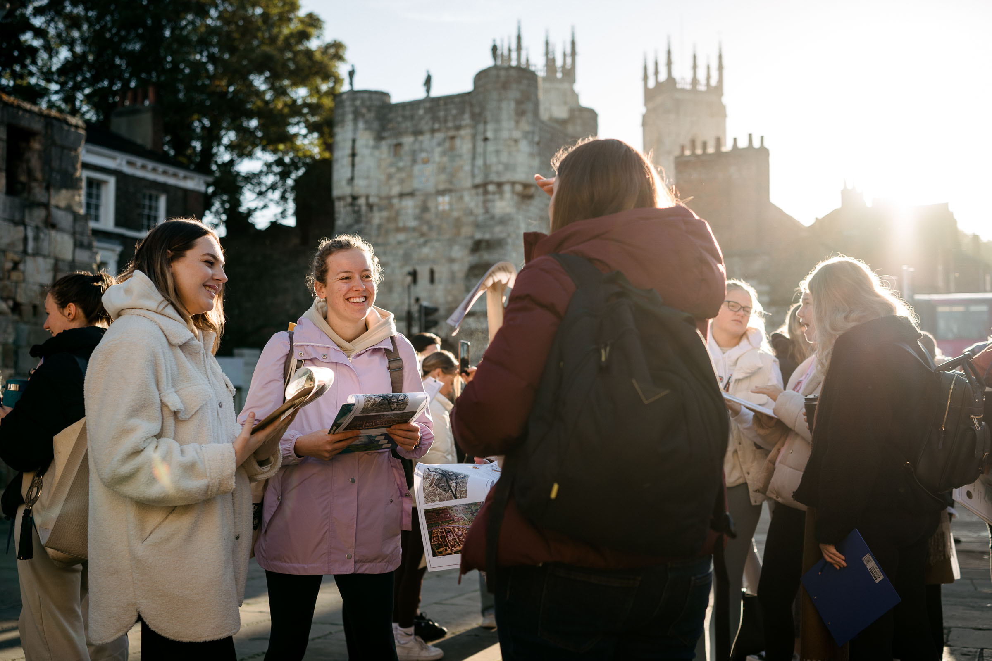
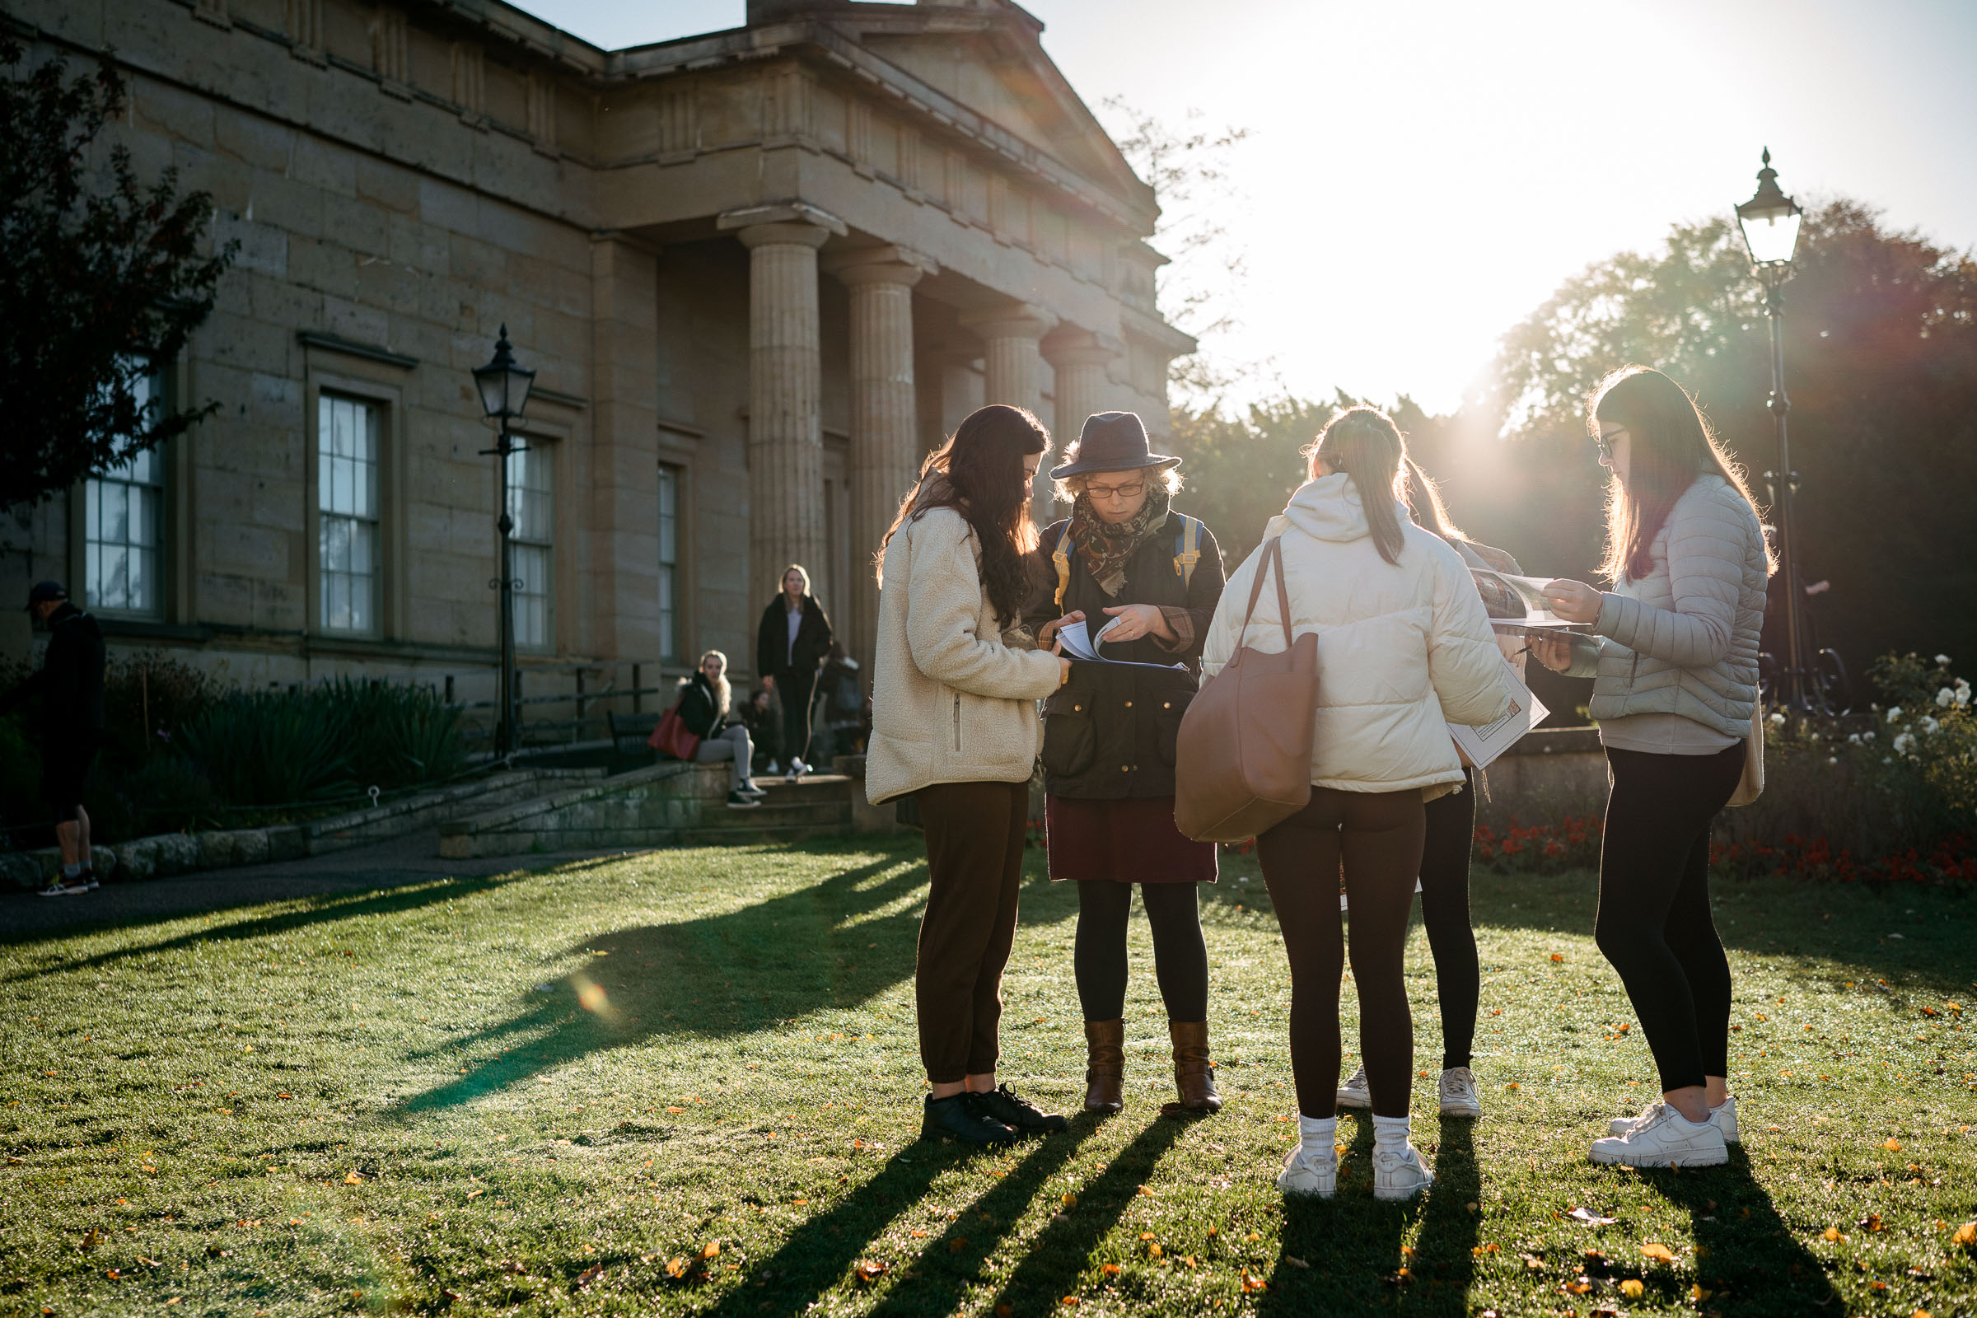
ITE Year 3
Elective module – Outdoor Learning (OL)
Roman trail - visit key Roman sites in York
Groups plan and deliver a microteach
Authentic context for learning - 'empowering educators' (Sobel, 2004)
Focus: significance of place, experiential learning, developing historical concepts
Notes:
Students to have to develop their place knowledge in order to teach this….
Concepts: enquiry, evidence, cause and consequence, significance

Slide 14
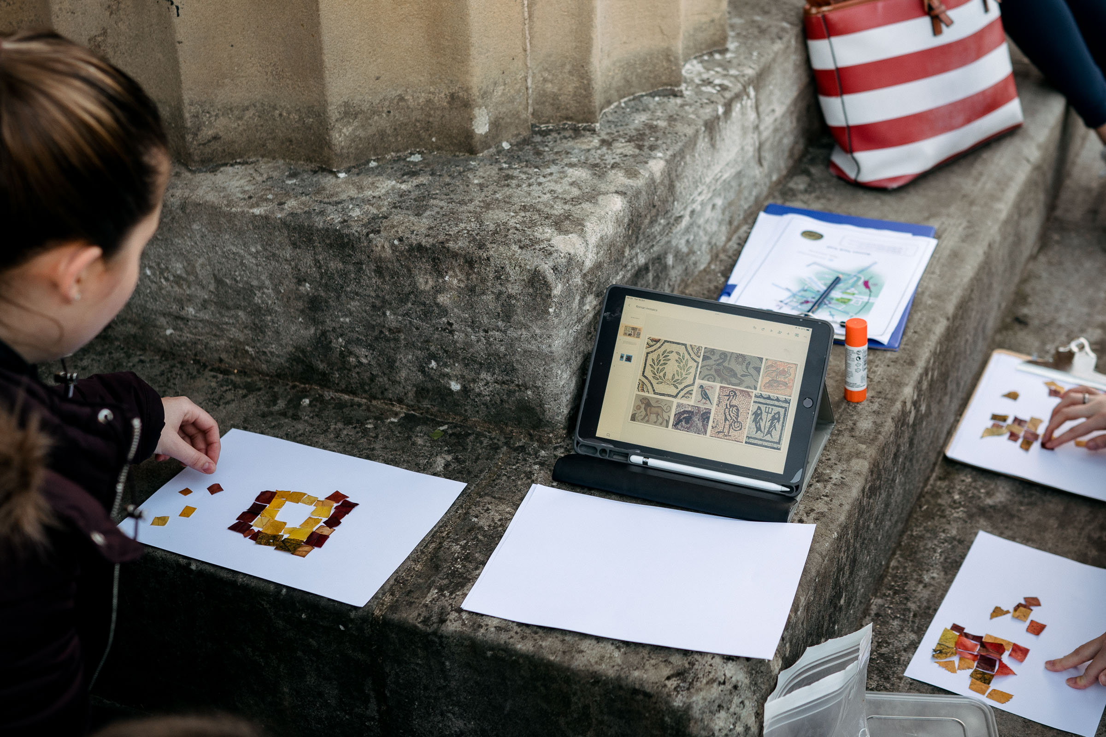
ITE Year 3
Elective module – OL
Roman trail examples:
Acting out Roman army 'drills' in the shadow of the multangular tower
Creating Roman mosaics using natural materials
Notes:
Explore the local environment - Tangible and immediate
First-hand, experiential, learning
Sense of place & belonging
Empower educators (Sobel, 2004)
Put trust in teachers. Empower educators. Teachers know their pupils and communities best so they should have freedom to adapt the curriculum and lessons to fit their specific context & use local resources (Sobel, 2004).

Slide 15
Wider Implications of PBP
"Place-essential" learning (Mannion 2012)
Experiential learning in whole curriculum
Wider skills development for sustainability and society:
    empowering learners with 'knowledge, skills, values and attitudes to take informed decisions and make responsible actions for environmental integrity, economic viability and a just society' ('Education for sustainable development', UNESCO, 2021, paragraph 1.)
Community, locality, world and beyond
Environmental stewardship
Transformation of educational practice
Notes:
LS
These slides have shown a journey of development of our student teachers – on a personal, community and professional level as they develop as teachers.
The big idea centres around developing pedagogy that supports them to develop connection to place and belonging, i.e. from foundation year and Year one, transformative, place-based practice that challenges disconnect and provides authentic contexts to develop social, cultural and professional educational and other capital.
We encourage them to step outside of their comfort zones to explore teaching and learning as ‘place-essential’. This approach goes beyond history, through repeated experiences, across the history and other aspects of the ITE curriculum, student teachers explore other ideas of place in education, such as field work in Geography, explorations in science, play-based learning in languages, forest schools, and other outdoor learning in other echelons of their university experience.
There is still the potential to PBP to play a role in other areas, however perhaps this is limited by common ‘barriers’ to PBP such as pressures of timetable, curriculum delivery, perceptions of risk and the paperwork of risk assessments and ‘safer’, well-tried and tested teaching techniques that keep within our comfort zones. However, experiential, Place-based learning can be taken across the whole curriculum, as we have done as Primary Teachers in our own schools.
From our experiences, PBP opens new possibilities of educational practice, and offers new perspectives on what can, and should, be valued in education. Within our delivery of a Broad and balanced curriculum – PBP can also support the development of wider skills for sustainability and society Transversal skills (UNESCO)
This takes learning – as a consequence of teaching – beyond the school, into the Community and beyond – e.g. In a Middlesborough school I visited last week, pupils were engaged in a project, involving a presentation to local community leaders, providing their ideas on how budgets should be spent to effectively transform places, encouraging innovation, creativity and problem-solving in school-aged pupils to address significant issues in their own communities. It is this attention to place, people and context, that genuine learning of how to care for our communities, localities and the planet can be enacted.
Education for Sustainable Development for UNESCO, (paras 1 & 2) is a life long learning process and an integral part of quality education. It enhances the cognitive, social and emotional and behavior dimensions of learning. It is holistic and transformational, and encompasses learning content and outcomes, pedagogy and the learning environment itself.
Student teachers thus develop the confidence, knowledge and skills to take PBP into practice. They take ownership of using place-essential approaches to teaching and learning, across the whole of the school-based curriculum by creating a treasure-chest of practice that their pupils will be able to access and benefit from.

Slide 16
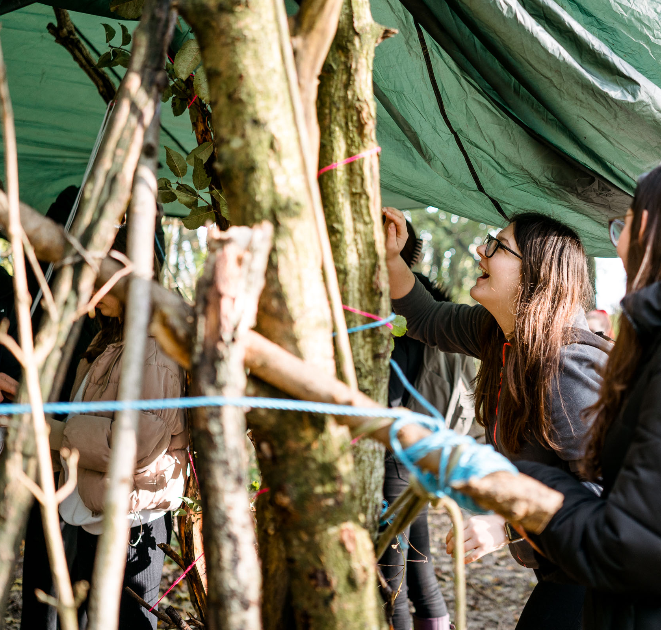
Transformative Practice
Student teacher autonomy, agency and confidence
Increased sense of belonging and connection to 'place'
Research at undergraduate and doctoral level
Deeper understanding of theory for students and lecturers
Notes:
What was our impact?
Student teacher agency and confidence. In our research, one of our students said 'how can we teach children to climb trees if we haven't climbed them ourselves?'. Our student teachers frequently share with us examples of how they've used place based pedagogies in their own teaching practice
Increased sense of belonging and connection to 'place' , both to previously unfamiliar places on campus, such as the YSJ Community Orchard, but also to the community of York, such as the Minster.
Research: student dissertation study – e.g., they’ve researcher children's place connection and how this effects their learning; Steph is basing her PhD research on PBP; we've written a book chapter about place-based and place-responsive pedagogies, which is published in a book that Lucy has edited and is released in September.
Deeper understanding of theory for students and lecturers – which led us to consider how we had come to gain this deeper understanding, as it has felt organic and practice-led.

Slide 17
A collaborative, place-based framework for theorising teaching practice
Explicit experiential theoretical knowledge and meta-reflection (Rolfe et al, 2001)
Reflection on action (Schon, 1983, 1987)
Tacit experiential practical knowledge (Rolfe et al, 2001)
Place: university, community, world...
Generative Critical Conversation (Huntsley & Brentnall, 2021)
Notes:
This was our journey to better understanding our practice. Collaboratively, we started with our implicit values & experiential teaching knowledge, largely based on our earlier careers as primary teachers. This influenced and informed our teaching, and through reflection, we came to understand how we might situate our practice in theory, and too, our own reflective processes. A key proces at each stage was engaging in critical generative conversations, where we both challenged each other and the theory, and generated deeper understandings of our values, which then influenced our practice. And we recognise that, in all of this, our conversations and practice, are situated in a specfic place, which itself influences educative possibilities.
We now consider ourselves to be in dialogue, with each other, with theory and our practice, and with the place in which we teach.

Slide 18
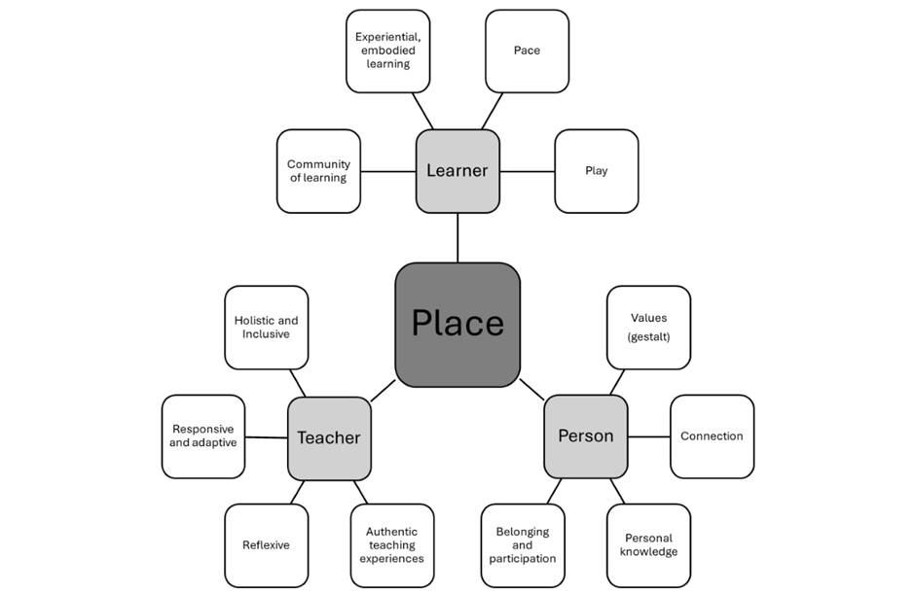
Place at the centre of learning
Research student-teacher voice
Experiences are connected to place on different levels
Emerging as a teacher
‘Level reduction’ Mindmap of the Outdoor Learning module (BA Hons Primary Education, Year Three). Taken from Sors, L. Huntsley, J. and Jach, S. (in print, 2025) 'The Next Generation of Learning Outside: Fostering Place-responsive Pedagogy in Initial Teacher Education' in Sors, L. and Unsworth, R. (Eds.) (2025). The BERA Guide to Outdoor Learning: Place-responsive Pedagogy in Educational Research and Practice
Notes:
Interviews Student-teachers experience learning on three different levels (person-teacher-learner).
This framework distills the connections that are developed by students interactively responding in different places they experience.

Slide 19
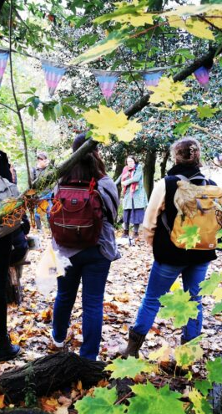
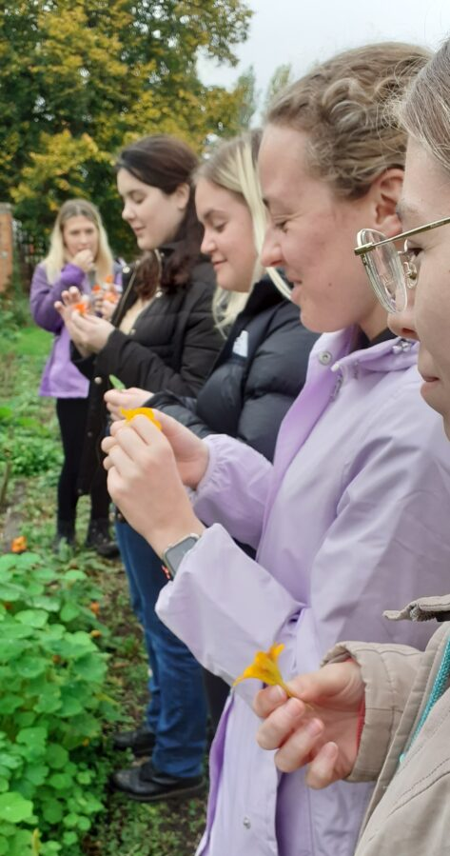
Place-responsive Pedagogy
Critical engagement in the 'here and now' and in the 'there and then' (Biesta, 2021).
'In the moment' responsive, active noticing (Mason, 2002) of connections and interactions.
Lived experiences of students in different places generates "making-meaning in, about, and for various environments" (Porter & Couper, 2021)
Inclusive and holistic approaches that respond to people and places (Sors, in print, 2025)
Notes:
Underpinning throughout Place connection is beyond the present and involves interaction between different temporal and spatial planes.
Responses are informed by critical engagement with place in the 'here and now' and in the 'there and then' (Biesta, 2021).
Asking critical questions and interrogating 'capital': Practice past – present – future – drawing on temporal and spatial journeys.
Mason's 'active noticing' developed in The Discipline of Noticing askes us to attune ourselves to the possibilities of experience, developing sensitivity and awareness of what is happening at any given time. This accounts for memory, sociocultural background and context, cognitive and affective responses, of connections and interactions between person – place – space – time – objects – context. This asks us, as teachers, to engage in responsive active noticing (Mason, 2002) Foss Fairies – noticing the responses of student-teachers and fostering creativity as response to place.
In place-responsive pedagogy, we look at how these 'happenings' transcend place and time, to inform how noticing a possibility in the present moment, reflecting back on what has been noticed, or known, before in order to prepare for the future.
Lived experiences of students support development of philosophy that is socially, culturally and environmentally aware.
Pedagogy of place – Biesta – ‘key pedagogical approaches – education has to take place in the here and the now’ (Contrast with Gruenwald -critical approach -decolonisation through history and geography e.g. Constantine)

Slide 20
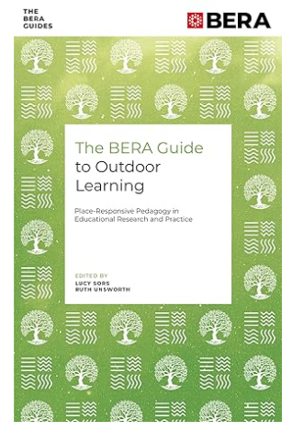
Find out more...
The BERA Guide to Outdoor Learning offers diverse perspectives on outdoor learning in all educational settings and advocates a teaching philosophy centred on immersive experiences, nature connection, play, dialogue and experiential learning, making use of place-based pedagogical perspectives.
This collection shows how place-based pedagogy can support the teaching in all educational contexts including Higher Education.

Slide 21
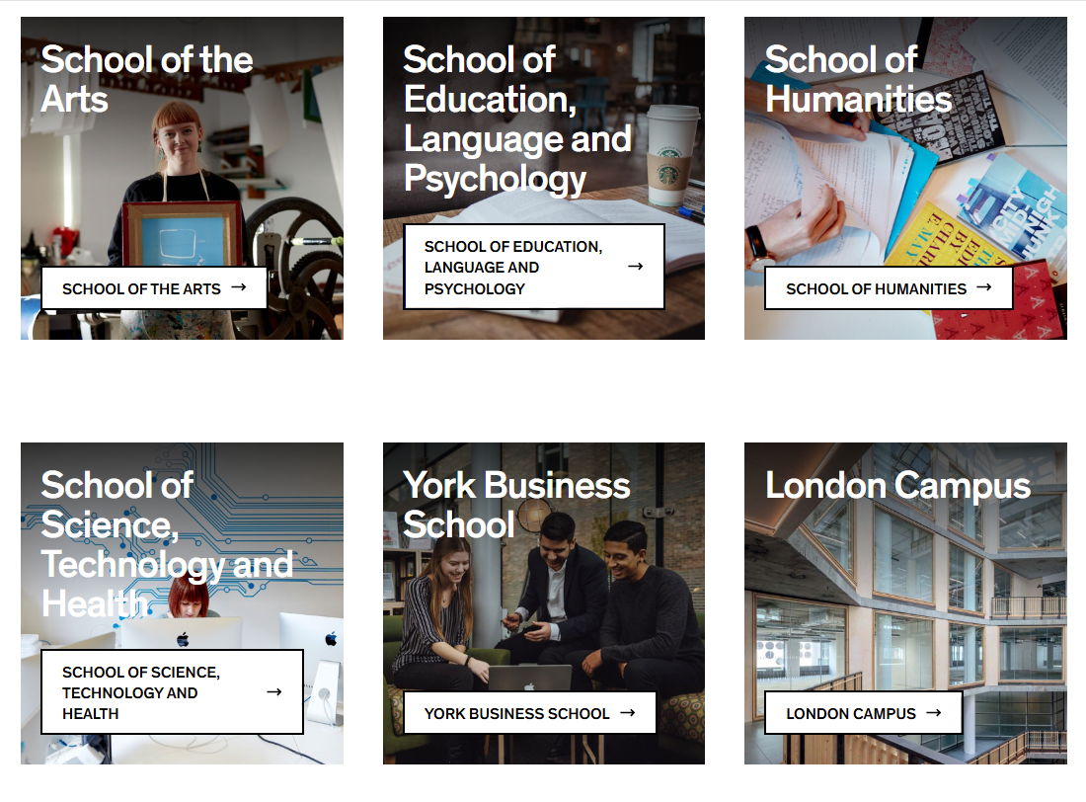
Join the conversation...
What does place-based pedagogy offer you in your thinking (and talking) about teaching?
How can you build belonging into your teaching so that your students are 'citizens not tourists'?

Slide 22
References
Beames, S., Higgins, P. & Nicol, R., 2011. Learning Outside the Classroom: Theory and Guidelines for Practice. Abingdon: Routledge.
Beames, S., Higgins, P., Nicol, R. & Smith, H. (2024). Outdoor Learning Across the Curriculum: Theory and Guidelines for Practice. Abingdon: Routledge.
Beames, S. and Ross, H. (2010) 'Learning through local landscapes', in Higgins, P., Nicol, R. and Beames, S. (eds.) Learning Outside the Classroom. London: Routledge.
Biesta, G. (2021). World Centred Education: A view for the present. Routledge
Gruenewald, D. A. (2003). The best of both worlds: A critical pedagogy of place. Educational Researcher, 32(4), 3–12.
Israel, A. L. (2012). Putting Geography Education into Place: What Geography Educators Can Learn from Place-Based Education, and Vice Versa. Journal of Geography, 111(2), 76–81. https://doi.org/10.1080/00221341.2011.583264
Mannion, G. (2012). Intergenerational education: the significance of 'reciprocity' and 'place'. Journal of Intergenerational Relationships, 10 (4): 386-99
Mason, J. (2002). Researching Your Own Practice: The Discipline of Noticing (1st ed.). Routledge.
Nichols, J.B., Howson, P.H., Mulrey, B.C., Ackerman, A. & Gately, S.E., 2016. Promise of place: Using place-based education principles to enhance learning. International Journal of Pedagogy and Curriculum, 23(2), pp.27–41
Porter, S., & Couper, P. (2021). Autoethnographic stories for self and environment: a reflective pedagogy to advance ‘environmental awareness’ in student outdoor practitioners. Journal of Adventure Education and Outdoor Learning, 23(1), 25–37. https://doi.org/10.1080/14729679.2021.1935284
Sobel, D., 2004. Place-Based Education: Connecting Classrooms & Communities. Great Barrington, MA: Orion Society.
Smith, G. A. (2002). Place-Based Education: Learning to Be Where We are. Phi Delta Kappan, 83(8), 584-594. https://doi.org/10.1177/003172170208300806 (Original work published 2002)
Smith, G, A. & Sobel, D. (2010). Place- and Community-based Education in schools. London: Routledge.
Sors, L. (in print, 2025). 'Inclusive and Holistic Practice in Place-responsive Outdoor Learning' in Sors, L. and Unsworth, R. (Eds.) (2025). The BERA Guide to Outdoor Learning: Place-responsive Pedagogy in Educational Research and Practice. BERA, Emerald.
Sors, L. Huntsley, J. and Jach, S. (in print, 2025) 'The Next Generation of Learning Outside: Fostering Place-responsive Pedagogy in Initial Teacher Education' in Sors, L. and Unsworth, R. (Eds.) (2025). The BERA Guide to Outdoor Learning: Place-responsive Pedagogy in Educational Research and Practice. BERA, Emerald.
Yemini, M., Engel, L., & Ben Simon, A. (2023). Place-based education – a systematic review of literature. Educational Review, 77(2), 640–660. https://doi.org/10.1080/00131911.2023.2177260
Waite, S. (2013). ‘Knowing your place in the world’: how place and culture support and obstruct educational aims. Cambridge Journal of Education, 43(4), 413–433. https://doi.org/10.1080/0305764X.2013.792787
Waite, S. & Pratt, N. (2017). 'Theoretical perspectives on learing outdside the classroom: relationships between learning and place. In Waite (ed.). 2017. Children Learning Outside the Classroom from Birth to Eleven. (2nd Edition).
Waite, S. (2013). ‘Knowing your place in the world’: how place and culture support and obstruct educational aims. Cambridge Journal of Education, 43(4), 413–433. https://doi.org/10.1080/0305764X.2013.792787

