Slide 1
Local history: teaching and learning through place-based pedagogy
A sense of history is inextricably entwined with a sense of place. How might we best support primary teachers in using their immediate location to teach history? We share case studies of our work in initial teacher education to model and exemplify how key concepts in a history curriculum (e.g. chronology, change, cause and consequence) can be 'made real' through interactive place-based pedagogies. This workshop will be suitable for primary teachers, student teachers and teacher educators.
Learning outcomes:
to reflect on how best to support student teachers and early career teachers in primary history
to know how key concepts in primary history may be taught through place-based pedagogies
to take part in place-based learning activities suitable for primary history lessons

Slide 2
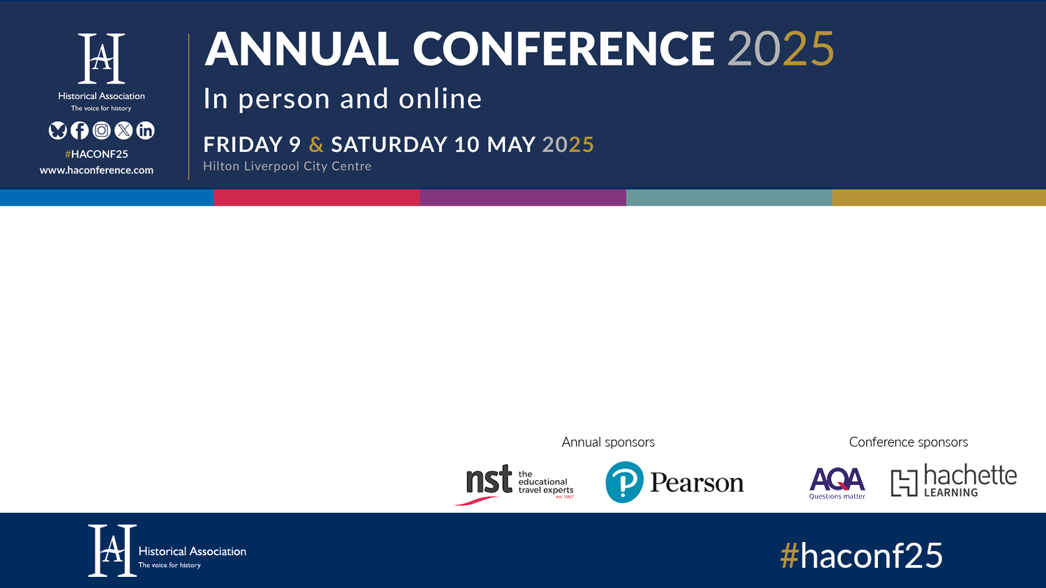
Local history: teaching and learning through place-based pedagogy
Jen Huntsley & Steph Jach
York St John University

Slide 3
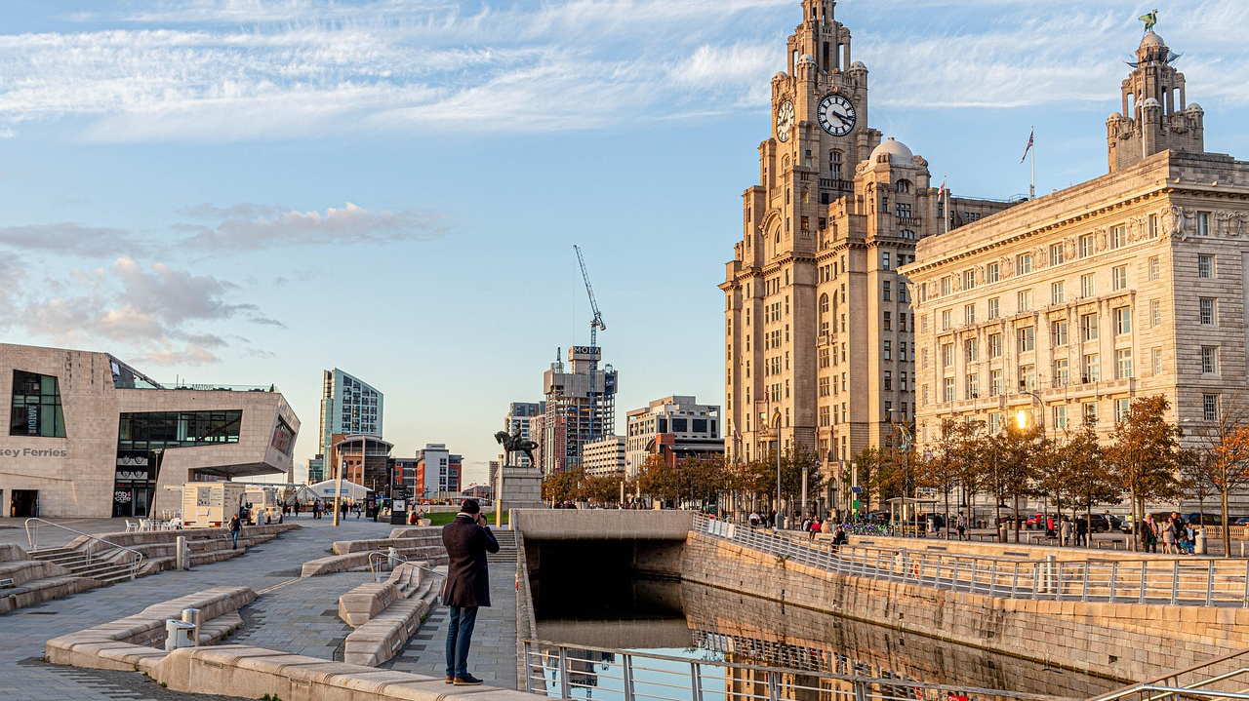
What does Liverpool mean to you?
Notes:
connection to place –what does it mean to you?
Jen
–– excitement, novelty
Steph
Beatles soundtrack to childhood
Parents studied here
– coming as a teenager – Everton.
Visited several times since. Memorable- taking my mum for her 70th birthday
Discuss/ share
Why did we do this activity?
We are in primary ITE
- we wanted to exemplify what connection to place might mean & how different it can be
Helps build connections here in this room.
first year students in geography - incorporate their lived experiences.
Through finding out their connections to place we can learn about their understanding and feelings about the world and make connections. (Catling and Martin 2011; Barlow and Whitehouse, 2019)
We link to this in first year history sessions by starting with students’ own and family history ,looking at their connections to place and what led them to be in York.
Our connections to place and personal histories are entwined.
It's not just what Liverpool means to you – it's how you conceptualsie it based on your own personal histories.
Jen
- represent, decompose & aproximate.
This is the process of what we do in ITE- we do an activity that you could do with children and then we step back and analyse the learning that could come from that activity.
- And we situate this in the academic literature which is what we are going to do now.

Slide 4
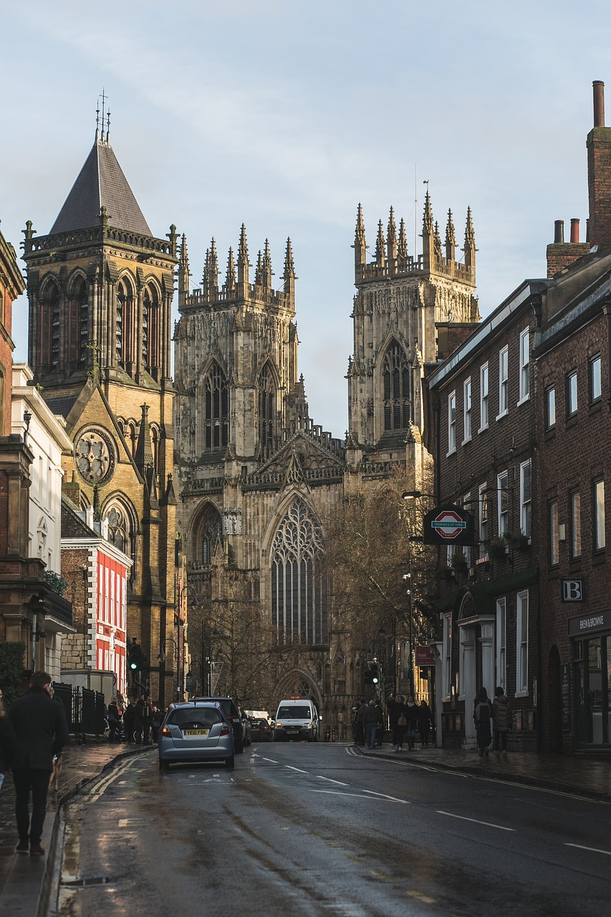
Focus for today:
Place-Based Pedagogy
ITE Case Studies
Enquiry Activity
Primary History at YSJ

Slide 5
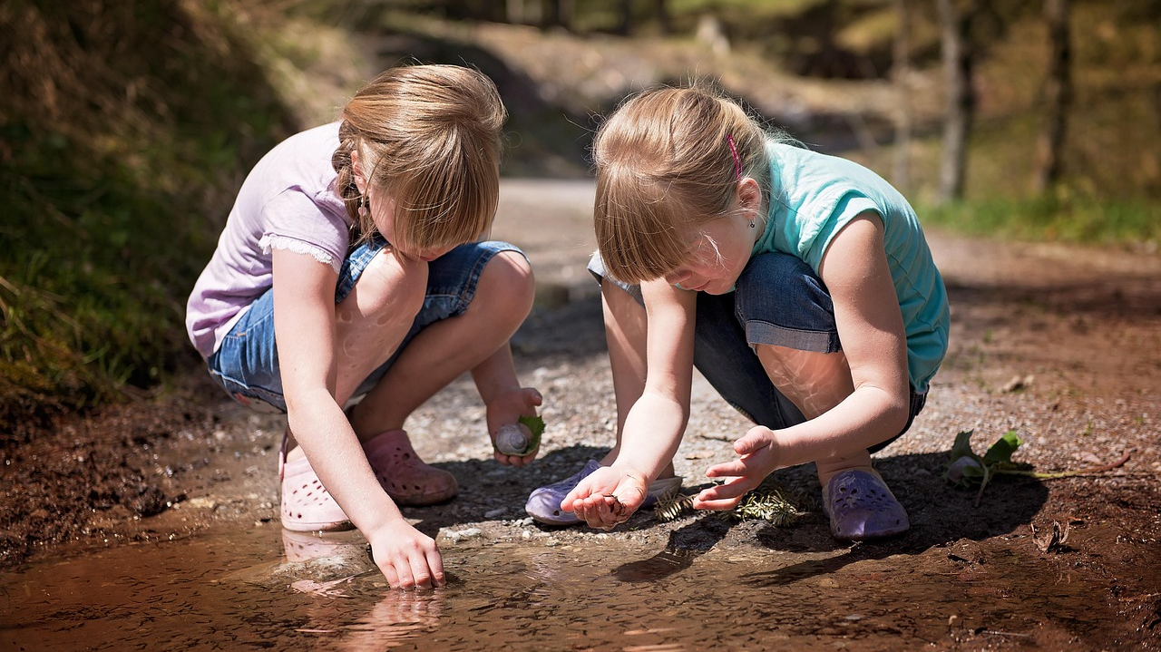
Place-Based Pedagogy (PBP)
Notes:
An umbrella term for pedagogical practices that prioritise:
experiential,
community-based,
and contextual learning

Slide 6
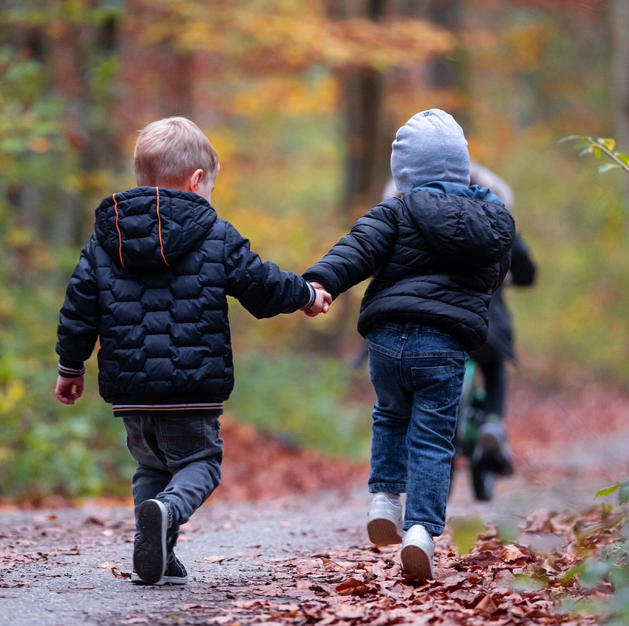
Aims
Grounding learning in local cultural, environmental and historical contexts (Gruenewald, 2003; Smith, 2002)
Understanding your place in the local story (Beames and Ross, 2010)
Creating a greater attachment to local community and context (Nichols et al. 2016; Yemini et al. 2023)
Notes:
It uses the local environment as a starting point for learning.
‘situated’ in the unique local context. (Beames et al. 2011)
Aims to understand the story of the local area . (Beames and Ross, 2010)
Considers how we can connect the curriculum content to the unique stories of the place.
2. Engaging with local landscapes allows learners to explore and appreciate the unique cultural, historical, and environmental aspects of their communities,
this contributes to a deeper understanding of themselves and their place in the world.(Beames and Ross, 2010).
3. Fosters a genuine appreciation for your own environment & community..
Directly interacting with ‘place’ will foster an appreciation of, & care for the place and community
Students become custodians of their place.

Slide 7
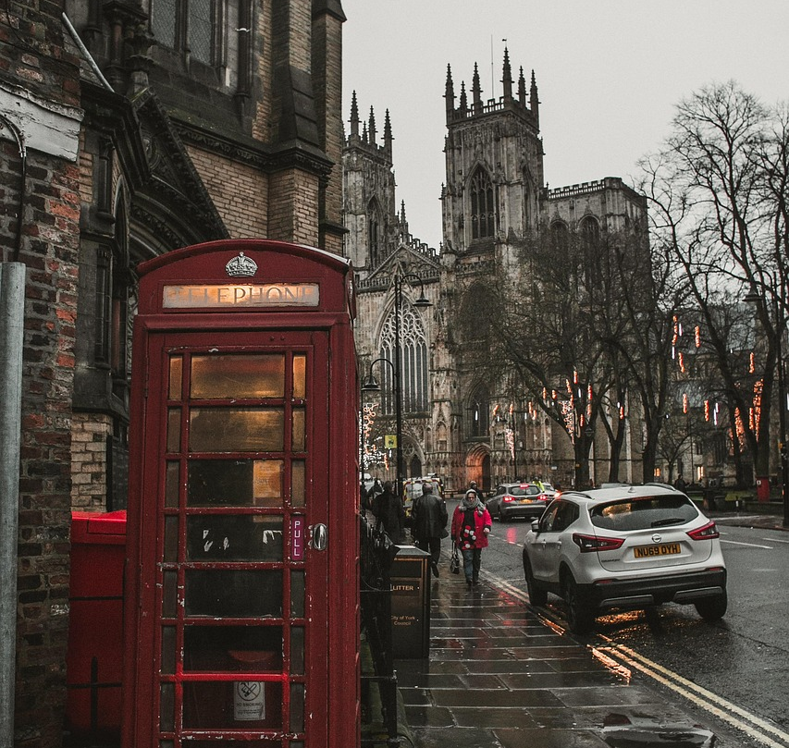
Our Purpose
Develops :
sense of place (Beames et al, 2023).
belonging & identity
stronger communities
(Sobel, 2004; Beames et al. 2011)
Notes:
Sense of place -
Deep, personal, and emotional connection with a particular location through lived experience, cultural meaning, and engagement.
about understanding:
The history, stories, and people connected to a place
The values, meanings, and emotions associated with it
having students come to know ‘their places’ is the starting point for most meaningful learning .(Smith and Sobel, 2010 in Beames et al. 2011)
Leads to
Developing sense of belonging & identity (Sobel, 2004; Beames et al. 2011)
Leads to
Caring for your community & local environment (Sobel, 2004)
For teachers of primary history – developing empathy, emotional connection.
Responsibility to carry forward the stories of the places they are connected to.

Slide 8
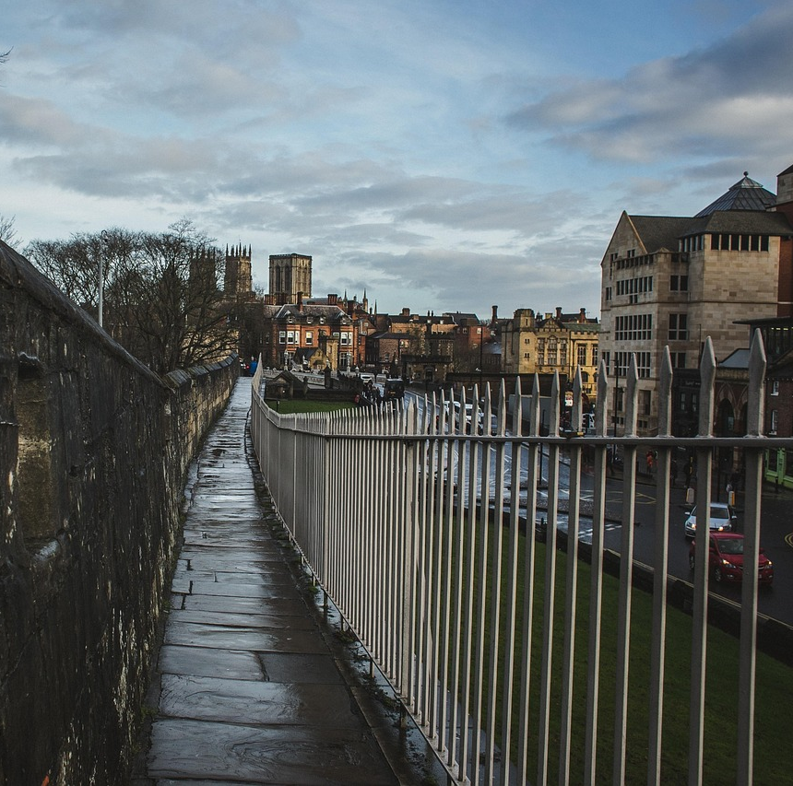
PBP Approaches in Local History :
Exploring the local environment (Isreal, 2012)
First-hand, real-world learning (Waite, 2013)
Experiential, active, enquiry based learning (Isreal, 2012; Waite 2013; Yemini et al. 2023)
Incorporating students lived experiences
Interdisciplinary (Sobel, 2004; Gruenewald, Koppelman and Elam, 2007).
Notes:
Exploring the local environment . Learning that take place in local environment. Direct physical engagement (Beames & Atencio, 2008; Maeda, 2005; Rickinson et al., 2004; cited in Beames and Ross, 2010).
First-hand, real-world learning (Waite, 2013). Getting outside in the environment. It's not passive- you're experiencing things first hand. Direct interaction builds a sense of place (Sobel, 2004).
Experiential, active learning (Isreal, 2012; Waite 2013; Yemini et al. 2023) Encourages learners to investigate and question their environment. Why is this place like it is? Why is this place important?
Incorporating students lived experiences. As we did in our starter activity, we incorporate student-teachers own experiences. Our connections to place and personal histories are entwined.
Interdisciplinary (Gruenewald, Koppelman and Elam, 2007). Weaves local history, culture and environment together –seeing connections. History - the story of the land you are standing on (Sobel, 2004).

Slide 9
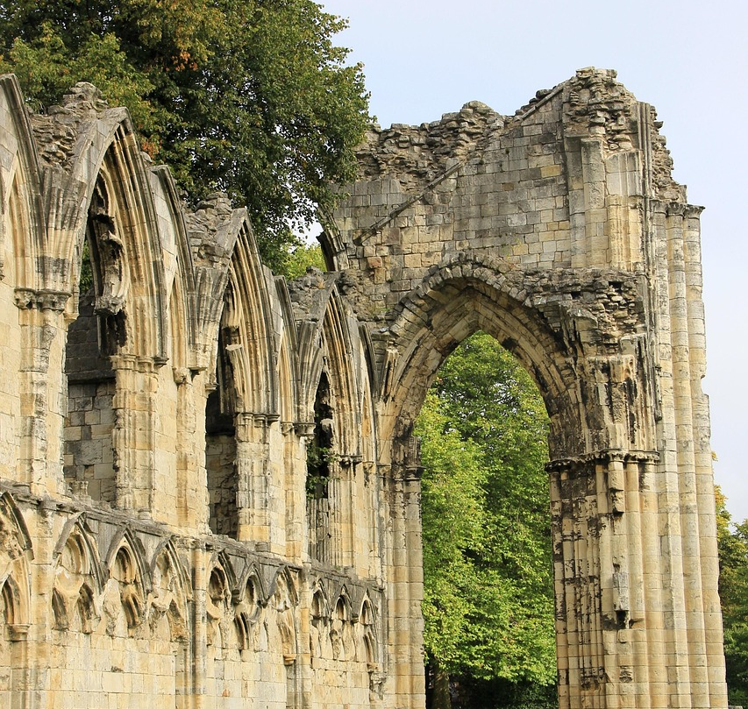
Pedagogy that is:
Relevant (Beames et al. 2011; Gruenewald, 2003; Smith, 2002)
Tangible & immediate
Inclusive (Gruenewald, 2003; Smith, 2002)
Enriching (Hein 1998; Hooper-Greenhill 2007)
Connected beyond the local (Gruenewald, 2003; Yemini et al. 2023)
Notes:
Pedagogy
This is why is important for children. This is why we want student teachers to take this forward into their profession,
Relevant
– grounded in students' lived experiences
more relevant & meanigful to children’s everyday lives, as it is rooted within a familiar location (Beames et al. 2011; Sobel, 2004).
-More authentic and engaging, It taps into natural curiosity. (Sobel, 2004).
2. Tangible -
ample opportunity for visits in the local history. (Gruenewald, Koppelman and Elam, 2007).
Anchors Abstract History - gives students a way to connect abstract ideas to local experience.
Instead of learning about generic events, they investigate how those events unfolded locally
3. Values local knowledge and experience,
-Gives voice to ordinary people and diverse communities, not just 'high status' history.
enables pupils to recognize the value of their own cultural capital (Smith 2002; Gruenewald, 2003)
4. Enriching learning experiences (cultural capital)
. Expanding Cultural Exposure and Literacy -immersive experiences - help learners develop broader understandings of history, society, and culture & expand cultural horizons.” (Hein, 1998; Hooper-Greenhill 2007)
5. Connections beyond local
Local history helps tell the national story, and vice versa.
the concept of place highlights connections between local contexts and larger global trends (Gruenewald, 2003 cited in Yemini et al. 2023)
It reveals how global events (e.g., empires, wars, migrations) impact the local landscape and people.
Encourages multi-level thinking: connecting family, local, national, and global timelines.

Slide 10
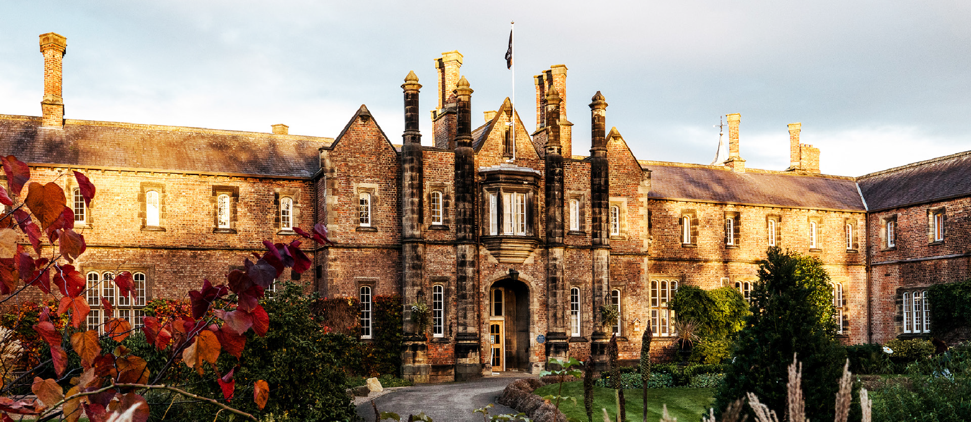
Primary History in ITE at York St John University

Slide 11
Aims:
Sense of place, belonging and connection through history (Husband, 2016)
Content knowledge of history (Shulman, 1986), including substantive and disciplinary knowledge (Ofsted, 2023)
Curricular knowledge of history (Shulman, 1986), including key concepts (Lomas, 2019)
Pedagogical content knowledge of history (Shulman, 1986)
Notes:
These are our broad aims
making history relevant to the lives of the children and giving them an improved sense of identity and place through engagement with the ‘real thing’.(Husband, 2016)
Not only is local history a significant part of the primary National Curriculum but where we live and grow up is an important part of who we are. (Husband, 2016)
Teaching history teachers, not history

Slide 12
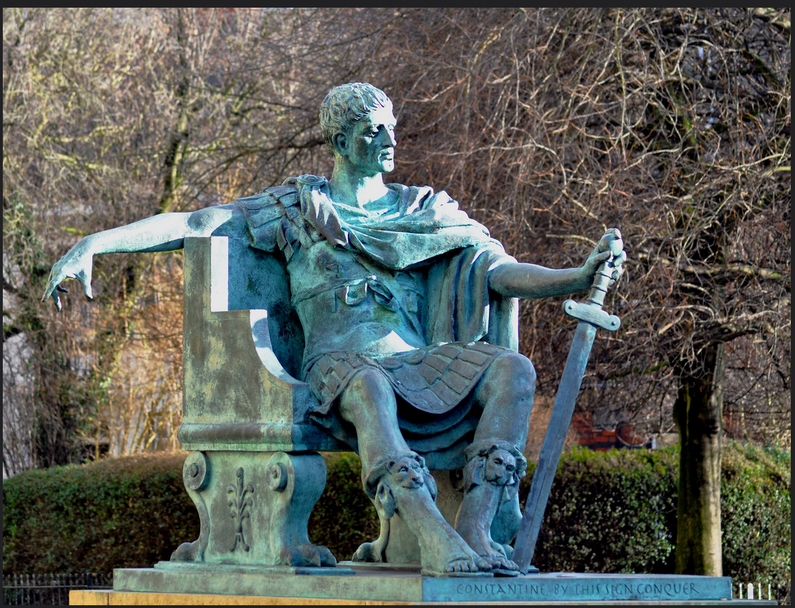
YSJ ITE Primary History
Curriculum Concepts
Time, change, chronology
Reasons and results
Interpretations
Historical evidence
Significance
Lomas, 2019
Image: York Minster

Slide 13
PBP, Local History and ITE
PBP and local history - situated and contextual learning experiences
How do we create engaging learning experiences?
How do we support student teachers to understand the salient aspects of such experiences?
Notes:
PBP- experiential
Teaching PBP because it supports local history so well.
Developing pedagogical content knowledge (how to teachthe curriculum (Shulman) learn through situated experiences – situated and contextual. Going to the Minster is deeply situated and contextual – can’t have that experience in classroom or anywhere else. They form their ideas of how to teach through the experiences we give them.
Our challenge is:
Provide situated experiences where they learn primary history.
Need to support them to take a step back and what was that situated experience which helped us learn.
Engage children in PBP to create connection, to engage, to enthuse etc.

Slide 14
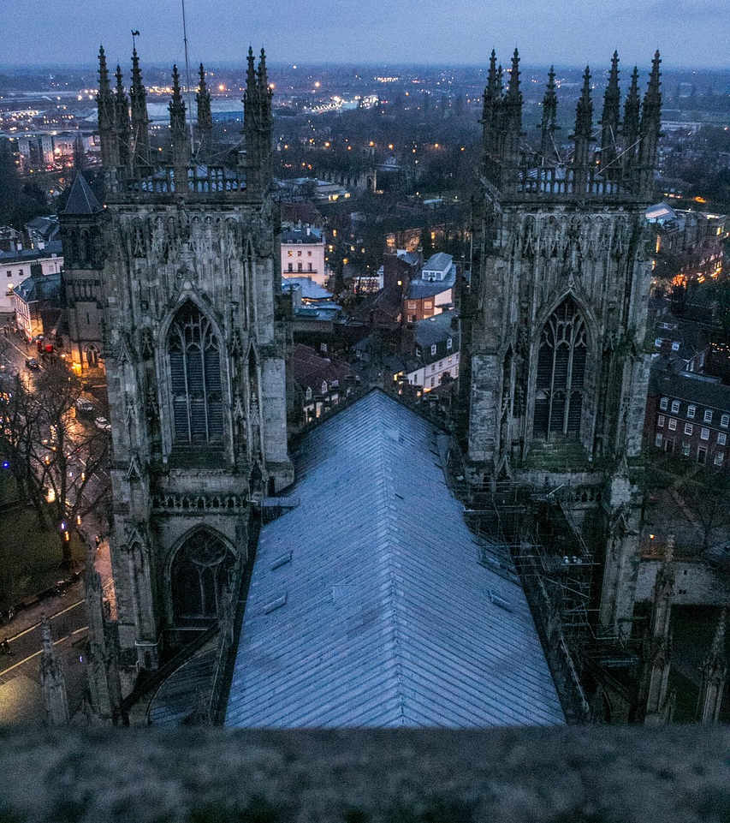
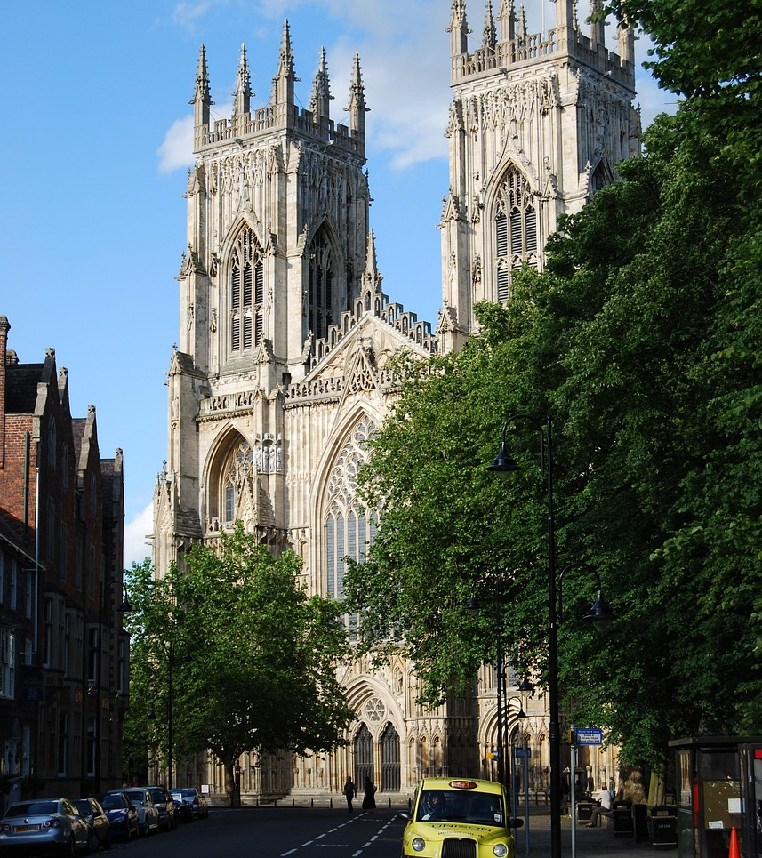
Case Studies

Slide 15
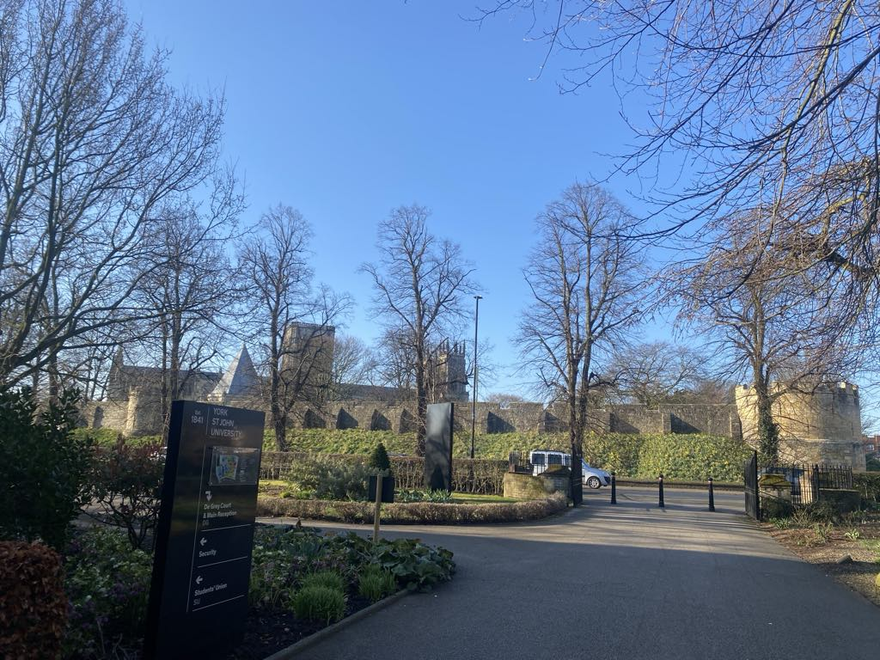
How is this PBP?
York Minster Visit
Explore the local environment
Tangible, immediate
First-hand & experiential
Enriching
Interdisciplinary
Connections beyond local
Notes:
Over 50% of YSJ students come from backgrounds traditionally underrepresented in higher education
Many students had never been to the Minster.
Barriers: Cost & sense of Cultural Distance ( Feeling that it is “not for them”)
Help student teachers develop broader understandings of history in this immersive environment and through this expanding their cultural horizons. (Hein, 1998; Hooper-Greenhill, 2007)

Slide 16
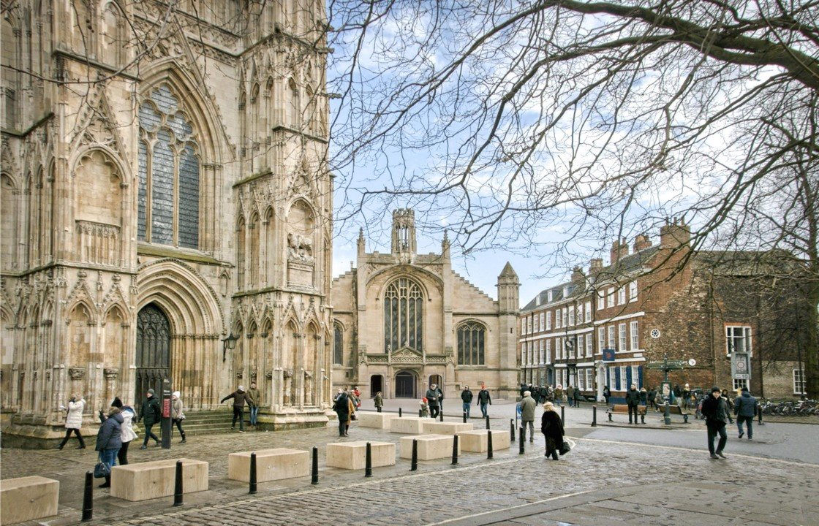
Substantive and disciplinary knowledge through PBP
Local stories
Use of historical artefacts
Image: Belfray.org
Notes:
Events beyond living memory & significant individuals– grounded in local stories.
For example – we learn about Guy Fawkes – from York and baptized here.
Ma
Relevant & meaningful
We use images of historical artefacts to develop understanding of similarities and differences between life in 1605 and now.
Consider how we learn about the past

Slide 17

PBP Approach:
Awe and wonder
Emotional response
Significance
Connection
Curiosity
Care
Notes:
Stop, pause, look around. Sense of awe and wonder
Consider emotional response. Grounds students in the place and present moment
helps them feel the significance of the place
Deepens connections & begin to see the place as meaningful
Activates curiosity & student led inquiry
Can help develop feelings of respect and care

Slide 18
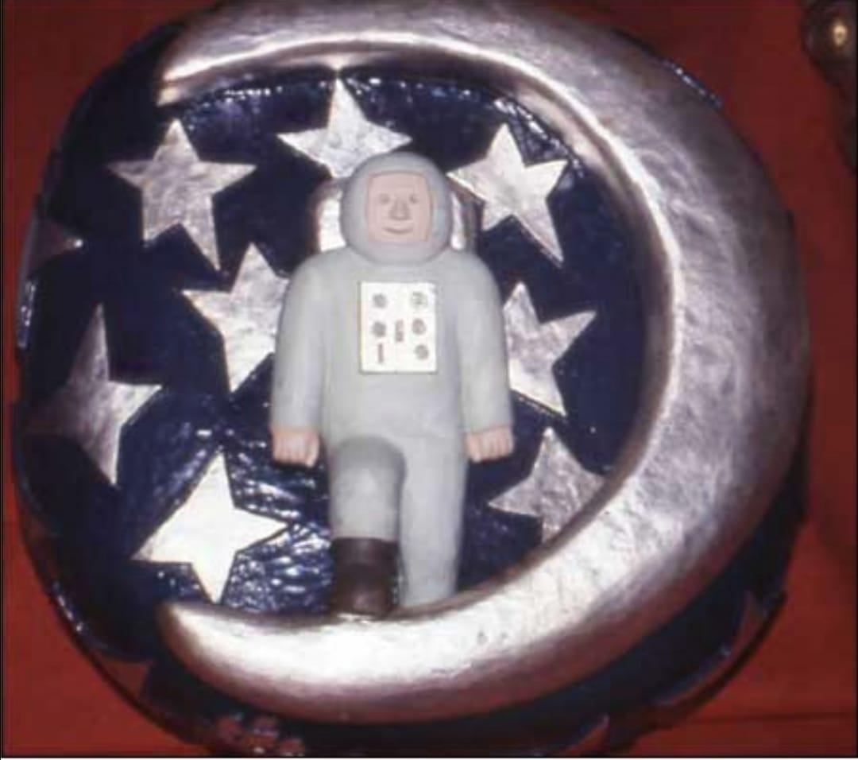
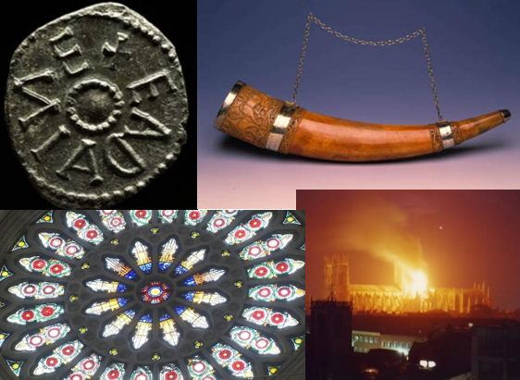
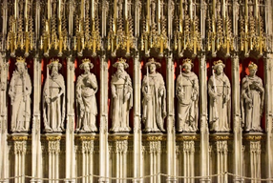
Substantive and disciplinary knowledge through PBP
Focus on key artefacts:
  Roman remains
  Anglo Saxon Coin
  Horn of Ulf
  Quire Screen
  Rose Window
  Ceiling bossess
Images: York Minster & Sky News
Notes:
Every place is built on layers of time
Focus on Key artefacts:
Through these specific local stories we can make links outwards.
Unique, story of the this place connects to a larger, national narrative.
Tell the story about the history of Britian through these items.
Roman remains York Minster- site of the HQ of Roman fortress with a large basilica. Constantine proclaimed the next Emperor here. The remains of the fortress are still visible in the Undercroft, alongside artefacts from the period
Anglo-Saxon Coin- First minster built on this site. This ninth-century coin providing evidence for a mint very nearby The presence of a mint confirms York’s position of power and authority in the Anglo Saxon Kingdom of Northumbria and, the country,
Viking Horn of Ulf – Minster survived Viking invasion.1,000-year-old elaborately carved elephant tusk, gifted to the cathedral by Viking lord Ulf.
Quire screen -Present buiding took 250 years. It was completed in 1472. It became a major centre for Christianity in the north of England.
Screen shows fifteen stone king statues from William I to Henry IV.
Rose Window - Commissioned to mark the end of the war of the Roses. Symbolic of the Tudor royal family.
Ceiling bosses- Devestating fire in 1984 – the Minster was struck by lightening, Boss: A wooden or stone carving on the ceiling that pins the beams together and covers the join. When the roof was rebuilt, the children’s programme Blue Peter launched an appeal for children to design new roof bosses. Make connections with Great Fire of London. Also, changes in living memory- fire service, Children's TV/entertainment.

Slide 19

Pedagogical Content Knowledge of History through PBP
Group microteach around key artefacts
Develop knowledge on site
Student teachers learn how to use historical sites to:
spark curiosity
learn about the past (historical evidence)
teach historical concepts
Image: Sky News
Notes:
Every place is built on layers of time
We develop student teachers' substantive knowledge of the Minster on site
In groups, students are given one of these areas to focus on. They have to plan and deliver a learning activity for another group at the Minster
They need to consider
Learning focus
Key questions & knowledge
Historical concepts
Activities help student teachers develop their understanding of how they can:
use historical buildings and artefacts to spark curiosity and learn about the past
Teach historical concepts e.g. significance of the Rose window

Slide 20

Aims:
Relevant
Meaningful
Connection
Belonging
Represents York
Students to see themselves as part of the story of York Minster and York
Image: Graduation 2024 | York St John University
Notes:
Graduation 2024 | York St John University
Connection, belonging and community through place-based pedagogies

Slide 21
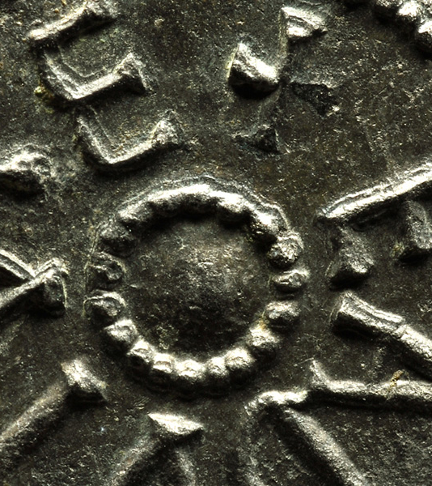
Curricular knowledge through PBP
  PBP historical enquiries:
  What was Roman life like in Eboracum?
  What was Anglo-Saxon life like in Eoforwic?
  What was Viking life like in Jorvik?
Image: York Minster
Notes:
Jen – KS2 – chronology & significance
Coherent chronological narrative
Deliberate sequencing to build chronological timeline of Britain

Slide 22
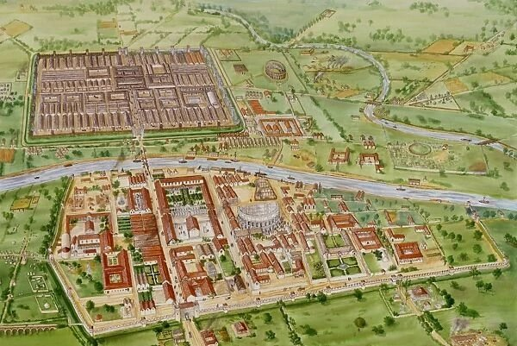
Substantive and disciplinary knowledge through PBP
Map of Eboracum
Anglo-Saxon poems
Jorvik historical artefacts
Christianity in Eboracum, Eoforwic and Jorvik
Notes:
Map of Eboracum – connecting current knowledge of place with original establishment of the city, imagining where Roman buildings would have been based on modern-day local landmarks (pubs!) – CHANGE // REASONS & RESULTS
Comparing Anglo-Saxon poems – The Ruin with Alcuin’s poem of York – two Anglo-Saxon ‘primary’ sources – what York might have been like in early Anglo-Saxon times compared to later ones; interpretation of sources/bias etc (Disciplinary knowledge development) HISTORICAL EVIDENCE, INTERPRETATIONS
Story of establishment of Jorvik – understanding the significance of York as the Viking capital of the Danelaw, comparing to modern-day local landmarks again, why did the Vikings choose Jorvik (similar reasons to Romans, but also boats) – SIGNIFICANCE, REASONS AND RESULTS
Historical artefacts found in York – particularly Roman and Viking, interpretation of sources (e.g., Viking coins minted in Jorvik) (Disciplinary knowledge development) – HISTORICAL EVIDENCE, INTERPRETATIONS
Christianity in Eboracum, Eoforwic and Jorvik 1. Roman era - Emperor Constantine was made Emperor in Eboracum 306CE, granted Edict of Milian in 313CE which granted religious tolerance to Christianity. 2. Anglo Saxon era - Gaelic and Roman Christianity, Queen Ethelburga brought Roman Christianity to Eoforwic when marrying King Edwin in 625CE on the site of York Minster; 3. Viking era – Christianity and pagan religions existing alongside each other – evidenced in some of the coins we look at. – TIME, CHANGE, CHRONOLOGY // REASONS AND RESULTS // SIGNIFICANCE

Slide 23
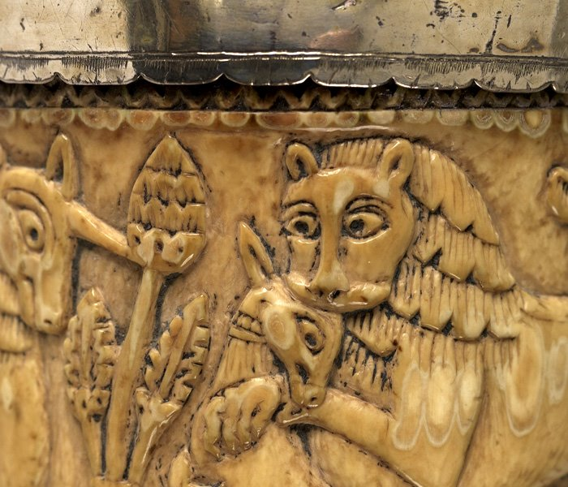
Substantive and disciplinary knowledge through PBP
‘York through the ages’ timeline activity
  Practise substantive knowledge retrieval
  Identify opportunities to emphasise historical concepts across different topics
Image: York Minster
Notes:
Map of Eboracum – connecting current knowledge of place with original establishment of the city, imagining where Roman buildings would have been based on modern-day local landmarks (pubs!) – CHANGE // REASONS & RESULTS
Comparing Anglo-Saxon poems – The Ruin with Alcuin’s poem of York – two Anglo-Saxon ‘primary’ sources – what York might have been like in early Anglo-Saxon times compared to later ones; interpretation of sources/bias etc (Disciplinary knowledge development) HISTORICAL EVIDENCE, INTERPRETATIONS
Story of establishment of Jorvik – understanding the significance of York as the Viking capital of the Danelaw, comparing to modern-day local landmarks again, why did the Vikings choose Jorvik (similar reasons to Romans, but also boats) – SIGNIFICANCE, REASONS AND RESULTS
Historical artefacts found in York – particularly Roman and Viking, interpretation of sources (e.g., Viking coins minted in Jorvik) (Disciplinary knowledge development) – HISTORICAL EVIDENCE, INTERPRETATIONS
Christianity in Eboracum, Eoforwic and Jorvik 1. Roman era - Emperor Constantine was made Emperor in Eboracum 306CE, granted Edict of Milian in 313CE which granted religious tolerance to Christianity. 2. Anglo Saxon era - Gaelic and Roman Christianity, Queen Ethelburga brought Roman Christianity to Eoforwic when marrying King Edwin in 625CE on the site of York Minster; 3. Viking era – Christianity and pagan religions existing alongside each other – evidenced in some of the coins we look at. – TIME, CHANGE, CHRONOLOGY // REASONS AND RESULTS // SIGNIFICANCE

Slide 24
What is PBP about this?
Relevant: builds on learning from the previous year
Tangible & immediate: imagine the streets we walk down every day
Inclusive: starts with what the learners already know
Enriching: creative application of knowledge, critical thinking through enquiry, epistemic emotions
Connected beyond the local: the place and its place in history
Continues to build sense of belonging and identity in place
Notes:
Relevant: builds on learning from the previous year
Tangible & immediate: imagine the streets we walk down every day
Inclusive: starts with what the learners already know
Enriching: creative application of knowledge, critical thinking throguh enquiry, epistemic emotions
Connected beyond the local: the place and its place in history
Continues to build sense of belonging and identity in place

Slide 25
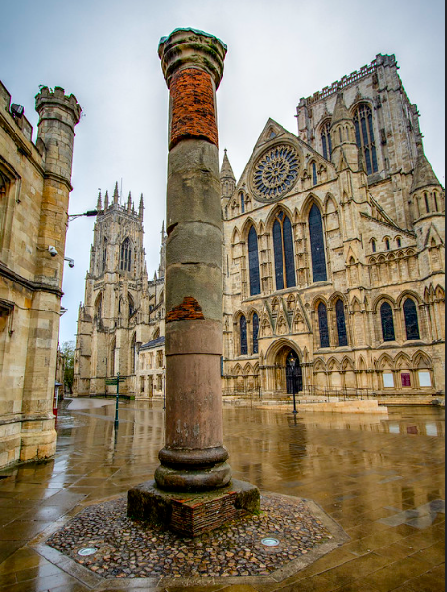
Pedagogical Content knowledge through PBP
Elective module – Outdoor Learning
Roman trail
Visit key Roman sites in York
Groups plan and deliver PBP historical activity
Focus: significance of place, experiential learning, developing key concepts
Image: Paul Jewell
Notes:
Students to have to develop their place knowledge in order to teach this….
Concepts: enquiry, evidence, cause and consequence, significance

Slide 26
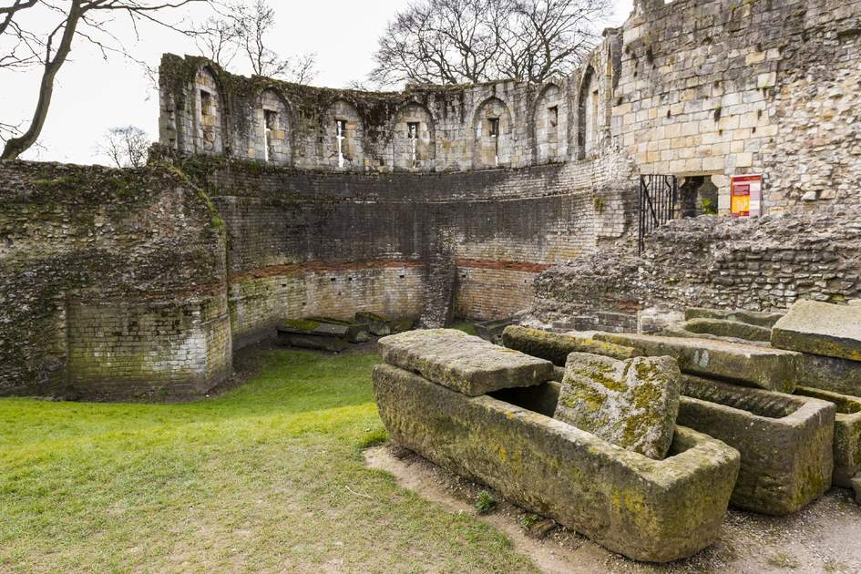
Roman Microteach Examples
Acting out Roman army 'drills' in the shadow of the multangular tower
Creating mini Roman soldiers using natural materials
Image: Insight Guides

Slide 27
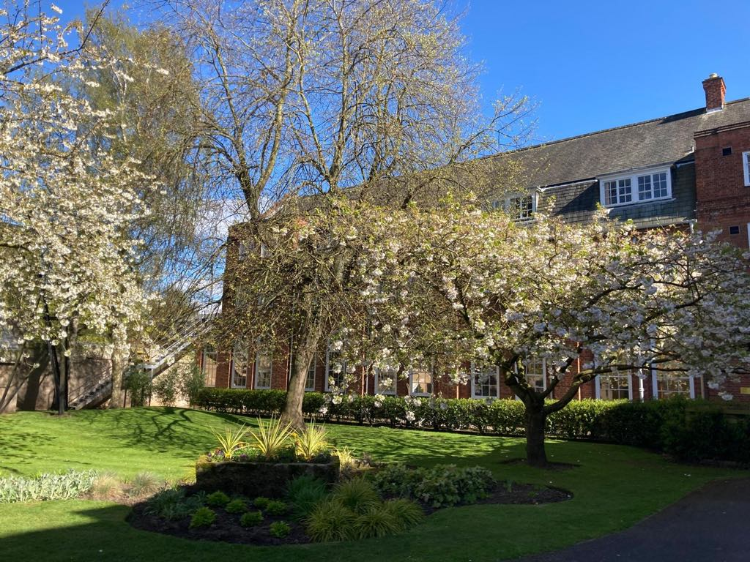
What is PBP about the Roman Trail?
Explore the local environment
Tangible and immediate
First-hand, experiential, learning
Sense of place & belonging
Empower educators (Sobel, 2004)
Notes:
Put trust in teachers. Empower educators. Teachers know their pupils and communities best so they should have freedom to adapt the curriculum and lesssons to fit their specific context & use local resources (Sobel, 2004).

Slide 28
Enquiry Activity

Slide 29
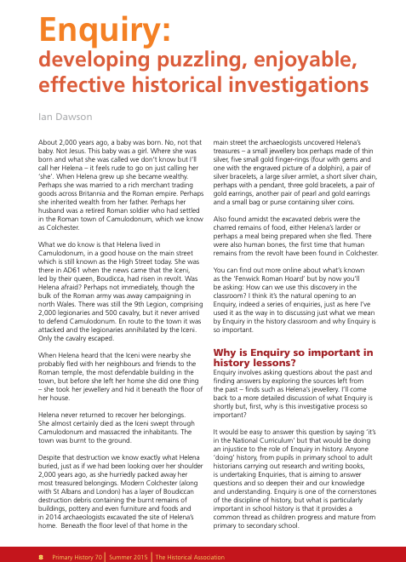
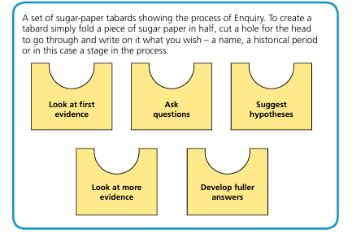
Image: Dawson, 2015
Notes:
This enquiry process based on Dawson’s 2015 HA article which focused on Roman Colchester

Slide 30
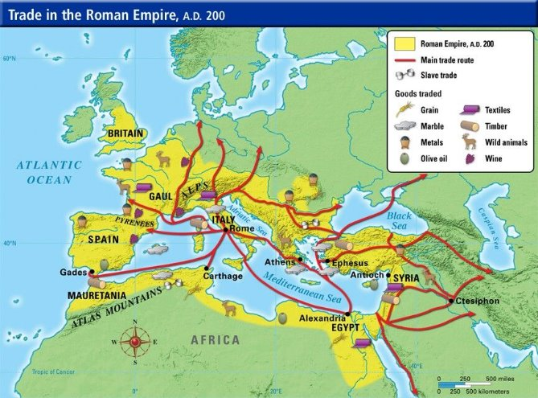
Key Substantive Knowledge
Roman Britain was a province of the Roman Empire from 43 to 409.
RomanoBritish culture developed with trade links across the empire (Howorth 2015)
Image: History Rocks
Notes:
Important that pupils have a sense of who the Romans were because they will use that term throughout subsequent lessons with an assumption that pupils know what we are referring to
After initial Celtic rebellions, the Romans controlled the lands south of Hadrian’s wall in relative peace & a distinctively RomanoBritish culture developed with trade links across the (Howorth 2015)

Slide 31
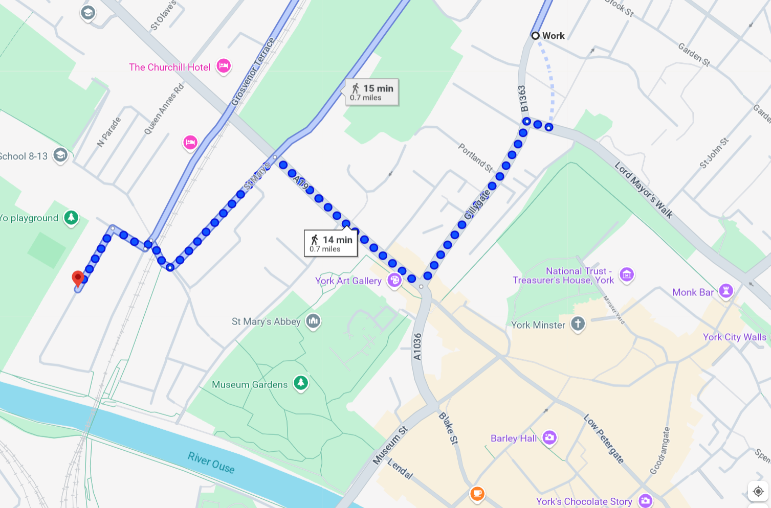
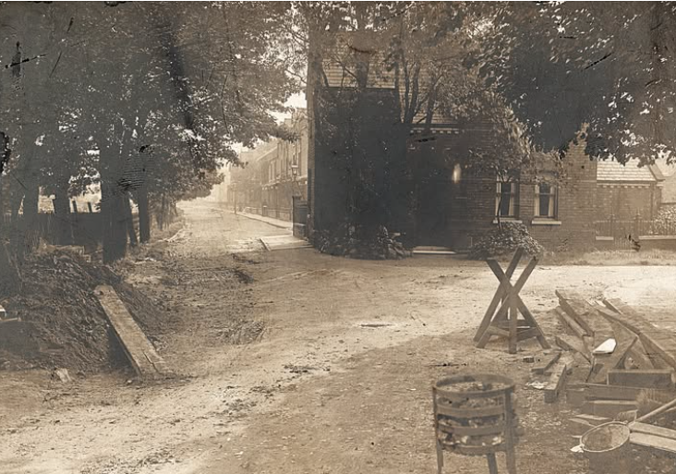
Images: Google Maps, York St John University, Clifton Local History Group
Notes:
Works to expand the street in 1901 on Sycamore Terrace (less than a mile from campus)
Begin by pretending to be archaeologists and finding objects...

Slide 32
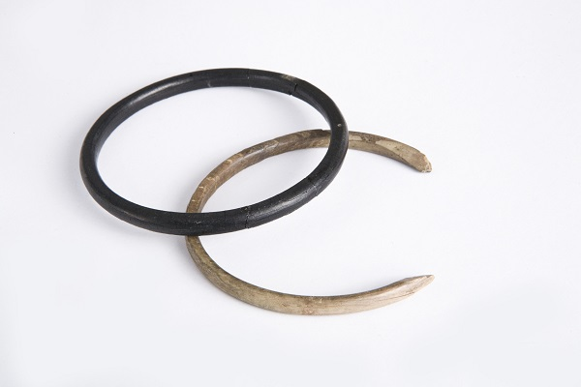
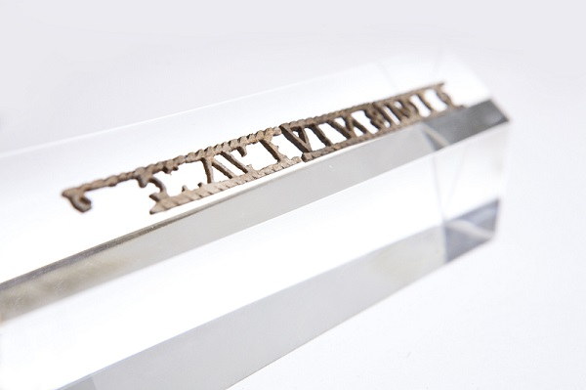
The Enquiry process
Stage 1 Show children one or two pieces of evidence
Images: YMT
Notes:
Discussion – what can you see? What are they? Initial thoughts. What do you notice? Materials? Describing words.
Model splitting large sheet into 5-6 boxes and make notes on each stage of the enquiry process.
For example – perhaps it was owned by someone rich, a woman.

Slide 33
The Enquiry process
Stage 2 Prompt children to ask questions about this evidence
Images: YMT
Notes:
What questions do you want to ask? And so your enquiry is under way.
For example – What is it? How old is it? Who owned it? Where was it found? Did a back smith make it? What is it made of?
Turn thoughts into questions
Discussion on tables - questions

Slide 34
The Enquiry process
Stage 3 – Prompt children to suggest answers (which we can call hypotheses) to some of the questions
Think about which questions are the most important to answer.
Images: YMT
Notes:
For example – perhaps it was owned by someone rich, a woman.
Discussion on tables -hypotheses
For example – perhaps it was owned by someone rich, a woman.
Discussion on tables -hypotheses

Slide 35
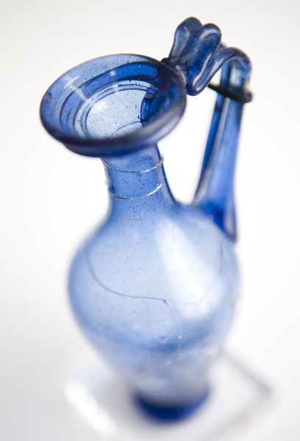
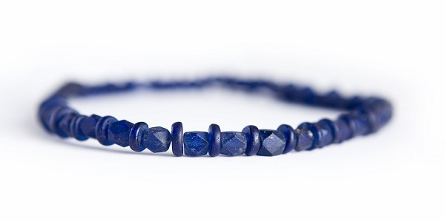
The Enquiry process
Stage 4 Provide more information and evidence for children to explore to see if they can find answers to their questions.
Images: YMT
Notes:
This is the lengthiest stage and could be broken up into sections.
It’s at this stage that children can use textbooks, source material, pictures and web resources to build up and deepen their knowledge of the topic.
Get out packs – you're going to find out more information about the items burried with this person.

Slide 36
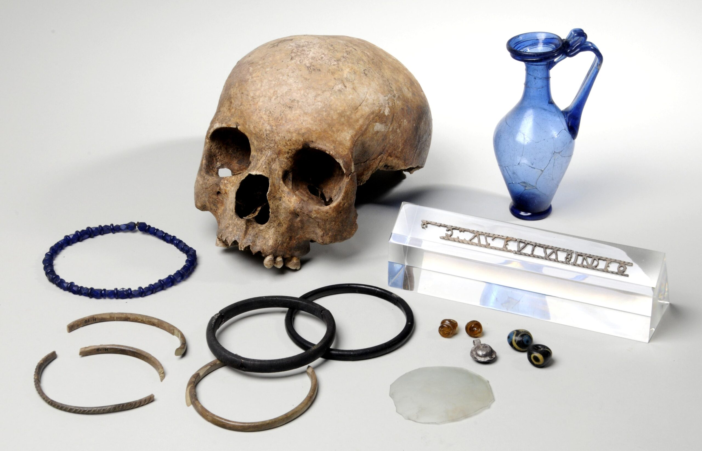
Stage 4 Provide more information and evidence for children to explore to see if they can find answers to their questions.
The Ivory Bangle Lady
Inscription: ‘Hail sister, may you live in God’
Other items buried with her include:
some blue glass beads,
fragments of five bone bracelets,
silver and bronze lockets,
two yellow glass earrings,
two marbled glass beads,
a small round glass mirror
a blue glass perfume bottle.
Jet bracelet
Images: YMT
Notes:
It revealed the remains of a Roman woman.
She lay within a stone coffin, adorned with beautiful jewellery and accompanied by a range of objects. Most of Eboracum’s residents were modestly buried, without elaborate coffins or grave goods.
She became known as the Ivory Bangle Lady (because of the ivory bangles with which she was buried).
A shard of bone was discovered inside her stone coffin. It had the inscription SOROR AVE VIVAS IN DEO which translates as ‘Hail sister, may you live in God’.
A number of other goods were also buried with her:
some blue glass beads,
fragments of five bone bracelets,
silver and bronze lockets,
two yellow glass earrings,
Jet bracelet
two marbled glass beads,
a small round glass mirror
a blue glass perfume bottle.

Slide 37
The Enquiry process
Stage 5 Develop stronger answers supported by evidence.
Images: YMT
Notes:
[Stages 4 and 5 could be repeated so that children never spend too long on exploring the topic without coming back to and thinking about their answers to the enquiry question or questions.]
Discussion on tables – develop stronger hypotheses
What can we now say about this person?
The luxury items buried with her indicated that she was wealthy.
Paints a picture of a wealthy, elite Roman woman living a luxury lifestyle.

Slide 38
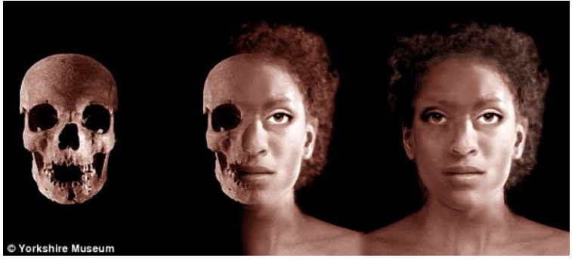
Ivory Bangle lady
Images: YMT
Notes:
Whilst we know many things about her, her name is not one of them, so she is affectionately known as the ‘Ivory Bangle Lady’.
Analysis by archaeological scientists show that Ivory Bangle Lady had mixed racial heritage and ancestral links to North Africa and she didn’t grow up in York but migrated here later in her life. They also suggest that she spent her childhood somewhere with a warmer climate, on the coast. Whilst this may have been in southern England, given her heritage it was more likely somewhere on the Mediterranean coast, perhaps even North Africa itself.
The remains of Ivory Bangle lady helped archaeologists discover that wealthy people from across the Empire were living in fourth century York
These new insights transform our understanding of the life of Ivory Bangle Lady and highlight how diverse the people of Roman Yorkshire were. Like most urban areas of the Roman Empire, Eboracum was a cultural melting pot which welcomed visitors from provinces as far as Africa and the Near East. Ivory Bangle Lady was one of many migrants with African heritage who made the city their home.
Analysis from Roman burials in York indicates that around 10% of the sample were of African decent. Parts of Roman York were more multicultural than modern York are today.
Students reaction to her.

Slide 39
Connections beyond the locality
Image: History Rocks
Notes:
A closer look at these allows us to appreciate the international trade networks within which Eboracum sat and the cosmopolitan nature of its inhabitants. Beautifully crafted fashionable goods, some made with exotic materials from distant provinces of the Roman Empire, were available to purchase at Eboracum’s markets, by those who could afford them... and Ivory Bangle Lady certainly could.
North Africa- Ivory Bangle lady born/grew up
ivory bangles – imported from Africa
Baltic- amber earrings
Perfume – the Rhineland
Jet bracelet – Whitby
Christian – religion recently arrived from the east
Buried in York
International Roman York is exemplified through this one woman’s story.

Slide 40
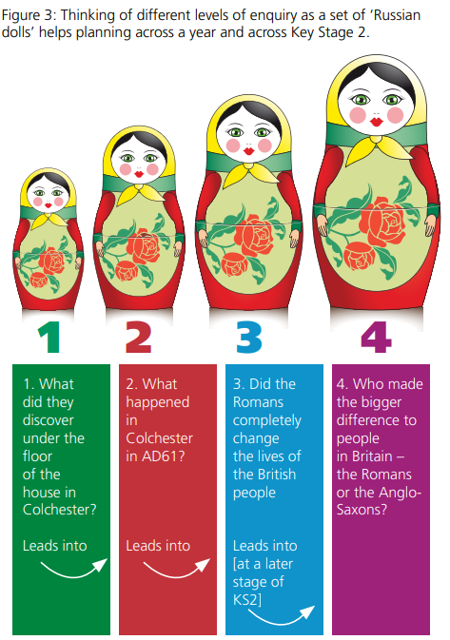
Developing a More substantial Enquiry
Roman burial
Roman York
Roman Britain
Historical themes​
​
Image: Dawson, 2015
Notes:
Her story represents wider issues/connections of international trade, opportunities, travel.
Abstract concepts become tangible through real stories in the locality.
You can start with 1 person then go onto think of the city, country and world.
The Ivory Bangle Lady’s story provides a personal insight into a real person from our past. The combined study of her burial, grave goods and ancestry bring the character of this woman to life. She had an eye for fashion and the means to buy exotic and rare goods. With mixed racial heritage and family from North Africa she travelled to Eboracum, a diverse city of the fringes of the empire, where she spent the rest of her short life. We can only wonder why she travelled here. Maybe she was the wife or relative of soldier who was stationed here, or perhaps she came to take advantage of the many opportunities that Britannia’s thriving second city had to offer.
Whilst we don’t know how she died, I find it incredible and humbling that we can know so much about the life of someone who lived in York more than 1,600 years ago
Examples:
What was discovered in Sycamore Terrace in 1901? Who was the lady buried? What were the items buried with her? What do they tell us about her?
2. Where was she from? Where were the items buried with her from?
What does Ivory bangle lady tell us about life in York in AD400? How cosmopolitan was Roman York? What does she tell us about the people in York and its global links AD400?
3. What were the connections between Roman York/Roman Britain and the rest of the world?/ How did the global connections change York/Britain?
How/Why did the Romans travel/trade/invade Britain/other countries? What did they bring to Britain? What did they take from Britain?
What were the global trade links in the Roman Empire? How did Christianity spread in the Roman era?
4. Compare Roman and different empires e.g. British empire. Compare their global connections and trade links
Look at spread of religions,
What were Roman attitudes to race and nationality? How are they different from other periods studied?

Slide 41
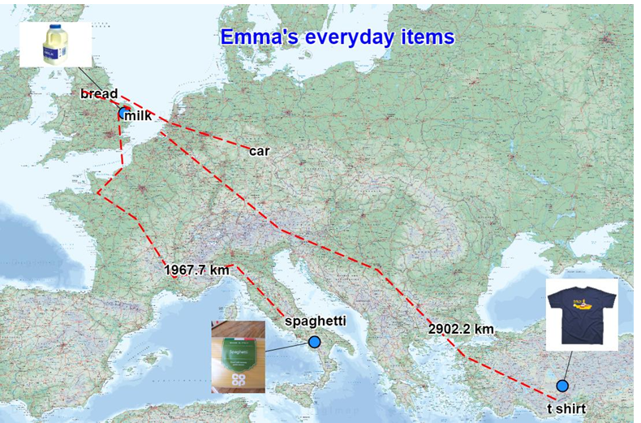
Interdependence
Interdisciplinary geographical enquiry
Trade links & Interdependence
Incorporates students lived experiences
Similarities and differences with Roman York
Image: EDINA, 2024
Notes:
Links to geography session on place knowledge which develops local to global locational knowledge.
EDINA (2024) 'The World Came to My Place Today', Digimap for Schools. Available at: https://digimapforschools.edina.ac.uk/learning-resources/resource/3-world-came-my-place-today.html (Accessed: 2 May 2025).
Emma Espley and Simon Catling
Discussion on our daily items and where they come from
Book – The World Came to my place tody’
Use food, clothing & technology - map source and how it reached its destination using Digimaps for schools
How do the items you consume link our country to the rest of the world
Develops understanding of trade links, global footprints and interdependence
Similarities and difference

Slide 42
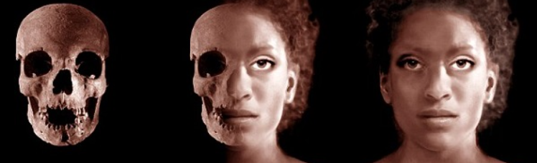
Enquiry grounded in the locality
Relevant & meaningful
Connections beyond local
Interdisciplinary
Makes the abstract tangible:
empire
trade
What is PBP about this?
Images: YMT
Notes:
Concepts developed include significance, interpretations, similartiies and differences.

Slide 43
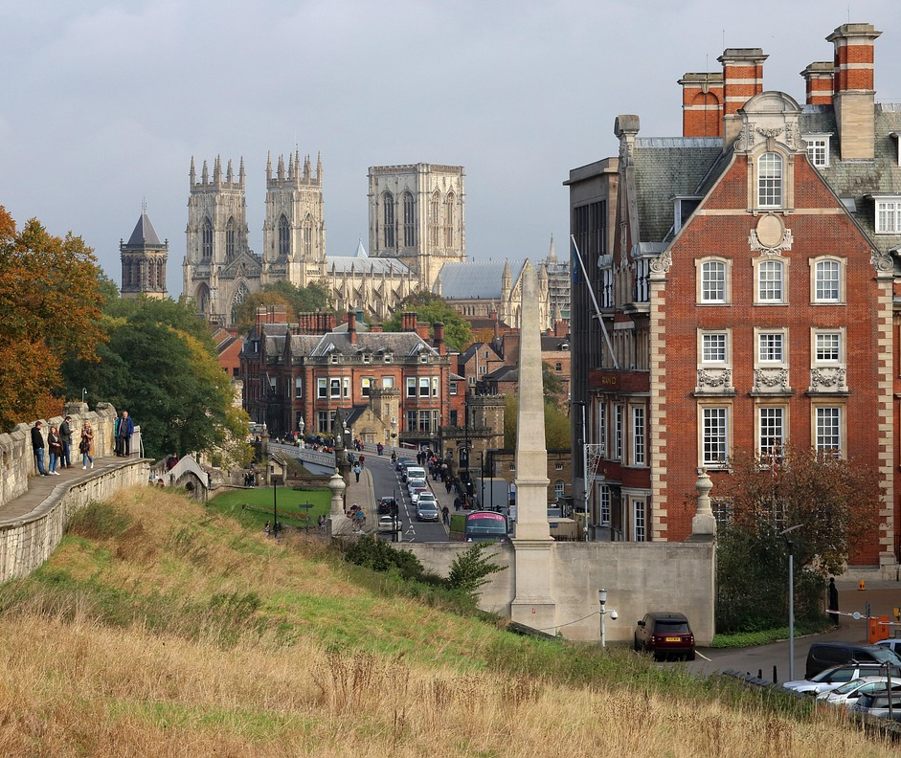
Conclusions

Slide 44
Local History through PBP
Initial focus: local history (locally focused, engaged with locality, connected beyond local )
PBP enhances local history:
Sense of place & connection
Experiential, first-hand
Interdisciplinary/holistic
Aligns with and informs our professional values
Potential to make abstract historical concepts ‘real’ for student teachers

Slide 45
Next steps
Stepping back…
  The concept of ‘connection to place’ is explicit in our history teaching… what about ‘place-based pedagogies’?
Stepping forward…
  What values do student teachers perceive in learning through place-based pedagogies? Co-constructive research
  Strengthen our interdisciplinary connections
Notes:
The concept of ‘connection to place’ is explicit in our history teaching… what about ‘place-based pedagogies’? – need to take another step back for the student teachers to understand PBP as a teaching approach

Slide 46
Reflection and invitation
Learning outcomes:
To reflect on how best to support student teachers and early career teachers in primary history
To know how key concepts in primary history may be taught through pbp
To take part in pbp activities suitable for primary history lessons
What does place-based pedagogy offer you in your thinking about history education?
How might you may weave PBP into your next teaching encounter?
Why might PBP matter to the places and communities you work in?

Slide 47


With thanks to

Slide 48
References
Barlow, A. & Whitehouse, S., 2019. Mastering Primary Geography. London: Bloomsbury Academic.
Beames, S. and Ross, H. (2010) 'Learning through local landscapes', in Higgins, P., Nicol, R. and Beames, S. (eds.) Learning Outside the Classroom. London: Routledge.
Beames, S., Higgins, P. & Nicol, R., 2011. Learning Outside the Classroom: Theory and Guidelines for Practice. Abingdon: Routledge.
Catling, S. & Martin, F., 2011. Contesting powerful knowledge: the primary geography curriculum as an articulation between academic and children’s (ethno-) geographies. The Curriculum Journal, 22(3), pp.317–335.
Dawson, I. (2015) 'Enquiry: developing puzzling, enjoyable, effective historical investigations', Primary History, 70, Summer. Available at: https://www.history.org.uk/publications/categories/299/resource/8381/developing-enjoyable-historical-investigations (Accessed: 3 May 2025).
EDINA (2024) 'The World Came to My Place Today', Digimap for Schools. Available at: https://digimapforschools.edina.ac.uk/learning-resources/resource/3-world-came-my-place-today.html (Accessed: 2 May 2025).
Grossman, P. et al. (2009) ‘Teaching Practice: A Cross-Professional Perspective’, Teachers College Record: The Voice of Scholarship in Education, 111(9), pp. 2055–2100. Available at: https://doi.org/10.1177/016146810911100905.
Gruenewald, D. A. (2003). The best of both worlds: A critical pedagogy of place. Educational Researcher, 32(4), 3–12.
Gruenewald, D.A., Koppelman, N. and Elam, A. (2007) 'Our Place in History: Inspiring Place-Based Social History in Schools and Communities', Journal of Museum Education, 32(3), pp. 233–242. Available at: https://www.jstor.org/stable/40479614 (Accessed: 1 May 2025).

Slide 49
References
Hein, G. E. (1998). Learning in the Museum. Routledge.
Hooper-Greenhill, E. (2007). Museums and Education: Purpose, Pedagogy, Performance. Routledge.
Husband, A. (2016) 'Local history as a way of developing a sense of identity and place', Primary History, 74, Autumn. Available at: https://www.history.org.uk/publications/resource/9006/local-history-and-a-sense-of-identity (Accessed: 3 May 2025).
Israel, A. L. (2012). Putting Geography Education into Place: What Geography Educators Can Learn from Place-Based Education, and Vice Versa. Journal of Geography, 111(2), 76–81. https://doi.org/10.1080/00221341.2011.583264
Lomas, T., 2019. 'Getting to grips with concepts in primary history'. Primary History, (82), pp.9–17.
Nichols, J.B., Howson, P.H., Mulrey, B.C., Ackerman, A. & Gately, S.E., 2016. Promise of place: Using place-based education principles to enhance learning. International Journal of Pedagogy and Curriculum, 23(2), pp.27–41
Ofsted (2023) Rich encounters with the past: history subject report. Department for Education. Available at: https://www.gov.uk/government/publications/subject-report-series-history/rich-encounters-with-the-past-history-subject-report#main-findings (Accessed: 6 February 2025).
Shulman, L.S. (1986) ‘Those Who Understand: Knowledge Growth in Teaching’, Educational Researcher, 15(2), pp. 4–14. Available at: https://doi.org/10.3102/0013189X015002004.

Slide 50
References
Smith, G. A. (2002). Place-Based Education: Learning to Be Where We are. Phi Delta Kappan, 83(8), 584-594. https://doi.org/10.1177/003172170208300806 (Original work published 2002)
Smith, G. A., & Sobel, D. (2010). Place- and Community-Based Education in Schools.
Sobel, D., 2004. Place-Based Education: Connecting Classrooms & Communities. Great Barrington, MA: Orion Society.
Waite, S. (2013). ‘Knowing your place in the world’: how place and culture support and obstruct educational aims. Cambridge Journal of Education, 43(4), 413–433. https://doi.org/10.1080/0305764X.2013.792787
Woodhouse, J.L. and Knapp, C.E. (2000) Place-Based Curriculum and Instruction: Outdoor and Environmental Education Approaches. ERIC Digest. Available at: https://files.eric.ed.gov/fulltext/ED448012.pdf (Accessed: 30 April 2025).
Yemini, M., Engel, L., & Ben Simon, A. (2023). Place-based education – a systematic review of literature. Educational Review, 77(2), 640–660. https://doi.org/10.1080/00131911.2023.2177260

