Slide 1
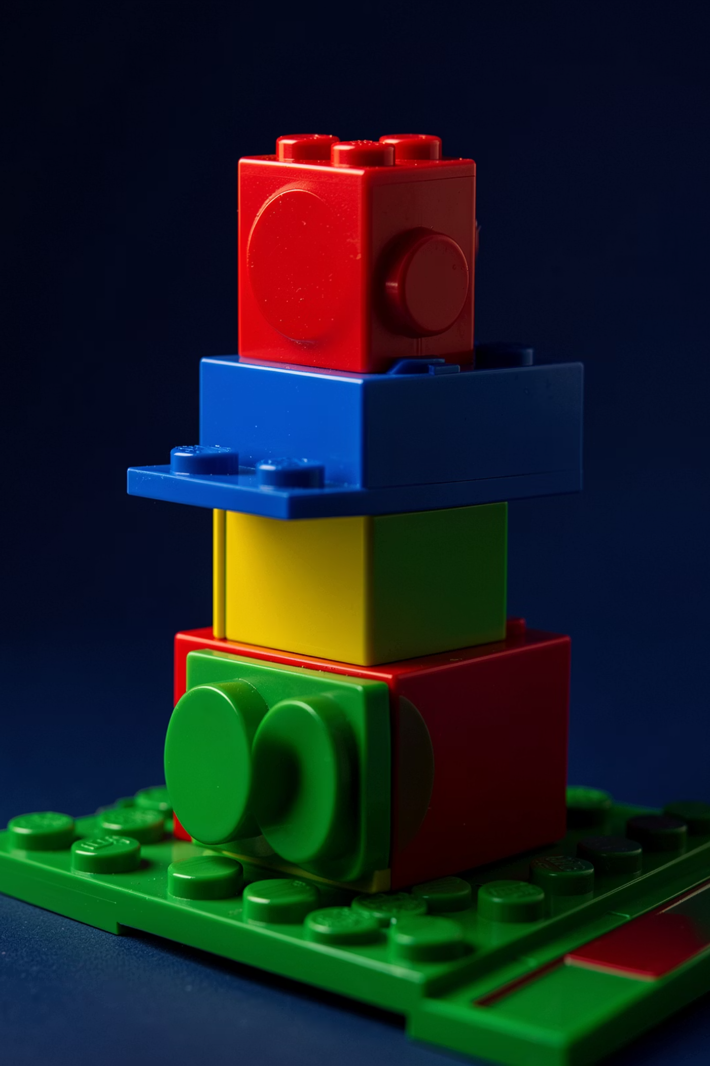
Beyond Content :
Rethinking Higher Education with LEGO® Serious Play®
Olalekan Adisa ·
York St John University

Slide 2




ABACKGROUND
From a Danish carpenter to a global learning method.
1932 · Origins
Ole Kirk Christiansen founded LEGO in Billund, Denmark — wooden toys first. Leg godt — "play well."
1949–1958 · The Brick
Plastic "Automatic Binding Bricks" (1949). The 1958 stud-and-tube patent created the LEGO System of Play.
Late 1990s · Reinvention
Financial difficulty drove reinvention: Mindstorms, LEGO Education, and major partnerships.
Today · Learning at Scale
LEGO Foundation and LEGO Education champion creativity, problem-solving, collaboration, and critical thinking worldwide.
"Only the best is good enough." — Ole Kirk Christiansen

Slide 3
THE PROBLEM IN HIGHER EDUCATION
Higher education is over-delivering content and under-developing meaning-making.
~50% forgotten within 24 hours
+6% exam scores; −55% failure rates
Students mis-rate passive lectures
Of new lecture content is lost within a day. (Murre & Dros, 2015)
Active learning in STEM dramatically improves outcomes. (Freeman et al., 2014)
Students prefer passive lectures even when they learn less. (Deslauriers et al., 2019)
Content alone undersells what higher education can do.

Slide 4
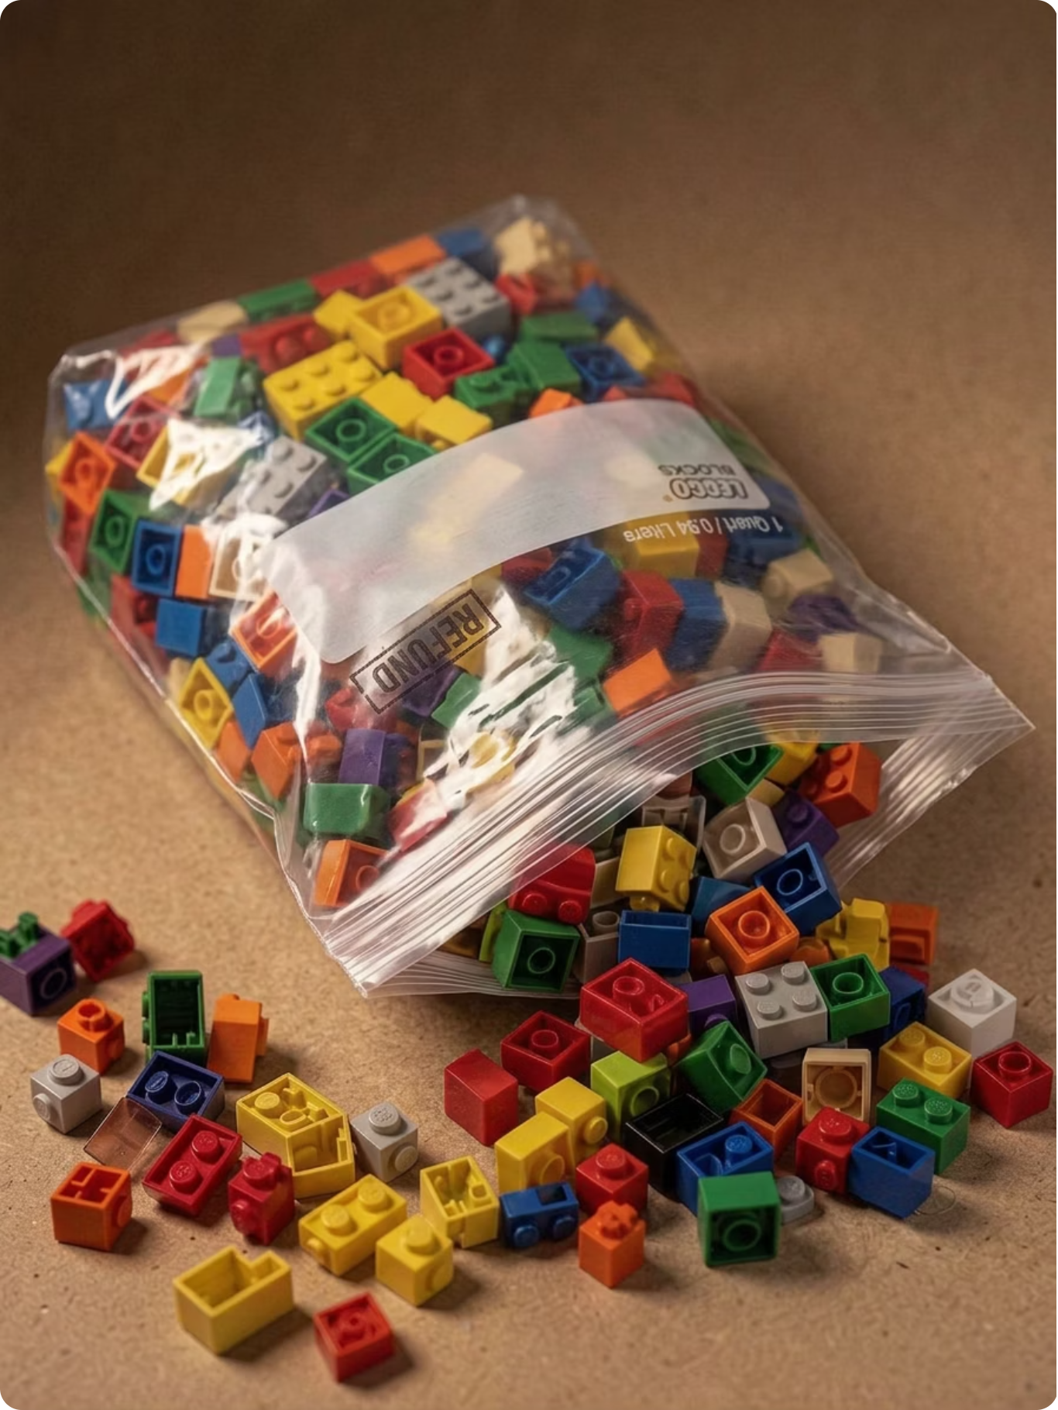





YOUR TURN
LEGO ACTIVITY
Look at the zip locks of bricks in front of you.
In 2 minutes, pick ONE or Two bricks that represents something true about you right now.
Turn to the person next to you and tell them why you picked it.
Listen to their reason(s).
Let's listen to two or more stories.
What did the brick let you say that words wouldn't have?

Slide 5
WHAT YOU JUST DID HAS A NAME
LEGO Serious Play: a facilitated method, not a toy.
Everyone builds. Everyone speaks.
The hand knows things the mind hasn't said yet.
The model carries the meaning.
100% participation is the rule. No one sits on the sidelines.
Roos & Victor (2018) call this "thinking with your hands."
We discuss the build, not the builder and therefore reducing defensiveness and deepening dialogue.
Traditional
LEGO Serious Play
Lecturer-centred · transmission · students as recipients
Learner-centred · construction · students as contributors
Developed at IMD in the late 1990s by Roos and Victor with the LEGO Group; now used in over 30 countries.

Slide 6
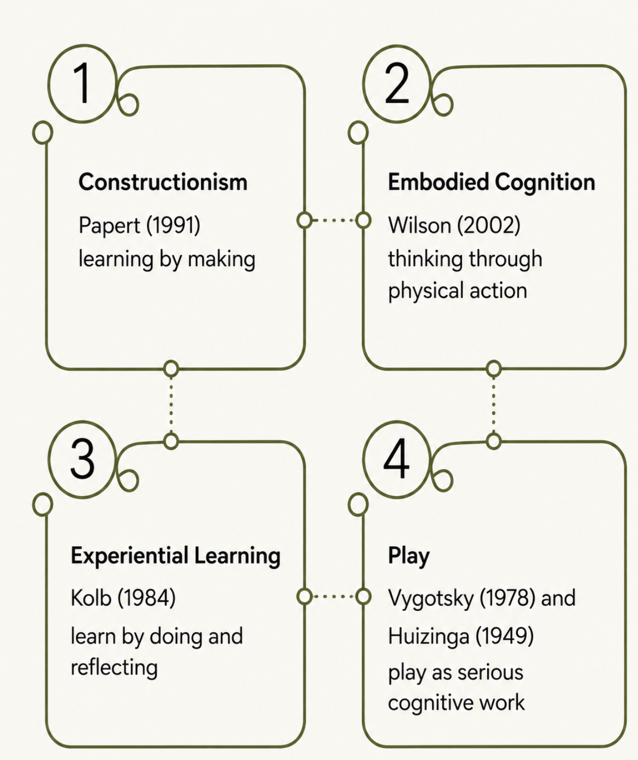
THE THEORY UNDERNEATH
Four traditions converging in one method.
LEGO Serious Play is not novel because it uses LEGO. It is rigorous because it sits at the intersection of four established traditions.
Each pillar contributes something essential: Constructionism gives us making as knowing; Embodied Cognition gives us the hand as a thinking tool; Experiential Learning gives us reflection on action; and Play theory gives us serious work in a low-stakes frame. Together, they justify LSP as a method, not a gimmick.

Slide 7





WHY THIS MATTERS FOR HIGHER EDUCATION
Five HE pain points LSP touches at once.
Disengagement → Structural participation
Surface learning → Tacit knowledge made visible
Forgettable content → Embodied, reflected learning
Lecturer-dominant rooms → Flattened power
Narrow assessment → Built artefacts as evidence
Richer discussions
Better view of student perspectives
More inclusive sessions
LSP does not fix all of these. But it touches all of them at once.

Slide 8



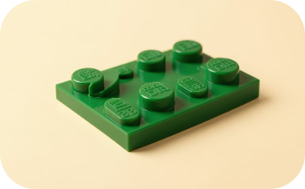
WHERE IT IS ALREADY WORKING
HE practice and evidence so far.
Reflective Practice
Hospitality & Tourism
Student Identity & Transition
Research Methods & Concept Mapping
James (2015) : Professional reflection and identity work
Wengel et al. (2022) : Experiential teaching in applied disciplines
McCusker (2014) : Supporting first-year belonging and self-concept
Roos & Victor (2018) : making abstract thinking tangible
Concerns → Responses
Time constraints
Initial scepticism
Large class sizes
Resource availability
Start small — 15–30 minutes
Link explicitly to learning outcomes
Use table-level groups
Faculty kit pools

Slide 9
DIRECT ALIGNMENT WITH SEVEN UK HIGHER EDUCATION PRIORITIES
What adopting LEGO Serious Play achieves
Student Engagement & Belonging
Active & Experiential Learning
Inclusive Teaching Practices
Graduate Employability
Innovation & Entrepreneurship
Transferable Skills
Reflective & Transformative Learning
"Students don't learn what we deliver. They learn what they build."

Slide 10
Discussions/Feedback

Slide 11
REFERENCE
Deslauriers, L., McCarty, L.S., Miller, K., Callaghan, K. and Kestin, G. (2019) 'Measuring actual learning versus feeling of learning in response to being actively engaged in the classroom', Proceedings of the National Academy of Sciences, 116(39), pp.19251–19257. https://doi.org/10.1073/pnas.1821936116
Freeman, S., Eddy, S.L., McDonough, M., Smith, M.K., Okoroafor, N., Jordt, H. and Wenderoth, M.P. (2014) 'Active learning increases student performance in science, engineering, and mathematics', Proceedings of the National Academy of Sciences, 111(23), pp.8410–8415. https://doi.org/10.1073/pnas.1319030111
Huizinga, J. (1949) Homo Ludens: A Study of the Play Element in Culture. London: Routledge & Kegan Paul.
Kolb, D.A. (1984) Experiential Learning: Experience as the Source of Learning and Development. Englewood Cliffs, NJ: Prentice Hall.
Murre, J.M.J. and Dros, J. (2015) 'Replication and analysis of Ebbinghaus' forgetting curve', PLOS ONE, 10(7), e0120644. https://doi.org/10.1371/journal.pone.0120644
Papert, S. (1980) Mindstorms: Children, Computers, and Powerful Ideas. New York: Basic Books.
Papert, S. (1991) 'Situating constructionism', in Harel, I. and Papert, S. (eds.) Constructionism. Norwood, NJ: Ablex Publishing, pp.1–11.
Piaget, J. (1972) The Psychology of the Child. New York: Basic Books.
Vygotsky, L.S. (1978) Mind in Society: The Development of Higher Psychological Processes. Cambridge, MA: Harvard University Press.
Wilson, M. (2002) 'Six views of embodied cognition', Psychonomic Bulletin & Review, 9(4), pp.625–636. https://doi.org/10.3758/BF03196322

