Slide 1
BACP Research Conference 2016 Meaning-making in bereavement counselling: clients’ assimilation of grief experiences
John Wilson¹, Lynne Gabriel², Hazel James²
Presenter: John Wilson
¹Senior Bereavement Counsellor, Saint Catherine’s Hospice Scarborough
and PhD Student, York St John University
²York St John University

Slide 2
Our testable theory
Bereavement disrupts physical and emotional equilibrium.
The greater the number of complicating factors, the greater the disruption.
Grief is the process by which a human restores disrupted equilibrium. She/he attempts this by making sense of the complications she/he faces.
The process is one of adaptation to change.
The process is observable.

Slide 3
Our testable theory
Bereavement disrupts physical and emotional equilibrium.
The greater the number of complicating factors, the greater the disruption.
Grief is the process by which a human restores disrupted equilibrium. She attempts this by making sense of the complications she faces.
The process is one of adaptation to change.
The process is observable

Slide 4
Observing the process
The process is observable.
Constructivist Psychotherapy: George Kelly (1963), Robert Neimeyer (2009).
The assimilation and accommodation of schemas: (Piaget, 1952), (Janoff-Bulman, 1992), (Neimeyer, 2009), (Stiles 1999, 1990).

Slide 5
Articulating the theory
Each human constructs a personal reality of the world that serves to ensure biological survival. From early childhood the individual constantly tells and retells her own story in the construction of a self-narrative (Neimeyer et al., 2002). When we experience a loss or a traumatic event such as bereavement, this narrative is disrupted and new understanding must be accommodated in a revised version (Attig, 2001, 2011).

Slide 6
Articulating the theory
Grief counselling can offer an empathic engagement with the client’s disequilibrium of lost attachment which purposefully facilitates the client’s relearning of this disrupted personal world. Changes to the self-narrative of grief will be articulated in the therapeutic dyad, both in conversation with the counsellor and conversation with the self.

Slide 7
The search for a research tool
The Assimilation of Problematic Experiences Scale APES (Stiles 1999).
It involves listening to clients.
Therapeutic change is observed against a scale.
The client is viewed as a “community of voices” (Stiles 1999, p.1).

Slide 8
The Assimilation of Problematic Experiences Scale
8 point descriptive sequence:
0 | Warded off/ dissociated | Client is unaware of the problem; the problematic voice is silent. Affect may be minimal, reflecting successful avoidance.
1 | Unwanted thoughts | Client prefers not to think about the experience. Problematic voices emerge in response to therapeutic interventions or external circumstances and are suppressed or avoided. Affect involves unfocused negative feelings: their connection with the content may be unclear.
2 | Vague awareness/ emergence | Client is aware of a problematic experience but cannot formulate the problem clearly. Problematic voice emerges into sustained awareness. Affect includes acute psychological pain or panic associated with the problematic material.

Slide 9
The Assimilation of Problematic Experiences Scale
8 point descriptive sequence:
3 | Problem statement/ clarification | Content includes a clear statement of a problem – something that can be worked on, Opposing voices are differentiated and can talk to each other. Affect is manageable, not panicky.
4 | Understanding/insight | The problematic experience is formulated and understood in some way. Voices reach an understanding with each other (a meaning bridge) . Affect may be mixed, with some unpleasant recognition but also some pleasant surprise.
5 | Application/ working through | The understanding is used to work on a problem. Voices work together to address problems of living. Affective tone is positive, optimistic.

Slide 10
The Assimilation of Problematic Experiences Scale
8 point descriptive sequence:
6 | Problem solution | Client achieves a successful solution for a specific problem. Voices work together to address problems of living. Affect is positive, satisfied.
7 | Mastery | Client automatically generalizes solutions; voices are integrated, serving as resources in new situations. Affect is positive or neutral (i.e. this is no longer something to get excited about).

Slide 11
APES for grief
Wilson, J. (2011). The assimilation of problematic experiences sequence: An approach to evidence-based practice in bereavement counseling. Journal of social work in end-of-life & palliative care, 7(4), 350-362.

Slide 12
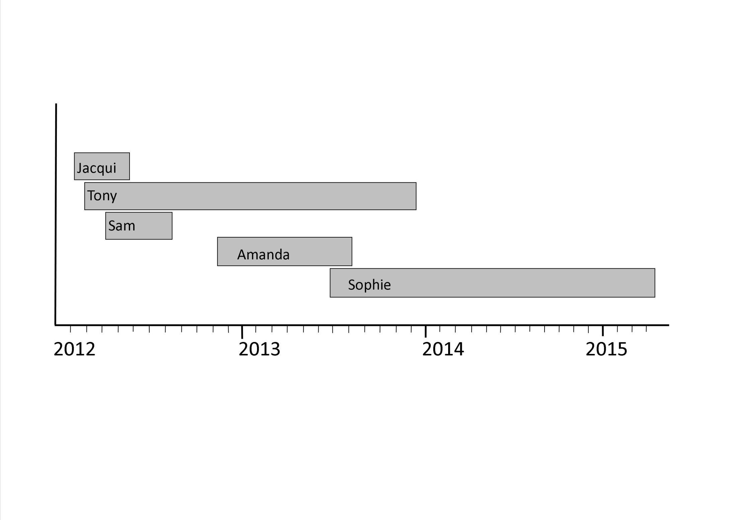
Timeline of 5 case studies

Slide 13
Methodology
Case studies were compared through a theory-building approach (Stiles, 2007, McLeod, 2010) and through adopting replication logic (Yin, 2013).
The study maintained a pluralistic approach which addressed both the reality of observer bias and the positivist reality of the observations. We have named this Cautious positivism (Wilson, Gabriel & James, 2014).

Slide 14
Transcribing the recordings

Slide 15
Assimilation analysis
Sections of each client’s transcript were matched against the APES scale. For example:
Sophie recognises that she sometimes feels guilty if she has a night out with friends, and this can lead to her avoiding some social situations.
APES 3 Problem statement/ clarification: Content includes a clear statement of a problem – something that can be worked on, Opposing voices are differentiated and can talk to each other. Affect is manageable, not panicky.

Slide 16
Triangulating the results
Each client invited to review the completed case study and discuss whether they regarded this as a valid record of events.
Reluctance. Only Sam did this.
Enrolled a team of experienced bereavement counsellors to listen to extracts and reach a consensus on the APES scale for each extract. High level of consensus on Tony’s case study (7 counsellors).

Slide 17
Session | Group consensus | Researcher
Assessment | APES 2.5 | APES 3.0
Session 2 | APES 2.0 | APES 3.0
Session 4 | APES 3.0 | APES 3.5
Session 5 | Strongly towards APES 4.0 | APES 4.0
Session 9 | APES 4.0 | APES 4.5
Session 10 | APES 4.0 | APES 4.5
Session 11 | Between APES 4 & 5 | APES 4.5
Session 23 | Well into APES 5.0 | APES 6.5
Session 24 | Cusp of APES 6.0 | APES 6.7
Session 37 | APES 6.0 towards 7 | APES 7.0

Slide 18
Confidence in the results
On the basis of the consensus exercise, APES was adapted for grief: The Assimilation of Grief Experiences Sequence, AGES is based on the transcripts of the 5 case studies.
AGES differs from APES in that initial avoidance and later on periodic avoidance is construed as helpful rather than maladaptive.

Slide 19
Assimilation of Grief Experiences Scale, AGES
Stage 1: Unwanted thoughts | Managing the pain of grief Reminders which intensify the grief are avoided. Some clients manage this by “keeping busy”. The client is often unaware of the full extent of her grief, although it is obvious to friends and family, who may begin to worry and suggest professional help. Circumstances Client shows extreme difficulty in talking about the circumstances of the death. If pressed to do so, the account is short and brief. The client avoids reminders, e.g. music, photographs etc. As she approaches stage 2 she becomes more willing to talk about the events with others, but does not easily raise the topic. She may become upset and tearful. Relationship to the deceased Client clings to pretence that the loved-one is still alive. They talk as if the loved one was still there, e.g. greeting them on returning home from being out. The house remains unchanged, including the possessions of the deceased. Places associated with the deceased are often avoided. The client may express difficulties with being away from home, because they feel they are abandoning their loved one. Client may cry out in anguish, calling to the deceased. There may be regular, even daily visits to the grave or place where ashes are scattered. The client sometimes displays searching behaviour which may be desperate and distressing.

Slide 20
Assimilation of Grief Experiences Scale, AGES
Stage 5: Application/ working through | Managing the pain of grief The client has learnt to oscillate comfortably between spending time dwelling on the loss and engaging in restorative activities. Thus periods of grief avoidance become helpful. The client becomes more accepting of her ‘up and down’ moods. Feeling ‘down’ becomes less frightening. Feelings of guilt at ‘moving on’ become successfully managed and sadness is no longer identified as essential for continued love loyalty towards the deceased. The interludes of grief and sadness become accepted and integrated into daily life: ‘That is how it is, and how it will be for some time yet.’ This stage can be summed up as ‘Keep calm and carry on’. Circumstances Client begins to reach a new understanding and acceptance. She articulates, perhaps with prompts and open questioning, that she can make sense of the circumstances surrounding the death. She may articulate a religious or spiritual meaning in which the client says they find comfort. Examples include, ‘She is at peace now’ and ‘He died so as to be there in heaven for his grandson’. At this stage there is often an acceptance that grief will be here to stay for a while, but pain is being replaced by sadness. Relationship to the deceased Visits to significant places, e.g. the graveside, become less importance and have less significance. Client is increasingly comfortable about being happy in relation to the deceased. Relationship to the deceased is negotiated and renegotiated towards a symbolic form. ‘Magical’ expectations that they can ever physically return become increasingly rare and fleeting. Client can find meaning in the life of the deceased, including shared experiences. Examples of things the client says include, ‘He had a good life’, ‘We did so much together’ and ‘She achieved so much in her life’.

Slide 21
Triangulating the results
To test the reliability of AGES, 18 counsellors rated 20 randomly selected statements made by Sophie against the scale.
Reliability was excellent: Cronbach’s alpha 0.9.

Slide 22
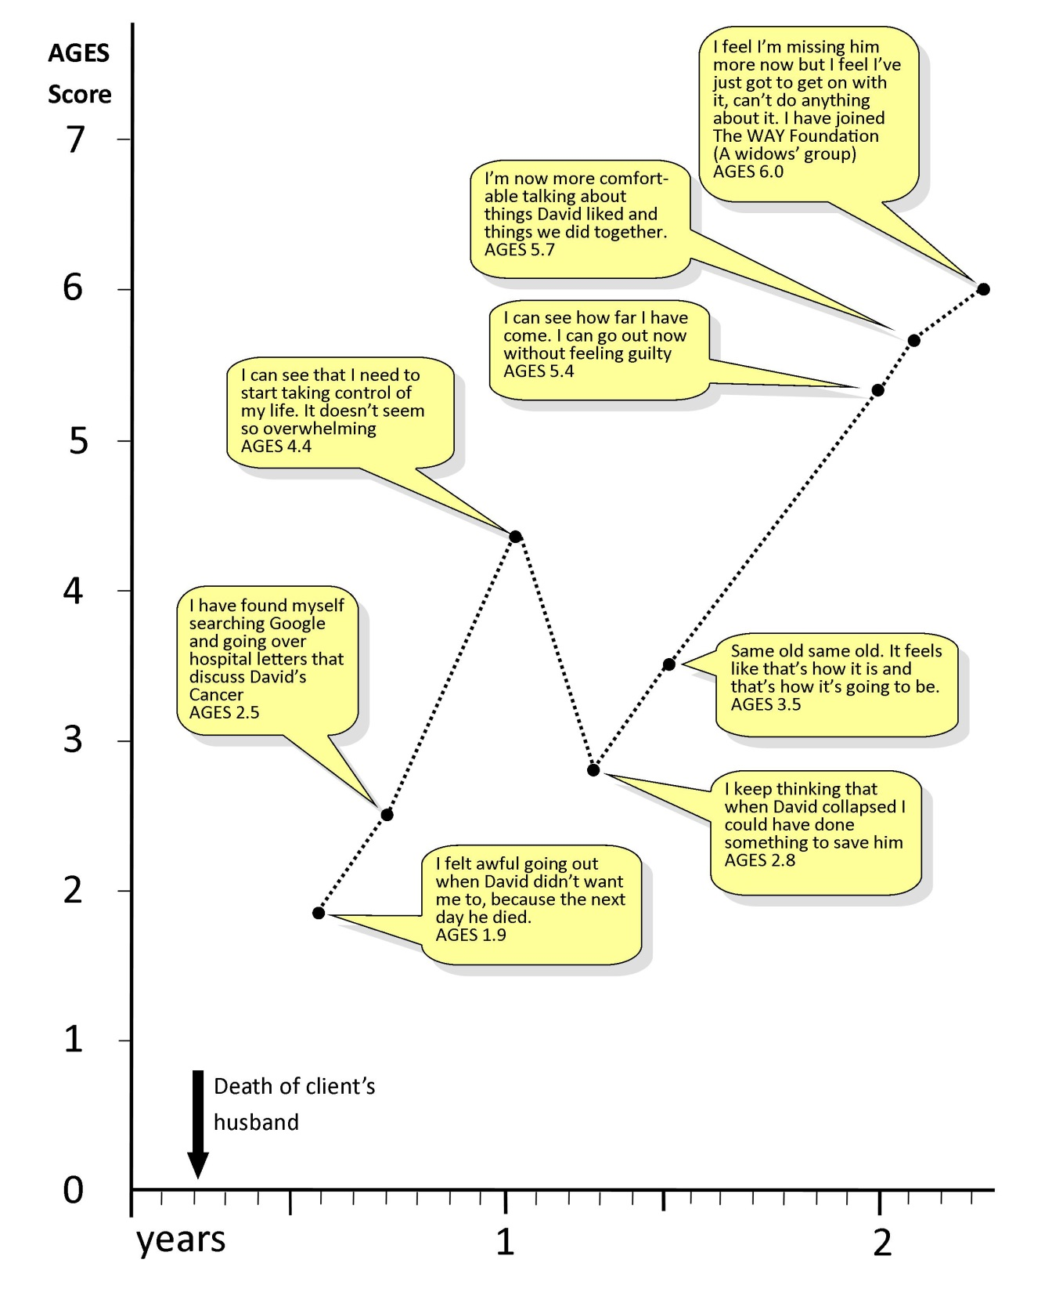
AGES score

Slide 23
Principal findings
Clients reach a problem solution once they can:
i) accept the reality of the death,
ii) make sense of the death,
iii) acquire and practice coping strategies. (Distraction and avoidance can play an important part in this),
iv) accept that for a time, sadness will be ‘as good as it gets’,
v) find meaning in a life without the deceased,
vi) anticipate a positive future . This may include an individualised and creative continuing bond with the deceased: moving forward in a continuing symbolic relationship.

Slide 24
Limitations
Whilst five case studies are inadequate to draw firm conclusions, a theory-building methodology allows each new case study to add a small degree of confidence to previous findings.

Slide 25
Implications
A reliable and valid Assimilation of Grief scale would provide clinical evidence of psychological change and could be developed into an outcome questionnaire.
Bereavement work may be more effective if counsellors are trained to stimulate and foster assimilation of the client’s post bereavement world.

Slide 26
Thank you for listening Questions?
john@moorsidecounselling.co.uk
john.wilson3@yorksj.ac.uk

